Slide 1
Theodore C. Friedman, M.D., Ph.D. (the Wiz) Professor of Medicine-UCLA Chairman, Department of Internal Medicine Charles R. Drew University Dr. Friedman’s Endocrinology Clinic Role of rT3 in treating hypothyroidism
PLOS One publication
GoodHormoneHealth Webinar June 22, 2025

Slide 2
Outline
How rT3 is made?
Is rT3 important?
Why is the PLOS One paper important?
What did it show?
What are normal rT3 values?
Who should get rT3 levels measured?
How do thyroid hormones affect rT3 levels?
How can you lower rT3?

Slide 3
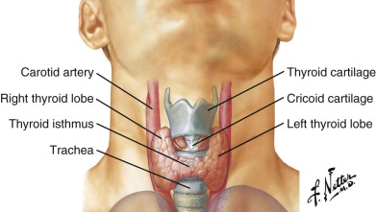
Thyroid

Slide 4
Hypothyroidism Treatment
Many options for thyroid hormone replacement.
L-T4 alone (Levothyroxine, Synthroid, Levoxyl, Tirosint, Unithroid)
L-T4 gel capsules-Tirosint, generic Tirosint, Thyquidity
L-T3 (Cytomel, liothyronine) alone
L-T4/L-T3 combinations
Desiccated thyroid (Adthyza (may not be available), Armour, NatureThroid, WP thyroid, Erfa)-from pig thyroid. Often called Natural Desiccated Thyroid (NDT) or Desiccated Thyroid Extract (DTE)
Desiccated thyroid/L-T4 combinations
Proper treatment needs to be individualized (not one blood pressure medicine).
Multiple studies have shown poor quality of life among patients on L-T4 replacement alone

Slide 5
Hypothyroidism Treatment-Desiccated Thyroid
Desiccated thyroid has a higher T3/T4 ratio than the human thyroid.
Many patients on desiccated thyroid alone have high fT3, low fT4 and low TSH
Desiccated thyroid has a higher T3/T4 ratio than the human thyroid. Some patients on desiccated thyroid (especially Armour) alone have high fT3, low fT4 and low TSH
Armour thyroid is now made by Abbvie and distributed by Allergan USA and concern about variability of preparations and lack of standardization are unfounded.
WP thyroid was a brand of desiccated thyroid with minimal binders and fillers
Both WP thyroid and NatureThroid (made by RLC labs) have been on backorder for 5 years and unlikely to return.
NatureThroid has more fillers than WP thyroid, but still pretty pure.
NatureThroid was recalled in 2020, but not recently

Slide 6
Hypothyroidism-T4/T3 treatment
Some but not all studies show a benefit of L-T4/L-T3 treatment over L-T4 alone.
Large study in Italy (Gullo, PLoS One, 2011, 6:e22552) found that in patients without a thyroid given L-T4 replacement, 15% had a low serum fT3 level, but normal TSH levels.
This suggests that certain patients have a different setpoint for TSH secretion and that some patients need L-T4/L-T3 treatment to achieve normal freeT3 and freeT4 levels.

Slide 7
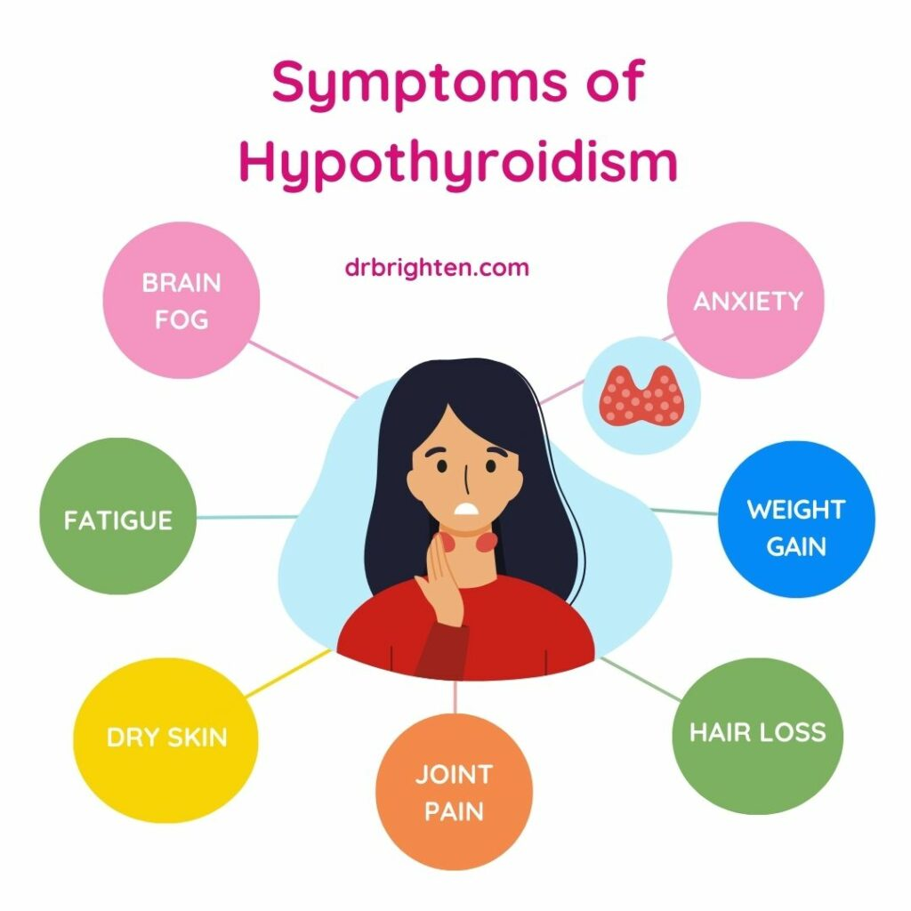
So what is the problem?
Approximately 15-20% of the population on L-T4 monotherapy with a normal TSH have hypothyroid symptoms including fatigue and poor quality of life
These patients are the vocal minority who are not doing well on T4 treatment and would benefit from seeing a thyroid specialist like myself
Is T4/T3 or desiccated thyroid the answer?
Is rT3 part of the answer?

Slide 8
Summary Desiccated Thyroid Articles
7 peer-reviewed articles (some good and some not so good journals) showed that DTE was preferred over L-T4 and some articles over L-T4/L-T3
No studies showed L-T4 was better than desiccated thyroid
Side effects including hyperthyroidism were minimal
Bottom Line: Patients feel better on desiccated thyroid.
https://www.medscape.com/viewarticle/928573

Slide 9
T4 to T3 or Reverse T₃ (rT₃)
Most of the circulating T₃ is derived from 5′-deiodination of circulating T₄ in the peripheral tissues by type 1 deiodinase.
Deiodination of T₄ can occur at the outer ring (5′-deiodination), producing T₃ (3,5,3′-triiodothyronine), or at the inner ring, producing reverse T₃ (3,3,5′-triiodothyronine) by type 3 deiodinase.
Type 2 deiodinase in the pituitary also converts T₄ to T₃ and is regulated differently from type 1 deiodinase.

Slide 10
T4 to T3 or Reverse T₃ (rT₃)
Reverse T₃, a biologically inactive form of T₃ may block T₃ from binding to the thyroid hormone receptor.
Many years ago, endocrinologists realized that in severe illness, type 3 deiodinase increases and rT₃ is often high and T₃ is often low. Endocrinologists termed this “sick euthyroid syndrome” and noted that it was common in many types of chronic illnesses, especially in patients hospitalized in intensive care units.
It was usually recommended that these patients not be treated with thyroid hormone and in most cases, the elevated rT₃ resolved when the patient’s health returned.

Slide 11
T4 to T3 or Reverse T₃ (rT₃)
However, more recently, alternative doctors, now called functional medicine doctors, have made quite an issue about rT₃.
They argue somewhat appropriately that high rT₃ is bad and can block T₃ from binding to the thyroid hormone receptor.
They also state that rT₃ can go up in various conditions including systemic illness, stress, inflammation, chronic pain, dieting, weight gain, and depression.
They often quote articles showing that these diseases are correlated with a high rT_{3,} but do not necessarily show that the rT₃ plays a significant role in the disease.

Slide 12
Reverse T₃
These functional medicine doctors rely extremely heavily on rT₃ to treat patients that may have no other laboratory findings of hypothyroidism and often prescribe them T₃-only preparations to try to lower the rT₃.
They have not published on whether this is effective or not, and may treat a person with completely normal thyroid function tests and put him on T₃ to try to lower the rT₃.
They often use a high rT₃: T₃ ratio as further indication to treat these patients.

Slide 13
T4 to T3 or Rt3

Slide 14
Mainstream Endocrinologist and Reverse T₃
Conclusion
Reverse T3 is physiologically relevant to thyroid economy. However, its clinical use as a biochemical parameter of thyroid function is very limited. Currently, no evidence supports the use of rT3 to monitor levothyroxine therapy, either given alone or in combination with liothyronine.

Slide 15
Mainstream Endocrinologist and Reverse T₃
However, the diagnostic utility of rT3 for this indication is questionable, and testing of rT3 is not recommended by any professional practice guidelines.

Slide 16
Reverse T₃ publication
Wilson J.B., Hoang, T.D., Lee, M.L., Epstein, M., Friedman, T.C. (2025) Reverse T3 in patients with hypothyroidism on different thyroid hormone replacement. PLoS One 20(6): e0325046. https://doi.org/10.1371/journal.pone.0325046
PLOS One is a peer reviewed journal published by the Public Library of Science
On goodhormonehealth.com

Slide 17
Reverse T₃ publication
We retrospectively analyzed rT₃ in 976 consecutive patients who came to see me from from 2010 to 2021 at Goodhormonehealth.com with potential thyroid problems.
All of these had signs and symptoms of hypothyroidism, and many of them were already treated with different thyroid preparations.

Slide 18
Reverse T₃ publication
I used the upper limit of normal for rT₃ at either Quest or Labcorp, which is usually 24 ng/dL.
I did not calculate any type of ratios.
IRB approved

Slide 19
Type of thyroid medicine.
Type of thyroid medicine | Number of patients
None | 376
L-T₄ alone | 139
L-T₃ alone | 23
L-T₄ + L-T₃ | 83
Desiccated thyroid extract (DTE) | 226
DTE + L-T₄ | 138
DTE + L-T₃ | 15
DTE + L-T₄ + L-T₃ | 7

Slide 20
Table 1. Mean, SD, N of rT₃ (ng/dL), Free T₃ (pg/mL), Free T₄ (ng/dL) and TSH (µIU/mL)
 | rT₃ | FreeT₃ | FreeT₄ | TSH
Mean | 16.4 | 3.2 | 1.2 | 2.3
SD | 6.6 | 1.0 | 0.3 | 4.3
N | 976 | 452 | 455 | 513

Slide 21
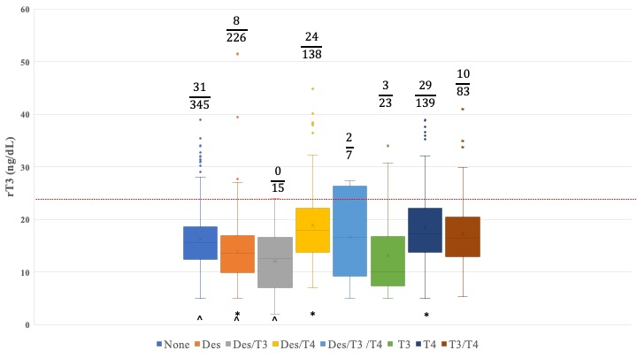
Reverse T₃ in patients with hypothyroidism on different thyroid hormone replacement
976 consecutive patients

Slide 22
Table 3. Effect of L-T₄ treatment on rT₃ levels
 | All groups on L-T₄ treatment | All groups not on L-T₄ treatment | p-value
rT₃ (Mean ± SD) | 18.4 ± 7.1 | 15.2 ± 6.0 | <0.00001*
% with rT₃ >24.1 | 65/367 (17.7%) | 42/609 (6.9%) | p=1.63 x 10⁻⁷^

Slide 23
Table 4. Correlations between rT₃ levels and other hormones
 | FreeT₃ | FreeT₄ | Log TSH
Pearson correlation | 0.184 | 0.624 | -0.298
p | 0.0001 | <0.0001 | <0.0001

Slide 24
Reverse T₃ Results
The number of patients with rT₃ levels above normal range varied significantly with the type of thyroid hormone replacement.
Overall, 107 (11.0) patients had an elevated rT₃ value.
The highest rate of an elevated rT₃ was 21% (29/139) in patients taking T₄ alone.
9% (31/345) of patients not taking thyroid hormone replacement had elevated rT₃ values.
In contrast, only 4% (8/226) of patients taking desiccated thyroid hormone had above normal rT₃ values, compared to to 12% (10/83) of patients taking a T₃-T₄ combination and 17% (24/138) of patients taking desiccated thyroid-T₄ combination.
Patients on all types of L-T₄ treatment had higher rT₃ levels than those not on L-T₄ treatment (p < 0.0001) and a higher percent of rT₃ levels above the cutoff of 24.1 ng/dL (p < 0.0001).
Linear regression analysis showed rT₃ levels strongly correlated with free T₄ levels, and more weakly with free T₃ and inversely with log TSH levels.

Slide 25
Reverse T₃ Results TPO ab
For most thyroid treatment regimens, the proportion of patients with above normal rT₃ levels did not vary significantly with TPO antibody status, except for patients taking desiccated thyroid hormone replacement.
For this group, 0% (0/67) of the patients with circulating anti-TPO antibodies had elevated rT₃ levels, while 7% (6/88) of patients without these antibodies or who did not have them tested had elevated rT₃ levels (p=0.037).
Antibodies may be beneficial, but it might be an aberration

Slide 26
Reverse T₃ Results
I did not look at whether high rT3 was correlated with hypothyroid symptoms, but plan to using the the Thyroid Symptom Questionnaire
I have patients with a high rT3 that are doing well and those with a low rT3 that are not.

Slide 27
Reverse T₃ Results (from press release)
The results showed that patients on L T₄ alone (often considered the standard therapy for treating hypothyroidism) had the highest levels of rT₃—a biologically inactive hormone that can accumulate when the body fails to convert T₄ into active T₃.
In contrast, patients using T₃-containing treatments such as DTE had significantly lower rT₃ levels, suggesting that standard therapies may not be optimal for all patients.
As CDU continues to champion research that serves underserved populations and addresses long-standing gaps in health equity, this study underscores the value of reexamining medical norms in light of new data and patient experiences.

Slide 28
Reverse T₃ Discussion
The high prevalence of patients treated with thyroid preparations other than L-T₄ reflects the heterogeneity of providers as well as the dissatisfaction with conventional treatment among this group of patients.
We found that the proportion of patients with above normal rT₃ values varied significantly depending on the type of thyroid medication they were taking.
This proportion was higher in patients taking preparations containing L-T₄ but was lower in patients taking desiccated thyroid or L-T₃ preparations.
Groups that took preparations containing desiccated thyroid and/or L-T₃ with L-T₄ had a larger proportion of patients with above normal rT₃ values than groups that took the same preparations without L-T₄.
Our results are consistent with previous findings that in short-term settings, L-T₄ can raise rT₃ levels and L-T₃ can lower rT₃ levels, although these effects need to be verified prospectively in larger, newer studies.

Slide 29
Reverse T₃ Strengths and Limitations
The strengths of our study include a large number of subjects taking different types of thyroid preparations, similar to what many patients are taking in real world settings.
Another strength is the measurement of rT₃ levels with an accurate mass-spectrometry methodology.
The limitations of the study include a potential bias of subjects more inclined to taking L-T₄ +L-T₃ and DTE preparations than would be seen in a typical Endocrinology clinic.
However, our findings of the highest rT₃ levels in those on L-T₄ alone would favor higher rT₃ levels in a typical Endocrinology clinic in which most patients are on L-T₄ alone.
Other limitations include the retrospective nature of the study, lack of objective measurements of fatigue and quality of life (QOL), and the lack of a causal relationship between rT₃ levels and fatigue and QOL symptoms, a limitation that should be addressed in future studies.

Slide 30
Reverse T₃ study-conclusions
Measuring rT₃ may be helpful in some patients, especially those already on thyroid treatments that contain T₄.
rT₃ is less likely to be helpful in those not on thyroid medication
Patients that have an elevated rT₃ on thyroid treatment with either L-T4 alone or L-T4 plus desiccated thyroid may benefit from decreasing the amount of L-T4 given and increasing the amount of L-T3 or the desiccated thyroid given.

Slide 31
Reverse T₃ study- future directions
Further studies are needed to understand the implications of elevated rT₃ values in patients both on and off thyroid hormone replacement and whether its measurement will be useful in clinical practice to guide thyroid hormone replacement.
Randomized control studies are needed to determine if treatment with DTE or L-T₃ in patients with elevated rT₃ values will both lower elevated rT₃ values and improve measurements of fatigue and QOL.
Additional further studies are needed to determine what factors raise rT₃ values and if correcting them improves hypothyroid symptoms.
Overall, our study will open new avenues of thyroid disease research that could lead to improvement in clinical outcomes in patients with hypothyroidism.

Slide 32
Reverse T₃ Conclusions
The area of rT₃ is clearly an interesting area, and there is a clear division between endocrinologists who do not measure all and the functional doctors who measure it in almost everybody and treat almost everybody for it.
The test can be helpful in certain patients, but some discretion needs to be used in who gets thyroid medicine (especially for the rest of their life) and who does not.

Slide 33
What are normal rT3 values?
Our study used the normal range < 24 ng/dL
Probably < 20 ng/dL might be a target if hypothyroid symptoms persist.

Slide 34
Who should get rT3 levels measured?
Patients on thyroid hormone replacement with symptoms of persistent hypothyroidism/fatigue

Slide 35
How do thyroid hormones affect rT3 levels?
L-T4 appears to raise it and L-T3 or desiccated thyroid appears to lower it

Slide 36
How can you lower rT3?
Increase L-T3 or desiccated thyroid
Reduce stress
Lose weight
Eat cleaner
See Dr. Friedman
This is not on the radar of most conventional Endos (but hopefully it will)
Functional medicine doctors often don’t have the overall endocrine training to proper treat hypothyroid patients and often use rT₃ to an extreme and lack Dr. Friedman’s research experience.

Slide 37
Visit goodhormonehealth.com
For more information or to schedule an appointment.
Talk will posted in a few days on my Website and YouTube
https://www.facebook.com/goodhormonehealth
It will also be on Dr. Friedman’s podcast channel- available on spotify, apple podcasts, iheartradio, podcastidex, and amazon music
mail@goodhormonehealth.com
Special thanks to social media expert Tiffany Sanders

