Slide 1


Theodore C. Friedman, M.D., Ph.D.
(the Wiz)
Professor of Medicine-UCLA
Chairman, Department of Internal Medicine
Charles R. Drew University
Dr. Friedman’s Endocrinology Clinic
Oh-Oh-Oh-Ozempic
Webinar on Ozempic and other new weight loss medicines. https://www.youtube.com/watch?v=bzIBj90D3YA
GoodHormoneHealth Webinar
July 8, 2023

Slide 2

Outline
Focus on Health and Wellness
Who should go on weight-loss medications?
Which weight-loss medications are the best?
What are the side effects?
How do they work with diet and exercise?
How do you get insurance coverage?
There will be an opportunity for patients to share their experience on Facebook

Slide 3
Focus on Health and Wellness
My main approach to weight loss is to rule out any endocrine problems, such as hypothyroidism, Cushing syndrome, or growth hormone deficiency, that may lead to weight gain.
Simultaneous I encourage the patient to consume a low-calorie diet, and I often recommends eating a large quantity of vegetables, as they are low in calories with a large amount of nutrition, as well as to move.
Get a good night sleep
Good mental health
Be out in nature
Avoid stress or at least don’t let stress bother you.

Slide 4
But I’ve done all that
Many of his patients already have a healthy diet and exercise.
Many patients need a jumpstart for the weight loss, and this is where weight loss medications comes into play.
They can often reduce food cravings.
Dr. Friedman often prescribes weight loss medications after other endocrine conditions are diagnosed/treated.

Slide 5
2022 Endocrine Society
At Dr. Friedman’s most recent Endocrine Society meeting, it was pointed out that only 2% of patients with obesity are on weight loss medications.
Imagine if only 2% or patients with diabetes were on diabetes medicines or 2% of patients with high blood pressure were on anti-hypertensive medications.
Reasons why?
  Doctors don’t prescribe them
  Unrealistic views that if obese patients had more willpower, they could lose weight
  Costs
  Lack of insurance coverage/difficult preauth requirements.
  Side effects

Slide 6
Type of Weight Loss Medications
Stimulants (related to amphetamine)
  Phentermine
  Phendimetrazine
  Tenuate
  Phentermine-topiramate Qsymia)
GLP-1 receptor agonists (originally diabetes drugs)
  Ozempic (semaglutide)
  Rybelsus (semaglutide)
  Wegovy (semaglutide)
  Mounjaro (tirzepatide)
  Liraglutide (Victoza, Saxenda)
  Dulaglutide (Trulicity)
Others
  Naltrexone-bupropion Contrave)
  Orlistat (Alli)
Belviq (lorcaserin) was removed from the market in 2020 due to increased rates of cancer.

Slide 7
  Phentermine
Also called Adipex-P, Suprenza
Was part of Fen-phen, fenfluramine was removed from the market due to heart and lung problems, phentermine has been used for 50 years and is safe
15 mg, 30 mg, or 37.5 mg tablets or capsules
$40/month (37.5 mg)
Approved for short-term use (2-4 months)
Decreasing appetite and may have some effects on increased metabolism
In the family of amphetamine-like drugs.
Common side effects
  hyper or jittery
  rapid heart beat,
  increased blood pressure
  trouble sleeping
  urinary retention
Works well at low cost
I usually give a half pill before lunch and dinner, if insomnia move to earlier in the day
Long -term use not established
I usually gives this for a period of 2 to 6 months.

Slide 8
Phendimetrazine
Also called (Bontril)
Immediate release 35 mg. SR 105 mg
32.14 per 90 tablets (35 mg) $33.64 (30 tablets105 mSR)
Decreasing appetite and may have some effects on increased metabolism
In the family of amphetamine-like drugs.
Common side effects
  dizziness
  dry mouth
  difficulty sleeping (insomnia
  irritability
  nausea
  vomiting
  upset stomach
  Diarrhea
The standard immediate-release form is labeled as PDM, a reference to the active ingredient phendimetrazine.
It is a 35 mg tablet most often prescribed for use two to three times per day, to be taken orally 30-60 minutes before each meal.
The sustained-release formula is taken as a single dose of one 105 mg tablet taken 30-60 minutes before the morning meal each day
May work in people who failed phentermine
Sometimes hard to find

Slide 9
  Phentermine/topiramate
Also called Qsymia
  3.75mg/23mg
  7.5mg/46mg
  11.25mg/69mg
  15mg/92mg
$629/month
A mix of two medications: phentermine (but at lower doses), which lessens your appetite, and topiramate, which is used to treat seizures or migraine headaches.
May make you less hungry or feel full sooner.
Common side effects
  constipation
  dizziness
  dry mouth
  taste changes, especially with carbonated beverages
  tingling of your hands and feet
  trouble sleeping
  “stupamax”
I don’t see an advantage over phentermine

Slide 10
  GLP-1 receptor agonists
Incretin effect
Oral glucose raises more insulin than iv glucose
GI factor that secretes insulin
Found to be GLP-1 and GIP-1
Found to have GLP-1 receptors in the brain that control appetite

Slide 11


  GLP-1 receptor agonists
In 1980, researchers at Massachusetts General Hospital wanted to use new technology to find the gene that encodes a hormone called glucagon. The team decided to study Anglerfish, which have special organs that make the hormone, simplifying the task of gathering samples of pure tissue.
They determined the genetic sequence of glucagon and they learned that the same gene encodes related hormones known as peptides
It was called glucagon-like peptide-1 and its nickname was GLP-1.
Scientists in Massachusetts and Europe learned that it encourages insulin release and lowers blood sugar. That held out hope that it could help treat diabetes. Later they discovered that GLP-1 makes people feel fuller faster and slows down emptying of food from the stomach.
But there was a problem: GLP-1 vanishes from the human body nearly as fast as it is secreted, chewed up by enzymes and washed away by the kidneys in minutes. That meant there was little chance of developing the magic peptide into a drug.
Scientists turned to the gila monster, who don’t get high or low blood sugar despite eating four meals per year.
They live most of their lives below ground, slowly digesting energy stored in their tails.
Anglerfish
Gila monster

Slide 12
  GLP-1 receptor agonists
Eng and Raufman studied powdered Gila monster venom ordered from the Miami Serpentarium, whose owner survived 172 snake bites over the years as he produced venom for research.
Eng isolated a small peptide that he called Exendin-4, which they found was similar to human GLP-1.
Eng then tested his new peptide on diabetic mice and found something intriguing: It not only reduced blood glucose, it did so for hours.
Nausea was a major side effect
David Nathan, a MassGen physician scientist who led a 1991 study, still remembers what happened when they increased the dose: “One person leaned over the side of his chair and threw up on my shoes.”
They worked to develop Exendin-4 into a drug by synthesizing the Gila monster peptide.
The Food and Drug Administration approved the first GLP-1-based treatment in 2005.
Novo Nordisk worked on its own drug that more closely resembled the human peptide. With some clever chemistry it bumped up this drug’s time in the body to a day. Its first GLP-1 drug, the once-daily shot liraglutide, would receive FDA approval in 2010.
Anglerfish
Gila monster

Slide 13
  GLP-1 receptor agonists
Seven years later came its longer-lasting diabetes drug, the once-weekly shot semaglutide. As it turned out, it was also the best of the drugs for weight loss, making it the first blockbuster in the category. A higher dose was approved in 2021 to treat obesity.
Those two approved doses are better known today by their brand names: Ozempic and Wegovy.
Anglerfish
Gila monster

Slide 14
Mechanism of GLP-1 receptor agonist
In hyperglycemic states, GLP-1 receptor agonists stimulate insulin secretion
Delays gastric emptying
In hyperglycemic or euglycemic states → suppress glucagon secretion
Decreases appetite
Reduces body weight
Incretin effects

Slide 15
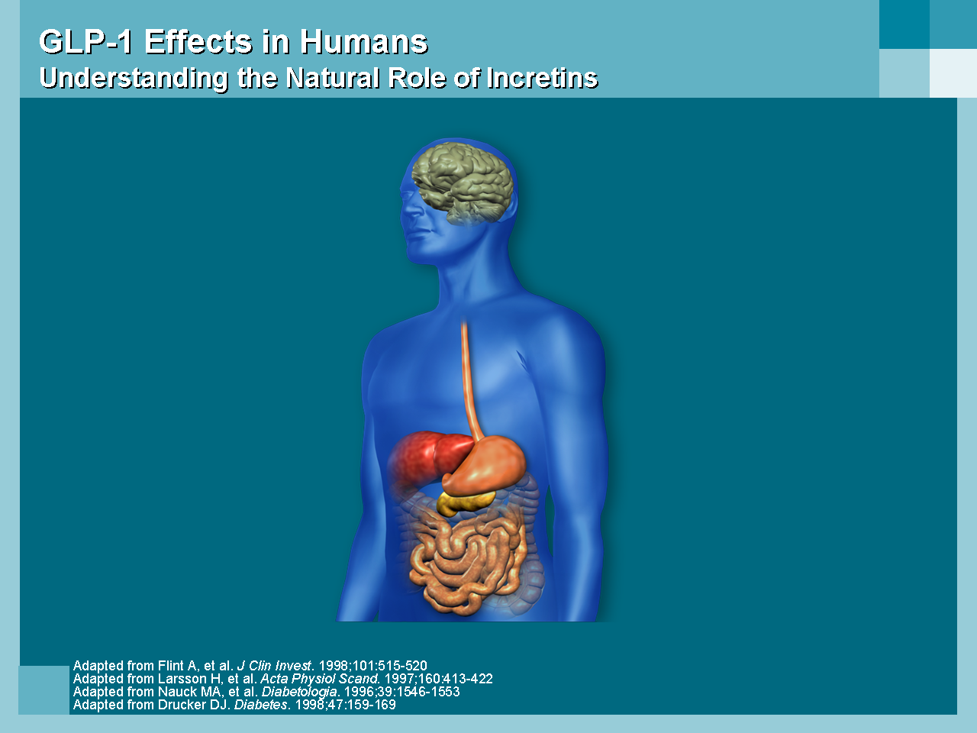
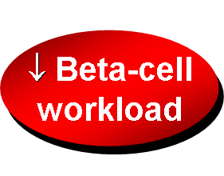
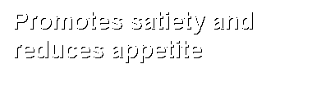
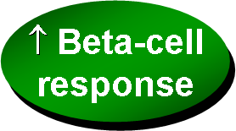
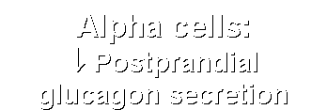
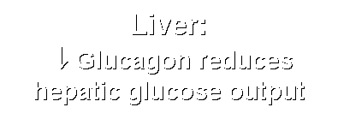


GLP-1 Effects in Humans
Understanding the Natural Role of Incretins
Notes:
Required
DISCUSSION POINTS:
--Upon food ingestion, GLP-1 is secreted into the circulation from L cells of small intestine.
--GLP-1 increases beta-cell response by enhancing glucose-dependent insulin secretion.
--GLP-1 decreases beta-cell workload and hence the demand for insulin secretion by:
--Regulating the rate of gastric emptying such that meal nutrients are delivered to the small intestine and, in turn, absorbed into the circulation more smoothly, reducing peak nutrient absorption and insulin demand (beta-cell workload)
--Decreasing postprandial glucagon secretion from pancreatic alpha cells, which helps to maintain the counterregulatory balance between insulin and glucagon
--Reducing postprandial glucagon secretion, GLP-1 has an indirect benefit on beta-cell workload, since decreased glucagon secretion will produce decreased postprandial hepatic glucose output
--Having effects on the central nervous system, resulting in increased satiety (sensation of satisfaction with food intake) and a reduction of food intake
--By decreasing beta-cell workload and improving beta-cell response, GLP-1 is an important regulator of glucose homeostasis.
SLIDE BACKGROUND:
--Effect on Beta-cell: Drucker DJ. Diabetes. 1998; 47:159-169
--Effect on Alpha cell: Larsson H, et al. Acta Physiol Scand. 1997; 160:413-422
--Effects on Liver: Larsson H, et al. Acta Physiol Scand. 1997; 160:413-422
--Effects on Stomach: Nauck MA, et al. Diabetologia. 1996; 39:1546-1553
--Effects on CNS: Flint A, et al. J Clin Invest. 1998; 101:515-520

Slide 16
  Semaglutide (Ozempic)
Semaglutide (Ozempic) is a diabetes medicine that leads to profound and sustained weight loss.
It is not an amphetamine like drug so patients who have side effects on Phentermine or Phendimetrazine are likely to tolerate Ozempic.
To avoid side effects including nausea (which is common) and feeling full, it is recommended to go up gradually on the dose of Ozempic (0.25 mg weekly for 1 month, then 0.5 mg weekly for 1 month, then 1 mg weekly).
Some patients do fine on a lower dose.
The 2 mg dose has recently been approved and patients can go right from the 1 mg dose to the 2 mg and get an additional weight loss effect.
I recommend taking the 2 mg dose every 10 days for the first 2 doses.
If you get mild nausea, go down to a lower dose (go to 0.25 mg a week, if on 0.5.mg).
We can prescribe Zofran for the nausea

Slide 17
  Semaglutide (Ozempic)
18 clicks is 0.25 mg, so patients who develop nausea can go down in clicks.
If the nausea is severe, stop the Ozempic until the nausea resolves, then restart at 8 clicks and go up by 5 clicks every 2 weeks as tolerated..
The weight loss is greater at higher doses. Other side effects include vomiting, diarrhea and constipation.
Ozempic lowers HbA1c (only modestly if already low), has cardioprotective and renal protective effects and improves PCOS and fatty liver disease.
It usually doesn’t give low blood sugars.
Side effects
  Nausea
  Feeling full
  Vomiting
  Food stuck in your chest
  abdominal pain
  loss of appetite
  diarrhea
  constipation

Slide 18
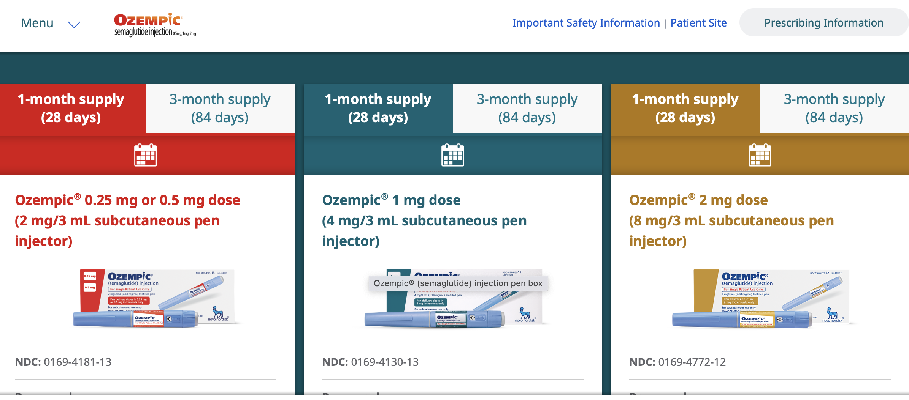
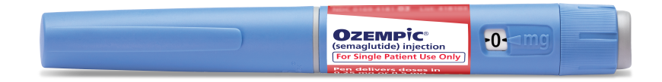
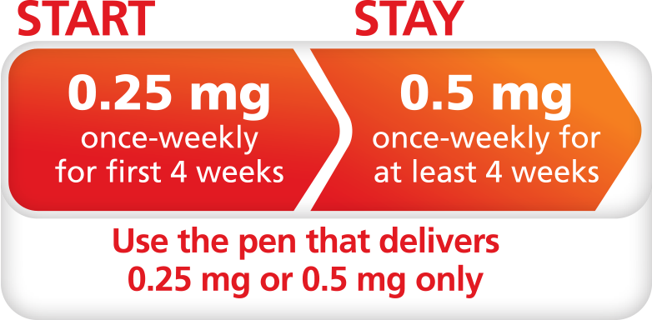
  Semaglutide (Ozempic)
Getting started
We will order 2 of the 0.25 or 0.5 mg (2 mg/3 ml) pen (red label)
Start with Ozempic 0.25 mg weekly for 4 weeks
Then go to Ozempic 0.5 mg weekly for 6 weeks
That will use up the two of the 2 mg/3 ml and last 2 and ½ months

Slide 19

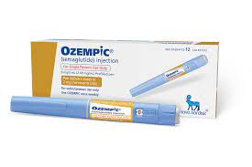
  Semaglutide (Ozempic)
Then THE 1MG DOSE PEN (blue label)
We will then order 3 of the 1 mg dose (4 mg/3 ml) pen (blue label)
to be taken weekly that will last 3 months
Patients need to have an appointment after 3 months
We could then order 3 of the 2 mg dose (8mg/ 3 ml) (brown label) pen that will last 3 months
Then THE 2MG DOSE PEN (brown label)

Slide 20
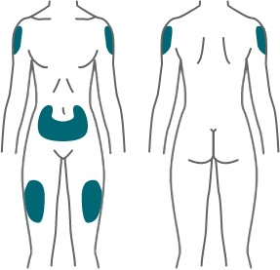


  Semaglutide (Ozempic)
Ozempic (Semaglutide) A once-a-week injection! Can use with or without meals Inject just once a week, same day each week Is not the same as insulin! | 🩸 Ozempic reduces blood sugar A1C Ozempic does not cause low blood sugar. Ozempic can reduce weight Ozempic can reduce risk of heart, kidney, and liver disease
Inject under your skin on the
abdomen, thigh, or upper arm. Do not inject into a muscle or vein.
Change (rotate) your injection site.
If you are having side effects, do not increase dose and notify your provider.
Store your pen in the refrigerator.

Slide 21
  Semaglutide (Ozempic)
Ozempic is an expensive medicine, so patients should check with their insurance to see if they cover Ozempic (used for diabetes) or Wegovy (used for weight loss) and what is the approval process.
Insurance companies vary in their coverage and are getting more strict with coverages
Some require being on less expensive GLP-1R drugs (Trulicity, Victoza) before Ozempic.
Our office will do one pre-auth for these medications, but can not battle insurance companies.
The final option is it is available at a lower cost (but still expensive) from Canadian pharmacies.
I don’t recommend compounded semaglutide (at least now)

Slide 22
  Long-term side effects (Ozempic)
Unknown
Many but not all weight loss meds (Phen/Fen, Lorcaserin, Sibutramine) were found to have long term side effects and pulled from the market.
I don’t think this will happen with Ozempic
In rats, it causes a rare type of thyroid cancer called medullary thyroid Cancer
In people a few, but not most studies have found a slight increase in papillary thyroid cancer.
I don’t think this a a concern and don’t recommend anything to monitor or prevent it.
But only take Ozempic if you need it

Slide 23
  Semaglutide (Wegovy)
Wegovy and Ozempic are the same drug, but Wegovy is approved for weight loss.
It comes in 0.25 mg, 0.5 mg, 1 mg, 1.7 mg and 2.4 mg delivery pens and does not allow partial dosing (clicks).
Patients should stay on each dose for 1 month and only go up if they are not experiencing side effects.
There is a shortage of the medications, patients should try different pharmacies.
Its side effects are similar to Ozempic.

Slide 24
  Semaglutide (Rybelsus)
Rybelsus , Wegovy and Ozempic are the same drug, but Rybelsus is oral and gives less weight loss than Ozempic
It is approved for diabetes.
It comes in 7 and 14 mg
Patients should stay on each dose for 1 month and only go up if they are not experiencing side effects.
Its side effects are similar to Ozempic.
I rarely prescribe it.

Slide 25
  Mounjaro (tirzepatide)
Mounjaro (tirzepatide) Mounjaro is a new diabetes drug that is called a dual incretin (GLP-1 plus GIP).
Not yet FDA-approved for weight loss and hasn’t been found to have cardio-protective effects (but probably does)
It has very impressive weight loss properties with patients on the highest dose losing up to 25 pounds.
It is given once a week like Ozempic and has similar side effects as Ozempic including nausea, diarrhea, decreased appetite, vomiting, constipation, indigestion, and abdominal pain.
The doses are 2.5 mg, 5 mg, 7.5 mg, 10 mg, 12.5 mg, or 15 mg per 0.5 mL in single-dose pen and a patient should stay on the same dose for 4 weeks and only go up the higher dose if no side effects are present.
Some patients do fine on a lower dose.
There is a coupon that patients can pay as little as $25/3 months at https://www.mounjaro.com/savings-resources.
But coverage is less than it used to be, but can be helpful if a high co-pay.

Slide 26
Background
Tirzepatide “twincretin” is a dual glucose-dependent insulinotropic polypeptide (GIP) and glucagon- like peptide-1 (GLP-1) receptor agonist that is under development for the treatment of type 2 diabetes.
GLP
GIP
Enhanced Incretin effects
“Incretin” GI peptides that lower glucose

Slide 27
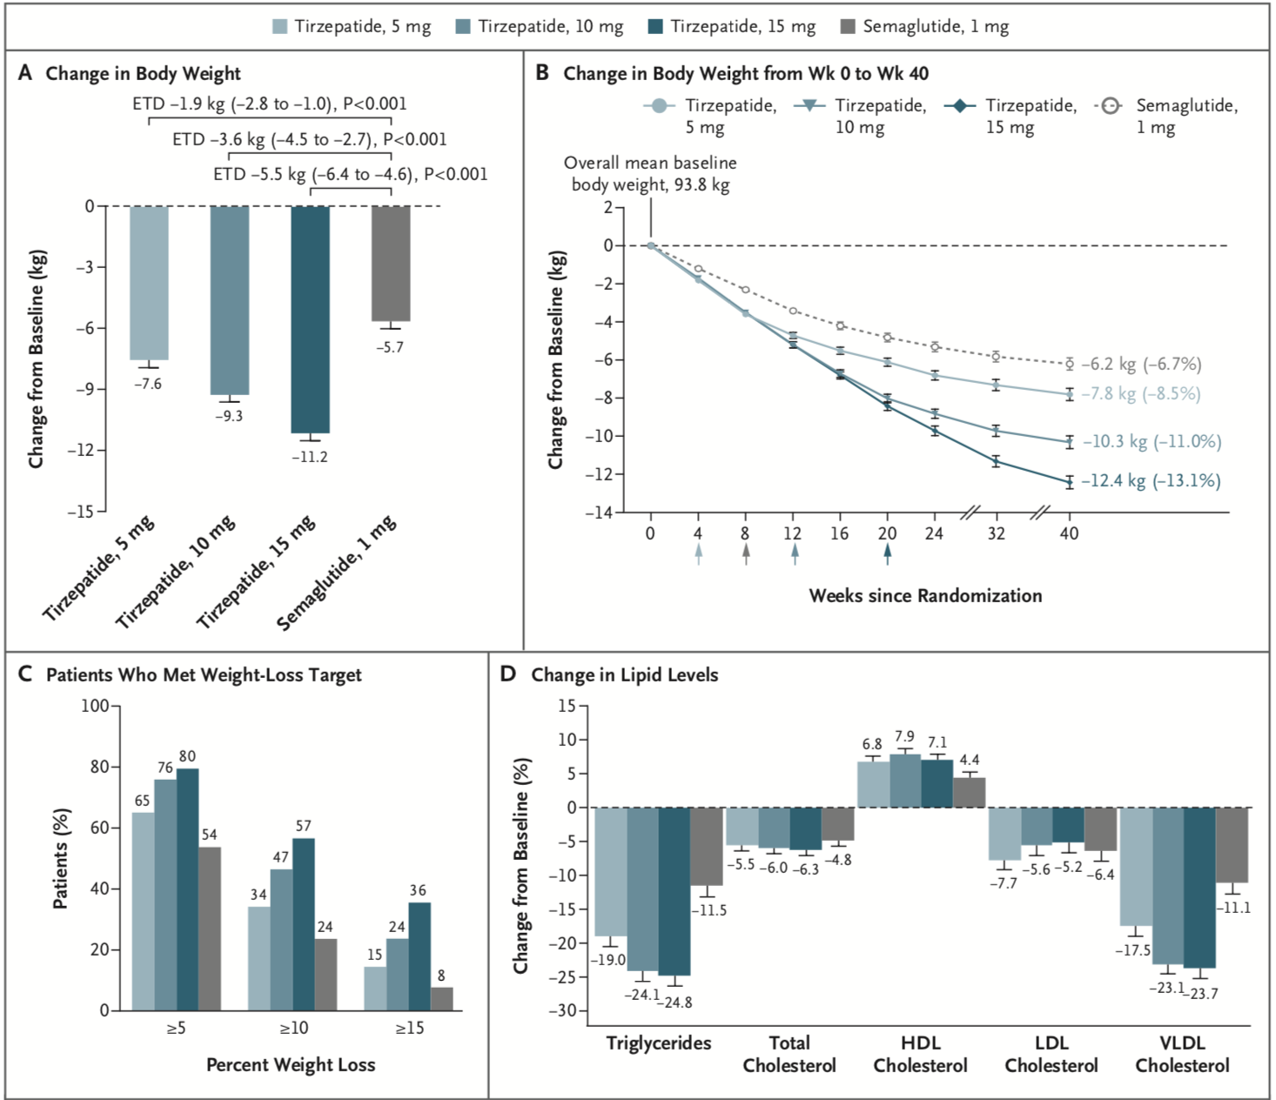

Effect of Once-Weekly Tirzepatide, as Compared with Semaglutide, on Body Weight, the Percentage of Patients Who Met Weight-Loss Goals, and the Lipid Profile.
Frías JP et al. N Engl J Med 2021;385:503-515
Notes:
Figure 2 Effect of Once-Weekly Tirzepatide, as Compared with Semaglutide, on Body Weight, the Percentage of Patients Who Met Weight-Loss Goals, and the Lipid Profile. Least-squares means (±SE) are presented, unless otherwise noted. Error bars indicate the standard error. Panel A shows the change from baseline in body weight at 40 weeks, as assessed with analysis of covariance with multiple imputation for treatment for missing weight at 40 weeks (treatment-regimen estimand). ETDs are least-squares means (95% confidence interval) at 40 weeks in the modified intention-to-treat population. Panel B shows the change from baseline in body weight over time, derived from a mixed-model repeated-measures analysis (efficacy estimand). The percent changes from baseline values at 40 weeks are shown in parentheses. Arrows indicate the times at which the maintenance doses of tirzepatide (5 mg, 10 mg, or 15 mg) and semaglutide 1 mg were achieved. Panel C shows the percentage of patients who had body-weight reductions of at least 5%, 10%, or 15% from baseline to week 40 (treatment-regimen estimand). The percentage was calculated with the use of Rubin’s rules by combining the percentages of patients who met the target in imputed data sets. Panel D shows the percent change (±SE) from baseline in lipid levels at 40 weeks, as estimated with the use of log transformation. HDL denotes high-density lipoprotein, LDL low-density lipoprotein, and VLDL very-low-density lipoprotein.

Slide 28
How do you get insurance coverage?
Call up your insurance to see if they cover weight loss medicines (many don’t cover at all).
Ask the criteria for coverage and if there is a pre-auth form
Ask what the criteria for coverage of Ozempic is (do you have to diabetes or does insulin resistance or pre-diabetes qualify or PCOS qualify)
If no coverage for these medicines, appeals or face-to-face appeals are unlikely to be successful.

Slide 29
How long do you take weight loss medications?
Until you get side effects
Until you are at your ideal weight (and then taper)
Phentermine usually stops working in 3-6 months, take a holiday and restart
Most weight loss medications have some rebound weight gain when they are stopped

Slide 30
What do you do when Ozempic stops working
Push the diet and exercise
Take a break for a month and restart
See if your insurance covers Mounjaro

Slide 31
How do they work with diet and exercise?
Weight loss medications curb appetite, so you put less toxic foods in your body
Food is expensive and time consuming
Allows for a jumpstart
Decreases cravings
Decreases insulin resistance
People feel better with less weight
Less inflammation
Easier to exercise
Better gut health (microbiome)

Slide 32
Ozempic diet
Ozempic can result in loss of muscle mass, so consume a fair amount of protein.
Ride the decrease in food cravings and eat a low carb diet
Eat clean

Slide 33
Questions and comments
Patients to share their experience on Facebook

Slide 34
For more information/to schedule an appointment
Talk will be posted at www.goodhormonehealth.com in a few days
Please email us at mail@goodhormonehealth.com

