Slide 1


Theodore C. Friedman, M.D., Ph.D.
(the Wiz)
Professor of Medicine-UCLA
Chairman, Department of Internal Medicine
Charles R. Drew University
Dr. Friedman’s Endocrinology Clinic
Lifestyle Medicine for Endocrine Problems
Adult division of the 30th Annual Magic Foundation Convention
Chicago
July 12, 2024

Slide 2

Outline
Dr. Friedman will discuss
What are the 6 pillars of lifestyle
Nutrition
What is lifestyle medicine?
Why is it important for patients with endocrine Problems to optimize their lifestyle
Survey of health
Exercise
Sleep
Stress Reduction
Good Relationships
Avoiding Risking Behaviors
Blue Zones
Lifestyle medicine treatment for osteoporosis

Slide 3
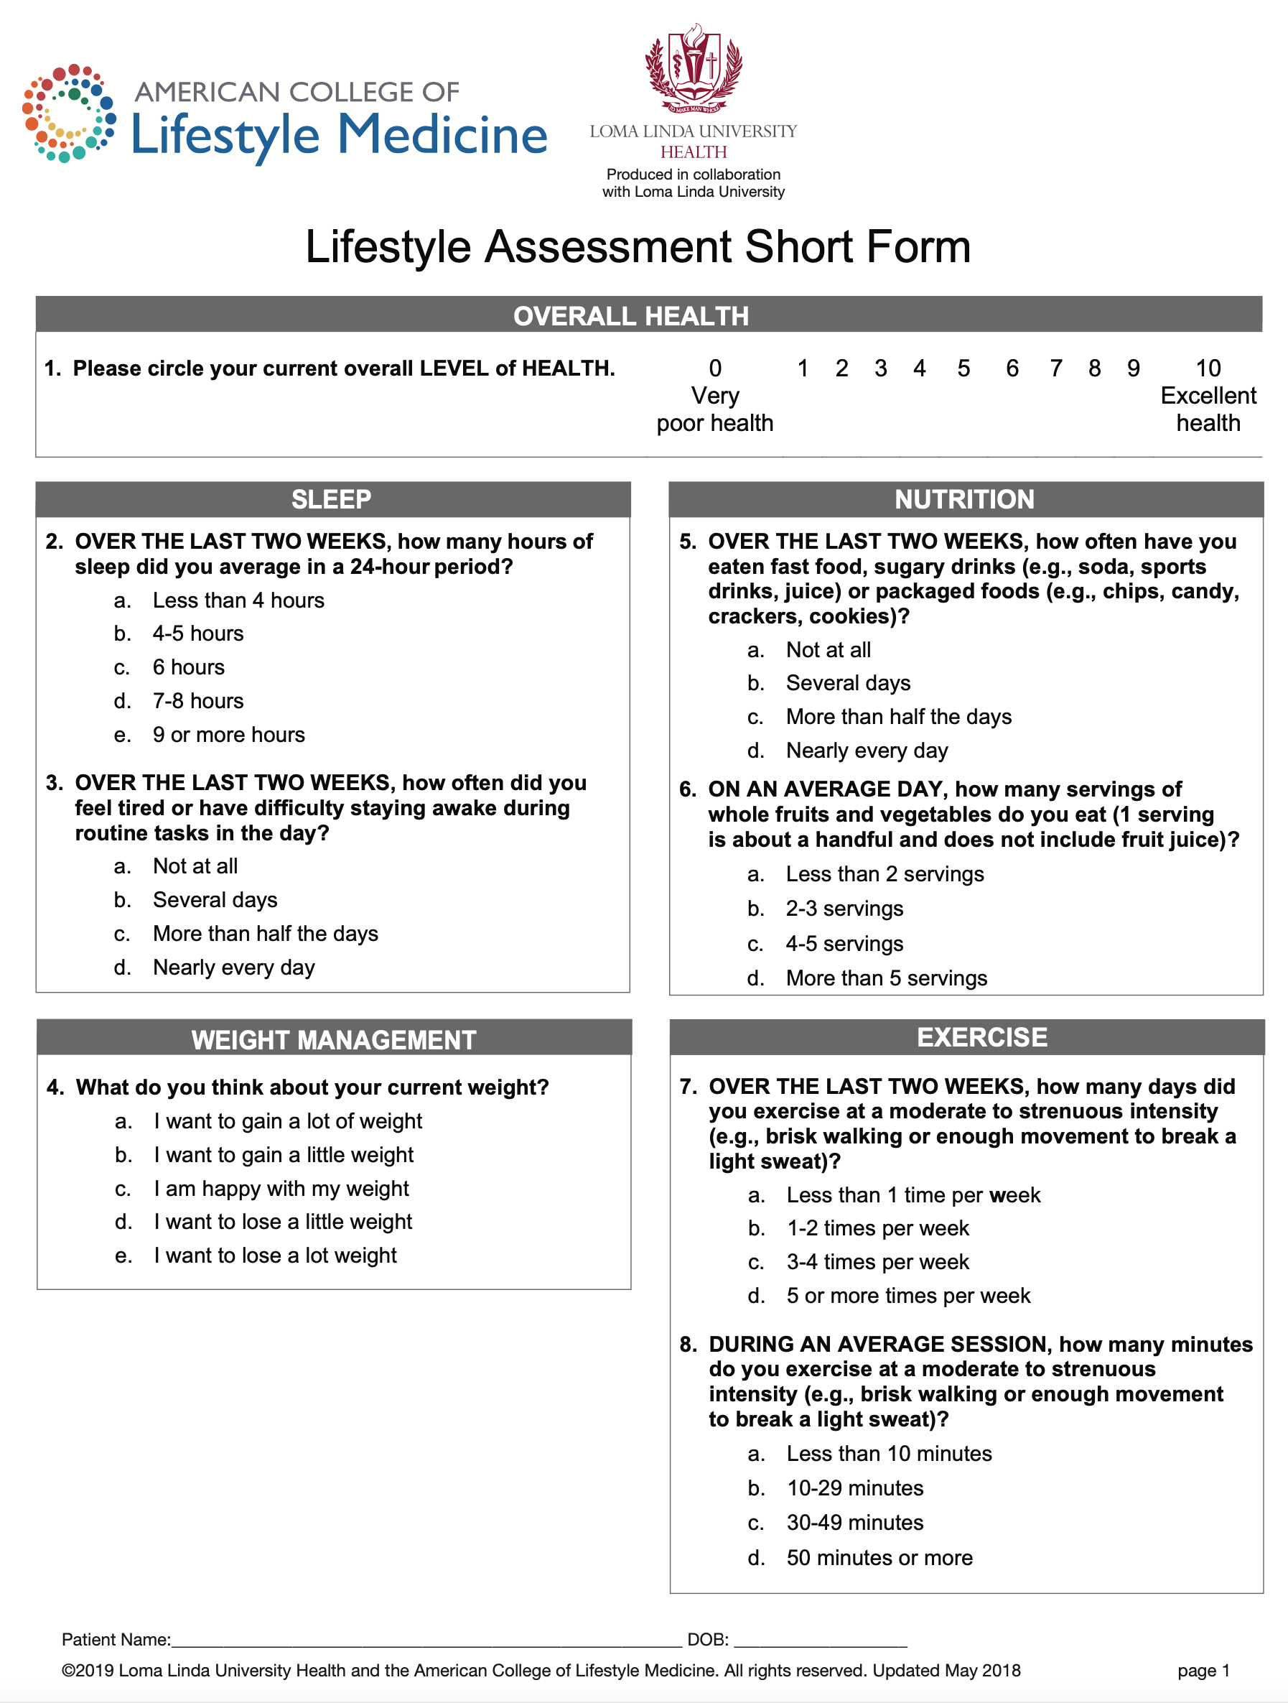

Slide 4
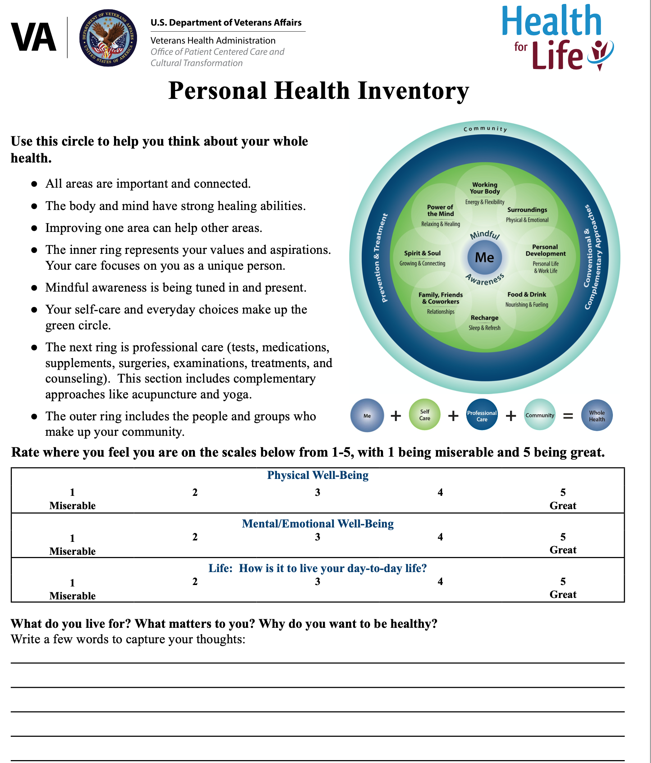
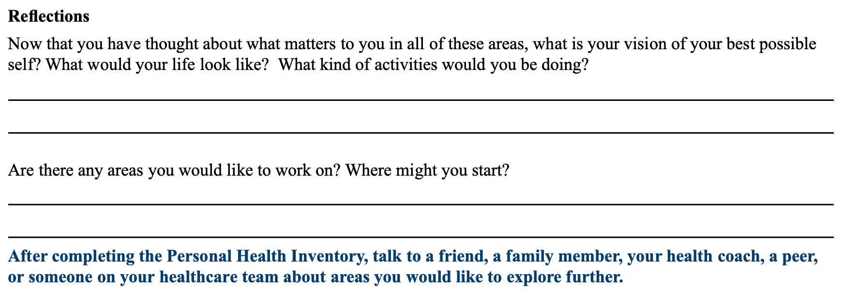

Slide 5
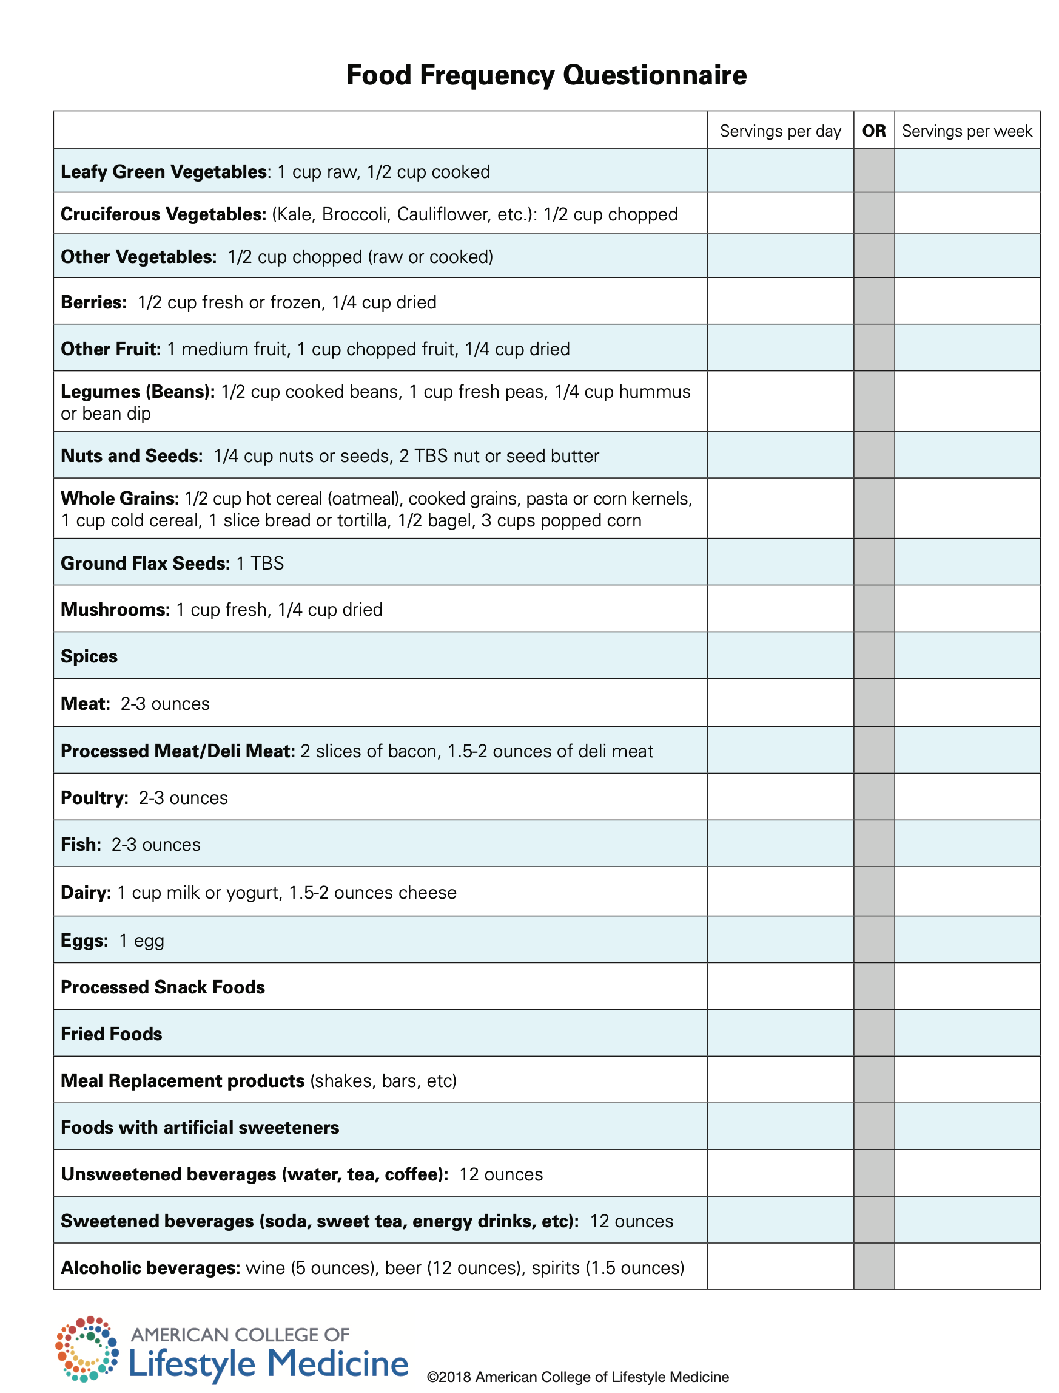

Slide 6
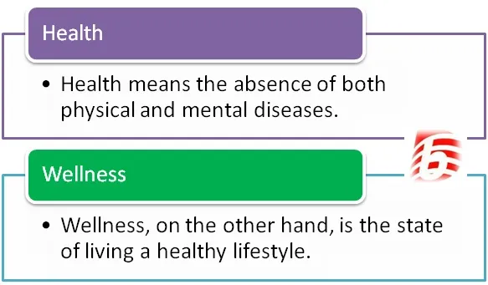
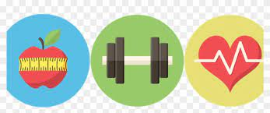

Health vs Wellness

Slide 7
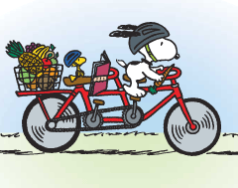


What is the Difference between a Diet and Life Style Changes
Long term, not quick fix
Eating better
More exercise
Join the Magic Foundation

Slide 8
Focus on Health and Wellness
My main approach to getting patients to be healthy is to to diagnose and treat any endocrine problems, such as hypothyroidism, Cushing syndrome, or growth hormone deficiency, that may lead to symptoms such as weight gain and fatigue.
As a result of their endocrine condition, many of my patients are overweight and feel like crap
I work on optimizing hormones.
Simultaneously, I encourage patients to consume a low-calorie diet, and I often recommends eating a large quantity of vegetables, as they are low in calories with a large amount of nutrition, as well as to move.
Get a good night sleep
Good mental health
Avoid stress or at least don’t let stress bother you.
Hike and be in nature
Learn from the Blue zones

Slide 9
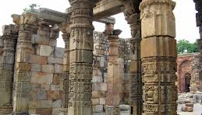
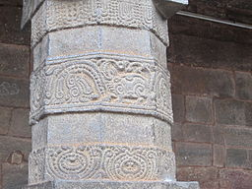

3 pillars of Endocrine health
Correct Diagnosis
Optimize hormones
Optimize Lifestyle

Slide 10
Lifestyle Medicine
Lifestyle medicine is a medical specialty that uses therapeutic lifestyle interventions as a primary modality to treat chronic conditions including cardiovascular diseases, type 2 diabetes, and obesity.
Lifestyle medicine-certified clinicians are trained to apply evidence-based, whole-person, prescriptive lifestyle change to treat and, when used intensively, often reverse such conditions.

Slide 11
Less Than 3 Percent of Americans Live a ¨Healthy Lifestyle¨ Statistics from a Mayo Clinic study
Mayo clinic researchers looked at data from a representative sample of 4,745 people who participated in the National Health and Nutrition Examination Survey.
They found that less than 3 percent of Americans live a ¨Healthy Lifestyle¨ defined by four qualifications:
Moderate or vigorous exercise for at least 150 minutes a week
A diet score in the top 40 percent on the Healthy Eating Index
A body fat percentage under 20 percent (for men) or 30 percent (for women)
Not smoking

Slide 12
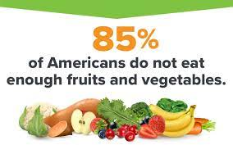
Do Americans Eat fruits and vegetables?
75 percent of Americans Say They Eat Healthy – Despite Evidence To The Contrary
NPR poll conducted with Truven Health Analytics, which surveyed a nationally representative sample of 3.000 U.S. adults in May, 2016.
One question they asked: How healthy would you consider your eating habits to be? About 75 percent of respondents ranked their diets as good, very good or excellent.
Fact:
According to the 2020–2025 Dietary Guidelines for Americans, about 90 percent of the U.S. population does not meet the recommendation for vegetables and 80 percent consume too little fruit.

Slide 13
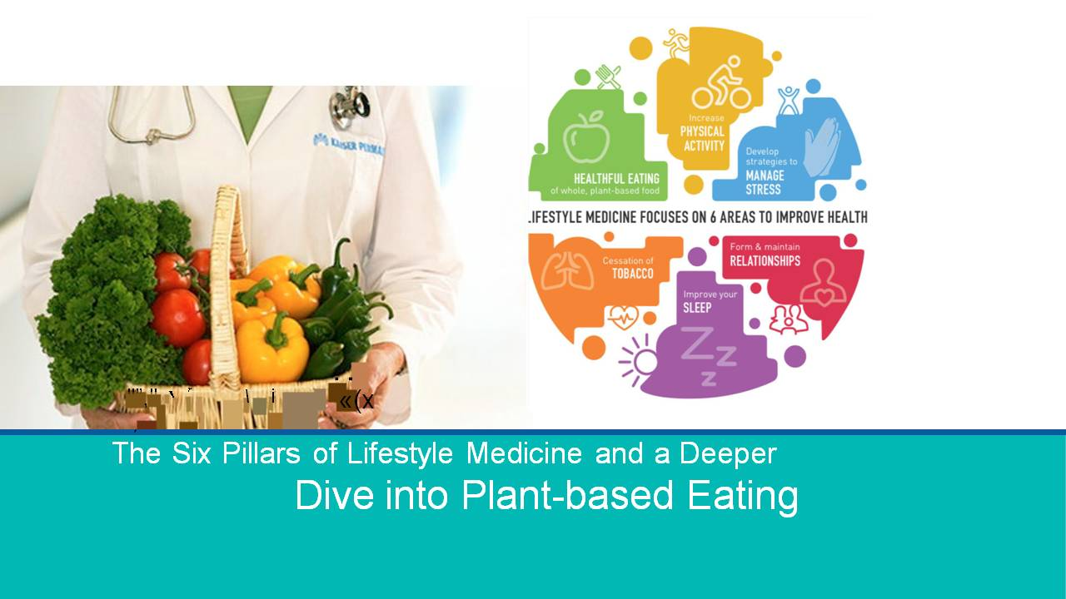
https://lifestylemedicine.org/

Slide 14
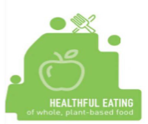
Pillar 1 – Healthful Eating of Whole, Plant-based Food
What is a whole foods, plant-based (WFPB) diet?
Whole foods: Single ingredient foods, unprocessed or minimally processed, as they exist in nature
Plant-based: In its broadest sense, >95% of calories coming from fruits, vegetables, whole grains, and legumes

Slide 15
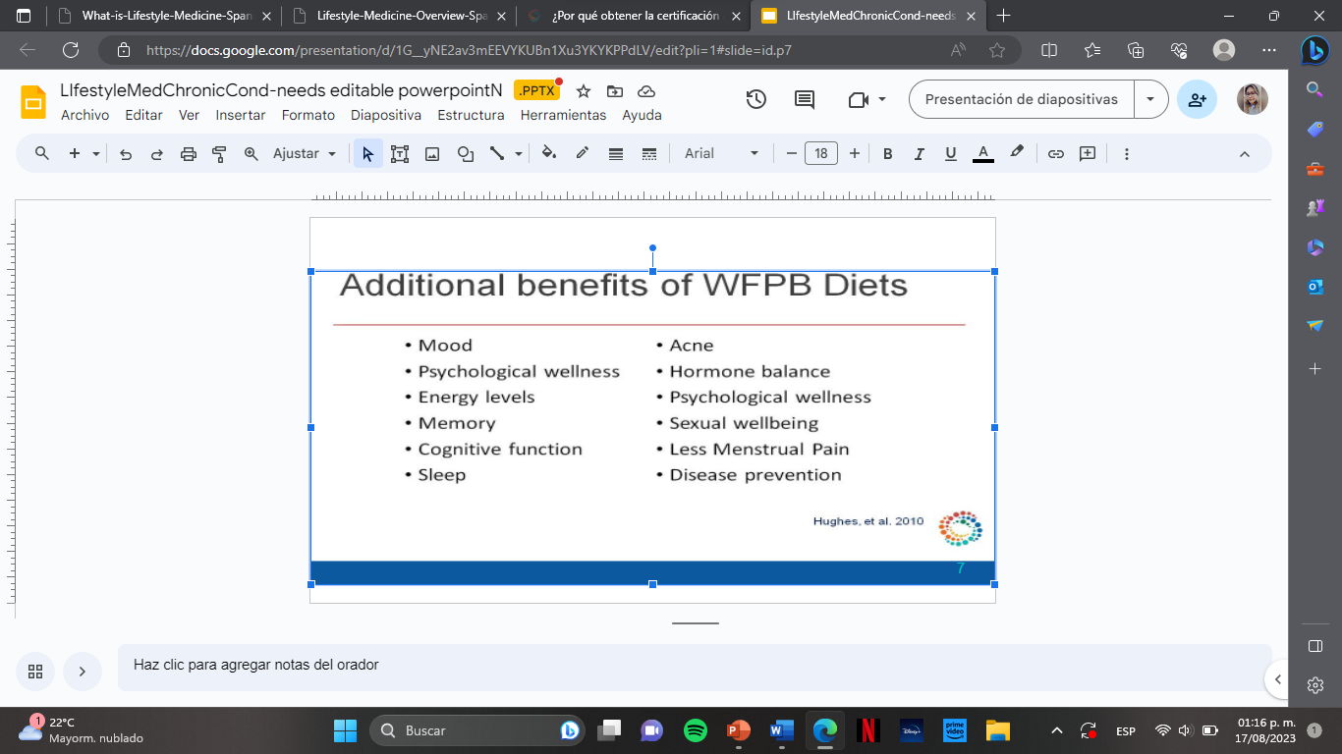
Additional benefits of WFPB Diets
Mood
Psychological wellness
Energy levels
Memory
Cognitive function
Sleep
Acne
Hormone balance
Psychological wellness
Sexual wellbeing
Less Menstrual Pain
Disease prevention

Slide 16
WFPB Diets Impact Disease States
Heart disease
Renal disease
Autoimmune conditions – IBD, Lupus, RA, Psoriasis, MS
High cholesterol
Hypertension
Cancer
Dementia and Alzheimer´s
Diabetes
Diabetic Neuropathy
Weight management
Asthma
Migraines
Erectile dysfunction
Fibromyalgia
Overall morbidity and mortality
Steiber, 2011
Grant, 2014

Slide 17
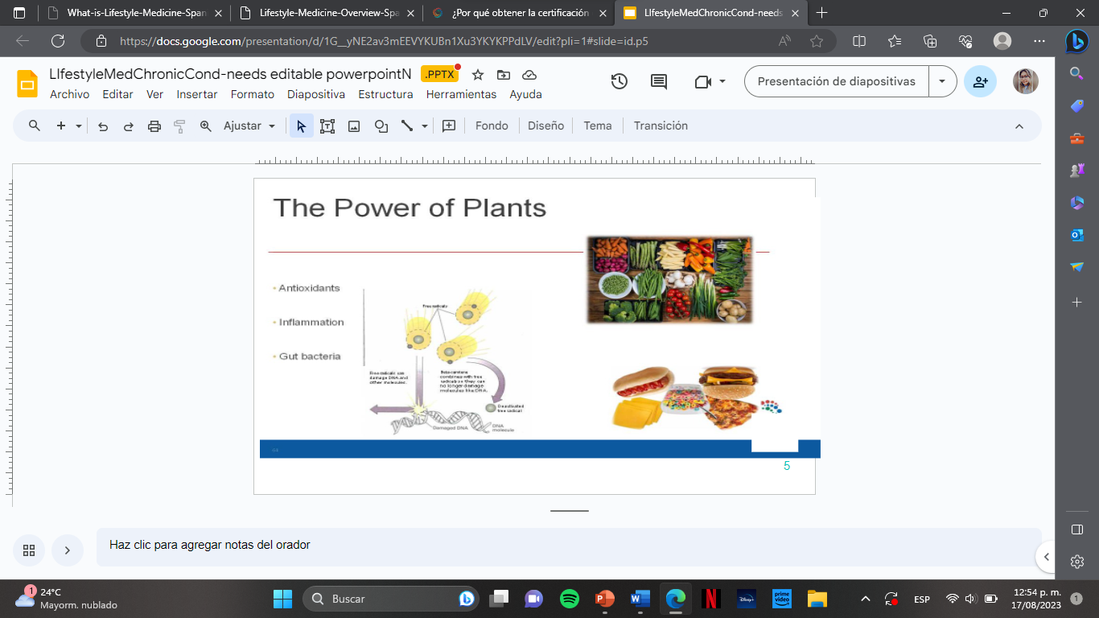
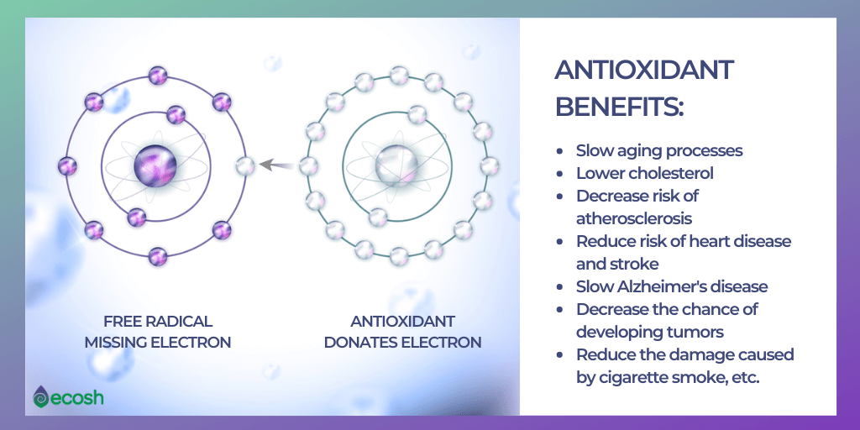
The Power of Plants
Antioxidants
Inflammation
Gut bacteria

Slide 18
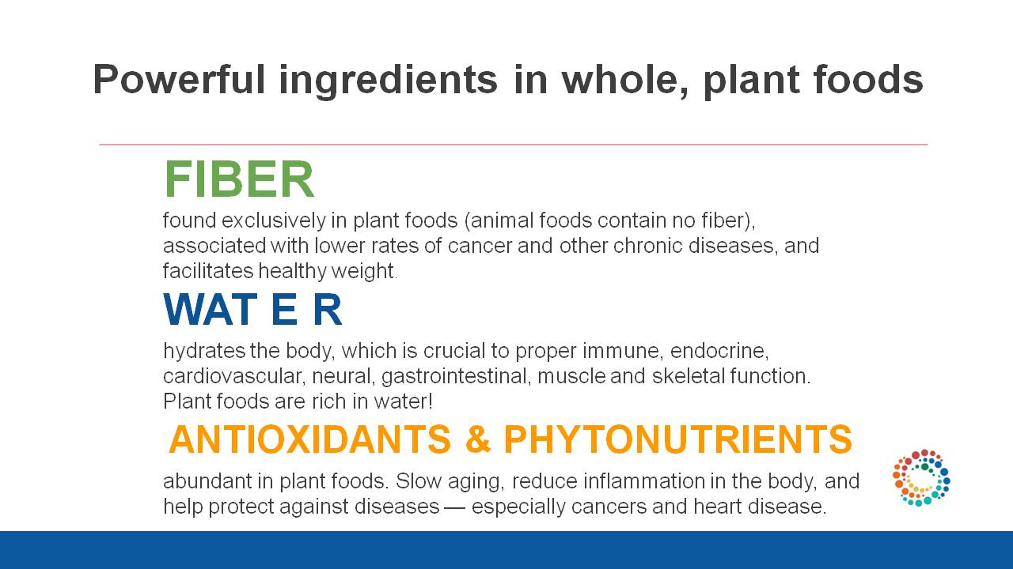

Slide 19

Vegetable Diet
Vegetables have lots of nutrition and little calories
Eat as much vegetables as you want (except corn and potatoes), but at least 2 servings per meal.
Breakfast, lunch and dinner
Focus on vegetables with a lot of fiber (asparagus, green beans, broccoli)
Vegetables can be fresh, canned, frozen or blended (not juiced) or in soups

Slide 20
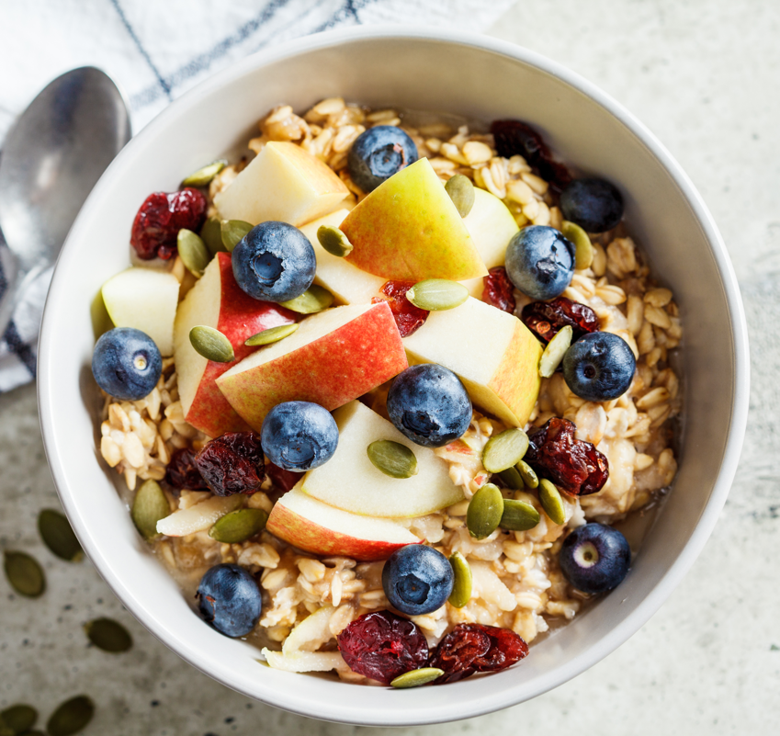
Whole grains linked to lower diabetes risk: benefits of fiber
Fiber
Improved glucose response
Increased satiety
Lower calorie density
For every 14g fiber added per day, overall calorie intake decreases by 10-18%

Slide 21
Key elements of a healthful plant-based eating pattern
Beans, peas, lentils, chickpeas, edamame, tofu, tempeh, quinoa, nuts, seeds
Plant Fats
Avocado, nuts, seeds, plant oils rich in unsaturated fats
Brown rice, oats, quinoa, barley, whole wheat, wild rice, millet, farro, bulgur, corn, etc
Image modified from American College of Lifestyle Medicine
Notes:
Emphasis on minimally processed plant foods

Slide 22
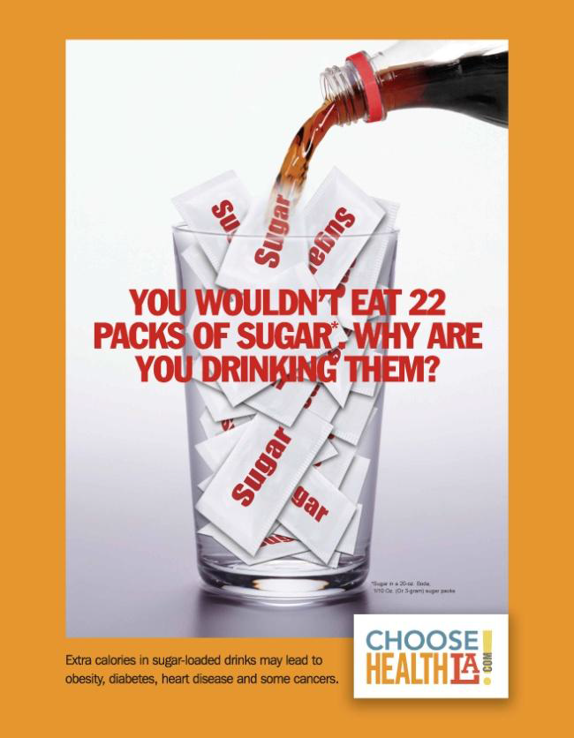
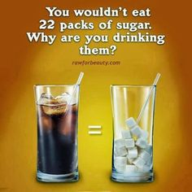
Soft Drinks

Slide 23

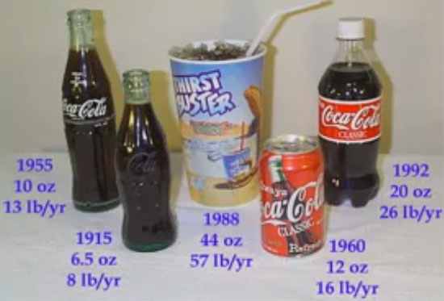

Coca-Cola
Is it really the great American company?
150 cals/12 oz can
Drinking 1 can of coke a day will lead to 16 pound weight gain
Has high fructose corn syrup-doesn’t fill you up.
Studies show it makes you more hungry
Contains salt (55 mg) and caffeine (a diuretic): which leads to dehydration and thirst and more drinking
Coke-Don’t do it!

Slide 24


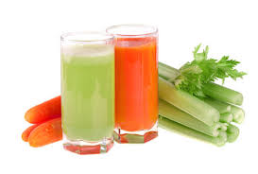
What should I drink instead?
Water
Water
Water
Sparkling water
Herbal/regular ice tea
Vegetable blending

Slide 25
If the taste of water doesn’t appeal to you, make it “plantastic”!!!

Slide 26
Diet sodas
Diet sodas?? Controversial.
  Probably better than sugar sodas
  Body is confused-stimulates sweet taste buds, but doesn’t deliver calories
  Sucralose (Splenda) is a modified sugar molecule-500X more potent than sugar
  Very little Splenda in a Splenda package-mostly fillers
  Nutrasweet (Equal) is a pure chemical that doesn’t resemble sugar
  Both are probably safe, but it would be better to not use at all
  My take-Diet sodas are better than sugar sodas
  But it would be best to minimize its intake

Slide 27
WHAT NOT TO EAT/ BUY?

Slide 28
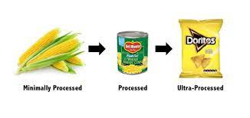
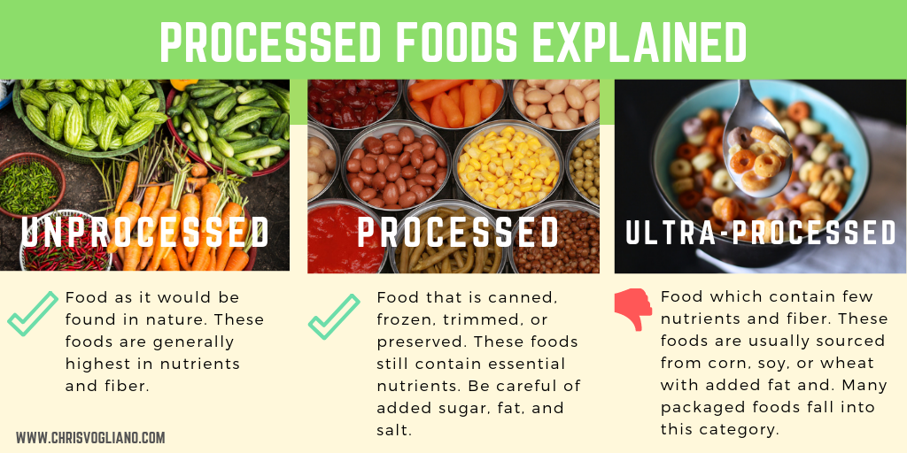
What else should I stop right away?
Ultra-processed foods

Slide 29
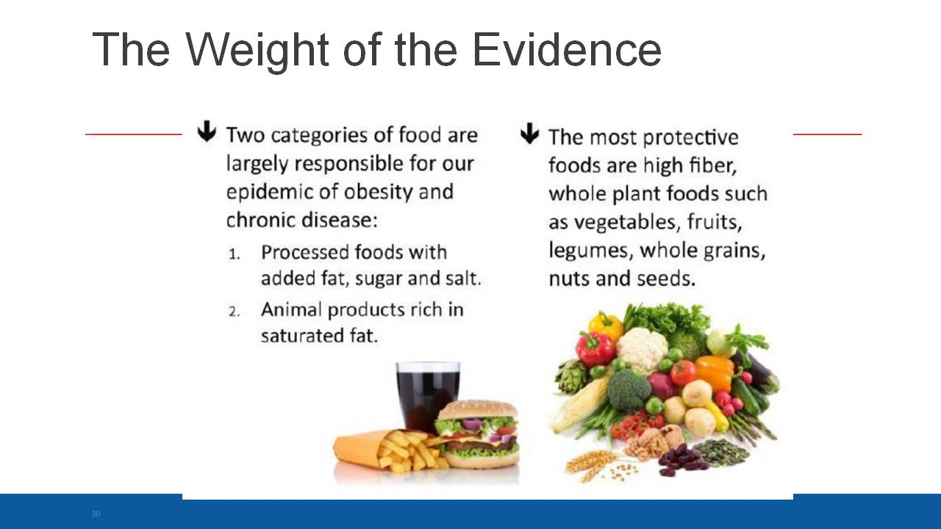

Slide 30
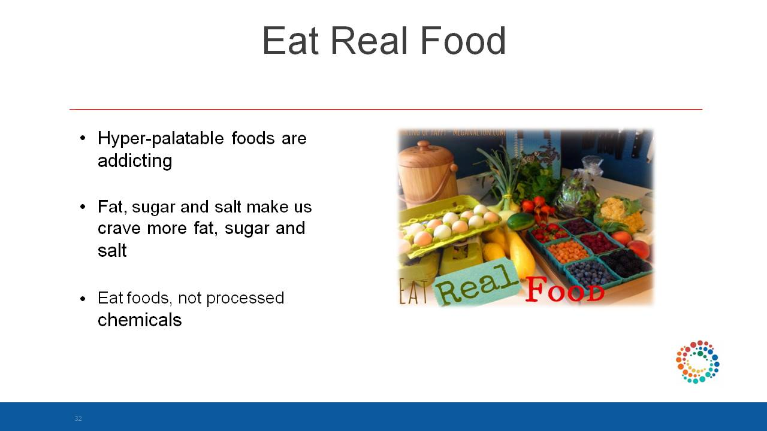

Slide 31
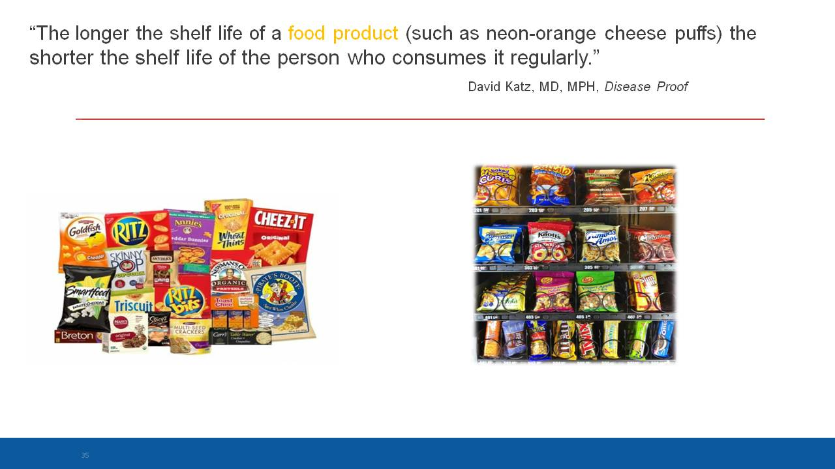

Slide 32
NUTRITIONALLY EMPTY CALORIES

Slide 33


Slide 34
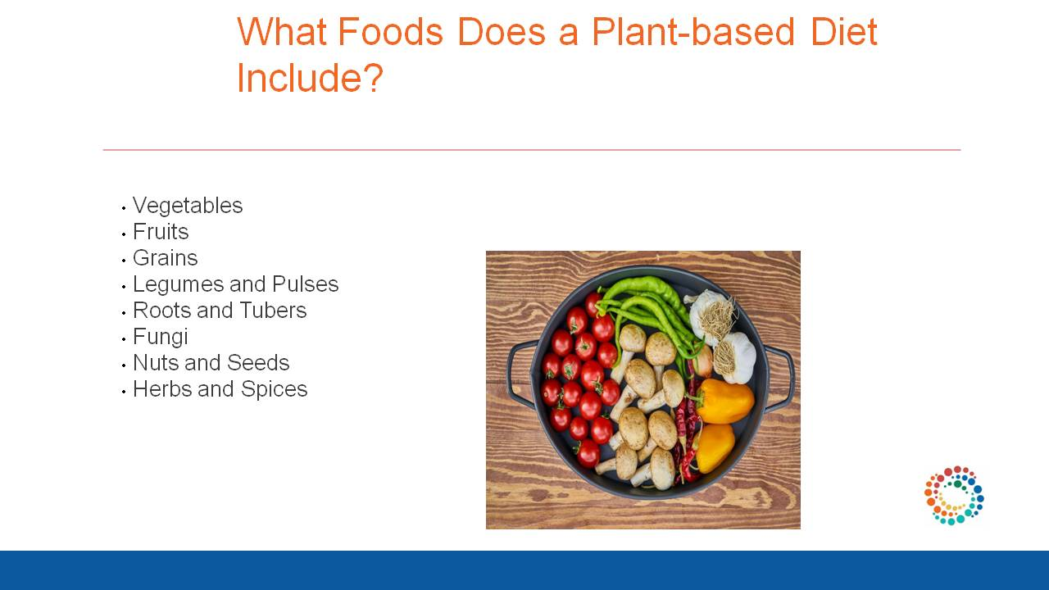

Slide 35
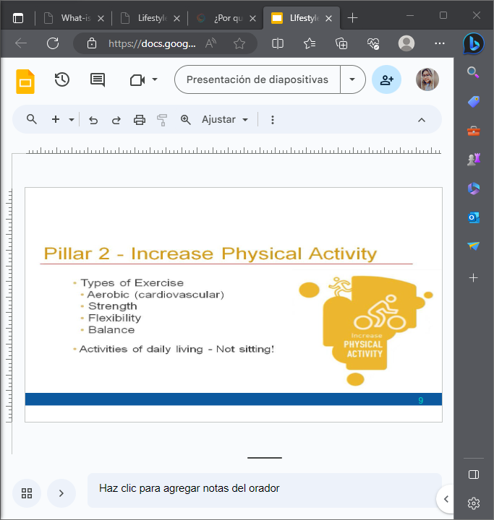
Pillar 2 – Increased Physical Activity
Types of Exercise
Aerobic (cardiovascular)
Strength
Flexibility
Balance
Activities of daily living – Not sitting

Slide 36
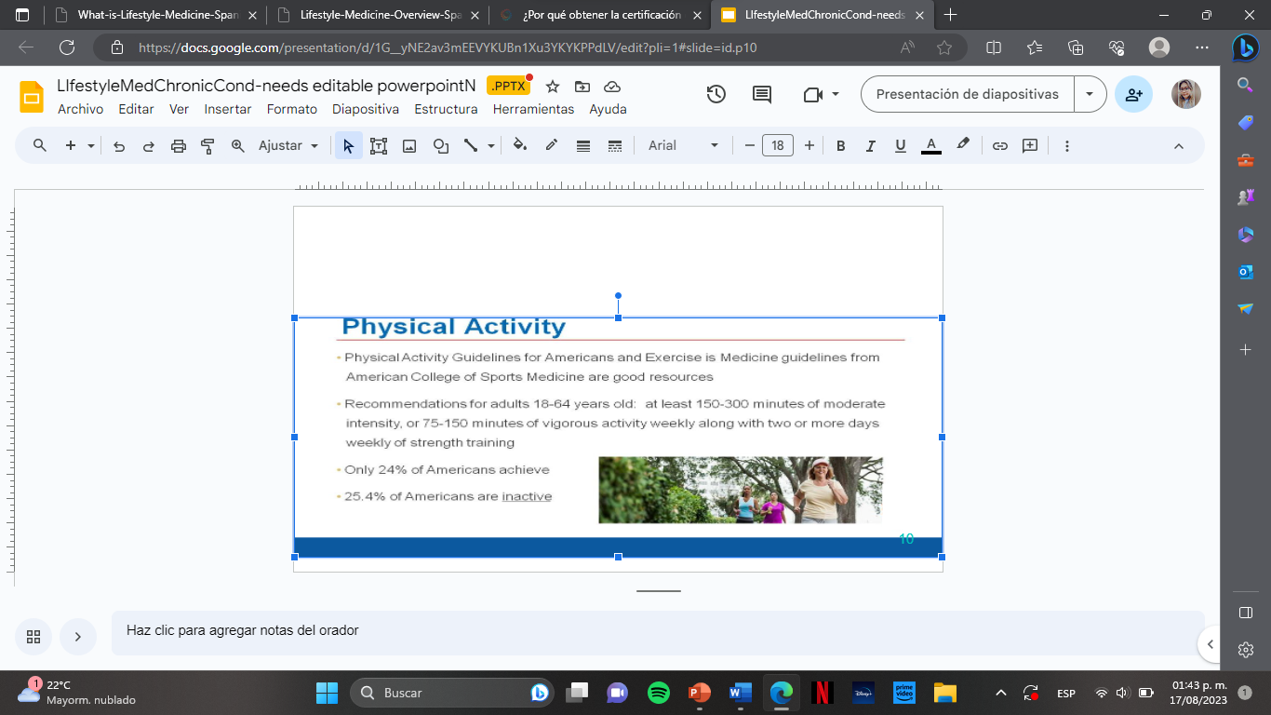
Physical Activity
Physical Activity Guidelines for Americans and Exercise is Medicine guidelines from American College of Sports Medecine are good resources
Recommendations for adults 18-64 years old: at least 150-300 minutes of moderate intensity, or 75-150 minutes of vigorous activity weekly along with two or more days weekly of strength training
Only 24% of Americans achieve the recommendations
25.4% of Americans are totally inactive

Slide 37
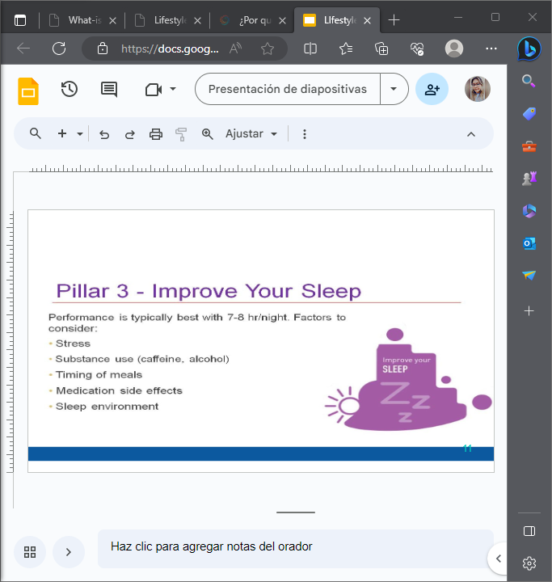
Pillar 3 – Improve Your Sleep
Performance is typically best with 7-8 hr/night.
Factors to consider:
Stress
Substance use (caffeine, alcohol)
Timing of meals
Medication side effects
Sleep environment

Slide 38
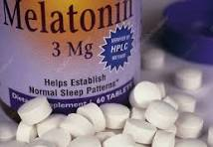
Sleep
National Sleep Foundation recommends 7-9 hours of sleep a day for most adults
1 in 3 adults do not get enough sleep
Suspect sleep deprivation in any patient with a clinical complaint of daytime hypersomnolence who reports consistently getting less than 7 hours of sleep per night
Nurses and other essential workers who get < 7 hours sleep/night have increased risk of burnout
Sleep < 6-8 hours a night increases risk of early death by 12 percent
Melatonin is a low cost supplement that works in many patients

Slide 39
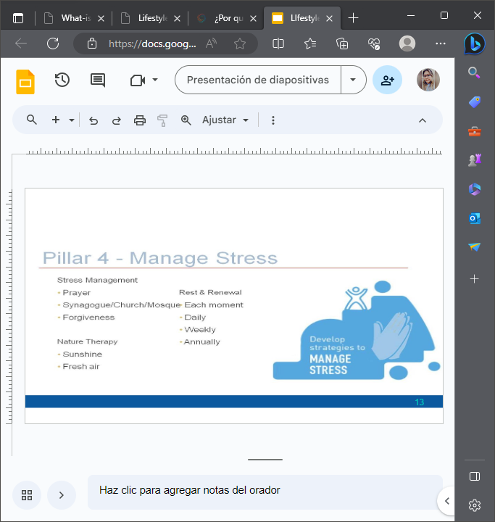
Pillar 4 – Manage Stress
Stress Management
Prayer
Synagogue/church/mosque
Forgiveness
Nature Therapy
Sunshine
Fresh Air
Rest & Renewal
Each moment
Daily
Weekly
Annually

Slide 40
Stress Management
Stress defined as “any demand for change.”
Stress response is a cascade of physiological events that can lead to improved health and productivity or anxiety, depression, obedity, immune dysfunction and poor health outcomes
Assisting patients to recognize maladative stress responses and transform them into responses that improve health and well-being is an essential part of LM practice at all levels.
Teach patients how to avoid stress AND how to deal with stress

Slide 41
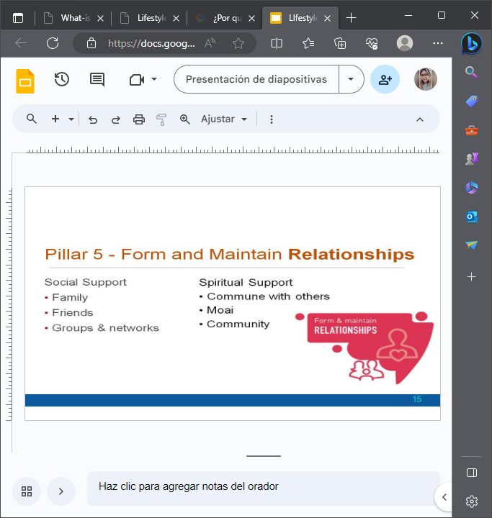
Pillar 5 Form and Maintain Relationships
Spiritual support
Commune with others
Moais are a friendship tradition from Okinawa, Japan – essentially, it is a friend circle that starts in childhood. Moais offer emotional and moral support, and the effect on people's health can be remarkably positive.
Social Support
Family
Friends
Groups and networks

Slide 42
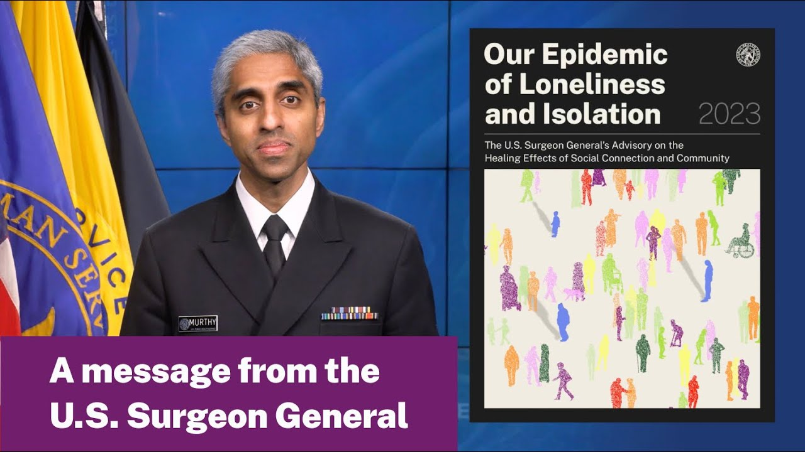
Dr Vivek Murthy
29% higher risk for premature death, 50% higher risk for dementia, 29% higher risk for CVD; 32% risk for stroke.
Decreasing loneliness can cut the risk for dying early by as much as 50%
Notes:
HOUSE CALLS with Dr Vivek Murthy on 5/2/23: Youtube
29% higher risk for premature death, 50% higher risk for dementia, 29% higher risk for CVD; 32% risk for stroke; decreasing loneliness can cut the risk for dying early by as much as 50%

Slide 43
Social Connection
Humans are social beings-need for social connection is a basic survival urge hardwired into our nervous systems
Social relationships are as important to health as diet, exercise and smoking habits. In fact, the quality of our relationships may determine whether or not we choose to engage in healthy lifestyle behaviors – the Rosetto effect
Unhealthy social relationships, isolation and loneliness are associated with increased mortality and morbidity especially among individuals with established lifestyle-related diseases

Slide 44

“Social connection is as essential to humanity as food, water or shelter, the advisory says. Humans have historically needed to rely on each other for survival, and modern people remain wired for that connection and for proximity to others.”

Slide 45
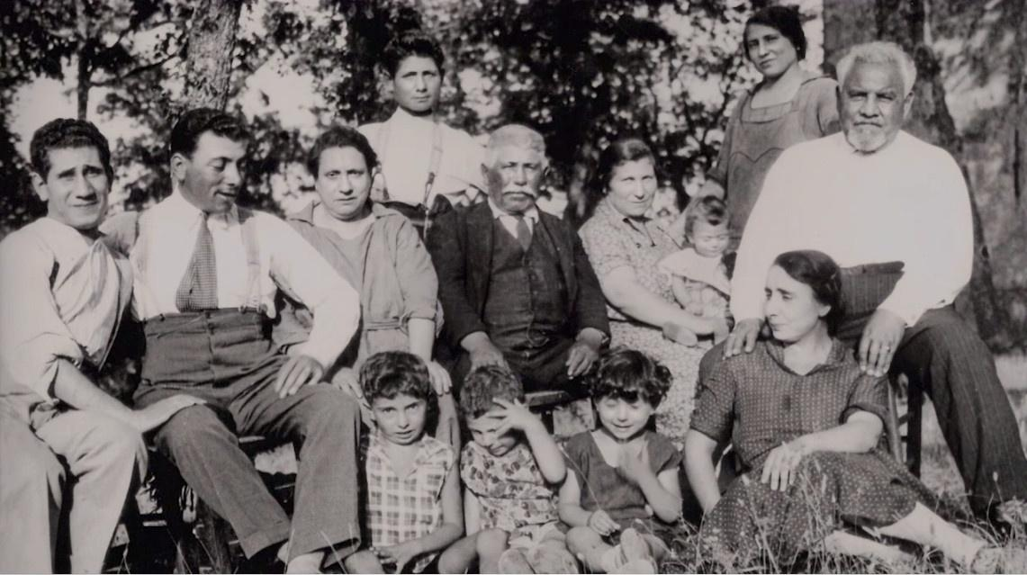
The Roseto effect
The Roseto effect is the phenomenon by which a close-knit community experiences a reduced rate of heart disease. The effect is named for Roseto, Pennsylvania.
The Roseto effect was first noticed in 1961 when a local Roseto doctor encountered Stewart Wolf, then head of Medicine of the University of Oklahoma, and they discussed, over a couple of beers, the unusually low rate of myocardial infarction in the Italian American community of Roseto compared with other locations
"Roseto effect," describes a close-knit community experiences a reduced rate of heart disease and extended life span. As Malcolm Gladwell indicated in his book Outliers – the high quality of interpersonal relationships was the reason for the Rosetans' long and happy lives.
Social relationships are as important to health as diet, exercise and smoking habits. In fact, the quality of our relationships may determine whether or not we choose to engage in healthy lifestyle behaviors – the Rosetto effect

Slide 46
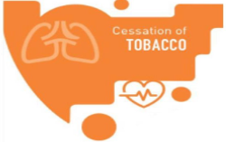
Pillar 6 – Avoid Tobacco and Others Exposures
(modified to include avoiding risky behaviors)
Dangerous exposures may include:
Tobacco
Alcohol
Illicit drugs
Pollutants
Chemicals and preservatives

Slide 47
Substance Use
Addiction is a chronic characterized by compulsive, or uncontrollable use of a substance or behavior despite harmful consequences
Over 40 million Americans meet clinical criteria for addiction to nicotine, alcohol or other drugs
Another 80 million may not be addicted but are risky users – more than number of people with cancer, diabetes or hypertension
Presence of an addiction or risky use doubles risk of overdose, motor vehicle crashes, traumatic injuries and chronic conditions, such asarthritis, chronic pain, hypertension, heart disease, stroke, diabetes, and asthma

Slide 48
Pillar 6A: Avoiding risky behaviors
Gun Safety
Suicide Prevention
Avoid Gambling
Accident Prevention
Safe Driving
Fall prevention

Slide 49




Nature Connection
Screen/Smartphone Time
Spirituality
Lifelong Learning
Other Lifestyle Dimensions

Slide 50
Nature Connection
Viewing a virtual nature video led to decreased state anxiety and salivary cortisol levels.
(Jo & Song, 2020)
Nature provides benefits to mental health, including stress reduction, improved cognitive function, and increased social cohesion.
(Bratman et al., 2019).
Viewing nature images led to augmented parasympathetic activity and improved sleep quality.
(Chou et al., 2021)
Compared to no nature contact, the likelihood of reporting good health or high well-being became significantly greater with contact ≥120 mins/week.
(White et al., 2019)

Slide 51
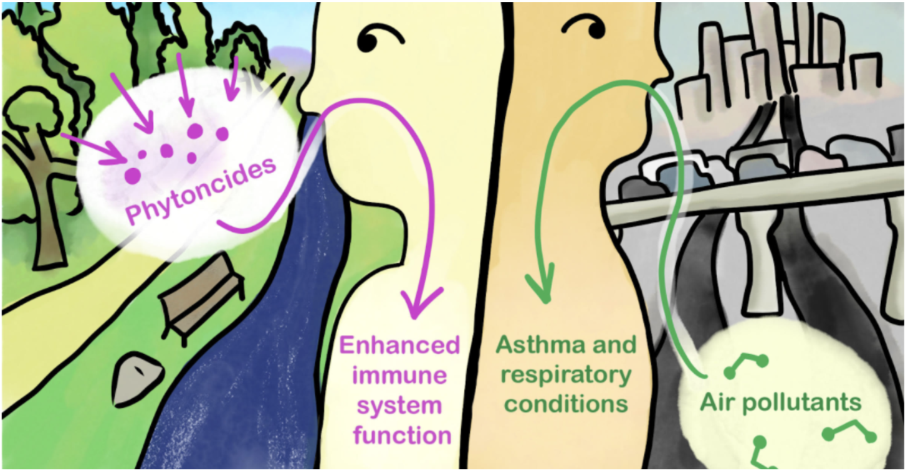
Nature

Slide 52

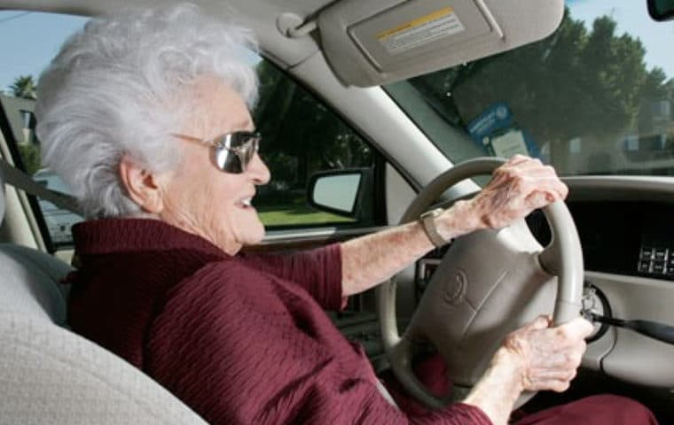
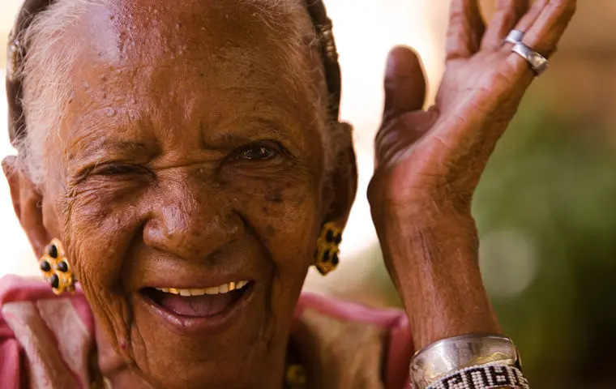
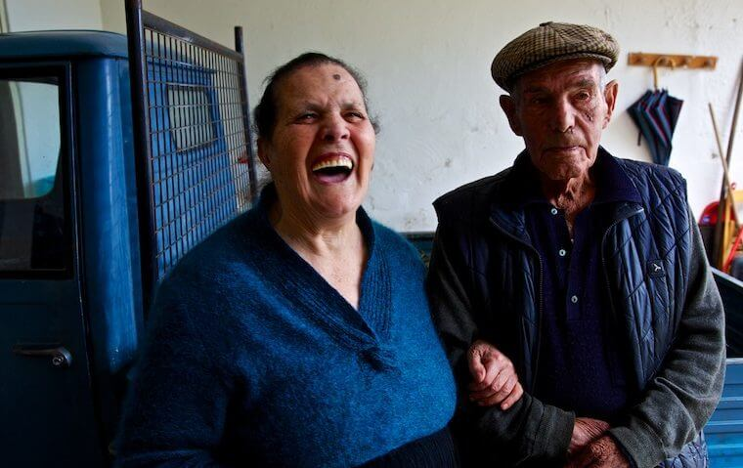

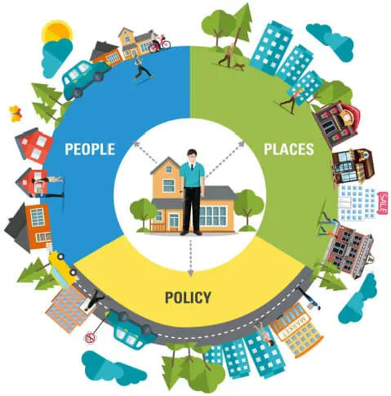
Blue Zones
Blue Zones was founded by adventurer and author Dan Buettner, an explorer who once circled the globe on his bicycle to earn three Guinness Book of World Records.
He has discovered five places in the world ­– dubbed blue zones – where people live the longest, and are healthiest.
All stress social relationships and also practice healthy eating and physical activity.
Ikaria, Greece
Loma Linda, California
Nicoya, Costa Rica
Sardinia, Italy
Okinawa, Japan

Slide 53
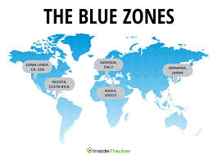
Blue Zones
The name "blue zones" derived simply during the original survey by scientists, who "used a blue pen on a map to mark the villages with long-lived population.

Slide 54


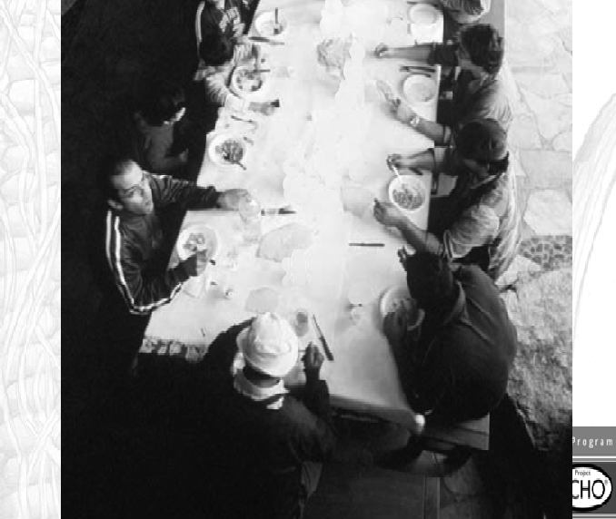
Sardinia
Eat a lean, plant-based diet accented with meat.
The classic Sardinian diet consists of whole-grain bread, beans, garden vegetables, fruits, and, in some parts of the island, mastic oil. Sardinians also traditionally eat pecorino cheese made from grass-fed sheep, whose cheese is high in omega-3 fatty acids. Meat is largely reserved for Sundays and special occasions.
Put family first.
Sardinia’s strong family values help assure that every member of the family is cared for. People who live in strong, healthy families suffer lower rates of depression, suicide, and stress.
Drink goat’s milk.
A glass of goats milk contains components that might help protect against inflammatory diseases of aging such as heart disease and Alzheimer’s.
Celebrate elders.
Grandparents can provide love, childcare, financial help, wisdom, and expectations/motivation to perpetuate traditions and push children to succeed in their lives. This may all add up to a healthier, better adjusted, and longer-lived children. It may give the overall population a life expectancy bump.
54

Slide 55
Sardinia
Take a walk.
Walking five miles a day or more as Sardinian shepherds do provides all the cardiovascular benefits you might expect, and also has a positive effect on muscle and bone metabolism without the joint-pounding of running marathons or triathlons.
Drink a glass or two of red wine daily.
Sardinians drink wine moderately. Cannonau wine has two or three times the level of artery-scrubbing flavonoids as other wines. Moderate wine consumption may help explain the lower levels of stress among men.
Laugh with friends.
Men in this blue zone are famous for their sardonic sense of humor. They gather in the street each afternoon to laugh with and at each other. Laughter reduces stress, which can lower one’s risk of cardiovascular disease.
55

Slide 56
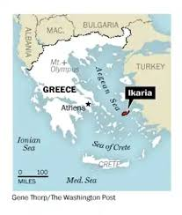

Ikaria, Greece
Mimic mountain living
The longest-lived Ikarians tended to be poor people living in the island’s highlands. They exercised mindlessly by just gardening, walking to their neighbors house or doing their own yard work. The lesson to us: Engineer more mindless movement into our lives.
Eat a Mediterranean-style diet
Ikarians eat a variation of the Mediterranean diet, with lots of fruits and vegetables, whole grains, beans, potatoes and olive oil.
Try cooking with olive oil, which contains cholesterol-lowering mono-unsaturated fats.
Stock up on herbal teas
People in Ikaria enjoy drinking herbal teas with family and friends, and scientists have found that they pack an antioxidant punch. Wild rosemary, sage and oregano teas also act as a diuretic, which can keep blood pressure in check by ridding the body of excess sodium and water.
Nap
Take a cue from Ikarians and take a midafternoon break. People who nap regularly have up to 35 percent lower chances of dying from heart disease. It may be because napping lowers stress hormones or rests the heart.

Slide 57
Ikaria, Greece
Fast occasionally
Ikarians have traditionally been fierce Greek Orthodox Christians. Their religious calendar called for fasting almost half the year. Caloric restriction – a type of fasting that cuts about 30 percent of calories out of the normal diet – is the only proven way to slow the aging process in mammals.
Make family and friends a priority
Ikarians foster social connections, which have been shown to benefit overall health and longevity. So get out there and make some plans.
Choose goat’s milk over cow’s milk
Instead of cow’s milk, Ikarians use grass-fed goat’s milk. It provides potassium and the stress-relieving hormone tryptophan. It’s also hypoallergenic and can usually be tolerated by people who are lactose intolerant.

Slide 58
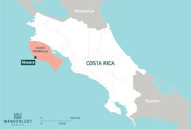

Nicoya, Costa Rica
Have a plan de vida.
Successful centenarians have a strong sense of purpose. They feel needed and want to contribute to a greater good.
Drink hard water.
Nicoyan water has the country’s highest calcium content, perhaps explaining the lower rates of heart disease, as well as stronger bones and fewer hip fractures.
Keep a focus on family.
Nicoyan centenarians tend to live with their families, and children or grandchildren provide support and a sense of purpose and belonging.
Eat a light dinner.
Eating fewer calories appears to be one of the surest ways to add years to your life. Nicoyans eat a light dinner early in the evening. For most of their lives, Nicoyan centenarians ate a traditional Mesoamerican diet highlighted with the “three sisters” of agriculture: squash, corn, and beans.

Slide 59
Nicoya, Costa Rica
Maintain social networks.
Nicoyan centenarians get frequent visits from neighbors. They know how to listen, laugh, and appreciate what they have.
Keep hard at work.
Centenarians seem to have enjoyed physical work of all their lives. They find joy in everyday physical chores.
Get some sensible sun.
Nicoyans regularly take in the sunshine, which helps their bodies produce vitamin D for strong bones and healthy body function. Vitamin D deficiency is associated with a host of problems, such as osteoporosis and heart disease, but regular, “smart” sun exposure (about 15 minutes on the legs and arms) can help supplement your diet and make sure you’re getting enough of this vital nutrient.

Slide 60


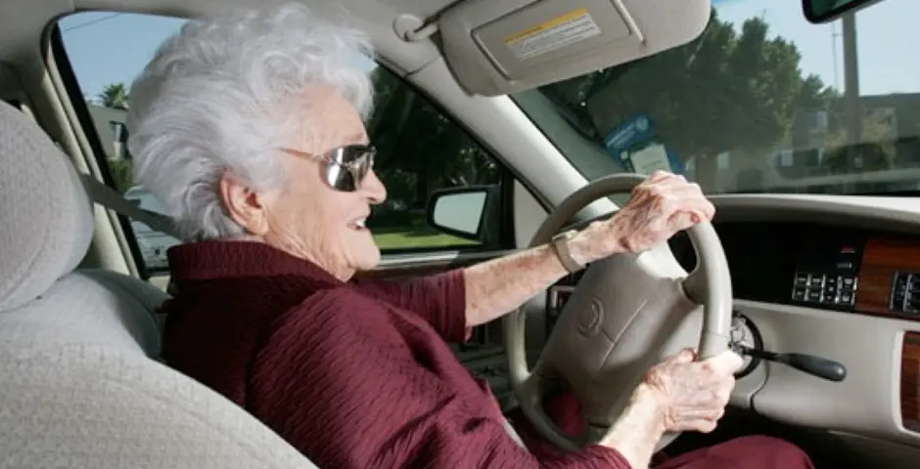
Loma Linda
Find a sanctuary in time.
A weekly break from the rigors of daily life, the 24-hour Sabbath provides a time to focus on family, God, camaraderie, and nature. Adventists claim this relieves their stress, strengthens social networks, and provides consistent exercise.
Maintain a healthy body mass index (BMI).
Adventists with healthy BMIs (meaning they have an appropriate weight for their heights) who keep active and eat meat sparingly, if at all, have lower blood pressure, lower blood cholesterol, and less cardiovascular disease than heavier Americans with higher BMIs.
Get regular, moderate exercise.
The Adventist Health Survey (AHS) shows that you don’t need to be a marathoner to maximize your life expectancy. Getting regular, low-intensity exercise like daily walks appears to help reduce your chance of having heart disease and certain cancers.
Spend time with like-minded friends.
Adventists tend to spend time with lots of other Adventists. They find well-being by sharing their values and supporting each other’s habits.
Snack on nuts.
Adventists who consume nuts at least five times a week have about half the risk of heart disease and live about two years longer than those who don’t. At least four major studies have confirmed that eating nuts has an impact on health and life expectancy.
60

Slide 61
Loma Linda
Give something back.
Like many faiths, the Seventh-day Adventist Church encourages and provides opportunities for its members to volunteer.
Eat meat in moderation.
Many Adventists follow a vegetarian diet. The AHS shows that consuming fruits and vegetables and whole grains seems to be protective against a wide variety of cancers. For those who prefer to eat some meat, Adventists recommend small portions served as a side dish rather than as the main meal.
Eat an early, light dinner.
“Eat breakfast like a king, lunch like a prince, and dinner like a pauper,” American nutritionist Adelle Davis is said to have recommended –an attitude also reflected in Adventist practices. A light dinner early in the evening avoids flooding the body with calories during the inactive parts of the day. It seems to promote better sleep and a lower BMI.
Put more plants in your diet.
In support of a biblical diet of grains, fruits, nuts, and vegetables, Adventists cite Genesis 1:29: “And God said, Behold, I have given you every herb bearing seed, which is upon the face of all the earth, and every tree, in which is the fruit of a tree yielding seed; to you, it shall be for meat.” The Adventists encourage a “well-balanced diet” including nuts, fruits, and legumes, low in sugar, salt, and refined grains.
61

Slide 62


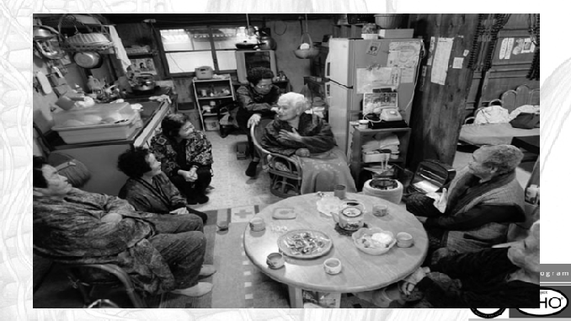
Okinawa
Rely on a plant-based diet.
Older Okinawans have eaten a plant-based diet most of their lives. Their meals of stir-fried vegetables, sweet potatoes, and tofu are high in nutrients and low in calories.
Goya, with its antioxidants and compounds that lower blood sugar, is of particular interest. While centenarian Okinawans do eat some pork, it is traditionally reserved only for infrequent ceremonial occasions and taken only in small amounts.
Get gardening.
Almost all Okinawan centenarians grow or once grew a garden. It’s a source of daily physical activity that exercises the body with a wide range of motion and helps reduce stress. It’s also a near-constant source of fresh vegetables.
Eat more soy.
The Okinawan diet is rich in foods made with soy, like tofu and miso soup. Flavonoids in tofu may help protect the hearts and guard against breast cancer. Fermented soy foods contribute to a healthy intestinal ecology and offer even better nutritional benefits.
Maintain a moai.
The Okinawan tradition of forming a moai provides secure social networks. These safety nets lend financial and emotional support in times of need and give all of their members the stress-shedding security of knowing that there is always someone there for them.
62
62

Slide 63
Okinawa
Enjoy the sunshine.
Vitamin D, produced by the body when it’s exposed on a regular basis to sunlight, promotes stronger bones and healthier bodies. Spending time outside each day allows even senior Okinawans to have optimal vitamin D levels year-round.
Stay active.
Older Okinawans are active walkers and gardeners. The Okinawan household has very little furniture; residents take meals and relax sitting on tatami mats on the floor. The fact that old people get up and down off the floor several dozen times daily builds lower body strength and balance, which help protect against dangerous falls.
Plant a medical garden.
Mugwort, ginger, and turmeric are all staples of an Okinawan garden, and all have proven medicinal qualities. By consuming these every day, Okinawans may be protecting themselves against illness.
Have an attitude.
A hardship-tempered attitude has endowed Okinawans with an affable smugness. They’re able to let difficult early years remain in the past while they enjoy today’s simple pleasures. They’ve learned to be likable and to keep younger people in their company well into their old age.
63
63

Slide 64

Okinawa
Tragically, Okinawa is no longer a Blue Zone according to Dan Bunetter.
On the Rich Roll podcast in March of 2020, Buettner revealed that due to the introduction of the Western diet, Okinawa has suffered the worst degeneration of all five Blue Zones, and now has the highest rates of obesity and diabetes of the original Blue Zones.

Slide 65
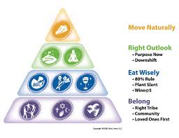
Blue Zones
Common themes

Slide 66
Blue Zones Family
We say that family is everything, but the people in the Blue Zones truly use it as a key to longevity.
Going beyond the traditional nuclear family, they keep grandparents, aunts, uncles, cousins, etc. close.
Many of them are even within walking distance.
With such a large support group nearby, it is no wonder that the people of the Blue Zones live longer, happier lives.

Slide 67
Blue Zones Purpose
If you don’t have a reason to get out of bed in the morning, you are not living the Blue Zone life.
Whether it is a job, game, garden, or family to tend to, longevity in the Blue Zones is traced back to having a purpose.
By both having one or more purposes and devoted each day to them, life is more worth living.

Slide 68
Blue Zones: Take It Down a Notch
Keeping up with the Jones’s may be an American staple of life, but it is a rarity in the Blue Zones.
In fact, working less hours, taking more breaks, and finding time to rest all contribute to longevity in the region.
In fact, they are often known to vacation much more than the typical two weeks.

Slide 69
No, this does not mean your Facebook or online role playing friends, it means an actual social network.
Whether a sports team, volunteering, or even a sewing circle, having lots of friends can lead to longevity.
It also gives you purpose and something to look forward to.
If you need help getting started, try volunteering in Spiritual setting.
Blue Zones: Social Network

Slide 70
Believing in God and having a spiritual life is an important longevity secret from the Blue Zones.
Not only does it give a purpose, but also a sense of community and belonging.
The power of prayer has also been shown to have positive health effects.
Blue Zones: Believe

Slide 71

Not just a staple for family-oriented sitcoms, the family dinner can actually have longevity benefits.
Not only does everyone share in preparing, eating, and cleaning after a meal, but since the food is prepared at home, no extra additives or anything harmful make it into the food.
Blue Zones: The Family Dinner

Slide 72
We have been told for years that fruits and vegetables are an important part of any diet.
And in the Blue Zones they are a not-so-well-kept secret to longevity.
In this study reported on by Dr. Mirkin, 70 percent of those eating the high plant diet had normal blood pressures, compared to 45 percent on the fruits- and-vegetables diet and 23 percent on the control diet.
Because each plant eaten has different nutritional properties, it is difficult to tell how much longevity to expect, but the benefits can include lower risk of cancer, diabetes, stroke, and many others
Blue Zones: High Plant Diet

Slide 73
It took the United States 25 million dollars in research to learn this longevity secret already well known in the Blue Zones.
Pomegranate juice can help heart health, prostate health, and proper erectile function.
An excellent non-alcohol alternative to red wine for containing many of the similar antioxidant properties.
Blue Zones: Pomegranate Juice

Slide 74
Not is it only good for the planet and for keeping your gas bills down, it can also lead to longevity.
People in the Blue Zones are often known to bicycle to the houses of family and friends, the market, and more.
It is also easier on the joints, and is a relaxing experience.
Blue Zones: Bicycling

Slide 75
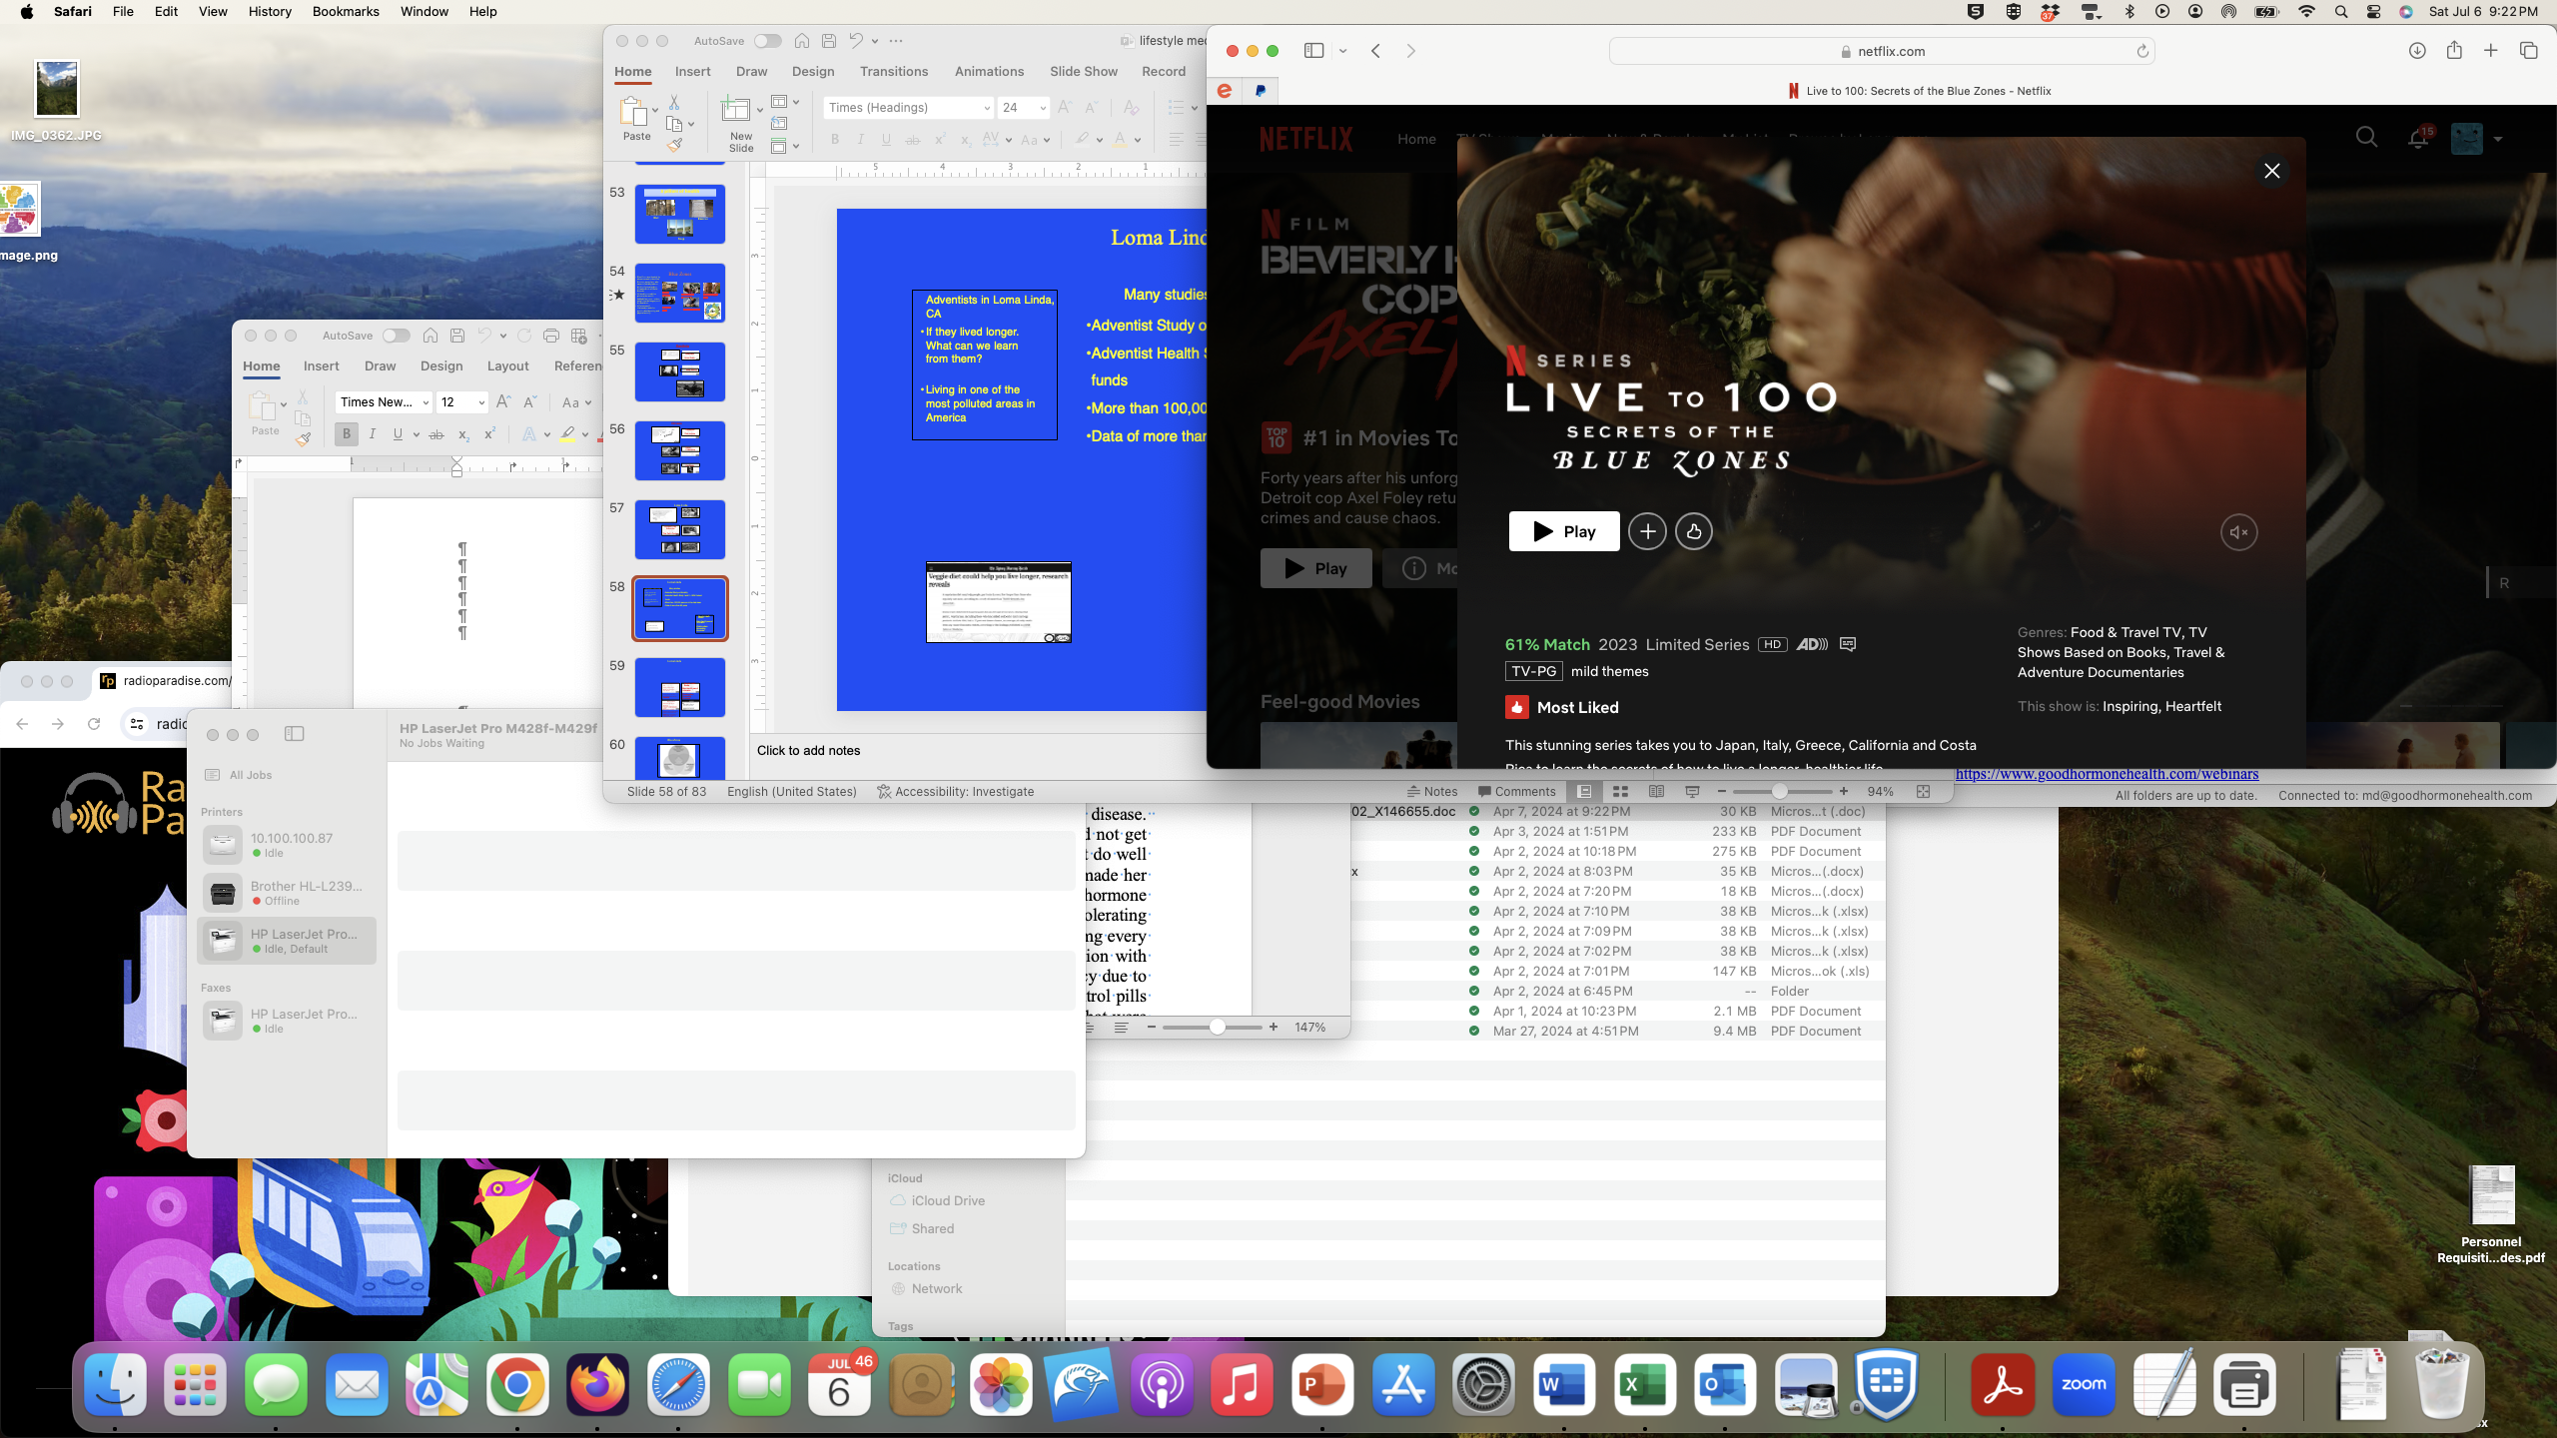

Blue Zone Netflix
https://www.netflix.com/title/81214929

Slide 76

Lifestyle Medicine vs Pharmaceutical Intervention for Osteoporosis
Osteoporosis, or thinning of the bones, is a big industry in the United States, with millions of dollars spent on testing and treatments that are usually expensive and have side effects. Of course, nobody wants to have a bone fracture. Is it needed, or is there a simple solution to help preserve bone health?
The main reason elderly get fractures is by falling.
While strengthen bone is important, preventing falls is even more important

Slide 77
Lifestyle Medicine vs Pharmaceutical Intervention for Osteoporosis
The current osteoporosis medicines are either older ones, of which the main one is alendronate, that work modestly well but is hard to take because you have to take it standing for a half hour.
Otherwise, you can get esophageal and stomach problems.
It is usually given once a week.
It is inexpensive, but it can lead to depression, and it also leads to what is called atypical fractures.
Atypical fractures, as opposed to regular fractures, occur without trauma and are usually in the large bone in the thigh called the femur bone.
The last thing someone wants is an atypical fracture, where you bone just snaps in half without any fall.
The risk of these atypical fractures is relatively high, although less than the amount of the typical fractures prevented by the medicine but is still a serious side effect.
Alendronate may need to be held for dental procedures. This should be discussed with your oral surgeon.

Slide 78

Lifestyle Medicine vs Pharmaceutical Intervention for Osteoporosis
The new medicines are extremely expensive and may or may not be covered by insurance and also have side effects.
One is called Prolia, which is a shot given in a doctor's office twice a year. This drug is also associated with atypical fractures and is quite expensive.
Another drug is called Forteo, which is a daily shot and does build up bone, but it also has a fair amount of side effects.

Slide 79
Calcium and Vitamin D
Recent students have suggested that calcium pills, which used to be given to strengthen bones, is actually detrimental overall and leads to a higher rate of heart disease.
The detrimental effects of calcium supplementation on the heart outweigh the beneficial effects on the bones, and I changed the DHS expected practice to no longer recommend calcium supplementation.
Vitamin D supplementation does seem to help prevent fractures to a small degree and is probably beneficial.
Camacho Endocrine Practice 2020

Slide 80
Lifestyle Medicine to Prevent and Treat Osteoporosis-Exercise
Exercise has been shown to increase bone density and helps with muscle strength, which helps prevent falls, which is the major reason why people break bones.
I recommend a combination of aerobic and weightbearing exercises to increase bones.
The exercises can include just walking or more strenuous exercises, depending on the health of the individual.

Slide 81
Lifestyle Medicine to Prevent and Treat Osteoporosis- Calcium from plant-sources
Studies have shown that dairy products actually increase fracture rates and are not recommended.
However, plant-based calcium is better absorbed than dairy-based such as broccoli, kale, and spinach do contain a lot of calcium, and that would be a better source for calcium intake.
Other high-calcium plant-based foods include tofu, fortified nut milks, beans, tahini, sweet potatoes, watercress, okra, chia seeds, and almonds.

Slide 82
Lifestyle Medicine to Prevent and Treat Osteoporosis- Conclusions
Overall, I recommend preventing falls by increased exercise and eating a plant-based diet.
Have a fall-prevention approach
Please look at these webinars from Lifestyle Medicine expert, Michael Greger, MD
https://nutritionfacts.org/webinar/preventing-and-treating-osteoporosis/
https://nutritionfacts.org/video/fall-prevention-is-the-most-important-thing-for-preventing-osteoporosis-bone-fractures/

Slide 83

Lets exercise !!!
Evelin Martinez, PA
MLK

Slide 84

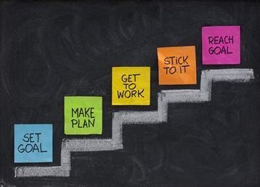
What are your goals to get healthy?

Slide 85
Session reflections
What is your greatest takeaway from this session?
THANK YOU
All of you for participating today!

Slide 86
Who runs the best pituitary patient conference?
The Magic Foundation
Thanks to Dianne Kremidas for putting on a great conference

Slide 87
For more information/to schedule an appointment/to listen again
Talk will be posted at www.goodhormonehealth.com in a few days
https://www.goodhormonehealth.com/webinars/
https://www.youtube.com/channel/UCC02VSVWL11qk1HUuT4ksoA
https://www.facebook.com/goodhormonehealth/
Schedule an appointment on www.goodhormonehealth.com
Please email us at mail@goodhormonehealth.com
It will also be on Dr. Friedman’s podcast channel- available on spotify, apple podcasts, iheartradio, podcastidex, and amazon music

Slide 88
Questions?

