Slide 1
COVID-19 Vaccines for Endocrine Patients
GoodHormoneHealth Webinar
December 27, 2020
All patients will be muted, but if you are unmuted, please mute your phone

Slide 2
What we will discuss tonight
How do the vaccines work?
What did the New England Journal of Medicine article say about the Pfizer vaccine?
What are the different vaccine options?
What are the side effects?
Who should and shouldn’t get a vaccine?
What about Dr. Friedman’s vaccine studies?
Q and A

Slide 3
Hanukkah 2020
FDA approved the Pfizer vaccine on the 1st day of Hanukkah December 11, 2020
FDA approved the Moderna vaccine on the 8th day of Hanukkah December 18, 2020
Dr. Friedman received his Pfizer vaccine on the 8th day of Hanukkah December 18, 2020
https://www.youtube.com/watch?v=s64sPqy2904&feature=emb_logo

Slide 4
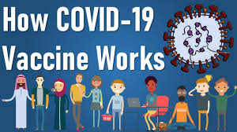

Slide 5
Vaccines work by generating antibodies that prevent the virus from infecting a patient

Slide 6
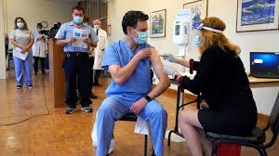
Dr. Friedman received his vaccine on December 18, 2020

Slide 7
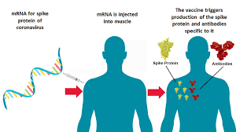
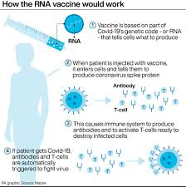

Slide 8
Vaccine trials
Phase 1 in animals
Phase 2 small trials in a few numbers of patients
Phase 3 large trials with a lot of patients
Vaccine vs placebo
Operation Warp Speed provided funding for Phase 3 vaccine trials over the summer and fall 2020.
Pfizer did accept government funding
6-8 different companies
Did not need to wait for results of animal studies
Companies started manufacturing the vaccine even before studies were out
Trials will continue for 2 more years to see if immunity persists and examine long-term safety

Slide 9
Vaccine trials
Phase 1 in animals
Phase 2 small trials in a few numbers of patients
Phase 3 large trials with a lot of patients
Vaccine vs placebo
Operation Warp Speed provided funding for Phase 3 vaccine trials over the summer and fall 2020.

Slide 10
Two vaccines completed their initial part of their trial and are FDA approved as of December 2020
Pfizer 43,448 subejct
Moderna 30,000 subjects
Both rNA vaccines-codes for protein
You can not get COVID from these vaccines

Slide 11
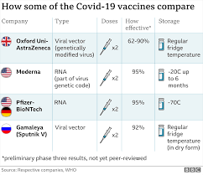

Slide 12
Three vaccines completed their initial part of their trial and are not FDA approved as of December 2020
AstraZeneca Oxford
Johnson and Johnson (Jannsen)
Merck

Slide 13
Ingredients in Vaccines
Pfizer-BioNTech’s vaccine contains:
A nucleoside-modified messenger RNA (modRNA) encoding the viral spike glycoprotein of SARS-CoV-2
Lipids, or fatty substances, including: (4-hydroxybutyl)azanediyl)bis(hexane-6,1-diyl)bis(2-hexyldecanoate), 2-[(polyethylene glycol)-2000]-N, N-ditetradecylacetamide, 1,2-distearoyl-snglycero-3-phosphocholine, and cholesterol
Potassium chloride
Monobasic potassium phosphate
Sodium chloride (salt)
Dibasic sodium phosphate dihydrate
Sucrose (sugar)
No preservatives

Slide 14
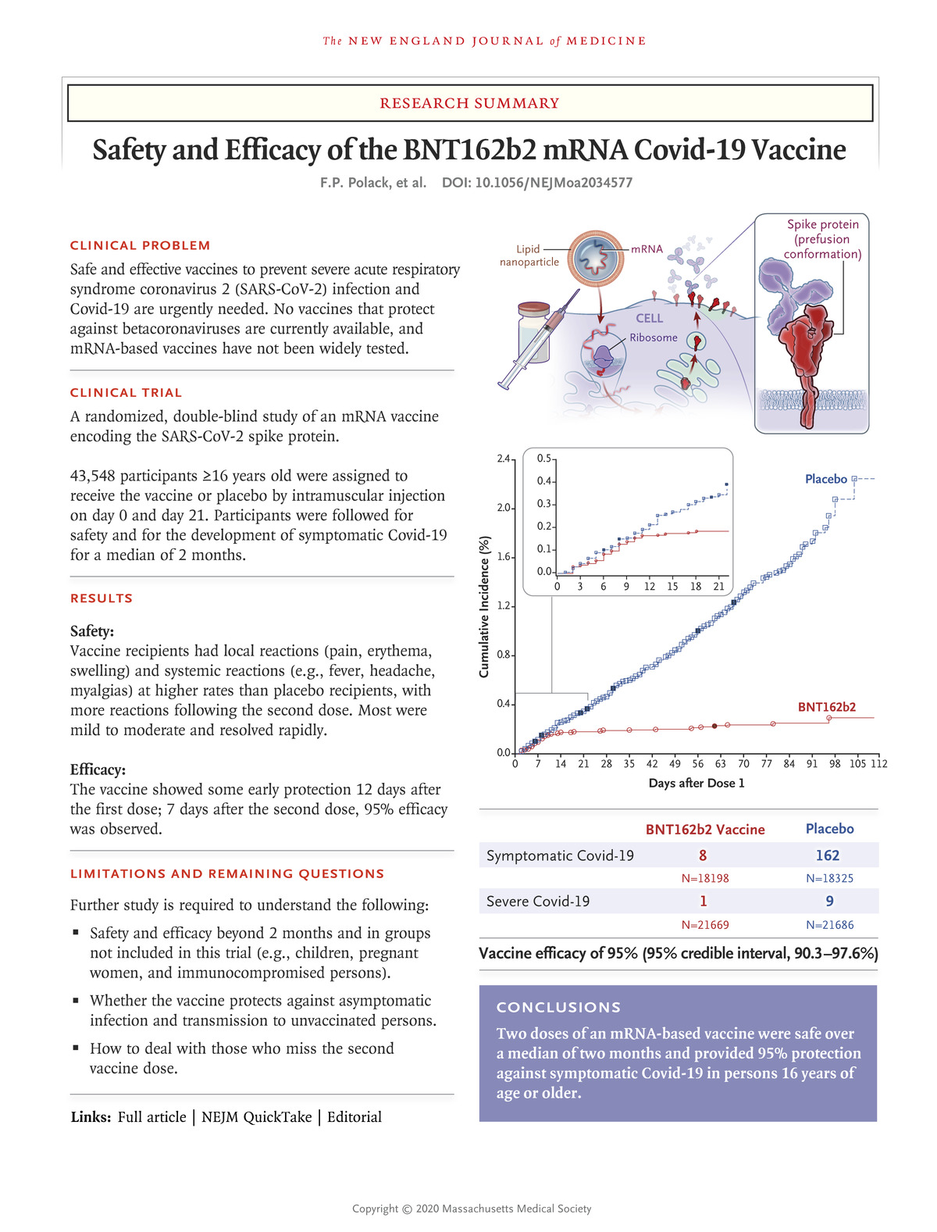
FP Polack et al. N Engl J Med 2020. DOI: 10.1056/NEJMoa2034577
https://www.nejm.org/doi/full/10.1056/NEJMoa2034577
Notes:
. Download a PDF of the Research Summary.

Slide 15
Efficacy
Primary endpoint:
Efficacy against COVID-19
Symptoms
AND Positive COV-19 by PCR
Did not look at patients with symptoms and negative test
Or patients with a positive test and not symptoms
Will look at infectivity (positive COV-19 in respiratory culture)
And antibody levels in future

Slide 16
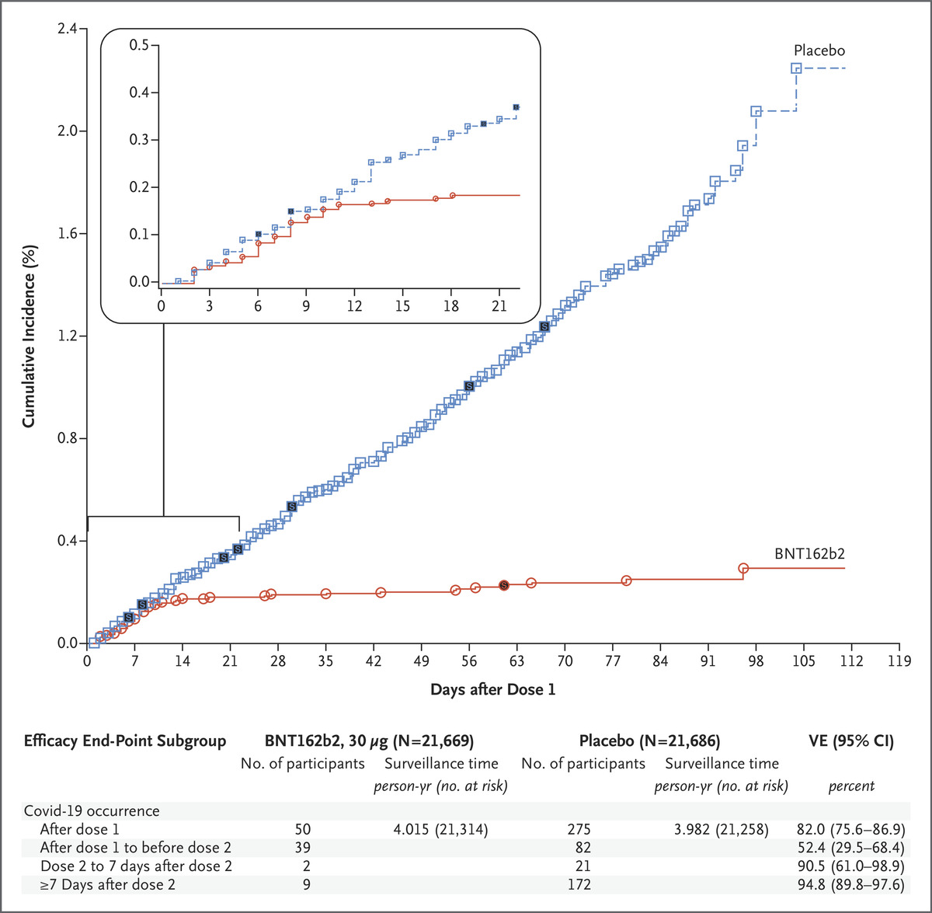
FP Polack et al. N Engl J Med 2020. DOI: 10.1056/NEJMoa2034577
Efficacy of BNT162b2 against Covid-19 after the First Dose.
Notes:
Figure 3. Efficacy of BNT162b2 against Covid-19 after the First Dose. Shown is the cumulative incidence of Covid-19 after the first dose (modified intention-to-treat population). Each symbol represents Covid-19 cases starting on a given day; filled symbols represent severe Covid-19 cases. Some symbols represent more than one case, owing to overlapping dates. The inset shows the same data on an enlarged y axis, through 21 days. Surveillance time is the total time in 1000 person-years for the given end point across all participants within each group at risk for the end point. The time period for Covid-19 case accrual is from the first dose to the end of the surveillance period. The confidence interval (CI) for vaccine efficacy (VE) is derived according to the Clopper–Pearson method.

Slide 17
Effectiveness
The Pfizer vaccine was 95% effective in preventing COVID-19. 8 of the 18,198 study participants who received the vaccine developed COVID-19, compared with 162 of the 18,325 participants who got the placebo.
The cases among placebo and vaccine recipients started to diverse by 12 days after the injection indicating some immunity starts early.
The Moderna vaccine was 94.5% effective in preventing COVID-19. 5 of the 13,934 study participants who received the vaccine developed COVID-19, compared with 90 of the 13,883 participants who received the placebo.

Slide 18
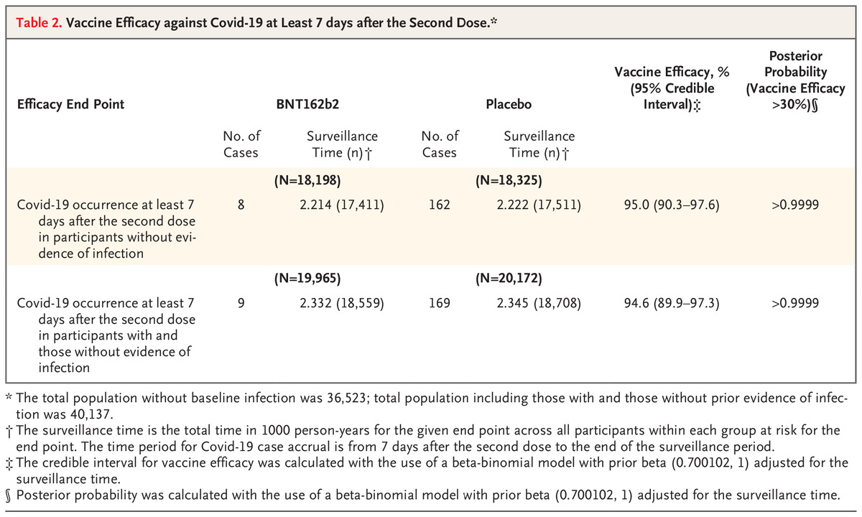
FP Polack et al. N Engl J Med 2020. DOI: 10.1056/NEJMoa2034577
Vaccine Efficacy against Covid-19 at Least 7 days after the Second Dose.*
Notes:
Table 2. Vaccine Efficacy against Covid-19 at Least 7 days after the Second Dose. *

Slide 19
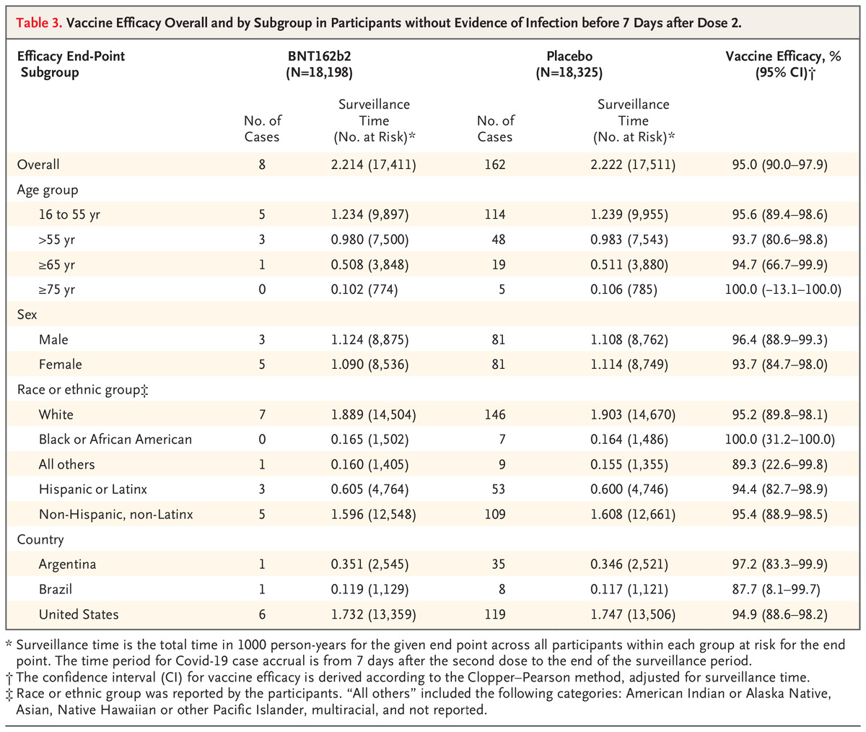
FP Polack et al. N Engl J Med 2020. DOI: 10.1056/NEJMoa2034577
Vaccine Efficacy Overall and by Subgroup in Participants without Evidence of Infection before 7 Days after Dose 2.
Notes:
Table 3. Vaccine Efficacy Overall and by Subgroup in Participants without Evidence of Infection before 7 Days after Dose 2.

Slide 20
Were the vaccines effective in older people?
Yes.
The Moderna vaccine was 100% effective in people 65 or older.
It was also 93.4% effective in people between the ages of 18 and 64.
The Pfizer vaccine was 93.7% effective in people 56 or older.
It was also 95.6% effective in people between the ages of 16 and 55.

Slide 21
How well did the vaccines work in people with preexisting medical conditions?
The Moderna vaccine was 95.9% effective in people with a select group of health issues — chronic lung disease, significant cardiac disease, diabetes, liver disease, HIV and severe obesity. For people without these conditions, it was 94% effective.
The Pfizer vaccine was 95.3% effective in people with a wider range of health issues and 94.7% effective in people without them.

Slide 22
Did the vaccines help people of color?
The Pfizer vaccine was 100% effective for Black study participants and 94.5% effective for Latino participants, slightly below the 94.7% effectiveness for white subjects. In addition, it was 74.4% effective in Asian Americans, and 100% effective in
Native Americans and Pacific Islanders.
The Moderna vaccine was 100% effective in Black, Latino
and Asian Americans, as well as in people with mixed racial backgrounds.

Slide 23
Did the vaccines work equally well in men and women?
Both vaccines performed slightly better in men than in women.
The Moderna vaccine was 95.5% effective in men and 93.5% effective in women.
The Pfizer vaccine was 95.3% effective in men and 93.9% effective in women.

Slide 24
Did the vaccines prevent severe cases of COVID-19?
The Moderna vaccine was 100% effective at preventing cases of severe COVID-19. Eleven people in the trial developed severe disease, and all of them were in the group that received the placebo. Three of those patients were sick enough to be admitted to a hospital.
The Pfizer vaccine was 66.4% effective at preventing cases of severe COVID-19. Of the four study participants who developed severe illnesses after receiving two shots, one had received the vaccine and three recieved the placebo. Two of those in the placebo group were hospitalized, including one who was admitted to an intensive care unit.

Slide 25
The Pfizer vaccine needs to be stored at about -95 degrees Celsius, about 50 degrees colder than any vaccine currently used in the US. The vaccine can be put in the refrigerator for only up to five days before it expires.
Moderna's vaccine can be kept at about -20 degrees Celsius, or about the temperature of a home freezer. Moderna's vaccine can also be kept in a refrigerator for 30 days before it expires.

Slide 26
Moderna's vaccine is administered as two doses given 28 days apart.
Pfizer's vaccine is administered as two doses given 21 days apart.
The Moderna vaccine would be used in people 18 and older.
The Pfizer vaccine is authorized for people 16 and older.

Slide 27
Adverse Effects
If you take a 100,000 people, X will get a heart attack and Y will get a stroke with or without a vaccine
The most common adverse reactions to the vaccine have been injection site pain, fatigue, headache, muscle pain, joint pain and chills, according to the document. Swollen lymph nodes have also been reported.
Short-term pain at the injection site was extremely common with both vaccines. Roughly 90% of those who got the Moderna vaccine reported such pain after their two doses, as did roughly 80% of those who got the Pfizer vaccine. In both trials, injection-site pain was far less common for people who received the placebo.

Slide 28
Adverse Effects
 | BNT162b2 (30 μg) (Na=21621) | Placebo (Na=21631)
Adverse Event | n (%) | n (%)
Any event | 5770 (26.7) | 2638 (12.2)
Related | 4484 (20.7) | 1095 (5.1)
Severe | 240 (1.1) | 139 (0.6)
Life-threatening | 21 (0.1) | 24 (0.1)
Any serious adverse event | 126 (0.6) | 111 (0.5)
Related | 4 (0.0) | 0
Severe | 71 (0.3) | 68 (0.3)
Life-threatening | 21 (0.1) | 23 (0.1)
Any adverse event leading to withdrawal | 37 (0.2) | 30 (0.1)
Related | 16 (0.1) | 9 (0.0)
Severe | 13 (0.1) | 9 (0.0)
Life-threatening | 3 (0.0) | 6 (0.0)
Death | 2 (0.0) | 4 (0.0)

Slide 29
Allergies
The number to date in the US is 6 people out of 272,000 doses administered had allergic reaction.
They all occurred within a 30 minute window and were treatable.
Stay around for 30 min after injection.

Slide 30
Should patients with endocrine disorders get the COVID vaccine?
Dr. Friedman recommends the virus in everyone
Endocrine patients are more susceptible to getting a severe infection from COVID-19, so they should certainly get it
I see no reason to put it off now that the trials have come out.

Slide 31
Do I need the vaccine if I was already infected?
Yes, some patients who have been infected, got a 2nd infection
Immunity is likely to be much stronger with the vaccine than with exposure to the virus

Slide 32
Will the vaccine work against the new strain of COVID-19 from the UK
Most likely as the antibodies are made against the whole spike protein and the mutated virus still has most of spike protein intact.

Slide 33
Who should not get the COVID-19 vaccine?
Potentially someone who had a reaction to the first dose
This is different than the flu or other vaccines, so someone can still get the COVID-19 vaccine if they had a reaction to another vaccine
Someone with severe allergies should discuss with their PCP, but it would be reasonable to get steroid/anti-histamine pretreatment.

Slide 34
Why should I take the COVID-19 vaccine when I don’t usually take vaccines?
COVID-19 vaccine much more studied than other vaccines
Getting COVID-19 can be more serious than getting the flu, measles etc
Getting the vaccine will help wipe out the virus and end the pandemic
No preservatives.
Not a money maker for big pharma

Slide 35
Will I still need to wear a mask?
Probably
It depends on the vaccine trials which are still ongoing
Will look at antibody levels
May need a booster vaccine

Slide 36
Herd immunity
Dr. Fauci says when 85% of the country gets vaccinated, herd immunity will develop and the virus should die out
I think it is important for almost all Americans to get the vaccine before next fall as antibody levels may start declining.
While I belief in freedom of Americans to choose to get or not get a vaccine, ending the pandemic will likely occur only if most people get the vaccine.

Slide 37
Roll out of vaccines
Other vaccines in the pipeline
My guess is government is going to push for increased production of Pfizer and Moderna vaccines and those will be the only 2 vaccines in the US.
My guess is most Americans who want to be vaccinated will be vaccinated in spring-summer 2021
My guess is that as the vaccine is rolled out and found to be effective and safe, most (but not all) Americans will want to get the vaccine.
Americans will be asked to show their vaccine card to get into movie theaters, restaurants, to see Dr. Friedman in person, etc.

Slide 38
COVID-19 Vaccination Record Card

Slide 39
TABLE. Advisory Committee on Immunization Practices recommendations for allocation of COVID-19 vaccines to persons aged ≥16 years — United States, December 2020
Phase | Groups recommended to receive COVID-19 vaccine | No. (millions)
 |  | Total persons in each group* | Unique persons in each group† | Unique persons in each phase
1a | Health care personnel | 21 | 21 | 24
 | Long-term care facility residents | 3 | 3
1b | Frontline essential workers§ | 30 | 30 | 49
 | Persons aged ≥75 years | 21 | 19
1c | Persons aged 65–74 years | 32 | 28 | 129
 | Persons aged 16–64 years¶ with high-risk medical conditions | 110 | 81
 | Essential workers§ not recommended for vaccination in Phase 1b | 57 | 20
2 | All persons aged ≥16 years¶ not previously recommended for vaccination | All remaining | All remaining | All remaining

Slide 40
What about Children?
Children age 12-15 were studied, but not reported
Children under 12 and pregnant women were not studied.

Slide 41
What can I do?
Continue social distancing and wearing masks until you get the vaccine.
Be safe and avoid holiday gatherings.
Pray the pandemic ends.

Slide 42
Charles R. Drew University was supposed to be a study site
A. Novavax
B. Sanofi
Both had manufacturing problems and did not get FDA clearance
We are supposed to be a site for the Sanofi trial vs Pfizer/Moderna in February, but it may not occur.

Slide 43
Thanks for joining us
Questions? Please use the chat button
Thank you for sharing your time tonight!
If you have any more questions after tonight or want an appointment, please email: mail@goodhormonehealth.com
www.goodhormonehealth.com
Webinar will be posted in a few days

