Slide 1
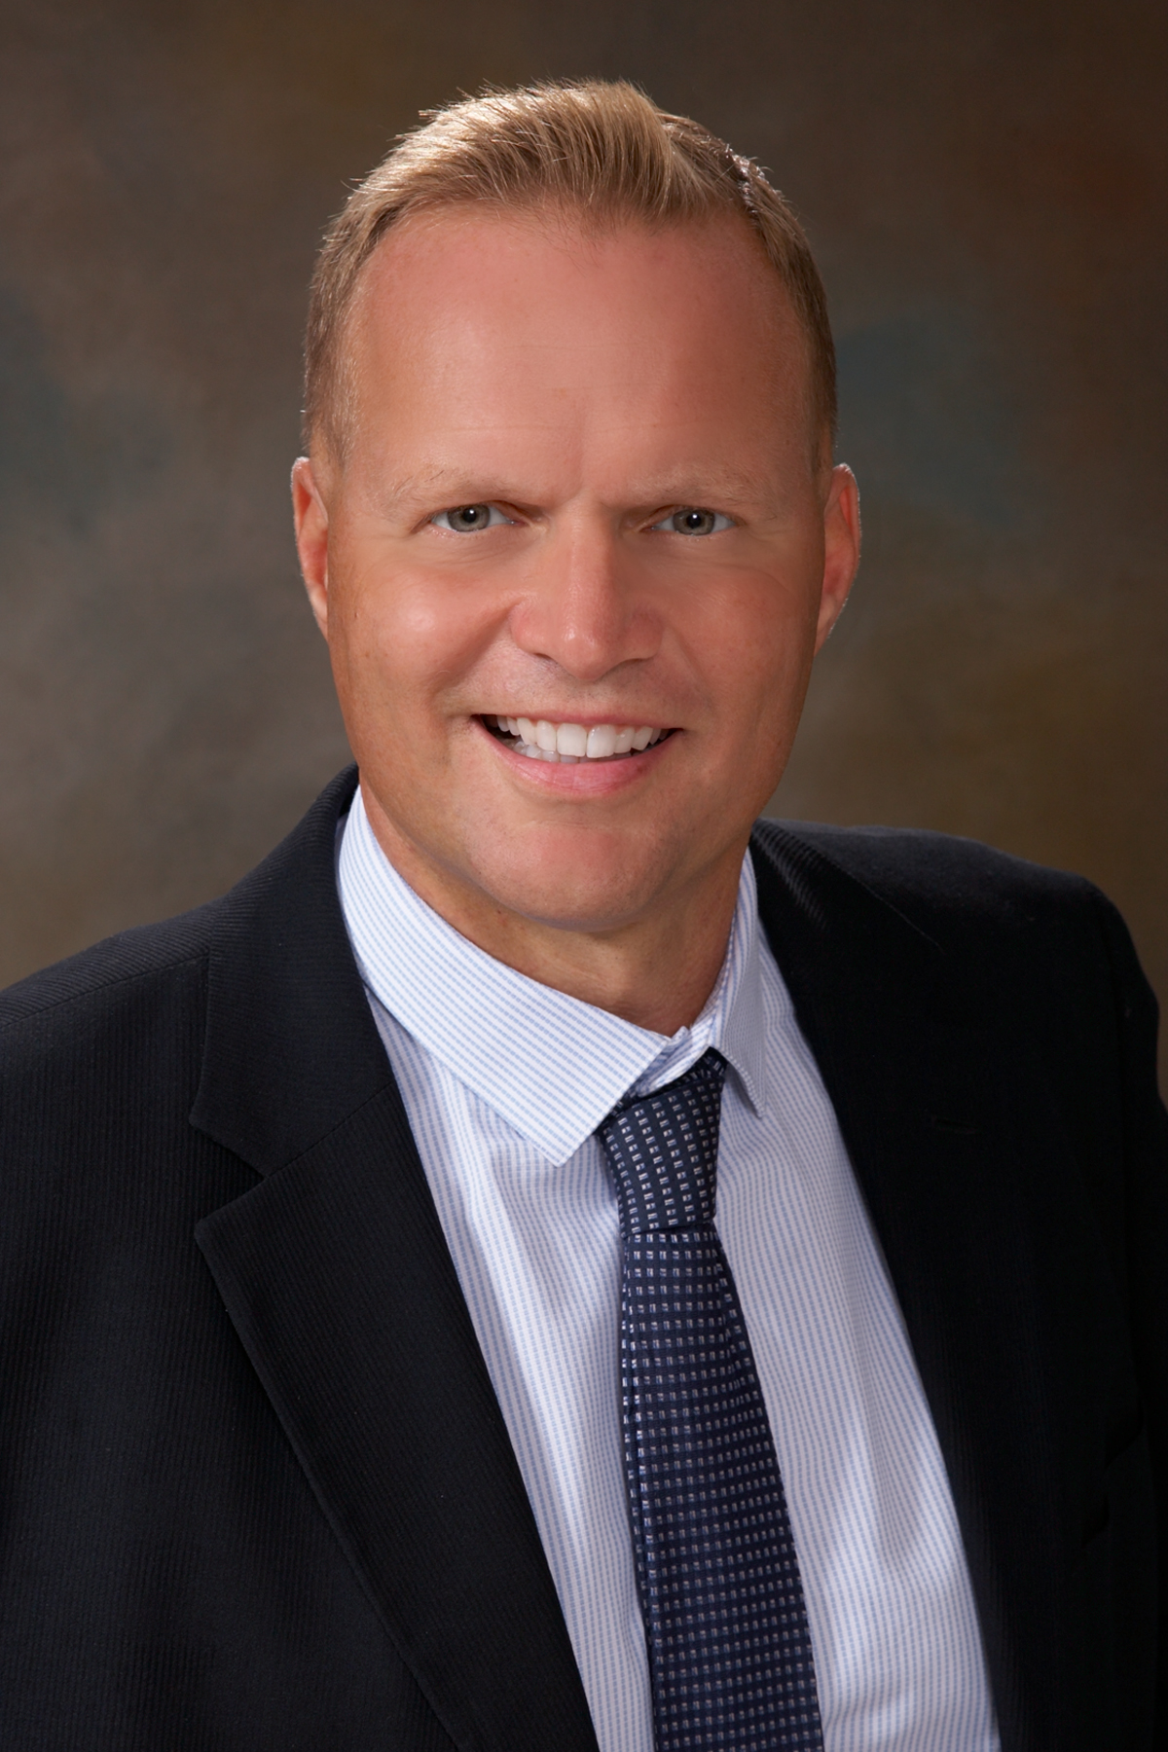
Theodore C. Friedman, M.D., Ph.D. Professor of Medicine-UCLA Chairman, Department of Internal Medicine Charles R. Drew University Dr. Friedman’s Endocrinology Clinic Hosting Tobias Carling, MD, PhD, FACS
The 20-minute Mini Back Scope Adrenalectomy (MBSA)
GoodHormoneHealth Webinar November 7, 2021

Slide 2
Reasons for Adrenal Surgery
Bilateral Adrenalectomy for Pituitary or Ectopic Cushing’s (ACTH-dependent) that can’t be treated with pituitary surgery or medications
Adrenal tissue removal for adrenal remnant tissue
Unilateral Adrenalectomy for Adrenal (ACTH-independent) Cushing’s
Unilateral Adrenalectomy for aldosteronoma
Unilateral or less likely Bilateral Adrenalectomy for Pheochromocytoma

Slide 3
Tobias Carling, MD, PhD, FACS
Surgeon-in-Chief & Founder Carling Adrenal Center
.
Hospital for Endocrine Surgery .
Tampa, FL

Slide 4
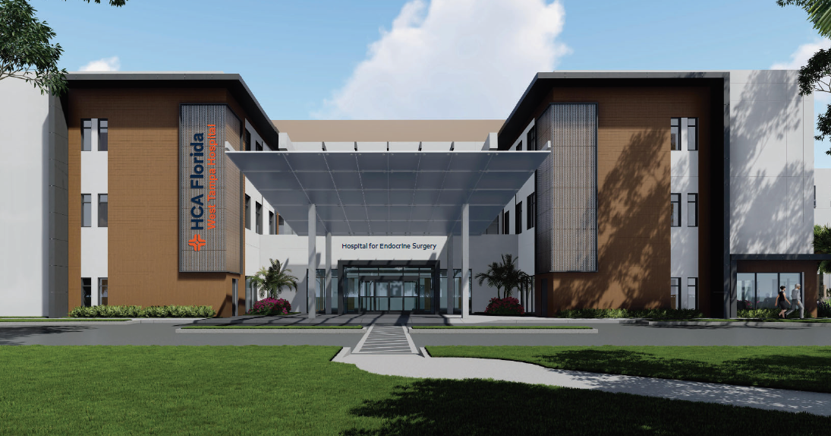
Hospital for Endocrine Surgery
Tampa

Slide 5
scarless-thyroid.com
thyroidcancer.com
Norman Parathyroid Center

Slide 6
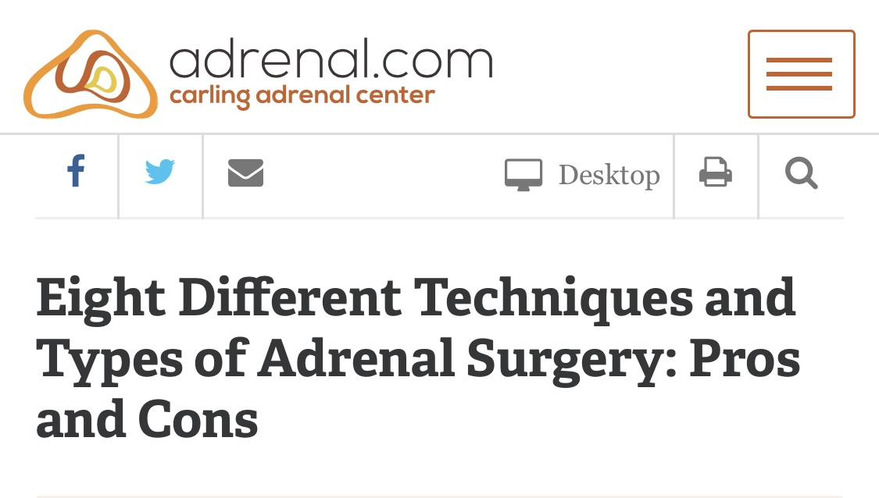
Eight Different Approaches to Adrenal Surgery
Mini Back Scope Adrenalectomy (MBSA)
Laparoscopic Trans-Abdominal Adrenalectomy (LTA)
Laparoscopic Hand-port Assisted Trans-Abdominal Adrenalectomy
Open Standard Trans-Abdominal Adrenalectomy
Open Thoraco-Abdominal Adrenalectomy
Open Posterior Adrenalectomy
Open Retroperitoneal Adrenalectomy
Robotic (Robot-Assisted) Adrenalectomy

Slide 7
Mini Back Scope Adrenalectomy (MBSA)
Preferred approach in 96.3% of our cases
Better
Faster (12-23 min. in non-obese)
Shorter LOS (<23h) & recovery
Less pain
Superior cosmesis

Slide 8
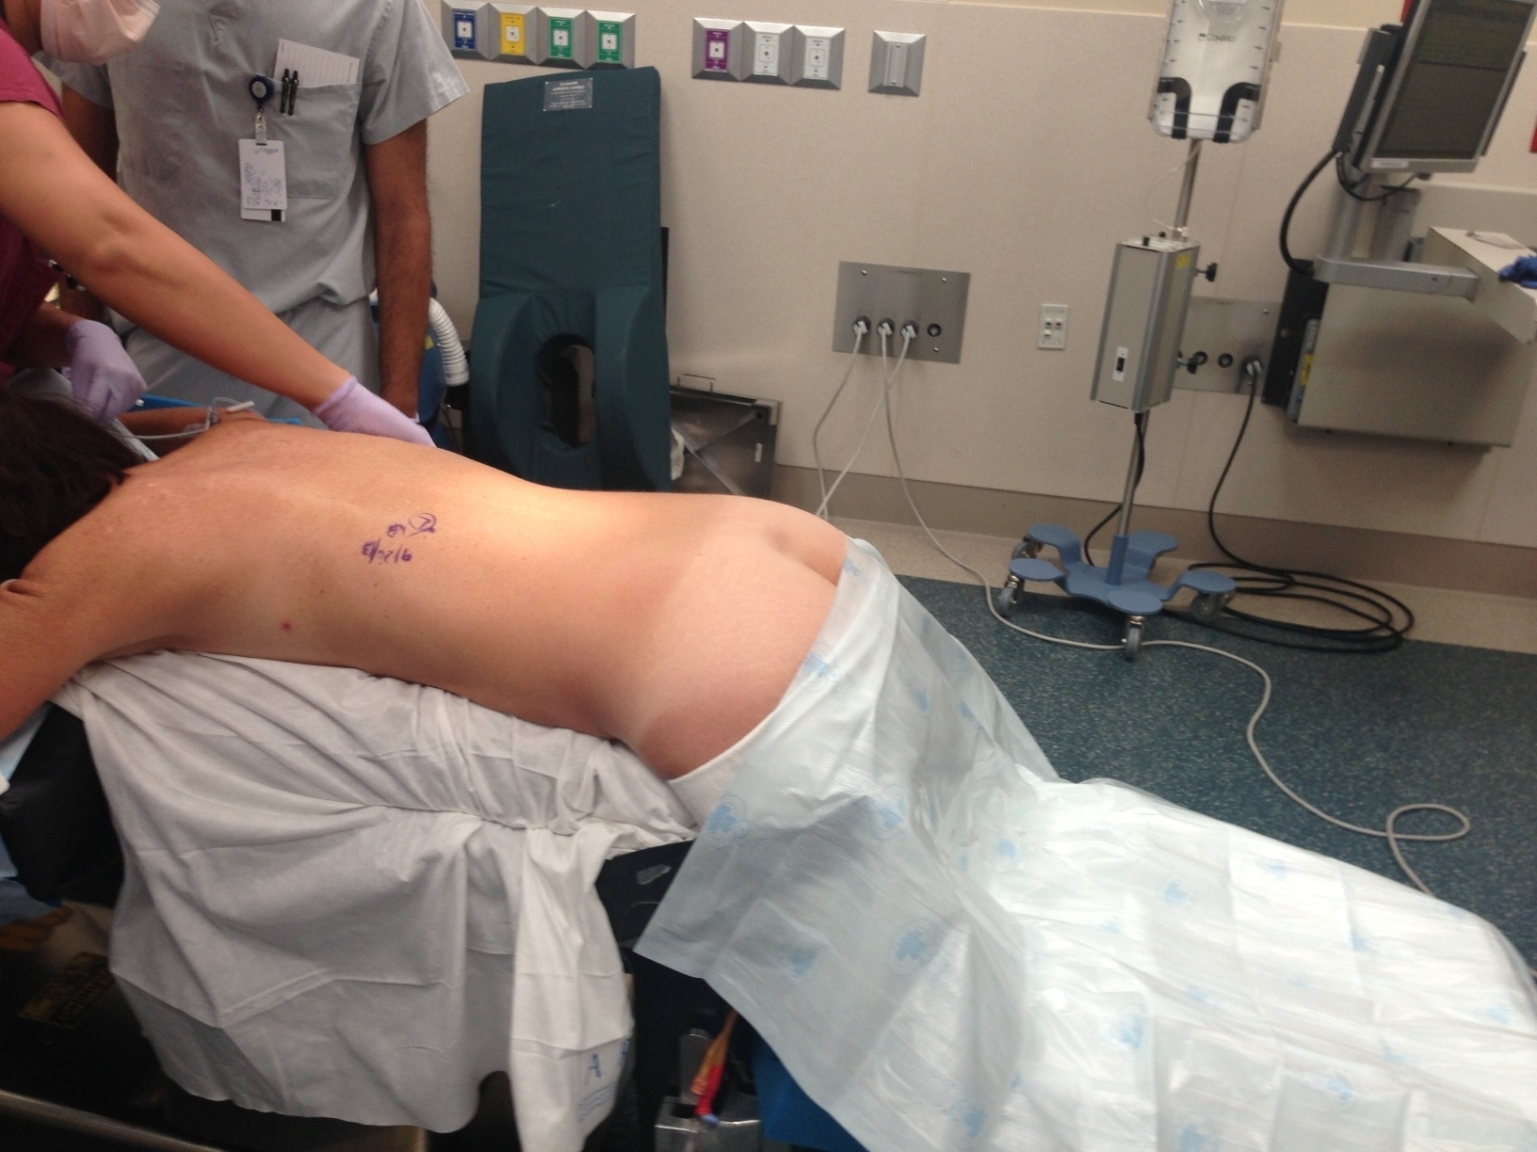
Prone position

Slide 9
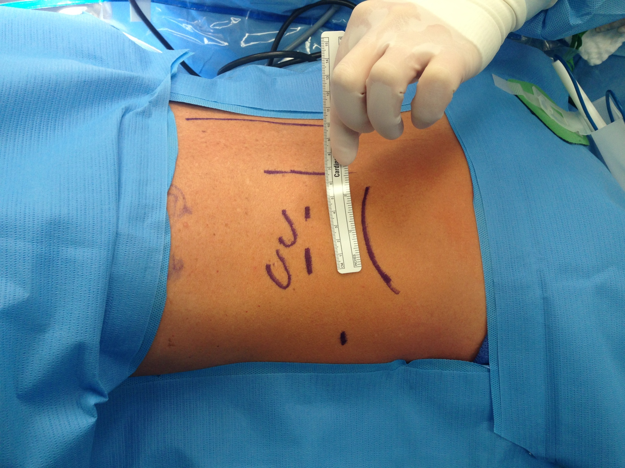

Slide 11
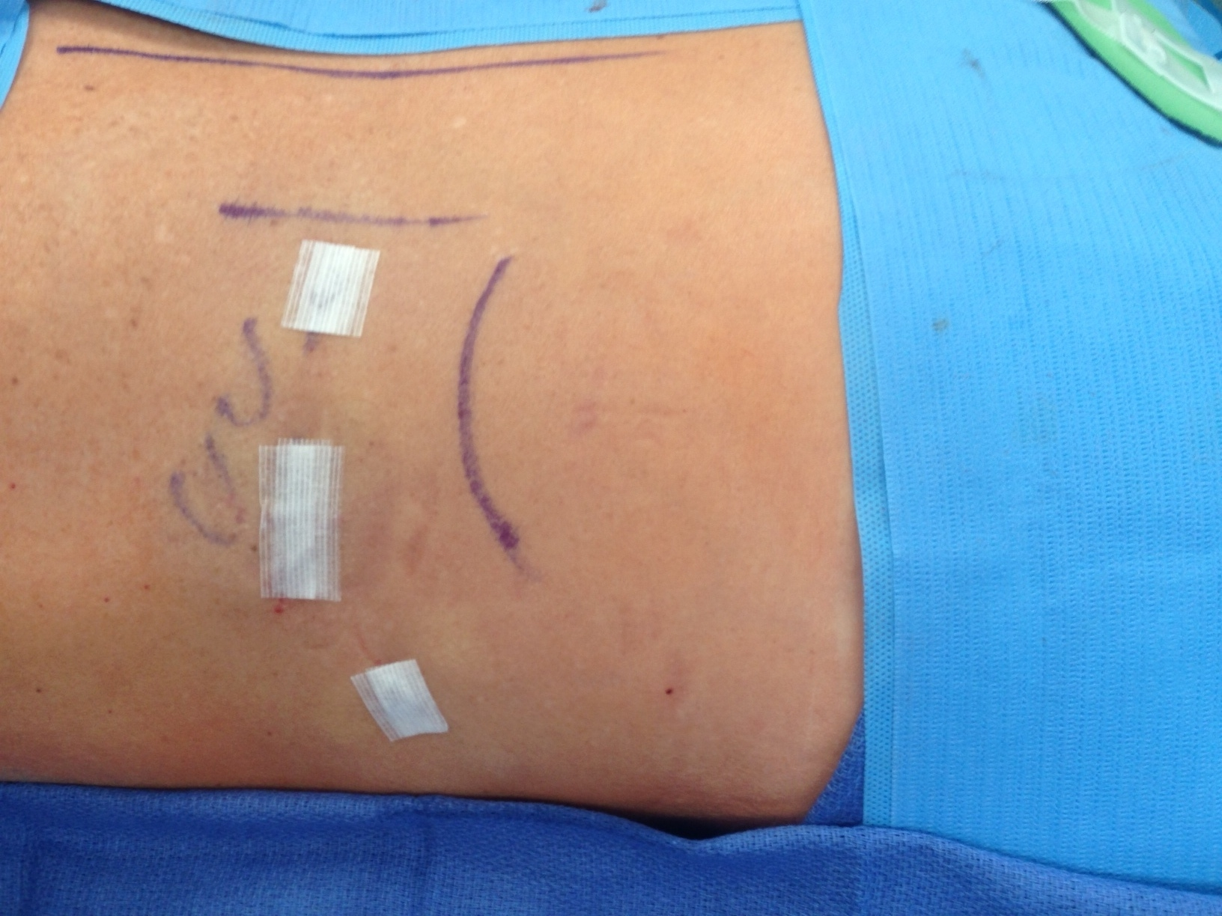
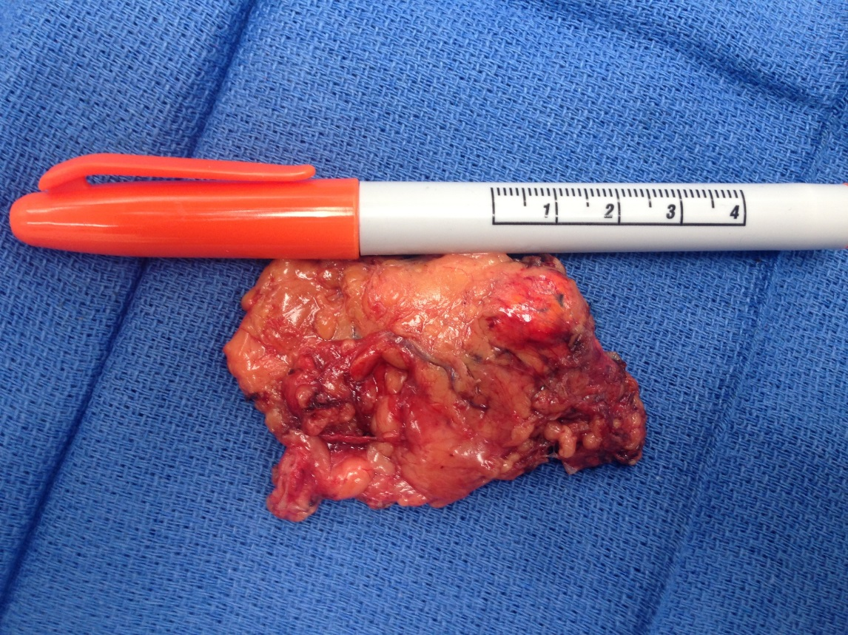

Slide 12
Duration of Surgery for MBSA is Related to BMI of Patient
*As low as 12 min. for non-obese patients
Compared to
120-240 min. for laparoscopic adrenalectomy
150-300 min. for robotic adrenalectomy
at most US institutions
40
30
20
10
Operative time (Minutes)
*
<20 25 30 35 40 >45
BMI
Carling (unpublished) 2021

Slide 13
Patient | Age | Gender | ARR | Tumor Weight (g) | Tumor Diameter (mm) | HTN | Serum K⁺ (mmol/L)
APA10 | 57 | F | 438 | 12 | 23 | + | 3.8
APA12 | 34 | F | 1,250 | 15.2 | 25 | + | 3.7
APA6 | 48 | F | 332 | 11 | 8 | + | 3.4
APA8 | 33 | F | 718 | 9.3 | 20 | + | 3.9
APA15 | 34 | M | 700 | 14 | 25 | + | 3.1
APA19 | 56 | F | 230 | NA | 20 | + | 3.4
APA20 | 31 | F | 457 | NA | 22 | + | 2.5^
APA18 | 37 | F | 480 | 13.8 | 40 | + | 4.5
APA16 | 34 | F | 259 | NA | 46 | + | 3.4
APA9 | 28 | F | 256 | 46 | 48 | + | 3.4
APA11 | 39 | M | 500 | 9.7 | 10 | + | 2.9^
APA22 | 65 | F | 271 | NA | 25 | + | 3.9
APA1 | 44 | F | 235 | 8.5 | 9 | + | 3.3
APA4 | 59 | F | 284 | 35 | 41 | + | 3.6
APA5 | 62 | M | 241 | 22 | 24 | + | 4.1
APA14 | 60 | M | 246 | NA | 45 | + | 3.8
APA7 | 53 | F | 482 | 41 | 45 | + | 3.5
APA2 | 34 | M | 356 | 21 | 25 | + | 3.4
APA3 | 63 | F | 618 | 14 | 20 | + | 2.8^
APA17 | 59 | M | 243 | NA | 32 | + | 3.8
APA13 | 53 | F | 317 | 31 | 38 | + | 3.5
APA21 | 57 | F | 326 | 28 | 32 | + | 3.5
Mean | 47.3 | NA | 420.0 | 20.7 | 28.3 | NA | 3.5
Unilateral Aldosterone-Producing Adenoma (APA)
Causing Primary Hyperaldosteronism

Slide 14
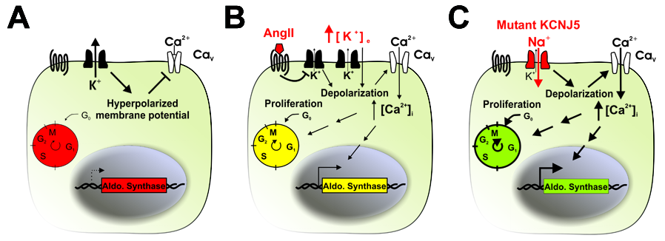
Molecular Pathogenesis of Aldosteronism
Choi M…Carling T & Lifton RP. Science 2011

Slide 15
Molecular Pathogenesis of Aldosteronism
Scholl U…Carling T, & Lifton RP. Nature Genet 2014

Slide 17
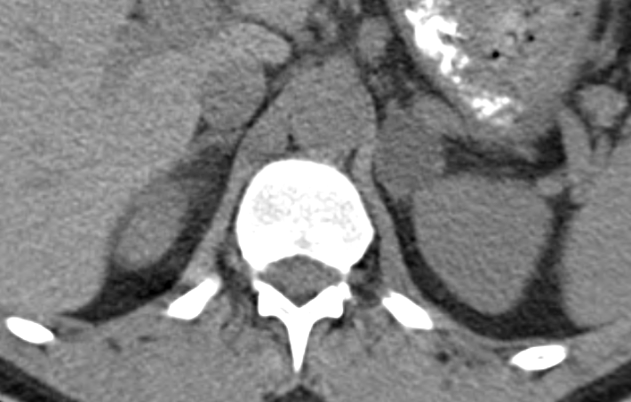
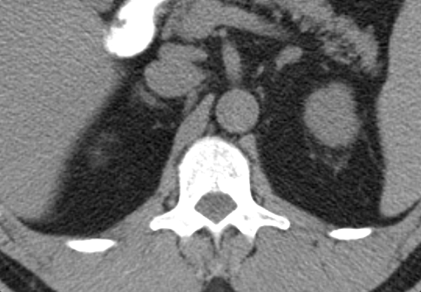
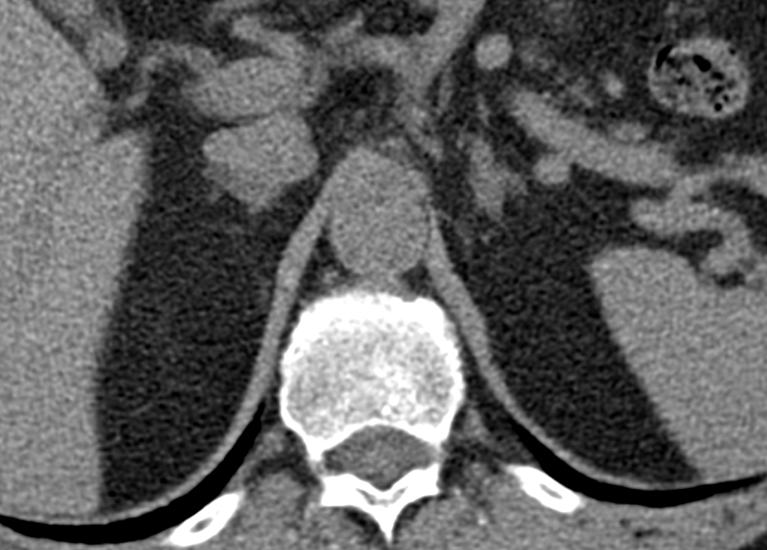
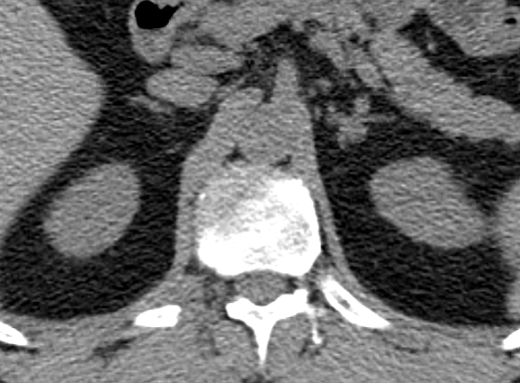
KCNJ5 mutant
Dimensions: 27 x 23 mm
Average H.U. (-2)
CACNA1D
mutant
Dimensions: 1.3 x 9 mm
Average H.U. (39)
A
B
ATP1A1 mutant
Dimensions: 9 x 7 mm
Average H.U. (10)
Wild Type tumor
Dimensions: 9 x 7 mm
Average H.U. (27)
C
D

Slide 18
High Probability of Unilateral Aldosterone-Producing adenoma (APA)
Very High PAC
Very High 24U aldo
Very low Potassium
Severe HTN
Good response to MR-A

Slide 19
Primary Hyperaldosteronism - outcomes
30 – 60% cured of hypertension (no meds)
95% improved (fewer meds)
100% cure rate for hypokalemia
Direct aldosterone effect
Myocardial fibrosis
LVH
↑ CHF, mortality
↑ ischemic, vascular, clotting abnormalities

Slide 20
Primary Hyperaldosteronism - postop
Hold ALL K⁺ (replace cautiously), stop MR-A
Continue β-blockers
Add back or delete other drugs as indicated
May take weeks for BP to normalize
Surgery has superior outcomes versus medical therapy

Slide 21
Conn’s Syndrome is Common and NOT Harmless
Cause of hypertension in 10% of all patients with elevated blood pressure!
Primary aldosteronism and cardiovascular disease.
>95 % of patients with Conn’s syndrome fail to be diagnosed and treated
Funder. Science 2011

Slide 22
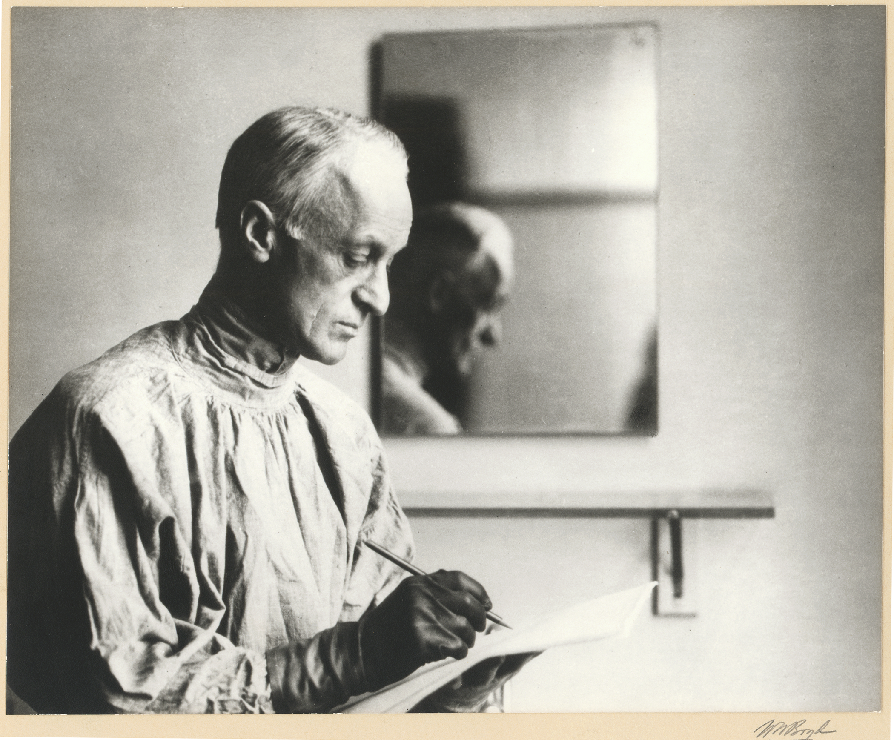

Slide 23
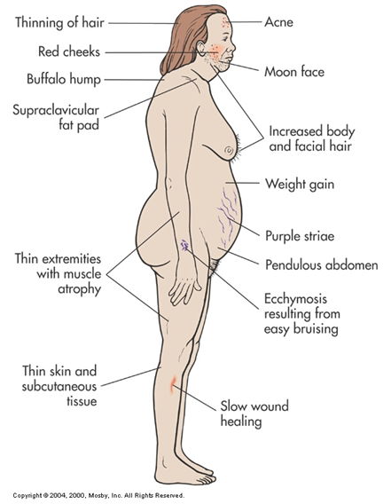
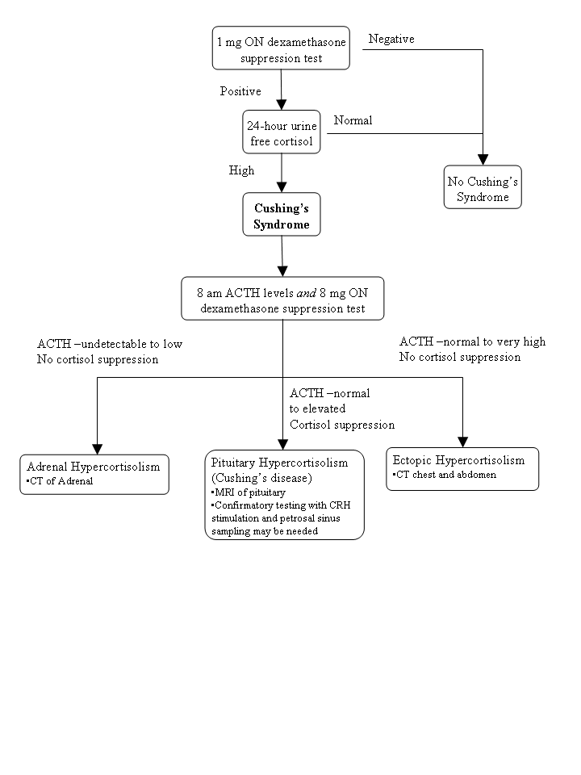
Cushing’s Syndrome
~15-25% ~70% ~10%
Carling T, Udelsman R. “Principles and Practice of Geriatric Surgery”, 2011

Slide 24
Methods – Adrenal Cushing’s Syndrome
Exome sequencing of matched samples (normal – tumor) from 25 patients with cortisol-producing adrenocortical tumors
3 ACC
22 ACA
Validation cohort of an additional 38 patients
Total cohort:
36/63 overt ACTH-independent Cushing’s syndrome
27/63 subclinical adrenal hypercortisolism
Unilateral adrenalectomy
Mean tumor size 5.2 cm

Slide 25
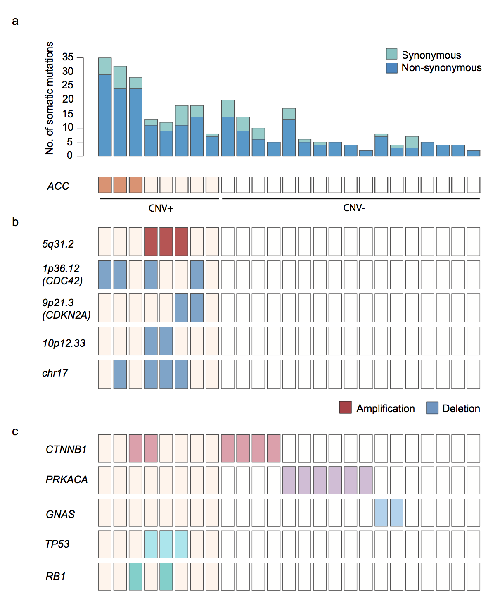

Slide 27
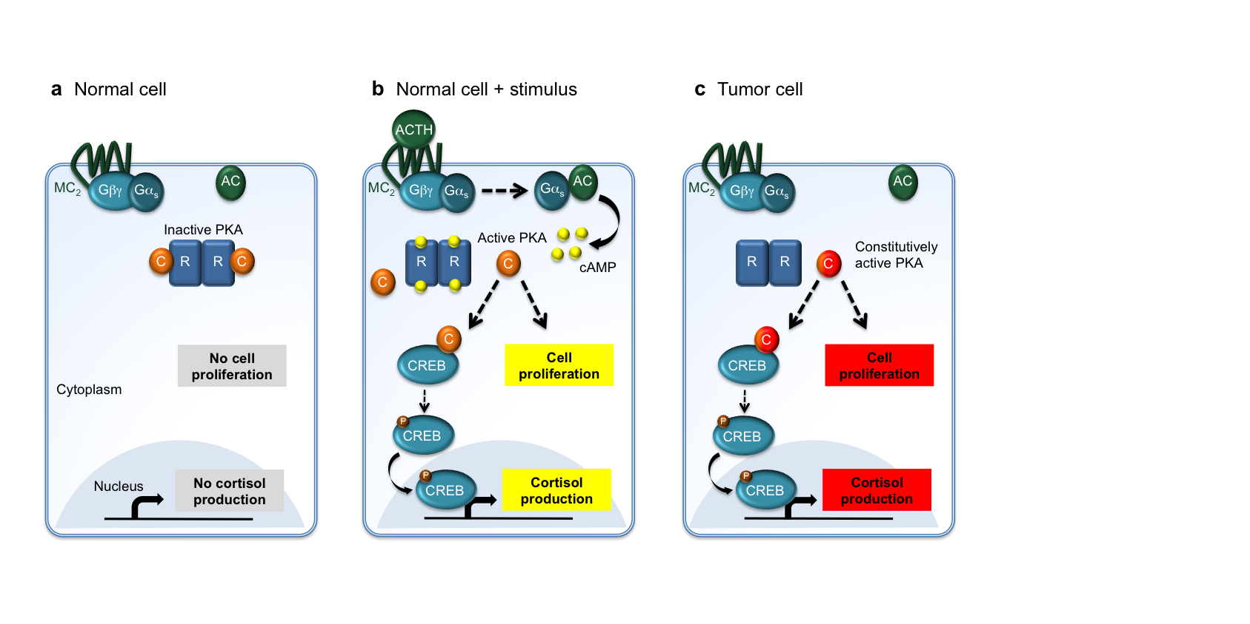
Molecular Mechanism of Cortisol-Producing Adrenocortical Adenomas
Goh G…Carling T, & Lifton RP. Nature Genet 2014

Slide 28
NEJM 2014
Science 2014
Science 2014

Slide 29
Subclinical Adrenal Hypercortisolism
“Given the low rates of complications and the possibility to reverse the detrimental effects of elevated cortisol secretion, we recommend minimally invasive adrenalectomy in patients with biochemically proven or suspected subclinical Cushing’s syndrome who are appropriate surgical candidates.”
Starker, Kunstman & Carling. Surg. Clin. North Am. 2014

Slide 30
Overt and Subclinical ACTH independent Cushing’s syndrome – pre and periop
>95 % MBSA is the preferred approach
Close monitoring of DM, HTN, potassium
Routine Synacthen (Cosyntropin) stimulation test at 4 am POD#1
Corticosteroids are weaned as outpatient
For bilateral disease (BAIMAH and PPNAD, etc), Cortex-sparing (partial) bilateral MBSA is the preferred operation in the majority of patients
*Bilateral total MBSA is used in Cushing’s Disease patients who have failed pituitary surgery

Slide 31
Surgery for Pheochromocytoma
>95 % MBSA is the preferred approach
Familial component
VHL, RET, NF1, SDHD, SDHAF2, SDHC, SDHB, SDHA, MAX, HIF2A, FH, TMEM127
α blockade (Doxazosin most commonly used), with fluid replacement. Addition of ß blockade if tachycardia is present. Phenoxybenzamine too expensive.
Metyrosine (Demser®)
Dedicated anesthesia team!
For bilateral disease, cortex-sparing (partial) bilateral MBSA is the preferred operation

Slide 32
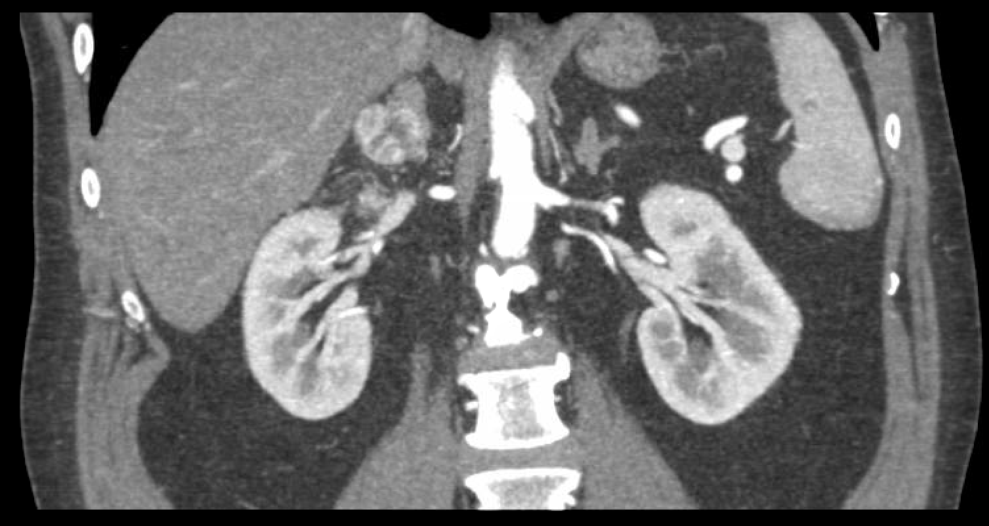
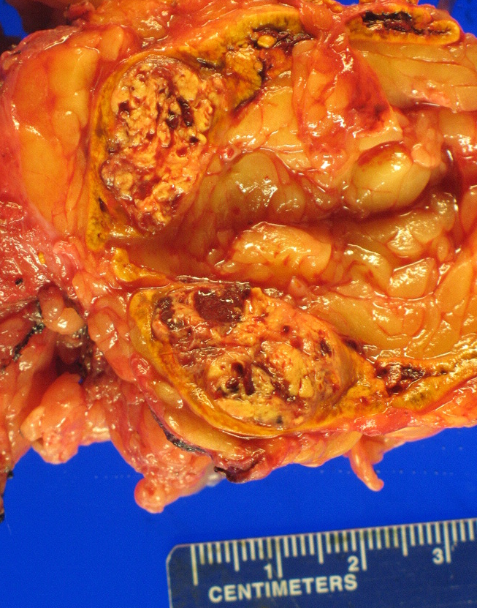
Mini Back Scope Adrenalectomy for Adrenal Metastasis
Liver
Kidney
Cortex-
sparing

Slide 33
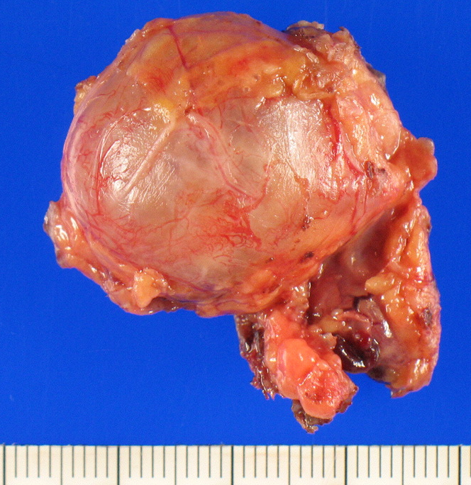
Mini Back Scope Adrenalectomy for Adrenal Metastasis
S/p Right nephrectomy and Left adrenalectomy for metastatic RCC
Time (POD#1) | Cortisol
0 min | 0.8 ug/dl
30 min | 18.0 ug/dl
60 min | 22.8 ug/dl
Liver
Spleen
Liver
Liver
Cortex-
sparing
Kidney

Slide 34
Cortex-sparing (partial) Adrenalectomy
Tumor
IVC
Cortex

Slide 35
Cortex-sparing (partial) Adrenalectomy
Tumor
IVC
Cortex

Slide 36
So, when is Mini Back Scope Adrenalectomy (MBSA) not the preferred approach…

Slide 37
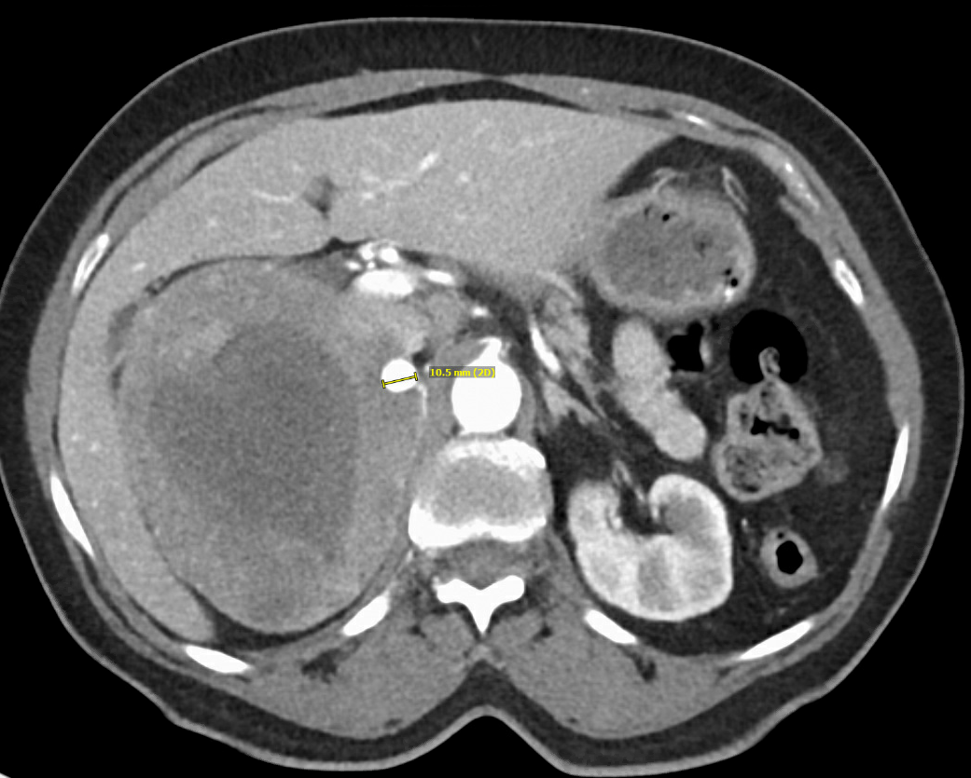
Laparoscopic transabdominal handport-assisted adrenalectomy
Liver
Liver
A
O
R
T
A
I
V
C
16 cm right pheochromocytoma

Slide 38
Open transabdominal surgery is required for
Pheochromocytomatosis
MIBG
MIBG

Slide 41
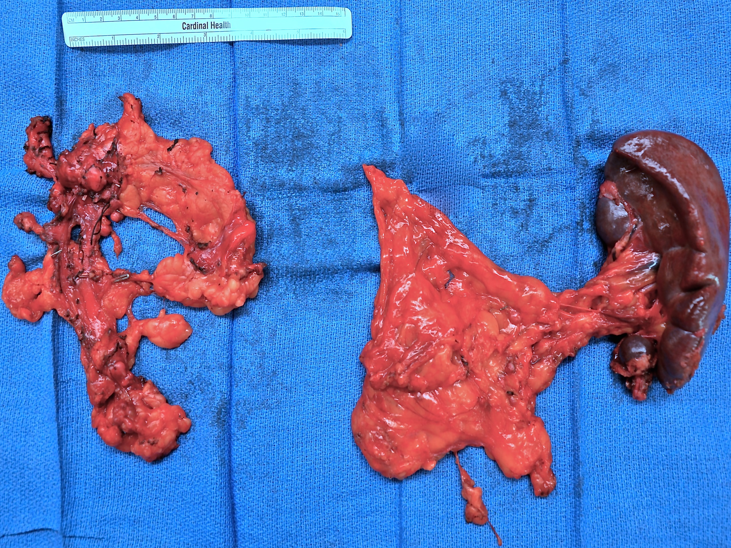
Left adrenal bed
Spleen and Omentum

Slide 42
Mini Back Scope Adrenalectomy (MBSA)
Preferred approach in 96.3% of our cases
Better
Faster (12-23 min. in non-obese)
Shorter LOS (<23h) & recovery
Less pain
Superior cosmesis

Slide 43
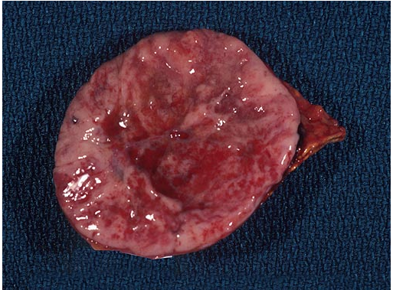
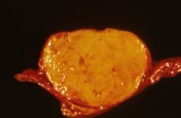
Significance of Adrenal Incidentaloma
Most are benign
Prevalence in those > 70 years old is about 5-7% but rare in those in their twenties (0.2%)
Risk of malignancy increases with size
> 4 cm need removed whether producing hormones or not
~ 20% turn out to be functional (hormone-producing)
5% prove to be a
Pheochromocytoma
5% prove to be an
Aldosteronoma (Conn’s) syndrome)
5% prove to be an
Adrenal Cushing’s syndrome
5% prove to be a
Metastasis

Slide 44
Thank You

Slide 45
Visit goodhormonehealth.com and adrenal.com
For more information or to schedule an appointment.
Talk will posted on both websites in a few days
Dr. Carling will review your adrenal imaging, but please have Dr. Friedman refer you to him for surgery.
mail@goodhormonehealth.com
intake@adrenal.com

