Slide 1
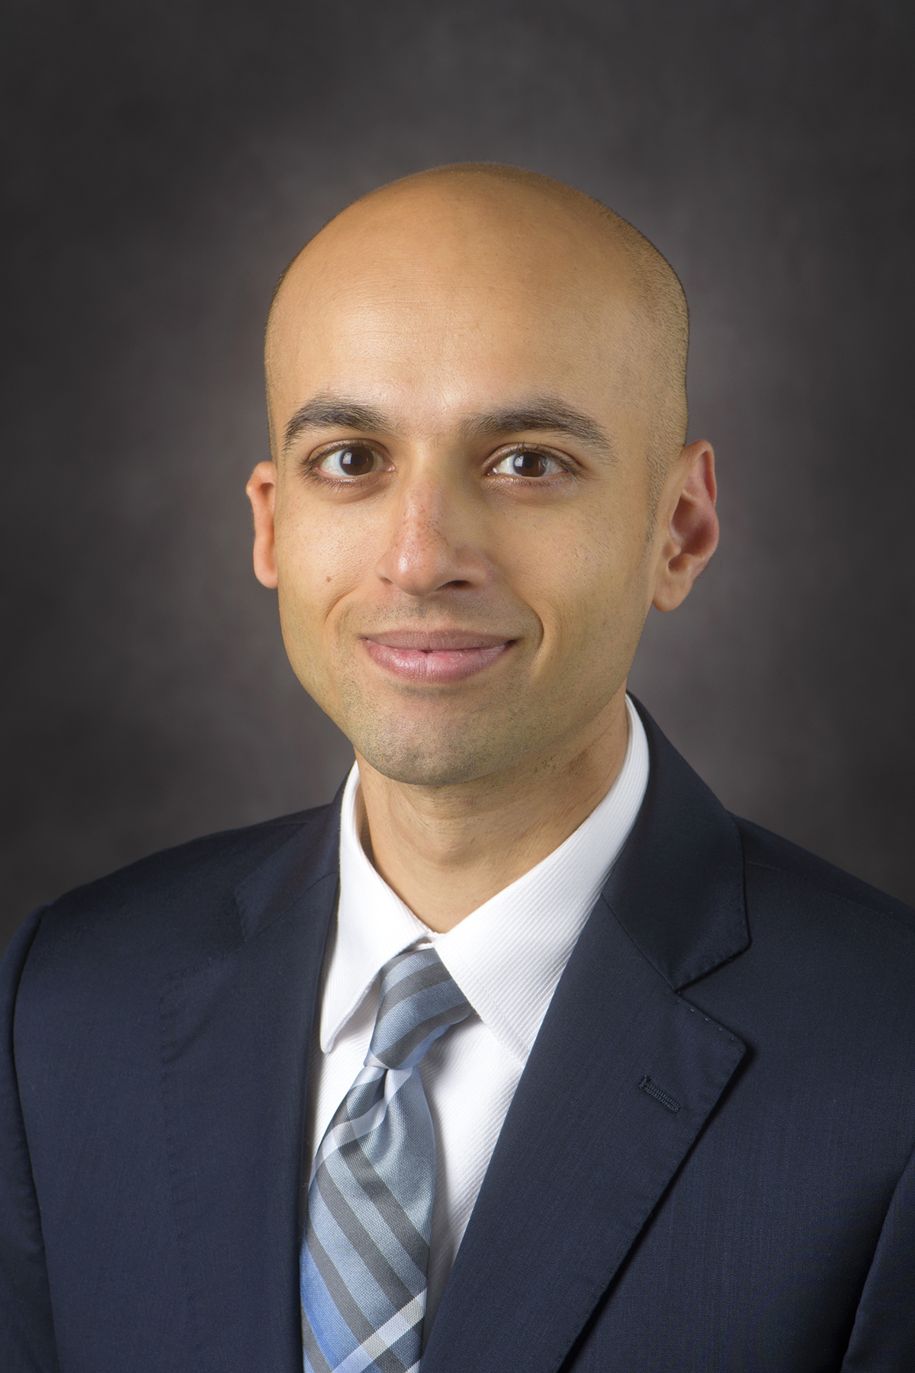



Approaches for Pituitary Surgery
GoodHormoneHealth Webinar
August 4, 2019
Please mute your phones!
Chat questions at the end

Slide 2
Topics to be discussed include
How does Dr. Friedman diagnose Cushing’s Disease
How does Dr. Friedman determine who goes to surgery?
What type of patients need surgery besides those with Cushing’s Disease?
How do the neurosurgeon and the Endocrinologist work together?
How does the neurosurgeon read pituitary MRIs?
What types of surgical approaches are used for pituitary surgery?
How long does surgery take and how long will a patient be in the hospital?
What are the risks of pituitary surgery and how can they be minimized?

Slide 3
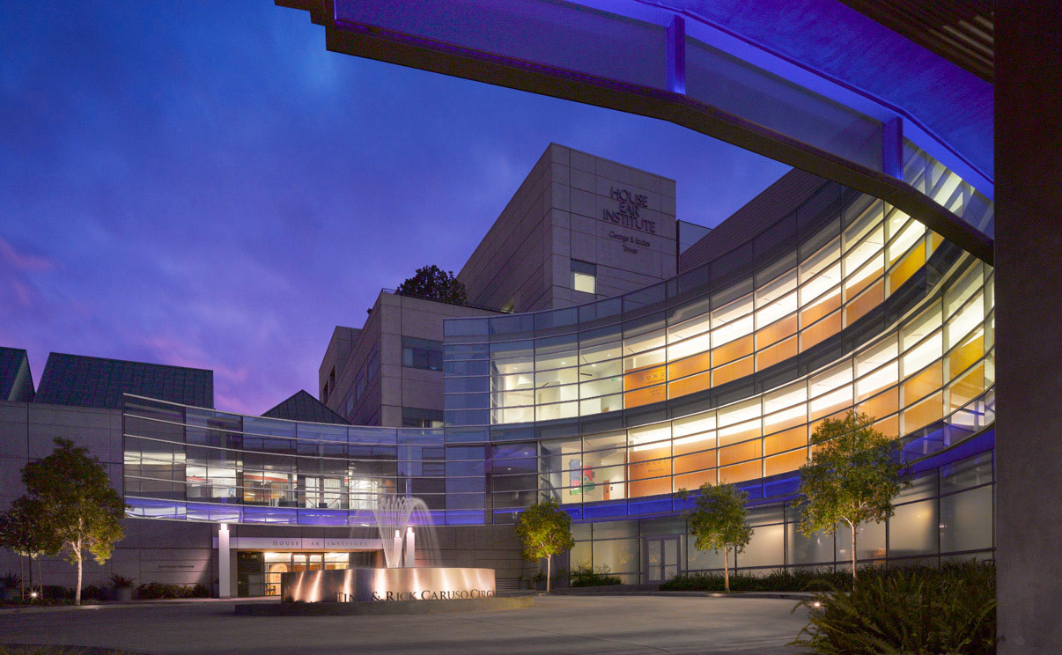
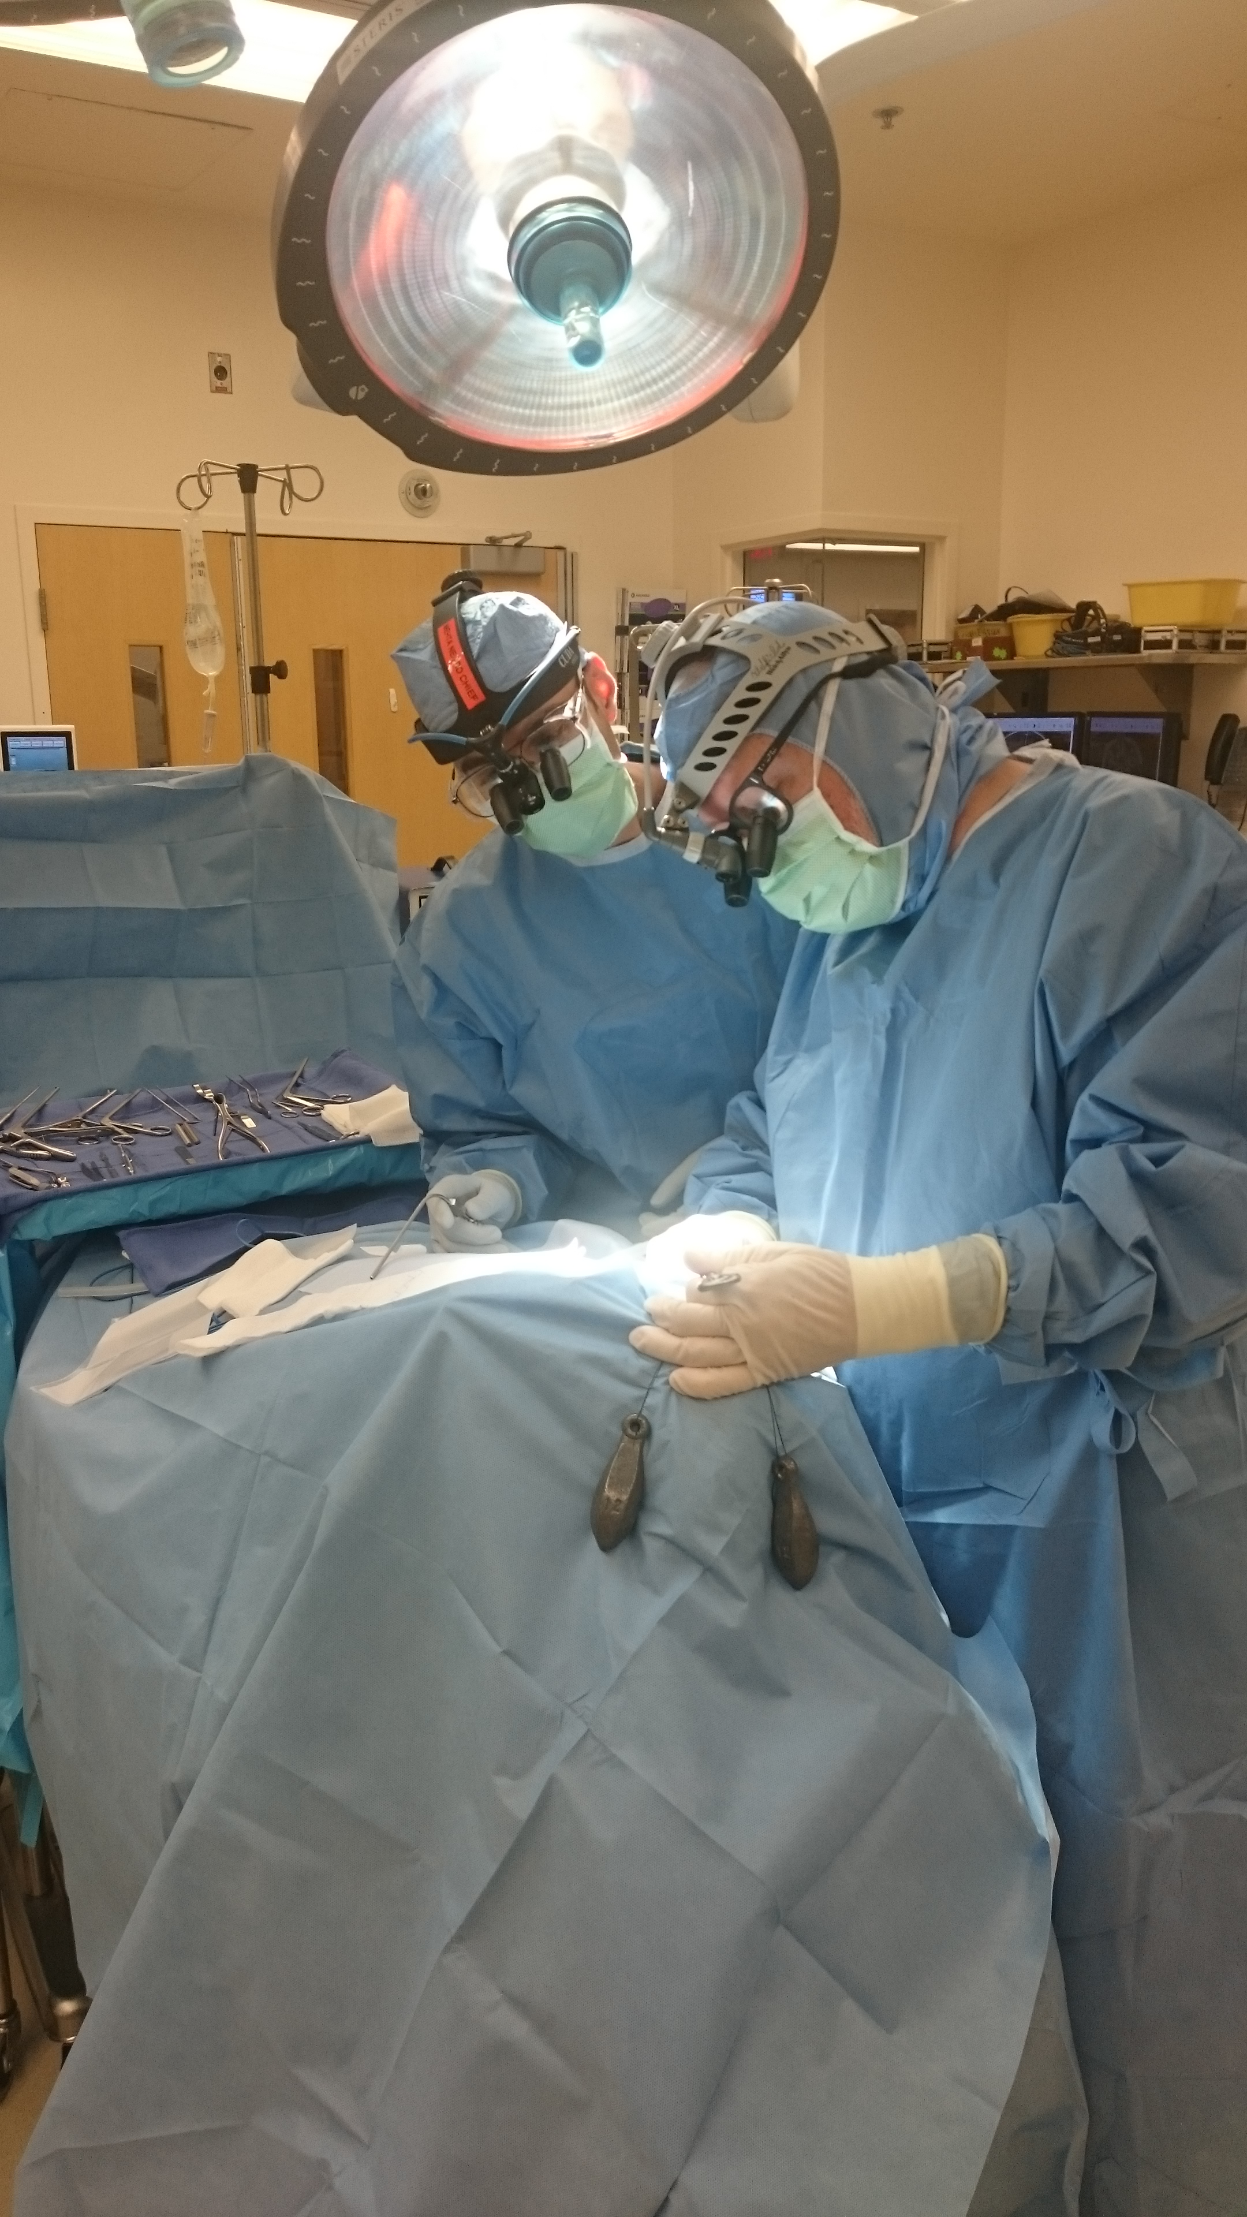
Meet Gautam Mehta, MD
Pituitary and skull base surgeon at the House Clinic – Downtown L.A.
Trained with Ed Oldfield at the NIH and University of Virginia and Ian McCutcheon at M.D. Anderson
Authored 20 publications and 4 book chapters on pituitary tumors
Awarded the American Brain Tumor Association Young Investigator Award for pituitary tumor research

Slide 4
Need to Distinguish Early or Mild Cushing’s from Other Diseases
Cushing’s is considered rare, but may not be that rare.
It is vastly under diagnosed.
Other diseases that have some symptoms/signs in common with Cushing’s (PCOS or Metabolic Syndrome) are more common, but present differently from Cushing’s. The treatment is different for these other diseases
Thus, a strategy needs to be developed to diagnose Cushing’s syndrome.

Slide 5

Should Cushing’s be Diagnosed Early?
Cushing’s patients are miserable.
Effective treatment (surgery and medicines) exists
Less pharmaceutical funding (better with Corcept).
Most doctors are not familiar with Cushing’s syndrome and may only be familiar with severe cases.

Slide 6

How to Diagnose Cushing’s Syndrome
Careful history and physical
Change in weight and body habitus
Look at old pictures
Not all patients have all signs and symptoms, especially “early” and “episodic” patients.
Most published data compared severe Cushing’s with normals.
Important to diagnose early before devastating sequelae develop.
Initial diagnosis most difficult aspect of Cushing’s syndrome.
“Gestalt” with as much information as possible
Episodic Cushing’s common, so one positive test may be worth more than 10 negative tests

Slide 7
Common symptoms I see
Wired at night
Trouble sleeping-trouble falling asleep or frequent awakenings
Severe fatigue-new onset
Abrupt weight gain-without other cause such as decreased activity or depression
Decreased ability to exercise
Menstrual abnormalities
Cognitive changes- “brain fog”
Decreased libido
Symptoms of adrenal insufficiency-joint pains, can’t get out of bed, nausea and vomiting
Depression, anxiety, mood-swings

Slide 8
Common Signs I see
Central obesity
Muscle atrophy
Thin skin on top of hand (Liddle’s sign)
Buffalo hump
Round, red face
Bruising
Extra hair growth
Acne
Loss of hair on head
Stretch marks

Slide 9
The Diagnosis of Cushing’s Syndrome: An Endocrine
Society Clinical Practice Guideline
J Clin Endocrinol Metab. May 2008, 93(5):1526–1540
1st line recommended tests
  UFC
  Low dose or overnight dexamethasone test
  Night-time salivary cortisols
Testing for Cushing’s syndrome in patients with multiple and progressive features compatible with the syndrome
Patients with an abnormal result see an endocrinologist and undergo a second test, either one of the above or, in some cases, a serum midnight cortisol or dexamethasone-CRH test.

Slide 10
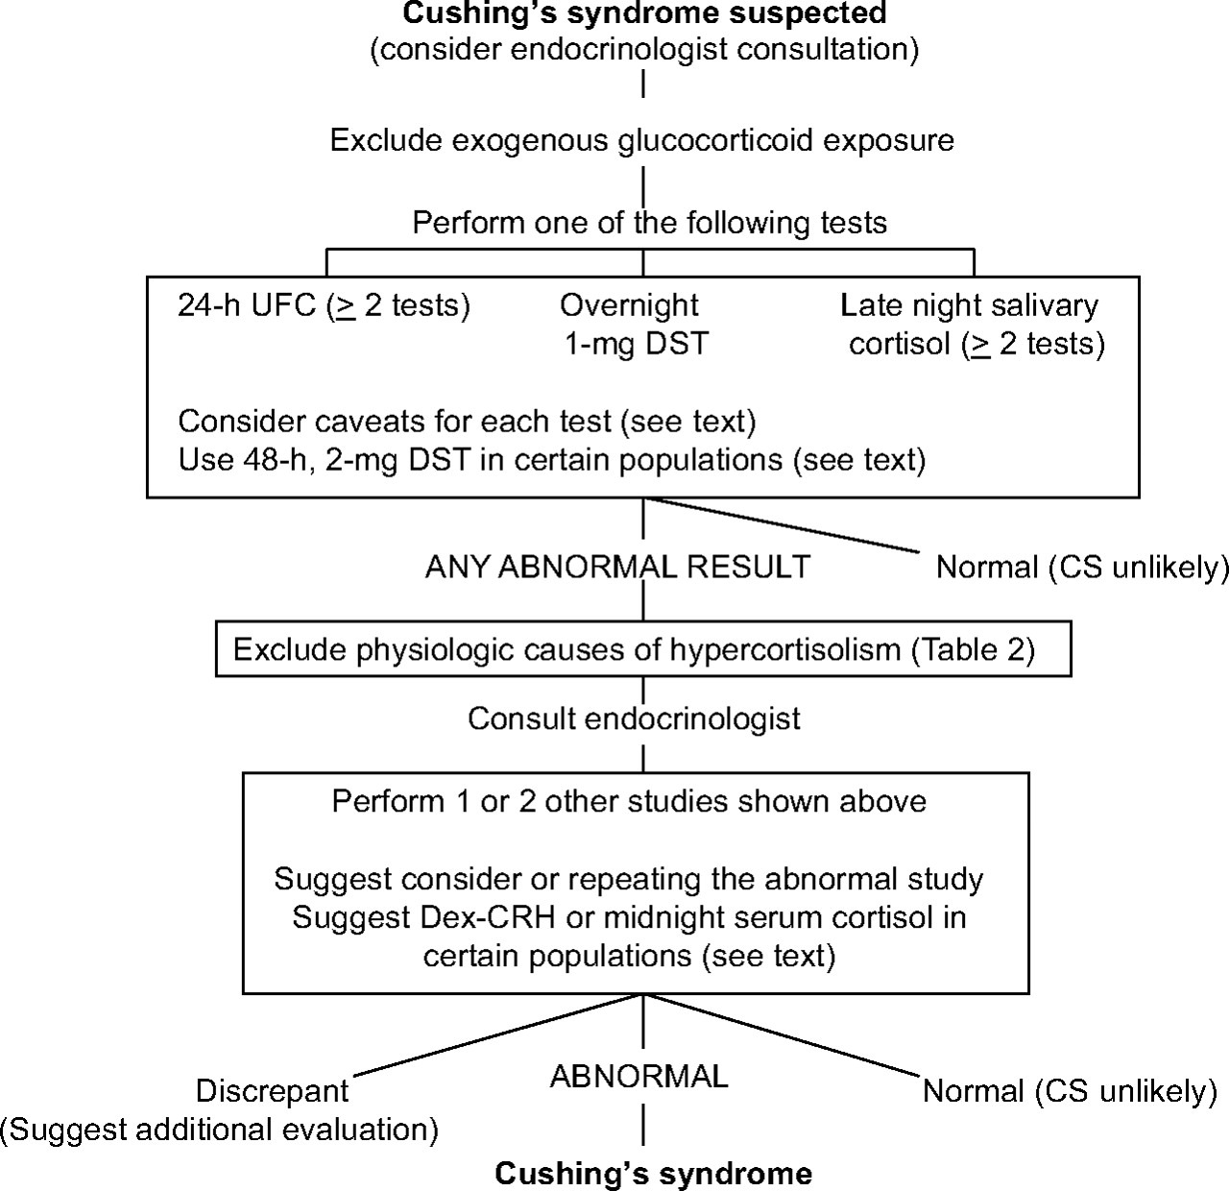
FIG. 1. Algorithm for testing patients suspected of having Cushing's syndrome (CS)

Slide 11
Episodic, Cyclical, Periodic
Periodic and cyclical refer to changes in cortisol levels that occur on a regular predictable basis.
Episodic refers to high cortisol levels that are random.
Most of my patients are episodic.

Slide 12
Episodic Cushing's
I agree with the Endocrine Society recommendations and like to see 2 different tests high.
The higher the test, the more likely Cushing's is
May limit the severity of the signs of hypercortisolism. (less weight gain)
Patients with mild/episodic Cushing's seem to have as many symptoms and as poor a quality of life as full-blown-may be due to daytime lows.

Slide 13
Episodic Cushing's Testing
Need to test in a high
Multiple 24 hr UFC (and 17 OHS)
Multiple 11 PM salivary cortisols-when symptoms of high cortisol.
Midnight serum cortisol (> 7.5 ug/dL)
Ketoconazole trial

Slide 14
Role of Imaging for the diagnosis of Cushing’s
Most of the patients I see have pituitary Cushing’s disease.
3T MRIs are high quality; most pituitary tumors are seen on MRI.
Patients can have incidentalomas, so a tumor doesn’t make the diagnosis of Cushing’s, but does give an important piece of information.
A negative MRI in a patient that has a normal or mildly elevated ACTH pretty much excludes Cushing’s (low ACTH=adrenal Cushing’s, high ACTH=ectopic)
Neurosurgeon usually more expertise in reading pituitary MRIs than Radiologists

Slide 15
Ketoconazole Trial for Cushing’s
Ketoconazole is safe, with the main side effect being increased liver tests, which usually occur at doses > 1000 mg/day and are reversible.
It does interact with a lot of drugs, but these interactions can usually be dealt with by changing the other drug or watching for side effects
It has a short-half life so it should be given at night, when cortisol is inappropriate high in Cushing’s patients.
I usually give 200 mg at 8 and 10 PM and have patients take 5 mg of Cortef in the AM, if needed.

Slide 16
Ketoconazole Trial for Cushing’s
Ketoconazole can be used diagnostically to determine which symptoms a patient has are due to high cortisol.
I use it in patients who I am pretty sure, but not completely sure has Cushing's and I want them to get symptomatic relief.
I’m concerned if someone doesn’t get better on ketoconazole, they really don’t have Cushing's.
I have kept patients on ketoconazole for up to 3 years without problems.
I often stop it for a round of testing, or if a patient develops a tumor on MRI.
Rise in ACTH following ketoconazole might be a sign of pituitary Cushing’s disease

Slide 17
Diagnosing Cushing’s Disease
Careful history and physical
At least 4 UFC and 17-OHS
At least 4 11 pm salivary cortisols
Night time serum cortisol
MRI
Ketoconazole trial
Make diagnosis if two distinct values are high
Have patient keep a diary and try to collect when “high”

Slide 18
Who goes to surgery for Cushing’s Disease?
Convincing Signs and Symptoms of Cushing’s syndrome
Two or more different positive values
Positive MRI
Responded to ketoconazole
Patient who wants to go with pituitary surgery

Slide 19
What type of patients need surgery besides those with Cushing’s Disease?
Acromegaly (GH secreting tumor)
Large pituitary tumors compressing the optic nerve (not prolactinomas)
Prolactinomas should be treated with cabergoline as they usually shrink with treatment
Large craniopharyngiomas
I see many patients who are worse off after surgery, so it needs to be a careful decision between neurosurgery and endocrinologist
Tumor that is growing (most tumors don’t grow) and looks aggressive (I have had two patients with this)
Nelson’s syndrome

Slide 20
How do the neurosurgeon and the Endocrinologist work together?
Endocrinologist does the hormonal workup.
Neurosurgeon consults by reading the MRI and determine if a tumor is present and the likelihood it can be removed
Following Neurosurgeon consult, Endocrinologist recommends surgery.
Neurosurgeon performs surgery and works with local Endocrinologist to assure proper perioperative management
Neurosurgeon informs Endocrinologist of surgical findings and pathology report
Endocrinologist recommends post-op cortisol replacement and does test to determine cure.

Slide 21
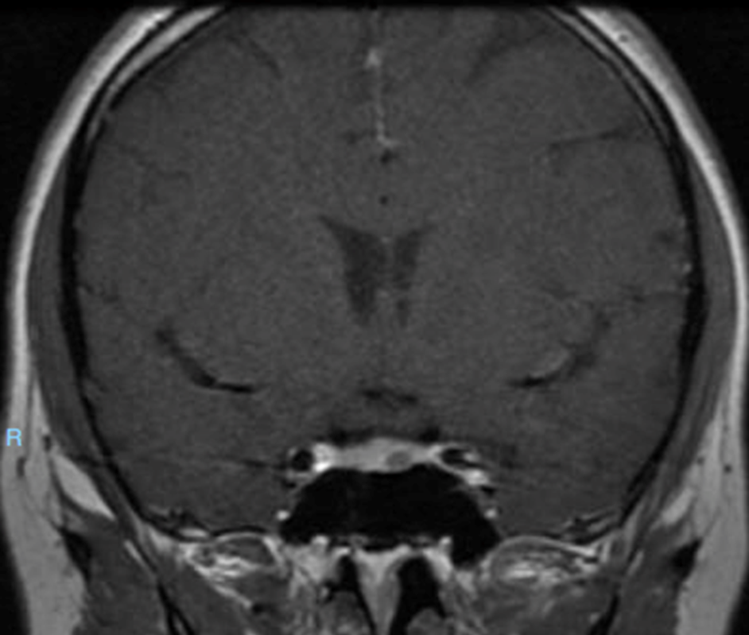
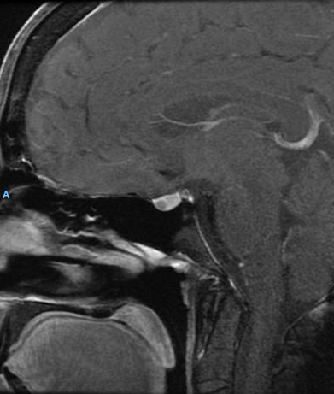
How does the neurosurgeon read pituitary MRIs?
Pituitary MRI – “Brain MRI” alone is usually not sufficient
MRI with contrast dye – Pituitary gland bright, tumor dark
1.5 Tesla MRI usually identifies tumor, 3 Tesla may be better
Coronal Image
Sagittal Image

Slide 22
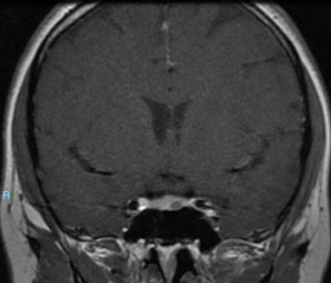
How does the neurosurgeon read pituitary MRIs?
Optic Chiasm
Cavernous Sinus
Carotid Artery
Pituitary Gland
Normal Pituitary
Gland
Pituitary Tumor

Slide 23
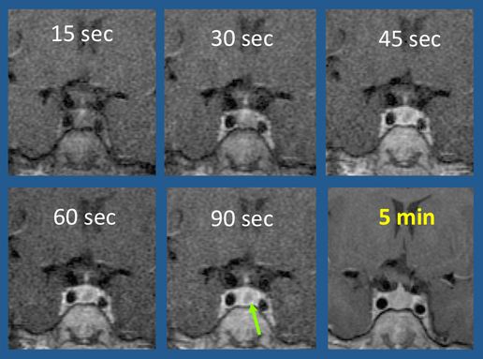
How does the neurosurgeon read pituitary MRIs?
Dynamic Imaging
  Timing of contrast dye affects if we see tumor
  Time window when pituitary gland takes up dye, but tumor does not
  Multiple fast, lower resolution scans done right after contrast given
  Final high-resolution scan delayed – often not done during optimal window – can lead to some tumors being missed

Slide 24
How does the neurosurgeon read pituitary MRIs?
What I see on MRI usually predicts what I find at surgery, but pituitary imaging can sometimes be misleading
Endocrinologist evaluation is key to diagnosis, MRI can help confirm diagnosis and aid with surgical approach
Dynamic – 2 minutes High-res – 4 minutes Standard – 8 minutes FLAIR – 30 minutes

Slide 25
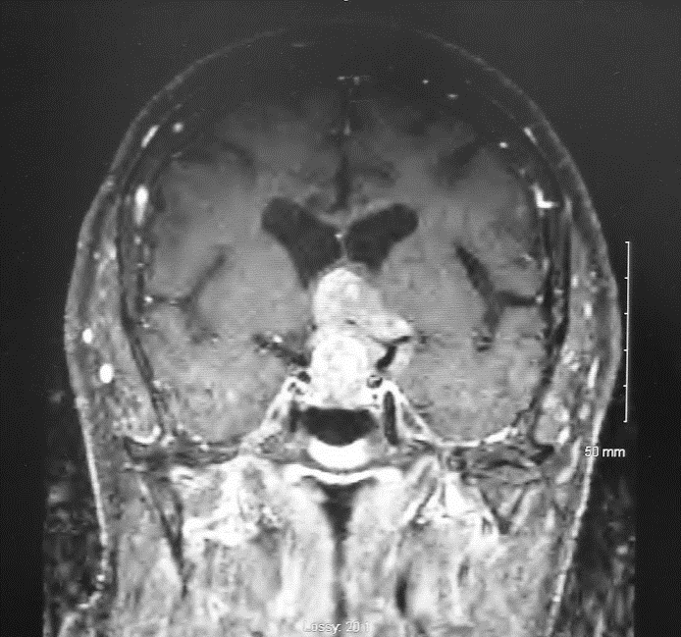
What types of surgical approaches are used for pituitary surgery?
Trans-sphenoidal
Trans-cranial

Slide 26
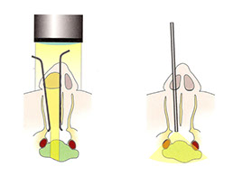
How do we remove pituitary tumors at surgery?
Microscope
  Stable field of view
  Only requires one surgeon
  Faster surgery
Endoscope
  Wider exposure
  Can see more structures (optic nerves, carotid artery)
  Less sinus pain right after surgery (but both do well over the long-term)
Microscope Endoscope

Slide 27
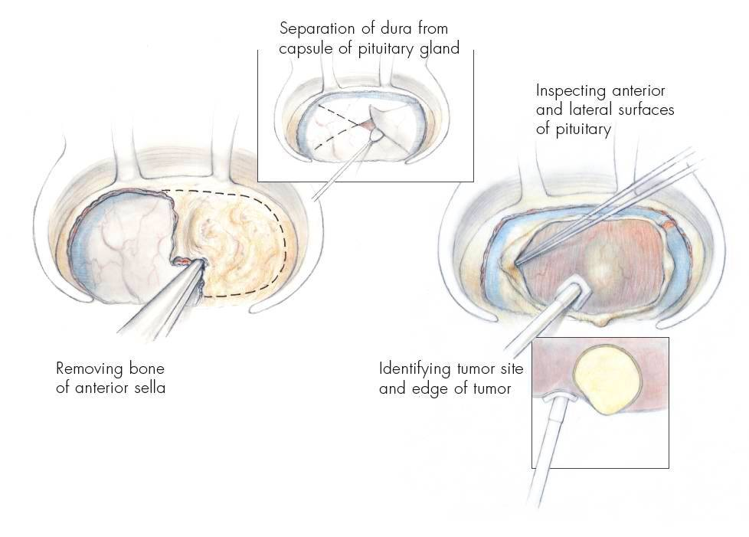
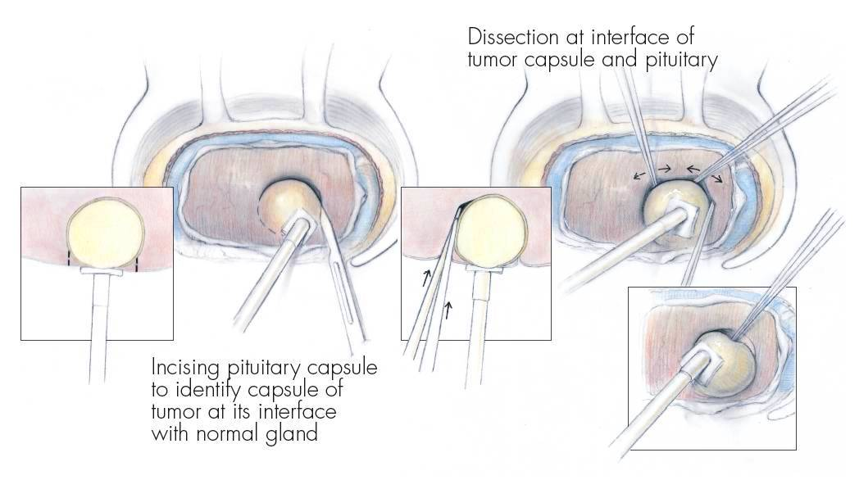
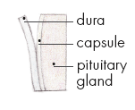
How do we remove pituitary tumors at surgery?

Slide 28
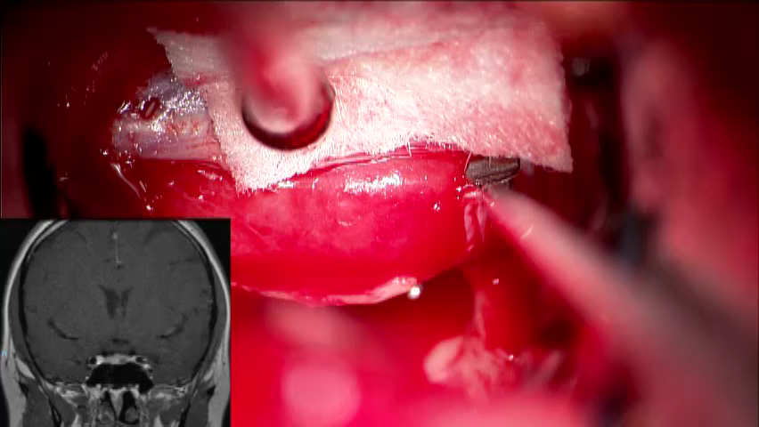
How do we remove pituitary tumors at surgery?

Slide 29
How do we remove pituitary tumors at surgery?

Slide 30
How long does surgery take and how long will a patient be in the hospital?
Surgery – 2 to 3 hours
  Operations where the tumor is unclear or not visible on MRI can take longer
  Operations where the tumor enters the cavernous sinus can take longer
Recovery – Most patients require 2 days to recover in the hospital after surgery

Slide 31
What is the after-hospital recovery like?
Most patients feel pretty normal by 2 weeks after surgery
Seen by otolaryngologist for nasal cleanings at 2 weeks after surgery - No sutures to remove
Most patients return to work 4-6 weeks after surgery (case-by-case)
No bending or heavy lifting for 4 weeks (this increases the risk of CSF leak)

Slide 32
What are the risks of pituitary surgery and how can they be minimized?
Cerebrospinal fluid (CSF) leak – Can be common at the time of surgery, but is not common after surgery (<1%)
  This can be minimized by using the “pseudocapsular technique” developed by Dr. Ed Olfield. Dissect right on the border of the tumor.
  Can be treated at surgery with a graft of abdominal fat or placement of a lumbar drain (requires 3 days of bedrest)
Diabetes insipidus (DI) – Some patients will have increased urine output after surgery due to low pituitary hormones
  This is almost always temporary, but needs to be treated carefully
  We watch urine output and blood sodium levels closely to monitor fluid levels

Slide 33
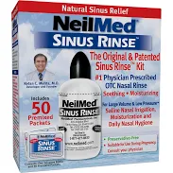
What are the risks of pituitary surgery and how can they be minimized?
Nasal stuffiness/dryness – can be common for 4-6 weeks after surgery
  I recommend nasal rinses twice daily for 4 weeks
Carotid injury – VERY unlikely (less than 1 in 1000)
  Surgeon should always use doppler or intraoperative image guidance to mark out the carotid
  Increased risk if tumor extends into the cavernous sinus
  Injury can be treated by interventional radiologists

Slide 34
Questions?
Please use the chat button
Thank you for sharing your time tonight!
If you have any more questions after tonight or want an appointment, please email: mail@goodhormonehealth.com
www.goodhormonehealth.com
Webinar will be posted in a few days
Contact Dr. Mehta through his assistant Noemi- neuroasst@houseclinic.com
https://www.houseclinic.com/mehta

