Slide 1
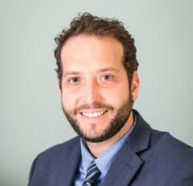
Migraine Update
Jonathan Eskenazi, M.D.
Director of Neurological Institute of Los Angeles
Assistant Clinical Professor of Neurology at Charles R. Drew University and UCLA David Geffen School of Medicine
Hosted by Theodore Friedman, MD, PHD

Slide 2
Overview
Types of Headache
Epidemiology of migraine
Pathophysiology of migraine
Evaluation of the patient
Diagnosis and Red Flags
Acute care treatment of migraine
Preventive treatment of migraine
A case
Conclusions

Slide 3
Headache Classification
Primary Headaches
Migraine
Tension-type
Trigeminal Autonomic Cephalgias
Cluster headache
Secondary Headaches
Tumor, hemorrhage
Meningitis, trauma, venous thrombosis
Sinusitis, Cervical problem
TMD
Giant cell arteritis
Other systemic disorders
Primary Headache
90%
ICHD -II Cephalalgia 2004; 24 (Suppl 1):1-160.
Notes:
Headache Classification and Diagnosis
The approach to headache classification and diagnosis centers around distinguishing between primary and secondary headaches. Primary headaches are diseases by themselves, as seen with migraine, tension-type, and cluster headaches. Secondary headaches are caused by an underlying structural, chemical, or other etiology. The majority of headaches seen in clinical practice is primary headache (approximately 90% or more).
Headache Classification Committee of the International Headache Society. Classification and diagnostic criteria for headache disorders, cranial neuralgias, and facial pain. Cephalalgia. 1988;8(Suppl 7):1-96. (p 19-20)

Slide 4
Prevalence of Migraine Globally
Brazil 22%
Canada 16%
France 12%
Denmark 12%
Italy 12%
USA 12%
Taiwan 9%
Japan 8%
China 3% {9.3%}
Adapted from Lipton RB, et al. Headache 1994
Sakai et al., Headache 2001
Notes:
Prevalence of Migraine Globally
During the last 15 years, an effort has been made to improve the diagnosis of migraine and the differential diagnosis relative to other headache disorders such as tension-type headache and chronic daily headache. Until a clear systematic approach was available for differentiating migraine from other headache types, accuracy of epidemiologic estimates for migraine were not certain. Recently, with the development and implementation of classification of migraine based on the IHS Criteria, migraine epidemiology can be more uniformly assessed on a global level. During the last 15 years, the prevalence of migraine has proven to be fairly homogenous across many countries. Differences may be because of methodological differences in the data collection process, deviations from the IHS diagnostic criteria, and cultural differences. Interestingly, the global prevalence rates for migraine range between 5–12%.
Headache Classification Committee of the International Headache Society. Classification and diagnostic criteria for headache disorders. Cranial neuralgias and facial pain. Cephalalgia. 1988;8(suppl 7):19-28.
Lipton RB, Silberstein SD, Stewart WF. An update on the epidemiology of migraine. Headache. 1994;34:319-328.
Wang et al. Prevalence of migraine in Taipei, Taiwan: a population-based survey. Cephalalgia. 2000;20:566-572.

Slide 5
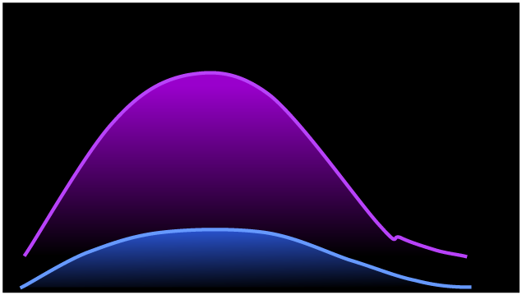
Migraine Prevalence by Age and Gender
30
25
20
Females
Migraine Prevalence %
15
10
5
Males
0
0
20
30
40
50
60
70
80
100
Age (years)
Lipton et al., Neurology 1993;43:S6-S10.
Lipton et al., Neurology 2002;58:885-894.
Notes:
Migraine Prevalence by Age and Gender
In the United States, Lipton and Stewart assessed the prevalence of migraine in the general population. Before puberty, there is not a dramatic difference in the prevalence of migraine between genders. This difference develops after menarche, when the prevalence becomes higher in females than males. During the most productive years, the prevalence of migraine in women is threefold higher than in men. This difference wanes later in life, with the difference between males and females becoming less pronounced after 60 years of age.
Lipton RB, Stewart W. Migraine in the United States: A review of epidemiology and health care use. Neurology. 1993;43(suppl 3):S6-S10.
Lipton RB, Scher AI, Kolodner K, Liberman J, Steiner TJ, Stewart WF. Migraine in the United States: epidemiology and patterns of health care use. Neurology. 2002;58(6):885-894.

Slide 6
Migraine Prevalence Compared With Other Neurologic Diseases
Disease prevalence, %
MS = multiple sclerosis; PD+HD = Parkinson disease + Huntington disease; AD = Alzheimer’s disease.
1. Hirtz D. et al. Neurology. 2007;68:326–337.
2. National Institute of Neurological Disorders and Stroke. Available at: www.ninds.nih.gov. Accessed May 17, 2007.
Notes:
Although the long-term impact of migraine is not as severe as that of other
neurologic diseases, its prevalence in the United States is substantially higher
than other neurologic diseases.
Multiple sclerosis, epilepsy, Parkinson disease and Huntington disease, and stroke all have ≤1% prevalence.^{1,2}[332a, 1a]
Alzheimer’s disease has a prevalence of 6.7%.¹ [332a]
Migraine has a prevalence of 12.1%, which is substantially higher than the prevalence of other common neurologic diseases.¹[332a]
References:
1. Hirtz D, Thurman DJ, Gwinn-Hardy K, Mohamed M, Chaudhuri AR, Zalutsky R. How common are the “common” neurologic disorders? Neurology. 2007;68:326–337.
2. National Institute of Neurological Disorders and Stroke. Huntington’s disease: hope through research. Available at: http://www.ninds.nih.gov/disorders/huntington/detail_huntington.htm. Accessed May 17, 2007.

Slide 7
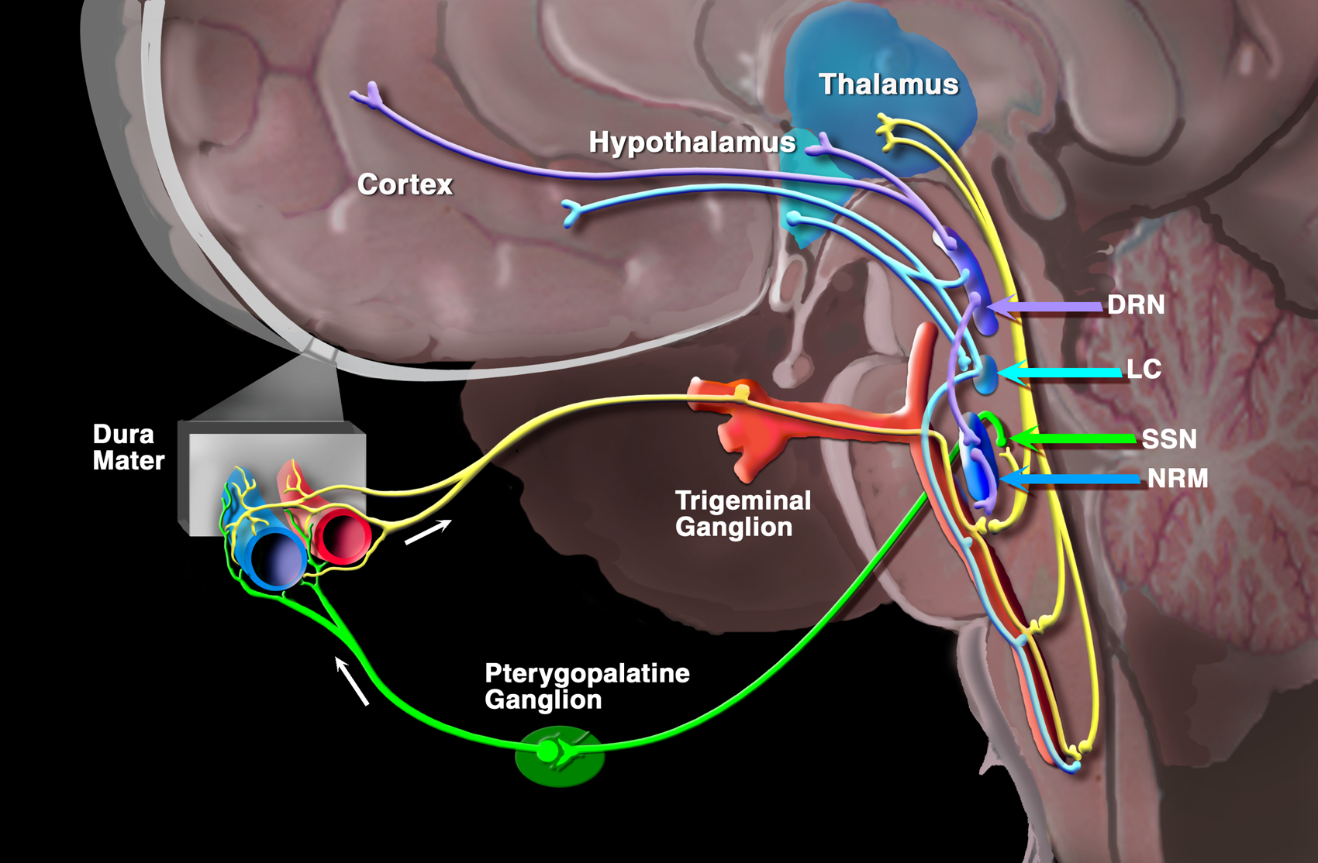
Neuroanatomy of Migraine
The Trigeminovascular System of Moskowitz
Goadsby, 2000
Notes:
Activation of the rostral brainstem in patients with spontaneous migraine has been demonstrated using positron emission tomography (PET). This region was active during the acute attack, and activation persisted after successful treatment but was not present between attacks (1). These findings suggest that there are brainstem regions that play a pivotal role in either initiation or termination of the acute attack of migraine. Indeed, migraine may well be a defect of normal control mechanism for suppressing input because similar regions in the experimental animal gate trigeminal nociceptive information.
SSN superior salivatory nucleous; DRN dorsal raphe nucleous; locus caerolius; NRM nucleous rafe magnus
Weiller C, May A, Limmroth V, Juptner M, Kaube H, Schayck RV, Coenen HH, Diener HC. Brainstem activation in spontaneous human migraine attacks. Nat Med. 1995;1:658-660.

Slide 8
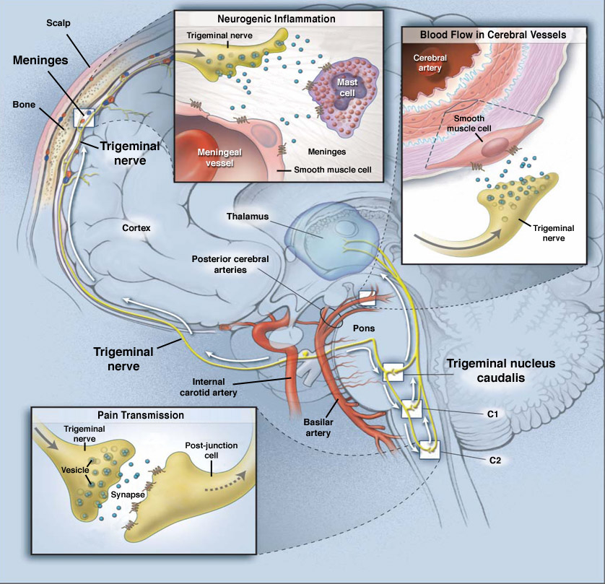
Activation of the Trigeminovascular System: Physiologic Impact
Meningeal events
Inflammation
Peripheral sensitization
Vasodilation of cerebral vessels
Brainstem events
Pain signal to CNS
Central sensitization
Allodynia
Adapted with permission from Durham PL. N Engl J Med. 2004;350:1073–1075.
Notes:
Physiologic impact of an increase of activity of the TGVS in migraine
Within the skull, pain sensitivity is primarily restricted to the meningeal blood vessels, which are densely innervated by nociceptive sensory afferent fibers of the ophthalmic division of the trigeminal nerve. It is generally recognized that the development of migraine headache depends on the activation of these afferents.¹[373-374]
Activation of the trigeminovascular afferents leads to the release of vasoactive neuropeptides contained in their peripheral nerve endings, including calcitonin gene–related peptide (CGRP) and substance P.¹[374]
Call out box in the upper middle: Based on animal studies, it is proposed that in the meninges the neuropeptides released by trigeminal ganglion stimulation produce a local neurogenic inflammation.¹[374]
Vasodilation of the meningeal vessels (mainly due to CGRP).¹[374]
Plasma extravasation (vessel leakage).¹[374]
Mast cell degranulation with secretion of other proinflammatory substances in the dura.¹[374]
Neuroinflammation of the dural and meningeal trigeminal nociceptors is thought to induce peripheral sensitization.² [p. S183 (c)]
Sensitization (peripheral or central) is the process whereby the stimulus needed to generate a response decreases over time, while the amplitude of the response to any given stimulus increases. [p. S183 (c)]
Call out box in the upper right: It is suggested that following alteration of cerebral blood vessel tone, activation of the trigeminovascular reflex counterbalances cerebrovascular constriction in part via the release of mediators that promote vasodilation of cerebral blood vessels.³ [450 (a)]
Call out box in the lower left: In addition, neuropeptides and other neuromediators relay nociceptive impulses to the central nervous system, leading to¹[1073 (c)]:
The trigeminal nerves (cell bodies of which lie in the trigeminal ganglion) synapse with second-order neurons in the trigeminal nucleus caudalis (TNC) in the brainstem.²[S183]
Activation of those afferents leads to activation of second-order dorsal horn neurons in the trigeminocervical complex comprising the TNC and the upper two divisions of the cervical spinal cord (C1 and C2).¹[374]
Nociceptive impulses are then carried rostrally to brain structures involved in the perception of pain.¹[374]
The escalating barrage of incoming stimulation from the trigeminal nerve - which results from peripheral sensitization - triggers abnormal neuronal hyperexcitability in the TNC.²[S183]
It is postulated that the enhanced responses of the second-order brainstem neurons of the TNC represent a state of central sensitization.²[S184]
Central sensitization is believed to be the underlying mechanism for cutaneous allodynia. Cutaneous allodynia is defined as the perception of pain resulting from ordinarily painless stimulation of normal skin or scalp.²[S184]
References:
1. Pietrobon D. Migraine: new molecular mechanisms. Neuroscientist. 2005;11:373–386.
2. Dodick D, Silberstein S. Central sensitization theory of migraine: clinical implications. Headache. 2006;46 (suppl 4):S182–S191.
3. Edvinsson L, Uddman R. Neurobiology in primary headaches. Brain Res Rev. 2005;48:438–456.

Slide 9
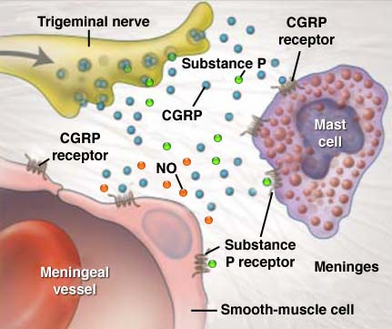
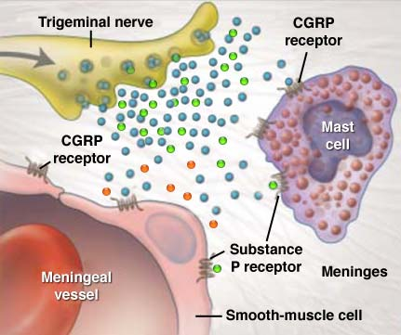
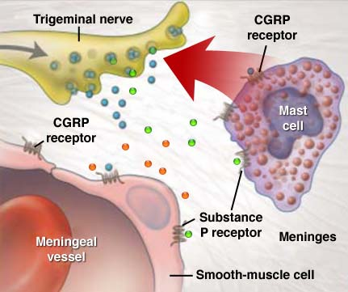
Neurogenic Inflammation Meninges
Cytokines initiate an inflammatory response in the meninges
Sensitizes TGVS nociceptors
Response threshold decreased
Response amplitude increased
Activated TGVS nociceptors release CGRP and substance P
NO also released
Leads to
Vasodilation CGRP, NO, substance P
Mast cell degranulation CGRP, substance P
Plasma extravasation substance P
CGRP and substance P activate mast cells
Mast cell degranulation
Histamine
NGF
Serotonin
Proinflammatory cytokines
TNFα, IL-1, IL-6
Longoni M, Ferrarese C. 2006;27 (Suppl 2):S107–110; Pietrobon D. Neuroscientist. 2005;11:373–386.
Durham PL N Engl J Med. 2004;350:1073–1075. Edvinsson L, Uddman R. Brain Res Rev. 2005;48:438–456.
Theoharides TC. et al. Brain Res Rev. 2005;49:65–76; Goadsby PJ. Trends Mol Med. 2007;13:39–44.
Levy D. et al. Headache. 2006;46 (suppl 1):S13–S18; Levy D. et al. Pain. 2007; April 23; [Epub ahead of print].
Notes:
The pain of migraine may be a form of sterile neurogenic inflammation
In dura mater, neurogenic inflammation involves the release of various vasoactive neuropeptides from trigeminal perivascular fibers, which evoke a cascade of events characterized by vasodilatation, plasma protein extravasation, and the release of proinflammatory mediators.¹ [S107 (a)]
Among various substances that may be involved in the neurogenic inflammation process, the leading role for its genesis is proposed to be played by CGRP.¹ [S107 (b)]
Activated nociceptors of the trigeminal system release neuropeptides that include CGRP and substance P in the meninges.² [375 (c)]
A parasympathetic reflex triggered by the activation of the trigeminal system may also lead to the release of NO.² [375 (c)]
Those neuromediators have a number of actions in the meninges:
CGRP³ [62, 64], NO⁴ [443 (a), 445 (a)] and substance P⁴ [444 (a)] induce blood vessel vasodilation.
CGRP and substance P activate mast cell degranulation⁵ [65(a)]
Substance P⁶ [40(a)] induces plasma extravasation.
Substance P plays a major role in plasma extravasation.⁶ [40 (a)]
Mast cell degranulation induced by CGRP and substance P leads to the release several substances that include histamine, serotonin, nerve growth factor, as well as pro-inflammatory cytokines such as TNF-α, IL-1, and IL-67.⁷ [S14(a)]
According to the neurogenic theory, those factors released in the vicinity of sensory fibers innervating the meninges activate and sensitize peripheral nociceptors.¹ [S107 (a)]
A recent study has provided support for this theory, showing that mast cell degranulation can produce a long-lasting activation of meningeal nociceptors. Furthermore, mast cell degranulation can also promote downstream activation of nociceptive neurons in the spinal trigeminal nucleus.⁸ [1(a), 2(a)]
Furthermore, although not depicted on this slide, evidence suggests that neurogenic inflammation in the trigeminal ganglion in addition to neurogenic inflammation in the meninges may contribute to the development of migraine headache pain. Recent experimental data suggest that CGRP can stimulate the release of cytokines from trigeminal ganglion glial cells, and that inflammatory signals propagate within the ganglion.⁹
References:
1. Longoni M, Ferrarese C. Inflammation and excitotoxicity: role in migraine pathogenesis. Neurol Sci. 2006;27 (suppl 2):S107–S110.
2. Pietrobon D. Migraine: new molecular mechanisms. Neuroscientist. 2005;11:373–386.
3. Geppetti P, Capone JG, Trevisani M, Nicoletti P, Zagli G, Tola MR. CGRP and migraine: neurogenic inflammation revisited. J Headache Pain. 2005;6:61–70.
4. Edvinsson L, Uddman R. Neurobiology in primary headaches. Brain Res Rev. 2005;48:438–456.
5. Theoharides TC, Donelan J, Kandere-Grzybowska K, Konstantinidou A. The role of mast cells in migraine pathophysiology. Brain Res Rev. 2005;49:65–76.
6. Goadsby PJ. Recent advances in understanding migraine mechanisms, molecules and therapeutics. Trends Mol Med. 2007;13:39–44.
7. Levy D, Burstein R, Strassman AM. Mast cell involvement in the pathophysiology of migraine headache: A hypothesis. Headache. 2006;46 (suppl 1):S13–S18.
8. Levy D, Burstein R, Kainz V, Jakubowski M, Strassman AM. Mast cell degranulation activates a pain pathway underlying migraine headache. Pain. 2007. April 23; [Epub ahead of print]
9. Durham PL, Thalakoti S, Patil VV, Damodaram SV, Vause CV, Langford LE, Freeman SE. Neuronal-Glia Signaling in Trigeminal Ganglion: Implications for Migraine Pathology. Abstract OR1, 49th Annual Scientific Meeting American Headache Society, Chicago, IL

Slide 10
Different Phases of Migraine¹⁻³
Yawning^{2,3,4}
Fatigue
Nausea
Mood changes
Neck stiffness
Food cravings
Premonitory
hours-days
Hypersensitivity to light, sound, and touch^{2,5}
Headache
Anxiety
Nausea
Interictal
Interictal
Aura
<1 h
Scintillating scotoma^{1,6}
Visual distortion
Pins and needles
Headache
4–72 h
Headache
4–72 h
Throbbing headache ^{2,7,8}
Nausea
Vomiting
Photophobia
Phonophobia
Cognitive dysfunction
Congestion
Allodynia
Postdrome hours-days
Cognitive dysfunction^{2,3}
Fatigue
Depression
Nausea
Photophobia
1. Charles A. Lancet Neurol. 2018;17(2):174-182. 2. Linde M. Acta Neurol Scand. 2006;114(2):71-83. 3. Charles A. Headache. 2013;53(2):413-419. 4. Kelman L. Headache. 2004;44(9):865-872. 5. Cady RK. Headache. 2007;47(suppl 1):S44-S51. 6. Headache Classification Committee of the International Headache Society. Cephalalgia. 2013;33(9):629-808. 7. Farooq K et al. Contin Educ Anaesth Crit Care Pain. 2008;8(4):138-142. 8. Burstein R et al. J Neurosci. 2015;35(17):6619-6629.

Slide 11
Diagnostic Workup
Dedicated Headache History
Imaging Studies: MRI > CT
Blood work: thyroid, CBC, ESR, ANA, Lyme, etc
Cardiac Risk Factors and Workup
LP
MRA, CTA, Angiography
Rapoport AM, Sheftell FD 2006

Slide 12
Endocrine Causes of Migraines
Hypothyroidism
Pituitary Macroadenomas
Growth hormone deficiency
Acromegaly
Cushing’s syndrome
Pheochromocytoma
Adrenal Insufficiency
Workup primary based on other symptoms

Slide 13
Warning Signs/“Red Flags” of Conditions More Serious Than Migraine
Onset after age 50
Atypical headache
“First or worst headache ever”
Rapidly accelerating headache
Headache from exertion
Headache associated with neurological or VS changes

Slide 14
IHS 2004 Diagnostic Criteria: Migraine Without Aura
1.1 Migraine without Aura
At least 5 attacks lasting 4-72 hours
At least 2 of the following 4 criteria:
Unilateral
Pulsating (to the beat of the heart)
Moderate to severe intensity
Aggravated by mild physical activity
At least 1 of the following criteria:
Nausea and/or vomiting
Photo and phonophobia
No evidence on history or exam of disease that might cause headache
ICHD -II Cephalalgia 2004; 24 (Suppl 1):1-160.

Slide 15
Underdiagnosis of Migraine in Clinical Practice
U.S. population-based study
Never received medical diagnosis
Received medical diagnosis
48%
52%
Lipton RB, et al. Headache 1998;38:87–96

Slide 16
Alternative Method of Diagnosing Migraine
Any patient with a stable pattern of recurrent, severe headache which produces significant disability, followed by a period of no headache, has migraine until proven otherwise
A careful, brief neurologic history and exam and appropriate tests will rule out organic causes of headache

Slide 17
ID Migraine™: Final Item Choice and Scoring System
Nausea
Sensitivity : 0.81
Positive If “Yes” Answer to 2 Out of 3 Items
Disability
Specificity: 0.75
Photophobia
PPV: 0.93
Lipton RB et al. Neurology,
Notes:
Reference:
29. Lipton RB, Dodick D, Sadovsky R, et al. A self-administered screener for migraine in primary care: results of the ID-Migraine™ validation study. ((citation to come when published))

Slide 18
37-year-old woman complains of sinus headaches 2 times a month. The pain starts in her sinuses and eventually moves behind one eye but may switch sides. Occasionally, she has a runny nose and feels sick. Attacks usually last a day or two, are moderately painful and get worse with movement. Her headaches partially respond to OTC sinus medications. Her 9 year old daughter is starting to get headaches.
A Case of ? Sinusitis

Slide 19
Sinus Features at Onset of Headache Hide the Presence of Migraine
Headache Symptoms at Screen
97%
Moderate-Severe Pain
Stuffiness
73%
Common symptoms associated with sinus
Photophobia
66%
Drainage
67%
Worsened by Activity
63%
Unilateral
63%
Nausea
63%
Weather Associated
57%
Pulsating
53%
Phonophobia
40%
Vomiting
20%
0%
33%
67%
100%
n=30 (subjects may report more than one symptom)
Cady et al. Poster presented at: 10th IHC; June 29-July 2, 2001; New York

Slide 20
Acute Treatment Strategies: General Principles - 1
Proper treatment begins with accurate diagnosis of all headache types
Pts should participate in their own care
Patient education and behavioral management
Strategies for identifying triggers
Trigger avoidance
Regular sleep, meals and exercise routines
Stress management, biofeedback, cognitive re

Slide 21
Acute Treatment Strategies: General Principles - 2
Review past treatments in detail
Successes and failures + AEs
Attack frequency, duration and disability determines Rx plan
Think about the “entire” migraine complex
Treatment needs to encompass pain relief and associated symptoms
Specifically ask about disability
Consider co-morbid conditions (e.g. MOH, depression, sleep disorders)

Slide 22
Migraine Co-Morbidity
Raynaud’s disease
Mitral valve prolapse
Stroke
Sleep Disorders
PFO
Epilepsy
Depression
Anxiety/panic disorder + others
Irritable bowel syndrome

Slide 23
Consider Co-Occurring Conditions
Hypertension/ Hypotension
Angina/MI
Ulcer disease/reflux
Vertigo/dizziness
Current or prior medication overuse
Allergies
Asthma
Hypothyroidism

Slide 24
Goals of Acute Migraine Treatment
Treat attacks rapidly and consistently without recurrence →→ Pain Free State
One and done
Restore the patient’s ability to function
Prevent adverse events
Minimize the use of rescue and backup medications
Optimize self-care and reduce resource utilization (avoid ER)
Be cost-effective

Slide 25
Headache Therapeutic Options
Nonpharmacologic approaches
Acute (abortive, symptomatic) therapy
Preventive therapy
Adjunctive therapies (Vitamins, Minerals, Supplements, Herbs, Ayurvedic medicine): discussed later
Physical Techniques
Rapoport AM, Sheftell FD 2008

Slide 26
Classes of Medications for Acute Treatment of Migraine
OTC simple analgesics
OTC NSAIDs
OTC Combination analgesics
Prescription NSAIDs (diclofenac K Sachet)
Butalbital-containing (Fiorinal®, Fioricet®, Esgic®)
Opiates and tramadol
Antiemetics
Steroids
Ergots (ergotamine tartrate and DHE)
5-HT agonists (Triptans)
Rapoport AM, Sheftell FD, Tepper SJ 2008

Slide 27
MIGRAINE MANAGEMENT
Issues at first visit
Based on attack profile, associated symptoms and level of disability
Initial Therapy
Recurrence
If Fail
Back-up Therapy
If Fail
Rescue Therapy
Follow-up visit

Slide 28
What is the Syndrome of “Rebound Headache” now called Medication Overuse Headache?
Occurs only in patients with pre-existing chronic headache
A self-sustaining rhythm of predictable and escalating medication use
Headaches increase in frequency and intensity and become refractory to acute care and preventive treatments
Medication withdrawal results in escalation of headache followed by improvement
Rapoport, Sheftell & Tepper, 2008

Slide 29
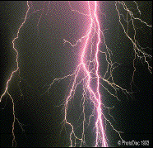
Phases of a Migraine Attack
Pre-HA
Headache
Post-HA
Moderate
to Severe
Mild
Premonitory/
Prodrome
Aura
Headache
Postdrome
Time
Early Intervention

Slide 30
TRIPTANS: Routes of Delivery
Tablets
Sumatriptan
Zolmitriptan
Naratriptan
Rizatriptan
Almotriptan
Frovatriptan
Eletriptan
“Fast-melt”
Rizatriptan-MLT
Zolmitriptan-ZMT
Suppository
Sumatriptan (Europe)
Subcutaneous
Sumatriptan
Nasal Spray
Sumatriptan
Zolmitriptan
Rapoport AM, Sheftell FD 2008

Slide 31
Pharmacokinetics of the Triptans
t_{max} Bioavail. t _{1/2} Metabolism/
(h) (%) (h) Excretion
Sumatriptan 2.0 (2.5) 14 2 MAO-A
Rizatriptan 1.0–1.5*^ 45 2–3 MAO-A
Zolmitriptan 1.5 (2.0) 40 3 MAO-A (P450)
Naratriptan 2-3 (3-4) 70 6 Renal (P450)
Almotriptan 2-3 70 3-4 MAO-A (P450)
Eletriptan 1.3 (2.8) 50 4–5 P450 3A4
Frovatriptan 2–3 22–33 26 Renal (P450)
( ) = during migraine attack
* No increase during attack
^Rizatriptan ODT is 1.6-2.5 hrs

Slide 32
Techniques for Achieving Sustained Pain Free Response: One and Done
Optimal Dose of a Triptan or NSAID
Optimal Formulation
Early Intervention, during mild pain, < 30 minutes into attack
If needed, add an NSAID to the triptan to increase efficacy and decrease recurrence
After Tepper

Slide 33
How to Choose a Triptan
Treat at least two or three attacks before judging effectiveness of acute medications
Review outcome measures (diaries, MIDAS, etc.)
Assess efficacy, adverse effects, speed of onset, completeness of response, recurrence and satisfaction with current routine
If treatment is not working, find out why
Consider:
Choice of drug
Choice of dose or route of administration
Need for adjunct therapy
Interfering medication
After Silberstein SD et al. Wolff’s Headache and Other Head Pain. 2001.

Slide 34
Triptan Drug Interactions
 | Almotriptan (AXERT®) | Sumatriptan (IMITREX®) | Rizatriptan (MAXALT®) | Naratriptan (AMERGE®) | Zolmitriptan (ZOMIG®) | Eletriptan (RELPAX®) | Frovatriptan (FROVA®)
MAOI SSRI Propranolol CYP 3A4 inhibitors | No No No No | Yes* No No No | Yes* No Yes† No | No No No No | Yes* No No No | No No No Yes* | No No No No
Dahlöf CG et al. Headache. 2002;42:99-113.
MAOI = monoamine oxidase inhibitors., SRI = selective serotonin reuptake inhibitors.
*Contraindicated. †Modification to use required or may be required.
AXERT® (almotriptan malate) Tablets Prescribing Information. Imitrex (sumatriptan) Prescribing Information. Zomig (zolmitriptan) Prescribing Information. Amerge (naratriptan) Prescribing Information. Maxalt (rizatriptan) Prescribing Information. Frova (frovatriptan) Prescribing Information. Relpax (eletriptan) Prescribing Information. Association of the British Pharmaceutical Industry Medicines Compendium.

Slide 35
SUMMARY OF ACUTE MIGRAINE MANAGEMENT
Make a specific, credible diagnosis and communicate it
Assess migraine severity and it’s impact on the patient
Determine the patient’s preferences and needs
(e.g., fast or complete relief, no AEs)
Identify coexistent conditions that influence therapy
Develop a therapeutic partnership and communicate realistic expectations
Create plan based on migraine type and severity, as well as patient’s needs, preferences, and comorbidities
Consider need for preventive treatment

Slide 36
Indications for Preventive Strategies
Frequency
more than two attacks per month
Disability/QOL related to headache
Unresponsive to acute therapies
Contraindications to acute therapies
Significant adverse events with acute therapies
Pharmacoeconomic considerations
To prevent progressive disease
Sheftell FD, Rapoport AM, 2008

Slide 37
Migraine Prevention Is Underutilized, Though Many Patients Have the Opportunity
Landmark Study of 162,576 People Reveals Prevention Is Still an Underutilized Treatment Option
n=18,968
Many Eligible Sufferers Are Not Receiving Migraine Prevention













Total Number of Migraine Sufferers






































































































































40% Eligible

13% Currently Receiving Prevention
Lipton RB et al. Poster presented at: American Headache Society
47th Annual Scientific Meeting; June 23-26, 2005; Philadelphia, PA.

Slide 38
Dietary Supplements for prevention
▪ Butterbur- strong
▪ Vitamin B2- strong
▪ Mag citrate - strong
▪ CoQ10 - strong
▪ Fatty acids/fish oil -no
▪ Melatonin -no
Canadian Headache Society
Guide for Migraine
Prophylaxis, 2012
http://www.ncbi.nlm.nih.gov/pubmed/
22683887

Slide 39
Butterbur (Petasites hybridus root)
Systematic review: 2 trials: 150 mg daily better than 100 mg daily (Agosti, 2006)
▪ Music and butterbur better than TAU in kids with migraines (Oelkers-Ax, Eur J Pain, 2008)
AVOID butterbur with pyrrolizidine alkaloids: hepatotoxic!
▪ https://nccih.nih.gov/health/butterbur
Notes:
Butterbur is a shrub that grows in Europe and parts of Asia and North America, typically in wet, marshy ground. The name, butterbur, is attributed to the traditional use of its large leaves to wrap butter in warm weather.
The raw, unprocessed butterbur plant contains chemicals called pyrrolizidine alkaloids (PAs). PAs can cause liver damage and can result in serious illness. Only butterbur products that have been processed to remove PAs and are labeled or certified as PA-free should be used.

Slide 40
Supplements: Vitamin B2
▪ 200 mg BID with meals for 3 months -> 68% reduction in migraine attacks in RCTs
▪ Side effect: yellow urine
Schoenen. Neurology, 1998; Sandor. Headache, 2000; Magis. Headache, 2007 Negative small studies on pediatric migraine; + for TTH (Bruijn J, Cephalgia 2010; MacLennan J Child Neurol, 2008)

Slide 41
Supplements: Magnesium
▪ 1 gram iv acutely or 300 – 500 mg daily po to prevent (aspartate, citrate, gluconate)
▪ Good dietary sources: soy beans, black beans, tofu, seeds, nuts, whole grains, shellfish (high fiber foods)
▪ Avoid taking Mg supps with Fe, Ca, Zn
▪ Side effect: Diarrhea
Mauskop. Headache, 2002; Pfaffenrath. Cephalgia, 1996;Mazzotta. Cephalgia, 1999; Wang, Headache, 2003;Peikert. Cephalgia, 1996; Facchinetti F, Headache, 1991; Teigen L. Cephalgia, 2015

Slide 42
Coenzyme Q-10
1. Open label, 150 mg qd X 3 months; 62% had > 50% reduction in number of HA days
2. Hershey Pediatric study - safe
Measured CoQ10 in 1550 patients (avg. age 13 years)
33% with levels below reference range, given 1-3 mg/kg-d CoQ10
Follow up 3+ months later: Signif increase in CoQ10 level; Signif decrease in HA disability
3. RCT of CoQ10 (100 mg) add on for 76 kids with migraines; faster improvement over first 4 weeks; no difference later
Rozen and Silberstein, Cephalalgia 22: 137-141, 2002 Hershey AD. Headache, 2007 Slater SK. Cephalgia, 2011

Slide 43
Migraine Preventive Agents
Beta blockers
Propranolol*
Nadolol
Atenolol
Timolol*
Metoprolol
Ca channel blockers
Verapamil
Amlodipine
Diltiazem
Nifedipine
Nimodipine
(Flunarazine)
Nisoldipine
Antidepressants
Tricyclics
Amitriptyline
Nortriptyline
MAOIs
Misc-Bupropion
SNRIs
--Venlaf,Dulox
SSRIs
Flu,Sert,Par
Escitalopram
Antiepileptics
Divalproex sodium*
Gabapentin
Topiramate *
Carbamazepine
Dilantin
Lamotrigine
Tiagabine
Zonegran
Levetiracetam
Oxcabazepine
NSAIDs
Naproxen
Meclofenamate
Ibuprofen
Ketoprofen
Flurbiprofen
Celecoxib
Valdexcoxib
Rofecoxib
5-HT₂ antagonists
Cyproheptadine
Methysergide*
Methylergonovine‡
Alternative therapies
Riboflavin
Magnesium
?Cyanocobalamin
Feverfew, Co Q 10
Melatonin, Petasites
Others
ACE inhibitors
BotulinumtoxintypeA
Memantine (Nam)
ARBs-candesartan
Quetiapine
Tizanidine
Daily naratriptan
?Opiates
Future
AMPA/Kainate Antag
NOS inhibitors
? LT antagonists
NMDA antagonists
CSD antagonists
Adenosine A1 Agon
Pure 5-HT_{1B/1D} Agon
Approved indication for migraine in US; †Not available in the US;
‡ Methylergometrine in Europe; NOS = nitric oxide synthase;
LT = leukotriene; CSD = cortically spreading depression
Rapoport AM, Sheftell FD, 2010

Slide 44
OnabotulinumtoxinA in Prevention of Chronic Migraine: COMPEL Study

Slide 45
Monoclonal Antibodies to CGRP or the CGRP Receptor
mAbs are really big molecules
> 500 times larger than “small molecule” medications
mAbs are eliminated by the reticuloendothelial system
No liver, renal toxicity identified
mAbs do not cross the blood-brain barrier
Action is peripheral
Associated with low AE profile
mAbs may be dosed monthly (or longer)
Metabolic pathway allows long bioavailability
Israel. Curr Pain Headache Rep. 2018;22:38.

Slide 46
Meet the Monoclonal Antibodies
Erenumab
Erenumab is a mAb against the CGRP receptor
Erenumab is the only mAb in the group that is fully humanized
FDA approved for migraine 5/17/18
Fremanezumab
Antibody against the CGRP ligand or peptide
Humanized (95%)
May be given monthly or quarterly
FDA approved for migraine 9/14/2018
Cell
Neurocyte
CGRP Receptor
CGRP
CGRP Receptor
Murine
Human
Human
Galcanezumab
Eptinezumab
The only anti-CGRP mAb administered by IV
Antibody against the CGRP ligand or peptide
Humanized (90%)
PDUFA 2/21/2020
Antibody against the CGRP ligand or peptide
Humanized (90%)
FDA approved for migraine 9/27/2018
FDA approved for cluster headache 6/4/2019
Neurocyte
Neurocyte
CGRP Receptor
CGRP
CGRP Receptor
CGRP
Murine
Yeast
Human
Human
Tepper. Headache. 2018;58:238. Edvinsson. Cell. 2018;175:1719.

Slide 47
Meet the Monoclonal Antibodies
Erenumab
70 mg or 140 mg SC monthly
Fremanezumab
225 mg SC monthly or 675 mg SC quarterly
Cell
Neurocyte
CGRP Receptor
CGRP
CGRP Receptor
Murine
Human
Human
Galcanezumab
Eptinezumab
30-300 mg IV quarterly
240 mg month loading dose, then 120 mg SC monthly
Neurocyte
Neurocyte
CGRP Receptor
CGRP
CGRP Receptor
CGRP
Murine
Yeast
Human
Human
Tepper. Headache. 2018;58:238. Edvinsson. Cell. 2018;175:1719.

Slide 48
Meet the Monoclonal Antibodies
All 4 mAbs are positive in regulatory episodic and chronic migraine trials (primary endpoint: reduction in monthly migraine days)
40% to 60% of chronic migraine registration study subjects had medication overuse
All 4 mAbs:
Quick onset, separating from placebo within 1 week
Demonstrate clinically meaningful response by 1 month
Have favorable responder rates for ≥ 50%
Safety and tolerability similar to placebo
Almost all secondary endpoints are also positive
Decreased acute medication days
Improved impact, disability, and/or QoL
Tepper. Headache. 2018;58:238.

Slide 49
Conclusions
Make an accurate diagnosis of migraine
Rule out secondary disorders
Triptans with or without NSAID should be your first choice for patients with significant acute migraine attacks, in the absence of vascular contraindications
Treat medication overuse headache first
Set limits on acute care medications to 2 days per week
Administer triptans or NSAIDs early in the attack, when pain is mild, in optimal dose and formulation to maximize likelihood of a sustained pain free response – one and done
Change triptan dose, or route of administration or try another triptan if response is poor. Or use an NSAID
Use prevention for frequent and/or disabling headache

Slide 50
Thank you for your attention!
Visit us at: thenila.com
Newport beach office
455 Old Newport Blvd
Newport Beach , CA, 92663
Downtown LA Office
510 S. Alvarado St.
Los Angeles, CA, 90057
Maywood Office
4347 Slauson Avenue
Maywood , CA, 90270
West Hollywood Office
948 N Fairfax Avenue Ste. 201
West Hollywood, CA, 90046
East LA Office
6007 Whittier Blvd
Los Angeles, CA, 90022
North Hollywood Office
1101 N. Vermont Avenue
Los Angeles , CA, 90029
West LA Office
6363 Wilshire Ave Suite 516
Los Angeles , CA, 90048

Slide 51
Questions?
Please use the chat button
Thank you for sharing your time tonight!
If you have any more questions after tonight or want an appointment with Dr. Friedman, please email: mail@goodhormonehealth.com
www.goodhormonehealth.com
Webinar will be posted in a few days

