Slide 1
Vegetarian, Vegan, and Caveman Diets?

Slide 2
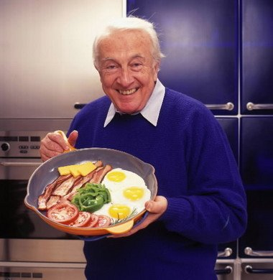
Diet Matters: Heart Disease
Leading Cause of Death in US
LDL = bad cholesterol
High Fat diets increase LDL
Robert Atkins
Created the “Atkins Diet”
Not Overweight
Had Multiple Heart Attacks

Slide 3
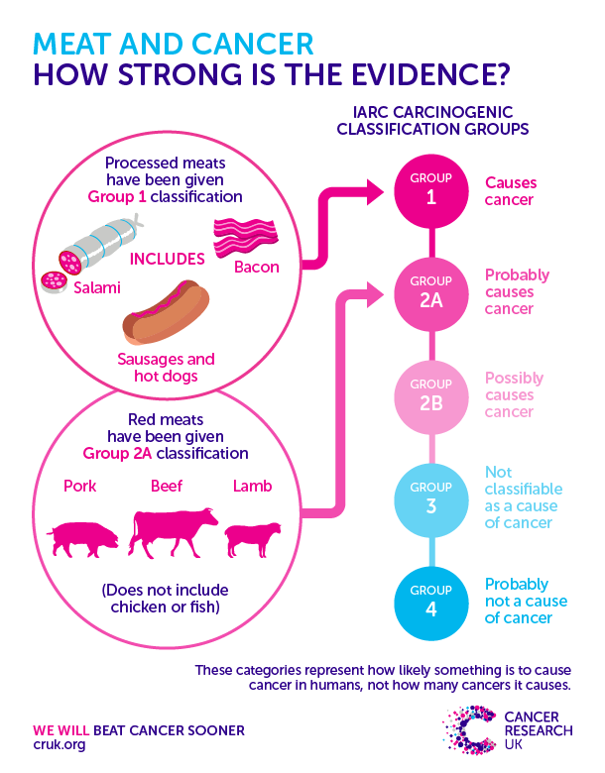
Diet Matters: Cancer
2nd Cause of Death in US
Fat, Processed Increases
Grilled, Smoked Increases
Fruit, Vegetable, Fiber Reduces
Digestive System Cancers
US has 50% more than Japan

Slide 4
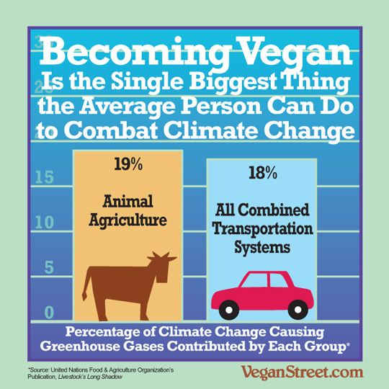
Vegetable Diets: Motivation
Improve Health
Prevent Animal Cruelty
Fight Global Warming

Slide 5
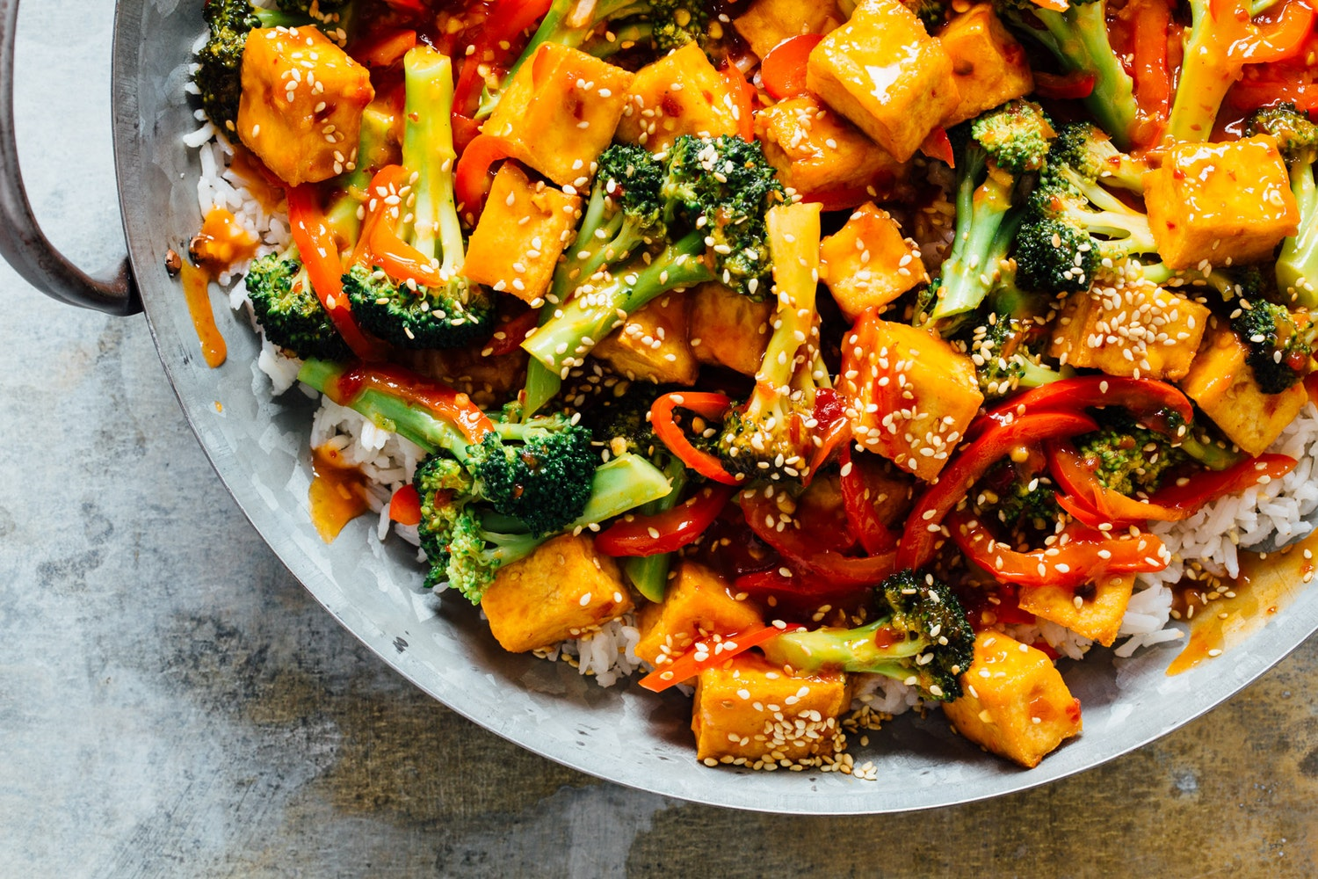
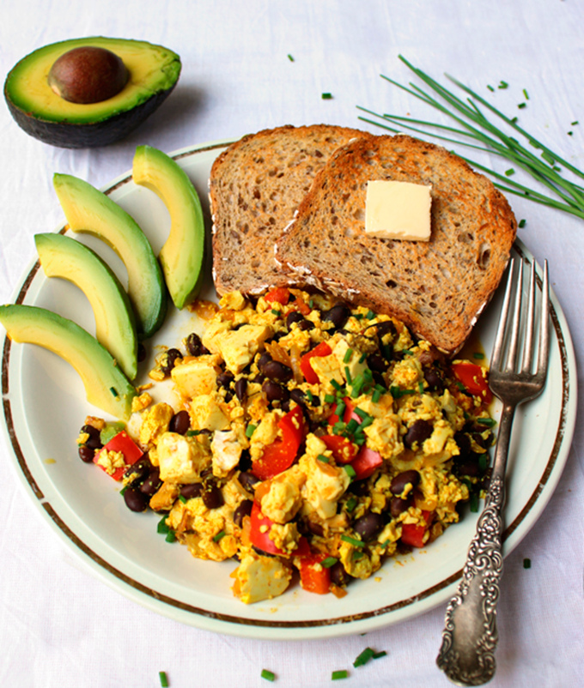
Vegan
Grains, seeds, nuts, legumes, soy, fruits, vegetables, and oils
No Animal Products
No diary
No eggs

Slide 6
Vegan
Pros
Less Calories, Fat (generally)
More Fiber, Fullness
Cons
Could have lots of Calories,Fat
Difficult to obtain Protein
Need “complimentary” Proteins (beans and rice)

Slide 7
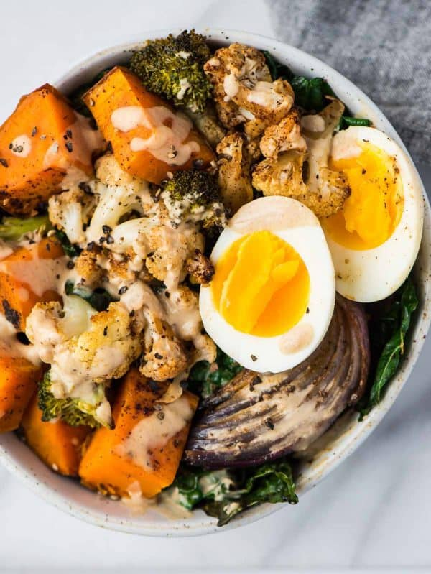
Vegetarian
Many variations
Same as Vegan but:
May eat dairy (lacto-vegetarian)
May eat eggs (ovo-vegetarian)

Slide 8
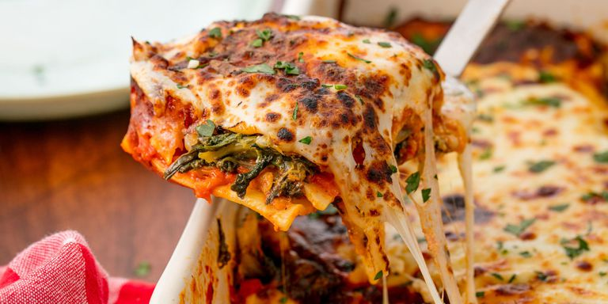
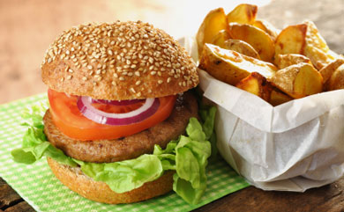
Vegetarian
Pros
Less Calories, Fat (generally)
More Fiber, Fullness
Can get Protein
Cons
Could have lots of Calories,Fat
Need to get enough Protein

Slide 9
Paleo Diet = Caveman Diet
Humans “born” began 500,000 years ago during last Ice Age
For 490,000 years no farms
No bread or processed foods
Meat, Vegetables, Nuts, Berries
Should we be eating bread?

Slide 10
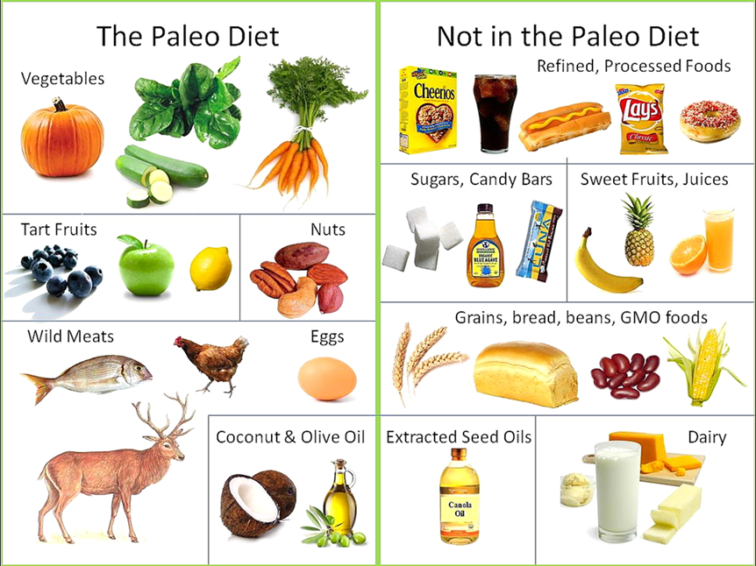
Paleo Diet = Caveman Diet

Slide 11
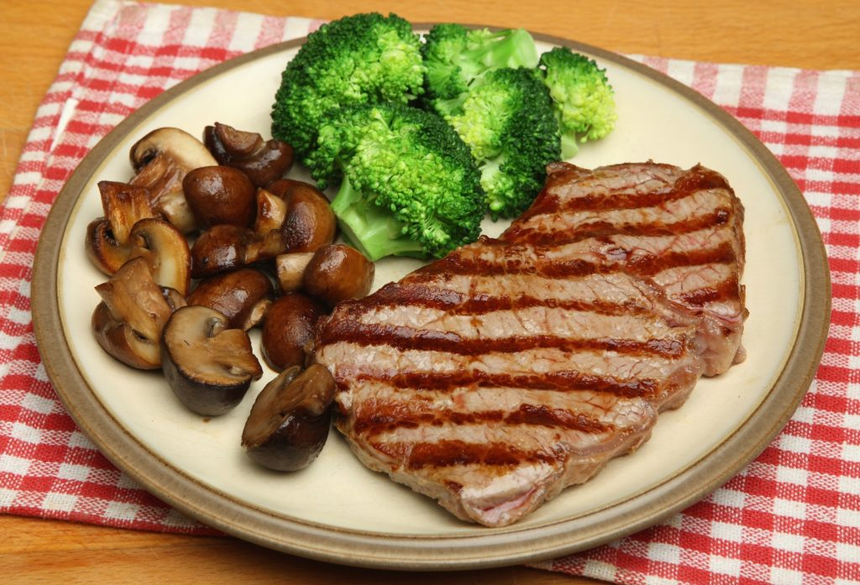
Paleo Diet = Caveman Diet
Pros
Less Calories, Fat
More Fiber, Fullness
Can easily Protein
Cons
Could have lots of Calories,Fat
Cooked meat and Cancer

Slide 12
Vegan vs. Vegetarian vs. Paleo
Can gain or lose weight with any diet
Depends on the portion
Eat right amount and will lose weight
Depends on the food type
Eat right food and will lose weight

Slide 13
Vegan vs. Vegetarian vs. Paleo
Vegan:
Very difficult to follow
Too little protein can cause stroke
Vegetarian
Difficult to follow
May get enough protein
Paleo (Caveman)
Easiest to follow
Cooked meat and Cancer
Easiest to make unhealthy

Slide 14
The Winner is: Paleo Diet
Low Fat
Low Carb

