Slide 1



Theodore C. Friedman, M.D., Ph.D.
(the Wiz)
Professor of Medicine-UCLA
Chairman, Department of Internal Medicine
Charles R. Drew University
Dr. Friedman’s Endocrinology Clinic
Updates on Treating Hypothyroidism
GoodHormoneHealth Webinar
April 30, 2023

Slide 2
Outline
Which thyroid medicine is the best?
Importance of measuring T4/T3
What is the difference between desiccated thyroid and synthetic thyroid hormones?
New articles showing patients prefer desiccated thyroid
New thyroid hormone preparations
T3 alone?
Is rT3 important?
Does biotin affect thyroid tests?
Hypothyroidism diet?

Slide 3
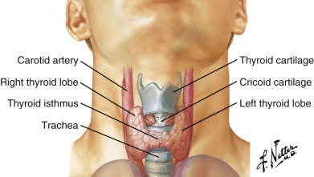
Thyroid

Slide 4
Hypothyroidism Treatment
Many options for thyroid hormone replacement.
L-T4 alone (Levothyroxine, Synthroid, Levoxyl, Tirosint, Unithroid)
L-T4 gel capsules-Tirosint, generic Tirosint, Thyquidity
L-T3 (Cytomel, liothyronine) alone
L-T4/L-T3 combinations
Desiccated thyroid (Adthyza, Armour, NatureThroid, WP thyroid, Erfa)-from pig thyroid. Often called Natural Desiccated Thyroid (NDT) or Desiccated Thyroid Extract (DTE)
Thyrogold-New Zealand cows
Desiccated thyroid/L-T4 combinations
Proper treatment needs to be individualized (not one blood pressure medicine).
Multiple studies have shown poor quality of life among patients on L-T4 replacement alone

Slide 5
Hypothyroidism-T4/T3 treatment
Some but not all studies show a benefit of L-T4/L-T3 treatment over L-T4 alone.
Large study in Italy (Gullo, PLoS One, 2011, 6:e22552) found that in patients without a thyroid given L-T4 replacement, 15% had a low serum fT3 level, but normal TSH levels.
This suggests that certain patients have a different setpoint for TSH secretion and that some patients need L-T4/L-T3 treatment to achieve normal freeT3 and freeT4 levels.

Slide 6
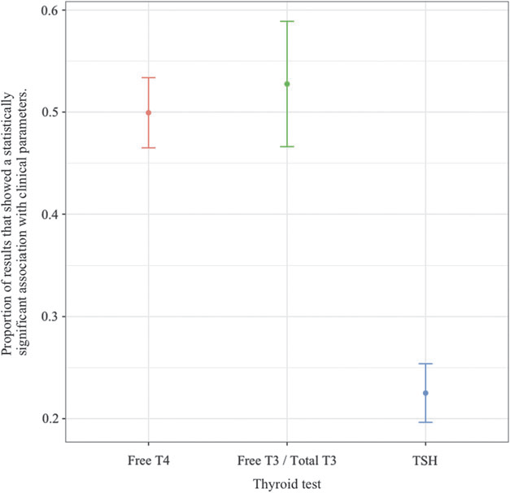
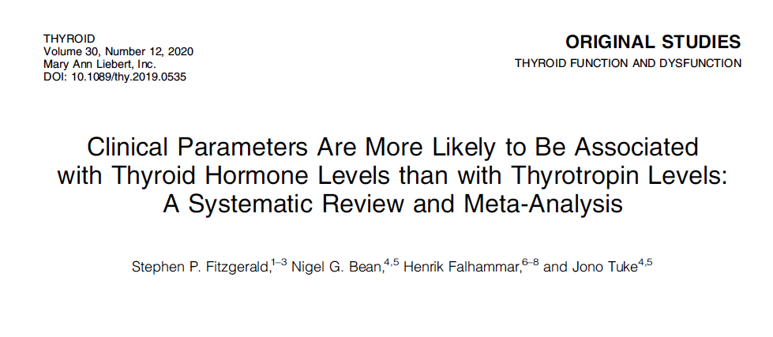
Importance of measuring fT4/fT3 on thyroid treatment
Thyroid hormones levels, and in particular, FT4 levels, seem to have stronger associations with clinical parameters than do TSH levels.
Clinical and research components of thyroidology currently based on the measurement of the thyroid state by reference to TSH levels warrant reconsideration.

Slide 7
Importance of measuring fT4/fT3 on thyroid treatment
It supports measuring freeT3 and freeT4 in patients on treatment.
It is ok to have a low TSH, especially on desiccated thyroid/ T4/T3 treatment, or with pituitary problems
It also supports replacing T4 and T3 either by combination treatment or with desiccated thyroid

Slide 8
Hypothyroidism Treatment-Polymorphism
About 16% of patients have a polymorphisms (change in DNA) in their type 2 deiodinase that converts T4 to T3 (Panicker et al, JCEM, 2009, 94:1623-1629).
The patients with this polymorphism required higher T4 dosing and had more psychological problems than those that did not have the deiodinase polymorphism.
They did not examine whether these patient would benefit from T4/T3 combination and also did not actually measure the enzyme, they only looked at the gene coding for this enzyme.

Slide 9
Hypothyroidism Treatment-T4/T3 combination treatment
These intriguing papers challenge the idea that all patients with hypothyroidism should be treated with T4.
I use different thyroid medicines to treat patients with hypothyroidism including T4/T3 combinations, and desiccated thyroid that contains T4 and T3.
We don’t use one blood pressure medicine for all patients
I interpret this data that some, but not all of hypothyroid patients do fine on T4 alone As discussed later, T4 therapy can lead to high rT3 which can be detrimental
Approximately 15-20% of the population does need T4/T3 combination to have an optimal effect on the thyroid.
These patients are the vocal minority who are not doing well on T4 treatment and would benefit from seeing a thyroid specialist like myself

Slide 10
Hypothyroidism Treatment-Desiccated Thyroid
Desiccated thyroid has a higher T3/T4 ratio than the human thyroid.
Many patients on desiccated thyroid alone have high fT3, low fT4 and low TSH
Desiccated thyroid has a higher T3/T4 ratio than the human thyroid. Some patients on desiccated thyroid (especially Armour) alone have high fT3, low fT4 and low TSH
Armour thyroid is now made by Abbvie and distributed by Allergan USA and concern about variability of preparations and lack of standardization are unfounded.
Abbvie has over 60 products
WP thyroid was a brand of desiccated thyroid with minimal binders and fillers
NatureThroid has more fillers than WP thyroid, but still pretty pure.
NatureThroid was recalled in 2020, but not recently
Both WP thyroid and NatureThroid (made by RLC labs) have been on backorder for 4 years and unlikely to return.

Slide 11
Hypothyroidism Treatment-Desiccated Thyroid
T3 has a short half-life and desiccated thyroid or T3 or should be given twice a day
Otherwise the T3 is gone from your system and you are hypothyroid in the evening and next morning
2nd dose can be around 2-3 PM
There may be other components of thyroid missing in synthetic preparations.
I usually give desiccated thyroid in a twice a day, especially in patients with a poor quality of life on L-T4 alone.
Both doses should be separate from food by about 45 min

Slide 12
Hypothyroidism Treatment-Desiccated Thyroid- JCEM article
In the May 2013 issue of Journal of Clinical Endocrinology and Metabolism http://www.ncbi.nlm.nih.gov/pubmed/23539727, Huang and colleagues from the Walter Reed Medical National Military Medical Center in Bethesda, Maryland published the results of a randomized crossover study in which 70 patients completed the study and received either desiccated thyroid or levothyroxine replacement.

Slide 13
Hypothyroidism Treatment-Desiccated Thyroid- JCEM article
Patients were on a stable dose of levothyroxine and had a normal TSH before the study started.
78 patients were randomized and 70 concluding the study, with 35 received Armour Thyroid at the beginning and 35 received levothyroxine at the beginning.
The dose of either the levothyroxine or the Armour Thyroid was adjusted after six weeks so that the TSH was between 0.5 and 3.0.
They continued on that dose for an additional 10 weeks.
After 16 weeks, patients were switched over to the other compound with the same adjustment at 6 weeks and continued for another 10 weeks.

Slide 14
Hypothyroidism Treatment-Desiccated Thyroid- JCEM article
There was not a statistical improvement in symptoms for general health questionnaires or neuropsychological testing, however there was a trend toward improvement in these tests for the group that took the desiccated thyroid compared to the levothyroxine replacement group.
There was a 2.9 pound weight loss among the group that took the desiccated thyroid compared to the levothyroxine group that was significant.
Patients on Armour Thyroid did have a slightly lower HDL level that is the good cholesterol, so that could be a potential detriment to Armour replacement.
Both total T4 and free T4 were much lower on the Armour Thyroid than on levothyroxine replacement indicating that patients on Armour Thyroid need an additional low dose of levothyroxine, as Dr. Friedman often prescribes.
rT3 was higher in the levothyroxine replacement group, which may be detrimental

Slide 15
Hypothyroidism Treatment-Desiccated Thyroid- JCEM article
Most importantly, 49% of the patients preferred Armour Thyroid, 19% preferred levothyroxine and 33% did not notice a difference.
This was important as the study was blinded and they didn’t know which thyroid preparation they were taking and indicates some subtle improvement in how they were feeling with Armour Thyroid.
The subgroup that preferred Armour Thyroid lost even more weight; they lost 4 pounds on Armour Thyroid compared to levothyroxine.
They had better well-being and their thyroid symptoms were significantly better with better cognitive function on Armour Thyroid compared to when they were on levothyroxine.
This suggests that a subset of patients need Armour Thyroid as opposed to levothyroxine alone.
These patients may be poor converters of T4 to T3.

Slide 16
Hypothyroidism Treatment-Desiccated Thyroid- JCEM article
There were no side effects in the Armour Thyroid group; specifically there was no increase in heart rate or pulse.
The authors concluded that improvement with Armour Thyroid may not be detected by the relatively insensitive methods used in the study.
They also concluded that once-daily desiccated thyroid in place of levothyroxine caused modest weight loss and possible improvements in symptoms and mental health without appreciable adverse effects.

Slide 17
Hypothyroidism Treatment-Desiccated Thyroid- my comments
I found it to be a very well designed and well executed study done by a reputable group and published in a superb journal.
I note that the Armour Thyroid was given as a single dose once a day without levothyroxine. Since Armour Thyroid contains T3 that has a short half-life, I prescribe Armour Thyroid twice a day.
I suspect that if the study gave Armour Thyroid twice a day, those patients would have done even better than on once a day Armour Thyroid.
This study clearly refuted that Armour Thyroid is inferior to levothyroxine.

Slide 18
Hypothyroidism Treatment-Desiccated Thyroid- my comments
The study also pointed out the importance of trying to determine the subset of patients to put on desiccated thyroid.
A significant subset of patients did prefer the desiccated thyroid.
Those who preferred desiccated thyroid were more likely to have autoimmune thyroid disease and had a slightly higher reverse T3, although neither of these were significant.

Slide 19
Hypothyroidism Treatment-Desiccated Thyroid- my comments
The study examined all patients with hypothyroidism on levothyroxine replacement, most of whom were doing well.
If the study used the subset of patients who were on levothyroxine replacement and feeling poor, I surmises that they would have done even better on desiccated thyroid.
Many of the patients who come to see me have a low quality-of-life on levothyroxine replacement.
If your doctor refuses to prescribe desiccated thyroid, show him the 2013 article or better yet, come out and see me.

Slide 20
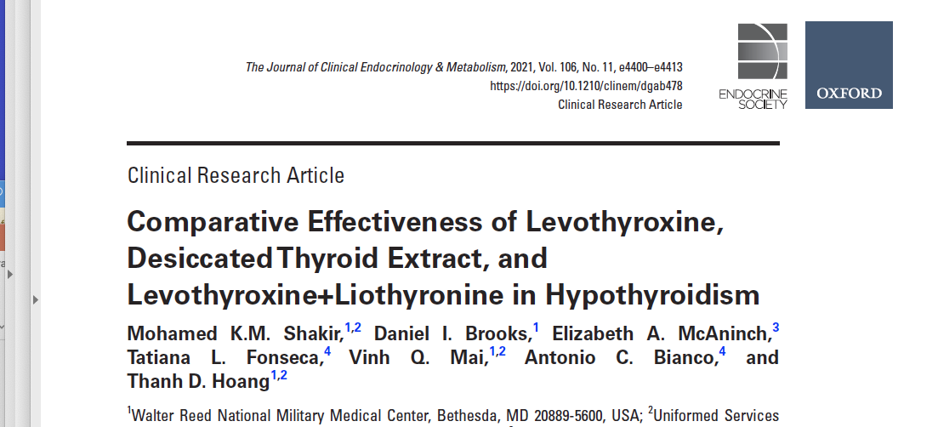
Shakir 2022 JCEM

Slide 21
Methods
This was a prospective, randomized, crossover study.
75 subjects completed the study.
There were 3 arms: DTE, LT4+T3 combination, and LT4
alone and blinded as to treatment.
Each subject was randomly allocated to one of these 3 arms for 12 weeks and then crossed over.

Slide 22
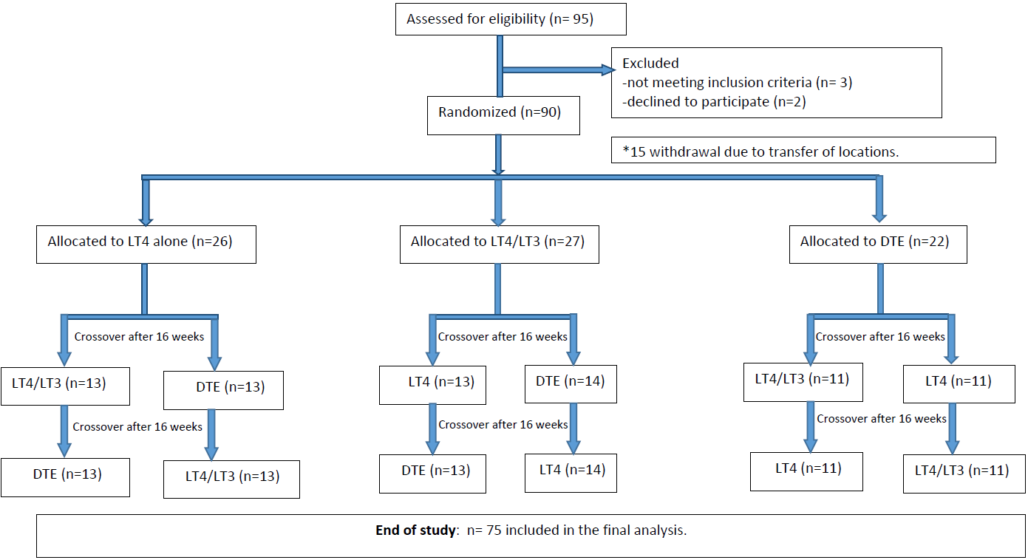
Huang 2021 Endocrine Society abstract

Slide 23
Results
Overall, 45% of patients indicated they preferred desiccated thyroid as their first choice of treatment, 32% preferred LT4/T3 as their first choice, and 23% preferred LT4 alone.
There was no significant difference between the 3 arms on the thyroid symptom questionnaire (p=.32).
For the secondary endpoints of weight, general health, depression (assessed using the Beck Depression Inventory), memory (Wechsler Memory Scale), lipids, and thyroid function, again, there were no significant differences between groups in any of the measures.
Polymorphisms did not affect outcomes

Slide 24
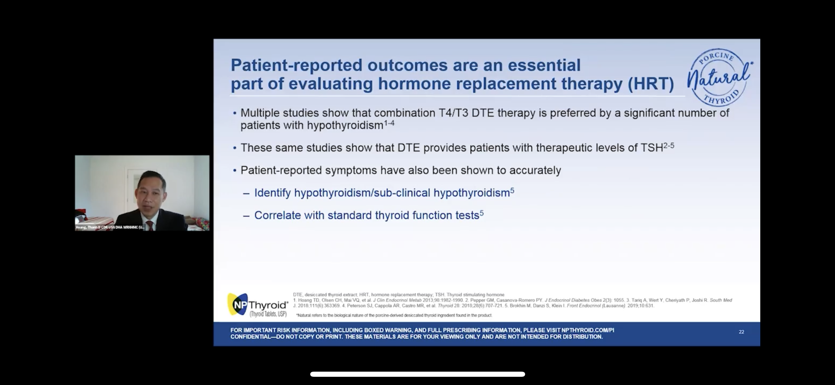
Hoang gave a Product talk at the 2021 Endocrine Society
Sponsored by Acella
Well-attended
Advocated for once a day desiccated thyroid use
Advocated for monitoring TSH
Mentioned several other articles showing increased patient satisfaction on desiccated thyroid.

Slide 25
Hoang’s comments
Subgroup analysis based on the scores of symptom questionnaires, we found that symptomatic patients on LT4 improved while being treated with LT4/T3 or desiccated thyroid
Reports of improvements in switching to desiccated thyroid were notable, Hoang added. "Many patients when switched from LT4 to desiccated thyroid extract said they felt much better, [with] more energy, less mental fogginess, a better outlook, less flair of lupus symptoms, easier to lose weight, etc."

Slide 26
Dr. Friedman’s comments
Advantage of the study is that it was blinded.
Small number of participants, but clearly desiccated thyroid was more preferred with a low number preferring L-T4 alone.
Didn’t pick patients specifically with hypothyroid symptoms.
Probably those with hypothyroid symptoms will likely have more pronounced.
Desiccated thyroid should be given twice a day, this was only once a day.
Huang gives desiccated thyroid to have a normal TSH, Dr. Friedman aims for a normal to high freeT4 and freeT3 and can have a suppressed TSH.

Slide 27
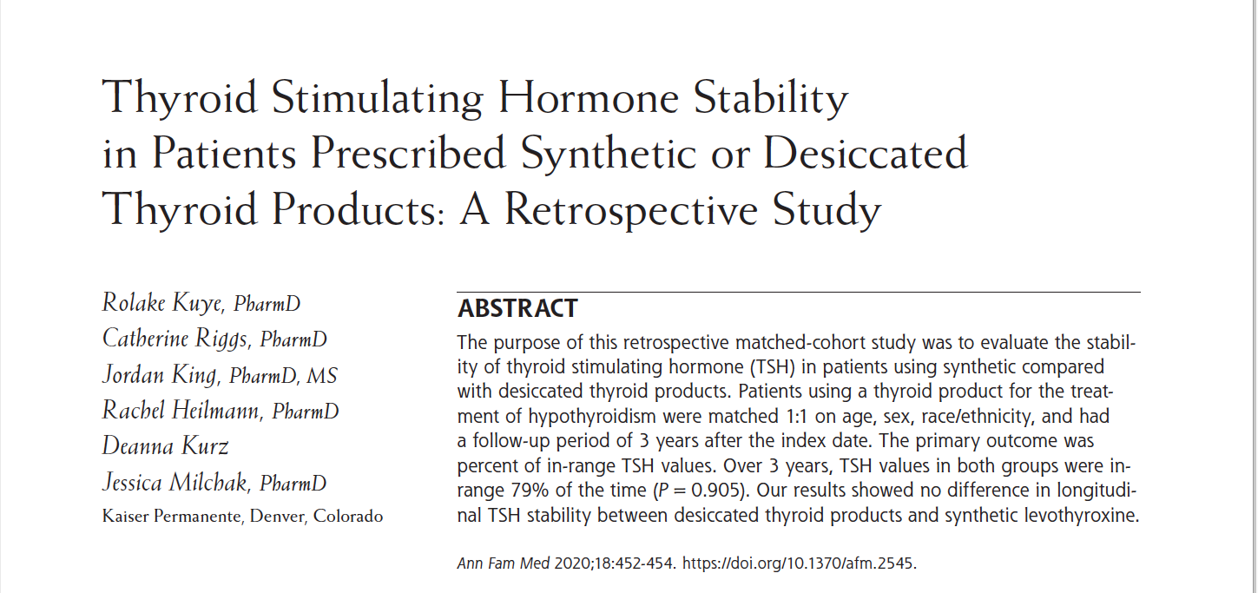
Desiccated Thyroid Articles

Slide 28
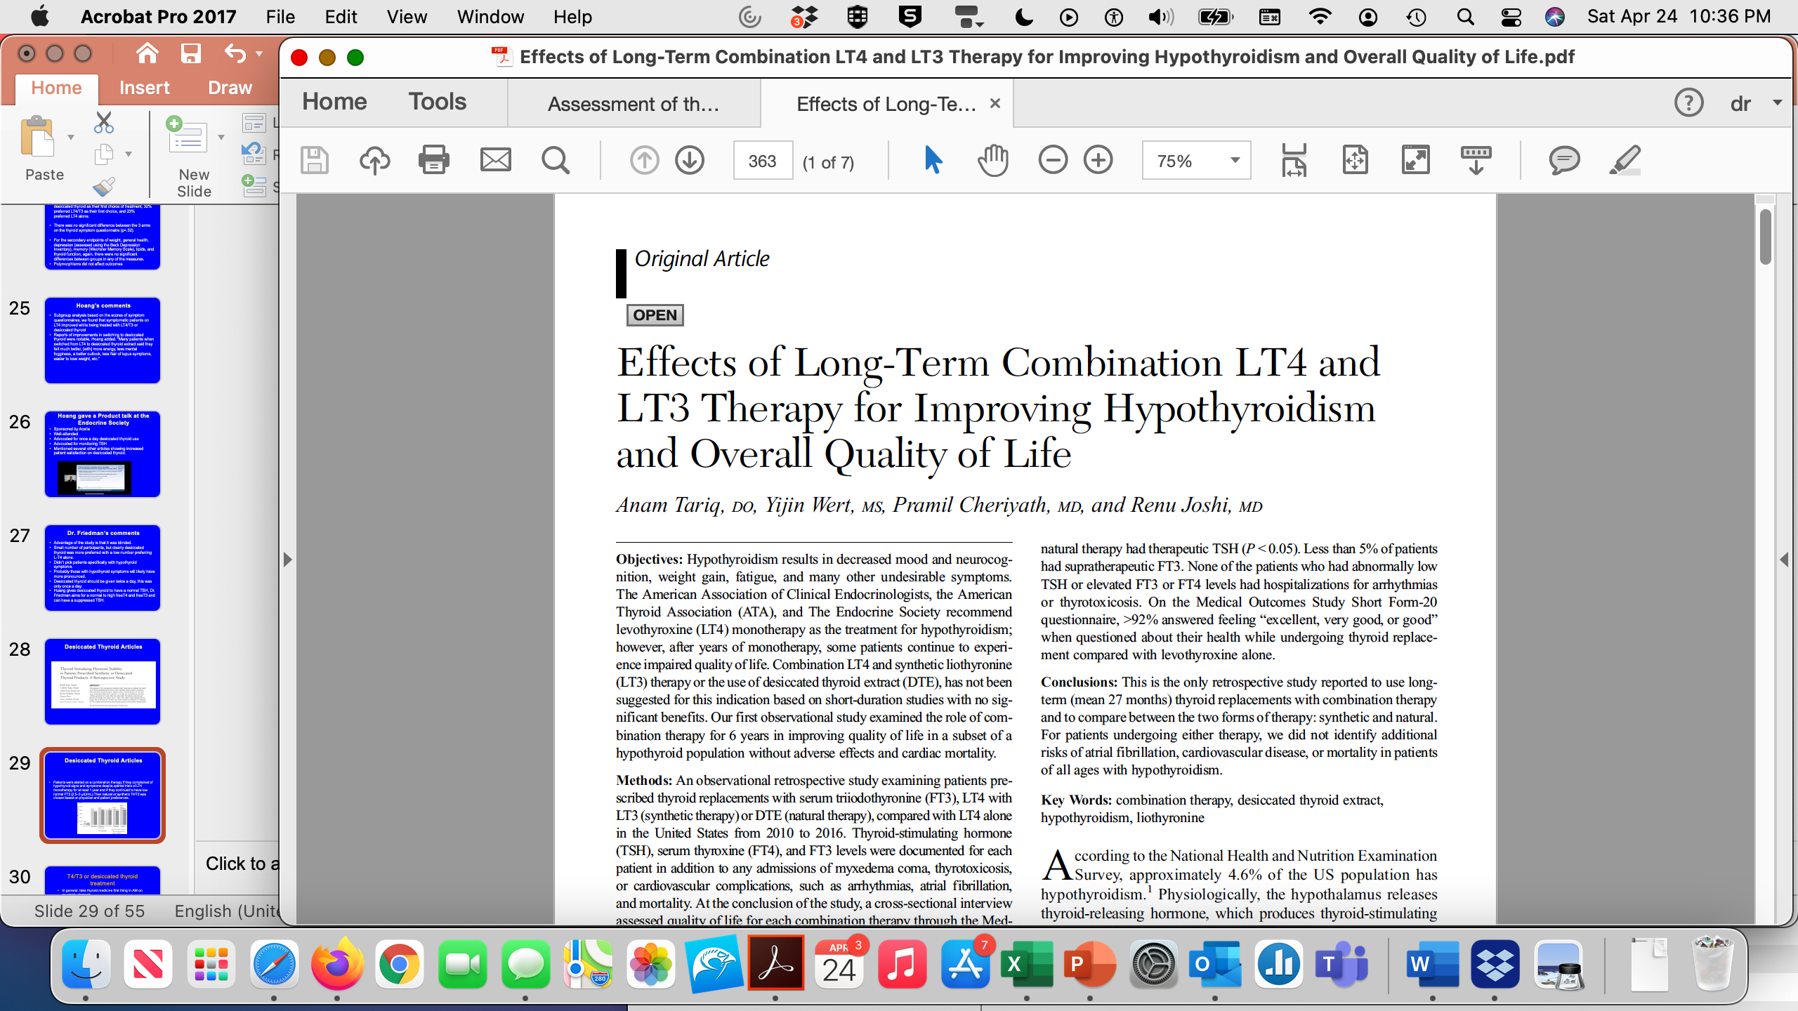
Desiccated Thyroid Articles
Southern Medical Journal • Volume 111, Number 6, June 2018
Patients were started on a combination therapy if they complained of hypothyroid signs and symptoms despite optimal trials of LT4 monotherapy for at least 1 year and if they continued to have low normal FT3 (2.5–3 μIU/mL).Then natural or synthetic T4/T3 was chosen based on physician and patient preferences.

Slide 29
Desiccated Thyroid Articles
Southern Medical Journal • Volume 111, Number 6, June 2018
In our subset population, the symptoms of hypothyroidism improved significantly with no increase in hyperthyroidism.
The abnormally low TSH and elevated FT4 and FT3 levels persisted only for a short duration because of dosage adjustments and varied among patients.
We did not find any difference in levels in patients according to the etiology of hypothyroidism.

Slide 30
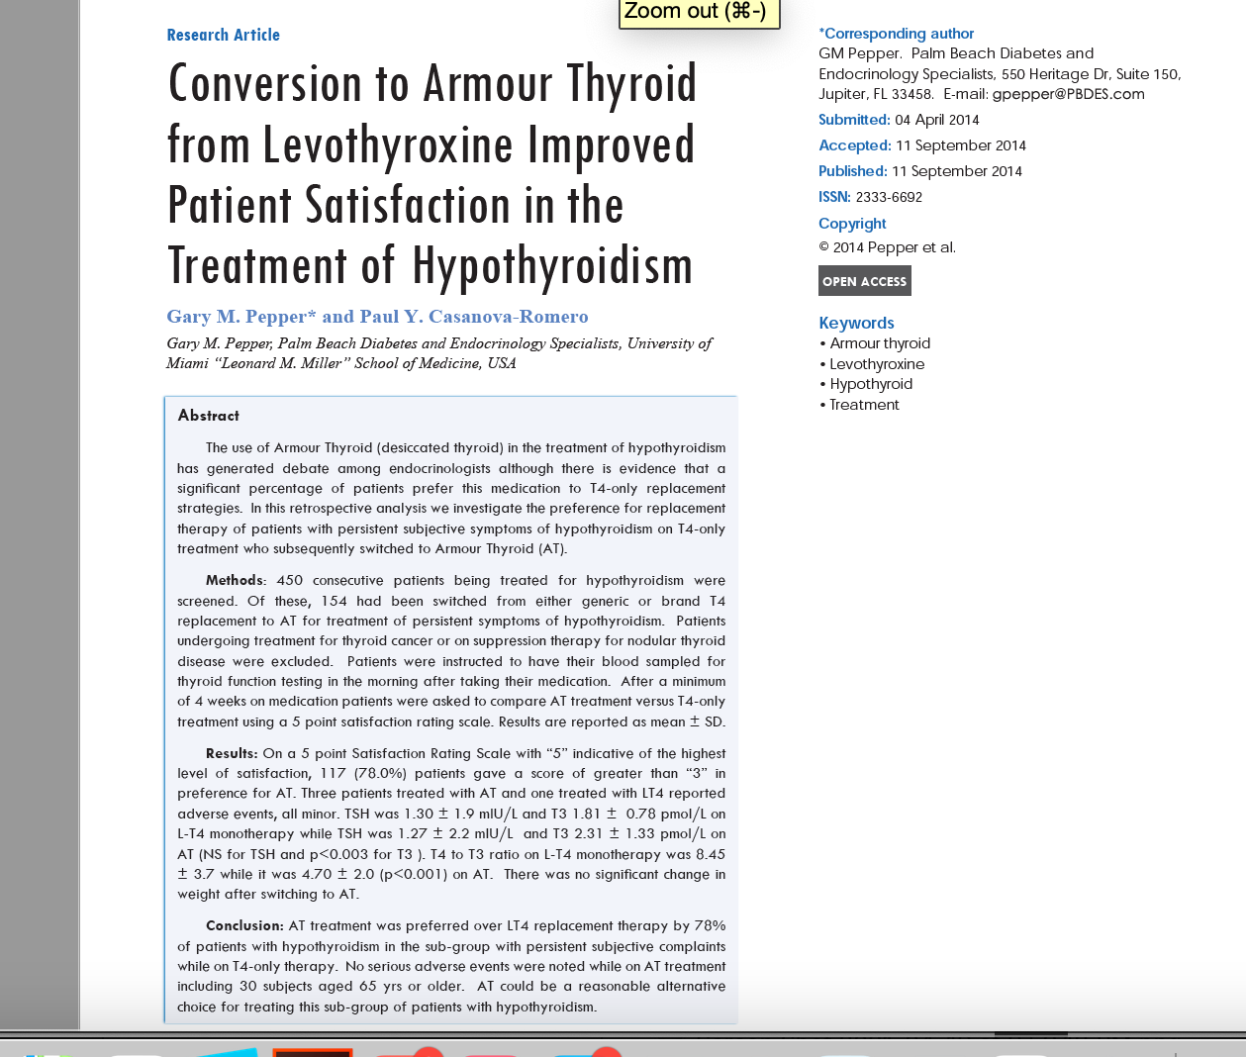
Desiccated Thyroid Articles

Slide 31
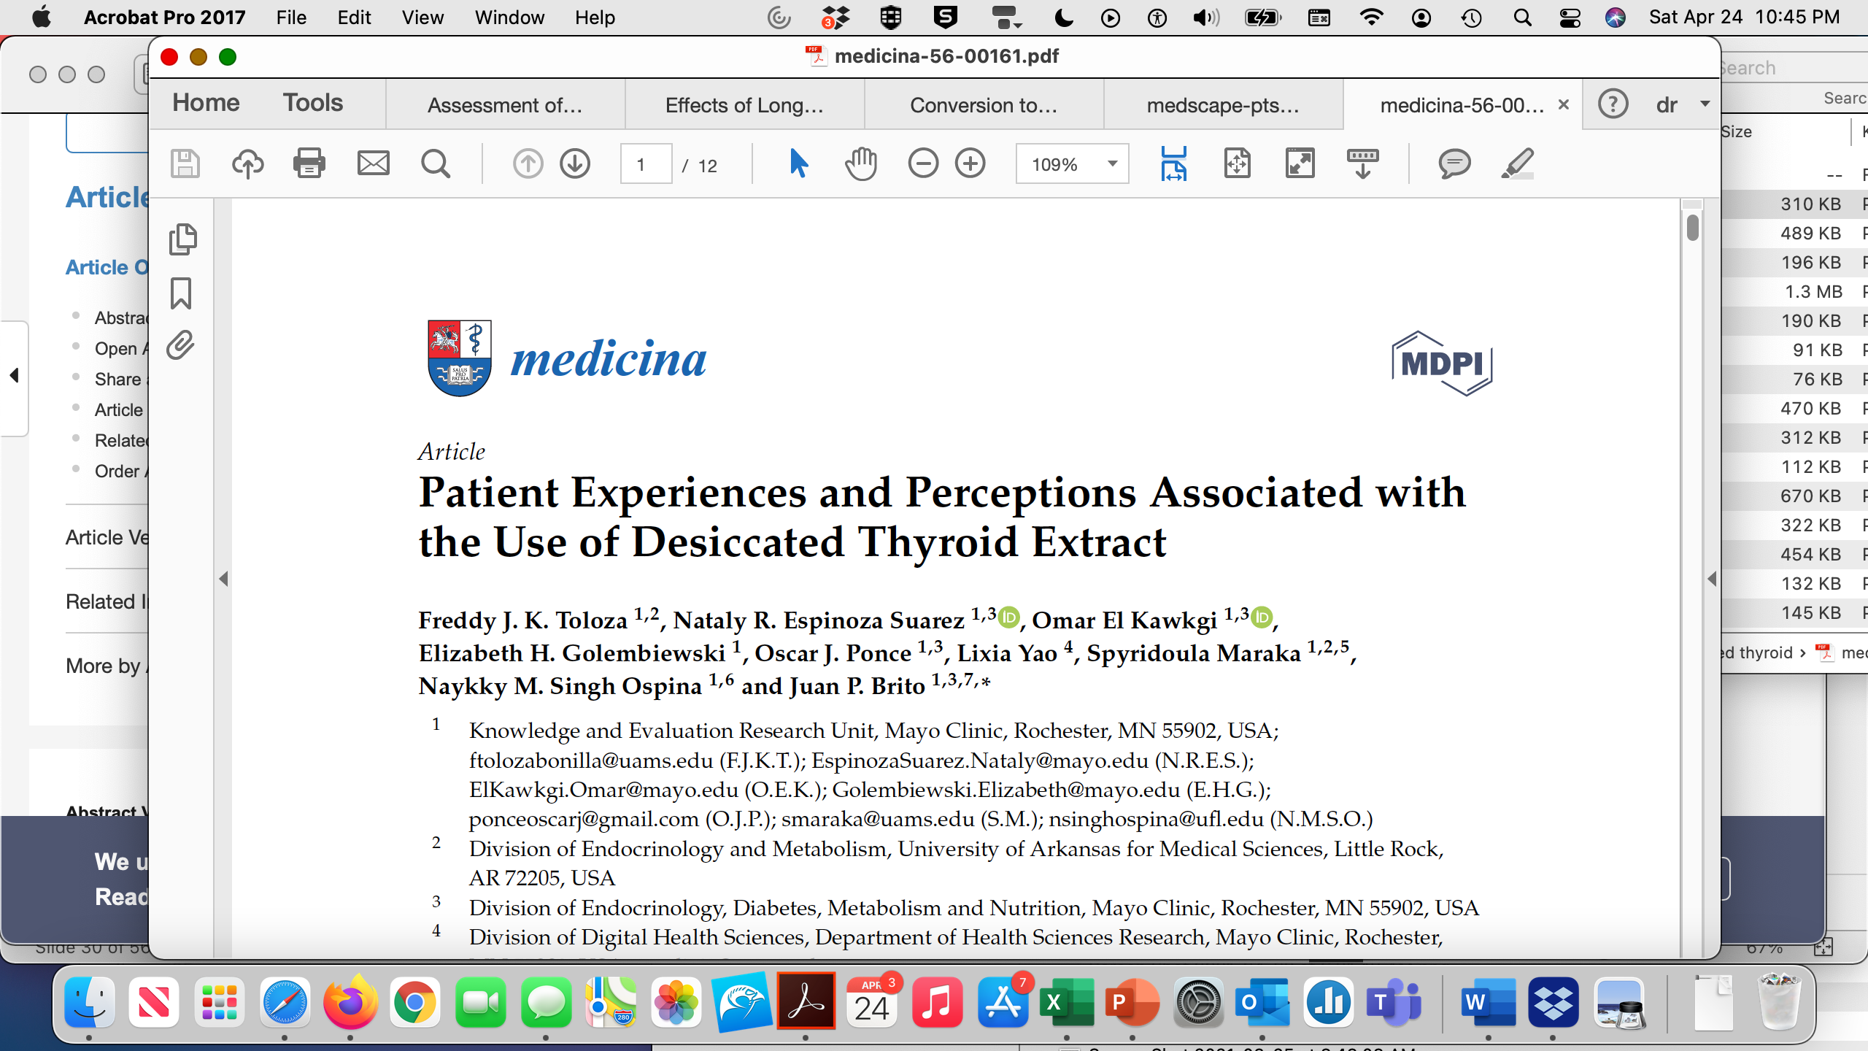
Desiccated Thyroid Articles
They conducted a mixed-methods study by evaluating the content of online posts from three popular hypothyroidism forums from patients currently taking DTE (n = 673).

Slide 32
Desiccated Thyroid Articles
Nearly half (46%) of the patients reported that a clinician initially drove their interest in trying DTE.
Patients described many reasons for switching from a previous therapeutic approach to DTE, including lack of improvement in hypothyroidism-related symptoms (58%) and the development of side effects (22%).
The majority of patients described DTE as moderately to majorly effective overall (81%) and more effective than the previous therapy (77%).
The most frequently described benefits associated with DTE use were an improvement in symptoms (56%) and a change in overall well-being (34%).
One-fifth of patients described side effects related to the use of DTE.

Slide 33
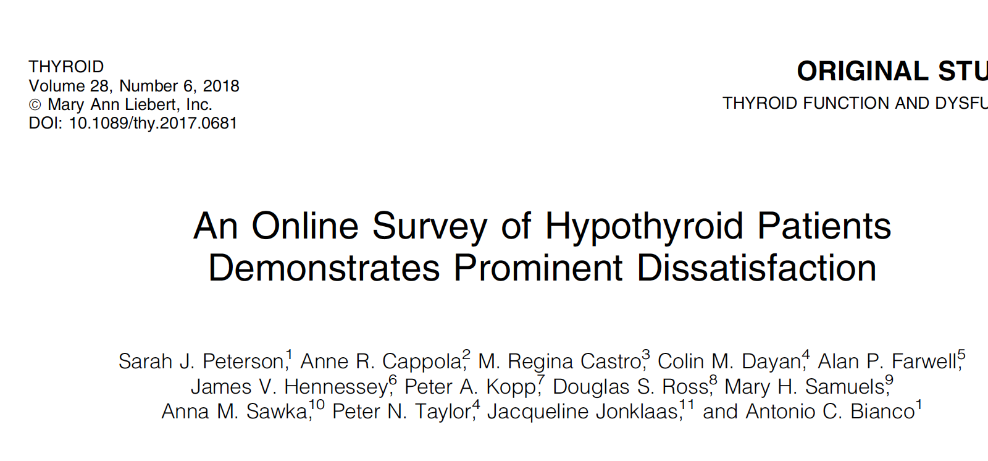
Desiccated Thyroid Articles
Methods: An online survey for hypothyroid patients was posted on the American Thyroid Association Web site and forwarded to multiple groups.
Respondents were asked to rank satisfaction with their treatment for hypothyroidism and their treating physician
Respondents reported the therapy they were taking, categorized as LT4, LT4 and liothyronine (LT4 +LT3), or desiccated thyroid extract (DTE).

Slide 34
Desiccated Thyroid Articles
Individuals taking DTE reported a higher median treatment satisfaction of 7 (IQR = 5–9) compared to other treatments.
At the same time, the LT4 treatment group exhibited the lowest satisfaction of 5 (IQR = 3–7), and for the LT4 + LT3 treatment group, satisfaction was 6 (IQR = 3–8).
Respondents taking DTE were also less likely to report problems with weight management, fatigue/energy levels, mood, and memory compared to those taking LT4 or LT4 + LT3.

Slide 35
Summary Desiccated Thyroid Articles
7 peer-reviewed articles (some good and some not so good journals) showed that DTE was preferred over L-T4 and some articles over L-T4/L-T3
No studies showed L-T4 was better than desiccated thyroid
Side effects including hyperthyroidism were minimal
Bottom Line: Patients feel better on desiccated thyroid.
https://www.medscape.com/viewarticle/928573

Slide 36
Is there a problem with a low TSH?
Probably not (heart and bones main problem)
Urine N-telopeptide looks at bone turnover.
The values reported are the urine N-telopeptide concentration in nmol BCE (bone collagen equivalents) over the concentration of creatinine in mg/dL and the range at LabCorp is 5 to 65.
I do every 6-12 months, aim for less than 60
Atrial fibrillation, unlikely in a younger person, use caution with desiccated thyroid in an older patient

Slide 37
T4/T3 or desiccated thyroid treatment
In general, take thyroid medicine first thing in AM on an empty stomach (45 min from food)
If on twice a day treatment, take 2nd dose in mid- afternoon
Avoid taking with
  Iron
  Calcium
  Vitamins with iron or calcium
  Proton pump inhibitors, carafate, oral bisphosponates (Fosamax), orlistat, cholestyramine
Minor effect of soy

Slide 38
Hypothyroidism Treatment-Armour Thyroid
Armour Thyroid has been in use for almost 100 years (since the 1920s) although it went out-of-favor about 30 years ago with more doctors prescribing synthetic levothyroxine.
However recently there has been an added interest in using Armour Thyroid and other formulations of desiccated thyroid, partly because of the low quality-of-life some patients have on levothyroxine replacement and partly because of an interest in patients to use something they consider “more natural” and less synthetic.
Most endocrinologists and consensus guidelines by the American Thyroid Association still recommend the use of synthetic levothyroxine and to avoid desiccated thyroid, in part due to the erroneous belief that desiccated thyroid is not standardized.

Slide 39
Hypothyroidism Treatment-Armour Thyroid
A Study of Armour® Thyroid Compared to Synthetic T4 (Levothyroxine) in Previously Hypothyroid Participants
ClinicalTrials.gov Identifier: NCT04124705
Started in 2019
Funded by Allergan

Slide 40
Hypothyroidism Treatment-NP thyroid
NP thyroid made by Acella is an excellent product and readily available
Recalled in 2020, but not since
In 2021, CVS made a business decision not to stock NP thyroid saying it is on backorder
But it is now readily available

Slide 41
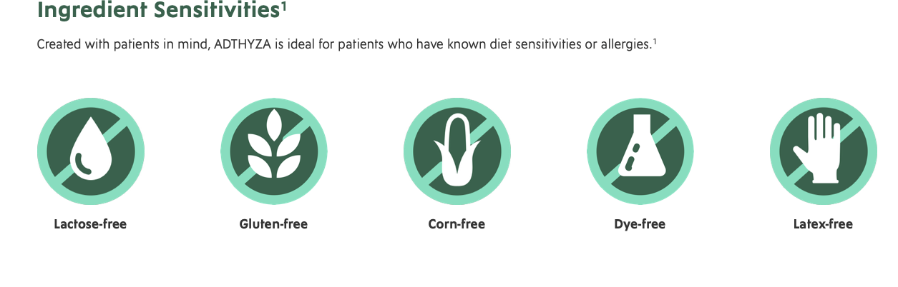

Hypothyroidism Treatment- Adthyza
Adthyza is made by Azurity and came out in 2023. It’s a desiccated thyroid product that comes in 16.25 mg, 32.5 mg, 65 mg, and97.5 mg, 130 mg
I think it will be a game changer as it’s a major company that focuses on innovative products that meet the needs of patients with underserved conditions
The potencies of both T₄ and T₃ in ADTHYZA are confirmed with LC assays to ensure the product meets USP specification standards
Each lot is individually tested (you can enter your lot number) (important because prior recalls were due to variation in thyroid potency by lots)
It looks like its covered by insurance (may need a pre-auth)

Slide 42
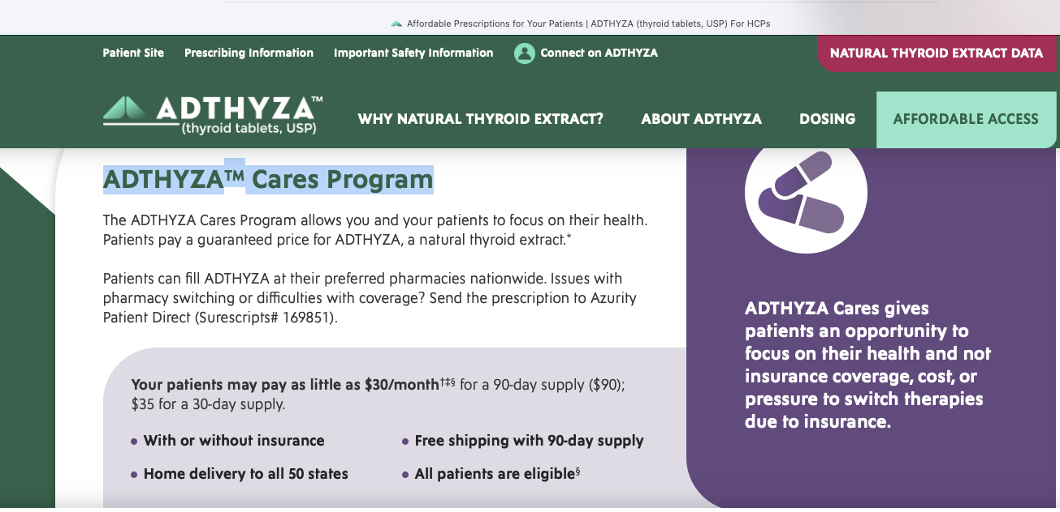
ADTHYZATM Cares Program

Slide 43
Tirosint
Gel capsule with almost no binders or fillers.
Less interference with medicines.
Doesn’t need acid in stomach for absorption (can take with antacids)
Expensive and often not covered by insurance.
Fixed dose liquid also available
Can start with the lowest dose of liquid (13 mcg), put in a glass of water and take only part of the glass and titrate up
Is available as 13 mcg, 25 mcg, 37.5 mcg, 44 mcg, 50 mcg, 62.5 mcg, 75 mcg, 88 mcg, 100 mcg, 112 mcg, 125 mcg, 137 mcg, 150 mcg, 175 mcg, and 200 mcg strength capsules

Slide 44
Generic Tirosint
Made by Lannett that also make Unithroid
It is also a gel capsule that only contains levothyroxine, gelatin, glycerin and water.
There are no dyes and it is gluten and lactose free.
It is manufactured in Switzerland with similar dosing
Unclear if the price is less than brand Tirosint

Slide 45

Thyquidity
Oral solution 100 mcg/5 mL
Inactive ingredients include citric acid monohydrate, glycerin, methylparaben sodium, sodium hydroxide and purified water.
Made by Vertice Specialty Group
THYQUIDITY enables gradual dose adjustments
The use of a calibrated oral syringe can help meet your patients’ unique needs
THYQUIDITY is gluten-free, sulfur-free, and lactose-free
THYQUIDITY is supplied in a package of two 100 mL bottles
Can get a co-pay and savings card at https://www.thyquidity.com/resources

Slide 46
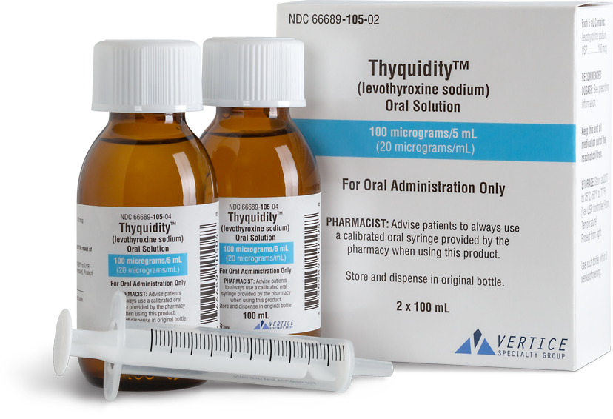
Thyquidity

Slide 47
Hypothyroidism-T3 alone treatment
The brand name of T3 is called Cytomel and the generic is called liothyronine.
Celi et al. (JCEM, 2011, 96:3466-74) found that patients on L-T3 alone had lower weight and better lipid profiles than those on L-T4 alone.
I frequently uses different combinations of thyroid medicine, including T4/T3 combinations and desiccated thyroid.
However, some more alternative doctors are prescribing only T3 to patients.

Slide 48
Hypothyroidism-T3 alone treatment
I recommend against this for several reasons.
First of all, several studies have shown that T4 gets into the brain much better than T3 does, and once it's in the brain the T4 can get converted to T3.
Therefore, in patients only on T3, the level of thyroid hormone in the brain might be quite low.
Additional, T4 has a long half-life and acts as a reservoir, while T3 has a short half-life and needs to be given several times a day if it is not in combination with T4.

Slide 49
Hypothyroidism-T3 alone treatment
I also thinks it is un-physiological to have a very low T4 level, which is what happens if someone is only taking T3.
If someone was misdiagnosed and really did not have hypothyroidism or has very mild hypothyroidism, the T4 could still be detectable (or even normal) when on only T3.
I usually do not give T3 alone treatment as I like the long acting “reservoir” of the T4 along with the shorter acting “boost” T3 effect.

Slide 50

Update on desiccated thyroid recalls-Mary Shomon
https://maryshomon.medium.com/whats-really-going-on-with-the-fda-and-natural-desiccated-thyroid-drugs-5b8448987c8

Slide 51
There are three companies making NDT drugs in the U.S.: two are small companies:
There are three companies making NDT drugs in the U.S.: two are, as noted, small companies:
Acella, which makes NP Thyroid, has less than 200 employees, and around $120 million in annual revenue.
RLC, which makes WP Thyroid and Nature-throid, has less than 50 employees, and around $30 million in annual revenue.
AbbVie, which makes Armour Thyroid, employs about 30,000 people in 75 countries, and has annual revenue of around $30 billion — yes, billion — a year. This global pharma behemoth also has huge armies of drug reps, marketing teams, and lobbyists on staff. Note that AbbVie only recently acquired Allergan — and Armour.
AbbVie also manufactures the best-known brand of levothyroxine: Synthroid

Slide 52
Price
Synthroid has the highest retail price of any brand-name levothyroxine tablet.
Armour Thyroid has the highest retail price of any natural desiccated thyroid drug.
AbbVie’s two thyroid drugs, in fact, frequently have a retail price that is more than double other brand names.
AbbVie PAC has donated almost $1.5 million to candidates during the 2020 election cycle.
The FDA may decide NDT a “new drug,” and all the NDT drugs will have to go through the new drug application (NDA) approvals process
The FDA letters to Acella and RLC also indicated that the FDA intends to change the designation of NDT drugs to define them as “biologics.”

Slide 53
Biologics
September 16, 2022 FDA sent a letter to National Association of Boards of Pharmacy (NABP) that DTE products “can put patients at harm” and that “therapies containing DTE are biological products subject to licensure under Section 351(i) of the PHS Act.” The letter encourages NABP to share the letter with its members, the state boards of pharmacy
Alliance for pharmacy compounding expressed concerned that FDA is implementing a sort of back-door restriction of compounded DTE that is problematic in its rationale and is communicating it by a novel approach – a letter from a CDER branch chief to the association of state boards of pharmacy – rather than a definitive industry communication
If biologic, likely to be very expensive and require extensive FDA documentation
The fact that Adthyza is on the market, makes me think this isn’t going to happen

Slide 54
T4 to T3 or Reverse T₃ (rT₃)
Most of the circulating T₃ is derived from 5′-deiodination of circulating T₄ in the peripheral tissues by type 1 deiodinase.
Deiodination of T₄ can occur at the outer ring (5′-deiodination), producing T₃ (3,5,3′-triiodothyronine), or at the inner ring, producing reverse T₃ (3,3,5′-triiodothyronine) by type 3 deiodinase.
Type 2 deiodinase in the pituitary also converts T₄ to T₃ and is regulated differently from type 1 deiodinase.

Slide 55
T4 to T3 or Reverse T₃ (rT₃)
Reverse T₃, a biologically inactive form of T₃ may block T₃ from binding to the thyroid hormone receptor.
Many years ago, endocrinologists realized that in severe illness, type 3 deiodinase increases and rT₃ is often high and T₃ is often low. Endocrinologists termed this “sick euthyroid syndrome” and noted that it was common in many types of chronic illnesses, especially in patients hospitalized in intensive care units.
It was usually recommended that these patients not be treated with thyroid hormone and in most cases, the elevated rT₃ resolved when the patient’s health returned.

Slide 56
T4 to T3 or Reverse T₃ (rT₃)
However, more recently, more alternative doctors, now called functional medicine doctors, have made quite an issue about rT₃.
They argue somewhat appropriately that high rT₃ is bad and can block T₃ from binding to the thyroid hormone receptor.
They also state that rT₃ can go up in various conditions including systemic illness, stress, inflammation, chronic pain, dieting, weight gain, and depression.
They often quote articles showing that these diseases are correlated with a high rT_{3,} but do not necessarily show that the rT₃ plays a significant role in the disease.

Slide 57
Reverse T₃
These functional medicine doctors rely extremely heavily on rT₃ to treat patients that may have no other laboratory findings of hypothyroidism and often prescribe them T₃-only preparations to try to lower the rT₃.
They have not published on whether this is effective or not, and may treat a person with completely normal thyroid function tests and put him on T₃ to try to lower the rT₃.
They often use a high rT₃: T₃ ratio as further indication to treat these patients.

Slide 58
T4 to T3 or Rt3

Slide 59
Reverse T₃ study
We retrospectively analyzed rT₃ in 976 consecutive patients who came to see me with potential thyroid problems.
All of these had signs and symptoms of hypothyroidism, and many of them were already treated with different thyroid preparations.
I used the upper limit of normal for rT₃ at either Quest or Labcorp, which is usually 24 ng/dL.
I did not calculate any type of ratios.

Slide 60
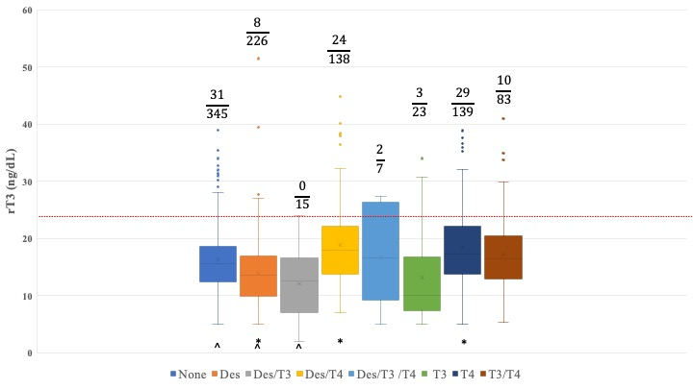
Reverse T₃ in patients with hypothyroidism on different thyroid hormone replacement
Julian B. Wilson, Maayan Epstein, Martin L. Lee, Theodore C Friedman¹
976 consecutive patients
IRB approved

Slide 61
Table 1. Effect of L-T₄ treatment on rT₃ levels.
 | All groups on L-T₄ treatment | All groups not on L-T₄ treatment | p-value
rT₃ (Mean ± SD) | 18.4 ± 7.1 | 15.2 ± 6.0 | <0.00001*
% with rT₃ >24.1 | 65/367 (17.7%) | 42/609 (6.9%) | p=1.63 x 10⁻⁷^
* Wilcoxon rank-sum test, ^chi-square test for homogeneity

Slide 62
Reverse T₃ Results
The number of patients with rT₃ levels above normal range varied significantly with the type of thyroid hormone replacement.
The highest rate of an elevated rT₃ was 21% (29/139) in patients taking T₄ alone.
9% (31/345) of patients not taking thyroid hormone replacement had elevated rT₃ values.
In contrast, only 4% (8/226) of patients taking desiccated thyroid hormone had above normal rT₃ values, compared to to 12% (10/83) of patients taking a T₃-T₄ combination and 17% (24/138) of patients taking desiccated thyroid-T₄ combination.
Patients on all types of L-T₄ treatment had higher rT₃ levels than those not on L-T₄ treatment (p < 0.0001) and a higher percent of rT₃ levels above the cutoff of 24.1 ng/dL (p < 0.0001).
Linear regression analysis showed rT₃ levels strongly correlated with free T₄ levels, but not free T₃ or TSH levels.

Slide 63
Reverse T₃ Results
I did not look at whether high rT3 was correlated with hypothyroid symptoms
I have patients with a high rT3 that are doing well and those with a low rT3 that are not.

Slide 64
Reverse T₃ study-conclusions
Measuring rT₃ may be helpful in some patients, especially those already on thyroid treatments that contain T₄.
Patients that do have an elevated rT₃ on thyroid treatment with either L-T4 alone or L-T4 plus desiccated thyroid may benefit from decreasing the amount of L-T4 given and increasing the amount of L-T3 or the desiccated thyroid given.

Slide 65
Reverse T₃ Conclusions
The area of rT₃ is clearly an interesting area, and there is a clear division between endocrinologists who do not measure all and the functional doctors who measure it in almost everybody and treat almost everybody for it.
The test can be helpful in certain patients, but some discretion needs to be used in who gets thyroid medicine (especially for the rest of their life) and who does not.

Slide 66
Biotin and thyroid tests
ATA states that biotin use can result in falsely high levels of T₄ and T₃ and falsely low levels of TSH, leading to either a wrong diagnosis of hyperthyroidism or that the thyroid hormone dose is too high.
The ATA has recommended that patients stop taking biotin for at least 2 days before thyroid testing to avoid the risk of having a misleading test.
Mostly case reports
Only if taking 20 mg or a day of biotin
Most supplements of biotin contain 10,000 mcg=10 mg a day
Most people will be ok
Could hold biotin for 2 days before testing

Slide 67
Biotin and thyroid tests
From Quest: TSH, freet4, freeT3 not on list

Slide 68


Thyroid Diet
A Thyroid Diet is a Clean Diet, just like I recommend for all my patients
Lots of fruits and vegetables
Limit processed foods
Limit simple carbohydrates
Otherwise little data on any specific diet for patients with thyroid disease

Slide 69
Thyroid Diet: Not proven
Functional doctors often promote diets to address “leaky-gut” a condition not recommended by the physicians
Anti-inflammatory- review articles on Hashimoto’s do not consider it a disease of inflammation
Gluten-free- myth
The Thyroid Diet: Is There Such a Thing?
  Angela M. Leung, MD, MSc
  https://www.medscape.com/viewarticle/901118#vp_4

Slide 70
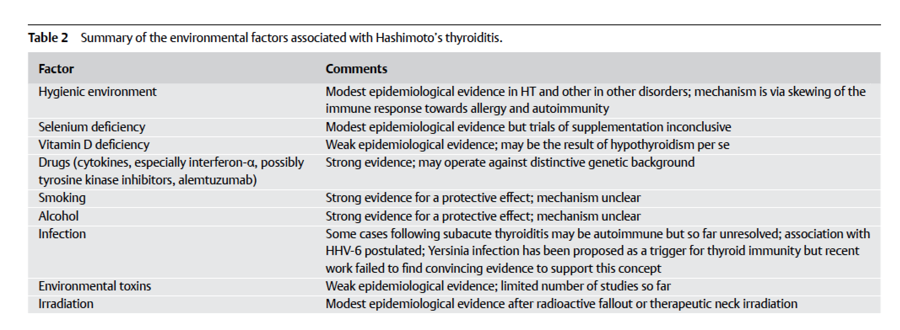
Hashimoto’s and diet
No discussion of inflammation
No discussion of gluten

Slide 71
Hypothyroidism-selenium
Selenium (200 mcg/day) increases T4 to T3 conversion and reduces TPO antibody levels.
Patients with untreated GH deficiency have decreased T4 to T3 conversion, so they are likely to benefit from selenium (but also benefit from GH treatment)
Selenium appears to increase the rate of diabetes.
I am cautious about giving selenium in those patients with prediabetes or diabetes or those with a family history of diabetes.

Slide 72
Thyroid Diet
Healthy diet
Exercise
Have your hypothyroidism properly treated

Slide 73

Visit goodhormonehealth.com
For more information or to schedule an appointment.
Talk will posted in a few days
mail@goodhormonehealth.com
Special thanks to social media expert Tiffany Sanders

