Slide 1



Theodore C. Friedman, M.D., Ph.D.
(the Wiz)
Professor of Medicine-UCLA
Chairman, Department of Internal Medicine
Charles R. Drew University
Dr. Friedman’s Endocrinology Clinic
Updates on Treating Hypothyroidism
GoodHormoneHealth Webinar
April 25, 2021

Slide 2
Outline
Which thyroid medicine is the best?
What is the difference between desiccated thyroid and synthetic thyroid hormones?
New articles showing patients prefer desiccated thyroid
T3 alone?
New thyroid hormone preparations
Update on desiccated thyroid recalls
Is rT3 important?
Is diet important in patients with hypothyroidism?

Slide 3
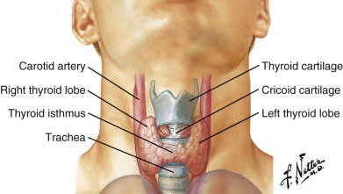
Thyroid

Slide 4
Hypothyroidism Treatment
Many options for thyroid hormone replacement.
L-T4 alone (Levothyroxine, Synthroid, Levoxyl, Tirosint, Unithroid)
L-T4 gel capsules-Tirosint, generic Tirosint, Thyquidity
L-T3 (Cytomel, liothyronine) alone
L-T4/L-T3 combinations
Desiccated thyroid (Armour, NatureThroid, WP thyroid, Erfa)-from pig thyroid. Often called Natural Desiccated Thyroid (NDT) or Desiccated Thyroid Extract (DTE)
Thyrogold-New Zealand cows
Desiccated thyroid/L-T4 combinations
Proper treatment needs to be individualized (not one blood pressure medicine).
Multiple studies have shown poor quality of life among patients on L-T4 replacement alone

Slide 5
Hypothyroidism-T4/T3 treatment
Some but not all studies show a benefit of L-T4/L-T3 treatment over L-T4 alone.
Large study in Italy (Gullo, PLoS One, 2011, 6:e22552) found that in patients without a thyroid given L-T4 replacement, 15% had a low serum fT3 level, but normal TSH levels.
This suggests that certain patients have a different setpoint for TSH secretion and that some patients need L-T4/L-T3 treatment to achieve normal freeT3 and freeT4 levels.
It supports measuring freeT3 and freeT4 in patients on treatment.
It also supports replacing T4 and T3 either by combination treatment or with desiccated thyroid

Slide 6
Hypothyroidism Treatment-Polymorphism
About 16% of patients have a polymorphisms (change in DNA) in their type 2 deiodinase that converts T4 to T3 (Panicker et al, JCEM, 2009, 94:1623-1629).
The patients with this polymorphism required higher T4 dosing and had more psychological problems than those that did not have the deiodinase polymorphism.
They did not examine whether these patient would benefit from T4/T3 combination and also did not actually measure the enzyme, they only looked at the gene coding for this enzyme.

Slide 7
Hypothyroidism Treatment-T4/T3 combination treatment
These 2 intriguing papers challenge the idea that all patients with hypothyroidism should be treated with T4.
I use different thyroid medicines to treat patients with hypothyroidism including T4/T3 combinations, and desiccated thyroid that contains T4 and T3.
I interpret this data that the many but not all of hypothyroid patients do fine on T4 alone (I currently take a T4/T3 combination).
As discussed later, T4 therapy can lead to high rT3 which can be detrimental
Approximately 15-20% of the population does need T4/T3 combination to have an optimal effect on the thyroid.
These patients are the vocal minority who are not doing well on T4 treatment and would benefit from seeing a thyroid specialist like myself

Slide 8
Hypothyroidism Treatment-Armour Thyroid
Armour Thyroid has been in use for almost 100 years (since the 1920s) although it went out-of-favor about 30 years ago with more doctors prescribing synthetic levothyroxine.
However recently there has been an added interest in using Armour Thyroid and other formulations of desiccated thyroid, partly because of the low quality-of-life some patients have on levothyroxine replacement and partly because of an interest in patients to use something they consider “more natural” and less synthetic.
Most endocrinologists and consensus guidelines by the American Thyroid Association still recommend the use of synthetic levothyroxine and to avoid desiccated thyroid, in part due to the erroneous belief that desiccated thyroid is not standardized.

Slide 9
Hypothyroidism Treatment-Desiccated Thyroid
Desiccated thyroid has a higher T3/T4 ratio than the human thyroid.
Many patients on desiccated thyroid alone have high fT3, low fT4 and low TSH
Desiccated thyroid has a higher T3/T4 ratio than the human thyroid. Most patients on desiccated thyroid alone have high fT3, low fT4 and low TSH
Armour thyroid is now made by Abbvie and concern about variability of preparations and lack of standardization are unfounded.
WP thyroid is a brand of desiccated thyroid with minimal binders and fillers
NatureThroid has more fillers than WP thyroid, but still pretty pure.
Both WP thyroid and NatureThroid (made by RLC labs) have been on backorder for 2 years.

Slide 10
Hypothyroidism Treatment-NP thyroid
NP thyroid made by Acella is an excellent product and readily available
CVS made a business decision not to stock NP thyroid saying it is on backorder (which is not true).
I think it is now readily avaialbe

Slide 11
Hypothyroidism Treatment-Desiccated Thyroid
T3 has a short half-life and desiccated thyroid or T3 or should be given twice a day
Otherwise the T3 is gone from your system and you are hypothyroid in the evening and next morning
2nd dose can be around 2-3 PM
There may be other components of thyroid missing in synthetic preparations.
I usually give desiccated thyroid in a twice a day, especially in patients with a poor quality of life on L-T4 alone.

Slide 12
Hypothyroidism Treatment-Desiccated Thyroid- JCEM article
In the May 2013 issue of Journal of Clinical Endocrinology and Metabolism http://www.ncbi.nlm.nih.gov/pubmed/23539727, Huang and colleagues from the Walter Reed Medical National Military Medical Center in Bethesda, Maryland published the results of a randomized crossover study in which 70 patients completed the study and received either desiccated thyroid or levothyroxine replacement.
In the introduction to this paper they commented that the T4 and T3 content of desiccated thyroid preparations, especially Armour Thyroid, has now been standardized.
They cited a paper by JC Lowe published in the journal Thyroid Science in 2009 states that it is that Armour Thyroid has indeed been standardized so that 1 grain of Armour Thyroid contains 38 mg of L-T4 and 9 mg of liothyronine (T3).

Slide 13
Hypothyroidism Treatment-Desiccated Thyroid- JCEM article
Patients were on a stable dose of levothyroxine and had a normal TSH before the study started.
78 patients were randomized and 70 concluding the study, with 35 received Armour Thyroid at the beginning and 35 received levothyroxine at the beginning.
The dose of either the levothyroxine or the Armour Thyroid was adjusted after six weeks so that the TSH was between 0.5 and 3.0.
They continued on that dose for an additional 10 weeks.
After 16 weeks, patients were switched over to the other compound with the same adjustment at 6 weeks and continued for another 10 weeks.

Slide 14
Hypothyroidism Treatment-Desiccated Thyroid- JCEM article
There was not a statistical improvement in symptoms for general health questionnaires or neuropsychological testing, however there was a trend toward improvement in these tests for the group that took the desiccated thyroid compared to the levothyroxine replacement group.
There was a 2.86 pound weight loss among the group that took the desiccated thyroid compared to the levothyroxine group that was significant.
Patients on Armour Thyroid did have a slightly lower HDL level that is the good cholesterol, so that could be a potential detriment to Armour replacement.
Both total T4 and free T4 were much lower on the Armour Thyroid than on levothyroxine replacement indicating that patients on Armour Thyroid need an additional low dose of levothyroxine, as Dr. Friedman often prescribes.
rT3 was higher in the levothyroxine replacement group, which may be detrimental

Slide 15
Hypothyroidism Treatment-Desiccated Thyroid- JCEM article
Most importantly, 49% of the patients preferred Armour Thyroid, 19% preferred levothyroxine and 33% did not notice a difference.
This was important as the study was blinded and they didn’t know which thyroid preparation they were taking and indicates some subtle improvement in how they were feeling with Armour Thyroid.
The subgroup that preferred Armour Thyroid lost even more weight; they lost 4 pounds on Armour Thyroid compared to levothyroxine.
They had better well-being and their thyroid symptoms were significantly better with better cognitive function on Armour Thyroid compared to when they were on levothyroxine.
This suggests that a subset of patients need Armour Thyroid as opposed to levothyroxine alone.
These patients may be poor converters of T4 to T3.

Slide 16
Hypothyroidism Treatment-Desiccated Thyroid- JCEM article
There were no side effects in the Armour Thyroid group; specifically there was no increase in heart rate or pulse.
The authors concluded that improvement with Armour Thyroid may not be detected by the relatively insensitive methods used in the study.
They also concluded that once-daily desiccated thyroid in place of levothyroxine caused modest weight loss and possible improvements in symptoms and mental health without appreciable adverse effects.

Slide 17
Hypothyroidism Treatment-Desiccated Thyroid- my comments
I found it to be a very well designed and well executed study done by a reputable group and published in a superb journal.
I note that the Armour Thyroid was given as a single dose once a day without levothyroxine. Since Armour Thyroid contains T3 that has a short half-life, I prescribe Armour Thyroid twice a day.
I suspect that if the study gave Armour Thyroid twice a day, those patients would have done even better than on once a day Armour Thyroid.
This study clearly refuted that Armour Thyroid is inferior to levothyroxine.

Slide 18
Hypothyroidism Treatment-Desiccated Thyroid- my comments
The study also pointed out the importance of trying to determine the subset of patients to put on desiccated thyroid.
A significant subset of patients did prefer the desiccated thyroid.
Those who preferred desiccated thyroid were more likely to have autoimmune thyroid disease and had a slightly higher reverse T3, although neither of these were significant.

Slide 19
Hypothyroidism Treatment-Desiccated Thyroid- my comments
The study examined all patients with hypothyroidism on levothyroxine replacement, most of whom were doing well.
If the study used the subset of patients who were on levothyroxine replacement and feeling poor, I surmises that they would have done even better on desiccated thyroid.
Many of the patients who come to see me have a low quality-of-life on levothyroxine replacement.
If your doctor refuses to prescribe desiccated thyroid, show him the 2013 article or better yet, come out and see me.

Slide 20
Huang 2021 Endocrine Society abstract
ENDO 2021. Abstract P51-6. Presented March 20, 2021.
Desiccated thyroid versus synthetic LT4/LT3 combination versus LT4 monotherapy in the treatment of primary hypothyroidism with special attention to the Thr92AlaD2 polymorphism
Thanh D. Hoang, Daniel Brooks, Antonio Bianco, Elizabeth McAninch, Tatiana Fonseca, Vinh Mai, Mohamed Shakir

Slide 21
Methods
This was a prospective, randomized, crossover study.
75 subjects completed the study.
There were 3 arms: DTE, LT4+T3 combination, and LT4
alone and blinded as to treatment.
Each subject was randomly allocated to one of these 3 arms for 12 weeks and then crossed over.

Slide 22
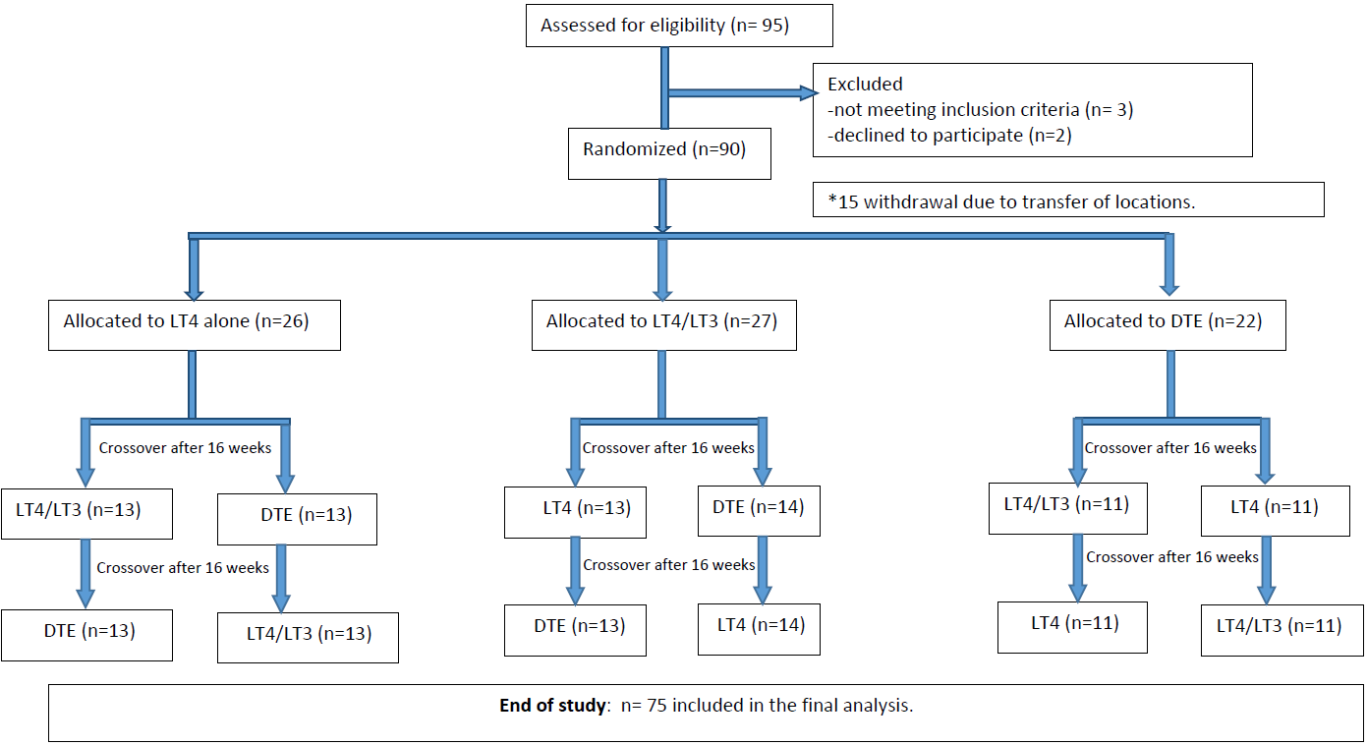
Huang 2021 Endocrine Society abstract

Slide 23
Results
Overall, 45% of patients indicated they preferred desiccated thyroid as their first choice of treatment, 32% preferred LT4/T3 as their first choice, and 23% preferred LT4 alone.
There was no significant difference between the 3 arms on the thyroid symptom questionnaire (p=.32).
For the secondary endpoints of weight, general health, depression (assessed using the Beck Depression Inventory), memory (Wechsler Memory Scale), lipids, and thyroid function, again, there were no significant differences between groups in any of the measures.
Polymorphisms did not affect outcomes

Slide 24
Hoang’s comments
Subgroup analysis based on the scores of symptom questionnaires, we found that symptomatic patients on LT4 improved while being treated with LT4/T3 or desiccated thyroid
Reports of improvements in switching to desiccated thyroid were notable, Hoang added. "Many patients when switched from LT4 to desiccated thyroid extract said they felt much better, [with] more energy, less mental fogginess, a better outlook, less flair of lupus symptoms, easier to lose weight, etc."

Slide 25
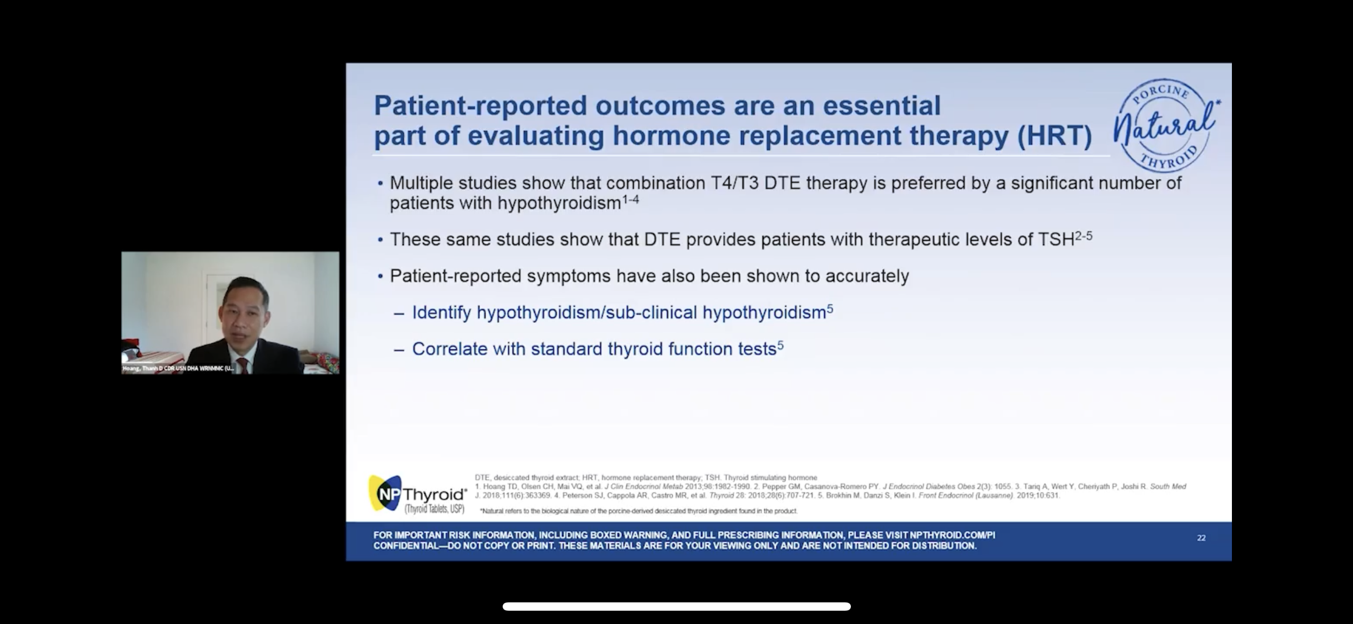
Hoang gave a Product talk at the Endocrine Society
Sponsored by Acella
Well-attended
Advocated for once a day desiccated thyroid use
Advocated for monitoring TSH
Mentioned several other articles showing increased patient satisfaction on desiccated thyroid.

Slide 26
Dr. Friedman’s comments
Advantage of the study is that it was blinded.
Small number of participants, but clearly desiccated thyroid was more preferred with a low number preferring L-T4 alone.
Didn’t pick patients specifically with hypothyroid symptoms.
Probably those with hypothyroid symptoms will likely have more pronounced.
Desiccated thyroid should be given twice a day, this was only once a day.
Huang gives desiccated thyroid to have a normal TSH, Dr. Friedman aims for a normal to high freeT4 and freeT3 and can have a suppressed TSH.

Slide 27
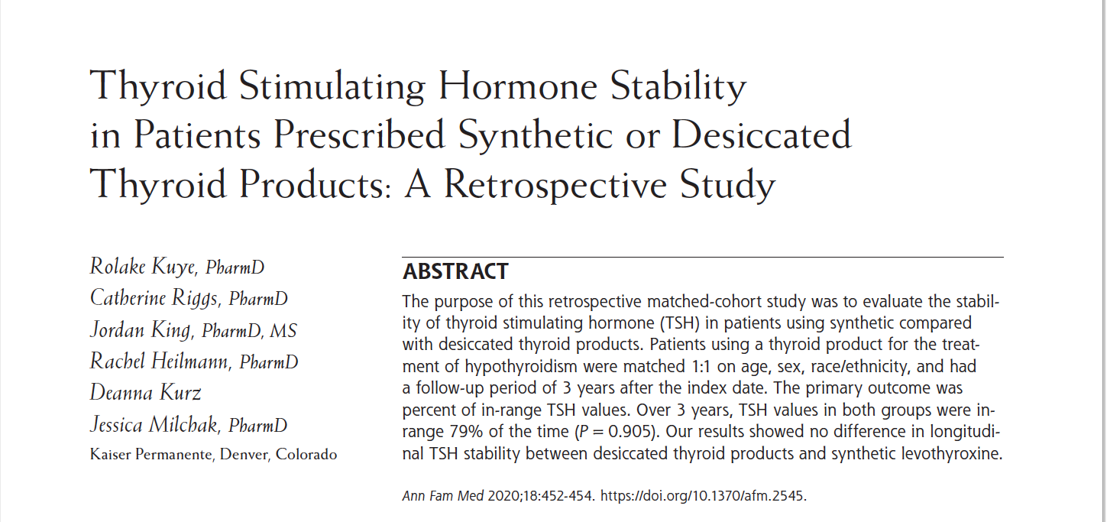
Desiccated Thyroid Articles

Slide 28
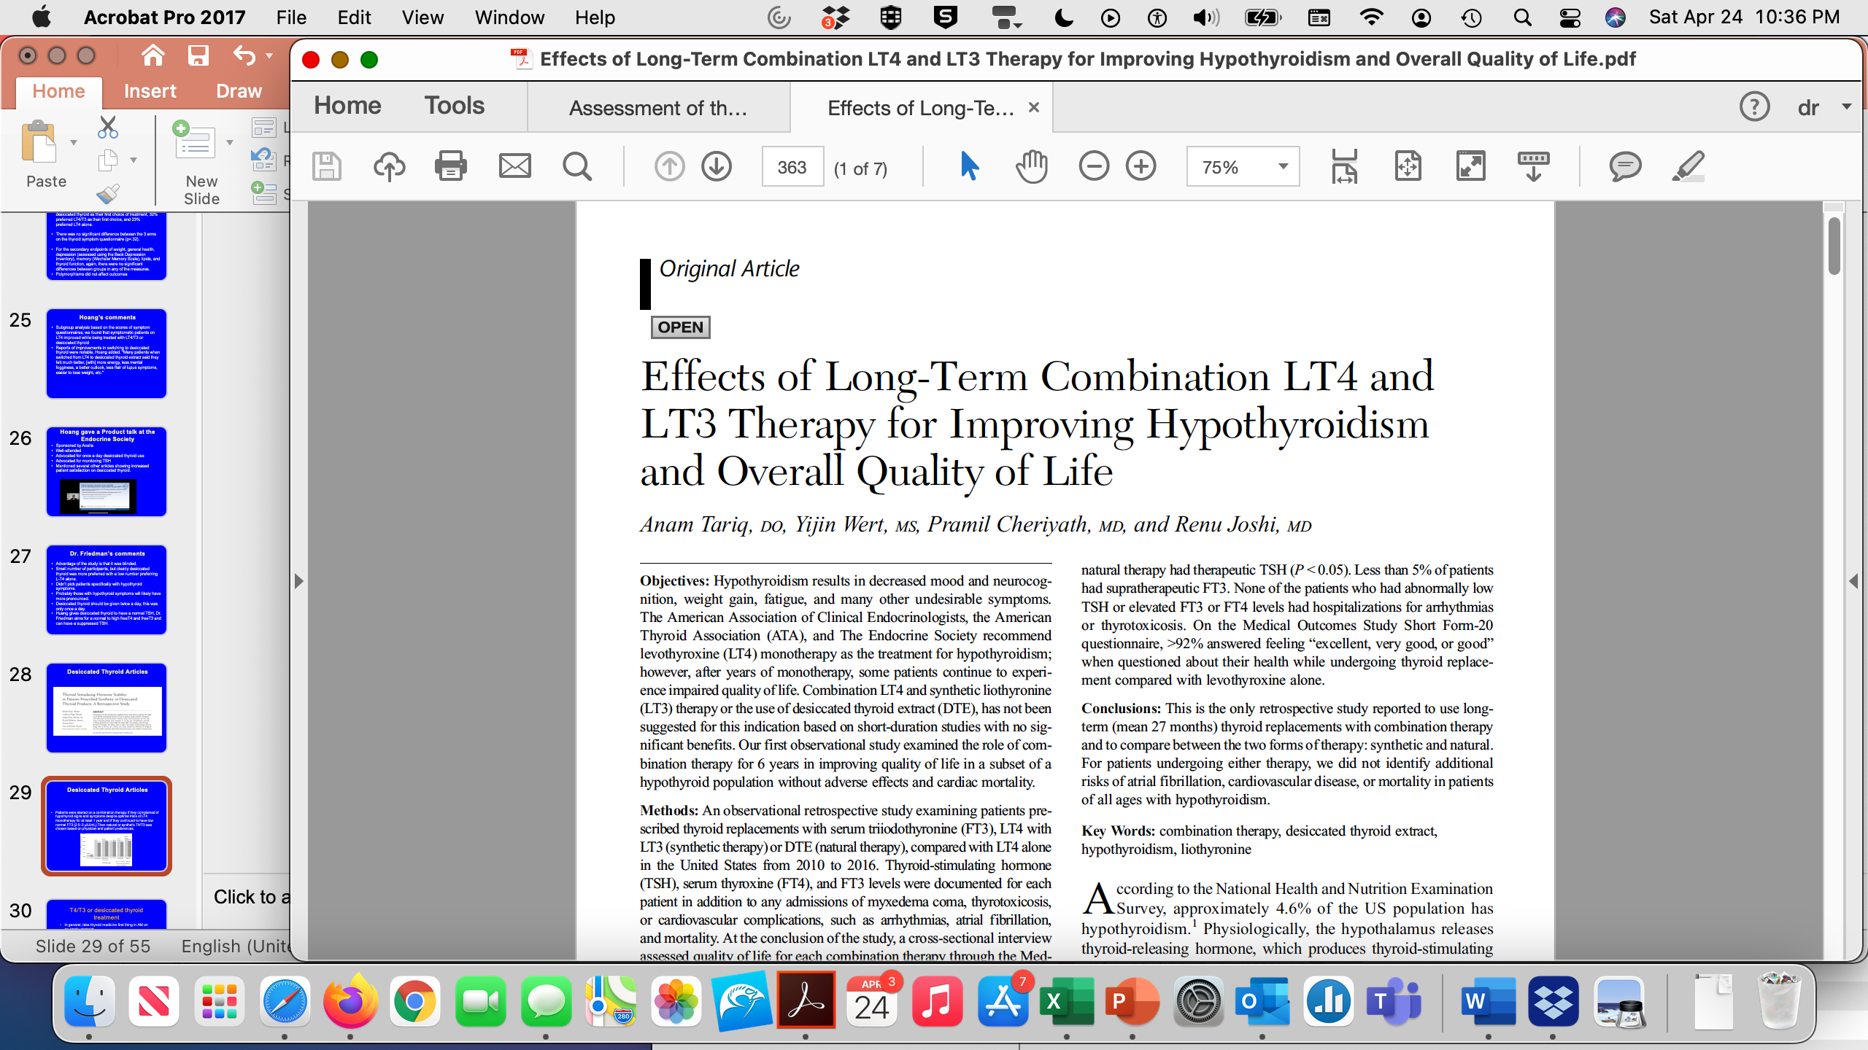
Desiccated Thyroid Articles
Southern Medical Journal • Volume 111, Number 6, June 2018
Patients were started on a combination therapy if they complained of hypothyroid signs and symptoms despite optimal trials of LT4 monotherapy for at least 1 year and if they continued to have low normal FT3 (2.5–3 μIU/mL).Then natural or synthetic T4/T3 was chosen based on physician and patient preferences.

Slide 29
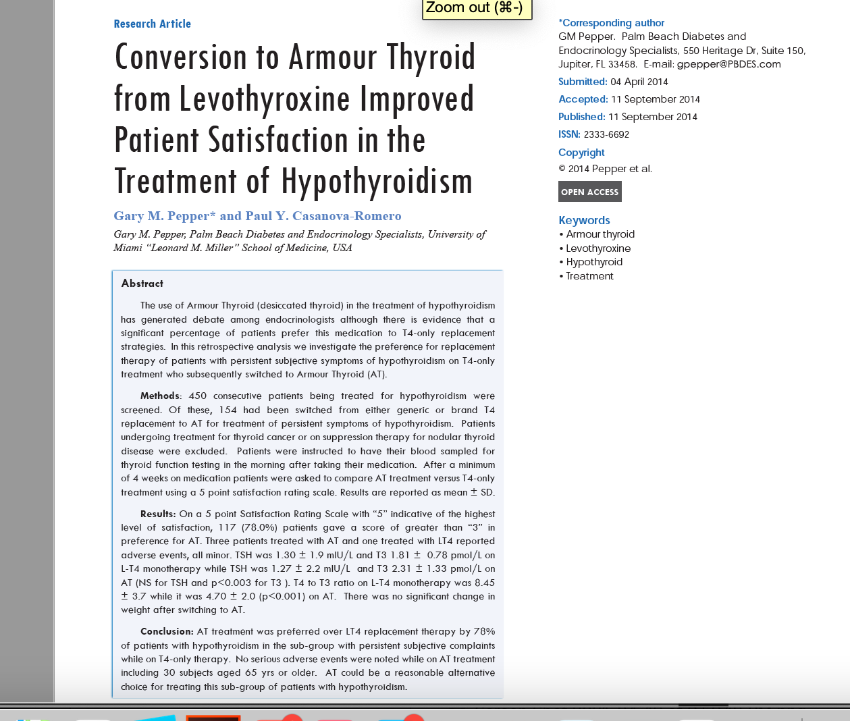
Desiccated Thyroid Articles

Slide 30
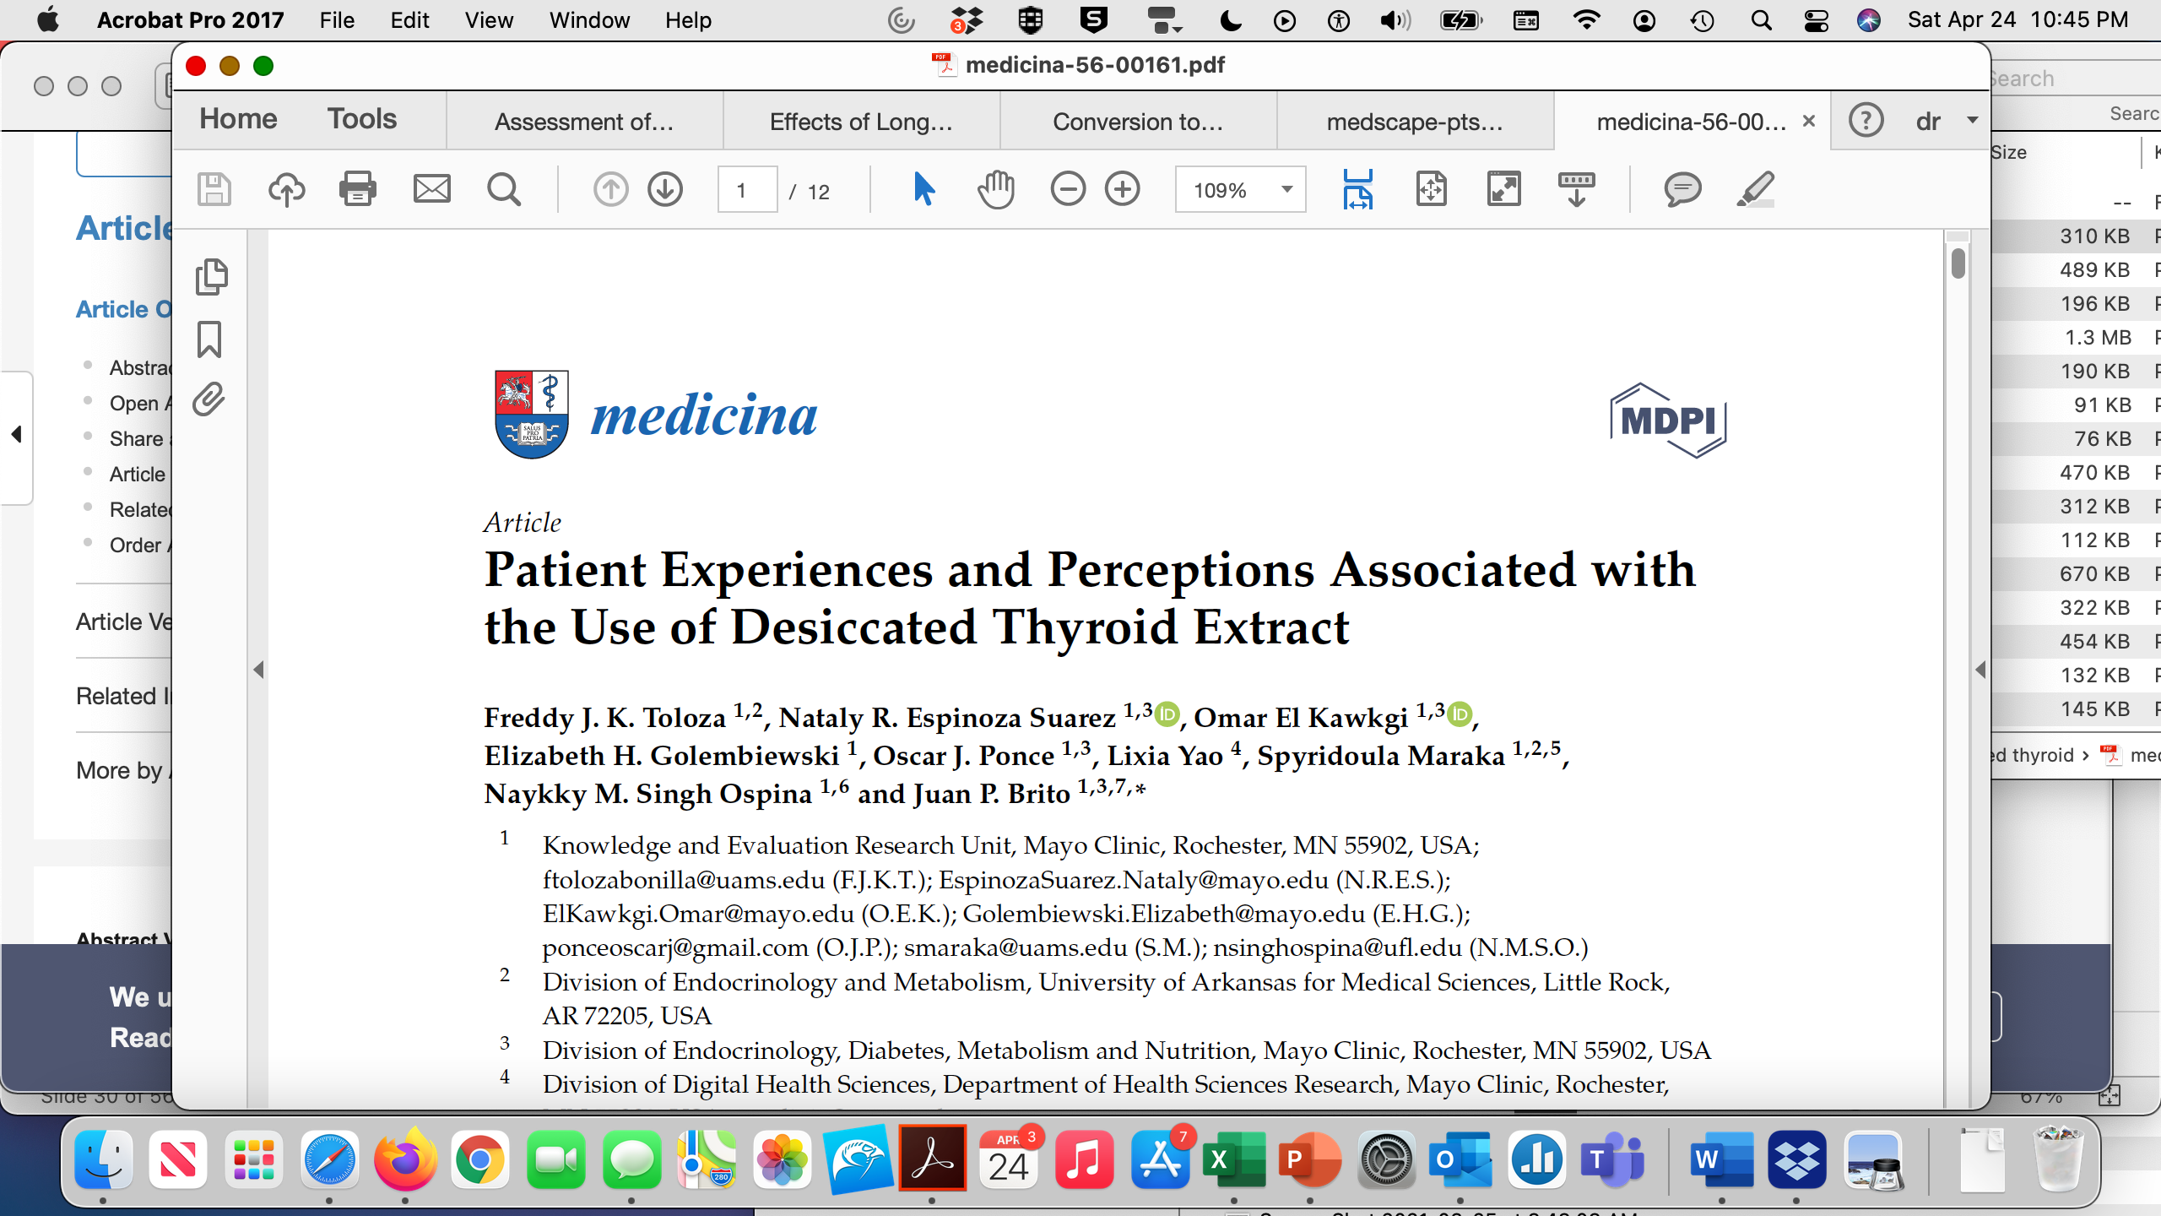
Desiccated Thyroid Articles
They conducted a mixed-methods study by evaluating the content of online posts from three popular hypothyroidism forums from patients currently taking DTE (n = 673).

Slide 31
Desiccated Thyroid Articles
Nearly half (46%) of the patients reported that a clinician initially drove their interest in trying DTE.
Patients described many reasons for switching from a previous therapeutic approach to DTE, including lack of improvement in hypothyroidism-related symptoms (58%) and the development of side effects (22%).
The majority of patients described DTE as moderately to majorly effective overall (81%) and more effective than the previous therapy (77%).
The most frequently described benefits associated with DTE use were an improvement in symptoms (56%) and a change in overall well-being (34%).
One-fifth of patients described side effects related to the use of DTE.

Slide 32
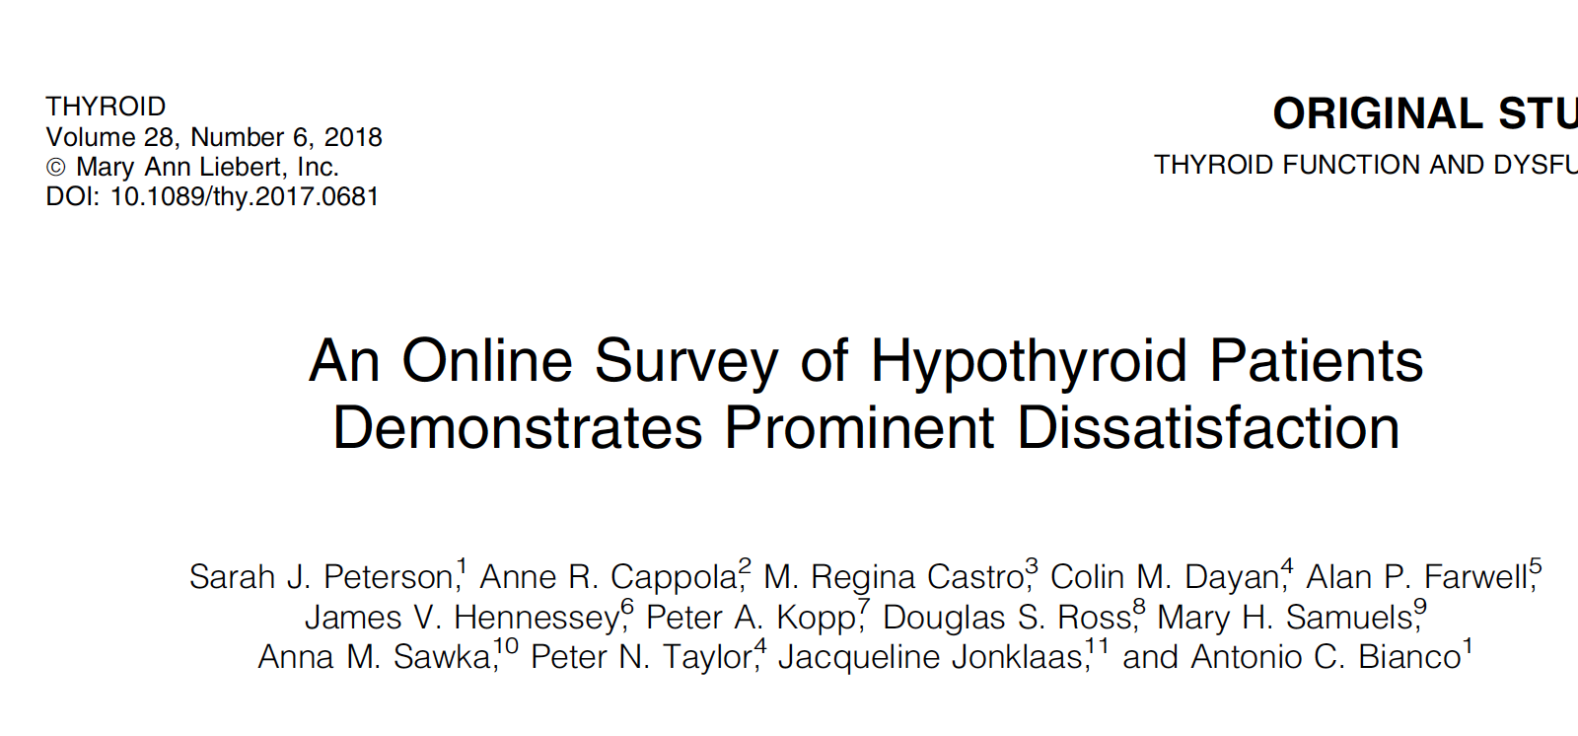
Desiccated Thyroid Articles
Methods: An online survey for hypothyroid patients was posted on the American Thyroid Association Web site and forwarded to multiple groups.
Respondents were asked to rank satisfaction with their treatment for hypothyroidism and their treating physician
Respondents reported the therapy they were taking, categorized as LT4, LT4 and liothyronine (LT4 +LT3), or desiccated thyroid extract (DTE).

Slide 33
Desiccated Thyroid Articles
Individuals taking DTE reported a higher median treatment satisfaction of 7 (IQR = 5–9) compared to other treatments.
At the same time, the LT4 treatment group exhibited the lowest satisfaction of 5 (IQR = 3–7), and for the LT4 + LT3 treatment group, satisfaction was 6 (IQR = 3–8).
Respondents taking DTE were also less likely to report problems with weight management, fatigue/energy levels, mood, and memory compared to those taking LT4 or LT4 + LT3.

Slide 34
Summary Desiccated Thyroid Articles
7 peer-reviewed articles in showed that DTE was preferred over L-T4 and some articles over L-T4/L-T3
No studies showed L-T4 was better than desiccated thyroid
Side effects including hyperthyroidism were minimal
Bottom Line: Patients feel better on desiccated thyroid.
https://www.medscape.com/viewarticle/928573

Slide 35
Is there a problem with a low TSH?
Probably not (heart and bones main problem)
Urine N-telopeptide looks at bone turnover.
The values reported are the urine N-telopeptide concentration in nmol BCE (bone collagen equivalents) over the concentration of creatinine in mg/dL and the range at LabCorp is 5 to 65.
I do every 6-12 months, aim for less than 60
Atrial fibrillation, unlikely in a younger person, use caution with desiccated thyroid in an older patient

Slide 36
T4/T3 or desiccated thyroid treatment
In general, take thyroid medicine first thing in AM on an empty stomach
If on twice a day treatment, take 2nd dose in mid- afternoon
Avoid taking with
  Iron
  Calcium
  Vitamins with iron or calcium
  Proton pump inhibitors, carafate, oral bisphosponates (Fosamax), orlistat, cholestyramine
Minor effect of soy

Slide 37
Hypothyroidism-T3 alone treatment
The brand name of T3 is called Cytomel and the generic is called liothyronine.
Celi et al. (JCEM, 2011, 96:3466-74) found that patients on L-T3 alone had lower weight and better lipid profiles than those on L-T4 alone.
I frequently uses different combinations of thyroid medicine, including T4/T3 combinations and desiccated thyroid.
However, some more alternative doctors are prescribing only T3 to patients.

Slide 38
Hypothyroidism-T3 alone treatment
I recommend against this for several reasons.
First of all, several studies have shown that T4 gets into the brain much better than T3 does, and once it's in the brain the T4 can get converted to T3.
Therefore, in patients only on T3, the level of thyroid hormone in the brain might be quite low.
Additional, T4 has a long half-life and acts as a reservoir, while T3 has a short half-life and needs to be given several times a day if it is not in combination with T4.

Slide 39
Hypothyroidism-T3 alone treatment
I also thinks it is un-physiological to have a very low T4 level, which is what happens if someone is only taking T3.
If someone was misdiagnosed and really did not have hypothyroidism or has very mild hypothyroidism, the T4 could still be detectable (or even normal) when on only T3.
I usually do not give T3 alone treatment as I like the long acting “reservoir” of the T4 along with the shorter acting “boost” T3 effect.

Slide 40
Tirosint
Gel capsule with almost no binders or fillers.
Less interference with medicines.
Doesn’t need acid in stomach for absorption (can take with antacids)
Expensive and often not covered by insurance.
Fixed dose liquid also available
Can start with the lowest dose of liquid (13 mcg), put in a glass of water and take only part of the glass and titrate up

Slide 41
Generic Tirosint
Made by Lannett that also make Unithroid
It is also a gel capsule that only contains levothyroxine, gelatin, glycerin and water.
There are no dyes and it is gluten and lactose free.
It is manufactured in Switzerland and is available as 13 mcg, 25 mcg, 50 mcg, 75 mcg, 88 mcg, 100 mcg, 112 mcg, 125 mcg, 137 mcg, 150 mcg, 175 mcg, and 200mcg strength capsules.
Unclear if the price is less than brand Tirosint

Slide 42

Thyquidity
Oral solution 100 mcg/5 mL
Inactive ingredients include citric acid monohydrate, glycerin, methylparaben sodium, sodium hydroxide and purified water.
Made by Vertice Specialty Group
THYQUIDITY enables gradual dose adjustments
The use of a calibrated oral syringe can help meet your patients’ unique needs
THYQUIDITY is gluten-free, sulfur-free, and lactose-free
THYQUIDITY is supplied in a package of two 100 mL bottles
Can get a co-pay and savings card at https://www.thyquidity.com/resources

Slide 43
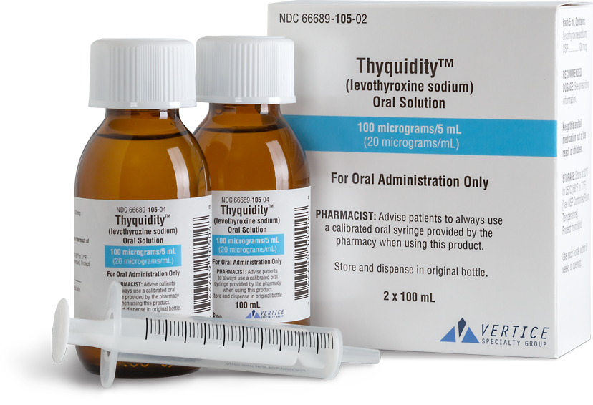
Thyquidity

Slide 44
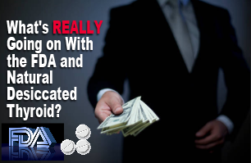
Update on desiccated thyroid recalls-Mary Shomon
https://maryshomon.medium.com/whats-really-going-on-with-the-fda-and-natural-desiccated-thyroid-drugs-5b8448987c8

Slide 45
There are three companies making NDT drugs in the U.S.: two are small companies:
There are three companies making NDT drugs in the U.S.: two are, as noted, small companies:
Acella, which makes NP Thyroid, has less than 200 employees, and around $120 million in annual revenue.
RLC, which makes WP Thyroid and Nature-throid, has less than 50 employees, and around $30 million in annual revenue.
AbbVie, which makes Armour Thyroid, employs about 30,000 people in 75 countries, and has annual revenue of around $30 billion — yes, billion — a year. This global pharma behemoth also has huge armies of drug reps, marketing teams, and lobbyists on staff. Note that AbbVie only recently acquired Allergan — and Armour.
AbbVie also manufactures the best-known brand of levothyroxine: Synthroid

Slide 46
Price
Synthroid has the highest retail price of any brand-name levothyroxine tablet.
Armour Thyroid has the highest retail price of any natural desiccated thyroid drug.
AbbVie’s two thyroid drugs, in fact, frequently have a retail price that is more than double other brand names.
AbbVie PAC has donated almost $1.5 million to candidates during the 2020 election cycle.
The FDA may decide NDT a “new drug,” and all the NDT drugs will have to go through the new drug application (NDA) approvals process
The FDA letters to Acella and RLC also indicated that the FDA intends to change the designation of NDT drugs to define them as “biologics.”

Slide 47
Biologics
Likely to be very expensive and require extensive FDA documentation

Slide 48
What to do?
Contact the FDA-see Mary Shomon’s article for links
Report Adverse Effects
Flood the FDA on Social Media!
Kim from RLC confirmed to me that she thought this was true
She did say there is no updates and the earliest she expects news is the fall of 2021

Slide 49
T4 to T3 or Reverse T₃ (rT₃)
Most of the circulating T₃ is derived from 5′-deiodination of circulating T₄ in the peripheral tissues by type 1 deiodinase.
Deiodination of T₄ can occur at the outer ring (5′-deiodination), producing T₃ (3,5,3′-triiodothyronine), or at the inner ring, producing reverse T₃ (3,3,5′-triiodothyronine) by type 3 deiodinase.
Type 2 deiodinase in the pituitary also converts T₄ to T₃ and is regulated differently from type 1 deiodinase.

Slide 50
T4 to T3 or Reverse T₃ (rT₃)
Reverse T₃, a biologically inactive form of T₃ may block T₃ from binding to the thyroid hormone receptor.
Many years ago, endocrinologists realized that in severe illness, type 3 deiodinase increases and rT₃ is often high and T₃ is often low. Endocrinologists termed this “sick euthyroid syndrome” and noted that it was common in many types of chronic illnesses, especially in patients hospitalized in intensive care units.
It was usually recommended that these patients not be treated with thyroid hormone and in most cases, the elevated rT₃ resolved when the patient’s health returned.

Slide 51
T4 to T3 or Reverse T₃ (rT₃)
However, more recently, more alternative doctors, now called functional medicine doctors, have made quite an issue about rT₃.
They argue somewhat appropriately that high rT₃ is bad and can block T₃ from binding to the thyroid hormone receptor.
They also state that rT₃ can go up in various conditions including systemic illness, stress, inflammation, chronic pain, dieting, weight gain, and depression.
They often quote articles showing that these diseases are correlated with a high rT_{3,} but do not necessarily show that the rT₃ plays a significant role in the disease.

Slide 52
Reverse T₃
These functional medicine doctors rely extremely heavily on rT₃ to treat patients that may have no other laboratory findings of hypothyroidism and often prescribe them T₃-only preparations to try to lower the rT₃.
They have not published on whether this is effective or not, and may treat a person with completely normal thyroid function tests and put him on T₃ to try to lower the rT₃.
They often use a high rT₃: T₃ ratio as further indication to treat these patients.

Slide 53
T4 to T3 or Rt3

Slide 54
Reverse T₃ study
I decided to measure rT₃ in 607 consecutive patients who came to see me with potential thyroid problems.
All of these had signs and symptoms of hypothyroidism, and many of them were already treated with different thyroid preparations.
I used the upper limit of normal for rT₃ at either Quest or Labcorp, which is usually 24 ng/dL.
I did not calculate any type of ratios.

Slide 55
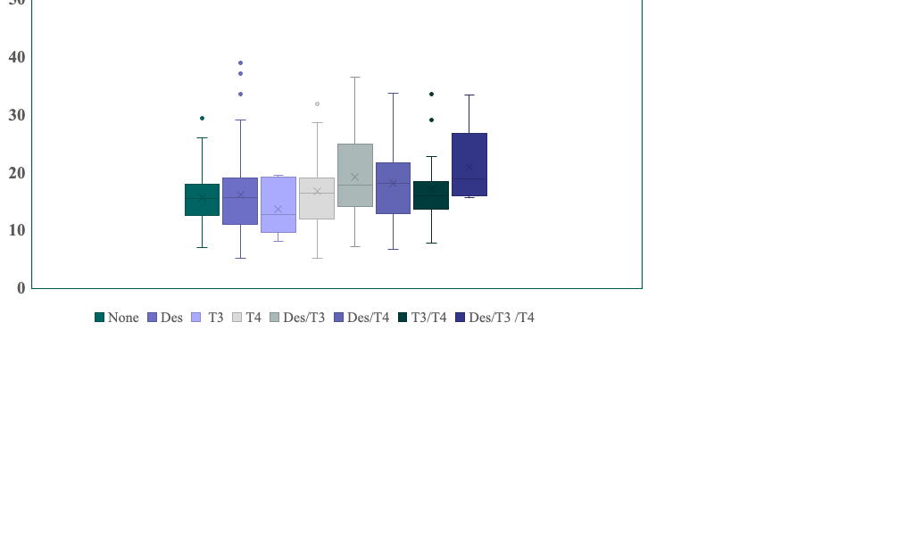
Reverse T₃ study
Reverse T3 in patients with hypothyroidism, helpful or a waste of time?
Julian Wilson1, Theodore C Friedman, MD, PhD
2021 Endo Soc
Abstract Number: 8115
17/203
7/26
5/55
7/26
5/55
16/104
2/8
9/58
2/8
5/143
9/58
16/104
5/143
0/10
0/10

Slide 56
Reverse T₃ Pilot
61 of the 607 (9.1) patients had a rT₃ above the normal range
3.4% of the patients on no thyroid medicine had a high rT3
15.5% of the patients on lT4 alone had a high rT3
Several of those on T4/T3 and desiccated thyroid/T4 combos had a high rT3 (need to reanalyze)
I did not look at whether high rT3 was correlated with hypothyroid symptoms
I have patients with a high rT3 that are doing well and those with a low rT3 that are not.

Slide 57
Reverse T₃ study-conclusions
Measuring rT₃ may be helpful in some patients, especially those already on thyroid treatments that contain T₄. Most patients that do have an elevated rT₃ on thyroid treatment with either L-T4 alone or L-T4 plus desiccated thyroid may benefit from decreasing the amount of L-T4 given and increasing the amount of L-T3 or the desiccated thyroid given.
I’m no longer giving L-T4 plus desiccated thyroid at the initial visit.
I start with desiccated thyroid twice a day and would add L-T4 if patient has low free T₄ and a rT3 < 20

Slide 58
Reverse T₃ Conclusions
The area of rT₃ is clearly an interesting area, and there is a clear division between endocrinologists who do not measure all and the functional doctors who measure it in almost everybody and treat almost everybody for it.
The test can be helpful in certain patients, but some discretion needs to be used in who gets thyroid medicine (especially for the rest of their life) and who does not.

Slide 59

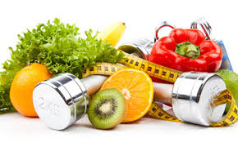
Thyroid Diet
A Thyroid Diet is a Clean Diet, just like I recommend for all my patients
Lots of fruits and vegetables
Limit processed foods
Limit simple carbohydrates
Otherwise little data on any specific diet for patients with thyroid disease

Slide 60
Thyroid Diet: Not proven
Functional doctors often promote diets to address “leaky-gut” a condition not recommended by the physicians
Anti-inflammatory- review articles on Hashimoto’s do not consider it a disease of inflammation
Gluten-free- myth
The Thyroid Diet: Is There Such a Thing?
  Angela M. Leung, MD, MSc
  https://www.medscape.com/viewarticle/901118#vp_4

Slide 61
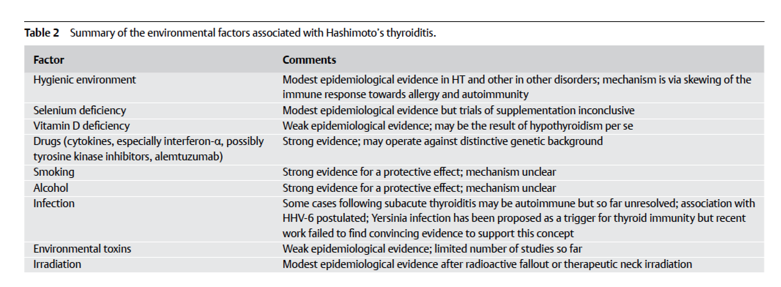
Hashimoto’s and diet
No discussion of inflammation
No discussion of gluten

Slide 62
Thyroid Diet: Iodine
Iodine deficiency is rare in the US.
T4 has 4 molecules of iodine and T3 has 3 molecules, so if you are on thyroid medicine, you get enough iodine
Can take a multivitamin with iodine
Some "iodine for thyroid health" tablets may contain several hundred-fold the daily recommended amount of iodine in just a single dose.
Other products labeled "for thyroid support" include tablets or liquid supplements containing spirulina (a superfood derived from blue-green algae) or kelp.
In some individuals, excess iodine exposure or ingestion may induce hyperthyroidism or hypothyroidism and chronic iodine excess may induce autoimmune thyroiditis, as highly iodinated thyroglobulin is immunogenic.

Slide 63
Hypothyroidism-selenium
Selenium (200 mcg/day) increases T4 to T3 conversion and reduces TPO antibody levels.
Patients with untreated GH deficiency have decreased T4 to T3 conversion, so they are likely to benefit from selenium (but also benefit from GH treatment)
Selenium appears to increase the rate of diabetes.
I am cautious about giving selenium in those patients with prediabetes or diabetes or those with a family history of diabetes.

Slide 64
Goitrogens
The term "goitrogen" refers to any substance that can produce goiter, an enlargement of the thyroid gland.
The most common examples of dietary goitrogens are cruciferous vegetables and soy products.
Cruciferous vegetables are defined as those in the Brassica genus and include broccoli, cabbage, Brussels sprouts, kale, turnips, cauliflower, collard greens, and bok choy.
Moderate consumption should not affect thyroid function, but avoid excesses

Slide 65
Celiac Disease and Hashimoto’s
Both celiac disease (in which one needs to be on a strict gluten-free diet) and Hashimoto’s hypothyroidism are autoimmune diseases
If you have Hashimoto’s hypothyroidism, you are more prone to getting celiac disease.
About 1/10,000 of all people have Celiac disease and 1/1000 of patients with Hashimoto’s have Celiac disease .
Yet the overwhelming majority of patients with Hashimoto’s hypothyroidism do not have celiac disease and do not need to be on a gluten-free diet.
Eliminating wheat and reducing carbohydrates may lead to feeling better, but you do not need to be gluten-free, unless you find that it helps with GI issues

Slide 66
Does Gluten Protein Resemble TPO antibody? NO
Gluten is a protein complex comprised of 2 components: gliadin (the water-soluble component) and glutenin (the water-insoluble component).
TPO is an enzyme that the incorporation of iodine into thyroglobulin for the production of thyroid hormone

Slide 67
Thyroid Diet
Healthy diet
Exercise
Have your hypothyroidism properly treated

Slide 68
Visit goodhormonehealth.com
For more information or to schedule an appointment.
Talk will posted in a few days
mail@goodhormonehealth.com

