Slide 1
The Social Network Effect
By Andrew Ajoku

Slide 2
The Classic Phrase

Slide 3
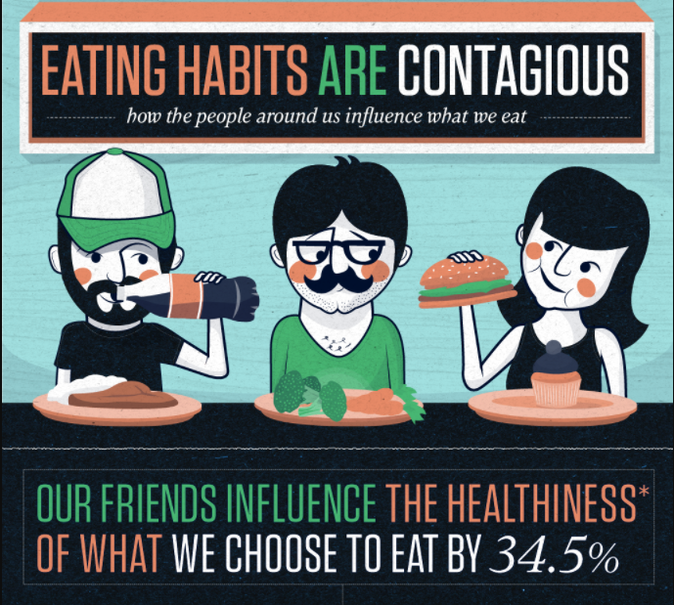

Slide 4
Time For An Update
Researchers from Harvard and UC San Diego ran a study
James Fowler, a co-author of the study states:
“You Are What You Eat is not the end of the story. You are What You and Your Friends Eat.”

Slide 5
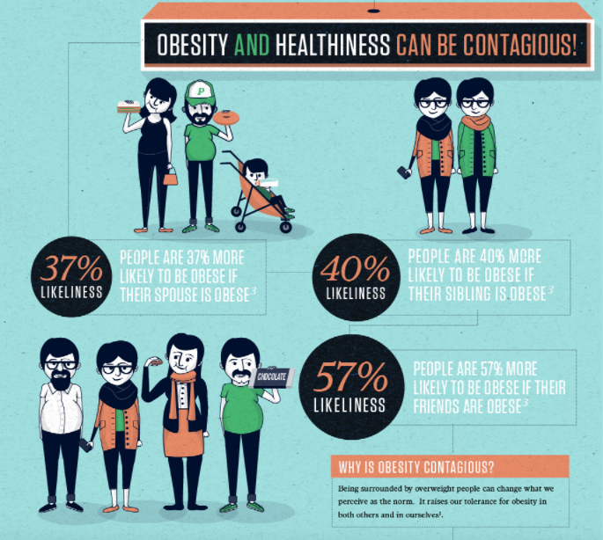

Slide 6
A Close-Up
The study also revealed that there was a 171% chance of gaining weight if a friend considered close was obese

Slide 7
The Ripple Effect
Even friends of friends have the power to increase the risk of obesity, termed the ripple effect
Lowering the social norm and many interactions can lead to weight gain

Slide 8
Who Has Influence?
Humans are social beings
Anybody you know can hold influence not only your friends
Family, Coworkers, and even fellow church members (watch those potlucks)

Slide 9
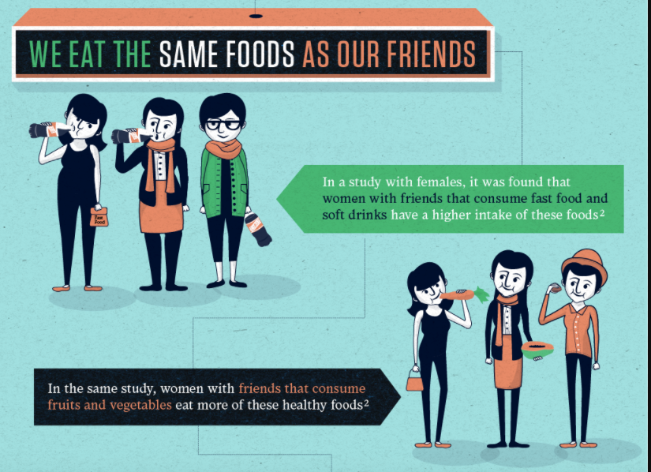

Slide 10
But Why?
We like being part of the crowd, being accepted
Could be unconscious, Monkey see, Monkey do
Others may feel uncomfortable with your positive choices
They may have feelings of judgment, jealousy, or insecurity
Change is not easy
Time spent with others might be different
They might be used to a social life that is largely inactive and sedentary

Slide 11
Negative Peer Pressure
Negative Comments
You are losing too much weight.
Why are you eating that? Enjoy yourself.
One piece of (insert unhealthy food item here) won’t kill you.
You only live once!
Temptation
Food eaten by others might look better than what you are eating
Lack of Motivation
If you are around people who don’t move, you have a higher chance of doing the same
Changing Your Views
You can adopt their unhealthy lifestyle
Settling for less
I’m still smaller than so and so
I’m only a little heavier than my ideal weight

Slide 12
Staying Strong in the Pressure
Stay focused
The decision to become healthy is for yourself, not others
Be neutral and non-defensive
Remind yourself that the comments are their negativity, not yours; a sense of humor helps
Remember your progress
The M in SMART Goals
Control What You Can
Surround yourself with active people or those who are eating healthy as well

Slide 13
Positive Peer Pressure
In addition to being around positive influences, you can be one too
Challenge friends to exercise or eat healthy with you
Implement the buddy system
Be the first one to order when you’re out with your friends
Ordering that salad first, can cause friends to change their orders to follow your health lead
Become a source of encouragement!

