Slide 1


Theodore C. Friedman, M.D., Ph.D.
(the Wiz)
Professor of Medicine-UCLA
Chairman, Department of Internal Medicine
Charles R. Drew University
Dr. Friedman’s Endocrinology Clinic
The New and The Old for Diagnosing Cushing's Syndrome
MAGIC Adult Convention
Phoenix AZ
March 3, 2019

Slide 2

States of Glucocorticoid Excess
ACTH-dependent States
a. Pituitary Adenoma (Cushing’s Disease) 90-95%
b. Ectopic ACTH Syndrome
ACTH-independent States
a. Adrenal adenoma
b. Adrenal carcinoma
Exogenous Sources
Glucocorticoid intake
Psychiatric Conditions (Pseudo-Cushing Disorders)
a. Depression
b. Alcoholism
Pregnancy

Slide 3

Pseudo-Cushing States
High Cortisol Secretion Rate without Convincing Clinical Features of Cushing Syndrome

Slide 4
Eucortisolemic Cushing’s Syndrome
Clinical Manifestations of Cushing’s Syndrome without evidence of increased cortisol levels
Exogenous glucocorticoid administration
Episodic (periodic) Cushing’s syndrome-common
Recently cured Cushing’s syndrome

Slide 5
Need to Distinguish Early or Mild Cushing’s from Other Diseases
Cushing’s is considered rare, but may not be that rare.
It is vastly under diagnosed.
Other diseases that have some symptoms/signs in common with Cushing’s (PCOS or Metabolic Syndrome) are more common, but present differently from Cushing’s. The treatment is different for these other diseases
Thus, a strategy needs to be developed to diagnose Cushing’s syndrome.

Slide 6
Is Cushing’s Syndrome Rare?
Probably not
Catargi et al. JCEM 2003, 88:5808-200 consecutive overweight patients with type 2 diabetes, but no other stigmata of hypercortisolism. 4 (2%) patients were found to have Cushing’s syndrome and another 7 are being evaluated.
Reimondo et al. Clin. Endo 2007,67:225-229 found that 5% of diabetic patients failed to suppress to dexamethasone.
Kadioglu et al. Endo Society 2004 86: P2-455- 100 consecutive obese patients. Cushing’s syndrome was diagnosed in 11%.
Nishikawa et al. Endo Society 2004 86: P3-437- 1020 patients with hypertension. 11 had Cushing’s syndrome and 10 had subclinical Cushing’s syndrome (2%).
These studies may have missed mild Cushing’s syndrome and may actually be low.
Maybe Cushing’s syndrome is not so rare

Slide 7

Should Cushing’s be Diagnosed Early?
Cushing’s patients are miserable.
Effective treatment (surgery and medicines) exists
Less pharmaceutical funding (better with Corcept).
Most doctors are not familiar with Cushing’s syndrome and may only be familiar with severe cases.

Slide 8

How to Diagnose Cushing’s Syndrome
Careful history and physical
Change in weight and body habitus
Look at old pictures
Not all patients have all signs and symptoms, especially “early” and “episodic” patients.
Most published data compared severe Cushing’s with normals.
Important to diagnose early before devastating sequelae develop.
Initial diagnosis most difficult aspect of Cushing’s syndrome.
“Gestalt” with as much information as possible
Episodic Cushing’s common, so one positive test may be worth more than 10 negative tests

Slide 9
Common symptoms I see
Wired at night
Trouble sleeping-trouble falling asleep or frequent awakenings
Severe fatigue-new onset
Abrupt weight gain-without other cause such as decreased activity or depression
Decreased ability to exercise
Menstrual abnormalities
Cognitive changes- “brain fog”
Decreased libido
Symptoms of adrenal insufficiency-joint pains, can’t get out of bed, nausea and vomiting
Depression, anxiety, mood-swings

Slide 10
Common Signs I see
Central obesity
Muscle atrophy
Thin skin on top of hand (Liddle’s sign)
Buffalo hump
Round, red face
Bruising
Extra hair growth
Acne
Loss of hair on head
Stretch marks

Slide 11

The Diagnosis of Cushing’s Syndrome: An Endocrine
Society Clinical Practice Guideline
J Clin Endocrinol Metab. May 2008, 93(5):1526–1540
Lynnette K. Nieman
Beverly M. K. Biller
James W. Findling
John Newell-Price
Martin O. Savage
Paul M. Stewart
Victor M. Montori

Slide 12
The Diagnosis of Cushing’s Syndrome: An Endocrine
Society Clinical Practice Guideline
J Clin Endocrinol Metab. May 2008, 93(5):1526–1540
1st line recommended tests
  UFC
  Low dose or overnight dexamethasone test
  Night-time salivary cortisols
Testing for Cushing’s syndrome in patients with multiple and progressive features compatible with the syndrome
Patients with an abnormal result see an endocrinologist and undergo a second test, either one of the above or, in some cases, a serum midnight cortisol or dexamethasone-CRH test.

Slide 13
The Diagnosis of Cushing’s Syndrome: An Endocrine
Society Clinical Practice Guideline
J Clin Endocrinol Metab. May 2008, 93(5):1526–1540
Patients with 2 or more normal results should not undergo further evaluation.
Recommend additional testing in patients with discordant results, normal responses suspected of cyclic hypercortisolism, or initially normal responses who accumulate additional features over time.

Slide 14
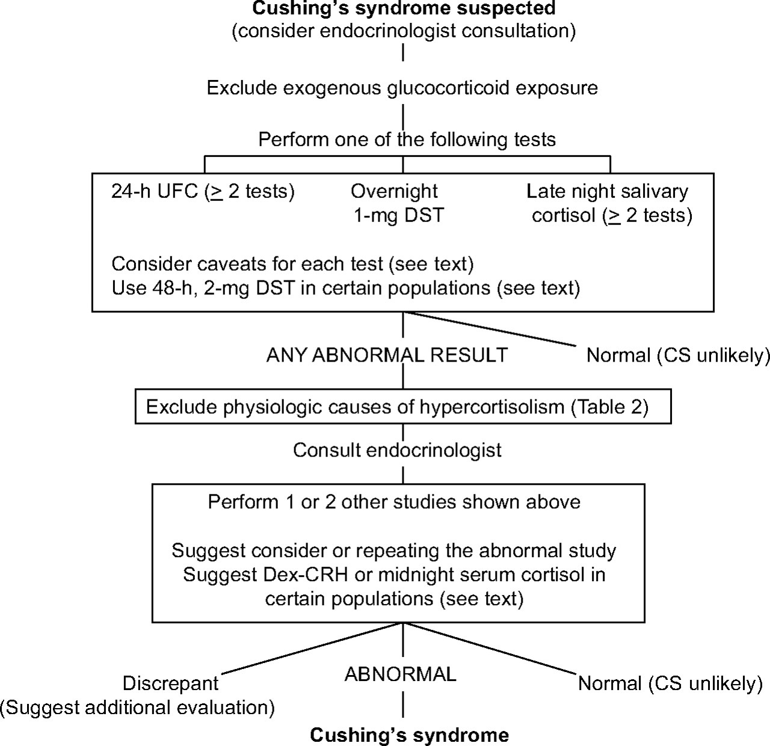
FIG. 1. Algorithm for testing patients suspected of having Cushing's syndrome (CS)

Slide 15
Episodic, Cyclical, Periodic
Periodic and cyclical refer to changes in cortisol levels that occur on a regular predictable basis.
Episodic refers to high cortisol levels that are random.
Most of my patients are episodic.

Slide 16
Episodic Cushing’s is common
Friedman, T.C., Ghods, D.E., Zachery, L., Shayesteh, N., Seasholtz, S., Zuckerbraun, E., Shahinian, H.K., Lee, M.L., McCutcheon, I.E. (2010) High Prevalence of Normal Tests Assessing Hypercortisolism in Subjects with Mild and Episodic Cushing’s Syndrome Suggests that the Paradigm for Diagnosis and Exclusion of Cushing’s Syndrome Requires Multiple Testing. Hormone and Metabolic Research. 42: 874-881.
We found that 65 of the 66 patients with Cushing’s syndrome had at least one normal test of cortisol status and most patients had several normal tests.
The probability of having Cushing’s syndrome when one test was negative was 92% for 2300 h salivary cortisol, 88% for 24-h UFC, 86% for 24-h 17OHS and 54% for night-time plasma cortisol.

Slide 17
Episodic Cushing’s is common
These results demonstrated that episodic hypercortisolism is highly prevalent in subjects with mild Cushing’s syndrome and no single test was effective in conclusively diagnosing or excluding the condition.
Rather, the paradigm for the diagnosis should be a careful history and physical examination and in those patients in whom mild Cushing’s syndrome/disease is strongly suspected, multiple tests assessing hypercortisolism should be performed on subsequent occasions, especially when the patient is experiencing signs and symptoms of short-term hypercortisolism.

Slide 18
Episodic Cushing’s is common
Our paper on episodic Cushing’s syndrome showed that most patients with confirmed Cushing’s syndrome are episodic with one or more normal values among high values.
Thus one normal value does not exclude Cushing’s.
A series of normal values does make Cushing’s unlikely at the current time

Slide 19
Episodic Cushing's: Conclusion
Data shows that all patients are episodic to some degree
May account for many patients incorrectly diagnosed as normal.
Marked by mostly normal (or low) cortisol levels with some high values accounting for the signs and symptoms of Cushing's syndrome
But lows interspersed with highs may make symptoms worse.
Can be all types of Cushing's syndrome, but in my hands, its pituitary.
Very difficult to diagnose and exclude

Slide 20
Episodic Cushing's Conclusions
I agree with the Endocrine Society recommendations and like to see 2 different tests high.
The higher the test, the more likely Cushing's is
May limit the severity of the signs of hypercortisolism. (less weight gain)
Patients with mild/episodic Cushing's seem to have as many symptoms and as poor a quality of life as full-blown-may be due to daytime lows.

Slide 21
Episodic Cushing's Testing
Need to test in a high
Multiple 24 hr UFC (and 17 OHS)
Multiple 11 PM salivary cortisols-when symptoms of high cortisol.
Midnight serum cortisol (> 7.5 ug/dL)
Overnight or low dose Dex tests (not helpful in episodic Cushing’s syndrome).
Very low dose Dex test
10 hr UFC/Cr ratio > 16 (did not achieve separation between Cushing’s and normal).
Pituitary MRI
Dex-CRH-not recommended.
Desmopressin test-possible
Ketoconazole trial

Slide 22
AM I HIGH?
Wired at night
Weight gain
Acne
Anxiety increase/mood swings/irritability
Euphoria/more energy than usual
Very few aches and pains
Tasks seem easier
Insomnia/inability to stay or fall asleep.
Energy levels that “perk up” after sunset.
“Speed talking” – mind is going faster than your brain can process the thoughts to speak them.
Water weight gain – edema
High blood pressure
High blood sugar if patient has diabetes

Slide 23
AM I HIGH?
Every patient is unique in how their bodies respond to fluctuations in cortisol.
A “high” period has some telltale signs for most sufferers.
However, in some cases, what patients have labeled as their “high” could be their “low” phase.
  Nausea
  Weight loss
  Depression
  Lethargy
  Extreme fatigue
  Muscle/joint pain

Slide 24
Wouldn’t it be nice (Beachboys):
To be able test your cortisol to see if you are in a high and get your results back right away?
Point of care testing: blood glucose monitoring, home pregnancy testing
What if you had the diagnostic resources of a clinical laboratory and the expertise of a medical specialist right on your smartphone?
There is a company www.peakbiometricresearch.com that has come up with a a salivary cortisol kit for your smartphone.

Slide 25

Joel Ehrenkranz MD
Chief Medical Officer
Endocrinologist and Director of Diabetes and Endocrinology at Intermountain Medical Center in Murray, Utah
Patented the technology in 2011

Slide 26
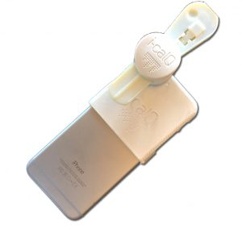
Salivary cortisol testing on your smartphone
https://www.peakbiometricresearch.com
Using nothing more than a smartphone with app, a reader, a strip and a saliva sample, the system quickly and accurately measures and analyzes your body’s levels of cortisol —the hormone that surges in response to stress.
Not FDA approved for diagnosis of Cushing’s syndrome

Slide 27
Salivary cortisol testing on your smartphone
Uses the ARUP assay (normal night time salivary cortisol < 0.112 µg/dL
Only works on iPhone 6, 6S or 7

Slide 28
Initial Kit – Smartphone Salivary Cortisol Monitoring System For iPhone 6/6S or 7
$425.00
kit includes:
  1 Reader/App
  25 Salivary Cortisol Test Strips
  25 Salivary Cortisol Collectors
  25 Collection Tubes
  25 Disposable Pipettes
  2 Reusable Cassettes
  2 Pipe Cleaners
  1 Standards (set)
  1 Syringe
  *kit does not include an iPhone

Slide 29
Refill Kit – Smartphone Salivary Cortisol Monitoring System For iPhone 6/6S or 7
$625.00
kit includes:
50 Salivary Cortisol Test Strips
50 Salivary Cortisol Collectors
50 Collection Tubes
50 Disposable Pipettes
4 Reusable Cassettes
4 Pipe Cleaners
2 Syringes
  *kit does not include an iPhone

Slide 30
Salivary Cortisol Personal Biometric Instructions for Use
Peak’s salivary cortisol assay is a wellness monitor to assess everyday normal variations in cortisol levels.
It is not intended for use as a medical device to detect, diagnose, or treat disease.
An instructional video is available on the Peak website. Please go to www.PeakBiometricResearch.com, select the FAQ’s tab.
Instructions for downloading app are there also.

Slide 31
Smartphone Salivary Cortisol Monitoring System For iPhone 6/6S/7
Refrain from eating, drinking, chewing or smoking for at least 30 minutes before collecting a sample.
Place the salivette in the mouth and chew to collect the saliva sample.
Using the saliva collector and pipette, transfer saliva onto the test strip and insert it in the reader.
Wait while the app rapidly measures and graphs your cortisol levels.
Note as to what triggered an increase or decrease, if desired, directly on the app.
Repeat whenever you want to gain insight into your stress.

Slide 32
Smartphone Salivary Cortisol Monitoring System: Does it Work?
Single patient (K.E) sending simultaneous samples to both Labcorp and using Smartphone-poor correlation

Slide 33
How does Dr. Friedman intend for his patients to use the Smartphone salivary kit?
Use the kit nightly to detect a value above 0.112 µg/dL.
When you find a value use a Labcorp or Quest salivary kit and send it off to the lab.
iCalQ will not count as a high
Record your symptoms.
Product is newly available. Please let me know your experience with it

Slide 34
Late Night Salivary Cortisol Test
    Salivary cortisol levels reflect plasma cortisol levels.
    Midnight plasma cortisol measurement requires blood-drawing and may be difficult to obtain in an outpatient setting.
    Can be done on multiple settings
    Quest, Labcorp, Esoterix, ACL
    Uses a "Salivette" in which the patient chews on a cotton tube for 2-3 minutes.
    Labcorp/Esoterix wants the requisition to say the number of samples, so freeze and bring in at once.
    The samples are stable for a week at room temperature or can be frozen and salivary cortisol is independent of the rate of saliva production.

Slide 35
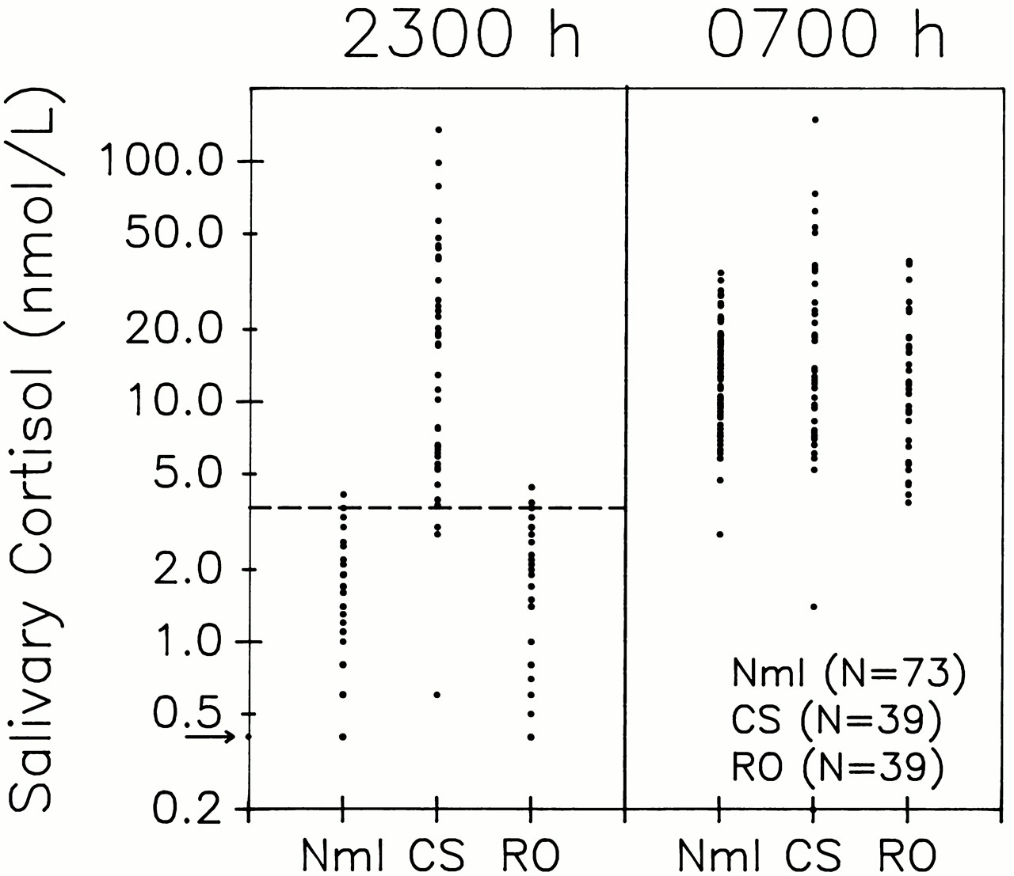
Late Night Salivary Cortisol Test
    36/39 patients with Cushing syndrome had a salivary cortisol > 3.6 nmol/L (0.13 μg/dl).
    38/39 normal volunteers had a value ≤ 3.6 nmol/l (mean 1.2 nmol/L) and 37/39 patients with rule/out Cushing syndrome had a value ≤ 3.6 nmol/l (mean 1.6 nmol/L).

Slide 36
Salivary cortisols in episodic Cushing’s
Convenient for periodic patients as the patient can collect many samples easily
Try to have the patient collect when high symptoms
I start with 4 at 11 PM
Patients can tests between 11 PM and 1 AM when symptoms of highs
Other times not helpful, cortisol starts rising at 2 AM.
Don’t use salivary kits geared for patients, ZRT, Genova, etc
Can complement UFC for picking up mild cases.

Slide 37
24-Hour Urinary Free Cortisol (UFC)
    Integration of plasma cortisol throughout the day
    “Good” assays (using HPLC or mass spectroscopy) have a normal range of 10-34 μg, with higher levels for men.
    PseudoCushings patients may have normal values in newer assays, but elevated levels in older assays.
    Many Cushing’s patients have normal values in the new assay-
    Cushing’s patients may have low cortisol during the day and high at night, cancelling out the high, yielding normal results.

Slide 38
Urinary 17-OH Corticosteroids (17-OHS)
One of the earliest tests
Went out of favor about 20 years ago and has been (incorrectly) replaced by UFC.
UFC is probably better for full-blown Cushing’s compared to obese and normal subjects.
17-OHS may be better for picking up mild cases.
Can use the same collection for both, so its worthwhile to measure 17-OHS in addition to UFC.
Can also express results per gram of creatinine to correct for obesity
I don’t use the 17OHS/Cr to diagnose Cushing’s only to confirm
Available from Quest and ARUP.
I have an agreement with Labcorp to send to ARUP.

Slide 39
17-hydroxysteroids (2)
At lower cortisol production rates, the 17OHS assay may be able to detect mild hypercortisolism in some patients with normal 24-h UFC levels.
UFC measurements will increase only mildly until a point of saturation of cortisol binding to CBG is exceeded
17OHS measurements which are not dependent on cortisol exceeding the threshold of binding to CBG are more likely to be linear with cortisol production.

Slide 40
Night Time Plasma Cortisol Test
    Normal individuals and patients with pseudo-Cushing states have a pronounced diurnal rhythm of cortisol with the highest values in the morning and lower values at night.
    Patients with Cushing syndrome lack their diurnal variation of cortisol.
    Papanicolaou et al. (JCEM, 1998, 83:1163-1167) compared morning and nighttime plasma cortisol in 97 patients with proven Cushing syndrome and 31 patients with pseudo-Cushing states.
    A midnight plasma cortisol greater than 7.5 μg/dL makes Cushing’s syndrome likely.
    Patients taking oral estrogens (or birth control pills) will have an increase in their CBG and a falsely high serum cortisol level.
    Can be done as an outpatient (Scand J Clin Lab Invest. 2002;62(5):357-60)
    Pretty good test, but hard to arrange. (except in my Tuesday night clinic)

Slide 41
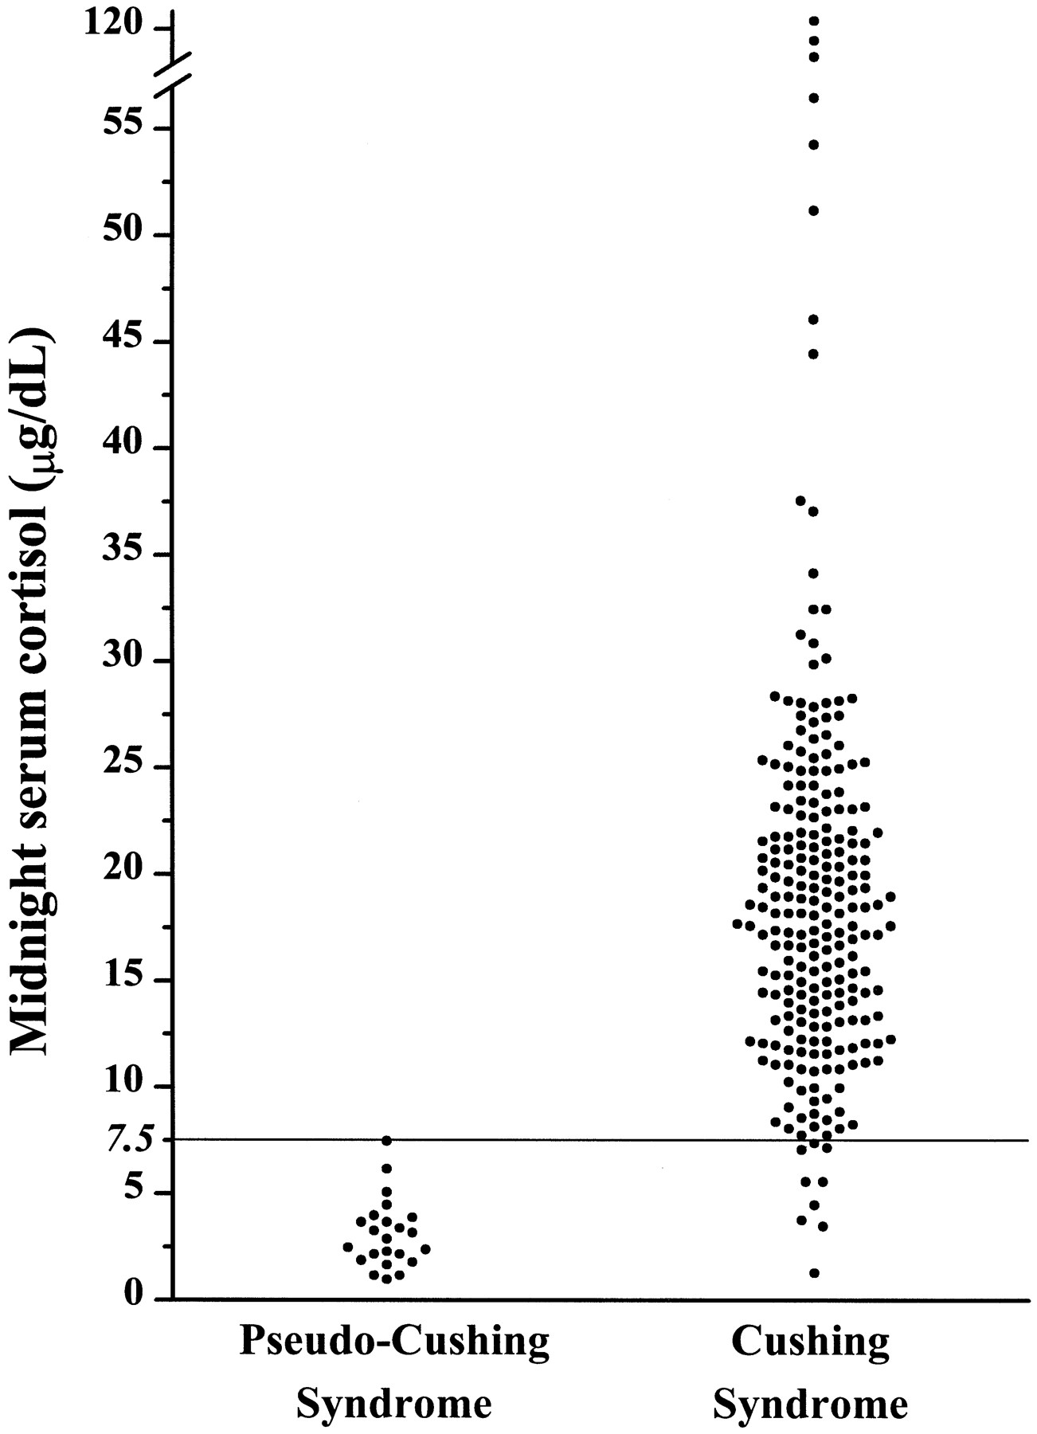
Midnight plasma cortisol
Papanicolaou et al. (JCEM, 1998, 83:1163-1167)

Slide 42
Both UFC and Salivary Cortisol are unlikely to pick-up mild Cushing’s
Serum cortisol less than 20 μg/dl (lower in evening when CBG is lower) is mainly (but not exclusively) bound to CBG and therefore little free cortisol is present in the blood.
This results in little increase in salivary cortisol or UFC.
At serum cortisol concentrations exceeding this cut-off, then salivary cortisol and UFC will rise dramatically.
Still these are the best tests we have.

Slide 43
Overnight dexamethasone test
Give 1 mg of dexamethasone at 11 PM or midnight- collect 8 am plasma cortisol
Cushing’s patients resistant to glucocorticoid feedback.
Old cut-off 5 mg/dL, new cut-off 1.8, mg/dL. Value greater than that consistent with Cushing’s syndrome.
Cortisol assay isn’t that good at low values
May get falsely high values if on oral estrogens.
Only half of classic Cushing’s patients have the genetic defects leading to resistance to dexamethasone-probably lower in mild/episodic patients (Bilodeau et al. 2006 20: 2871-2886 Genes & Dev.)
Friedman, T.C. (2006) An Update on the Overnight Dexamethasone Suppression Test for the Diagnosis of Cushing’s Syndrome: Limitations in Patients with Mild and/or Episodic Hypercortisolism. Experimental and Clinical Endocrinology and Diabetes 216: 356-360.

Slide 44
Overnight dexamethasone test
0800 h cortisol (μg/dL)
Patient #

Slide 45
Overnight dexamethasone test
Conclusion: test useless for excluding Cushing’s syndrome.
If someone has a high value after dexamethasone, may help with the diagnosis of Cushing’s syndrome, but those patients usually are severe and can be diagnosed anyway
If patient suppresses to overnight dexamethasone, adrenal adenoma or ectopic is unlikely.
I am now doing a prospective study using 0.25 mg of overnight dexamethasone, 1 mg of dexamethasone and the 2 mg/2 day dexamethasone test.

Slide 46
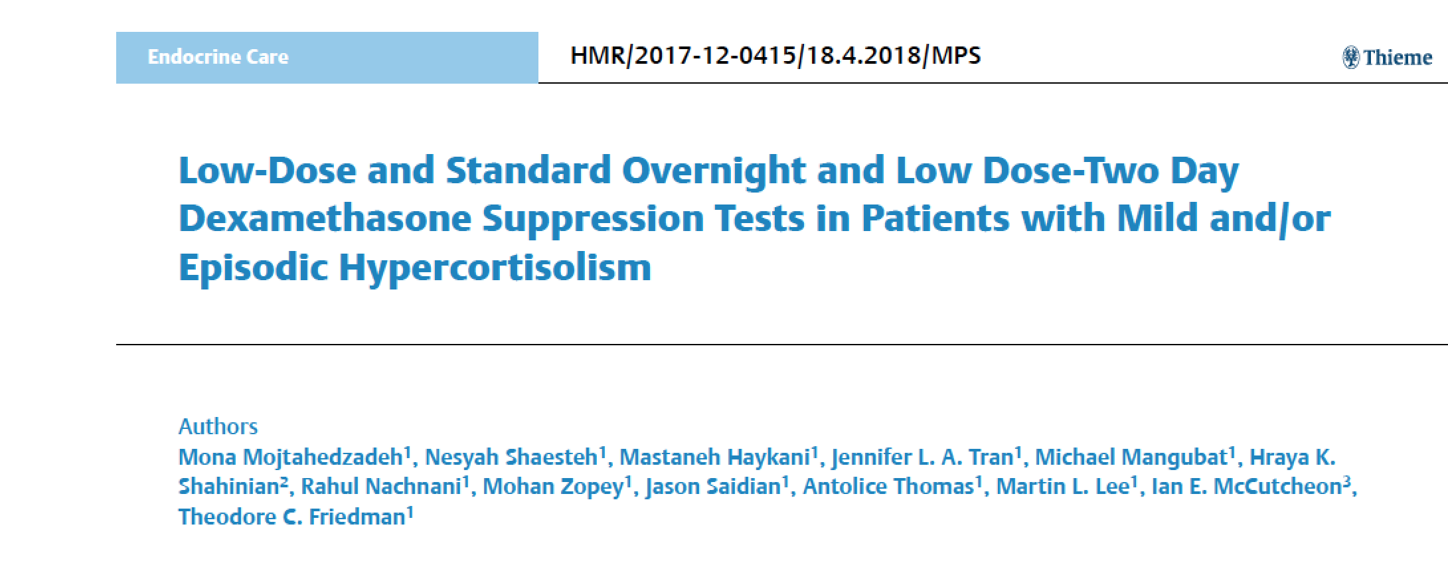
Very Low Overnight dexamethasone test

Slide 47
Very Low Overnight dexamethasone test
The objective of the current study was to determine the sensitivity and specificity of a 0.25 mg overnight DEX suppression test, the standard 1 mg overnight DEX suppression test and the two-day low-dose (Liddle test) DEX suppression test with and without correction for DEX levels in patients evaluated for mild and/or periodic Cushing’s syndrome.
Thirty patients determined to have Cushing’s syndrome by biochemical testing and 14 patients determined not to have the condition had the 0.25 mg and standard 1 mg overnight DEX suppression test and the two-day low-dose DEX suppression tests.

Slide 48
Very Low Overnight dexamethasone test
Our results show that morning serum cortisol and cortisol/DEX ratios following a 1 mg overnight dexamethasone suppression test were similar in patients with Cushing’s syndrome and those not having Cushing’s syndrome.
However, a morning cortisol value above 7.6 μg/dL following a dose of DEX of 0.25 mg was found in 12 patients with Cushing’s syndrome and none in those not having Cushing’s syndrome, suggesting that a high cortisol value after this low dose of dexamethasone can indicate that further testing for Cushing’s syndrome is warranted.
Our data suggests that the traditional 1 mg overnight or the 2 mg-2 day DEX suppression testing should no longer be used as a screening test in patients who could have mild and/or periodic Cushing’s syndrome, while the 0.25 mg dose of DEX may pick up some patients with mild Cushing’s syndrome.

Slide 49
Very Low Overnight dexamethasone test

Slide 50
Very Low Overnight dexamethasone test

Slide 51
Very Low Overnight dexamethasone test

Slide 52
Very Low Overnight dexamethasone test: Conclusions
In conclusion, our paper provides evidence that suppressibility to the 1 mg overnight or 2 mg-two day DEX test should not be used to exclude patients suspected of having mild or episodic Cushing’s syndrome.
A high cortisol value following the 0.25 mg DEX test suggest that the patient may have Cushing’s syndrome and should be evaluated further.
Patients suspected of Cushing’s syndrome should be screened with other tests such as nighttime serum or salivary cortisol measurements or UFC.
Evaluation of the 0.25 mg overnight DEX test in a larger number of patients with mild Cushing’s syndrome as well as those in whom Cushing’s syndrome was excluded may yield discrimination between the two conditions.

Slide 53
Dexamethasone-CRH test
    Patients with pseudo-Cushing’s states show a diminished response to exogenous CRH and a greater inhibition of cortisol production by glucocorticoids than patients with Cushing’s syndrome.
    Yanovski et al. (JAMA 1993, 269:2232-2238) studied 39 patients with surgery confirmed Cushing’s syndrome and 19 patients with pseudo-Cushing states. Both groups of patients had UFC between 90-360 ug/day (nl 20-100 ug/day).
    Dexamethasone (0.5 mg) is given every 6 hours for 8 doses, starting at noon. The last dose is given at 6 A.M, 2 hours before the CRH test. Ovine CRH (1 mg/kg) is then given at 8 A.M. Plasma samples were analyzed for cortisol and ACTH at 4 basal time points (-15, -10, -5 and 0) and at 5, 15, 30, 45 and 60 minutes after oCRH.

Slide 54
Dexamethasone-CRH test
    Using a cutoff of 1.4 mg/dL, a plasma cortisol drawn 15 minutes after oCRH administration (following dexamethasone suppression) was able to completely separate patients with pseudo-Cushing states from those with Cushing syndrome. This was much better than just performing a oCRH test or dexamethasone test alone.
    Subsequently, many articles have shown the test is not full-proof
    Timing is crucial.
    Has not been tested in mild or periodic patients.
    The dex-CRH test is expensive and time consuming. I found that most of my patients with mild Cushing’s syndrome had low cortisol values following the test.
    Cannot tell if a patients is in a high, so hard to plan when to perform test in those with episodic Cushing’s

Slide 55
Role of Imaging for the diagnosis of Cushing’s
Most of the patients I see have pituitary Cushing’s disease.
3T MRIs are high quality; most pituitary tumors are seen on MRI.
Patients can have incidentalomas, so a tumor doesn’t make the diagnosis of Cushing’s, but does give an important piece of information.
A negative MRI in a patient that has a normal or mildly elevated ACTH pretty much excludes Cushing’s (low ACTH=adrenal Cushing’s, high ACTH=ectopic)

Slide 56
Pituitary MRI
In literature approximately 50% of patients with Cushing disease have a visible tumor on MRI (older, non-dynamic, lower power MRIs).
10% of normal volunteers have MRIs consistent with a pituitary adenoma (Hall et al. Ann. Intern. Med., 1994, 120:817-820).
Now 3 Tesla doing dynamic MRIs can pick up small tumors are done.
Patients without Cushing’s syndrome or with adrenal/ectopic Cushing’s can have a pituitary incidentaloma.
Friedman, T.C., Zuckerbraun, E., Lee, M.L., Kabil, M.S., Shahinian, H.K. (2007) Dynamic Pituitary MRI Has High Sensitivity and Specificity for the Diagnosis of Mild Cushing’s Syndrome and Should be Part of the Initial Workup. Hormone and Metabolic Research 39:451-456.

Slide 57
Pituitary MRI
23 of 24 patients had had a MRI consistent with a pituitary lesion
12
10
8
Tumor size (mm)
6
4
2
0
Pt #

Slide 58
Pituitary MRI
    23 of 24 patients had had a MRI consistent with a pituitary lesion (21 with a microadenoma, two with pituitary asymmetry).
    Only 3 of 20 patients (2 patient did not have MRIs) in the Cushing’s excluded group had a pituitary lesion on dynamic MRI.
    Dynamic pituitary MRI had the highest sensitivity and negative predictive value of any testing modalities and its specificity and positive predictive value were similar to that of other tests.
    A negative MRI goes a long way in excluding Cushing’s syndrome, except in the patient with adrenal or ectopic Cushing’s syndrome, who usually has more severe hypercortisolism and is usually easy to diagnose.
    Positive MRI is helpful, but still needs biochemical evidence for hypercortisolism.

Slide 59
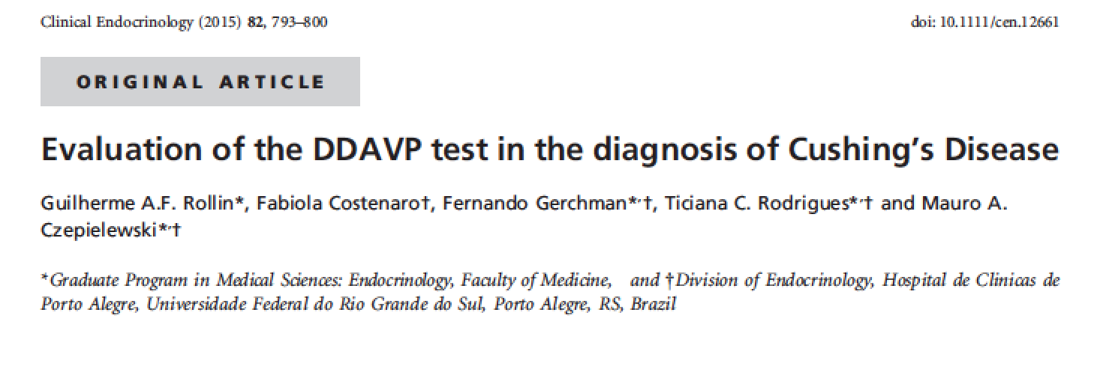
Desmopressin test

Slide 60
Desmopressin test
Blood samples for ACTH and cortisol measurements were obtained from an indwelling venous catheter 30 min before the test, as well as 15, 0, 15, 30, 45 and 60 min injection
10 mcg of DDAVP was administered via IV bolus.

Slide 61
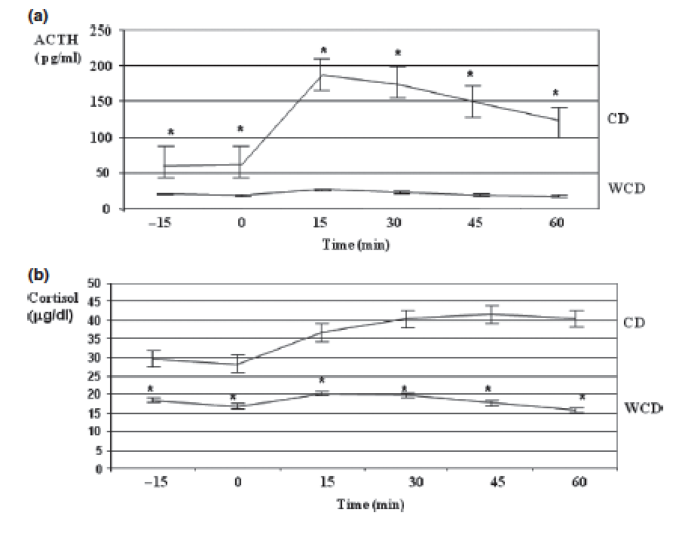
Desmopressin test
A peak ACTH response of 71.8 pg/mL or an ACTH increment of 37 pg/ml following DDAVP had the best diagnostic accuracy in terms of its sensitivity, specificity, positive and negative predictive value

Slide 62
Unhelpful tests
Morning cortisol (Friedman, T.C. and Yanovski, J.A. (1995) Morning Plasma Free Cortisol: Inability to Distinguish Patients with Mild Cushing Syndrome from Patients with Pseudo-Cushing States. J. Endocrinol. Invest. 18:696-701)
Morning ACTH (except to determine type of Cushing’s)
Late afternoon cortisol
Insulin tolerance test
CRH test

Slide 63
10 hr urine Cortisol/Cr
Corcuff, et al. Clinical Endocrinology 48:1998, 503-508.
Night-time (from 10 PM to 8 AM) UFC excretion (correct for g of creatinine)
16 nmol/umol was the cutoff
Helpful in subjects with high night time cortisol excretion and low daytime cortisol excretion
Correcting for US units 16 ug/g is a reasonable cut-off

Slide 64
10 hr urine Cortisol/Cr
Median 16 ug/g

Slide 65
10 hr urine Cortisol/Cr
Unfortunately it did not separate normals from those with Cushing’s syndrome
I’m not using it anymore, but looking at other tests

Slide 66
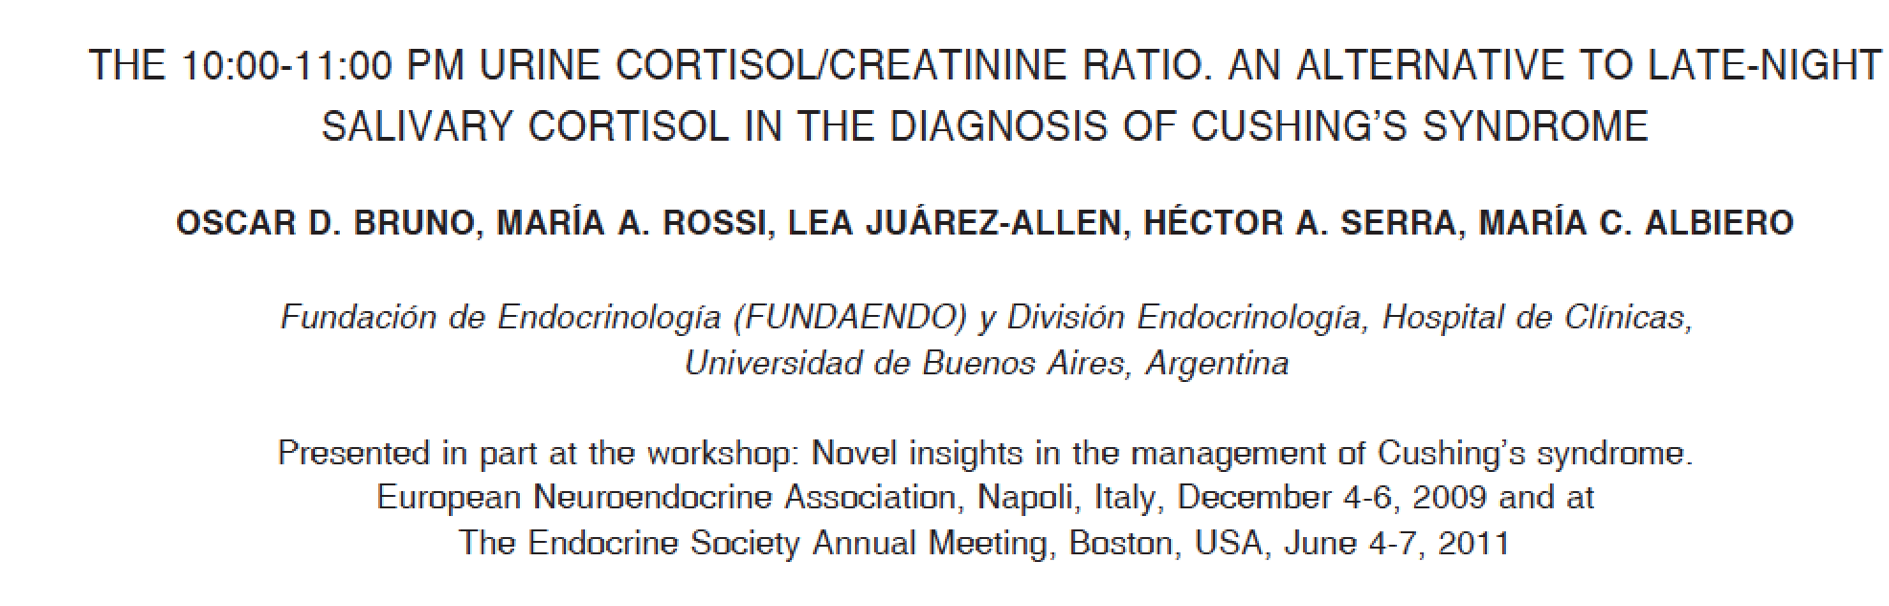
10 PM to 11 PM urine Cortisol/Cr

Slide 67
10 PM to 11 PM urine Cortisol/Cr
Cutoff 31/6 ug/g

Slide 68
Ketoconazole Trial for Cushing’s
Ketoconazole is safe, with the main side effect being increased liver tests, which usually occur at doses > 1000 mg/day and are reversible.
It does interact with a lot of drugs, but these interactions can usually be dealt with by changing the other drug or watching for side effects
It has a short-half life so it should be given at night, when cortisol is inappropriate high in Cushing’s patients.
I usually give 200 mg at 8 and 10 PM and have patients take 5 mg of Cortef in the AM, if needed.

Slide 69
Ketoconazole Trial for Cushing’s
Ketoconazole can be used diagnostically to determine which symptoms a patient has are due to high cortisol.
I use it in patients who I am pretty sure, but not completely sure has Cushing's and I want them to get symptomatic relief.
I’m concerned if someone doesn’t get better on ketoconazole, they really don’t have Cushing's.
I have kept patients on ketoconazole for up to 3 years without problems.
I often stop it for a round of testing, or if a patient develops a tumor on MRI.
Rise in ACTH following ketoconazole might be a sign of pituitary Cushing’s disease

Slide 70
RECOMMENDATIONS
Careful history and physical
At least 4 UFC and 17-OHS
At least 4 11 pm salivary cortisols
Night time serum cortisol
MRI
Ketoconazole trial
Make diagnosis if two distinct values are high
Have patient keep a diary and try to collect when “high”

Slide 71
For more information/to schedule an appointment
www.goodhormonehealth.com
mail@goodhormonehealth.com
Talks will be posted in a few days

Slide 72
Who runs the best pituitary patient conference?
The Magic Foundation

Slide 73


Thanks to:
Dianne Kremidas
Magic Foundation
All my patients
Surgeons: Ian McCutcheon, M.D., Mark Linskey, Hrayr Shahinian, M.D., Hae Dong Jho, M.D., Ph.D. , Sandeep Kunwar, M.D., Ed Phillips, M.D., Manfred Chiang, M.D.
Assistants: Lynne Drabkowski, Judy Sewell and Erik Zuckerbraun, M.D.

