Slide 1
Theodore C. Friedman, M.D., Ph.D. GoodHormoneHealth Webinar on Lifestyle Medicine for Patients with Endocrine Problems With Eddie Ramirez, MD January 22, 2023

Slide 2
Focus on Health and Wellness
My main approach to weight loss is to rule out any endocrine problems, such as hypothyroidism, Cushing syndrome, or growth hormone deficiency, that may lead to weight gain.
As a result of their endocrine condition, many of my patients are overweight and feel like crap
I work on optimizing hormones.
Simultaneously, I encourage patients to consume a low-calorie diet, and I often recommends eating a large quantity of vegetables, as they are low in calories with a large amount of nutrition, as well as to move.
Get a good night sleep
Good mental health
Avoid stress or at least don’t let stress bother you.
Hike and be in nature
I invited my good friend and colleague, Eddie Ramirez, MD to go into a deeper dive for the 6 pillars of health to get you to to feel better.

Slide 4
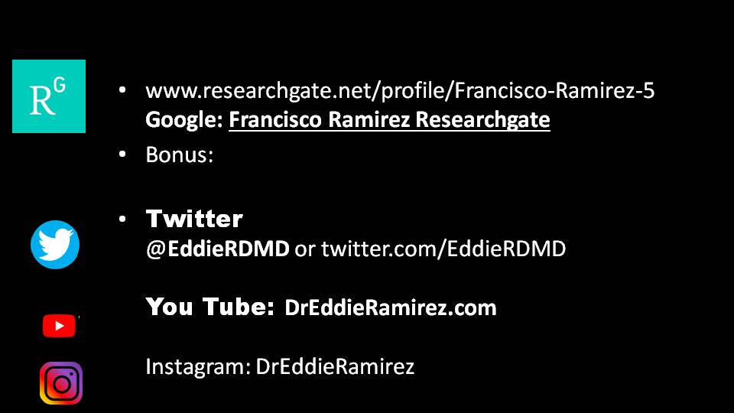

Slide 65
For more information/to schedule an appointment
Talk will be posted at www.goodhormonehealth.com in a few days
Visit www.goodhormonehealth.com to read other articles or schedule an appointment
https://www.tiktok.com/@goodhormomehealth
has increased, we have 913 followers from
https://www.facebook.com/goodhormonehealth
https://www.instagram.com/goodhormonehealth/?hl=en

