Slide 1
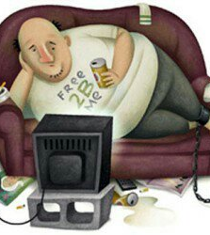
Sedentary Lifestyle:
A Silent Killer

Slide 2
What is a Sedentary Lifestyle?
It is a lifestyle that includes little or no physical activity.
Sedentary person is commonly known as a “couch potato”

Slide 3
Sitting Disease Facts
On average, Americans sit 11 hours a day.
300,000 deaths occur annually due to inactivity and poor dietary choices in the U.S. alone.
20% of all deaths of people 35 and older are attributed to a lack of physical activity.
6.5% of Americans meet the minimum physical guidelines requirements for work.

Slide 4
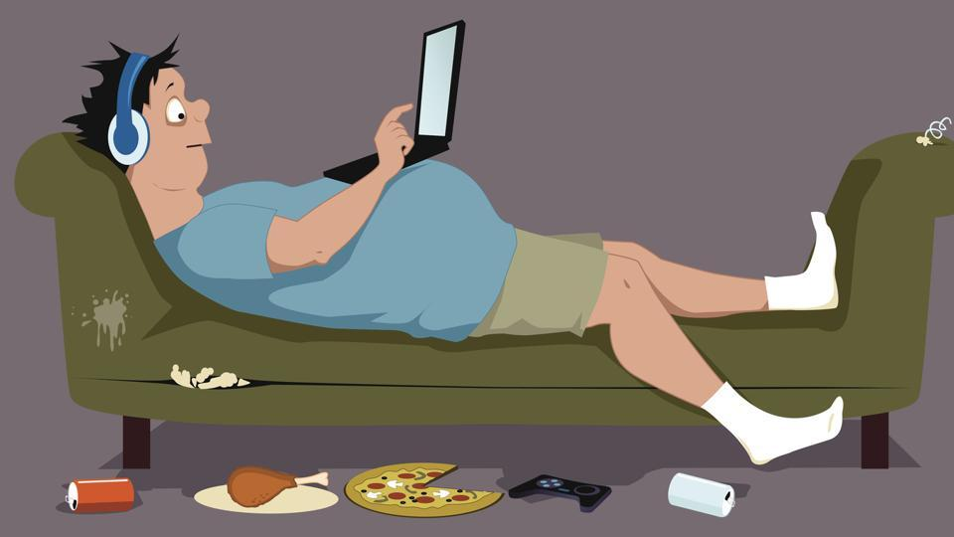
Reasons for Sedentary Lifestyle
Sedentary due to:
Increased use of technologies
Cellphones, television, laptop/iPad etc.
Increased use of automobiles
Clerical jobs

Slide 5
Effects of a Sedentary Lifestyle

Slide 6
Other Effects

Slide 7
Television and Sedentarism

Slide 8
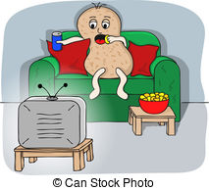
65% of Americans watch more than 2 hours of television everyday.
According to a study, there are 176 new cases of diabetes and 38 additional deaths from heart disease for every 2 hours Americans spend watching television.

Slide 9
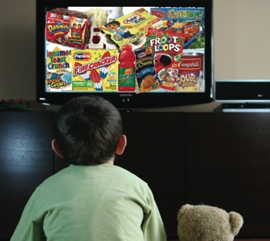
Why?
Affects food choices
Linked to unhealthy diets
Too much sugar, soda, processed food and snacks
Foods in commercial promote unhealthy foods
Linked with social isolation
Leisure time is wasted sitting and not exercising

Slide 11
General Tips to Combat a Sedentary Lifestyle

Slide 12
More Tips
Interrupt your sitting
Find somebody to motivate you to stick with an active life

Slide 13
Think about what is best for you!
Start some courses with physical activity

Slide 14
