Slide 1

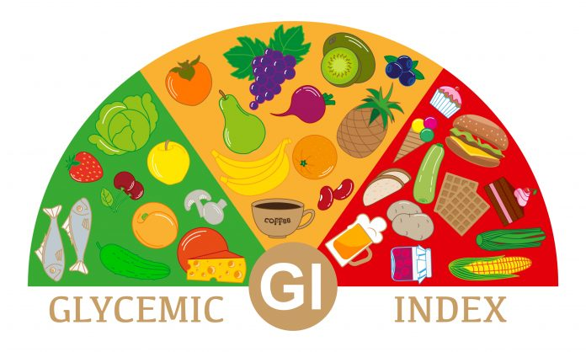
Power Clinic

Slide 2
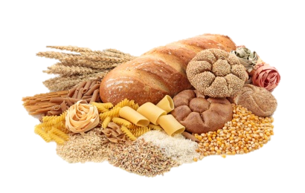
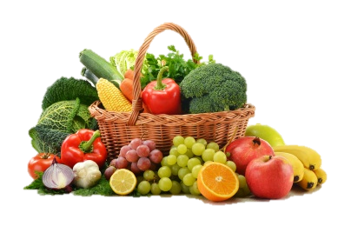
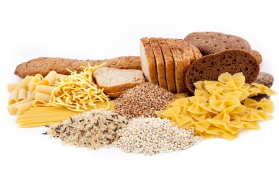
WHAT IS “GI” ?
Glycemic Index (GI) is a useful tool to help us choose the right type / quality of carbohydrates that will positively influence our health.
GI is a ranking of carbohydrate foods from 0 to 100 based on how quickly they raise our blood sugar levels.

Slide 3
WHAT IS “GI” ?
Carbohydrates that break down quickly after eating have the highest GI, while those that breakdown slowly, releasing glucose slowly into the blood stream have low GI.

Slide 4
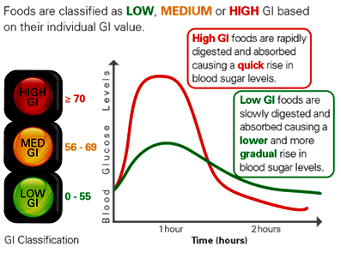
GI CLASSIFICATION

Slide 5
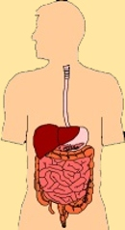
Factors Influencing GI Ranking
Type of starch
Cooking
Physical entrapment
Food processing
Acid content
Sugar content
Fat content
Protein content

Slide 6

BENEFITS OF A LOW GI DIET
Improves blood
glucose control
Prevents & manages diabetes
Increases the
feeling of fullness
Helps control food intake
Facilitates
weight loss
Reduces risk of
heart diseases

Slide 7
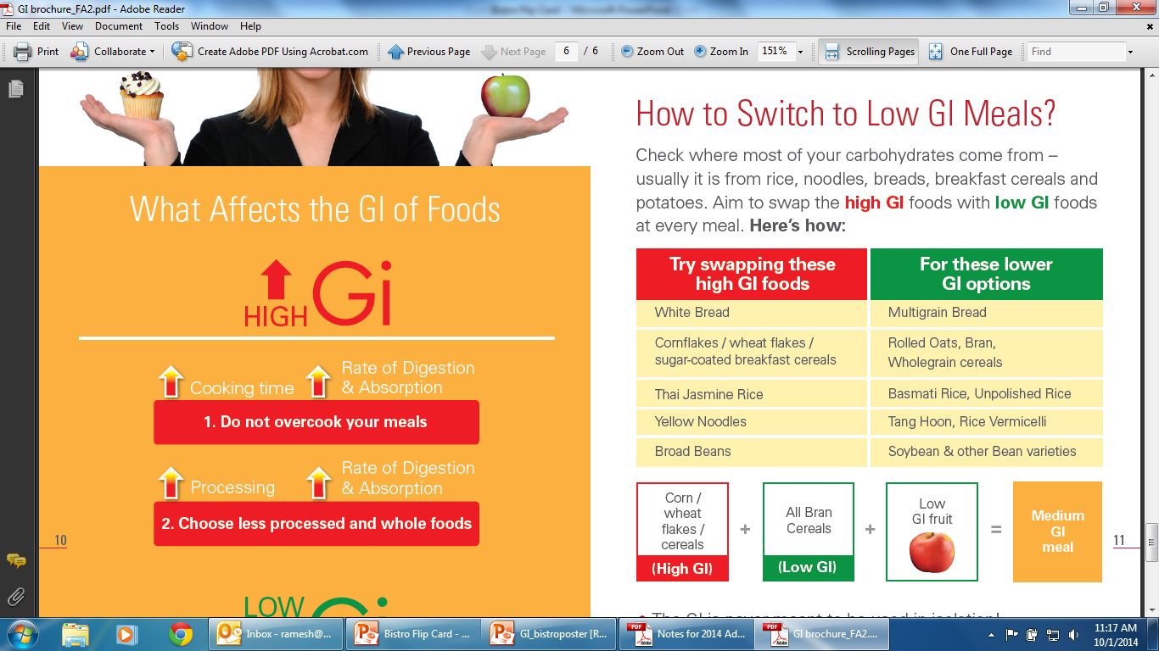
HOW TO SWITCH TO LOW GI MEALS

Slide 8
TIPS ON HEALTHY EATING WITH LOW GI
Eat two or more servings of fruits and vegetables every day
Include more beans and legumes such as soybeans and chickpeas in your diet.
Substitute your high GI breads, rice, and cereals with low GI varieties.

Slide 9

TIPS ON HEALTHY EATING WITH LOW GI
Consume less processed food. Use rolled oats instead of instant oats.
Include at least one low GI food in every meal.
Consume lower GI staple such as wholegrain cereals (e.g. brown rice & barley)

Slide 10


Pictures of Low/High GI Meals & Snacks
GI = 60
GI = 42

Slide 11


Pictures of Low/High GI Meals & Snacks
GI = 83
GI = 14

Slide 12
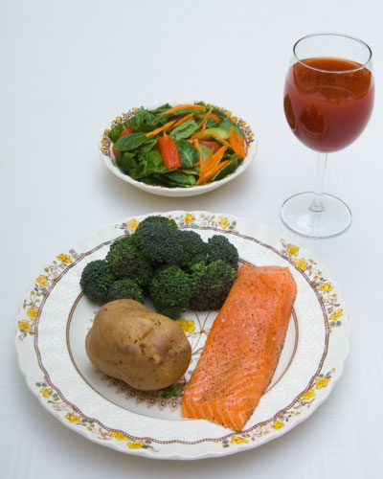

Pictures of Low/High GI Meals & Snacks
GI = 80
GI = 61

Slide 13
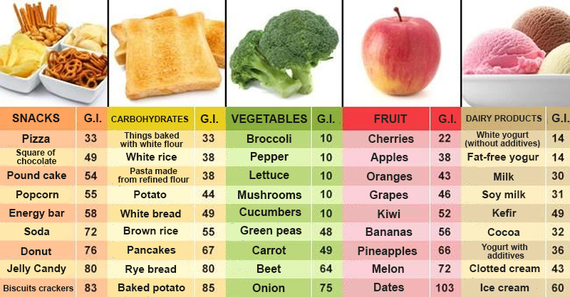
Foods with Glycemic Index

