Slide 1
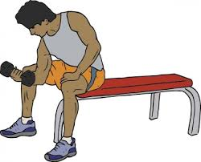
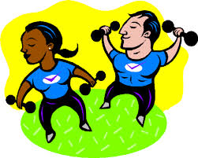
Staying on TOP of physical activity
The Inside Scoop on Indoor Activities

Slide 2
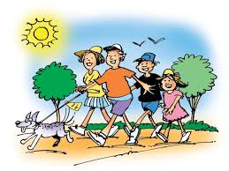
The PROBLEM
When the weather is just too hot, too cold, or too wet, you may want to think about moving your activity plans indoors. There may also be other reasons for not wanting to go outside, such as concern for safety.

Slide 3
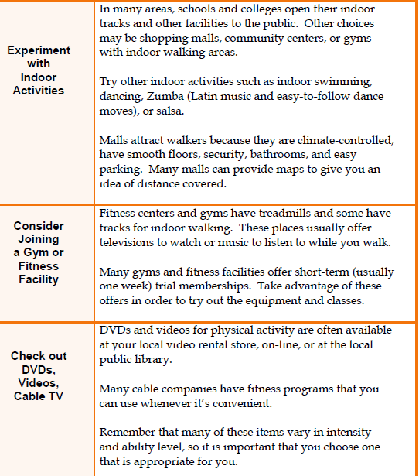
Solutions
“Sitting is the new smoking,” according to Dr. James Levine, of the
Mayo Clinic-
Arizona State University
Obesity Solutions Initiative.

Slide 4
Sitting measured by Science
One study compared adults who spent less than two hours a day in front of the TV or other screen-based entertainment with those who logged more than four hours a day of recreational screen time. Those with greater screen time had:
A nearly 50 percent increased risk of death from any cause
About a 125 percent increased risk of events associated with cardiovascular disease, such as chest pain (angina) or heart attack
Sitting in front of the TV isn't the only concern. Any extended sitting — such as behind a desk at work or behind the wheel — can be harmful. What's more, spending a few hours a week at the gym or otherwise engaged in moderate or vigorous activity doesn't seem to significantly offset the risk.
The solution seems to be less sitting and more moving overall. You might start by simply standing rather than sitting whenever you have the chance or think about ways to walk while you work.
http://www.mayoclinic.org/healthy-lifestyle/adult-health/expert-answers/sitting/faq-20058005

Slide 5
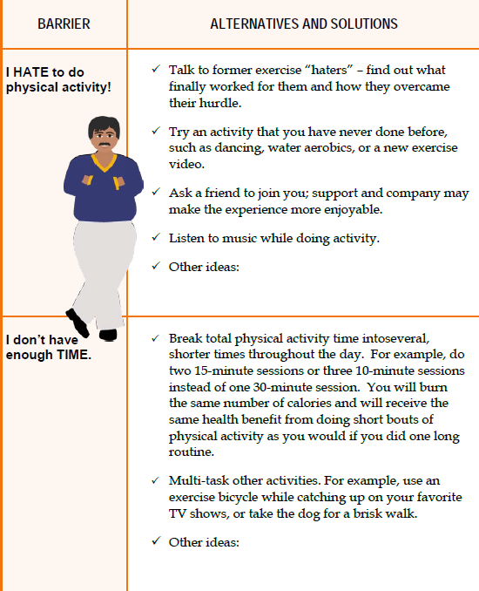
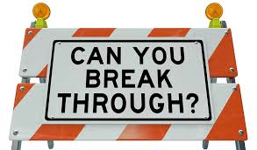
Barriers to exercise
The French study of more than 1,000 elderly subjects found a negative correlation between a person's level of physical activity and his or her risk of "all-cause" death.
In his presentation, Hupin emphasized that physical activity reduces mortality rates in a "dose-dependent" way, but even low levels of exercise (well below the current public health recommendations) have a protective effect.

Slide 6
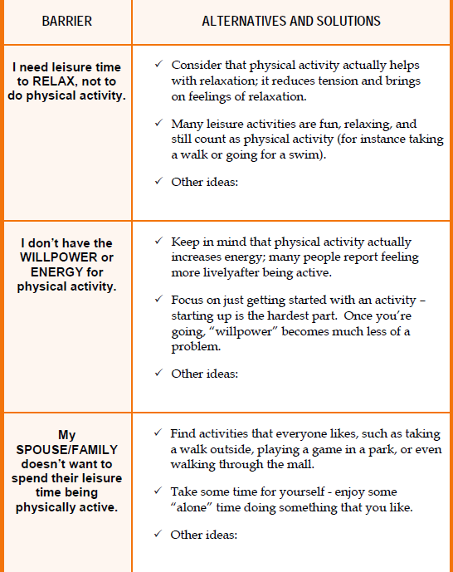
Barriers to Exercise
In another recent study on the benefits of small doses of physical activity, researchers at the University of Utah School of Medicine found that people who got up and moved around for at least two minutes for every hour of sitting had a 33 percent lower risk of dying.
The May 2015, “Light-Intensity Physical Activities and Mortality in the United States General Population and CKD Subpopulation,” was published in the Clinical Journal of the American Society of Nephrology.

Slide 7
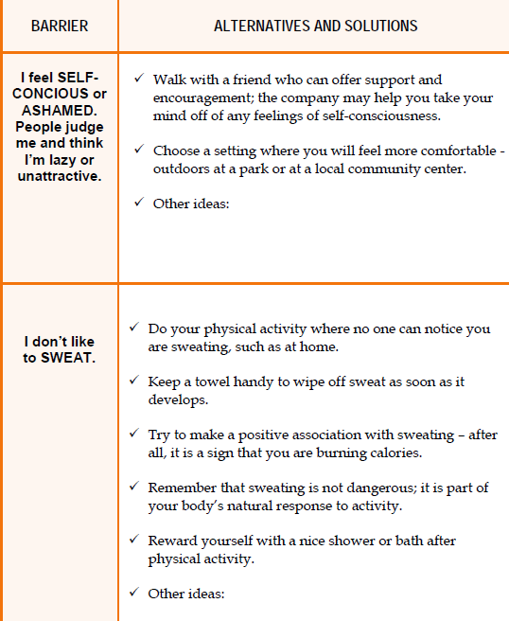
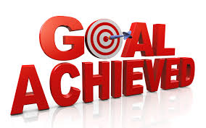
Barriers to Exercise
"If you can do five minutes every hour, you can actually end up burning 1,000 additional calories a week. That can decrease fat tissue and help maintain or even lose weight." In a conclusion that echoed the findings from the French report, Beddhu concluded

Slide 8
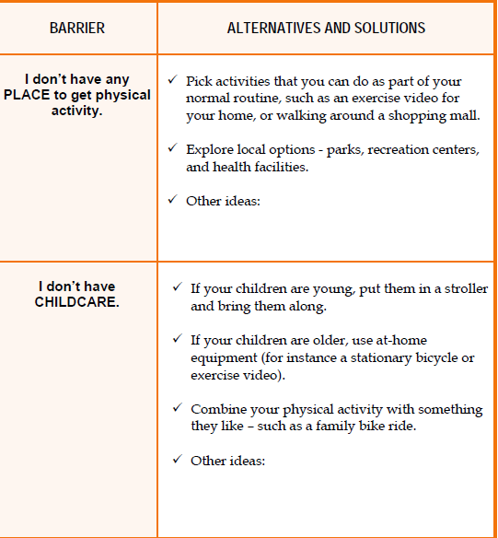
Barriers to Exercise
In a study published in Preventive Medicine in 2006, researchers found that multiple workout sessions as short as 6 minutes apiece could help sedentary adults reach fitness goals similar to those achieved
by working out for
30 minutes at a time.

Slide 9
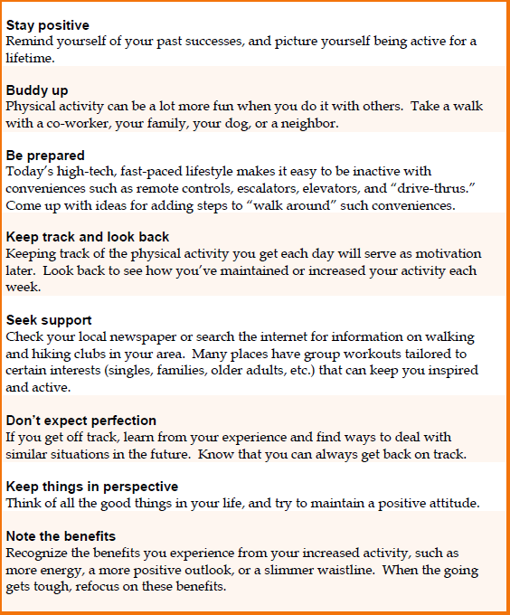
What Can You DO?

Slide 10
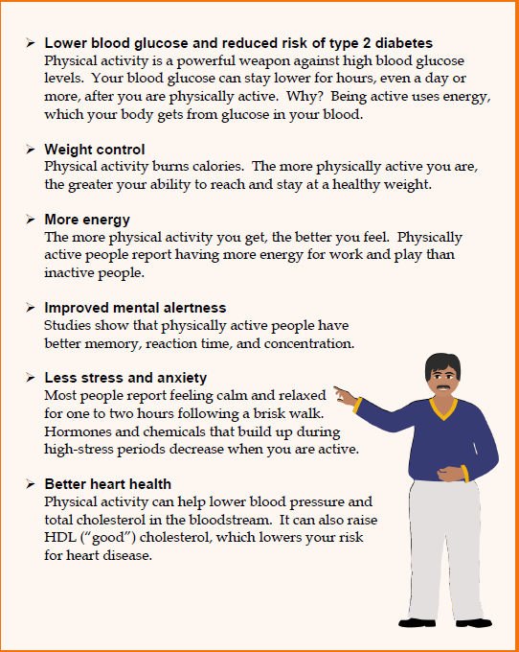
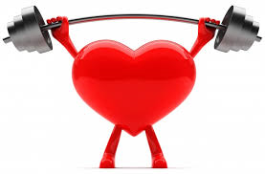
Health benefits of physical activity

Slide 11
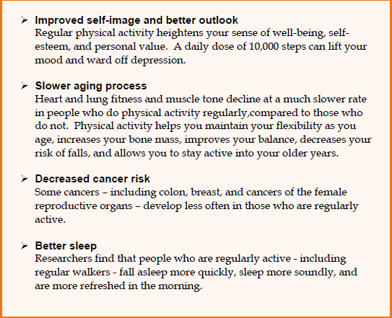
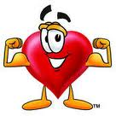
Health benefits of physical activity
It's important to make the most of those few minutes. "You should come away from your 2 minutes or your 5 minutes or your 10 minutes of exercise feeling as if you have accomplished something," she says. "There is a certain amount of pushing your body that has to take place, even if it's just for 5 minutes."

