Slide 1
Turn Dreams Into Goals… S.m.a.r.t. Goals
By Andrew Ajoku

Slide 3
What’s the Difference?
Dreams
Goals
Dreams are imaginary
Dreaming just takes an imagination, you can do it in your sleep
Dreaming is Free
Dreams inspire you
Goals are in real-time
Goals need action, they require hard work
Goals have a cost
(sweat, time, money, effort)
Goals change your life

Slide 4
What makes a Goal SMART?
Specific
Measureable
Achievable
Relevant
Timed

Slide 5
S - Specific
Define the goal so that it is very clear
Make it so anyone can understand it
Use the “W” questions:
Who
What
Where
When
Why

Slide 6
M - Measureable
A way to mark the progress towards your goal
Ask yourself:
How many?
How much?
How will I know it’s accomplished?

Slide 7
A - Achievable
Make the goal challenging but not impossible
Make the goal realistic:
Do I have the proper skills, resources, knowledge? etc.
Are you willing and able to make it happen?

Slide 8
R- Relevant
Make it important to YOU and what YOU want, not just what your friends and/or family members want
Does it fit into the master plan?
Is it worth the effort and will it meet your needs?
Can this goal be accomplished at this time?

Slide 9
T - Timed
Set a specific time limit
I will complete this step by this month/day/year
Creates a sense that the clock is counting down
Have checkpoints along the way to keep you on track

Slide 10
Simple vs. Smart – An Example

Slide 12
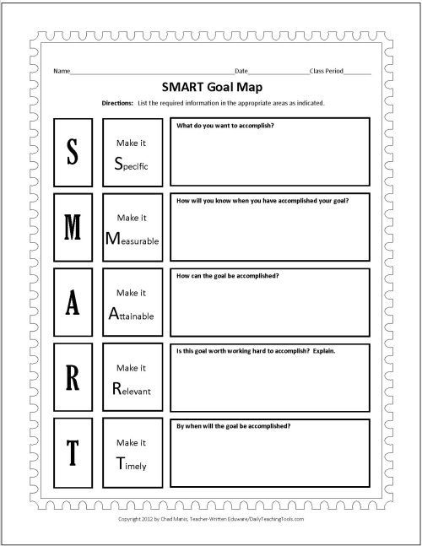
Smart Goal Worksheet
Tips for Setting Goals:
Write your goals on paper. People who write down their goals are more likely to achieve them.
Change is hard. Start with one or two goals to increase your chances of success.

