Slide 1

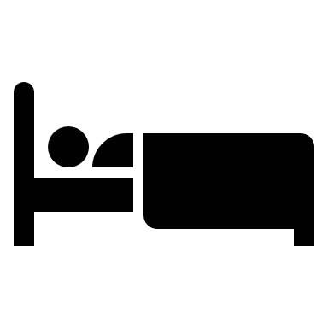

Obesity and Sleep Apnea

Slide 2
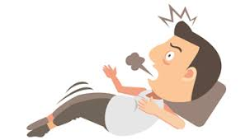
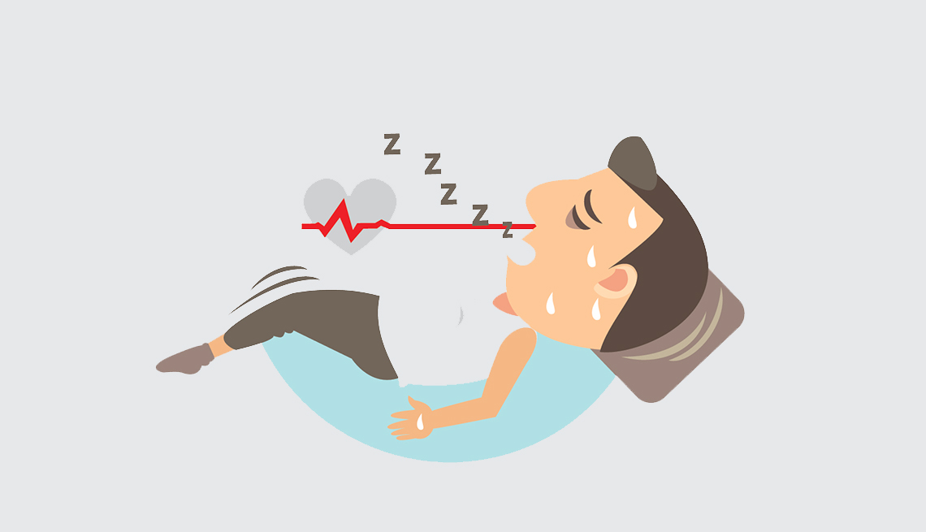
What is Sleep Apnea?
Sleep apnea is a potentially serious sleep disorder in which breathing repeatedly stops and starts. If you snore loudly and feel tired even after a full night's sleep, you might have sleep apnea.

Slide 3
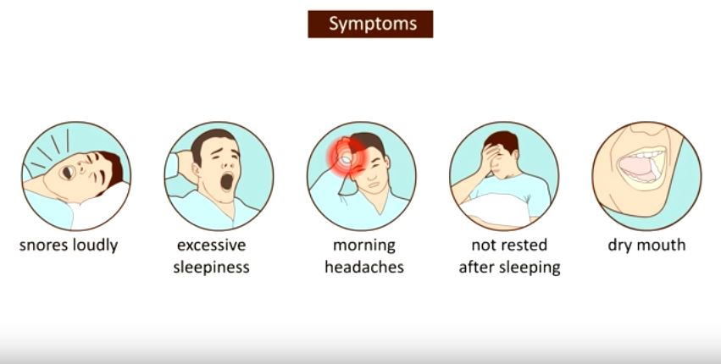
Sleep Apnea Symptoms

Slide 4
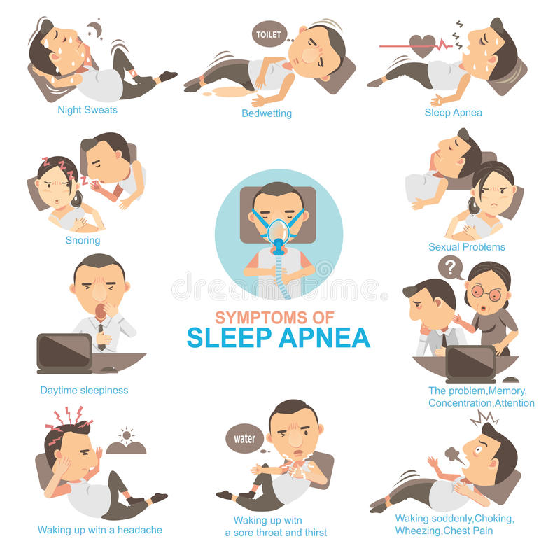
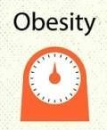
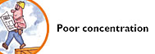
Getting up multiple times to use the bathroom during sleep
Difficulty concentrating during the day
Lack of dreaming
Gastroesophageal Reflux (GERD)
Hormone Imbalances

Slide 5
Snoring, Sleep Apnea and Hormones Leading to Weight Gain
Sleep deprivation whether from bad habits(work, devices at night or lifestyle)or sleep disordered breathing(OSA) will negatively impact metabolism
Ghrelin (makes you hungry). These levels increase with poor sleep
Cortisol (the stress hormone) levels are elevated with poor sleep = crave more sugar and fatty (comfort) foods
Insulin resistance – fragmented sleep and minimal REM sleep can disrupt proper insulin regulation and lead to increased insulin resistance and eventually diabetes
Leptin (makes you feel full, inhibits hunger). These levels decrease with poor quality sleep
More ghrelin and less leptin equals weight gain

Slide 6
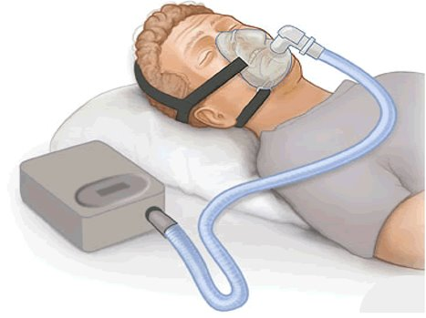
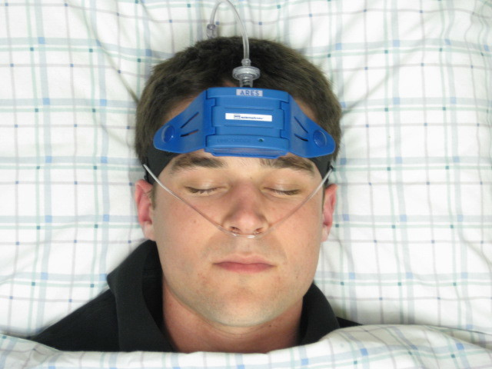
How do you find out you have sleep apnea?
Treatment with CPAP will improve sleep and often lead to weight loss
A Sleep Study Test needs to be performed-see you PCP

