Slide 1
New and Traditional Treatments for Male Hypogonadism
Theodore Friedman, MD, PhD
and Shira Miller, MD
GoodHormoneHealth Webinar
February 10, 2019

Slide 2
Outline
Causes of Male Hypogonadism
How to Diagnose Male Hypogonadism
Testosterone Replacement
HCG and Clomiphene (Clomid)
Supplements for Male Hypogonadism
Diets for Male Hypogonadism

Slide 3
Hormonal Axes
Adrenal (corticotropes)=CRH-ACTH-Cortisol
Thyroid (thyrotropes)= TRH-TSH-T4/T3
Gonads (gonadotropes)= GnRH-LH/FSH-Testosterone/estrogen
GH (sommatotropes) =GHRH-GH-IGF-1
Posterior pituitary-AVP and oxytocin

Slide 4
Order of Pituitary Hormone Deficiencies
GH
Gonadotropins (FSH, LH)
TSH
ACTH
Prolactin
Posterior pituitary hormones

Slide 5
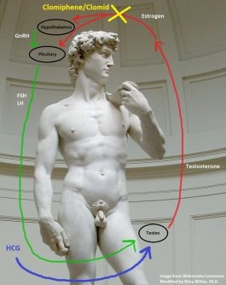
Hypothalamic-Pituitary-Gonadal Axis

Slide 6
Symptoms of Hypogonadism
Erectile Dysfunction
Low libido
Infertility
Decreased muscle strength
Poor endurance/stamina
Fatigue
Depression

Slide 7
Signs of Hypogonadism
Soft testes may be the earliest sign of gonadotropin deficiency
Small testes or gynecomastia (extra breast tissue)

Slide 8
Causes of Primary Hypogonadism
Testicular Causes
High LH and FSH
Testicular surgery
Testicular trauma
Klinefelter’s syndrome (XXY)
Chemotherapy
Radiation therapy to testis
Orchitis (mumps)

Slide 9
Causes of Secondary Hypogonadism
Hypothalamic/Pituitary Causes
Low LH and FSH
Kallmann’s syndrome (anosmia)
Pituitary tumor
Pituitary Surgery/Radiation
Hyperprolactinemia
Hypothalamic diseases (sarcoidosis, hemochromatosis)

Slide 10
Causes of Secondary Hypogonadism
Anywhere along the hypothalamic-stalk-pituitary axis
25% of male patients with microadenomas had secondary hypogonadism (Yuen, et al. Clinical Endocrinology 69:292-298, 2008)

Slide 11
Functional Hypogonadism: Intact HPT Axis
J Clin Endocrinol Metab. 2017 Mar 1;102(3):1067-1075. doi: 10.1210/jc.2016-3580.
https://www.ncbi.nlm.nih.gov/pubmed/28359097
Form of Secondary Hypogonadism (Inappropriately normal LH/FSH in the setting of low testosterone)
Benefit/risk ratio lower than anatomic HPT-axis pathology
Common 2.1-12.3%

Slide 12
Prevalence
J Clin Endocrinol Metab. 2017 Mar 1;102(3):1067-1075. doi: 10.1210/jc.2016-3580.
https://www.ncbi.nlm.nih.gov/pubmed/28359097

Slide 13
Traditional Causes of Functional Hypogonadism
Aging
Obesity
Diabetes
Opioids
Marijuana
Post-finasteride
Glucocorticoids
Exogenous Anabolic Steroids

Slide 14
Other Possible Causes of Functional Hypogonadism
Endocrine Disruptors (POPS) https://www.ncbi.nlm.nih.gov/pmc/articles/PMC3901884/
Stress https://www.ncbi.nlm.nih.gov/pubmed/5350299 https://www.ncbi.nlm.nih.gov/pubmed/26477499
Depression https://www.healio.com/endocrinology/reproduction-androgen-disorders/news/in-the-journals/%7B0f2f5b41-1789-44ee-ba5c-455e937aaef4%7D/depression-may-cause-nonclassical-hypogonadism
Disturbed sleep/sleep deprivation https://www.ncbi.nlm.nih.gov/pmc/articles/PMC4445839 https://www.ncbi.nlm.nih.gov/pubmed/24739309
Sedentary Lifestyle https://www.ncbi.nlm.nih.gov/pubmed/27501721
Cell phone usage https://www.ncbi.nlm.nih.gov/pmc/articles/PMC3921848 https://www.ncbi.nlm.nih.gov/pubmed/22897402

Slide 15
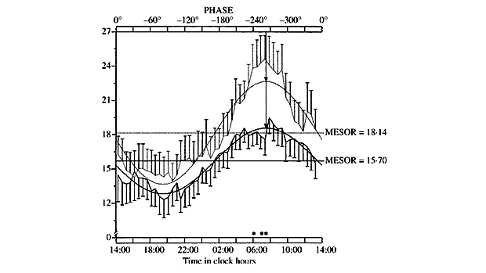
Circadian Rhythm of Testosterone
Testosterone is highest between 6 and 8 AM and declines throughout the day.
If testing for hypogonadism, you need to get your blood drawn at about 8 AM, otherwise it will be falsely low.

Slide 16
Sex-Hormone Binding Globulin (SHBG)
Binds to testosterone
Only the free testosterone form is active
SHBG is low in obesity and diabetes/prediabetes
Men with obesity or diabetes/prediabetes have low SHBG and low total testosterone, but normal free testosterone.

Slide 17
How to Diagnose Male Hypogonadism
Measure free and total testosterone around 8 AM on two occasions.
Cannot make the diagnosis on afternoon samples
If both draws for free and total testosterone are below the normal range, male hypogonadism is likely.
Anemia is usually seen in male hypogonadism, so I get a CBC and look for a low hemoglobin and hematocrit.
Measure PSA, if above 4, probably don’t treat, or use in combination with finasteride.

Slide 18
How to Determine Primary vs Secondary vs Functional Hypogonadism
Measure LH and FSH
If below range-secondary
If above range, especially FSH-primary
Measure prolactin-if high-probable secondary
If normal LH and FSH, probably functional
If it points to secondary, get a 3T pituitary MRI

Slide 19
Testing for Male Hypogonadism

Slide 20
Approach to Hypogonadism
J Clin Endocrinol Metab. 2017 Mar 1;102(3):1067-1075. doi: 10.1210/jc.2016-3580.
https://www.ncbi.nlm.nih.gov/pubmed/28359097

Slide 21
Androgen Replacements
Testosterone shots (IM or subcut)
Testosterone topical gel (Androgel or compounded)
Testosterone patch
Buccal testosterone
Testosterone implants
HCG
Clomiphene (Clomid)

Slide 22
Testosterone Cypionate vs Enanthate
Both are similar and need to be given by shots
Cypionate is mainly used in the US and Enanthate mainly in Europe
Cypionate has a longer effect than enanthate, because it has an 8 Carbon chain instead of a 7 Carbon chain like enanthate
Depo is short for depo-testosterone which is just cypionate
Cypionate may be less expensive than enanthate

Slide 23
Testosterone Subcut vs IM
Traditionally recommended that testosterone injections be given intramuscularly using a big needle, into a muscle, such as the buttocks or shoulder.
This is often quite painful and is difficult for the patient to do himself.
Used to be recommended for every 2 weeks-high levels after injection, low levels before injection
Dr. Friedman and some other endocrinologists have realized that testosterone can be given subcutaneously, in the stomach, with a small needle that is just as effective as the bigger needle.

Slide 24
Testosterone Subcut
Testosterone at a dose of 100 mg once a week or 50 mg twice a week.
10 mL vial of 100 mg/mL testosterone.
Often the pharmacy tries to substitute a smaller vial with 2 mL of 200 mg/mL, and this is much harder to dose accurately and does not last as long as the 10 mL vial.

Slide 25
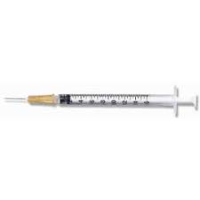
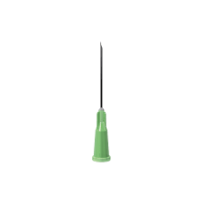
Testosterone Subcut
2 syringes with interchangeable needles.
A smaller one, which would be a 25-gauge, 5/8-inch syringe -needle, to inject testosterone in the stomach.
Larger needle 21-gauge, 1-inch syringe-needle to draw up the testosterone
The size of the syringe can be either 1 mL or 3 mL, but it is important to have needles that come off and can be replaced.

Slide 26
FDA Clears First Autoinjectable Testosterone, Xyosted
Testosterone enanthate
once-weekly self-administration using a disposable autoinjector
50 mg, 75 mg, and 100 mg
The cost for Xyosted (50 mg/0.5 mL) is around $504 for a supply of 2 milliliters (1 month)

Slide 27
Subcutaneous Testosterone

Slide 28
Testosterone Patches and Gels
Patches or gels usually do not achieve high enough levels, especially in obese men
They might be okay for an older person who just wants testosterone a little bit higher.
A younger person often needs the higher levels achieved by injections.
With gels, need to make sure not to contaminant women or children
Buccal-very inconvenient, only comes in one dose
Patches-lots of skin irritation

Slide 29
Testosterone Implants
High levels after implant, low levels before next implant
Probably want to avoid unless elderly

Slide 30
Testosterone Replacement
Measure morning (around 8 AM) free and total testosterone about 6 weeks after starting testosterone replacement
Measure midway between shots
3-4 days after weekly shot
2 days after biweekly shot
Aim for free testosterone level in upper normal
Make sure hematocrit is < 51%
Make sure PSA isn’t rising and is below 4 ng/mL

Slide 31
Hypothalamic-Pituitary-Gonadal Axis

Slide 32
Finasteride
Testosterone gets converted to dihydrotestosterone (DHT) which if high, can lead to prostate growth and/or hair loss.
Make sure DHT is normal (< 70 ng/dL)
If high, can add Finasteride
Comes as a more expensive 1 mg pill or less expensive 5 mg pill.
I usually prescribe the 5 mg pill, and the patient can take 1/2 pill of that twice or 3 times a week.
Monitor DHT levels.

Slide 33
Arimidex (Anastrozole)
Testosterone gets converted to estradiol
High estradiol can lead to breast enlargement and also breast tenderness.
I will measure the estradiol after starting and if the estradiol is above 35 pg/mL, I would add a Arimidex which blocks conversion of testosterone to estradiol.
Usual dose is 1 mg pills, 1/2 pill twice a week.
The estradiol usually comes down and breast tenderness resolves
Breast enlargement will take longer to resolve.

Slide 34
High Hematocrit
Patients on testosterone can also get a high hematocrit
This can lead, if left high, to blood clots and strokes.
A hematocrit above 51% is concerning.
The best remedy for this is for the patient to donate blood to the Red Cross.
There are no restrictions on blood donation [except for MSM (men who have sex with men)] the patient is on testosterone, and this is accomplishing a good deed for society and also helping the patient's health

Slide 35
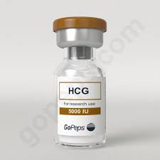
Human Chorionic Gonadotropin (HCG) for Testicular Shrinkage
Testosterone leads to testicular shrinkage because it is the product of the testes.
HCG is similar to the pituitary hormone LH
It stimulates the testes to make testosterone and can be used in combination with testosterone replacement.
Bottle comes as 10,000 iU/10 mL
Dose in addition to testosterone is usually 500-1000 units 3X/week
Can be given on days testosterone is not given

Slide 36
HCG for Fertility
Testosterone inhibits sperm counts and has been tried as a contraception
If patient desires fertility, testosterone can be replaced by HCG
Dose instead of testosterone is usually 2000 units 3X/week
Semen analysis can be done 2 months after starting HCG

Slide 37
Lifestyle Changes and Supplements for Function Hypogonadism
Overweight and Obesity Associated with Reduction in Total and Free Testosterone BMI 25-30: 66ng/dL reduction
BMI >30: 147ng/dL reduction
https://www.ncbi.nlm.nih.gov/pubmed/20173018
Weight Loss Can Increase Testosterone
In Overweight Men
5% weight loss: 58ng/dL increase
15% weight loss: 164ng/dL increase In Obese Men
Diet: 84ng/dL increase
Surgical weight loss: 251ng/dL increase https://www.ncbi.nlm.nih.gov/pubmed/23482592 https://www.ncbi.nlm.nih.gov/pubmed/23425925 Weight Loss Improves HPT Axis (LH, testosterone, estradiol) and Sexual Symptoms

Slide 38
Lifestyle

Slide 39
Lifestyle
Fat/Weight loss
Nutrition – Avoid Low Fat Diets https://www.ncbi.nlm.nih.gov/pubmed/6538617 (animal fat) https://www.ncbi.nlm.nih.gov/pubmed/23472458 (olive oil)
Intermittent Fasting https://www.ncbi.nlm.nih.gov/pubmed/2686332
Exercise (weights, resistance, high-intensity, interval) https://www.ncbi.nlm.nih.gov/pubmed/21058750/
Sexual activity https://www.sciencedirect.com/science/article/abs/pii/0031938492904539
Competition
Sweating/Detox from POPS https://www.ncbi.nlm.nih.gov/pubmed/28301147/ https://www.researchgate.net/publication/274696438_Effect_of_rehydration_on_hormonal_responses_to_heat_exposure_in_a_Finnish_sauna_bath
Avoid increased scrotal temperature (cell phones, laptops, hot tubs) https://www.ncbi.nlm.nih.gov/pubmed/30102388
UV, Red and Far Infrared Light https://www.ncbi.nlm.nih.gov/pubmed/23334615
Sleep-get at least 7-8 hrs of sleep a night https://www.ncbi.nlm.nih.gov/pubmed/30621925
Stop marijuana, opioids, glucocorticoids (if possible)

Slide 40
Supplements
Vitamin D https://www.ncbi.nlm.nih.gov/pubmed/21154195 https://www.ncbi.nlm.nih.gov/pubmed/28938446
Manganese, Selenium, Zinc, Magnesium https://pdfs.semanticscholar.org/27ca/2b845e2b2d92c1d95a5702396879f43487d1.pdf https://www.ncbi.nlm.nih.gov/pmc/articles/PMC3958794
Herbal supplements/foods: Ashwaganda, Ginger Extract, Pomegranate Juice, Garlic https://www.ncbi.nlm.nih.gov/pubmed/24371462 https://www.ncbi.nlm.nih.gov/pubmed/30360442 https://www.endocrine-abstracts.org/ea/0028/ea0028p313 https://www.ncbi.nlm.nih.gov/pubmed/11481410 Horny goat weed (phosphodiesterase inhibitor) https://www.ncbi.nlm.nih.gov/pubmed/20141584
Sexual enhancing supplements may be contaminated https://www.ncbi.nlm.nih.gov/pubmed/25459948

Slide 41
Clomiphene Citrate
Selective Estrogen Receptor Modulator (SERM)
In use for fertility in men since 1960s; currently off-label.
FDA approved in 1976 for women.
Enclomiphene citrate is seeking FDA approval for men.

Slide 42
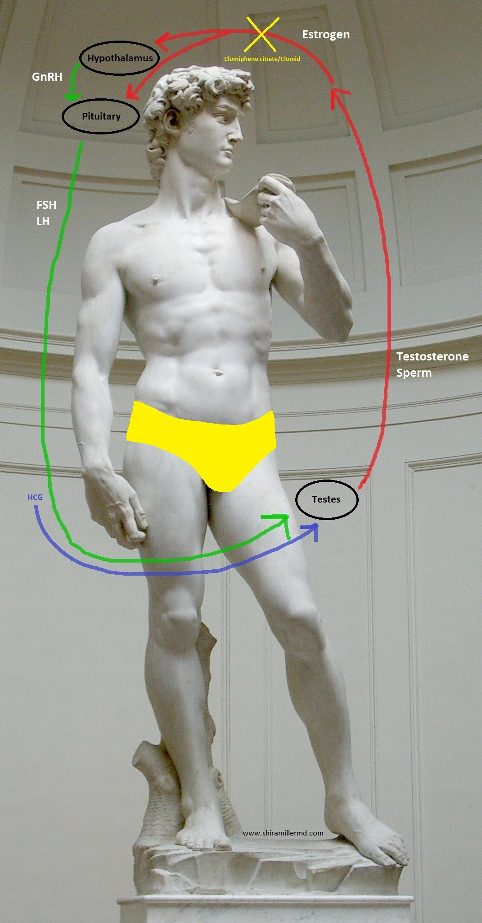
Clomiphene Citrate
Selective Estrogen Receptor Modulator (SERM)

Slide 43
Clomiphene Citrate
Long-term Safety and Efficacy Improvement in ADAM scores, bone density, and other measures. https://www.ncbi.nlm.nih.gov/pubmed/30522888/ https://www.ncbi.nlm.nih.gov/pubmed/22458540 https://www.ncbi.nlm.nih.gov/pubmed/22044663
Possible Side Effects Visual disturbances Breast enlargement Headaches Dizziness Exacerbation of psychiatric illness Increased PSA, estradiol

Slide 44
Clomiphene Citrate
Comprehensive baseline evaluation
Only for secondary hypogonadism
Loading dose
50mg QOD
25mg QD
Cycling?
Follow-up estradiol, PSA, CBC, +/- DHT, visual changes (eye exam)

Slide 45
Other Uses of HCG
Other Uses of Clomiphene Citrate (CC)
Testicular shrinkage
Infertility
Transition from Testosterone to HCG
Clomiphene side effects (visual disturbance)

Slide 46
Questions?
Please use the chat button
Thank you for sharing your time tonight!
If you have any more questions after tonight or want an appointment with Dr. Friedman please email: mail@goodhormonehealth.com
www.goodhormonehealth.com
To contact Dr. Miller, go to www.shiramillermd.com
Webinar will be posted in a few days

