Slide 1
Mindful Eating in Today’s Crazy World
Jill Roup, RD CD
UWGB Wellness Dietitian

Slide 2
Objectives
Define mindful eating
Learn 4 steps to practice mindful eating
Identify hunger versus satiety
Learn easy tips to incorporate mindful eating into your daily schedule
Notes:
Include reason why chose topic, not an expert

Slide 3
What is Mindful Eating
Paying attention to what we are eating, eating with AWARENESS
Being aware of each sensation of the experience of eating
Acknowledge chewing, tasting and swallowing food moment by moment

Slide 4
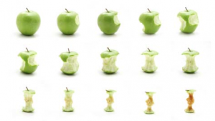
Why Practice Mindful Eating?
Over the past 25 years mindfulness practices have been shown to have a positive impact on psychological and physical health, including stress, depression, anxiety, chronic pain, and heart disease.

Slide 5
Why Practice Mindful Eating?
There is evidence that mindful eating helps with treatment of obesity as well as binge eating disorders.
The benefits of mindful eating are not restricted to physical and emotional health improvements; they can also impact one’s entire life, through a better sense of balance and well-being

Slide 6
Why Practice Mindful Eating?
Adults in the United States devote an average of 1 hour and 12 minutes per day to eating, yet spend between 2½ and 3 hours per day watching television
School lunch periods
provide an average of
7 to 11 minutes for
students to eat their lunch

Slide 7
Why Practice Mindful Eating?
Scientists are beginning to better understand the role of the mind-body connection in eating behavior.
When our mind is tuned out during mealtime, the digestive process may be up to 30% to 40% less effective.
This can contribute to digestive distress, such as gas, bloating and bowel irregularities.

Slide 8
Why Practice Mindful Eating?
The mind-body connection plays a pivotal role in our ability to accurately assess hunger and fullness.
We eat meal after meal, snack after snack, barely aware of what we’re eating and how much we’re consuming.
Mindful eating is powerful – it keeps you in the present and can help you facilitate change
Notes:
Has this ever happened to you? You start eating something, get side tracked by work, a book or the TV, and you realize your food is gone but you don’t even remember eating it?

Slide 9
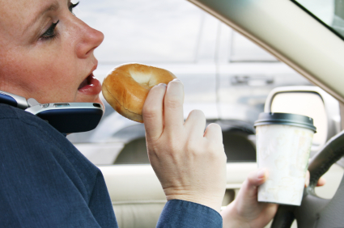
A Culture of Multi-tasking
We often pair eating with other activities, such as driving or working at our desks.
Where and how did you eat your breakfast today??

Slide 10
The Basic Mindful Bite
This is the core of Mindful Eating
Use this technique with any solid food

Slide 11
The Basic Mindful Bite
Group Activity
Open the chocolate.
As you bring food to your mouth, slow down and become aware of your movements.
Once the food is in your mouth, clear your hands. Put hands (or silverware) or remaining food down.

Slide 12
The Basic Mindful Bite
Chew this bite with your mind in laser-sharp focus on the process. Concentrate on the taste of the food and the act of eating. Don't do anything else while you're chewing. Simply chew and pay attention.
Keep chewing until the food is uniformly smooth. Use this consistency of the food as a signal to swallow.

Slide 13
The Basic Mindful Bite
After you swallow, but before you bring more food to your mouth, rest for a few seconds, thereby inserting a pause into your eating.
Notes:
Thoughts?

Slide 14
Types of Mindful Eating
With the Basic Mindful Bite as your fundamental technique, you can approach mindful eating in four ways:
Arriving at food
Awakening to the food
Tuning in to the body
Service with food

Slide 15
Step 1 : Arriving
Arriving at food means that we become aware before a meal or snack that food has come into our personal space.
This sounds simple, but actually it's more difficult that you might think. Food is so abundant in our society that we're scarcely aware of it and we can be eating and not even know that we've made a choice to eat.

Slide 16
Step 1 : Arriving
Before you begin eating any meal or snack, become silent for 30 seconds. During this 30 seconds:
Take a close look at the food. Notice colors, shapes and arrangements.
Name to yourself all the foods you see.
Name to yourself all the plants and animals that are represented in the food.
Bring your face close to the food and detect all the odors in the food.
Think about the human effort it took to get the food to you.
Imagine yourself eating each food attentively and on purpose.

Slide 17
Step 1 - Arriving
If you do this activity seriously, you will have truly arrived at your meal. This sets the stage for you to continue your mindfulness during your eating.

Slide 18
Step 2 - Awakening
Awakening to food means that we pay attention to all the aspects of food
When we awaken, we notice the sensations of the food, such as taste, change of flavors, texture and aromas. We can also look deeper to see the effort, resources and sacrifices within each food as well.
A mindful eater spends at least one moment during each bite waking up to some aspect of the food.

Slide 19
Step 2 - Awakening
Group activity
Bite # 1: Shape, color
Bite # 2: Flavor, aftertaste
Bite # 3: Texture
Bite # 4: Sounds
Bite # 5: Gratitude

Slide 20
Step 3 – Tune in to your Body
Mindful eaters pay close attention to themselves as they eat.
Become aware of how many chews it takes for you to chew your food completely.
Have a “baseline” number of chews for eat bite

Slide 21
Step 3 – Tune in to your Body
Notice your emotions when you eat
Notice how your body feels as you eat
With mindful eating there is no “bad” food, and no guilt associated with eating

Slide 22
Step 4 - Service
Mindful eating includes being aware of all the activities that surround food and eating.
Setting the table, clearing the table, loading the dishwasher, putting away leftovers
When we adopt a careful, deliberate way of behaving with any action involving food, we help ourselves stay in the moment and heighten the degree by which we honor food.
Notes:
Approach the task not as an obligation but as a wonderful opportunity to dwell in the present and to honor yet another aspect related to eating. Don’t put away the dishes just to get on to something else. Rather, put away the dishes to put away the dishes, fully aware of each moment.

Slide 23
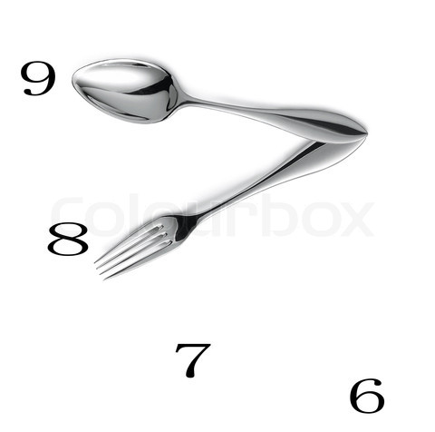
Hunger vs. Satiety
How do you
know when
it’s time to eat?

Slide 24
Hunger vs. Satiety
How to tell if you are hungry
Physical signs
The desire to eat doesn’t go away
The desire for food intensifies over time
A non-favorite food even sounds good

Slide 25
Hunger vs. Satiety
Do not ignore true hunger
Most people need to eat every 3-4 hours while awake
Metabolic rate
Blood sugars
Mood

Slide 26
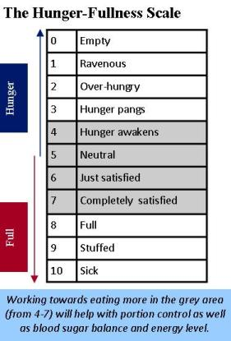

Slide 27
Hunger vs. Cravings
What is a craving?
No physical hunger “pains”
The thought of eating goes away if distracted
You feel “emotional” about eating that food
You want something specific: crunchy, sweet, salty

Slide 28
Hunger vs. Cravings
It’s normal to feel cravings
But we want to relate to them mindfully and not get blinded by them
We can learn to become aware of our cravings and their messages

Slide 29
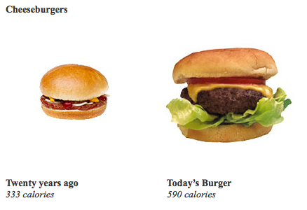
Mindful Portions
Notes:
In the 1950s, fast-food restaurants offered one portion size. Today, portion sizes have ballooned a trend that has spilled over into many other foods, from cookies and popcorn to sandwiches and steaks. A typical serving of French fries from McDonald’s contains three times more calories than when the franchise began. A single “super-sized” meal may contain 1,500–2,000 calories — all the calories that most people need for an entire day. And research shows that people will often eat what’s in front of them, even if they’re already full.

Slide 30
Mindful Portions
Normally, we think of portions as how much food is on the plate.
But in mindful eating, portions include:
How often we eat
How much food is on the spoon or fork
How long we take to chew our food
How often we stop during a meal to find out if we really need more food
How much time we pause between bites

Slide 32
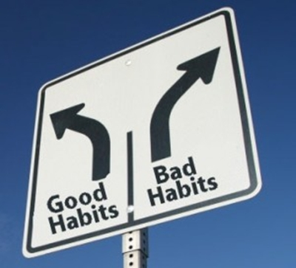
How to incorporate Mindful Eating
Breaking an eating habit and forming a new one is difficult!

Slide 33
Suggestions to Try
Eat sitting down
Create ambiance
Eat without TV, newspaper, computer or work
Chew your food 30 to 50 times per bite
Watch the clock; try to make the meal last at least 20 minutes.
Notes:
(Food is enjoyed in the mouth, eat slowly!)

Slide 34
Suggestions to Try
Eat with chopsticks
Eat with your non-dominant hand
Don’t eat from a bag or box
Box up half of the meal at a restaurant
Keep extra food away from table

Slide 35
Suggestions to Try
Use a smaller plate at meals
Do not skip meals
Plan meals and snacks ahead of time
Keep a mindful eating journal
Try a Two-Plate Approach
Use a second plate to eat from, taking only half of the food

Slide 36
Take Home Message
Mindful eating involves paying full attention to the experience of eating and drinking, both inside and outside the body.
Mindful eating helps us learn to hear what our body is telling us about hunger and satisfaction.
Eating mindfully can improve our overall health.
Try it at lunch and at home today!

Slide 37
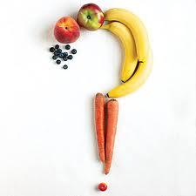
Questions?

Slide 38
References
The Center for Mindful Eating
www.tcme.org
The CAMP system
www.mindfuleating.org
Diettogo.com
United State Dept of Agriculture
www.choosemyplate.gov

