Slide 1
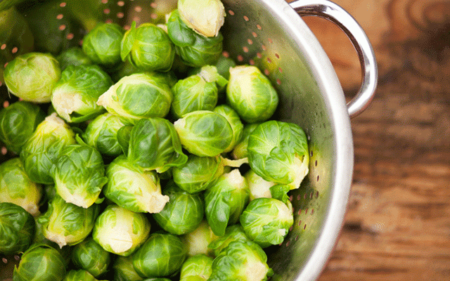
Mindful Eating

Slide 2
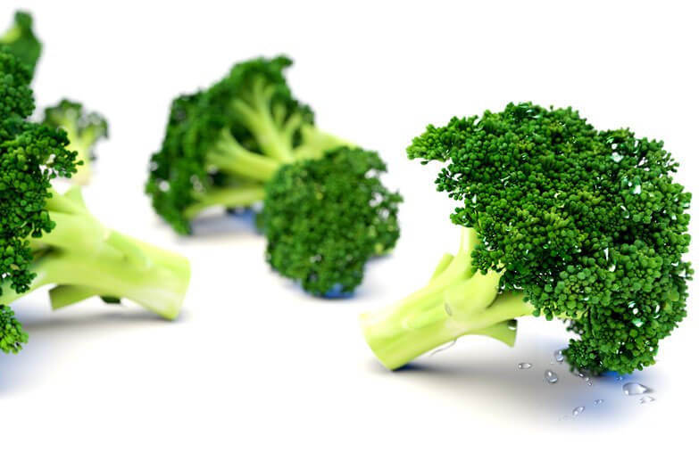
What is mindful eating?
“Mindful eating is an approach to food that focuses on individuals’ sensual awareness of the food and their experience with the food.”

Slide 3
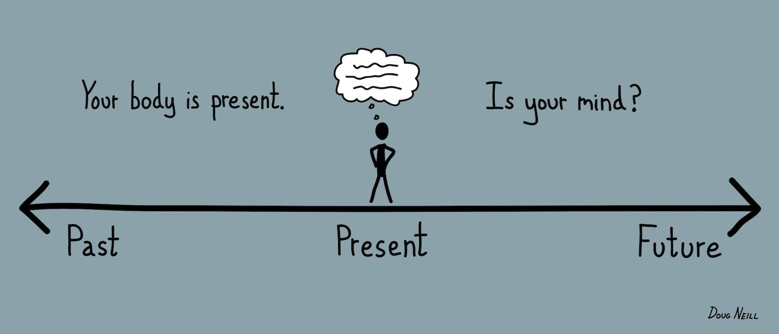
What does that mean?
Through this approach we want to help individuals savor their food while also being mentally present during the act of eating.

Slide 4
What are the benefits and how is this different from a diet?
Success in both require a behavior change
Diet
-Outcome driven
-Rules for eating
Mindfulness
-Process-oriented
-Individual experience

Slide 5
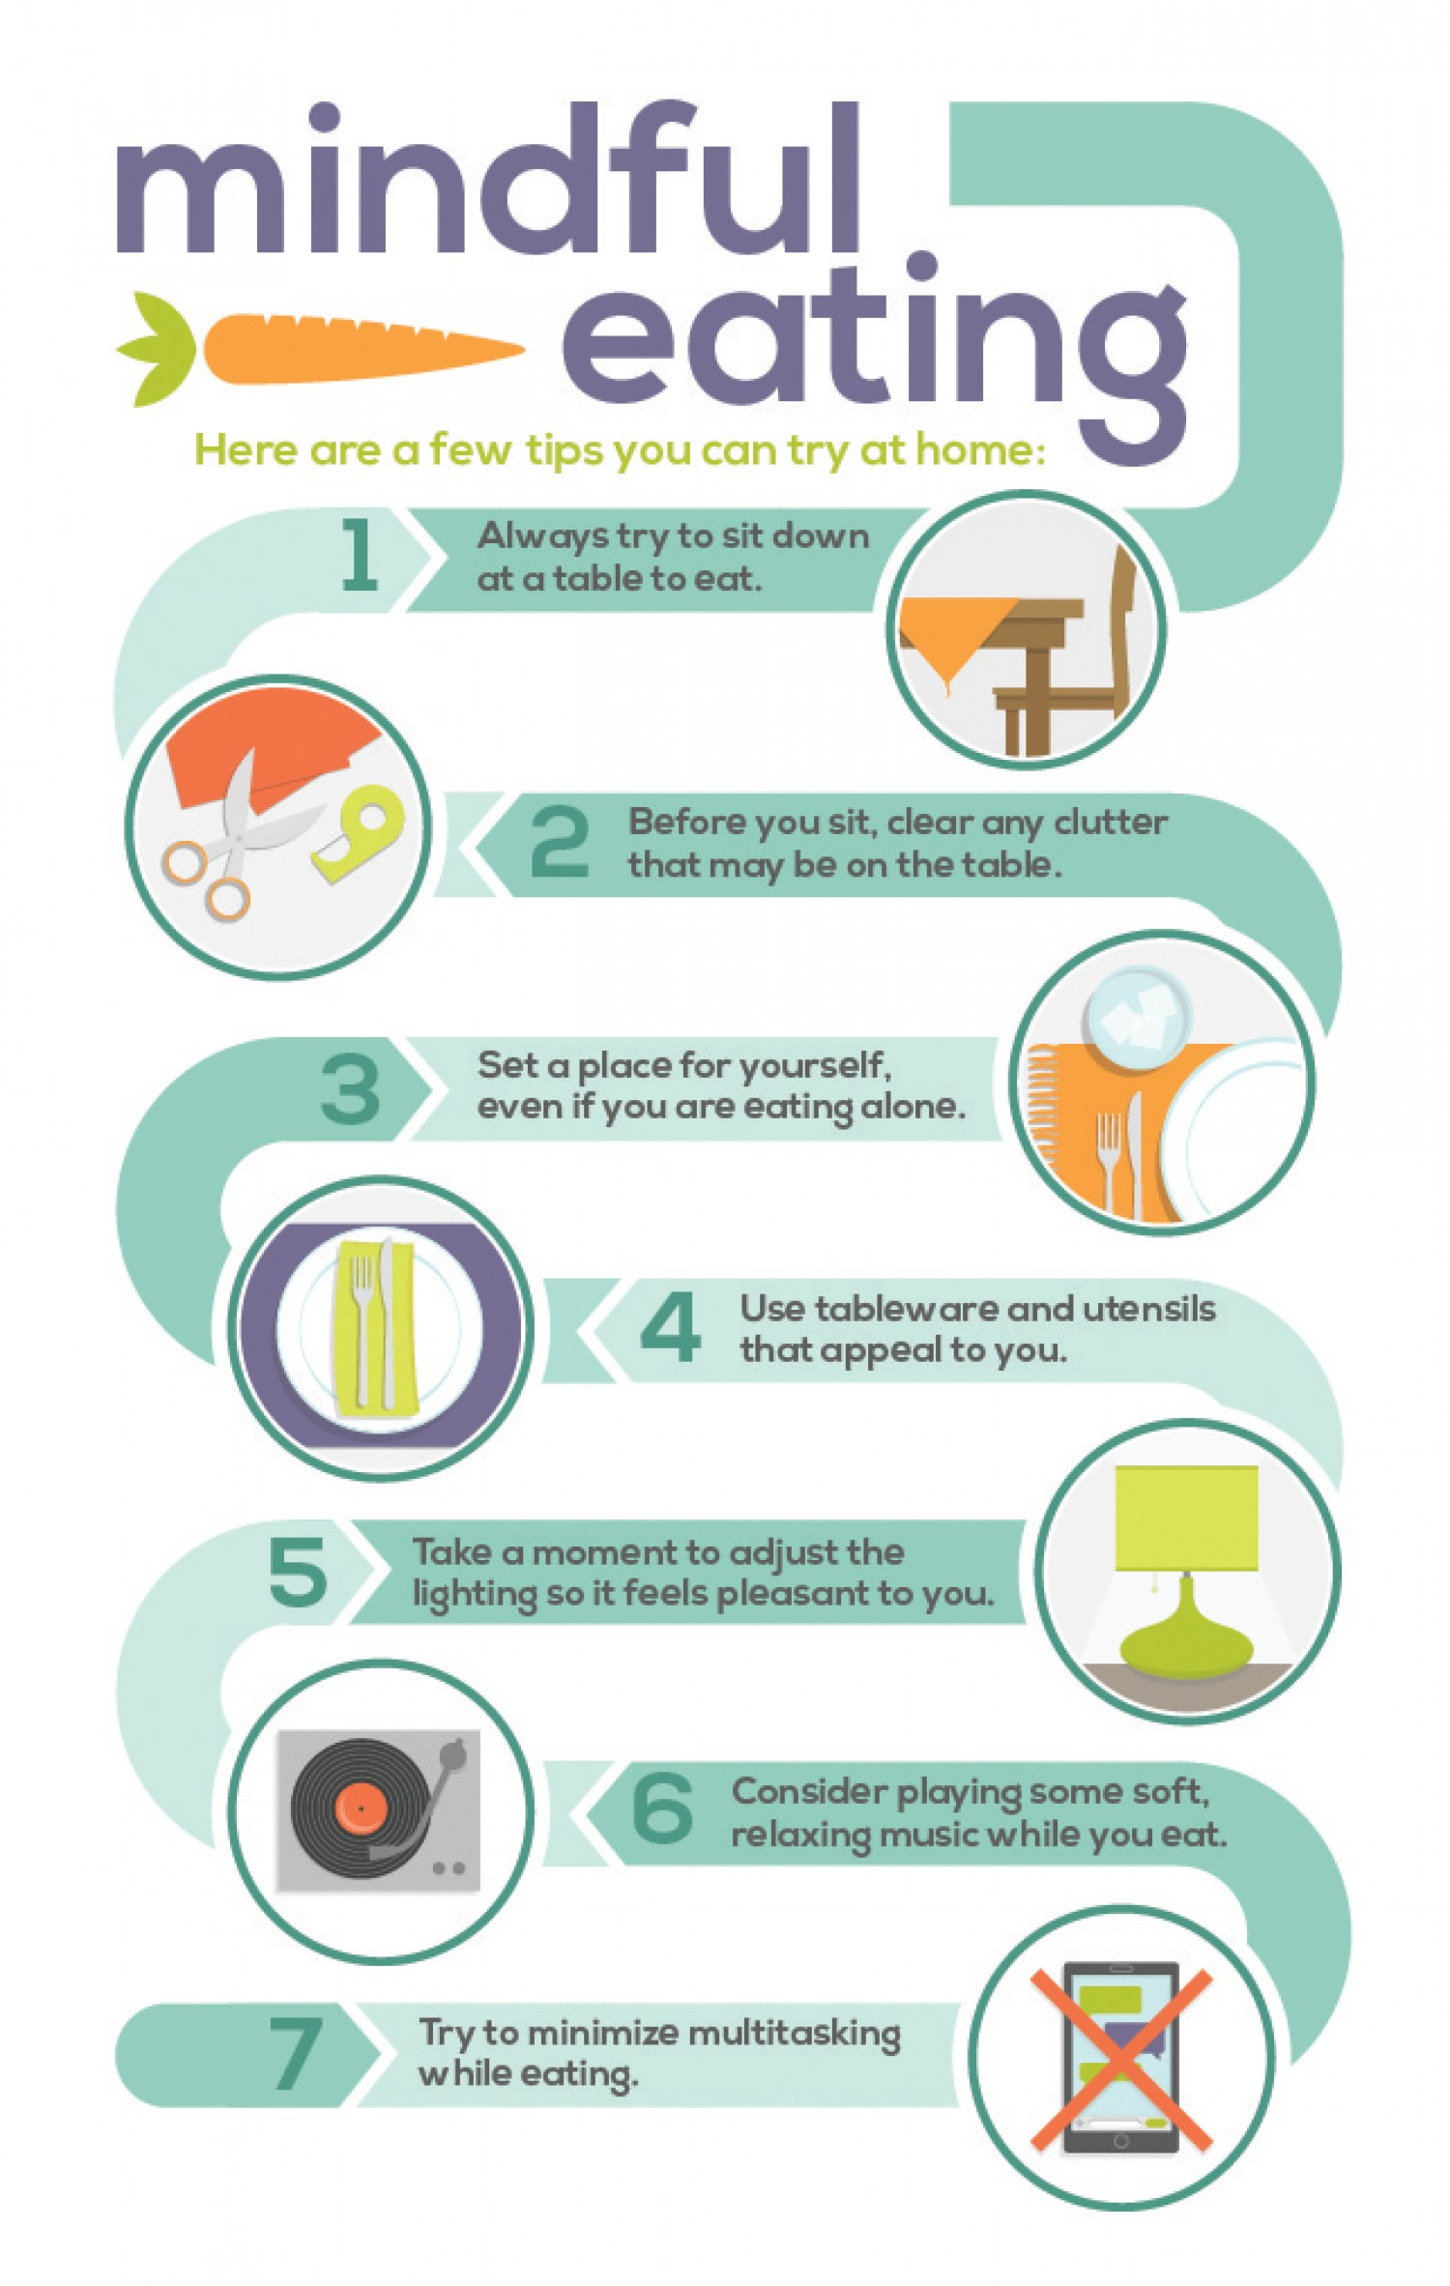
Some tips to try…

Slide 6
THERE ARE NO RULES OR GUIDELINES FOR THIS PROCESS. IT IS ALL ABOUT INDIVIDUAL EXPERIENCE. EVERYONE WILL HAVE A DIFFERENT EXPERIENCE AND THAT IS OKAY!

Slide 7
How does it work?
Let try it!

Slide 8
Lets imagine you have just been dropped on a foreign planet and you have no recollection of anything. You don’t remember anything about you past lifE,Not even food you have eaten.EVERYTHING IS NEW.

Slide 9
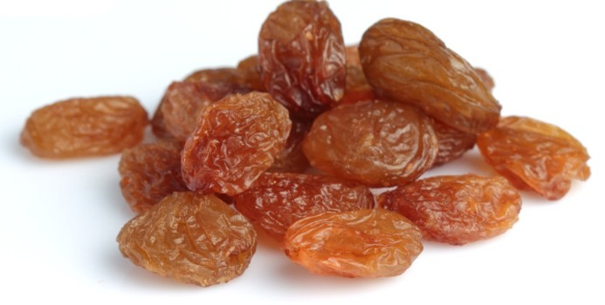
GRAB A RAiSIN>>>

Slide 10
STOP!!!!
-Don’t just fill your mouth with a handful of raisins.
-Take a deep breath and relax.
-Clear your mind of any judgments, fears or expectations...

Slide 11
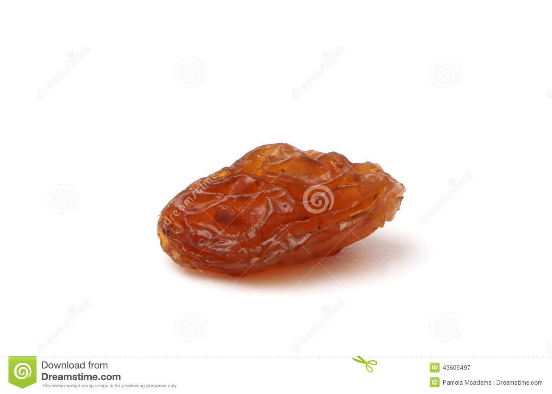
Experience the raisin...
LOOK AT IT AS IF IT WERE YOUR FIRST TIME SEEING A RASIN.
Look at it…
Pick it up…
Can you feel it’s weight in your hand?
Examine it:
It’s ridges
Shiny parts
Dull parts

Slide 12
SMELL THE RAISIN...

Slide 13
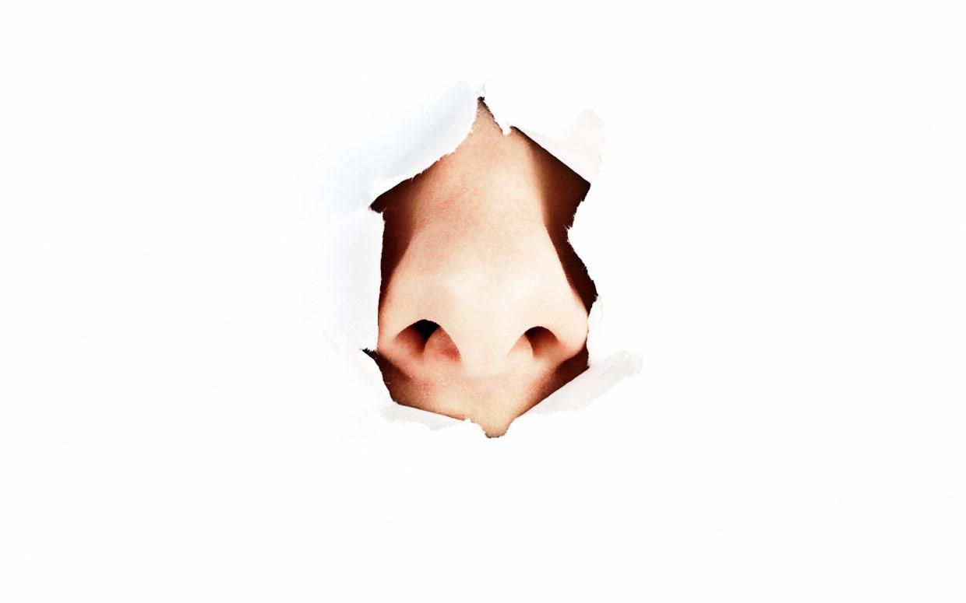
Observe yourself
How do you naturally react?
Are pleased with the smell?
Do you pull the raisin away from your nose?

Slide 14
Touch the raisin...
Roll it between your fingers…
Does it make a sound?
Is it sticky?
How does it feel?

Slide 15
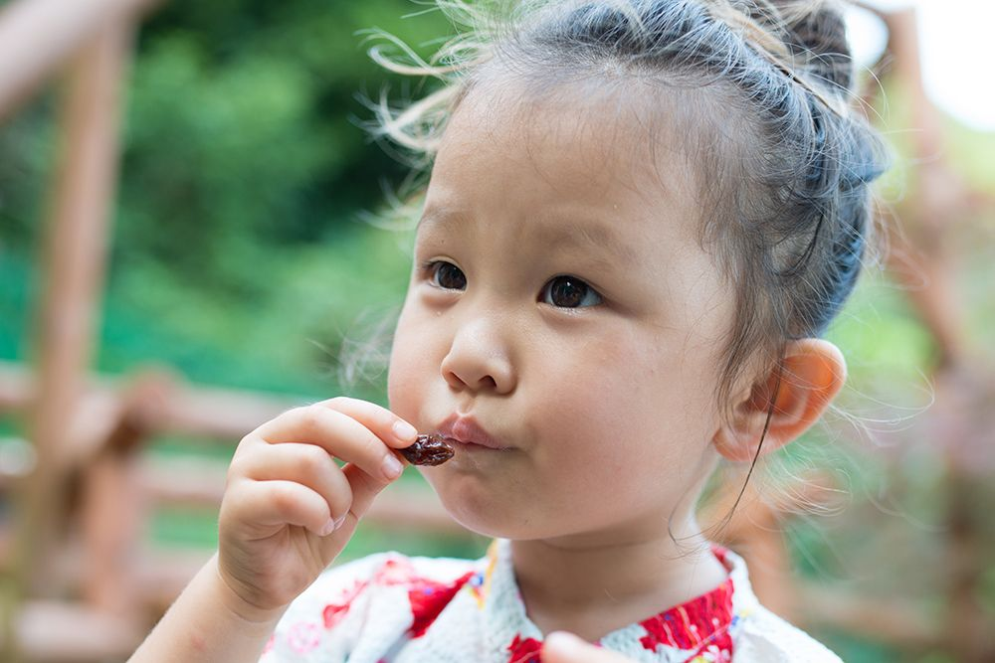
Place the raisin on your lips...
Hold it there for a few seconds…
What do you notice going on inside your body?
Are your hands getting sweaty?

Slide 16
Taste it...
Is there a taste?
Do you salivate?
How do you want to react?
How do you react?
Don’t chew it.
Just roll it around in your mouth

Slide 17
Bite down just once...
Slowly begin to chew…
Notice what you feel after each bite.
Chew it until the raisin is completely liquefied.
Then swallow.
Now take a second to think about the consequence of your experience.
How do you feel?

Slide 18
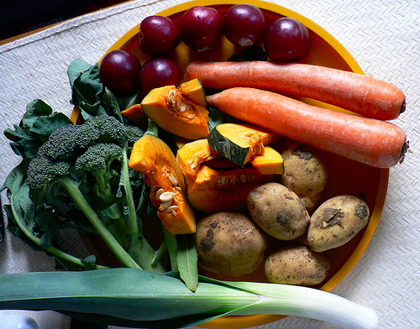
“Eating mindfully is about bringing full awareness to each plate or bite of food.”

Slide 19
Make this an intentional, regular practice
Think first!
Be mindful of your actions.
Are you eating because of your emotions?
Are you really hungry?
Or, are you stressed, bored, angry, sad or lonely?
Trust yourself.
Live and appreciate life as it is.

