Slide 1
Theodore C. Friedman, M.D., Ph.D. (the Wiz) Professor of Medicine-UCLA Chairman, Department of Internal Medicine Charles R. Drew University Dr. Friedman’s Endocrinology Clinic Macrilen Stimulation Test for Growth Hormone Deficiency
MAGIC Adult Convention Phoenix AZ March 3, 2019

Slide 2
Hormonal Axes
Adrenal (corticotropes)=CRH-ACTH-Cortisol
Thyroid (thyrotropes)= TRH-TSH-T4/T3
Gonads (gonadotropes)= GnRH-LH/FSH-Testosterone/estrogen
GH (sommatotropes) =GHRH-GH-IGF-1
Posterior pituitary-AVP and oxytocin

Slide 3
Causes of Hypopituitarism
Anywhere along the hypothalamic-stalk-pituitary axis
Microadenomas! (Yuen, et al. Clinical Endocrinology 69:292-298, 2008

Slide 4
Pituitary Causes of Hypopituitarism
Pituitary Tumor (macroadenomas vs. microadenomas)
Pituitary Surgery
Pituitary radiation
Sheehan’s syndrome/ pituitary apoplexy
Hypophysitis
Pituitary infiltration
Empty Sella
Malnutrition/critical illness
Head trauma

Slide 5
Stalk/Hypothalamic Causes of Hypopituitarism
Craniopharyngioma
CNS malignancy
Surgery/radiation
Head trauma/accidents
Infiltrative diseases (histiocytosis X, hemachromatosis, sarcoidosis)
Infection
Drugs (steroids, dopamine analogues, somatostatin analogues)

Slide 6
Order of hormone deficiencies
GH
Gonadotropins (FSH, LH)
TSH
ACTH
Prolactin
Posterior pituitary hormones

Slide 7
Microadenomas and hypopituitarism (Yuen et al, 2008)
38 patients with non-secreting pituitary microadenomas (mean tumor size 4.2 mm) and normal serum IGF-I levels were studied.
19 patients (50%) were found to be GH-deficient, and had higher body mass index (BMI) than those that passed the GHRH-arginine test and healthy controls.
19 patients (50%) had at least one other pituitary hormone deficit.
We concluded that a substantial number of patients with non-secreting pituitary microadenomas were GH-deficient despite normal serum IGF-I levels, and had at least one other pituitary hormone deficit, suggesting that non-secreting microadenomas may not be clinically harmless.

Slide 8
Microadenomas and hypopituitarism
Patients with low IGF-1 and a microadenomas are likely to be growth hormone deficient.
Many Endocrinologists test for hypopituitarism only if a patient has had prior surgery or radiation to their pituitary.
My approach is to measure pituitary hormones first in patients with symptoms of hypopituitarism and if it points to hypopituitarism, then get a pituitary MRI
If MRI shows a small pituitary or a tumor and IGF-1 is low, and the patient has symptoms of growth hormone deficiency, then do a growth hormone stimulation test

Slide 9
Growth Hormone Deficiency
There are more than 50,000 adults with a growth hormone (GH) deficiency diagnosis in the United States.

Slide 10
Overview of Growth Hormone

Slide 11
Growth Hormone Deficiency
Patients with hypopituitarism have increased mortality, suggested, but not proven to be due to GH deficiency
Growth hormone deficiency in adults results in:
Decreased bone formation
Increased fat mass (central obesity)
Decreased muscle mass
Lipid abnormalities
Increased thickness of blood vessels
Increased inflammatory markers
Impaired quality of life
Increased number of sick days
Impaired exercise tolerance
Most symptoms are corrected/improved by treatment

Slide 12
Growth Hormone Deficiency
If left undiagnosed, AGHD may lead to increased risk for premature mortality, significant morbidity, and multiple signs and symptoms, including
An increase in body fat
A decrease in muscle mass
Weakness and fatigue
Osteoporosis
An increased rate of fractures
Dyslipidemia
Cardiovascular disease
Impaired psychological well-being such as isolation, anxiety, or depression

Slide 13
Growth Hormone Deficiency

Slide 14
Growth Hormone Deficiency-Diagnosis
Growth hormone is pulsatile, so a random growth hormone is not helpful.
You could be at the top of the pulse or the bottom of the pulse

Slide 15
Growth Hormone Deficiency-Diagnosis
Screen with IGF-I:
If in top 50% of normal range for age and sex (> 150 ng/mL) GH deficiency less likely
If empty sella, history of head trauma, headache and low blood pressure after delivery (Sheehan’s syndrome), history of pituitary surgery or radiation or pituitary tumor (micro or macro adenoma)=GH deficiency more likely
If < 75 ng/mL-GH deficiency likely
If in the lower 25%, worth testing with a stimulation test
Stimulation testing
Glucagon stimulation test is preferred- GH deficient if GH is < 5 ng/mL ITT- GH deficient if GH is < 5 ng/ml
Macrilen Stimulation Test

Slide 16
IGF-1 is only a screening test

Slide 17
Current AGHD Testing

Slide 18
Macrilen Stimualtion test was recently published
Garcia et al. Macimorelin as a Diagnostic Test for Adult GH Deficiency
J Clin Endocrinol Metab, August 2018, 103(8):3083–3093

Slide 19
Macrilen Mechanisms of Action

Slide 20
Macrilen was compared against ITT

Slide 21
4 groups in the trial

Slide 22
Endpoints for the study

Slide 23
Evaluability

Slide 24
Sensitivity and Specificity
Macrilen stim test had similar sensitivity and specificity as the ITT

Slide 25
High Reproducibility

Slide 26
Adverse Events

Slide 27
Preparation before Macrilen

Slide 28
Administration of Macrilen

Slide 29
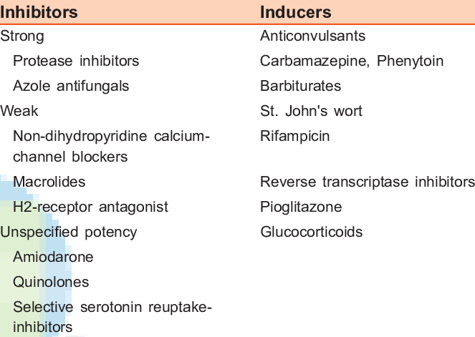
CYP3A4 Inducers/inhibitors
Strong CYP3A4 inducers may reduce macrilen levels and lead to a false positive test
Strong CYP3A4 inhibitors may increase macrilen levels and lead to a false negative test
I do not think patients need to stop glucocorticoids before testing
May want to stop ketoconazole one week before testing

Slide 30
Cutoffs

Slide 31
Cutoffs
The FDA has has set a cutoff for the Macrilen test of the peak GH level <2.8 ng/mL, although the paper in Journal of Clinical Endocrinology and Metabolism found that a GH level of 5.1 ng/mL gave the highest separation between normal and growth hormone deficient subjects.
I may start a trial of growth hormone on patients whose peak response between 2.8 and 5.1 ng/mL.

Slide 32
Glucagon vs Macrilen Stimulation Tests at Dr. Friedman’s clinic
Glucagon Stim Test
Macrilen Stim Test
$695
Does not need a pre-auth
Requires an intramuscular injection
Most patients get nauseous
7 blood draws
$350
Requires pre-authorization that may take up to a month
Not all insurances cover it ($5000 cash cost)
Oral solution
4 blood draws

Slide 33
Glucagon and Macrilen Stimulation Tests
Dr. Friedman will offer both Tuesday night
If coming from out of town, let us know well in advance for the pre-authization for Macrilen
You can have your appointment and stim test on the same night.
You need to fast for 8 hrs

Slide 34
Can you do GH Stimulation Tests at Night
Yes
Growth Hormone has a nocturnal rise when you go to sleep, not at night.

Slide 35
Can you do GH Stimulation Tests at Night

Slide 36
Visit goodhormonehealth.com
For more information or to schedule an appointment.
Talk will posted in a few days
mail@goodhormonehealth.com

Slide 37
Thanks
Magic Foundation for inviting me and doing great work!
Great job Dianne

