Slide 1
Low-Cost Healthy Foods
P.O.W.E.R.
Valerie Mira, MPH
Aug 22, 2016

Slide 2
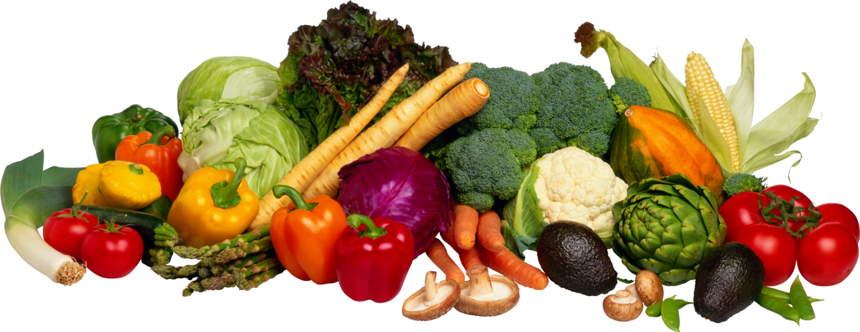
Eating “HEALTHY”…
starts with vegetables:
fill you up
low in calories
high in fiber
good source of vitamins and minerals
DHS Endocrinology
Notes:
Excellent sources of minerals and vitamins

Slide 3
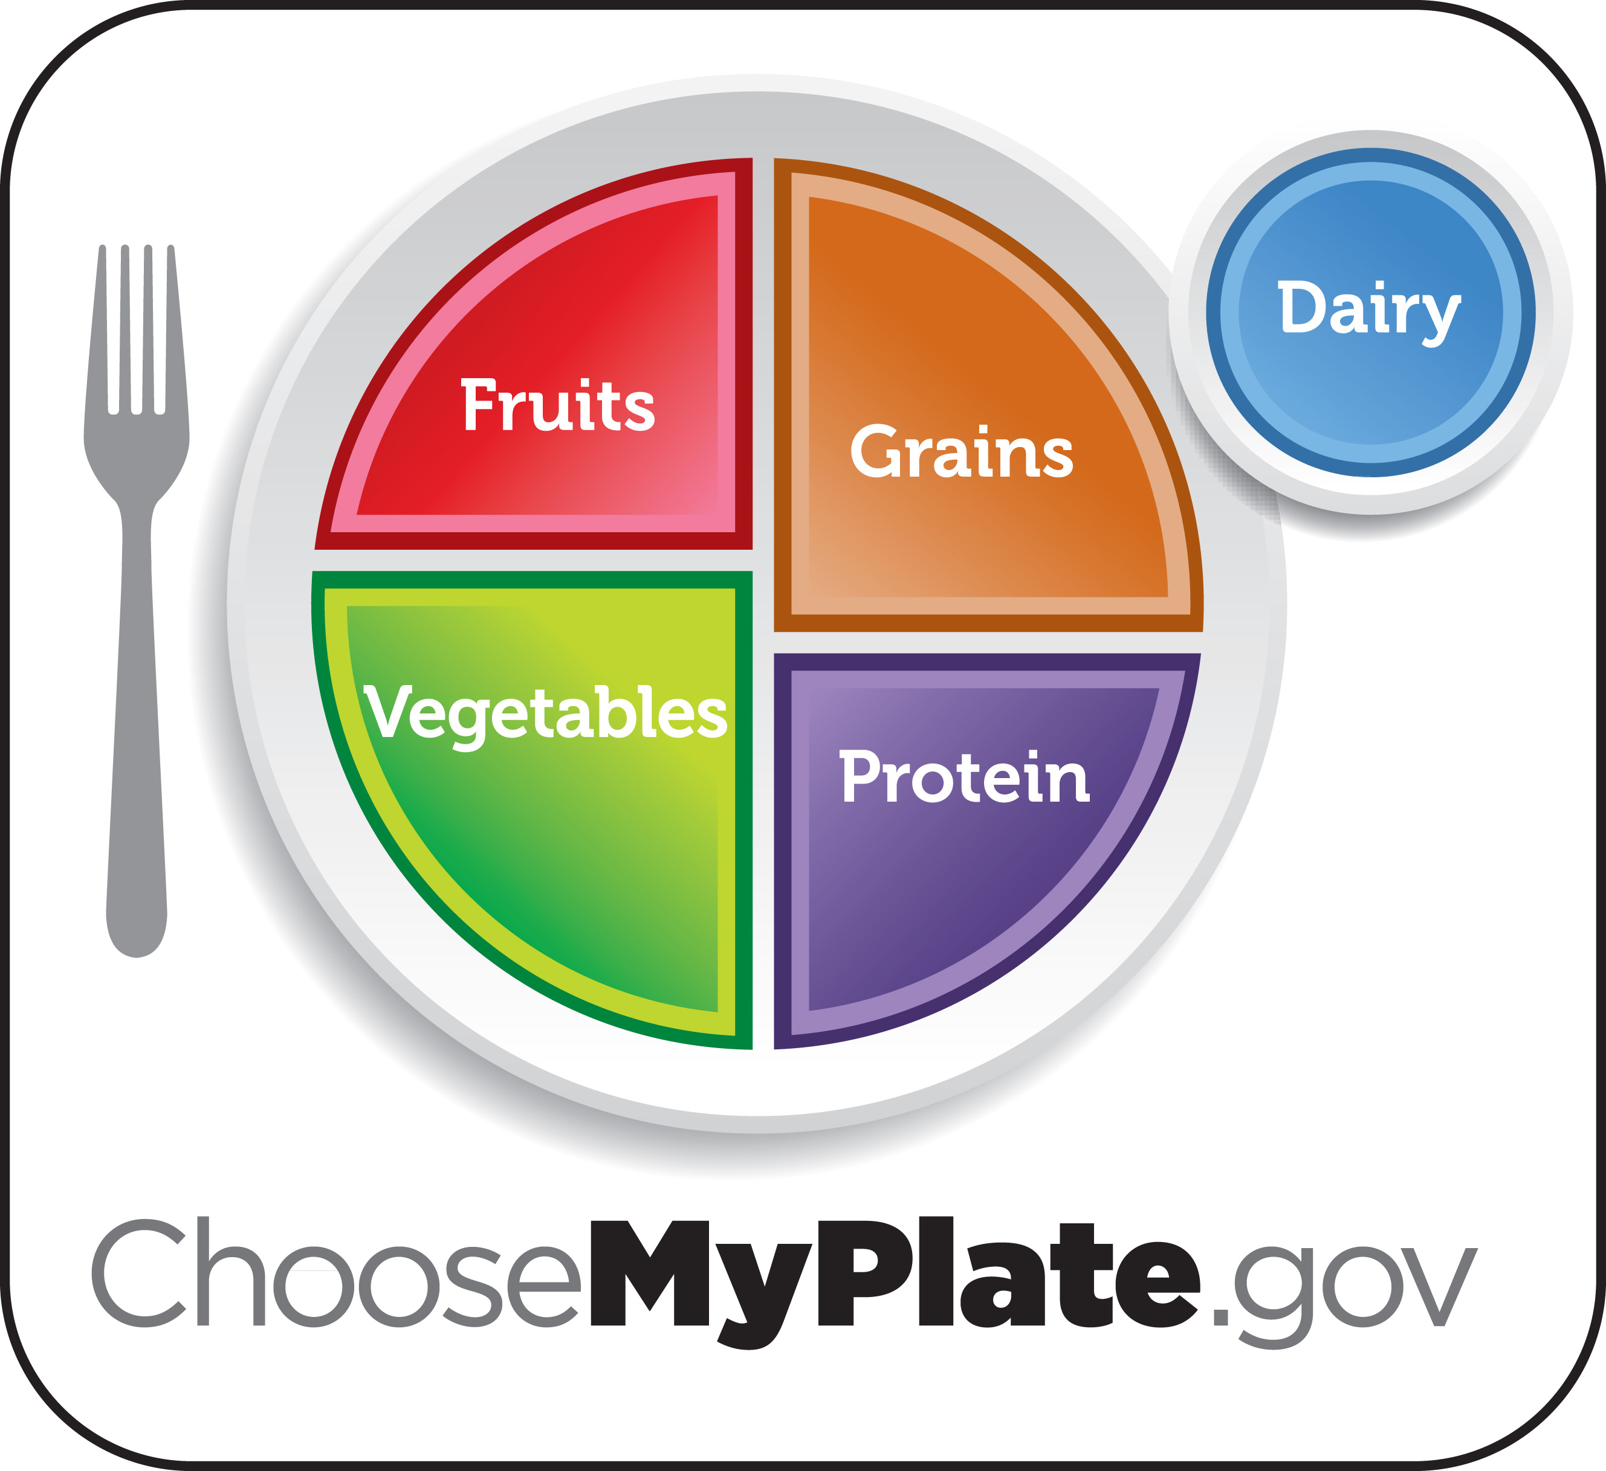
How much do you eat?
Two daily servings with EACH meal
one serving = 8 oz or a handful
half your plate
Breakfast
Lunch
Dinner
DHS Endocrinology
Notes:
My plate suggests ¼ fruit and ¾ vegetables, but for this class it should really be ½ plate of vegetables (whether it’s filled or empty), and only ¼ of the other 3 = grains, protein, dairy

Slide 4
How do you eat them?
Raw
Frozen
Canned
Stir-fry
oil spray (vegetable, canola, olive)
soy sauce
Flavored (spices, sauces)
Soups
DHS Endocrinology
Notes:
Stir-fried does not mean this is good for foods…
Flavored = sauces (soy, tomato, marinara)
If you need to start slow… try some fruit (1/2 cup)
Then slowly substitute it by cooking vegetables with eggs…

Slide 5
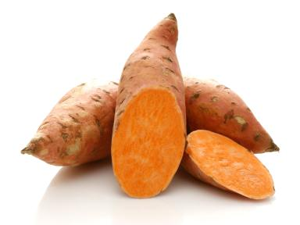
Are all vegetables healthy?
potatoes
corn
sweet potatoes
yams
→ starches
→ eat in moderation
DHS Endocrinology

Slide 6
Healthy Vegetables
artichokes
asparagus
bell peppers
broccoli
cabbage
cactus leaf
carrots
cauliflower
celery
cilantro
cucumbers
eggplant
green beans
green onions
jicama
kale
lettuce
mushrooms
radishes
spinach
squash
tomatoes
yucca root
zucchini
DHS Endocrinology

Slide 7
Reduce STARCHES!
bread
tortillas
pasta
rice
cold cereals
potatoes
corn
DHS Endocrinology

Slide 8
Eat WHOLE GRAIN instead!
WHEAT bread
WHEAT tortillas
WHEAT pasta
BROWN rice
but… in moderation!
DHS Endocrinology

Slide 9
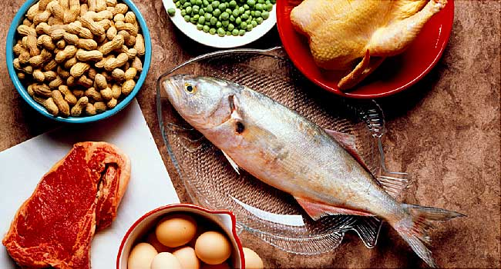
Protein
meat
chicken
fish
beans
eggs
but… in moderation!
DHS Endocrinology

Slide 10
Fruits
apples
avocados
bananas
blueberries
cantaloupe
cherries
grapes
honeydew
kiwi
mango
nectarines
oranges
papayas
peaches
pears
raspberries
strawberries
tangerines
watermelon
but… in moderation!
DHS Endocrinology

Slide 11
Dairy Products
milk
yogurt
cheese
but… in moderation!
DHS Endocrinology
Notes:
- But low in fat as possible

Slide 12
Where do you find healthy foods at low cost?
99 Ranch Market
Bonanza Market
El Super
Fiesta Rancho Market
Food 4 Less
Gardena Supermarket
Northgate Gonzalez Market
Ralphs
Smart and Final
Superior Grocers
Vons
Walmart
www.google.com/maps
Notes:
***ask participants to share their experiences and preferences***
- discuss prices on list given

Slide 13
Compare Prices:
White bread = $1.99
Flour tortillas = $2.99
pack of 10
WHEAT bread = $1.99
WHEAT tortillas = $2.79
pack of 11

Slide 14
What about ORGANIC?
Is it better?
What is the difference?
Notes:
**still working on this slide

Slide 15
Compare prices:
Organic
Non-Organic
bell peppers = $1.49/ea
broccoli = $1.99/lb
cabbage = $1.29/lb
cauliflower = $1.99/lb
carrots = $1.99
cucumbers = $1.29/ea
lettuce = $1.99
romaine = $2.89
zucchini squash = $1.99/lb
bell peppers = $0.99/ea
broccoli = $1.59/lb
cabbage = $0.50/lb
cauliflower = $1.49/lb
carrots = $0.79
cucumbers = $0.49/ea
lettuce = $0.99
romaine = $0.99
zucchini squash = $0.99/lb
Notes:
Carrot bunch
Green leaf lettuce

Slide 16
Thank you!
Remember… it’s a “LIFESTYLE” change not just a diet

