Slide 1



How to improve quality of life for those with no adrenals (BLA and Addison’s)
GoodHormoneHealth Webinar
May 17, 2020
All patients will be muted, but if you are unmuted, please mute your phone

Slide 2

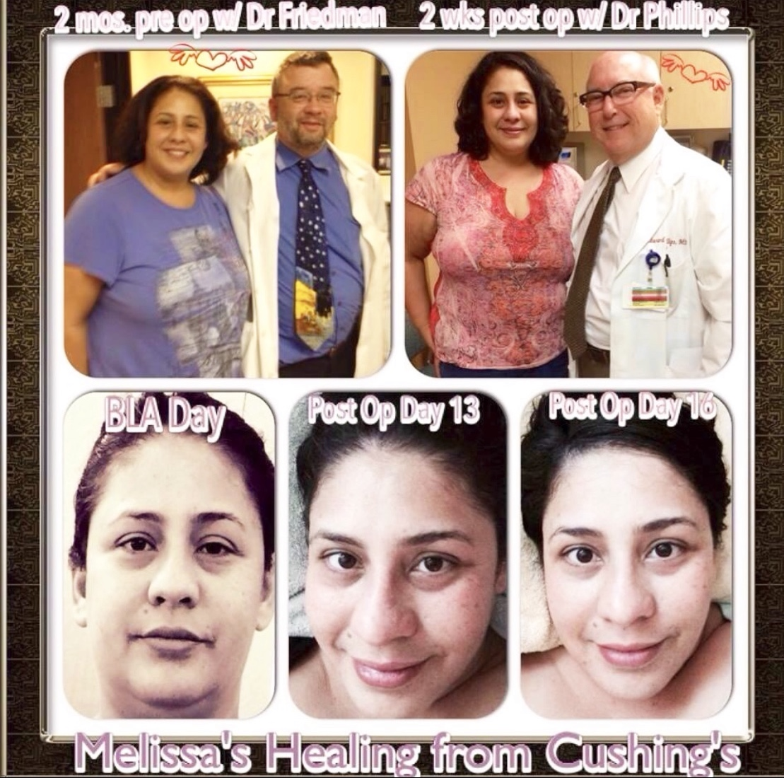
Thanks to Melissa
For suggesting the topic
Providing questions
Publicity

Slide 3
What we will discuss tonight
Adrenal hormones and physiology
Who should get an adrenalectomy?
How do you optimally replace adrenal hormones?
What laboratory tests are needed to monitor replacement?
When and how do you stress dose?
What about subcut cortisol versus cortisol pumps?
Patient Melissa will lead a Q and A

Slide 4
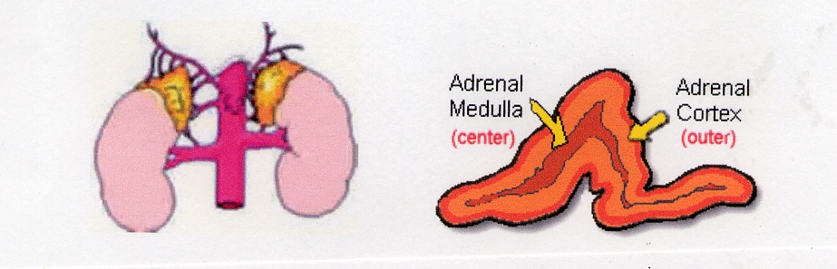
Adrenal Glands
The adrenal glands lie at the superior pole of each kidney.
They are composed of two distinct regions: the cortex and the medulla.

Slide 5
Adrenal Hormones
Glucocorticoids-Cortisol
Mineralocorticoids-Aldosterone
Androgens-DHEA(S), testosterone, androstenedione
Estrogens
Catecholamines-Epinephrine, Dopamine

Slide 6
Cortisol
Daily secretion 10-15 mg
Circadian cycle (highest at 8 am)
Has three forms:
  Free (5%), physiologically active
  bound to CBG/albumin
  Cortisol metabolites

Slide 7
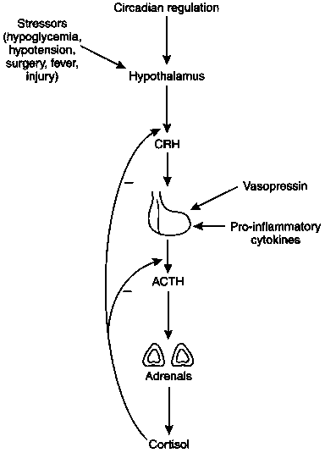
Cortisol (glucocorticoid): Brain-Hypothalamic-Pituitary-Adrenal Axis

Slide 8
Renin-Angiotensin-Aldosterone (Mineralocorticoid) Axis
Site
Liver
Angiotensinogen (452 A.A.)
Kidney
Prorenin
Renin
Angiotensin I (10 A.A.)
Lung,
Angiotensin-
Plasma
converting enzyme
Angiotensin II (8 A.A.)
Adrenal,
Angiotensin II receptor
Vascular
Adrenal
Aldosterone

Slide 9
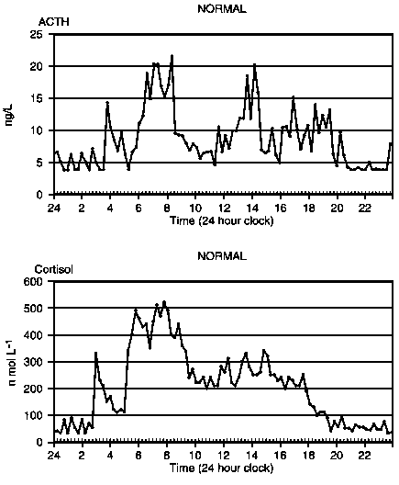
Daily ACTH/Cortisol Trends

Slide 10
Different Types of Glucocorticoid Insufficiency
Primary Adrenal Insufficiency
  Glucocorticoid and Mineralocorticoid Insufficiency
  Compensatory Increase in POMC (hyperpigmentation)
  Bilateral Adrenalectomy
Secondary (Central) Adrenal Insufficiency
  Glucocorticoid Insufficiency Only
Glucocorticoid Withdrawal
  Glucocorticoid Insufficiency Only

Slide 11
Symptoms of Glucocorticoid Insufficiency
GI issues (most common and most GI issues in adrenal insufficiency patients are due to cortisol problems, not GI problems)
Fatigue
Vomiting
Diarrhea
Anorexia
Malaise
Muscle and joint pain
Abdominal pain
Weight loss
Hypoglycemia
Hyponatremia (SIADH)

Slide 12
Symptoms of Mineralocorticoid Insufficiency
Decreased intracellular volume
Tachycardia, palpitations (most palpitations are due to fludrocortisone/HC issues and not GI issues
Hypotension
Dehydration
Shock
Hyponatremia
Hyperkalemia
  Arrhythmias
Acidosis
Salt-craving

Slide 13
Laboratory Findings of Primary Adrenal Insufficiency
Hyponatremia
Hyperkalemia
Hypoglycemia
Lymphocytosis
Eosinophilia
Mild normochromic Anemia
Notes:
Elevated eos- clin endo metab 1985 14 947-76
j of endo 1994 69-80

Slide 14
Treatment for Cushing’s Disease
Pituitary surgery-transphenoidal surgery (TSS)
Medical treatment
Repeat Pituitary Surgery
Bilateral Adrenalectomy (BLA)
Radiation Therapy-takes a long time to work and may give memory problems
Notes:
Elevated eos- clin endo metab 1985 14 947-76
j of endo 1994 69-80

Slide 15
Medical Treatment for Cushing’s Disease
Ketoconazole-In my opinion, the best
Korlym (RU486)-can get adrenal insufficiency and hard to monitor or correct adrenal insufficiency
Cabergoline-sporadic effects
Pasireotide-somatostatin analog-GI side effects, diarrhea, diabetes
Isturisa which blocks 11-beta-hydroxylase enzymes and is similar to metyrapone.
Notes:
Elevated eos- clin endo metab 1985 14 947-76
j of endo 1994 69-80

Slide 16
Who should get a BLA?
Failed initial pituitary surgery
No target for additional surgeries
Want more definitive treatment than medical treatment
Decreased cure rates with more pituitary surgery
Pituitary damage with fertility implications with further pituitary treatment vs BLA
Pituitary hyperplasia-harder to cure if pathology shows hyperplasia
Notes:
Elevated eos- clin endo metab 1985 14 947-76
j of endo 1994 69-80

Slide 17
Pluses and Minuses of BLA
Plus-cures right away
Minus-more difficult surgery than pituitary
My new series: about 10% get adrenal remnant tissue formation with recurrence
Nelson’s syndrome-pituitary overgrowth with increased ACTH secretion
  I haven’t seen it, but recommend followup pituitary MRIs
On glucocorticoids (HC) and mineralocorticoids (fludrocortisone) for the rest of your life.
More likely to get adrenal insufficiency/adrenal crisis than following pituitary surgery.
Notes:
Elevated eos- clin endo metab 1985 14 947-76
j of endo 1994 69-80

Slide 18
Adrenal Remnant Formation
If adrenal tissue is confined to the adrenal bed, it is considered adrenal remnant tissue, while if it is outside the adrenal bed, it is considered adrenal rest tissue.
Notes:
Elevated eos- clin endo metab 1985 14 947-76
j of endo 1994 69-80

Slide 19
Adrenal Remnant Formation
Wilson et al, submitted to Hormone and Metabolic Research
Ten of 51 patients who underwent BLA had adrenal remnant/rest tissue marked by detectable endogenous glucocorticoid production
9 of the 10 patients had signs and symptoms of hypercortisolism.
Localization and treatment proved difficult.
The first indication of remnant tissue occurrence is a reduction in glucocorticoid replacement with symptoms of hypercortisolism.
If this occurs, endogenous cortisol production should be tested for by cortisol measurements using a highly specific cortisol assay while the patient is taking dexamethasone or no glucocorticoid replacement.
Notes:
Elevated eos- clin endo metab 1985 14 947-76
j of endo 1994 69-80

Slide 20
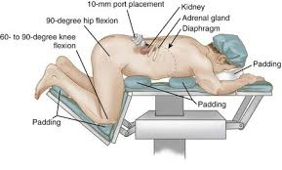
BLA Surgery and Hospitalization
Most cases can be done laparoscopically through a retroperitoneal approach
Very obese patients may need to be done with open surgery
Hospitalized about 5 days
Surgery can give IV hydrocortisone after surgery usually start on postop day 2
I usually have patients discharged on 30-50 mg po hydrocortisone and 0.1 mg twice a day fludrocortisone
High doses of steroids prevent wound healing and are not necessary
Notes:
Elevated eos- clin endo metab 1985 14 947-76
j of endo 1994 69-80

Slide 21
Postop BLA Monitoring
I get a day 7 DHEAS to show adrenals are completely removed and electrolytes
I get a day 22ish ACTH, renin and 24 hr urine on HC
ACTH should be between 100 and 1000 in patients on proper glucocorticoid replacement
Plasms renin activity is the most important test for BLA (and Addison’s patients and guides fludrocortisone dosing
Notes:
Elevated eos- clin endo metab 1985 14 947-76
j of endo 1994 69-80

Slide 22
Adrenal Insufficiency Treatment
Proper replacement is key to good quality of life
Both too much and too little is bad
HC and fludrocortisone
Notes:
Is 20 an absolute or relative number to baseline cortisol value?
In secondary, adrenal atrophic b/c of low acth levels but can still respond to high dose acthbut not to low dose/physiiologic doses

Slide 23
Quality of Life
In a postal survey of patients with primary adrenal failure from Norway, the SF 36 was used to assess subjective health status.
Seventy-nine out of 97 patients (81%) responded.
General health and vitality perception were most consistently impaired in the patients with Addison’s disease.
Scores for fatigue (both physical and mental) were also higher than normal (i.e. more fatigue).
24% of patients in the 18–67 years age range and 41% of patients in the 40–67 years age range were out of work and receiving disability beneﬁt, compared to 10% and 17%, respectively, in the general population.

Slide 24
Daily cortisol production rate in man
Esteban et al. (JCEM, 72: 39, 1991) measured daily cortisol production rates in normal volunteers with a stable cortisol isotope method.
10 mg a day
Not all of oral cortisol is absorbed, need to take 12-15 mg/day
Most glucocorticoid replacement is supraphysiological.
Leads to osteoporosis, glucose intolerance and increased infections.
True physiological replacement is likely to be benign
Main problem is malabsorption (cortisol is needed for adsorption, so it can be a vicious cycle)

Slide 25
Physiological Equivalents of Glucocorticoids
20 mg of hydrocortisone (shortest acting)
15 mg of iv or subcut solucortef
4-5 mg of prednisone (longer acting)
4 mg of methylprednisolone (longer acting)
0.75 mg of dexamethasone (liquid dexamethasone 0.5 mg/ 5 mL) (longer acting, no mineralocorticoid activity)
Each of these can be used and may be better in some patients

Slide 26
Types of Glucocorticoids
I start with hydrocortisone and use it 90% of my patients
  Can monitor with UFC/17OHS, salivary cortisol day curves, can’t with others
I try the others next
  Prednisone
  Methylprednisolone (Medrol)
  Liquid dexamethasone
  Sometimes combinations
Try to adjust when patient is feeling low vs high

Slide 27
Glucocorticoid Replacement
Most patients are over-treated
Earliest manifestation of excess treatment is easy bruisability
Weight gain, central obesity, etc.
Earliest manifestation of inadequate treatment is joint pain, nausea, abdominal pain.
Reasonable to mimic circadian rhythm with most of cortisol given first thing in the morning
But patients often go through cortisol and need doses throughout the day
Want to avoid large doses at night as it could lead to sleep disturbances,
But, some patients need a bit of cortisol to go into deep sleep
No studies comparing different treatment regimens

Slide 28
Glucocorticoids are Needed for Sleep
García-Borreguero D. et al.
(J Clin Endocrinol Metab. 2000 85:4201-6).
In Addison's patients, cortisol plays a positive, permissive role in REM sleep regulation and may help to consolidate sleep.
Suggests a need for a low dose of hydrocortisone (1.25-2.5 mg) at night.

Slide 29
Glucocorticoid Replacement (2)
My approach is to start with hydrocortisone mainly in AM-aim for dose between 15 and 20 mg/day in a women and slightly higher in a man.
  Hydrocortisone 10-15 mg on awakening
  Hydrocortisone 2.5-5 mg in mid-afternoon
  Hydrocortisone 1.25- 2.5 mg at bedtime
  Occasionally a 4th dose at about 5 pm is needed
  More physiological than prednisone or dexamethasone
Decrease dose slowly until some symptoms develop, then go back a dose.
Small changes make a big difference
Increase dose with illness, short term its better to err on giving more, long term its better to give less

Slide 30
Glucocorticoid Replacement (3)
Dosing is crucial, might be a different between brand and generic
Cortef is brand name, hydrocortisone is generic (pharmacy can substitute different suppliers without telling patient or doctor)
Greenstone is the best generic
Other brands are CorePharma, Qualitest and West-ward
Comes in 5, 10 and 20 mg pills
Stick with a brand you like
No evidence of shortages

Slide 31
Maintenance Therapy for Primary Adrenal Insufficiency
Primary adrenal insufficiency may need a bit more glucocorticoids than secondary
Mineralocorticoid Replacement
  Start with Fludrocortisone 0.05 mg to 0.5 mg daily (0.05 mg twice a day)
  Titrate based on renin levels
  Should be given twice a day-half-life is 3.5 hrs
  Fludrocortisone is generic; brand (Florinef) is not available)
  Probably will need more fludrocortisone in the summer
  Shortage late 2018 has passed
  Teva and Impax
Med-Alert Bracelet
Program your health tab in your phone
Solu-cortef -100 mg in Act-O-vial

Slide 32
Monitoring glucocorticoid replacement
Signs and symptoms
24 hr UFC over-estimate cortisol as it reflects amount in the urine right after dosing that exceeds 11b-HSD2 capacity.
17-OHS (mg/day) reflects cortisol metabolism and is more integrated throughout the day.
Serum or salivary cortisol day curves under-estimate cortisol as the ignore cortisone-cortisol shuttle
I don’t use salivary cortisol day curves much, but they can give an idea if a certain of day is higher than it should be
ACTH is high (100-1000) unless over-replaced
If ACTH >1000, get a pituitary MRI to look for Nelson’s

Slide 33
Monitoring mineralocorticoid replacement in primary adrenal insufficiency
Plasma renin activity is very accurate and probably should be measured every 2-3 months
Tube should be chilled and spun right away
If its high, more fludrocortisone is given, if its low, less fludrocortisone is given
Electrolytes are relatively insensitive and are not a substitute for frequent renin monitoring
If high blood pressure and normal renin, do not stop fludrocortisone, but give a blood pressure pill
Calcium channel blockers
  Amlodipine (Norvasc) or diltiazem (Cardiazem)
Do not give ACE inhibitors (benazepril, lisinipril), ARBs (losartan), spironolactone or diuretics

Slide 34
Salt and licorice
Use salt abundantly, especially if you are salt craving
Can take more before exercise
As long as you don’t have heart problems or hypertension, probably can take as much salt as you want
Licorice root inhibits the 11b-HSD enzyme allowing more cortisol to bind to the cortisol receptor in he kidney
Might be a good way to get more mileage from your cortisol and fludrocortisone
Licorice root from Nature’s Way 450 mg twice a day

Slide 35
DHEA
Only made by adrenal (0 if adrenalectomy)
I recommend 25 mg a day
May help with energy and immune system
Too much DHEA
  Oily skin
  Oily hair
  Acne

Slide 36
Testosterone
Half made by adrenals, half made by ovaries (regulated by the pituitary)
Most patients with BLA and prior pituitary surgery are low
Usually given by cream
2.5 mg/mL, 1 mL daily is a dose I often use
May help with energy, muscle strength, libido
Less side effects than DHEA
  Extra hair growth
  Acne

Slide 37
Typical Hormone Panel
Every 2-3 months
Renin-sitting is ok- chilled tube, spun immediately
ACTH chilled tube, spun immediately
DHEAS
Electrolytes (maybe every 6 months)
Bioavailable and total testosterone
Pituitary hormones as needed
  IGF-1
  Thyroid hormones (freeT4, freeT3, TSH, rT3)
Gonadal hormones as needed (Estradiol)
24 hr UFC/17-OHS on replacement (every 6 months)
No need to measure cortisol/do imaging (unless concerned about remnant tissue)
Don’t need to/can’t measure dopamine, catecholamines

Slide 38
Can someone with adrenal insufficiency?
Get a flu shot? Yes you should
Get steroid injections (back problems)? yes but minimize duration
Get oral steroids for asthma? yes but minimize duration
Use steroid inhalers? Yes
Use steroid creams? Yes
Get the COVID-19 vaccine? Why not

Slide 39
COVID-19 and stress-dosing
Concerned about getting COVID-19- definitely not
Have COVID-19 or contact with patient with COVOD-19, but not sick (no fever, vomiting)- no stress dose
With COVID-19, shortness of breath and sick-stress-dose and go to ER
Endocrinologist statement and AACE guidelines- “sick day rules” for our known patients with primary and secondary adrenal insufficiency taking glucocorticoid replacement therapy. As it relates to COVID-19, any patient with a dry continuous cough and fever should immediately double their daily oral glucocorticoid dose and continue on this regimen until the fever has subsided.
Some that are slightly sick, but not short of breath, can stress dose and stay home.
Most of these patients should go to the hospital

Slide 40
COVID-19 and stress-dosing
Make sure you drink fluids, take in salt.
I would stress dose by doubling your hydrocortisone, not tripling as Dr. Findling recommended.
See my quotes in Endocrine Today
Download Dr. Friedman’s adrenal crisis letter to bring to emergency rooms

Slide 41
Adrenal insufficiency and Immune system
Patients with properly treated Addison’s disease have an impaired immune response due to a T-cell problem (those with central adrenal insufficiency and adrenalectomy are probably not in this category).
Adrenally insufficient patients undertreated may do slightly worse with infections such as COVID-19, but patients over-treated are likely to do much worse.
So Adrenally insufficient patients should not stress-dose unless they are sick with COVID-19 or other infections.

Slide 42
Stress Dosing
Okay for short-term, try to avoid creeping up on your dose
  Fever
  Vomiting
Double glucocorticoid dose
Severe stress could add an extra 5 mg
Exercise, could add an extra 2.5-5 mg of HC and .05 mg of fludrocortisone before
Some women need a a bit extra around their menses

Slide 43
Adrenal Crisis
Usually in Patients with Primary Adrenal Insufficiency
Precipitated by Stress (emotional or physical)
Newly diagnosed vs. established patient
  Stopped/ran out of medicines
  Illness (gastrointestinal and upper respiratory tract infections)
  vomiting

Slide 44
Adrenal Crisis-symptoms
GI issues (nausea, vomiting, abdominal pain, diarrhea)
Fatigue
High or low blood pressure
High pulse
Weak
Feel like passing out
Poor circulation

Slide 45
Adrenal Crisis
Know when its coming on
Double dose first, if still AI, 100 mg of IM hydrocortisone
Take extra fludrocortisone/extra fluid and salt
Go to ER (bring crisis letter), but be prepared to wait
You may have to guide the ER doctor

Slide 46
Steroid coverage for illnesses or surgery
Moderate illness
  50 mg of hydrocortisone twice a day
Severe illnesses
  100 mg of IV hydrocortisone Q 8 hours
Minor procedures without anesthesia
  No extra coverage
Colonoscopy: double oral HC and fludrocortisone day before and day of procedure
Moderately stressful procedures (endoscopy or arteriography
  Single 100 mg IV dose of hydrocortisone prior to procedure
Major surgery
  100 mg of IV hydrocortisone before anesthesia and Q 8 hours
  Next day double your dose

Slide 47
Subcutaneous Cortisol
Useful in patients with gastro-intestinal issues that can’t absorb hydrocortisone
Uses solu-cortef in 100 mg Act-o-vial (reconstitute in 2 mL, so its 50 mg/mL)
Solu-cortef powder-can reconstitute in 1 mL so it is 100 mg/mL-may make it easier to calculate
Solu-cortef in 500 and 1000 mg vial may be available
Dose 3-4 times a day similar to oral HC
May be able to cut down the dose slightly
I am recommending patients to try subcutaneous cortisol before pumps

Slide 48
Glucocorticoid Pump
JCEM Volume 99 Issue 5 - May 2014 Continuous Subcutaneous Hydrocortisone Infusion versus Oral Hydrocortisone Replacement for Treatment of Addison's Disease: A Randomized Clinical Trial
Marianne Øksnes, Sigridur Björnsdottir, Magnus Isaksson, Paal Methlie, Siri Carlsen, Roy M. Nilsen, Jan-Erik Broman, Kai Triebner, Olle Kämpe, Anna-Lena Hulting, Sophie Bensing, Eystein S. Husebye, and Kristian Løvås
The objective of the study was to compare the effects of continuous sc hydrocortisone infusion (CSHI) with conventional oral hydrocortisone (OHC) replacement therapy.

Slide 49
Glucocorticoid Pump Results
No significant differences between treatments in weight, waist to hip ratio, or BP were observed, although there was a tendency toward an increase in weight and body mass index (BMI) with CSHI
Morning glucose levels increased with CSHI and were significantly higher on CSHI than on OHC
No difference in sleep parameters

Slide 50
Glucocorticoid Pump Conclusions
Pumps can be used safely
High ACTH may be detrimental and is due to pause in cortisol replacement over night
Less fatigue but some weight gain with pump.
I have heard of patients getting infections
Some patients get abdominal welts
I would reserve the pump to those who failed oral HC and at least one other steroid preparations
I would recommend subcutaneous solu-cortef first

Slide 51
Glucocorticoid Pumps
Need to use an insulin pump (Tandem, Omnipod or Medtronics).
Insurances may cover one product and each pump has pluses and minuses.
The pump reservoir carries a maximum of 3 ml or 300 units of solution

Slide 52
Glucocorticoid Pump Reconstitution
If you use the solu-cortef powder, reconstitute 100 mg in 1 mL of saline or sterile water, so it is 100 mg/mL.
If you use a 100 mg Act-O-vial, reconstitute in 1 mL saline or sterile water, so it is 100 mg/mL.
If you use a 250 mg Act-O-vial, reconstitute in 2.5 mL saline or sterile water, so it is 100 mg/mL.
Some places refer to a 1:1 ratio, that is in units and refers to 100mg=100 units

Slide 53
Typical Pump Dosing
Typical dose is around 25 mg/d, but this varies. Discuss with your endocrinologist.
Patients on inadequate doses of fludrocortisone as determined by a high renin may need higher doses, so fludrocortisone should be optimized (slide 31)
Patients should start at higher and can be tapered down depending on symptoms and UFC/17OHS urine levels and at times, salivary cortisol day curves (slide 32)
The solu-cortef needs to be at a concentration of 100 mg/mL.

Slide 54
Sample Pump Dosing
8:00 am to 10:00 am, 1.8 mL/h
10:00 am-2:00 pm, 1.2 mL/h
2:00–8:00 pm, 0.5 mL/h
8:00 pm to 4:00 am, 0.25 mL/h
4:00–8:00 am, 2.5 mL/h.

Slide 55
Thanks for joining us
Questions? Please use the chat button
Thank you for sharing your time tonight!
If you have any more questions after tonight or want an appointment, please email: mail@goodhormonehealth.com
www.goodhormonehealth.com
Webinar will be posted in a few days

