Slide 1
The Effects of a High Fructose Diet
By: Kendra Arriaga & Denise Jimenez

Slide 2
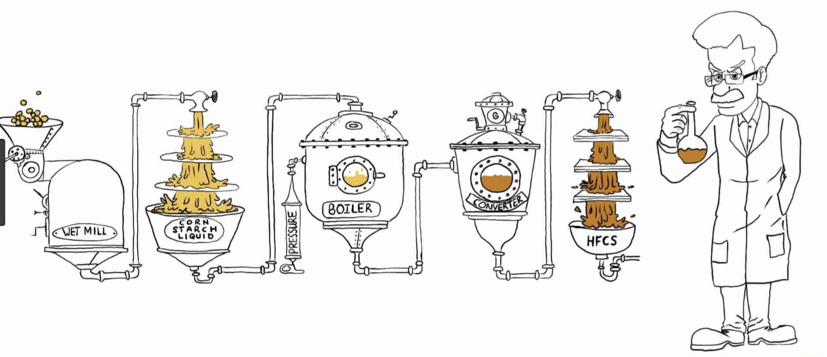
What is High Fructose
An artificial sweetener that has replaced natural sugar
Cheaper to produce
Comes from corn syrup

Slide 3
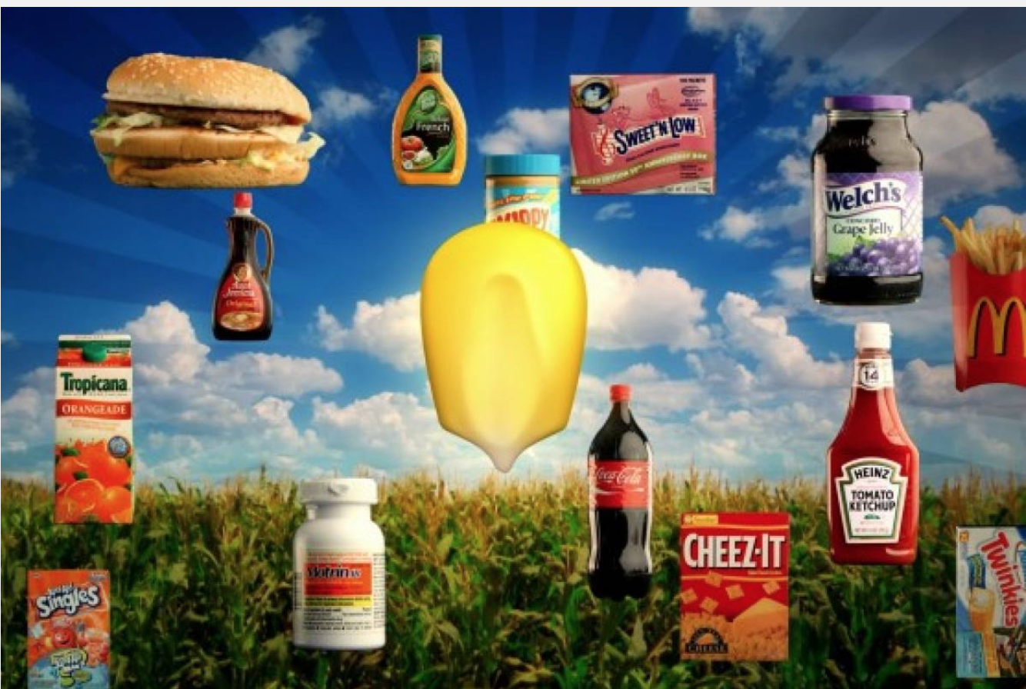
What food has High Fructose?
Used in packaged foods
High fructose corn syrup helps conserve food for longer periods of time

Slide 4
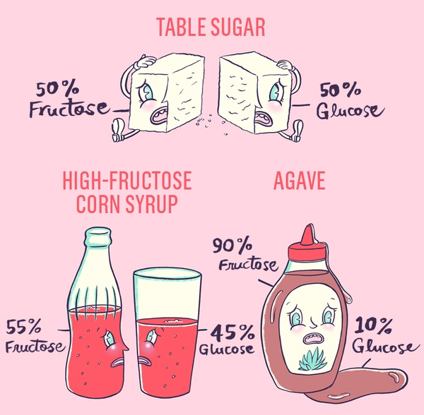
What is the difference between high fructose corn syrup and sucrose?
Sucrose is 50% fructose and 50% glucose.
High fructose corn syrup are combinations of:
55% fructose and 42% glucose
90% fructose and 10% glucose
Why is this important?

Slide 5
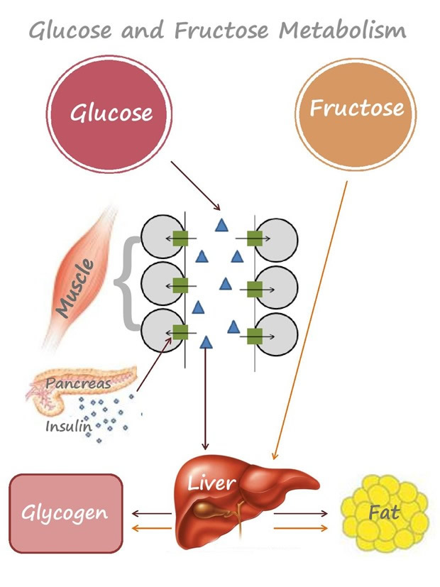
The human body processes fructose and glucose differently.
Glucose
Glucose is absorbed directly by the small intestine and into the blood, which then can be used by cells.
Cells use glucose for energy!

Slide 6
The human body processes fructose and glucose differently.
Fructose
Your liver has to convert fructose into glucose before your body can use it for energy.
If you eat more fructose than your liver can handle, the excess becomes cholesterol and triglycerides.

Slide 7
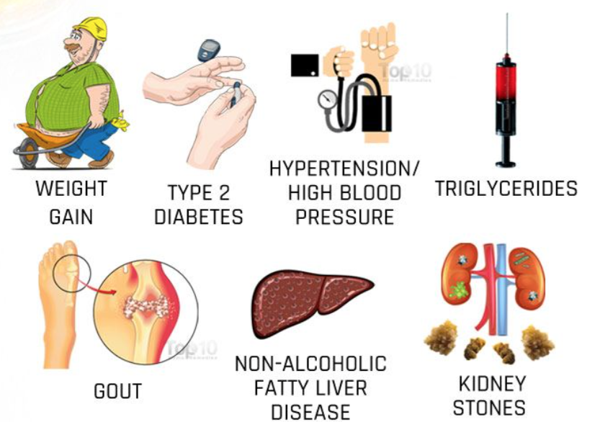
What are the effects of high fructose?
Obesity epidemic
Increases body fat, cholesterol, and triglycerides
Increases chance of heart attack
Children: provokes hyperactivity, ADHD, headaches, and affects ability to detect different flavors

Slide 8
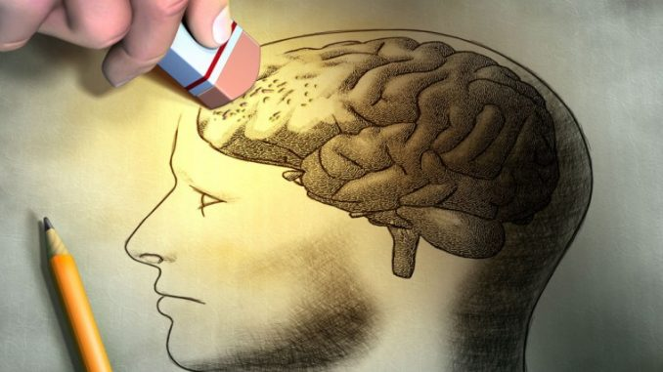
Effects of high fructose on the brain
Studies conducted at UCLA showed that excessive consumption of foods with high fructose content over a long period of time alters the brain's ability to learn and remember information
http://newsroom.ucla.edu/releases/this-is-your-brain-on-sugar-ucla-233992

Slide 9
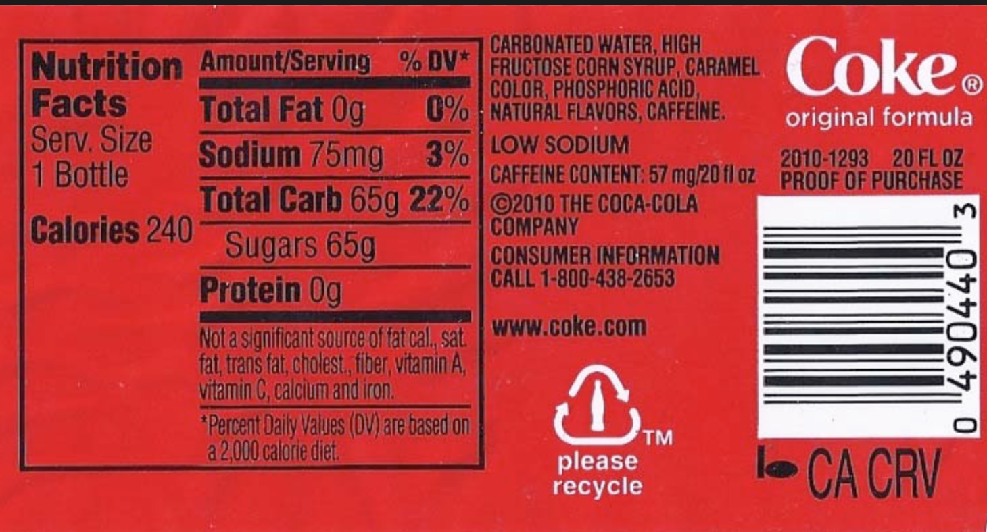
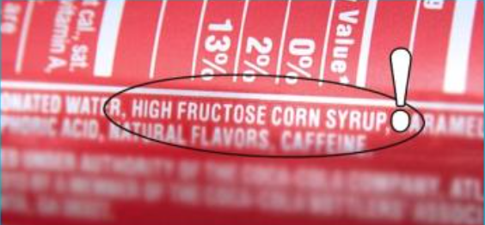
What can you do?
Check food labels!!
High fructose corn syrup
Sugars
Total Carb

Slide 10
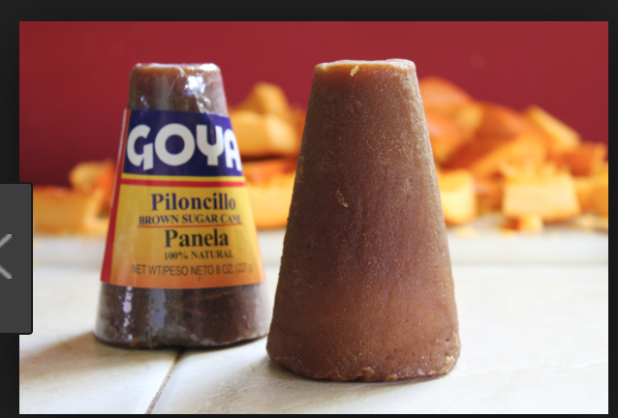
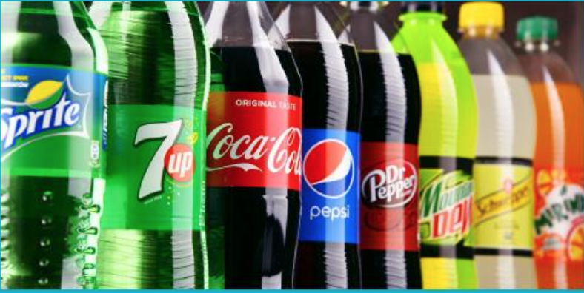
What can you do?
Choose more natural products
Panela (form of brown sugar)
Natural bee honey
Bread directly from bread store
* CAUTION: these options are still sugar; must be taken with moderation!
Avoid drinking soda
SHARE THE INFORMATION!!

