Slide 1

Hidden (Non-Endocrine) Causes of
Chronic Fatigue Syndrome
Dean C. Mitchell, M.D.
57 West 57th Street, Suite 601
New York, NY 10019
www.mitchellmedicalgroup.com
Podcast: The Smartest Doctor in the Room

Slide 2
Chronic Fatigue is a “Syndrome”Not a Disease
A syndrome is a set of abnormalities that tend to occur together
A disease is marked by three factors:
  A biological cause
  Defined symptoms
  Anatomical changes
Fatigue is a symptom that arises when energy demands exceed energy delivery.
Examples of energy usage in the body: Liver 27%, brain 19%, skeletal muscle 18%, kidneys 10%, heart 7% and the rest of organs 19%.
***Liver is highest energy use organ because it’s needed to detox ingested food nutrients.

Slide 3
What’s below “ the hood”? Testing to evaluate CFS

Slide 4
Symptoms of CFS

Slide 5
The Big 4: Toxic mold, Mast Cell Activation, Mitochondrial Dysfunction and Candida
The “ Big 4” are not well recognized in the established medical community.
The “ Big 4” are present in many of the cases I evaluate in my practice.
Why are these conditions mysterious to most conventional physicians, yet seem to be embraced by alternative physicians?

Slide 6

Toxic mold:
Dr. Joseph Brewer Infectious Disease specialist in Kansas City published paper that 93% of his CFS patients were found to have mycotoxins present in the urine.

Slide 7
Symptoms of CFS
“Look familiar?”

Slide 11
Urine Mycotoxin

Slide 13
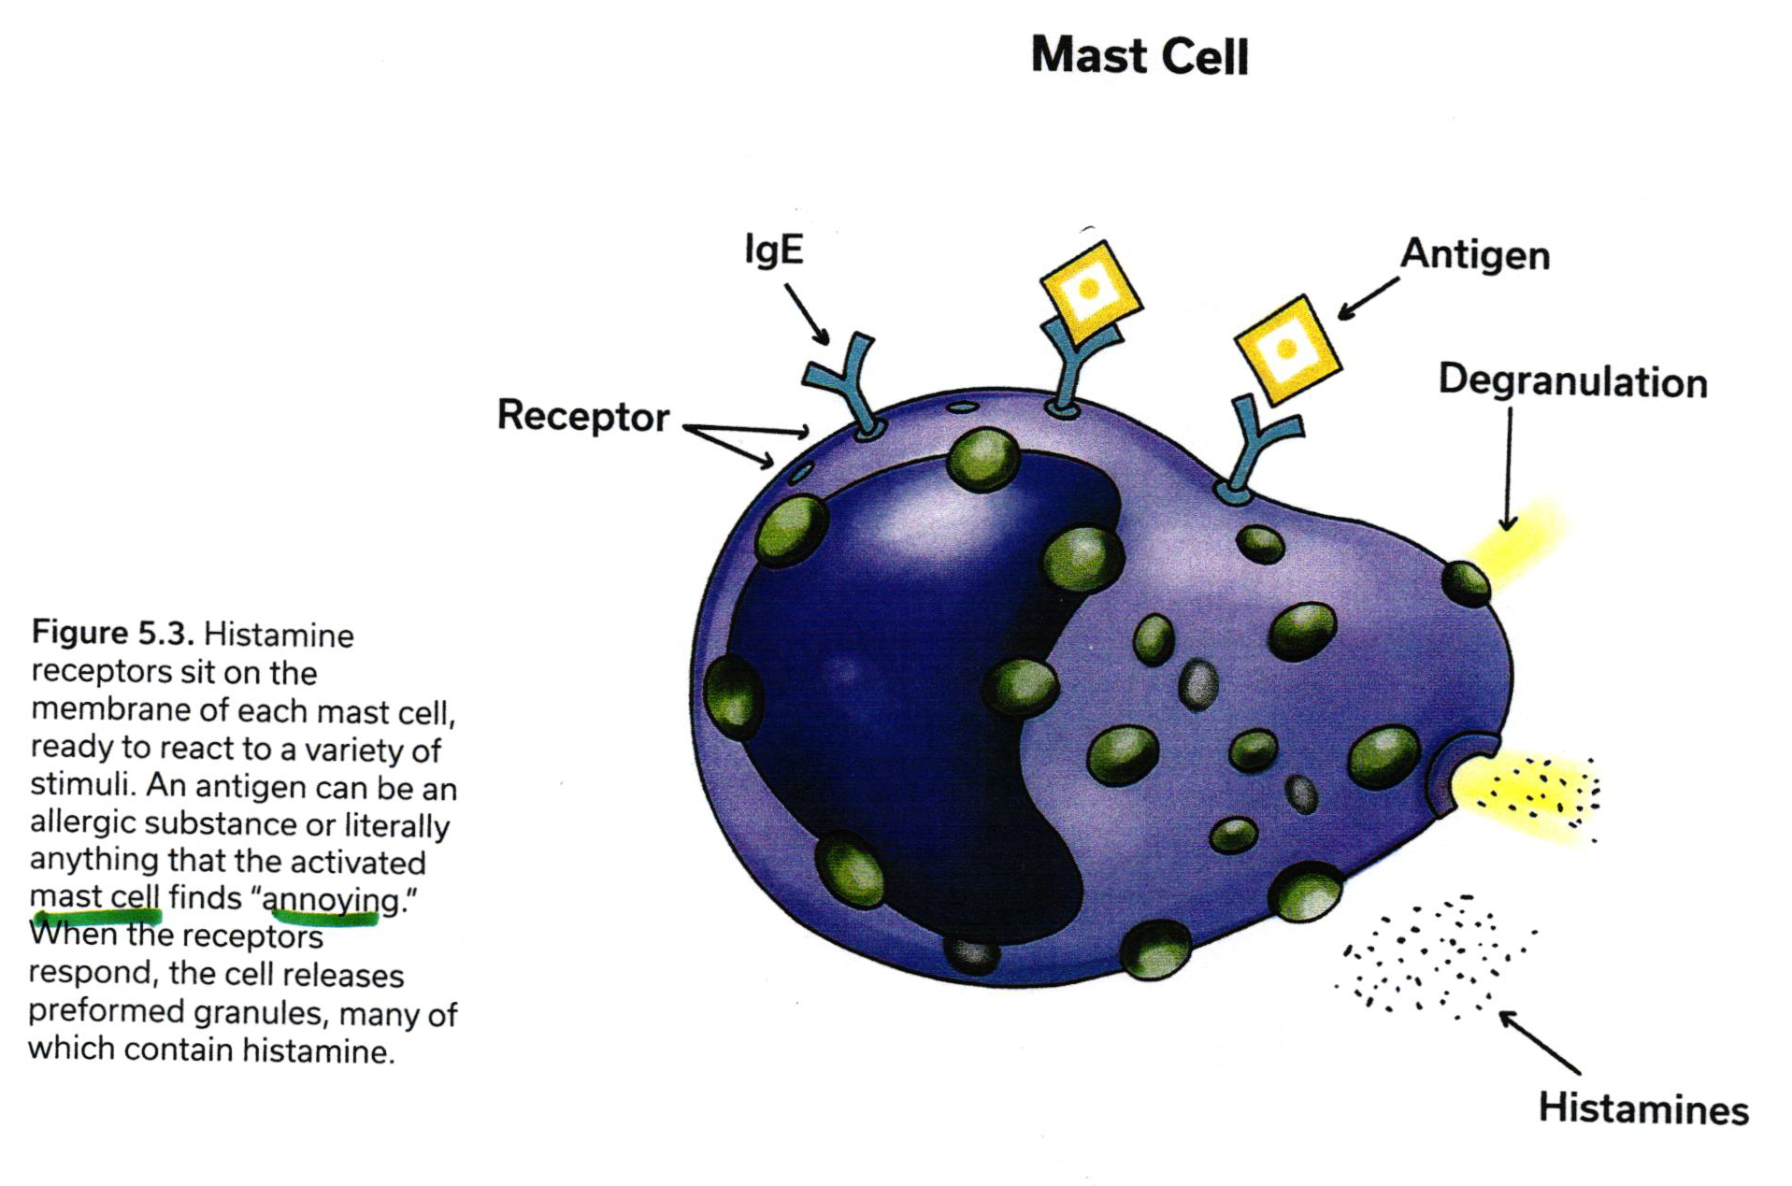
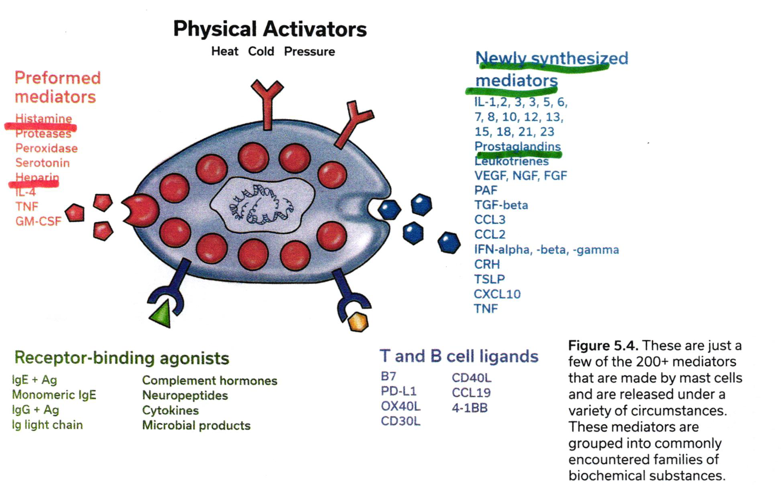

Slide 14
Candida Hypersensitivity
Epidemic due to widespread overuse of antibiotics in the general population.
Examples: chronic use of doxycycline for acne, antibiotics for Lyme disease, sinusitis and other respiratory conditions.
Testing: intradermal skin test helpful
Treatment: low sugar diet avoiding wheat, milk, cheese and alcohol.

Slide 15
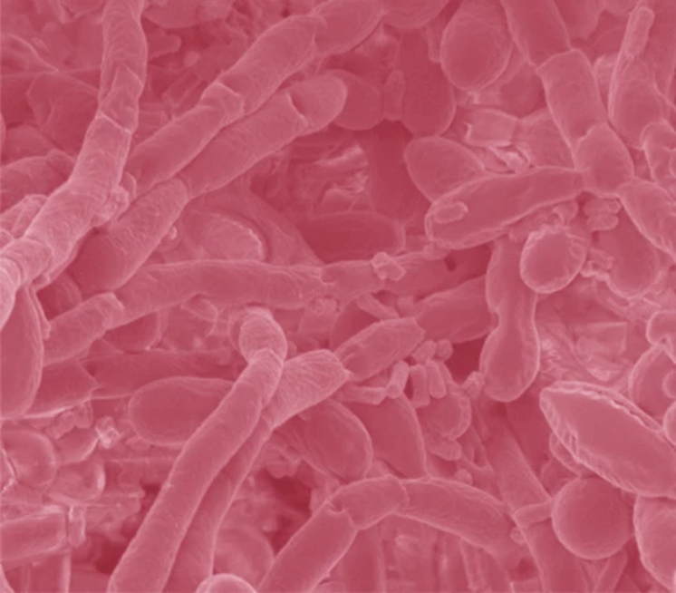
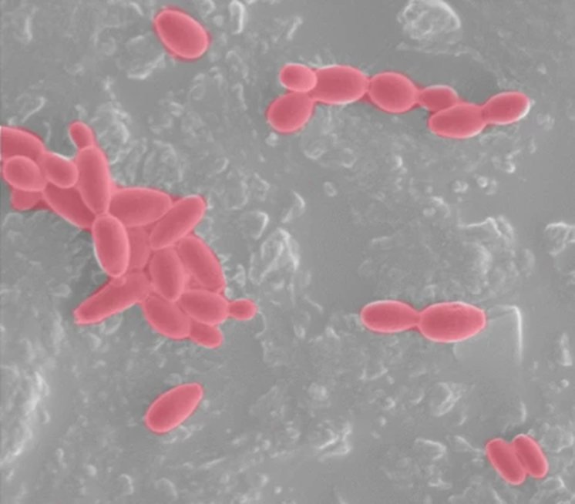
Why Focus on Candida?

Slide 16
Factors that cause Candida Overgrowth
Antibiotics
Acid blockers
Birth Control pill
Corticosteroids
Highly refined Carbohydrate diet
Endocrine dysfunction: PCOS, diabetes, thyroid or adrenal insufficiency.

Slide 17
Stages of Candida
Use my handout as template
Stage 1: Intestinal symptoms- bloating, gas, reflux and constipation
Stage 2: Extraintestinal symptoms- vaginitis, sinusitis and dermatitis
Stage 3: Neuropsychiatric symptoms- poor concentration, memory
Stage 4: Muscle symptoms- fatigue, muscle pain

Slide 18
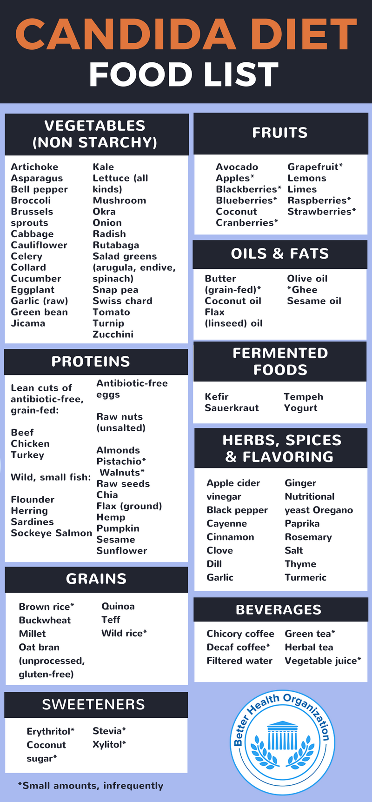

Slide 19
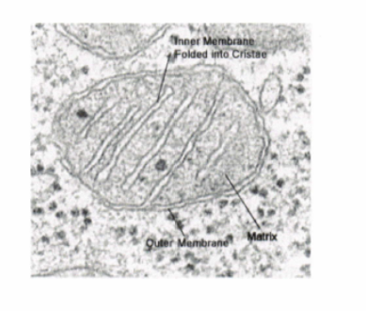
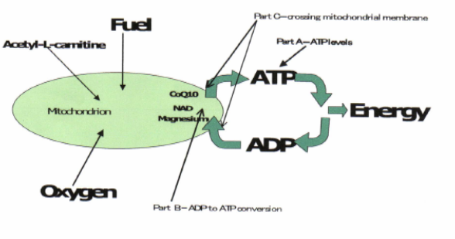
Mitochondrial Dysfunction:
What is mitochondrial dysfunction?
Doctors really don’t like going back to biochemistry- otherwise they would be working in a lab instead of with patients.
Discuss low Cardiac output…leads to low blood volume..low BP..perfusion defects…POTS

Slide 20
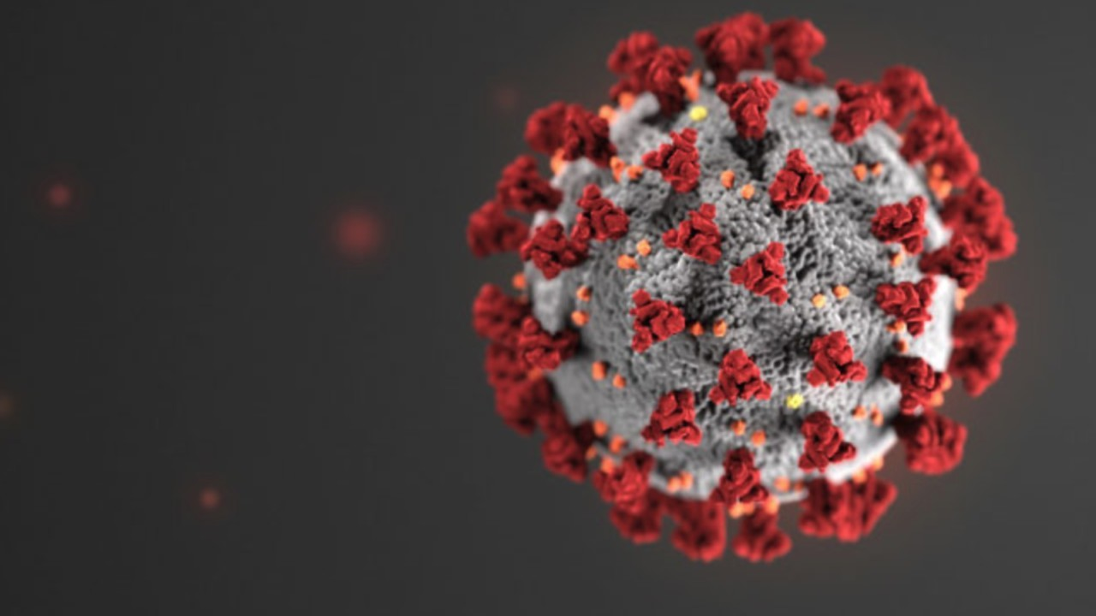
COVID-19: Picture of Spike protein on virus
Long haulers infected with COVID-19 have been a mystery?
Striking loss of energy, autonomic dysfunction: tachycardia alternating with postural hypotension.
No clear cut treatment approach at this time

Slide 21

Contact Information:
Main Numbers:
  New York 212-397-0157
  Rockville Centre 516-678-9600
Website:
  www.mitchellmedicalgroup.com
Email:
  care@mitchellmedicalgroup.com

Slide 22
Thanks for joining us
Questions? Please use the chat button
Thank you for sharing your time tonight!
If you have any more questions after tonight please email: mail@goodhormonehealth.com
If you want an appointment with Dr. appointment, please go to www.goodhormonehealth.com
Webinar will be posted in a few days

