Slide 1
Are you able to read the label?
Presented by Perla Saldivar, B.S.

Slide 2
Nutrition facts label

Slide 3
Why read the label?
Know what you are eating!
  Find amount per serving of:
    Calories
    Saturated fat
    Cholesterol
    Sodium
    Protein
Important for people trying to manage their weight
Find Allergens
Notes:
Anyone allergic to any food?
Also important to compare between foods!

Slide 4
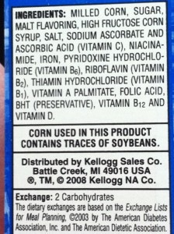
Ingredients
List of ingredients tells you what is in the food
Ingredients appear in descending order
  by WEIGHT
More prevalent ingredient FIRST

Slide 5
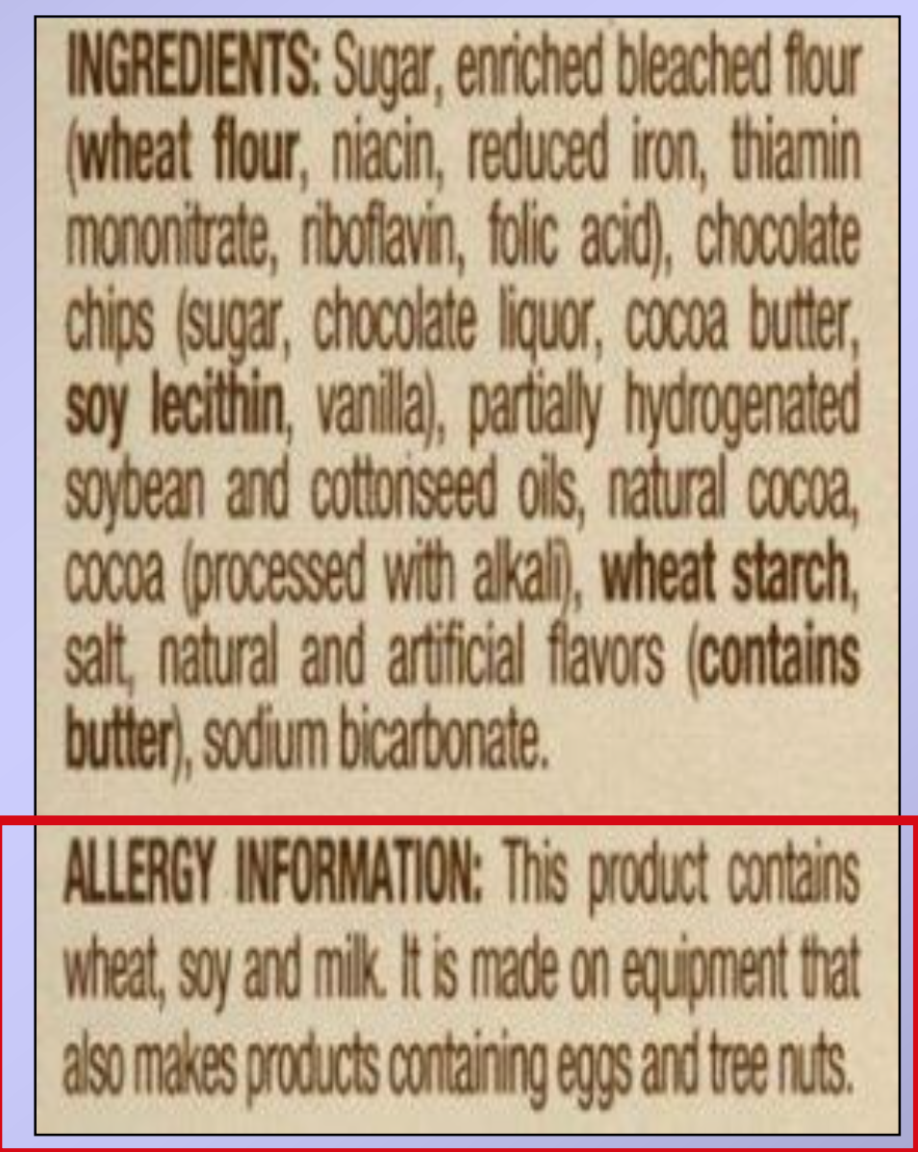
Allergens
Allergens can cause mild to severe physical reaction to people allergic to them.
Milk Products
Eggs
Peanuts
Fish
Shell fish
Soy
Wheat
Tree nuts

Slide 6
Serving size
Serving size
  Measurement of one serving
  All nutrients in label based on that amount
Servings Per Container
  How many servings in package

Slide 7
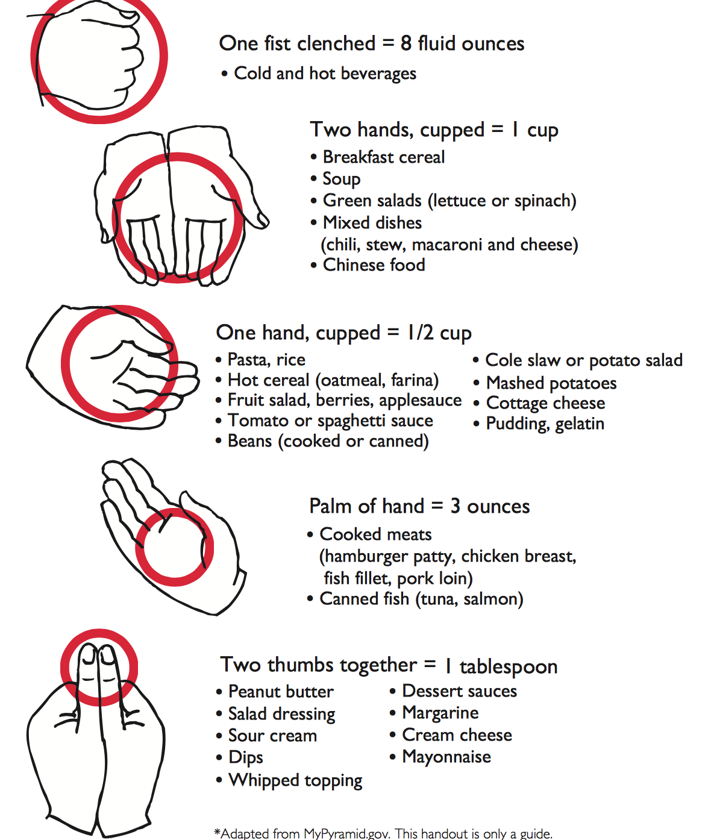
Portion sizes
Guide:
  adult woman’s hand

Slide 8
Calories
Calories per gram:
  1 gram of fat = 9 calories
  1 gram of Carbohydrate = 4 calories
  I gram of Protein = 4 calories
AMOUNT:
  Low = 40 calories
  Moderate = 100 calories
  High = 400 calories
d

Slide 9
Calories
Where do they come from?
  Carbohydrates, Proteins, Fat
Calories give us Energy!
  Need calories to carry out everyday tasks
How to calculate Calories in MORE than ONE serving
  servings X Calories

Slide 10
% Daily Value
% Daily Values
  how much you should get each day
  based on 2,000 Calorie Diet
Percentages
  how much per ONE serving
AMOUNT:
  Low = less than 5%
  Moderate = between 6-19%
  High = more than 20%
Notes:
No DV for Trans FAT
Avoid it as much as possible
Sugars just excess calories

Slide 11
FATS-
TOTAL FAT- 30% Daily Calories
Number of Fat grams in ONE SERVING
No more than 30% of all your Daily Calories from fat
600 calories in a 2,000 Calorie Diet
d

Slide 12
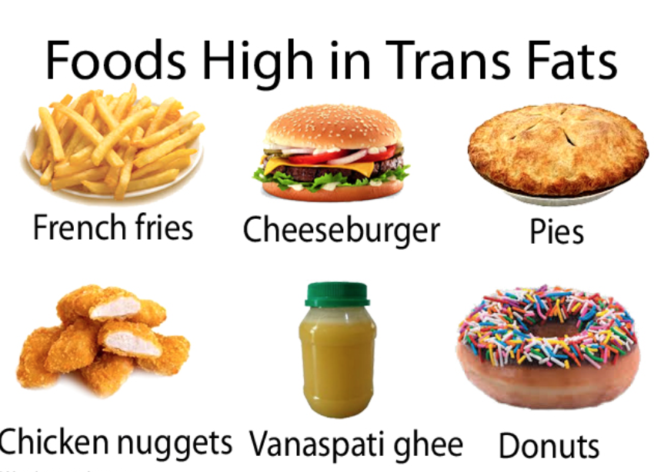
FATS-
Saturated Fats and Trans Fat
  BAD FAT
  Less than 10% Saturated Fat
  No more than 13g/day
Low Fat is Good
  Total 3 grams or less
4 g/ tsp of lard
SATURATED FAT
Meat
Seafood
Poultry skin
Egg yolks
Whole Fat Dairy
  cheese
  milk
  ice Cream

Slide 13
The Good FAts
Monounsaturated and Polyunsaturated Fats
  Lower LDL “Bad Cholesterol”
  Increase HDL “Good Cholesterol”
  Protects Arteries, (w/exercise, medication, changing fat profile)
POLYUNSATURATED
Omega 3 Fatty Acids
Salmon
Fish Oil
Sunflower Oil
MONOUNSATURATED
Nuts
Canola Oil
Olive Oil
Notes:
Coconut oil high in saturated fat 84% and LDL
Made mostly of medium chain triglycerides body handles differently than long chain triglycerides
Medium chain tryglycerides may boost your good cholesterol and bad one too

Slide 14
Food Cholesterol
Found in Meat and Dairy Products
Part of cells structure
d

Slide 15
Sodium
How much SALT is in your food
Less than 2400 milligrams/day
  around ONE teaspoon of salt or 6 grams
d
Notes:
1/2 teaspoon salt = 1,150 mg sodium
he American Heart Association recommends people aim to eat no more than 1,500 milligrams of sodium per day. That level is associated with a significant reduction in blood pressure, which in turn reduces the risk of heart disease and stroke.

Slide 16
Sodium
Notes:
1/2 teaspoon salt = 1,150 mg sodium
he American Heart Association recommends people aim to eat no more than 1,500 milligrams of sodium per day. That level is associated with a significant reduction in blood pressure, which in turn reduces the risk of heart disease and stroke.

Slide 17
Total CarbohydratE
What do they do?
  Energy for Muscles and Brain
Notes:
So, if you get 2,000 calories a day, between 900 and 1,300 calories should be from carbohydrates. That translates to between 225 and 325 grams of carbohydrates a day.
5 g per s
Indigestible fiber- helps other food and waste products move through the gut more easily.
skin on potatoes, wholegrain bread and breakfast cereals, brown rice and wholewheat pasta .
Fibre can help keep our bowels healthy and can help us feel full, which means we are less likely to eat too much.
wholegrain starchy foods and potatoes eaten with their skins on a particularly good choice if you're trying to lose weight.
Some types of fibre – present in fruits and vegetables can be partly digested, and may help reduce the amount of cholesterol in the blood.
apples, turnips, sweet potatoes, oats
Starch, Your body uses starch to provide glucose to all cells.
But where you get your starch from matters. Ideally, all of the starch in your diet should come from fresh produce, whole grains and legumes.
You’ll get the complex carbohydrate from black, kidney, garbanzo, navy, pinto, lima or white beans. Processed beans such as baked, canned and refried beans are starchy too. Brown, yellow, green or other variety of lentils provide additional sources of starch.
you are concerned about your intake of sugars, make sure that added sugars are not listed as one of the first few ingredients. Other names for added sugars include: corn syrup, high-fructose corn syrup, fruit juice concentrate, maltose, dextrose, sucrose, honey, and maple syrup.
To limit nutrients that have no %DV, like trans fat and sugars, compare the labels of similar products and choose the food with the lowest amount.

Slide 18
Total CarbohydratE
Sources
  Rice, Bread, Potatoes, Pasta, Vegetables, Fruit
Found in label:
  Fiber = helps with digestion and to keep full
    high fiber is good (3g of more)
  Sugars = source of Energy
  Starch = found in Ingredients section
2,000 calories a day
  between 900 and 1,300 calories should be carbohydrates
  between 225 and 325 grams of carbohydrates a day
Notes:
So, if you get 2,000 calories a day, between 900 and 1,300 calories should be from carbohydrates. That translates to between 225 and 325 grams of carbohydrates a day.
5 g per s
Indigestible fiber- helps other food and waste products move through the gut more easily.
skin on potatoes, wholegrain bread and breakfast cereals, brown rice and wholewheat pasta .
Fibre can help keep our bowels healthy and can help us feel full, which means we are less likely to eat too much.
wholegrain starchy foods and potatoes eaten with their skins on a particularly good choice if you're trying to lose weight.
Some types of fibre – present in fruits and vegetables can be partly digested, and may help reduce the amount of cholesterol in the blood.
apples, turnips, sweet potatoes, oats
Starch, Your body uses starch to provide glucose to all cells.
But where you get your starch from matters. Ideally, all of the starch in your diet should come from fresh produce, whole grains and legumes.
You’ll get the complex carbohydrate from black, kidney, garbanzo, navy, pinto, lima or white beans. Processed beans such as baked, canned and refried beans are starchy too. Brown, yellow, green or other variety of lentils provide additional sources of starch.
you are concerned about your intake of sugars, make sure that added sugars are not listed as one of the first few ingredients. Other names for added sugars include: corn syrup, high-fructose corn syrup, fruit juice concentrate, maltose, dextrose, sucrose, honey, and maple syrup.
To limit nutrients that have no %DV, like trans fat and sugars, compare the labels of similar products and choose the food with the lowest amount.

Slide 20
Proteins
What do they do?
  Make up muscles, organs, enzymes
10-20% of calorie needs
Expressed in label in GRAMS not %DV!

Slide 21
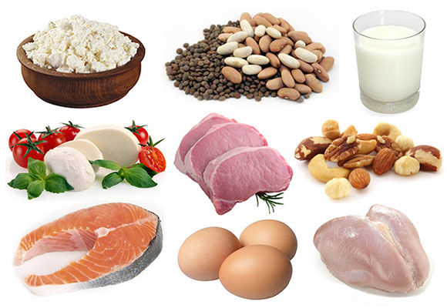
Proteins
Good Protein Sources
Eggs
Milk
Beef
Soy
Sesame
Chicken
Oats
Brown rice
Whole wheat
Beans
Peas

Slide 22
VITAMINS AND MINERALS
%DAILY VALUE of:
Vitamin C: immune defense system, healing
Vitamin A: eyesight, appetite, growth
Calcium: bones, blood clotting, muscle contraction
Iron: red blood cells and muscle function

Slide 23
Footnote
Tells you that all recommended daily values comes from a 2,000 Calorie meal plan

Slide 24
REferences
file:///Users/Perla/Desktop/Diabetes%20Research/are_you_able_to_read_the_label.pdf
http://www.fda.gov/Food/IngredientsPackagingLabeling/LabelingNutrition/ucm274593.htm

