Slide 1
Who Should Be Tested For Adult Growth Hormone Deficiency?
GoodHormoneHealth Webinar
January 26, 2020

Slide 2
What we will discuss tonight
Causes of growth hormone deficiency?
How Dr. Friedman differs from other Endocrinologists with regard to growth hormone deficiency?
Who should be tested?
What tests are available?
How to Interpret the tests?
What are the risks and benefits of growth hormone replacement?

Slide 3
Causes of Growth Hormone Deficiency
Pituitary Problems
Includes Traumatic Brain Injury

Slide 4
Hormonal Axes
Adrenal (corticotropes)=CRH-ACTH-Cortisol
Thyroid (thyrotropes)= TRH-TSH-T4/T3
Gonads (gonadotropes)= GnRH-LH/FSH-Testosterone/estrogen
GH (sommatotropes) =GHRH-GH-IGF-1
Posterior pituitary-AVP and oxytocin

Slide 5
Causes of Hypopituitarism
Anywhere along the hypothalamic-stalk-pituitary axis
Microadenomas! (Yuen, et al. Clinical Endocrinology 69:292-298, 2008.
Traumatic Brain Injury/concussions/head trauama

Slide 6
Pituitary Causes of Hypopituitarism
Pituitary Tumor (macroadenomas vs. microadenomas)
Pituitary Surgery
Pituitary radiation
Sheehan’s syndrome/ pituitary apoplexy
Hypophysitis
Pituitary infiltration
Empty Sella
Malnutrition/critical illness
Head trauma

Slide 7
Stalk/Hypothalamic Causes of Hypopituitarism
Craniopharyngioma
CNS malignancy
Surgery/radiation
Head trauma/accidents
Infiltrative diseases (histiocytosis X, hemachromatosis, sarcoidosis)
Infection
Drugs (steroids, dopamine analogues, somatostatin analogues)

Slide 8
Order of hormone deficiencies
GH
Gonadotropins (FSH, LH)
TSH
ACTH
Prolactin
Posterior pituitary hormones

Slide 9
Microadenomas and hypopituitarism (Yuen et al, 2008)
38 patients with non-secreting pituitary microadenomas (mean tumor size 4.2 mm) and normal serum IGF-I levels were studied.
19 patients (50%) were found to be GH-deficient, and had higher body mass index (BMI) than those that passed the GHRH-arginine test and healthy controls.
19 patients (50%) had at least one other pituitary hormone deficit.
We concluded that a substantial number of patients with non-secreting pituitary microadenomas were GH-deficient despite normal serum IGF-I levels, and had at least one other pituitary hormone deficit, suggesting that non-secreting microadenomas may not be clinically harmless.

Slide 10
Microadenomas and hypopituitarism
Patients with low IGF-1 and a microadenomas are even more likely to be growth hormone deficient.
Many Endocrinologists test for hypopituitarism only if a patient has had prior surgery or radiation to their pituitary.
My approach is to measure pituitary hormones first in patients with symptoms of hypopituitarism and if it points to hypopituitarism, then get a pituitary MRI
If MRI shows a small pituitary or a tumor and IGF-1 is low, and the patient has symptoms of growth hormone deficiency, then do a growth hormone stimulation test

Slide 11
Growth Hormone Deficiency
There are more than 50,000 adults with a growth hormone (GH) deficiency diagnosis in the United States.

Slide 12
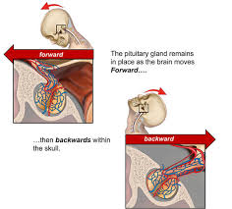
Traumatic Brain Injury

Slide 13
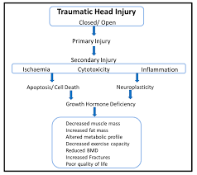
Traumatic Brain Injury

Slide 14
Overview of Growth Hormone

Slide 15
Growth Hormone Deficiency
Patients with hypopituitarism have increased mortality, suggested, but not proven to be due to GH deficiency
Growth hormone deficiency in adults results in:
Decreased bone formation
Increased fat mass (central obesity)
Decreased muscle mass
Lipid abnormalities
Increased thickness of blood vessels
Increased inflammatory markers
Impaired quality of life
Increased number of sick days
Impaired exercise tolerance
Most abnormalites are corrected by treatment

Slide 16
Growth Hormone Deficiency
If left undiagnosed, AGHD may lead to increased risk for premature mortality, significant morbidity, and multiple signs and symptoms, including
An increase in body fat
A decrease in muscle mass
Weakness and fatigue
Osteoporosis
An increased rate of fractures
Dyslipidemia
Cardiovascular disease
Impaired psychological well-being such as isolation, anxiety, or depression

Slide 17
Growth Hormone Deficiency

Slide 18
Growth Hormone Deficiency: The rest of the Endocrinologists in the world
Growth hormone deficiency is rare.
Idiopathic (without a clear cut cause) growth hormone deficiency does not exist
Only if patient had prior surgery or radiation or maybe severe head trauma, should you look for it.
Only severe cases of growth hormone deficiency should be treated
Only treat growth hormone deficiency if the patient has other pituitary hormone deficiencies.

Slide 19
Growth Hormone Deficiency: Dr. Friedman
In most of medicine, you get a history and physical and if the patient has a constellation of symptoms, you look for a diagnosis.
Growth hormone deficiency is not that rare and explains symptoms in selected patients
Most patients with both mild and severe growth hormone deficiency get better with treatment.

Slide 20
Growth Hormone Deficiency: Dr. Friedman
Growth hormone is the first hormone deficiency to occur in cases of hypopituitarism
About 60% of the cells in the pituitary are somatotrophs and make growth hormone.
The pituitary insult can be mild to give growth hormone deficiency.
You do not need other pituitary hormones to be deficient to have growth hormone deficiency.
Empty sella, Sheehan’s syndrome and traumatic brain injuries are not that uncommon and give growth hormone deficiency.

Slide 21
Growth Hormone Deficiency: Dr. Friedman
Dr. Friedman will get an IGF-1 if you have symptoms of growth hormone deficiency and potential damage to your pituitary.
He will recommend a growth hormone stimulation if the IGF-1 is low or in the low-normal range.

Slide 22
Risk and Benefits of Growth Hormone Deficiency
Symptoms of growth hormone deficiency
Weight gain.
Trouble sleeping.
Psychological and psychiatric problems including depression, mood swings and irritability.
Their quality of life and functionality is much lower.
All these symptoms are improved with growth hormone replacement.

Slide 23
Risk and Benefits of Growth Hormone Deficiency
Growth hormone replacement has very few side effects.
The main side effects are joint pain and edema.
Some patients on growth hormone replacement can get worsening glucose control, but in general the patients feel so much better on growth hormone replacement, they exercise more and feel better and their blood sugar improves.

Slide 24
Risk and Benefits of Treating Mild Cortisol Deficiency
On the other hand, most Endocrinologists treats mild cortisol deficiency.
Certainly, if hydrocortisone is needed it should be given, but in many borderline cases it is unclear whether hydrocortisone needs to be given.
Giving exogenous cortisol shuts down the adrenal glands from making its own cortisol and therefore, once you start cortisol, it is may be very hard to stop it.

Slide 25
Risk and Benefits of Treating Mild Cortisol Deficiency
Additionally excess cortisol replacement leads to weight gain, diabetes, infections, and osteoporosis (thin bones).
Many endocrinologists erroneously feel that patients can die suddenly from cortisol deficiency.
This is based on old literature and occurred only in patients with severe cortisol deficiency.

Slide 26
Risk and Benefits of Treating Mild Cortisol Deficiency
More recent literature suggests that patients with mild cortisol deficiency do not die suddenly, do not necessarily need to be treated with hydrocortisone, and the benefits of treating with exogenous hydrocortisone most likely outweigh the risk unless the cortisol deficiency is severe.

Slide 27
Rest of the world vs Dr. Friedman for testing for and treating growth hormone deficiency
You decide

Slide 28
Growth Hormone Deficiency-Diagnosis
Growth hormone is pulsatile, so a random growth hormone is not helpful.
You could be at the top of the pulse or the bottom of the pulse

Slide 29
Growth Hormone Deficiency-Diagnosis
Screen with IGF-I:
If in top 50% of normal range for age and sex (> 150 ng/mL) GH deficiency less likely
If empty sella, history of head trauma, headache and low blood pressure after delivery (Sheehan’s syndrome), history of pituitary surgery or radiation or pituitary tumor (micro or macro adenoma)=GH deficiency more likely
If < 75 ng/mL-GH deficiency likely
If in the lower 25%, worth testing with a stimulation test
Stimulation testing
Glucagon stimulation test is preferred- GH deficient if GH is < 5 ng/mL ITT- GH deficient if GH is < 5 ng/ml
Macrilen Stimulation Test

Slide 30
IGF-1 is only a screening test

Slide 31
Growth Hormone Deficiency Stimulation testing
Glucagon stimulation test is preferred- GH deficient if GH is < 5 ng/mL
ITT- GH deficient if GH is < 5 ng/ml
Macrilen Stimulation Test

Slide 32
Current AGHD Testing

Slide 33
Macrilen Stimualtion test was recently published
Garcia et al. Macimorelin as a Diagnostic Test for Adult GH Deficiency
J Clin Endocrinol Metab, August 2018, 103(8):3083–3093

Slide 34
Macrilen Mechanisms of Action

Slide 35
Macrilen was compared against ITT

Slide 36
Endpoints for the study

Slide 37
Evaluability

Slide 38
Sensitivity and Specificity
Macrilen stim test had similar sensitivity and specificity as the ITT

Slide 39
High Reproducibility

Slide 40
Adverse Events

Slide 41
Preparation before Macrilen

Slide 42
Administration of Macrilen

Slide 43
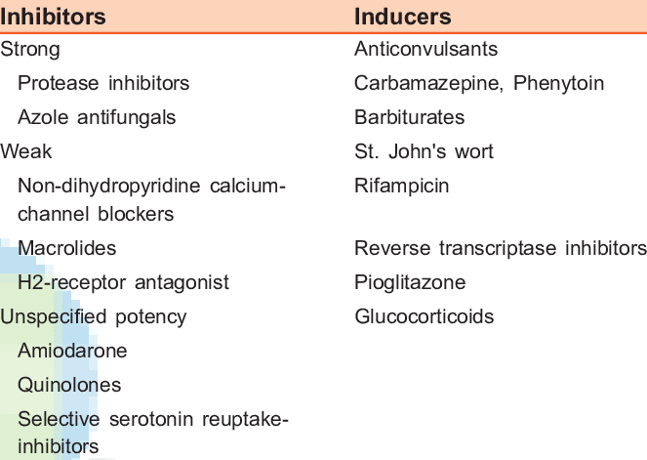
CYP3A4 Inducers/inhibitors
Strong CYP3A4 inducers may reduce macrilen levels and lead to a false positive test
Strong CYP3A4 inhibitors may increase macrilen levels and lead to a false negative test
I do not think patients need to stop glucocorticoids before testing
May want to stop ketoconazole one week before testing

Slide 44
Cutoffs

Slide 45
Cutoffs- Macrilen
The FDA has has set a cutoff for the Macrilen test of the peak GH level <2.8 ng/mL, although the paper in Journal of Clinical Endocrinology and Metabolism found that a GH level of 5.1 ng/mL gave the highest separation between normal and growth hormone deficient subjects.
Dr. Friedman may start a trial of growth hormone on patients whose peak response between 2.8 and 5.1 ng/mL.

Slide 46
Cutoffs- Glucagon
Endocrine Society recommends a cut-off of 3.0
Dr. Friedman may start a trial of growth hormone on patients whose peak response between 3.0 and 5.0 ng/mL.
Dr. Friedman does not agree with the recommendation of some authors that the cut-off for obese patients should be 1.0 ng/mL

Slide 47
Glucagon vs Macrilen Stimulation Tests
Glucagon Stim Test
Macrilen Stim Test
$695
Does not need a pre-auth
Requires an intramuscular injection
Most patients get nauseous
7 blood draws
$350
Requires pre-authorization that may take up to a month
Not all insurances cover it ($5000 cash cost)
Oral solution
4 blood draws

Slide 48
Glucagon and Macrilen Stimulation Tests
Dr. Friedman offers both tests Tuesday night
If new patient, send us your IGF-1 and brief history related to your pituitary.
IGF-1 needs to be in the lower 50% of range (Z-score negative number)
If coming from out of town, let us know well in advance the pre-auth for Macrilen
You can have your appointment and stim test on the same night.
You need to fast for 8 hrs for both tests.
Water and medicines are ok.

Slide 49
Related articles on goodhormonehealth.com
Adult Growth Hormone Deficiency
Mild Growth Hormone Deficiency Versus Mild Cortisol Deficiency - Which One Should You Treat?
Macrilen Stimulation Test vs Glucagon Stimulation Test for Adult Growth Hormone Deficiency
Growth Hormone Treatment in Pregnancy and Breastfeeding
Hormones and Brain Injury: Did Junior Seau Suffer From Pituitary Dysfunction?

Slide 50
Questions?
Please use the chat button
Thank you for sharing your time tonight!
If you have any more questions after tonight or want an appointment, please email: mail@goodhormonehealth.com
www.goodhormonehealth.com
Webinar will be posted in a few days

