Slide 1
Theodore C. Friedman, M.D., Ph.D. Professor of Medicine-UCLA Chairman, Department of Internal Medicine Charles R. Drew University Dr. Friedman’s Endocrinology Clinic Growth Hormone Use in Adult-Onset Growth Hormone Deficiency
A4M/Metabolic Medical Institute (MMI) August 15, 2021

Slide 2
Hormonal Axes
Adrenal (corticotropes)=CRH-ACTH-Cortisol
Thyroid (thyrotropes)= TRH-TSH-T4/T3
Gonads (gonadotropes)= GnRH-LH/FSH-Testosterone/estrogen
GH (sommatotropes) =GHRH-GH-IGF-1
Posterior pituitary-AVP and oxytocin

Slide 3
Overview of Growth Hormone
GH is the most abundant pituitary hormone in humans.
The synthesis and secretion of GH by pituitary somatotrophs is regulated by growth hormone-releasing hormone (GHRH)
GH stimulates and somatostatin inhibits GH release.
GH receptors have been found in numerous tissues, including muscle, fat, liver, heart, kidney, brain, and pancreas.
Cell-surface GH receptors mediate the direct actions of GH in target tissues, primarily by the local production of insulin-like growth factor I (IGF-I)
GH also stimulates IGF-I secretion from the liver into the blood.
Circulating IGF-I mediates the effects of GH by activating tissue IGF-I receptors that promote growth and modulate metabolism.
In addition, circulating IGF-I inhibits GH secretion by negative feedback to the hypothalamus and pituitary.

Slide 4
Overview of Growth Hormone

Slide 7
Causes of Hypopituitarism
Anywhere along the hypothalamic-stalk-pituitary axis
Microadenomas

Slide 8
Pituitary Causes of Hypopituitarism
Pituitary Tumor (macroadenomas vs. microadenomas)
Pituitary Surgery
Pituitary radiation
Sheehan’s syndrome/ pituitary apoplexy
Hypophysitis
Pituitary infiltration
Empty Sella
Malnutrition/critical illness
Head trauma

Slide 9
Stalk/Hypothalamic Causes of Hypopituitarism
Craniopharyngioma
CNS malignancy
Surgery/radiation
Head trauma/accidents
Infiltrative diseases (histiocytosis X, hemachromatosis, sarcoidosis)
Infection
Drugs (steroids, dopamine analogues, somatostatin analogues)

Slide 10
Order of hormone deficiencies
GH
Gonadotropins (FSH, LH)
TSH
ACTH
Prolactin
Posterior pituitary hormones

Slide 11
Microadenomas and hypopituitarism (Yuen, et al. Clinical Endocrinology 69:292-298, 2008
38 patients with non-secreting pituitary microadenomas (mean tumor size 4.2 mm) and normal serum IGF-I levels were studied.
19 patients (50%) were found to be GH-deficient, and had higher body mass index (BMI) than those that passed the GHRH-arginine test and healthy controls.
19 patients (50%) had at least one other pituitary hormone deficit.
We concluded that a substantial number of patients with non-secreting pituitary microadenomas were GH-deficient despite normal serum IGF-I levels, and had at least one other pituitary hormone deficit, suggesting that non-secreting microadenomas may not be clinically harmless.

Slide 12
Microadenomas and hypopituitarism
Patients with low IGF-1 and a microadenomas are likely to be growth hormone deficient.
Many Endocrinologists test for hypopituitarism only if a patient has had prior surgery or radiation to their pituitary.
My approach is to measure pituitary hormones first in patients with symptoms of hypopituitarism and if it points to hypopituitarism, then get a pituitary MRI
If MRI shows a small pituitary or a tumor and IGF-1 is low, and the patient has symptoms of growth hormone deficiency, then do a growth hormone stimulation test

Slide 13
Growth Hormone Deficiency

Slide 14
Etiology of Adult-Onset GHD

Slide 16
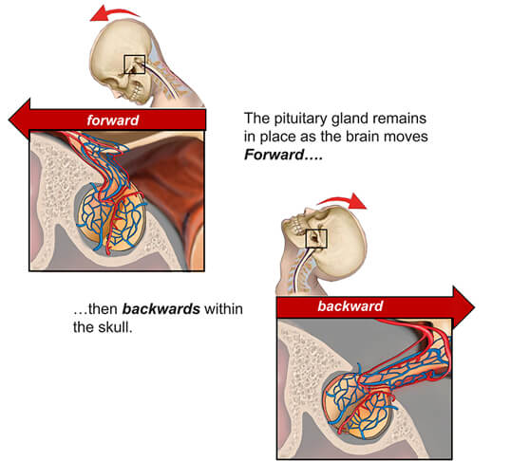
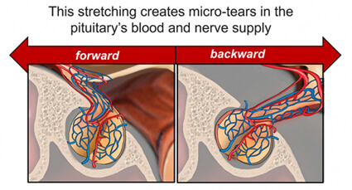
Traumatic Brain Injury

Slide 17
Traumatic Brain Injury

Slide 19
Growth Hormone Deficiency
If left undiagnosed, AGHD may lead to increased risk for premature mortality, significant morbidity, and multiple signs and symptoms, including
An increase in body fat
A decrease in muscle mass
Weakness and fatigue
Osteoporosis
An increased rate of fractures
Dyslipidemia
Cardiovascular disease
Impaired psychological well-being such as isolation, anxiety, or depression

Slide 20
Growth Hormone Deficiency
Patients with hypopituitarism receiving conventional therapy (without GH) have increased mortality, suggested, but not proven to be due to GH deficiency (Rosen and Bengtsson, Lancet, 1990, 336:285; Bates, et al., JCEM, 1996, 81:1169)
Thought to be due to increased cardiovascular disease
As GH is the first hormone to become deficient, microadenomas may cause GH deficiency.
The pituitary expends about 80% of its energy synthesizing GH (Clemmons, personal communication).

Slide 21
Growth Hormone Deficiency
Growth hormone deficiency in adults results in:
Decreased bone formation
Increased fat mass (central obesity)
Decreased muscle mass
Lipid abnormalities
Increased thickness of blood vessels
Increased inflammatory markers
Impaired quality of life
Increased number of sick days
Impaired exercise tolerance
Most symptoms are corrected/improved by treatment

Slide 22
Growth Hormone Deficiency
Treatment of Growth hormone deficiency in adults has been shown to:
Improve body composition
Improve lipid abnormalities
Improve exercise tolerance
Improve bone formation
Reverse inflammatory markers
Improve quality of life
Most (if not all) studies have been funded by pharmaceutical companies producing GH

Slide 23
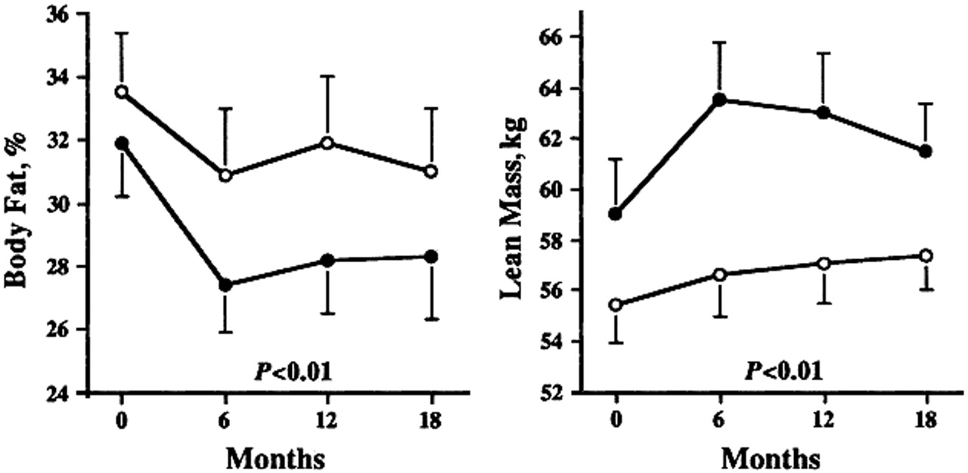
Growth Hormone and Body Composition
Baum et al., Ann Int. Med. 1996, 125:883 examined GH replacement in 24 patients with adult GHD for 6 months
GH lead to a decrease in fat mass of 5.7 kg (p < 0.0001) compared to placebo
GH lead to an increase in lean body mass of 5.5 kg (p < 0.0001) compared to placebo

Slide 24
Growth Hormone and Exercise Capacity
Two open label studies have demonstrated that GH treatment of GHD patients leads to an increase in submaximal exercise performance
Jorgenson et al. Eur. J. Endo. 1994, 130:224.
10 patients
Improvement in exercise capacity
Increased thigh muscle volume
Increased isometric muscle strength

Slide 25
Growth Hormone and Body Lipids
Several small open label studies (duration 18 months or greater) have demonstrated that GH treatment of GHD patients leads to favorable lipid changes
Reduction or no change in cholesterol
Increase or no change in HDL
Decrease or no change in LDL
No change in triglycerides

Slide 29
Growth Hormone and Cardiovascular Parameters
Caidahl et al., Clin. Endo. 1994, 130:393
Double-blind crossover study for 6 months-10 patients
Increased stroke volume
Increased LV mass
Increased cardiac output
Decreased peripheral resistance
Sesmilo et al., Ann. Intern. Med. 2000, 133:111
Single-blind placebo control trial for 18 months-44 men
Decreased CRP
Decreased interleukin-6
Increased Lp(a)

Slide 30
Growth Hormone and Carotid Intima Thickness
Pfeifer et al., JCEM. 1994, 84:453
Open label study for 18 months-11 patients
GH reversed carotid intima media thickening
Thickening returned to that of matched controls
Gibney et al., JCEM, 1999,84:295
Improvements in intima media thickness were maintained for 10 years

Slide 32
Growth Hormone Deficiency

Slide 33
Growth Hormone Deficiency-Diagnosis
Patient with a pituitary disorder
Low IGF-1
Abnormal growth hormone stimulation tests
Hartman et al. (JCEM, 2002, 87:477) have suggested that if 3 other pituitary hormones are deficient and the IGF-1 level is below 84 ng/mL, the patient has a 98% chance of being GH deficient
Low IGF-1 in liver or renal disease or with poor nutrition
Obesity is associated with low IGF-1 and abnormal stimulation testing
Unclear if the GH deficiency leads to obesity or obesity leads to GH deficiency
ITT has been considered gold standard, but it requires a doctor to be present and is associated with some danger.
Some normals have a blunted response to ITT, thus questioning its sensitivity (Hoeck, Eur. J. Endo. 1995, 133:305.

Slide 34
Growth Hormone Deficiency-Diagnosis
Growth hormone is pulsatile, so a random growth hormone is not helpful.
You could be at the top of the pulse or the bottom of the pulse

Slide 35
Growth Hormone Deficiency-Diagnosis
Screen with IGF-I:
If in top 50% of normal range for age and sex (> 150 ng/mL) GH deficiency less likely
If empty sella, history of head trauma, headache and low blood pressure after delivery (Sheehan’s syndrome), history of pituitary surgery or radiation or pituitary tumor (micro or macro adenoma)=GH deficiency more likely
If < 75 ng/mL-GH deficiency likely
If in the lower 25%, worth testing with a stimulation test
Stimulation testing
Glucagon stimulation test is preferred- GH deficient if GH is < 3 ng/mL ITT- GH deficient if GH is < 5 ng/mL (NIH consensus panel).
Some authors have proposed a GH response to glucagon cut-off of 1 ng/mL in patients with obesity, may miss mild cases
Macrilen Stimulation Test

Slide 36
IGF-1 is only a screening test

Slide 37
Growth Hormone Mild Deficiency-Diagnosis
Many experts advocate only treating patients with severe growth hormone deficiency and don’t recognize mild cases.
Others are concerned about treating a patient with growth hormone who is not growth hormone deficient.
Neither are evidence-based as growth hormone is the first hormone deficiency to occur in cases of hypopituitarism.
There was an article in the Journal of Clinical Endocrinology and Metabolism in June 2013 that suggested that idiopathic (without a clear cut cause) growth hormone deficiency does not exist.
This article suggested that growth hormone deficiency should only be treated if it is severe and if the patient has other pituitary hormone deficiencies.
In fact, many insurance companies require that the patient has at least 2 to 3 other pituitary hormone deficiencies before treatment.
To me, this makes no sense because the growth hormone deficiency is the first pituitary deficiency to occur.
So the question is why is it recommended that mild growth hormone deficiency not be treated.

Slide 38
Mild Growth Hormone Deficiency Versus Mild Cortisol Deficiency - Which One Should You Treat?
On the other hand, almost everybody treats mild cortisol deficiency.
Certainly, if hydrocortisone is needed it should be given, but in many borderline cases it is unclear whether hydrocortisone needs to be given.
Cortisol testing is often done in patients without symptoms of low cortisol.
But the benefit/risk ratio is higher for growth hormone than cortisol.

Slide 39
Mild Growth Hormone Deficiency Versus Mild Cortisol Deficiency - Which One Should You Treat?
 | Mild Growth Hormone Deficiency | Mild Cortisol Deficiency
Benefits of treating | Helps with symptoms including fatigue, poor sleep, joint pain, psychological issues | May prevent adrenal crisis
 | Helps with bone density, body composition, carotid intimal thickness, cardiovascular markers, lipids | May help with fatigue, joint pain, abdominal pain, nausea, diarrhea
Risks of treating | Easy to taper off or stop | Shuts down the adrenal glands from making its own cortisol, making it hard to taper off or stop
 | Joint pain and swelling | Weight gain, diabetes, infections, and osteoporosis
 | Theoretical risk of increased cancers and diabetes
 | Expensive and covered by insurance | Inexpensive and covered by insurance

Slide 40
Current AGHD Testing

Slide 41
Macrilen Stimualtion test was published
Garcia et al. Macimorelin as a Diagnostic Test for Adult GH Deficiency
J Clin Endocrinol Metab, August 2018, 103(8):3083–3093

Slide 42
Macrilen Mechanisms of Action

Slide 43
Macrilen was compared against ITT

Slide 44
Endpoints for the study

Slide 45
Evaluability

Slide 46
Sensitivity and Specificity
Macrilen stim test had similar sensitivity and specificity as the ITT

Slide 47
High Reproducibility

Slide 48
Adverse Events

Slide 49
Cutoffs
The FDA has has set a cutoff for the Macrilen test of the peak GH level <2.8 ng/mL, although the paper in Journal of Clinical Endocrinology and Metabolism found that a GH level of 5.1 ng/mL gave the highest separation between normal and growth hormone deficient subjects.
I may start a trial of growth hormone on patients whose peak response between 2.8 and 5.1 ng/mL.

Slide 50
Glucagon vs Macrilen Stimulation Tests
Glucagon Stim Test
Macrilen Stim Test
Does not need a pre-auth
Requires an intramuscular injection
Most patients get nauseous
7 blood draws
Requires pre-authorization that may take up to a month
Few insurances cover it ($5000 cash cost)
Oral solution
4 blood draws

Slide 51
Growth Hormone Treatment
Many large, double-blind studies have shown an improvement in these outcomes with GH.
Most early studies and clinical guidelines used supraphysiological doses of GH resulting in high IGF-I levels and frequent side effects.
With lower, gradually-increasing dosing, side effects are uncommon but include edema, decreased insulin sensitivity, arthralgias and myalgias.
$3,000-$10,000/year-some doctors (not me!!) have suggested that it may be cheaper to give membership to a gym, statin, alendronate, psychotherapist???

Slide 52
Adult Growth Hormone Treatment-My Approach
10% of dose/body weight than that of children.
Don’t need to adjust for body weight in adults.
Oral, but not transdermal estrogens inhibit the action of GH at the liver, leading to higher GH and lower IGF-I levels (Wolthers et al, AJP-Endo, 2001, 281:E1191).
Women, especially on oral estrogens, need higher doses than men.
Start at 0.4 mg/day in women, 0.2 mg/day in men.
Give at night
Final dose varies widely and can not be predicted.
Titrate upwards with IGF-I measurements every 1-2 months.
Aim for IGF-I in upper 1/3 of normal range for age and gender (200-300 ng/mL).
May not see an improvement in symptoms until in this range.

Slide 53
Long-Acting Growth Hormone Analogues
In August 2020, once-weekly Somapacitan (Sogroya®, Novo Nordisk A/S, Denmark) was approved by the FDA for treatment of adult GHD
Somapacitan is a long-acting human GH derivative to which a small noncovalent albumin-binding moiety is attached to facilitate reversible binding to endogenous albumin, delaying its elimination, and thereby extending its duration of action with little to no accumulation of the drug when administered once-weekly.
In a Phase 3, 26-week randomized, controlled multi-center study of 92 adults with GHD treated with Somapacitan or daily Norditropin, Somapacitan was well-tolerated, IGF-I standard deviation scores remained in the therapeutic range, and patients preferred the weekly Somapacitan therapy .

Slide 54
Long-Acting Growth Hormone Analogues
However, although recently approved by the FDA in the United States, Somapacitan will not be available for commercial use in the foreseeable future as the launch date is yet to be determined by its manufacturer.
Two LAGH analogs (Eutropin Plus and Jintrolong) are currently being marketed in Asia
Several long-acting growth hormone analogues are in trials
Thus, there are no long-acting growth hormone analogues available in the US.

Slide 55
Treatment of Growth Hormone Deficiency
Growth hormone if covered by insurance and fail GH stimulation test
Cash pay for growth hormone
Zomacton $100 for 5 mg (if dose is 0.4 mg, will last 12 days)=$250/month
University Compounding Pharmacy
Ocean Breeze Pharmacy
Amino acid blends
O-tropin (Orenda)-restores the pituitary, delivered by liposomes ($48/month)
Serovital (amino acids), serovital.com or Costco ($94 for 40 day supply)

Slide 56
GH deficiency: Similarity to Cushing’s
11β-HSD1 physiologically converts inactive cortisone to active cortisol in the liver and adipose tissue.
IGF-I inhibits 11β-HSD1 leading to lower levels of intra-tissue cortisol (Stewart et al., Hormone Res. 2001, 56 Suppl 1:1).
Patients with acromegaly have low 11β-HSD1 activity, while GH-deficient patients have high 11β-HSD1 activity.
Thus, many of the symptoms of GH-deficiency may be due to local glucocorticoid excess.
Local, intra-tissue hypercortisolism may occur in GH deficiency and account for the similar symptoms between Cushing’s and GH deficiency.
Low levels of 11β-HSD1 in the skin may account for the lack of skin manifestations (striae, bruising) in GH deficiency.

Slide 57
Symptoms and Signs in Cushing’s, PCOS and Growth hormone deficiency
Symptoms/signs | Cushing’s | GH deficiency | PCOS
Weight gain | +++ | ++ | +
Irregular periods | ++ | + | +++
Daytime fatigue | +++ | +++ | +
Acne, facial hair | ++ | + | +++
Hairloss | ++ | ++ | ++
Poor sleep | +++ | ++ | ++
Joint pain | ++ | +++ | +
Depression/mood changes | +++ | ++ | ++
Infertility | ++ | + | +++

Slide 58
Hormonal Interactions related to GH replacement
Oral, but not transdermal estrogens, increase the need for GH replacement.
Women on oral estrogens and stable doses of GH may develop GH toxicity (edema and joint pains) if oral estrogens are stopped.

Slide 59
Hormonal Interactions (2)
GH increases T4 to T3 conversion (Jorgensen et al, JCEM, 1989, 69:1127)
GH deficient patients may benefit more from T3 supplementation than GH-replete patients.
Patients on T4/T3 combinations may get T3-toxicosis when GH treatment is initiated
Low T3/T4 ratio may be a clue to GH deficiency

Slide 60
Hormonal Interactions (3)
11β-HSD1 physiologically converts inactive cortisone to active cortisol in the liver and adipose tissue.
IGF-I inhibits 11β-HSD1 leading to lower levels of cortisol (Stewart et al., Hormone Res. 2001, 56 Suppl 1:1).
GH-deficient patients have high 11β-HSD1 activity
Thus, treating a patient with hypopituitarism with GH will decrease tissue cortisol levels.
It is well known that treating a patient with hypopituitarism with thyroid medicines before replacing cortisol will decrease tissue cortisol levels.
May explain why panhypopituitarism patients are much less symptomatic than patients with primary adrenal insufficiency (patients with hypopituitarism have low IGF-1 and low T4/T3 leading to increased conversion from cortisone to cortisol, and their little cortisol goes a long way)

Slide 61
Hormonal Interactions (4)
I had one patient that was over-replaced on glucocorticoids, under-replaced on thyroid hormone and not treated with GH.
We started GH, decreased her glucocorticoids and increased her L-thyroxine-she went into adrenal crisis.
Make changes slowly.

Slide 62
Suspecting a pituitary tumor/GH deficiency from symptoms/labs
Try to make the diagnosis of early hypopituitarism and determine who should get an MRI.
Autopsy and imaging series show that 10-20% of individuals have a pituitary tumor.
Empty sella and history of traumatic brain injury are common.
These “incidentalomas”, empty sella or TBI may cause mild pituitary insufficiency.
Diagnosis of Sheehan’s syndrome should be entertained
Fatigue, central obesity, depression
Irregular periods, low libido/erectile dysfunction
Lowish free T4 in the context of a lowish TSH.
Low testosterone levels
Lowish IGF-I
Unlikely to benefit from microadenoma resection, but patient may still have symptoms after L-thyroxine treatment and should get a growth hormone stimulation test.

Slide 63
For more information or to refer patients
Goodhormonehealth.com

Slide 64
Thanks
Sahar Swidan, Pharm.D., BCPS, ABAAHP, FAARFM, FACA and the A4M/Metabolic Medical Institute (MMI) for organizing the event and inviting me.
Tiffany Duke and Lindsay Genereaux for organizing the CME

