Slide 1


Theodore C. Friedman, M.D., Ph.D.
(the Wiz)
Professor of Medicine-UCLA
Chairman, Department of Internal Medicine
Charles R. Drew University
Dr. Friedman’s Endocrinology Clinic
Dr. Friedman’s Guide to Weight Loss Medications and Wellness
GoodHormoneHealth Webinar
October 2, 2022

Slide 2

Outline
Who should go on weight-loss medications?
Which weight-loss medications are the best?
What are the side effects?
How do they work with diet and exercise?
How do you get insurance coverage?
Maimonides Guide to Wellness
Levels

Slide 3
Focus on Health and Wellness
My main approach to weight loss is to rule out any endocrine problems, such as hypothyroidism, Cushing syndrome, or growth hormone deficiency, that may lead to weight gain.
Simultaneous I encourage the patient to consume a low-calorie diet, and he often recommends eating a large quantity of vegetables, as they are low in calories with a large amount of nutrition, as well as to move.
Get a good night sleep
Good mental health
Avoid stress or at least don’t let stress bother you.

Slide 4
Focus on Health and Wellness
My main approach to weight loss is to rule out any endocrine problems, such as hypothyroidism, Cushing syndrome, or growth hormone deficiency, that may lead to weight gain.
Simultaneous I encourage the patient to consume a low-calorie diet, and he often recommends eating a large quantity of vegetables, as they are low in calories with a large amount of nutrition, as well as to move.
Get a good night sleep
Good mental health
Avoid stress or at least don’t let stress bother you.

Slide 5
Apps
Lose It! or MyFitnessPal to track calories

Slide 6
But I’ve done all that
Many of his patients already have a healthy diet and exercise
Many patients need a jumpstart for the weight loss, and this is where weight loss medications comes into play
Dr. Friedman often prescribes weight loss medications after other endocrine conditions are diagnosed/treated.

Slide 7
2022 Endocrine Society
At Dr. Friedman’s most recent Endocrine Society meeting, it was pointed out that only 2% of patients with obesity are on weight loss medications.
Imagine if only 2% or patients with diabetes were on diabetes medicines or 2% of patients with high blood pressure were on anti-hypertensive medications.
Reasons why?
  Doctors don’t prescribe them
  Unrealistic views that if obese patients had more willpower, they could lose weight
  Costs
  Lack of insurance coverage/difficult preauth requirements.
  Side effects

Slide 8
Type of Weight Loss Medications
Stimulants
  Phentermine
  Phendimetrazine
  Tenuate
  Phentermine-topiramate Qsymia)
GLP-1 receptor agonists
  Ozempic (semaglutide)
  Rybelsus (semaglutide)
  Wegovy (semaglutide)
  Mounjaro (tirzepatide)
  Liraglutide (Victoza, Saxenda)
  Dulaglutide (Trulicity)
Others
  Naltrexone-bupropion Contrave)
  Orlistat (Alli)
Belviq (lorcaserin) was removed from the market in 2020 due to increased rates of cancer.

Slide 9
Type of Weight Loss Medications
Stimulants (related to amphetamine)
  Phentermine
  Phendimetrazine
  Tenuate
  Phentermine-topiramate Qsymia)
GLP-1 receptor agonists (originally diabetes drugs)
  Ozempic (semaglutide)
  Rybelsus (semaglutide)
  Wegovy (semaglutide)
  Mounjaro (tirzepatide)
  Liraglutide (Victoza, Saxenda)
  Dulaglutide (Trulicity)
Others
  Naltrexone-bupropion Contrave)
  Orlistat (Alli)
Belviq (lorcaserin) was removed from the market in 2020 due to increased rates of cancer.

Slide 10
  Phentermine
Also called Adipex-P, Suprenza
Was part of Fen-phen, fenfluramine was removed from the market due to heart and lung problems, phentermine has been used for 50 years and is safe
15 mg, 30 mg, or 37.5 mg tablets or capsules
$40/month (37.5 mg)
Approved for short-term use (2-4 months)
Decreasing appetite and may have some effects on increased metabolism
In the family of amphetamine-like drugs.
Common side effects
  hyper or jittery
  rapid heart beat,
  increased blood pressure
  trouble sleeping
  urinary retention
Works well at low cost
I usually give a half pill before lunch and dinner, if insomnia move to earlier in the day
Long -term use not established
I usually gives this for a period of 2 to 6 months.

Slide 11
Phendimetrazine
Also called (Bontril)
Immediate release 35 mg. SR 105 mg
32.14 per 90 tablets (35 mg) $33.64 (30 tablets105 mSR)
Decreasing appetite and may have some effects on increased metabolism
In the family of amphetamine-like drugs.
Common side effects
  dizziness
  dry mouth
  difficulty sleeping (insomnia
  irritability
  nausea
  vomiting
  upset stomach
  Diarrhea
The standard immediate-release form is labeled as PDM, a reference to the active ingredient phendimetrazine.
It is a 35 mg tablet most often prescribed for use two to three times per day, to be taken orally 30-60 minutes before each meal.
The sustained-release formula is taken as a single dose of one 105 mg tablet taken 30-60 minutes before the morning meal each day
May work in people who failed phentermine
Sometimes hard to find

Slide 12
  Phentermine/topiramate
Also called Qsymia
  3.75mg/23mg
  7.5mg/46mg
  11.25mg/69mg
  15mg/92mg
$629/month
A mix of two medications: phentermine (but at lower doses), which lessens your appetite, and topiramate, which is used to treat seizures or migraine headaches.
May make you less hungry or feel full sooner.
Common side effects
  constipation
  dizziness
  dry mouth
  taste changes, especially with carbonated beverages
  tingling of your hands and feet
  trouble sleeping
  “stupamax”
I don’t see an advantage over phentermine

Slide 13
  GLP-1 receptor agonists
Incretin effect
Oral glucose raises more insulin than iv glucose
GI factor that secretes insulin
Found to be GLP-1 and GIP-1
Found to have GLP-1 receptors in the brain that control appetite

Slide 14
Mechanism of GLP-1 receptor agonist
In hyperglycemic states, GLP-1 receptor agonists stimulate insulin secretion
Delays gastric emptying
In hyperglycemic or euglycemic states → suppress glucagon secretion
Decreases appetite
Reduces body weight
Incretin effects

Slide 15
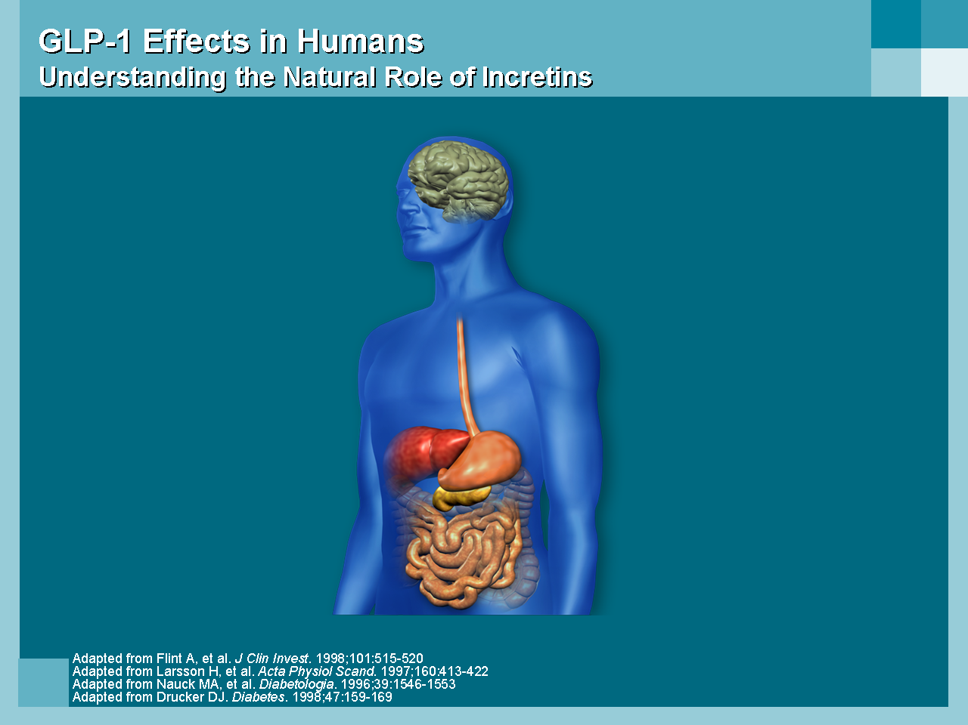
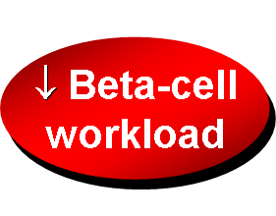
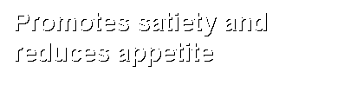

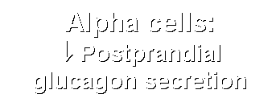
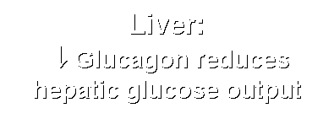
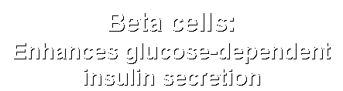

GLP-1 Effects in Humans
Understanding the Natural Role of Incretins
Notes:
Required
DISCUSSION POINTS:
--Upon food ingestion, GLP-1 is secreted into the circulation from L cells of small intestine.
--GLP-1 increases beta-cell response by enhancing glucose-dependent insulin secretion.
--GLP-1 decreases beta-cell workload and hence the demand for insulin secretion by:
--Regulating the rate of gastric emptying such that meal nutrients are delivered to the small intestine and, in turn, absorbed into the circulation more smoothly, reducing peak nutrient absorption and insulin demand (beta-cell workload)
--Decreasing postprandial glucagon secretion from pancreatic alpha cells, which helps to maintain the counterregulatory balance between insulin and glucagon
--Reducing postprandial glucagon secretion, GLP-1 has an indirect benefit on beta-cell workload, since decreased glucagon secretion will produce decreased postprandial hepatic glucose output
--Having effects on the central nervous system, resulting in increased satiety (sensation of satisfaction with food intake) and a reduction of food intake
--By decreasing beta-cell workload and improving beta-cell response, GLP-1 is an important regulator of glucose homeostasis.
SLIDE BACKGROUND:
--Effect on Beta-cell: Drucker DJ. Diabetes. 1998; 47:159-169
--Effect on Alpha cell: Larsson H, et al. Acta Physiol Scand. 1997; 160:413-422
--Effects on Liver: Larsson H, et al. Acta Physiol Scand. 1997; 160:413-422
--Effects on Stomach: Nauck MA, et al. Diabetologia. 1996; 39:1546-1553
--Effects on CNS: Flint A, et al. J Clin Invest. 1998; 101:515-520

Slide 16
  Semaglutide (Ozempic)
Semaglutide (Ozempic) is a diabetes medicine that leads to profound and sustained weight loss.
It is not an amphetamine like drug so patients who have side effects on Phentermine or Phendimetrazine are likely to tolerate Ozempic.
To avoid side effects including nausea (which is common) and feeling full, it is recommended to go up gradually on the dose of Ozempic (0.25 mg weekly for 1 month, then 0.5 mg weekly for 1 month, then 1 mg weekly).
18 clicks is 0.25 mg
The 2 mg dose has recently been approved and patients can go right from the 1 mg dose to the 2 mg and get an additional weight loss effect.
I recommend taking the 2 mg dose every 10 days for the first 2 doses.
If you get mild nausea, go down to a lower dose (go to 0.25 mg a week, if on 0.5.mg).
We can prescribe Zofran for the nausea

Slide 17
  Semaglutide (Ozempic)
If the nausea is severe, stop the Ozempic until the nausea resolves, then restart at 8 clicks and go up by 5 clicks every 2 weeks as tolerated..
The weight loss is greater at higher doses. Other side effects include vomiting, diarrhea and constipation.
Ozempic lowers HbA1c (only modestly if already low), has cardioprotective effects and improves PCOS and fatty liver disease.
It usually doesn’t give low blood sugars.
Side effects
  Nausea
  Feeling full
  Vomiting
  Food stuck in your chest
  abdominal pain
  loss of appetite
  diarrhea
  constipation

Slide 18
  Semaglutide (Ozempic)
Ozempic is an expensive medicine, so patients should check with their insurance to see if they cover Ozempic (used for diabetes) or Wegovy (used for weight loss) and what is the approval process.
The final option is it is available at a lower cost (but still expensive) from Canadian pharmacies.

Slide 19
  Semaglutide (Wegovy)
Wegovy and Ozempic are the same drug, but Wegovy is approved for weight loss.
It comes in 0.25 mg, 0.5 mg, 1 mg, 1.7 mg and 2.4 mg delivery pens and does not allow partial dosing (clicks).
Patients should stay on each dose for 1 month and only go up if they are not experiencing side effects.
There is a shortage of the medication except at 1.0, 1.7 or 2.4 mg.
It should be more available in December
Its side effects are similar to Ozempic.

Slide 20
  Semaglutide (Rybelsus)
Rybelsus , Wegovy and Ozempic are the same drug, but Rybelsus is oral and gives less weight loss than Ozempic
It is approved for diabetes.
It comes in 7 and 14 mg
Patients should stay on each dose for 1 month and only go up if they are not experiencing side effects.
Its side effects are similar to Ozempic.
I rarely prescribe it.

Slide 21
  Mounjaro (tirzepatide)
Mounjaro (tirzepatide) Mounjaro is a new diabetes drug that is called a dual incretin (GLP-1 plus GIP).
Not yet FDA-approved for weight loss
It has very impressive weight loss properties with patients on the highest dose losing up to 25 pounds.
It is given once a week like Ozempic and has similar side effects as Ozempic including nausea, diarrhea, decreased appetite, vomiting, constipation, indigestion, and abdominal pain.
The doses are 2.5 mg, 5 mg, 7.5 mg, 10 mg, 12.5 mg, or 15 mg per 0.5 mL in single-dose pen and a patient should stay on the same dose for 4 weeks and only go up the higher dose if no side effects are present.
There is a coupon that patients can pay as little as $25/3 months at https://www.mounjaro.com/savings-resources.

Slide 22
Background
Tirzepatide “twincretin” is a dual glucose-dependent insulinotropic polypeptide (GIP) and glucagon- like peptide-1 (GLP-1) receptor agonist that is under development for the treatment of type 2 diabetes.
GLP
GIP
Enhanced Incretin effects
“Incretin” GI peptides that lower glucose

Slide 23
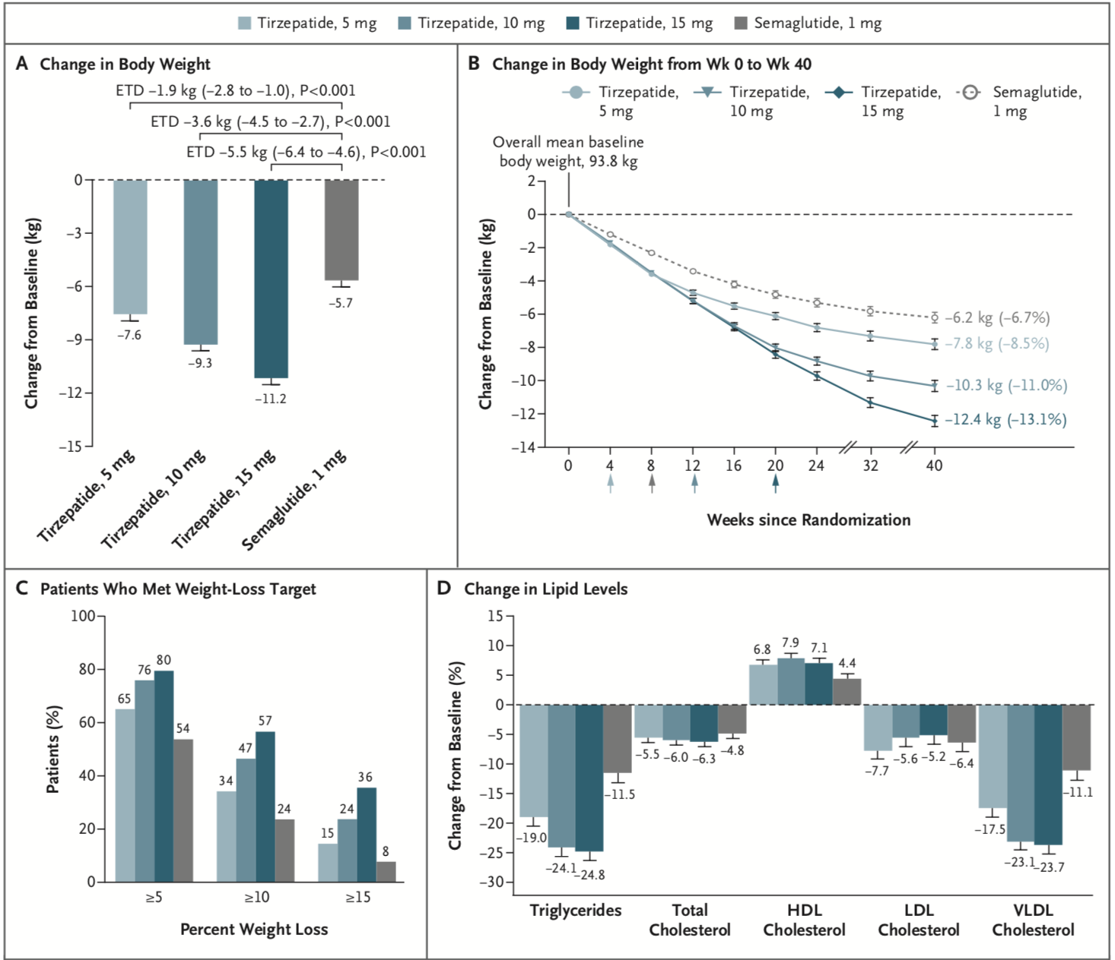

Effect of Once-Weekly Tirzepatide, as Compared with Semaglutide, on Body Weight, the Percentage of Patients Who Met Weight-Loss Goals, and the Lipid Profile.
Frías JP et al. N Engl J Med 2021;385:503-515
Notes:
Figure 2 Effect of Once-Weekly Tirzepatide, as Compared with Semaglutide, on Body Weight, the Percentage of Patients Who Met Weight-Loss Goals, and the Lipid Profile. Least-squares means (±SE) are presented, unless otherwise noted. Error bars indicate the standard error. Panel A shows the change from baseline in body weight at 40 weeks, as assessed with analysis of covariance with multiple imputation for treatment for missing weight at 40 weeks (treatment-regimen estimand). ETDs are least-squares means (95% confidence interval) at 40 weeks in the modified intention-to-treat population. Panel B shows the change from baseline in body weight over time, derived from a mixed-model repeated-measures analysis (efficacy estimand). The percent changes from baseline values at 40 weeks are shown in parentheses. Arrows indicate the times at which the maintenance doses of tirzepatide (5 mg, 10 mg, or 15 mg) and semaglutide 1 mg were achieved. Panel C shows the percentage of patients who had body-weight reductions of at least 5%, 10%, or 15% from baseline to week 40 (treatment-regimen estimand). The percentage was calculated with the use of Rubin’s rules by combining the percentages of patients who met the target in imputed data sets. Panel D shows the percent change (±SE) from baseline in lipid levels at 40 weeks, as estimated with the use of log transformation. HDL denotes high-density lipoprotein, LDL low-density lipoprotein, and VLDL very-low-density lipoprotein.

Slide 24
  Saxenda
Liraglutide (Victoza, Saxenda)
Daily shot
3 mg dose
Approved for obesity
More readily covered by insurance
Savings card on saxenda.com
May increase the chance of developing pancreatitis.
Has been found to cause a rare type of thyroid tumor in animals.

Slide 25
  Contrave
Naltrexone-bupropion (Contrave)
A mix of two medications: naltrexone, which is used to treat alcohol and drug dependence, and bupropion, which is used to treat depression or help people quit smoking.
May make you feel less hungry or full sooner.
Side effects include:
  constipation
  diarrhea
  dizziness
  dry mouth
  headache
  increased blood pressure
  increased heart rate
  insomnia
  liver damage
  nausea
  Vomiting
May increase suicidal thoughts
Dr. Friedman doesn’t prescribe much

Slide 26
  Orlistat
Available in lower dose without prescription (Alli)
$53 a month
Works in your gut to reduce the amount of fat your body absorbs from the food you eat
Orlistat dose 120 mg 3X/day
Alli dose 60 mg 3X/day
Side effects
  diarrhea
  gas
  leakage of oily stools
  stomach pain
Take a multivitamin pill daily to make sure you get enough of certain vitamins that your body may not absorb from the food you eat.

Slide 27
How do you get insurance coverage?
Call up your insurance to see if they cover weight loss medicines (many don’t cover at all).
Ask the criteria for coverage and if there is a pre-auth form
Ask what the criteria for coverage of Ozempic is (do you have to diabetes or does insulin resistance or pre-diabetes qualify or PCOS qualify)
If no coverage for these medicines, appeals or face-to-face appeals are unlikely to be successful.
The $25/month coupon for Mounjaro is probably the best bet and doesn’t need preauthorization.

Slide 28
How long do you take weight loss medications?
Until you get side effects
Until you are at your ideal weight (and then taper)
Phentermine usually stops working in 3-6 months, take a holiday and restart
GLP-1 agonists seem to keep working
Might have some rebound weight gain when they are stopped

Slide 29
How do they work with diet and exercise?
Weight loss medications curb appetite, so you put less toxic foods in your body
Food is expensive and time consuming
Allows for a jumpstart
Decreases cravings
Decreases insulin resistance
People feel better with less weight
Less inflammation
Easier to exercise
Better gut health (microbiome)

Slide 30
Maimonides
800 year-old wisdom
For wellness

Slide 31
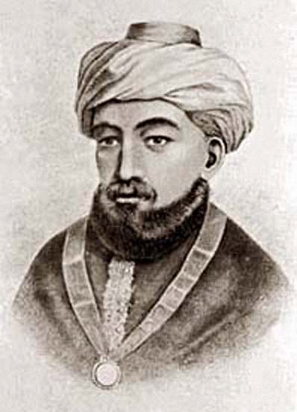
Maimonides
One of the greatest ancient physicians and philosophers just happened to also be a Rabbi. Commonly known as Maimonides or the Rambam, Rabbi Moshe ben Maimon (1135 to 1204) wrote about nutrition and health over 800 years ago and his teachings have stood the test of time.

Slide 32

Maimonides
Here are 14 bits of wisdom from Maimonides who wrote about all the relevant nutritional, medical and philosophical teachings of his times.

Slide 33

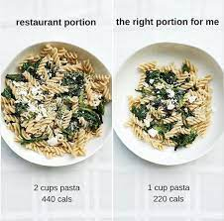
Maimonides
1. You should eat only when you are hungry and drink only when you are thirsty.
2. Overeating is like poison to the body and can lead to illness.
3. The preservation of health lies in abstaining from satiation.

Slide 34
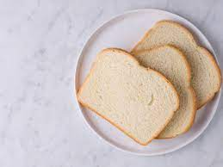
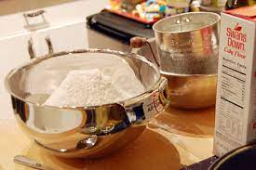

Maimonides
4. Even someone who exercises regularly will become obese if he constantly eats refined bread.
5. Flour that has been sifted so well that no bran remains is an unhealthy food and should not be eaten in quantity.
6. If wine is consumed properly, it is a major factor in the preservation of health and the cure of many illnesses

Slide 35
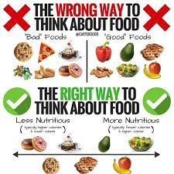

Maimonides
7. One of the most powerful forces of human nature is habit, irrespective of whether these are actions or perceptions. For instance, you may choose bad foods to which you are accustomed over good foods to which you are not accustomed, even though it is the less correct choice.
8. If you do not exercise, you will suffer from pain and depleted energy levels, even if the correct foods are eaten and all the rules of medicine are followed.

Slide 36

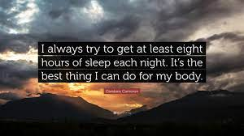
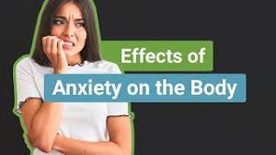
Maimonides
9. The most beneficial hours of sleep are the eight hours until sunrise.
10. One must pay attention and constantly consider one’s emotional activities. Maintaining them in equilibrium, during health and illness, must take precedence over any other regimen.
11. Constant anxiety damages the body.

Slide 37


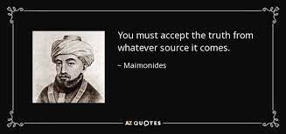
Maimonides
12. It is human nature to be influenced by your environment. You should only associate with people who will have a positive influence.
13. Accept the truth from whatever source it comes.
14. Let a person replace [stress and] anxiety with hope ...

Slide 38
Maimonides
Maimonides maintained that the “whole person” must be treated, not just the symptoms of illness.
You didn’t just call a doctor when you were sick.
You went to the doctor to discuss your general state of health and psychological well-being. If you were sick, the doctor would examine your eating habits, fitness levels and emotional state of mind.
The cause of illness was first discussed before the symptoms were diagnosed and treated.
Mind body balance was maintained in both times of illness and health.
We should all practice what Maimonides advocated

Slide 39
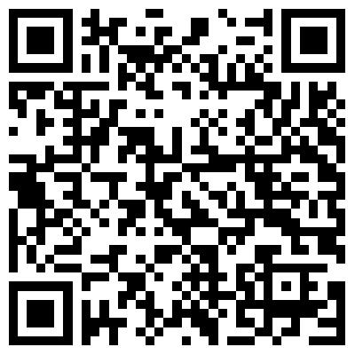
  Amazing Podcast
https://podcasts.apple.com/us/podcast/honestly-with-bari-weiss/id1570872415?i=1000579559765
Eating Ourselves to Death Honestly with Bari Weiss
•
Fifteen years ago, there was a lot of talk about the obesity epidemic. In 2008, Michelle Obama started a government program called “Let’s Move!” that sought to reduce childhood obesity. You might remember the First Lady teaming up with everyone from Beyonce to Big Bird to promote exercise and better eating habits. Unfortunately, the program was largely a failure. And the obesity statistics continued to rise.
74% of Americans today are either obese or overweight. And yet, we’re no longer talking about it. The national conversation around health and weight has turned away from things like good nutrition, weight loss and the importance of physical fitness, and instead adopted phrases like “fat acceptance” and “healthy at any size.” In some circles, there’s even blanket denial that there is anything unhealthy at all about being obese.
Shaming people for being overweight is unequivocally wrong. But in our attempt to not offend, we’ve lost sight of the very real fact that there’s a problem. Americans are heavier than ever, sicker than ever, dying earlier than ever, and... it's all preventable. So today, a conversation with Dr. Casey Means, a Stanford trained physician who left the traditional medical system behind to solve the one problem that she says is going to ruin us all: bad food.
https://www.levelshealth.com/blog/author/caseymeans/

Slide 40
  Levelshealth.com
Balanced approach to wellness and weight loss
Eat natural, unprocessed foods
Processed foods have a lot of toxins and chemicals (HFCS) so you eat more)
Move
Sleep
Preserve circadian rhythm
Good mental health
Microbiome (gut health) -avoid NSAIDS and antibiotics
Uses Continuous glucose monitors (CGM) to monitor how foods spike blood sugar levels
Newsletter worthwhile

Slide 41
For more information/to schedule an appointment
Talk will be posted at www.goodhormonehealth.com in a few days
Please email us at mail@goodhormonehealth.com

