Slide 1
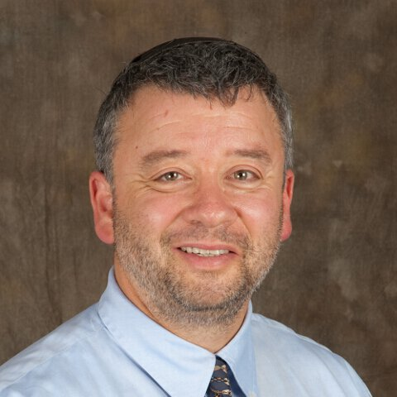
Coronavirus Information for Endocrine Patients
GoodHormoneHealth Webinar
April 5, 2020
All patients will be muted, but if you are unmuted, please mute your phone

Slide 2
What we will discuss tonight
What is COVID-19 and how is it transmitted?
What can endocrine patients can do to prevent getting COVID-19
Which endocrine patients are at higher risk for getting sick with COVID-19
What Dr. Friedman is doing to keep his patients safe and healthy
Questions from patients.

Slide 3
What is the difference between COVID-19 and Coronavirus
There are lots of Coronaviruses including some types of the common cold.
COVID-19 is the novel Coronavirus that originated in Wuhan China in December 2019

Slide 4
Coronavirus and Dr. Friedman
As far I know, I have one patient (D.S.) sick with coronavirus. I wish her a speedy recovery
My prayers are with all the other patients sick with coronavirus.

Slide 5
Caveats
Dr. Friedman was wrong about the coronavirus when patients asked him about it in February
It has proven to be more contagious and serious than anyone predicted
It’s future course is unpredictable.
Dr. Friedman is not an infectious disease doctor or primary care doctor.
Patients should contact their primary care doctor for non-endocrine questions, letters for work or testing kits, etc.

Slide 6
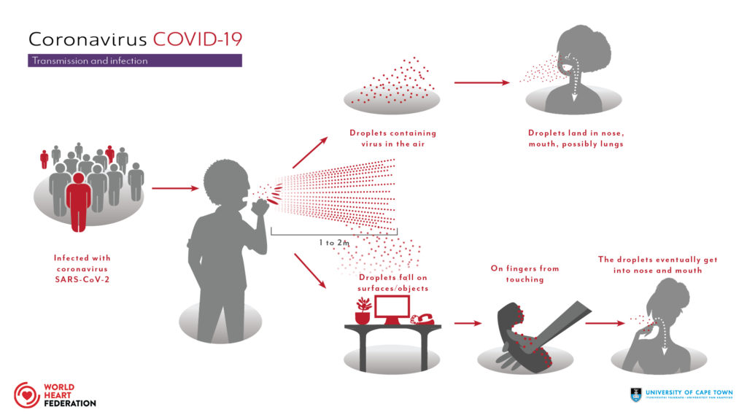
Transmission of COVID-19

Slide 7
Transmission of COVID-19
New evidence has found that people are contagious 2 days before they get symptoms.
A single cough can produce up to 3,000 droplets
To gain access to your body, the viral droplets must enter through the eyes, the nose or the mouth.
If some who is infected coughs on you and you are right in front of that patient, there is a good chance you will get it.
The farther away you are, the less chance you will get it, so that by being 6 feet away from someone who has it, there is almost no chance of getting it
That is why social distancing of 6 feet is recommended.
That is why stay at home laws have been passed

Slide 8
Transmission of COVID-19
If someone who is infected (even with no symptoms) coughs or sneezes on a something, the particles can land on the surface.
You can touch the surface, pick up the particles and then touch your mouth and then your face and get infected.
The virus may remain viable for up to 3 days on hard surfaces like metal, glad and plastic.
Porous surfaces like clothes and hair do not harbor the virus
Potentially an infected asymptomatic person touches a box of cereal at a store, then picks up another one, and you touch the infected one, and then touch your mouth, you could get infected.
That is why wearing gloves, especially in public places is recommend
That is why not touching your face is recommended
That why frequent hand washing or using hand sanitizer for 20 seconds is recommended.

Slide 9
Transmission of COVID-19
Universal precautions, everyone should be cautious
Act as if you are infected and the person in front of you is infected
No need to take off your clothes or shower when you come inside.

Slide 10
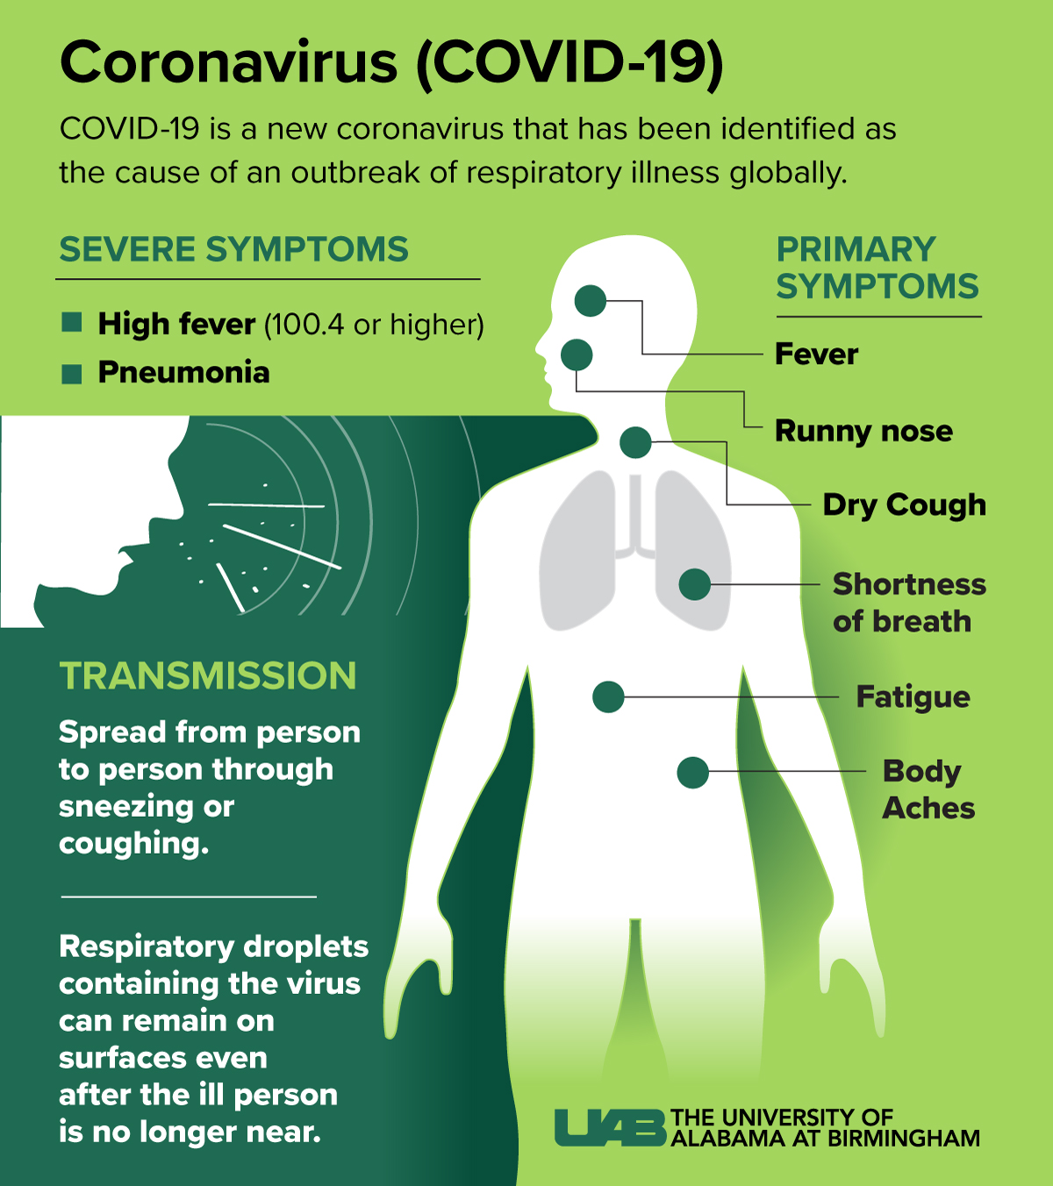
What are the symptoms of COVID-19

Slide 11
What should everyone do to not get infected?
Don’t panic
Be smart
Be Safe
Be a Germaphobe
Respect the Rona
Don’t panic
Be Smart
Listen to Public Experts

Slide 12
What should everyone do to not get infected?
Stay at home
Wear gloves outside
Wash your hands or using hand sanitizer for 20 seconds every few hours or when you come inside.
Take your shoes off
Don’t touch your face.
Limit people who come to your house to your immediate family

Slide 13
What should everyone do to not get infected?
Get plenty of sleep
Exercise
Eat Healthy
April may be the month with the highest amount of spread.

Slide 14
What about wearing a mask?
Probably a good idea if everyone wore a mask
More likely to prevent an asymptomatic person from transmitting the virus than from getting it
Masks can potentially harbor the virus
Spray with a disinfectant after wearing one

Slide 15
What about wearing a mask?

Slide 16
What about wearing an N95 mask?
Only if you are a respiratory therapist or a surgeon

Slide 17
Potential hotspots
Any indoor place with a lot of people
Stores (shop online)
Airplanes, airports
Public transportation, Uber/Lyft
Doctor’s offices/ hospitals
Labs
Take extra precautions at these places

Slide 18
Dr. Friedman recommended I go get my blood tests done-What should I do?
Yes go. Dr. Friedman needs to see your labs to adjust your medicines
Wear a mask and gloves
LabCorp and Quest are both still open and Quest has a new Peace of Mind program for lab services not related to COVID-19 and for patients who are 60 years of age or older, or have other conditions that put them at greater risk for COVID-19
Patients can come to their nearby Quest location during the first hour of each day for VIP care.
LabCorp has something similar
Both labs only allow a few people in the waiting room, sterilize everything between patients and staff members wear face shields and masks
Patients can wait in their cars until it is there turn

Slide 19
How is COVID-19 tested?
Currently it tests for the presence of the virus in nasal swabs or respiratory fluids-PCR
It is very specific and tests current or recent infections
Need to go deep into the nostrils for collection.
Both LabCorp and Quest perform the test, but patient needs to go to their primary doctor who can order the swabs and do the test.
Turnaround can be up to 10 days
Rapid (15 min) PCR tests are now available but limited
Antibody testing (blood) has just been approved and will determine the presence of the antibody.
Someone with a positive antibody test has been exposed andas far as we know can not get infected again.

Slide 20
Should I be tested for COVID-19?
I have no symptoms and just want to make sure: no way
I was exposed to someone with COVID-19: probably not, stay home and wear a mask and gloves if go outside
I have mild symptoms-discuss with your PCP
I have a fever, cough short of breath and feel sick- go to an emergency room.

Slide 21
Who is at a higher rate of getting sick with COVID-19?
Anyone exposed to COVID-19 can get it.
In general, people with poor immune system are more likely to get sick with it.
Older patients
Those with other diseases.
Patients with diabetes (and hypertension) are especially prone to get sick and die from COVID-19.
Not Prediabetes
Patients with diabetes should make a special effort to have their diabetes controlled.
Patients on high doses of steroids for other reasons (lung problems, rheumatological diseases) have a higher rate of getting sick COVID-19

Slide 22
What about Endocrine Patients and COVID-19?
Patients with active Cushing’s syndrome have an impaired immune response and are more likely to get sick from COVID-19.
They should go on medical treatment for Cushing’s but should try to avoid adrenal insufficiency.
Patients with properly treated Addison’s disease have an impaired immune response due to a T-cell problem (those with central adrenal insufficiency and adrenalectomy are probably not in this category).
Adrenally insufficient patients undertreated may do slightly worse, but patients over-treated are likely to do much worse.
So Addison’s patients should not stress-dose unless they are sick.

Slide 23
What about Growth Hormone Deficient Patients and COVID-19?
Patients with hypopituitarism and untreated growth hormone deficiency probably have a lower immune response and more likely to get sick.
Patient with treated growth hormone should be ok

Slide 24
Who with adrenal insufficiency should stress-dose?
Concerned about getting COVID-19- definitely not
Have COVID-19, but not sick (no fever, vomiting)- no stress dose
With COVID-19, shortness of breath and sick-stress-dose and go to ER
Endocrinologist statement and AACE guidelines- “sick day rules” for our known patients with primary and secondary adrenal insufficiency taking glucocorticoid replacement therapy. As it relates to COVID-19, any patient with a dry continuous cough and fever should immediately double their daily oral glucocorticoid dose and continue on this regimen until the fever has subsided.
Some that are slightly sick, but not short of breath, can stress dose and stay home.
Most of these patients should go to the hospital

Slide 25
Who with adrenal insufficiency should stress-dose?
Make sure you drink fluids, take in salt.
Patients with diabetes insipidus should take in more fluids.
I would stress dose by doubling your hydrocortisone, not tripling as Dr. Findling recommended.
See my quotes in Endocrine Today
Download Dr. Friedman’s adrenal crisis letter to bring to emergency rooms

Slide 26
Those with the following conditions are not more likely to get sick
Thyroid disease (hypothyroidism, Grave’s, Hashimoto’s, hypothyroidism)
Hypopituitarism if ACTH-cortisol axis is preserved, or replaced) and growth hormone is replaced
Menopause/perimenopause
Hypogonadism

Slide 27
Do medicines make it worse?
ACE inhibitors-benzapril, lisinopril
ARB-losartan
NSAIDS, Motrin, Advil, ibuprofen
All unproven, patients should stay on or discuss with their doctor

Slide 28
Medication supplies
Some reports of some pharmacies being out of hydrocortisone
Most pharmacies and mail-orders have it.
Patients should not request to switch to prednisone or other type of long-lasting glucocorticoid
Many patients have requested extra supply of their medications.
Dr. Friedman recommends to not stock-pile
Most insurances do not allow this and carefully monitor medication use.
Dr. Friedman strongly recommends patients to use a mail-order pharmacy and sign up for auto-refills so that they get a consistent supply of their medications.
Contact our office/ pharmacy well in advance as processing times may be slower

Slide 29
Medication supplies (2)
Patients have expressed concern that raw materials coming from China for the use of manufacturing of drugs may be limited.
This has turned out not to be true and the rate of infection of COVID-19 in China is reducing.

Slide 30
When will the pandemic end?
No one knows
Dr. Friedman thinks we will be in this for awhile, maybe late summer at the earliest.
Current rate of transmission is for every infected patient, two people get it.
Restrictions will only end with the rate of transmission is less than one.
Restrictions will end only when the rates are coming down.

Slide 31
When will the pandemic end?
Some people think it will decline when it is warmer, but it is still going strong in areas like Singapore where the temperature is in the 90s.
May resurge in the fall when flu season starts

Slide 32
What will end the pandemic?
Strict social isolation
Rapid tests and readily available tests for the virus
Herd immunity
Antibody tests
FDA-approved treatments (will help prevent people from dying)
CRISP-R technology -blocks the RNA from replicating- will be very specific but very expensive.
FDA-approved preventions from getting sick (like PREP for HIV)
Vaccines

Slide 33
Dr. Friedman’s Concern About Emotional Well-being
Tough time emotionally
Lots of stress, anxiety, family battles
Distancing, but not social isolation
Reach out and call/facetime/Zoom a friend or family member
Keep exercising
Get out and walk or go on a bike ride
Use online exercise resources
Think about your creator/be introspective

Slide 34
Dr. Friedman’s Concern About Financial Well-being
Tough time financially
Many people out of work
They can’t pay other people who lose their job
Its going to be a long recovery
People may need to reinvent themselves to take advantage of the situation
Try to keep paying your workers, if you can.

Slide 35
What is Dr. Friedman doing to see his patients?
During the COVID-19 pandemic, Dr. Friedman is now approved for telemedicine appointments for both in-state and out-of-state patients and is encouraging patients to see him remotely via FaceTime.
Telemedicine appointments should be booked using the regular Tuesday night slots -either for new patients (45 minutes) or followup appointment (30 minutes) with the same deposit.
We are no longer doing in person appointment unless absolutely necessary.

Slide 36
What is Dr. Friedman doing to see his patients?
For those who will schedule an appointment that will occur during April or May and who lost their job or had their income reduced by 50%, he will be sending them an Amazon gift card ($75 for growth hormone stimulation tests, $50 for new patients and $25 for followup appointments).
This can not be requested retroactively (once already booked).
Email us at mail@goodhormonehealth.com when you make your appointment if you qualify

Slide 37
Stay healthy my friend
Questions? Please use the chat button
Thank you for sharing your time tonight!
If you have any more questions after tonight or want an appointment, please email: mail@goodhormonehealth.com
www.goodhormonehealth.com
Webinar will be posted in a few days

