Slide 1


Theodore C. Friedman, M.D., Ph.D.
(the Wiz)
Professor of Medicine-UCLA
Chairman, Department of Internal Medicine
Charles R. Drew University
Dr. Friedman’s Endocrinology Clinic
Compounded Tirzepatide vs Semaglutide for patients with endocrine problems
Join on Facebook Live - https://www.facebook.com/goodhormonehealth
GoodHormoneHealth Webinar
November 17, 2024

Slide 2

Outline
Who should go on weight-loss medications?
What are the side effects?
How do they work with diet and exercise?
What is the difference between Tirzepatide and Semaglutide?
Are compounded medications safe?
Will they be discontinued?
How do you work with Dr. Friedman’s office to get the compounded medications?
There will be an opportunity for patients to share their experience on Facebook

Slide 3
Focus on Health and Wellness
My main approach to weight loss is to rule out any endocrine problems, such as hypothyroidism, Cushing syndrome, or growth hormone deficiency, that may lead to weight gain.
Simultaneous I encourage the patient to consume a low-calorie diet, and I often recommends eating a large quantity of vegetables, as they are low in calories with a large amount of nutrition, as well as to move.
Get a good night sleep
Good mental health
Be out in nature
Avoid stress or at least don’t let stress bother you.

Slide 4
But I’ve done all that
Many of his patients already have a healthy diet and exercise.
Many patients need a jumpstart for the weight loss, and this is where weight loss medications comes into play.
They can often reduce food cravings.
Dr. Friedman often prescribes weight loss medications after other endocrine conditions are diagnosed/treated.

Slide 5
2022 Endocrine Society
At Dr. Friedman’s 2022 Endocrine Society meeting, it was pointed out that only 2% of patients with obesity are on weight loss medications.
Imagine if only 2% or patients with diabetes were on diabetes medicines or 2% of patients with high blood pressure were on anti-hypertensive medications.
Reasons why?
  Doctors don’t prescribe them
  Unrealistic views that if obese patients had more willpower, they could lose weight
  Costs
  Lack of insurance coverage/difficult preauth requirements.
  Side effects
GLP-1RA have changed this.
Thus, Dr. Friedman thinks they may be the most important medical advancement in the 2st Century

Slide 6
Types of Weight Loss Medications
Stimulants (related to amphetamine)
  Phentermine
  Phendimetrazine
  Tenuate
  Phentermine-topiramate Qsymia)
GLP-1 receptor agonists (originally diabetes drugs)
  Ozempic (semaglutide)-approved by the FDA for diabetes in 2017
  Rybelsus (semaglutide)-(oral) diabetes
  Wegovy (semaglutide) approved for obesity in 2021
  Mounjaro (tirzepatide) –approved for diabetes in 2022
  Zepbound (tirzepatide) -approved for obesity in 2023
  Liraglutide (Victoza, Saxenda) - diabetes
  Dulaglutide (Trulicity) - diabetes
Others
  Naltrexone-bupropion Contrave)
  Orlistat (Alli)
Belviq (lorcaserin) was removed from the market in 2020 due to increased rates of cancer.

Slide 7
  GLP-1 receptor agonists
Incretin effect
Oral glucose raises more insulin than iv glucose
GI factor that secretes insulin
Found to be GLP-1 and GIP-1
Found to have GLP-1 receptors in the brain that control appetite

Slide 8
Mechanism of GLP-1 receptor agonist
In hyperglycemic states, GLP-1 receptor agonists stimulate insulin secretion
Delays gastric emptying
In hyperglycemic or euglycemic states → suppress glucagon secretion
Decreases appetite
Reduces body weight
Incretin effects

Slide 9
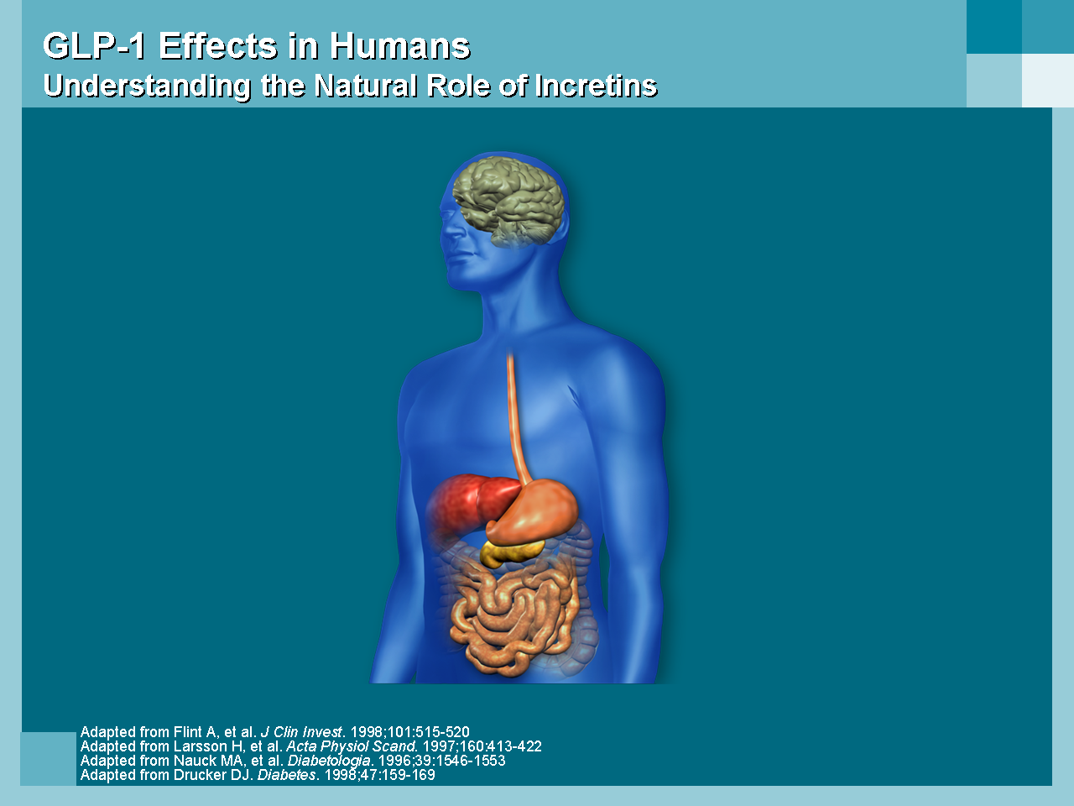




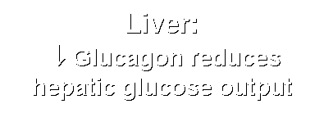


GLP-1 Effects in Humans
Understanding the Natural Role of Incretins
Notes:
Required
DISCUSSION POINTS:
--Upon food ingestion, GLP-1 is secreted into the circulation from L cells of small intestine.
--GLP-1 increases beta-cell response by enhancing glucose-dependent insulin secretion.
--GLP-1 decreases beta-cell workload and hence the demand for insulin secretion by:
--Regulating the rate of gastric emptying such that meal nutrients are delivered to the small intestine and, in turn, absorbed into the circulation more smoothly, reducing peak nutrient absorption and insulin demand (beta-cell workload)
--Decreasing postprandial glucagon secretion from pancreatic alpha cells, which helps to maintain the counterregulatory balance between insulin and glucagon
--Reducing postprandial glucagon secretion, GLP-1 has an indirect benefit on beta-cell workload, since decreased glucagon secretion will produce decreased postprandial hepatic glucose output
--Having effects on the central nervous system, resulting in increased satiety (sensation of satisfaction with food intake) and a reduction of food intake
--By decreasing beta-cell workload and improving beta-cell response, GLP-1 is an important regulator of glucose homeostasis.
SLIDE BACKGROUND:
--Effect on Beta-cell: Drucker DJ. Diabetes. 1998; 47:159-169
--Effect on Alpha cell: Larsson H, et al. Acta Physiol Scand. 1997; 160:413-422
--Effects on Liver: Larsson H, et al. Acta Physiol Scand. 1997; 160:413-422
--Effects on Stomach: Nauck MA, et al. Diabetologia. 1996; 39:1546-1553
--Effects on CNS: Flint A, et al. J Clin Invest. 1998; 101:515-520

Slide 10
  Semaglutide (Ozempic)
Semaglutide (Ozempic) is a diabetes medicine that leads to profound and sustained weight loss.
It is not an amphetamine like drug so patients who have side effects on Phentermine or Phendimetrazine are likely to tolerate Ozempic.
To avoid side effects including nausea (which is common) and feeling full, it is recommended to go up gradually on the dose of Ozempic (0.25 mg weekly for 1 month, then 0.5 mg weekly for 1 month, then 1 mg weekly).
Some patients do fine on a lower dose.
The 2 mg dose has recently been approved and patients can go right from the 1 mg dose to the 2 mg and get an additional weight loss effect.
I recommend taking the 2 mg dose every 10 days for the first 2 doses.
If you get mild nausea, go down to a lower dose (go to 0.25 mg a week, if on 0.5.mg).
We can prescribe Zofran for the nausea

Slide 11
  Semaglutide (Ozempic)-clicks
18 clicks is 0.25 mg, so patients who develop nausea can go down in clicks.
If the nausea is severe, stop the Ozempic until the nausea resolves, then restart at 8 clicks and go up by 5 clicks every 2 weeks as tolerated..
The weight loss is greater at higher doses. Other side effects include vomiting, diarrhea and constipation.
Ozempic lowers HbA1c (only modestly if already low), has cardioprotective and renal protective effects and improves PCOS and fatty liver disease.
It usually doesn’t give low blood sugars.
Side effects
  Nausea
  Feeling full
  Vomiting
  Food stuck in your chest
  abdominal pain
  loss of appetite
  diarrhea
  constipation

Slide 12
  Semaglutide (Ozempic)
Ozempic is an expensive medicine, so patients should check with their insurance to see if they cover Ozempic (used for diabetes) or Wegovy (used for weight loss) and what is the approval process.
Insurance companies vary in their coverage and are getting more strict with coverages
Some require being on less expensive GLP-1R drugs (Trulicity, Victoza) before Ozempic.
Now compounded Semaglutide (Ozempic) is available

Slide 13
  Long-term side effects (Ozempic)
Unknown
Many but not all weight loss meds (Phen/Fen, Lorcaserin, Sibutramine) were found to have long term side effects and pulled from the market.
I don’t think this will happen with Ozempic
In rats, it causes a rare type of thyroid cancer called medullary thyroid Cancer
In people a few, but not most studies have found a slight increase in papillary thyroid cancer.
I don’t think this a a concern and don’t recommend anything to monitor or prevent it.
But only take Ozempic if you need it

Slide 14
  Semaglutide (Wegovy)
Wegovy and Ozempic are the same drug, but Wegovy is approved for weight loss.
It comes in 0.25 mg, 0.5 mg, 1 mg, 1.7 mg and 2.4 mg delivery pens and does not allow partial dosing (clicks).
Patients should stay on each dose for 1 month and only go up if they are not experiencing side effects.
There is a shortage of the medications, patients should try different pharmacies.
Its side effects are similar to Ozempic.

Slide 15
  Mounjaro (tirzepatide)
Mounjaro (tirzepatide) is a newer diabetes drug that is called a dual incretin (GLP-1 plus GIP).
Zepbound (tirzepatide) is FDA-approved for weight loss
It has very impressive weight loss properties with patients on the highest dose losing up to 25 pounds.
It can reverse sleep apnea and get patients off CPAP
It is given once a week like Ozempic and has similar side effects as Ozempic including nausea, diarrhea, decreased appetite, vomiting, constipation, indigestion, and abdominal pain.
But the nausea side effect is considerably less due to the GIP
The doses are 2.5 mg, 5 mg, 7.5 mg, 10 mg, 12.5 mg, or 15 mg per 0.5 mL in single-dose pen and a patient should stay on the same dose for 4 weeks and only go up the higher dose if no side effects are present.
Some patients do fine on a lower dose.
Now compounded Mounjaro (tirzepatide) is available

Slide 16
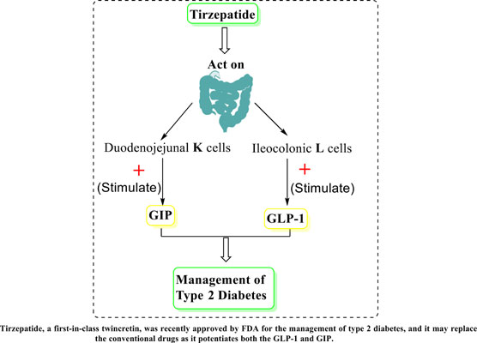
Background
Tirzepatide “twincretin” is a dual glucose-dependent insulinotropic polypeptide (GIP) and glucagon- like peptide-1 (GLP-1) receptor agonist
GLP
GIP
Enhanced Incretin effects
“Incretin” GI peptides that lower glucose

Slide 17
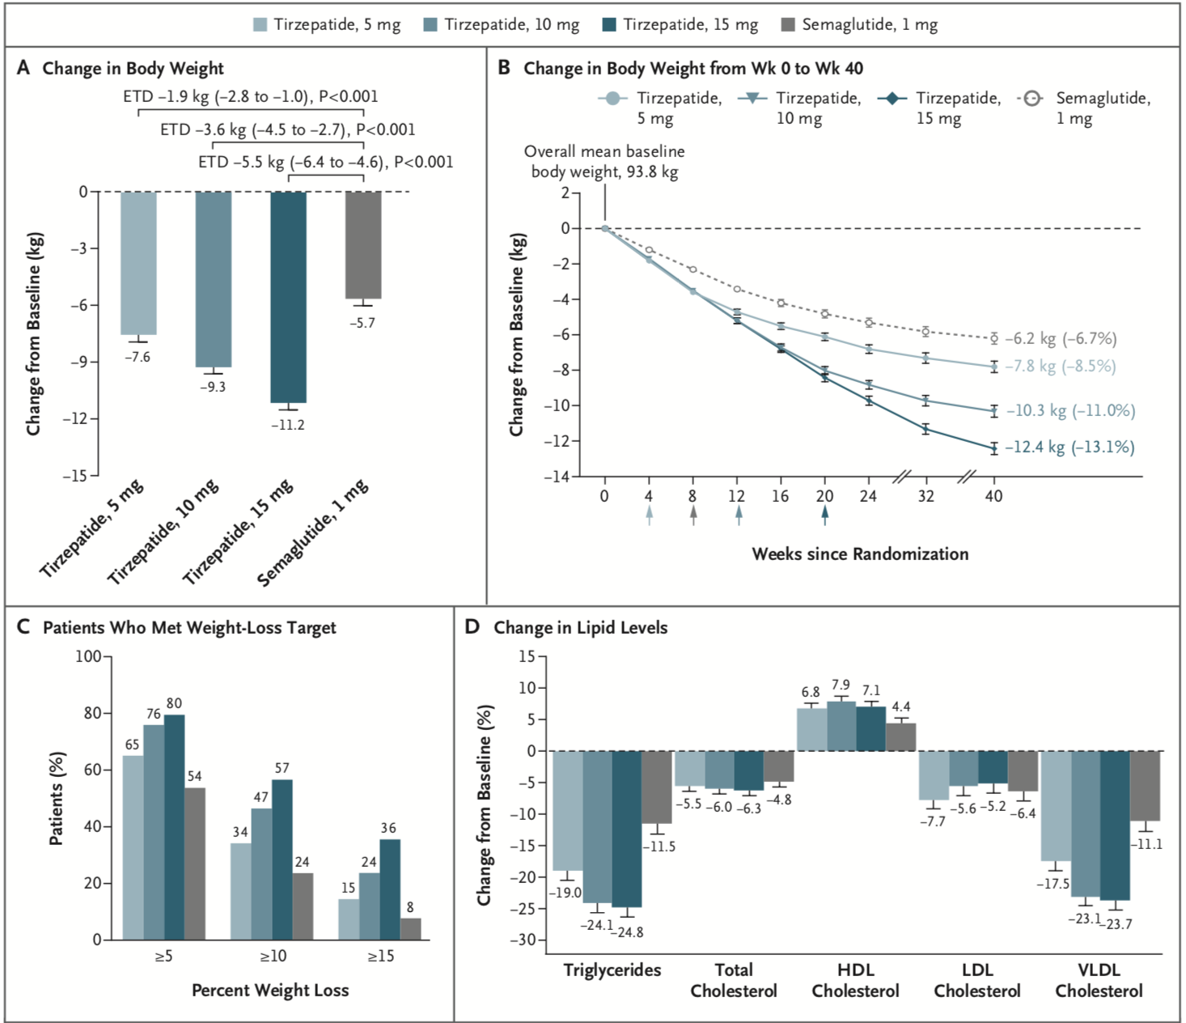

Effect of Once-Weekly Tirzepatide, as Compared with Semaglutide, on Body Weight, the Percentage of Patients Who Met Weight-Loss Goals, and the Lipid Profile.
Frías JP et al. N Engl J Med 2021;385:503-515
Notes:
Figure 2 Effect of Once-Weekly Tirzepatide, as Compared with Semaglutide, on Body Weight, the Percentage of Patients Who Met Weight-Loss Goals, and the Lipid Profile. Least-squares means (±SE) are presented, unless otherwise noted. Error bars indicate the standard error. Panel A shows the change from baseline in body weight at 40 weeks, as assessed with analysis of covariance with multiple imputation for treatment for missing weight at 40 weeks (treatment-regimen estimand). ETDs are least-squares means (95% confidence interval) at 40 weeks in the modified intention-to-treat population. Panel B shows the change from baseline in body weight over time, derived from a mixed-model repeated-measures analysis (efficacy estimand). The percent changes from baseline values at 40 weeks are shown in parentheses. Arrows indicate the times at which the maintenance doses of tirzepatide (5 mg, 10 mg, or 15 mg) and semaglutide 1 mg were achieved. Panel C shows the percentage of patients who had body-weight reductions of at least 5%, 10%, or 15% from baseline to week 40 (treatment-regimen estimand). The percentage was calculated with the use of Rubin’s rules by combining the percentages of patients who met the target in imputed data sets. Panel D shows the percent change (±SE) from baseline in lipid levels at 40 weeks, as estimated with the use of log transformation. HDL denotes high-density lipoprotein, LDL low-density lipoprotein, and VLDL very-low-density lipoprotein.

Slide 18
How do you get insurance coverage?
Call up your insurance to see if they cover weight loss medicines (many don’t cover at all).
Ask the criteria for coverage and if there is a pre-auth form
Ask what the criteria for coverage of Ozempic is (do you have to diabetes or does insulin resistance or pre-diabetes qualify or PCOS qualify)
If no coverage for these medicines, appeals or face-to-face appeals are unlikely to be successful.
Go to compounded options

Slide 19
Compounding Pharmacies that Compound GLP-1RAs
With the increasing demand for GLP-1RAs, high commercial cost and limited supply, compounded pharmacies started compounding these drugs for the patients at a fraction of the cost of brand-name drugs at commercial pharmacies.
They were allowed to do this because the FDA deemed that there was a shortage of brand-name drugs,
Since they were compounding Tirzepatide and Semaglutide and not the brand-names Ozempic, Wegovy, Mounjaro and Zepbound,
And because they were able to supply in-between dose or added ingredients such as Glycine + B12.

Slide 20
Compounding Pharmacies that Compound GLP-1RAs
However, in October 2024, the FDA under influence from Lilly declared the shortage of Mounjaro and Zepbound “resolved” and told compounding pharmacies to stop distributing compounded versions of these drugs.
However, the shortage of Mounjaro and Zepbound was not over and there is legal action between compounding pharmacies and the FDA.
The FDA announced later in October 2024 that compounding pharmacies can continue making Tirzepatide while the FDA reconsiders its decision to remove the drug from its shortage list.
Dr. Friedman agrees that compounding pharmacies are supplying a helpful service to patients and should continue to supply these medicines.

Slide 21
Will Compounding Pharmacies be allowed to continue to Compound GLP-1RAs
Although he cannot predict the future, Dr. Friedman expects compounding pharmacies to continue to supply these drugs and expand their use as providers realize these are good options for patients.
Dr. Friedman posits that Lilly pressured the FDA to say the shortage was over purely for profit-making reasons.

Slide 22
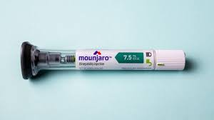
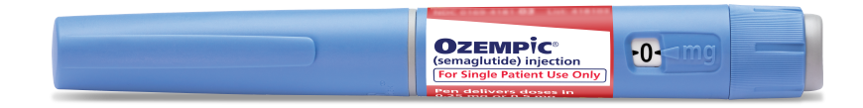
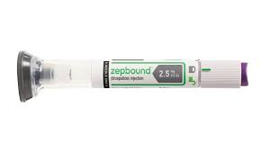
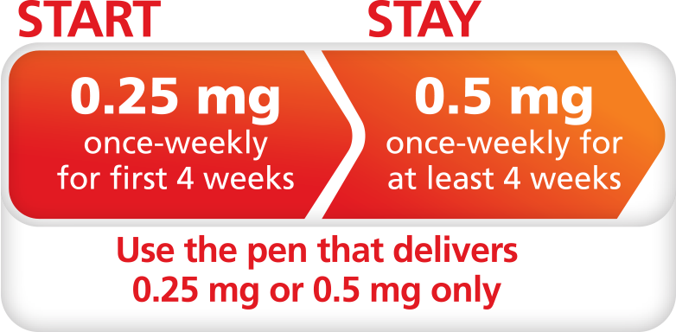
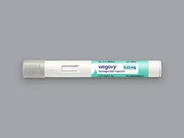
Individual Dosing
Another advantage of GLP-1RAs from compounding pharmacies over brand name products is that compounding pharmacies prescribed vials and syringes, so the dose can be individualized, while Wegovy, Zepbound and Mounjaro come as single-use, fixed-dose cartridges.
Ozempic is designed for multiple fixed-dose delivery, but by using “clicks” patients can give individualized dosing.

Slide 23
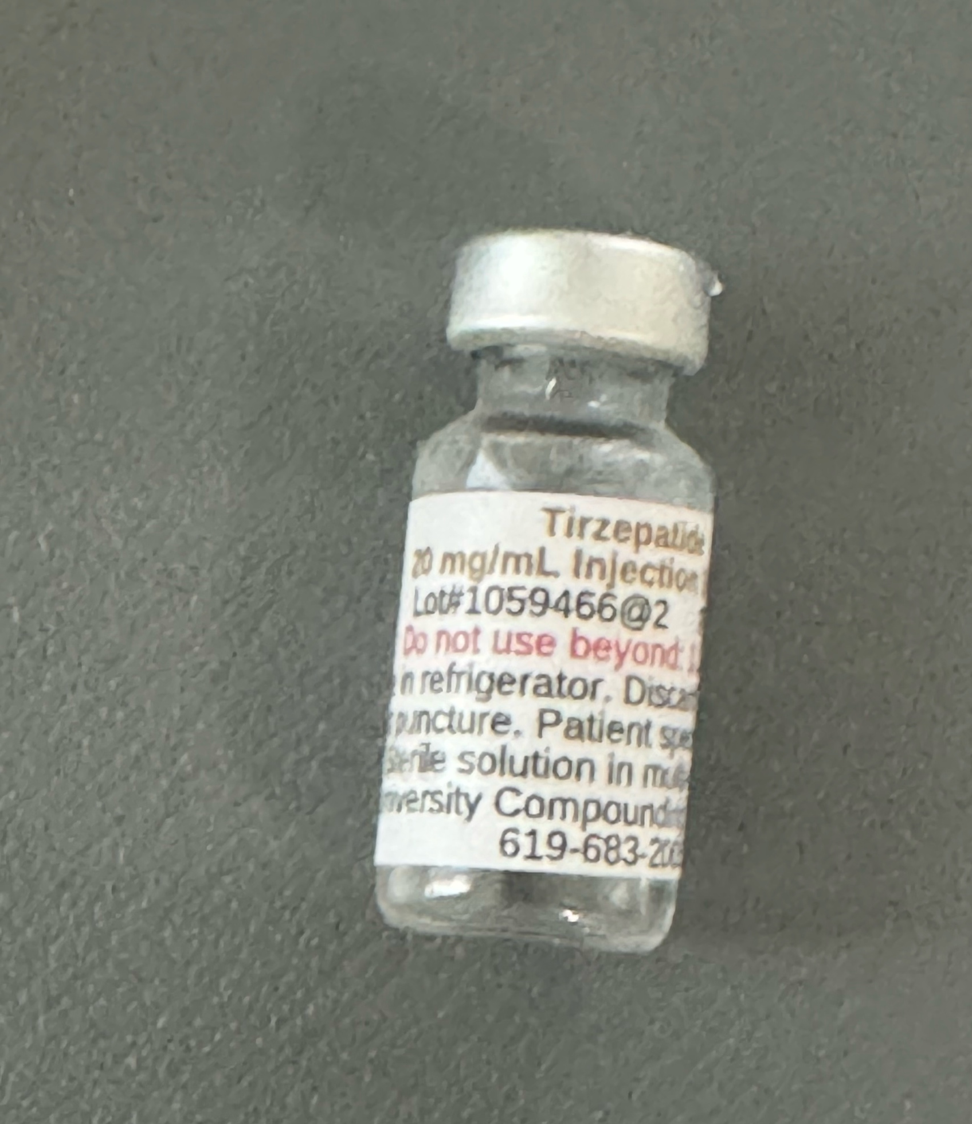
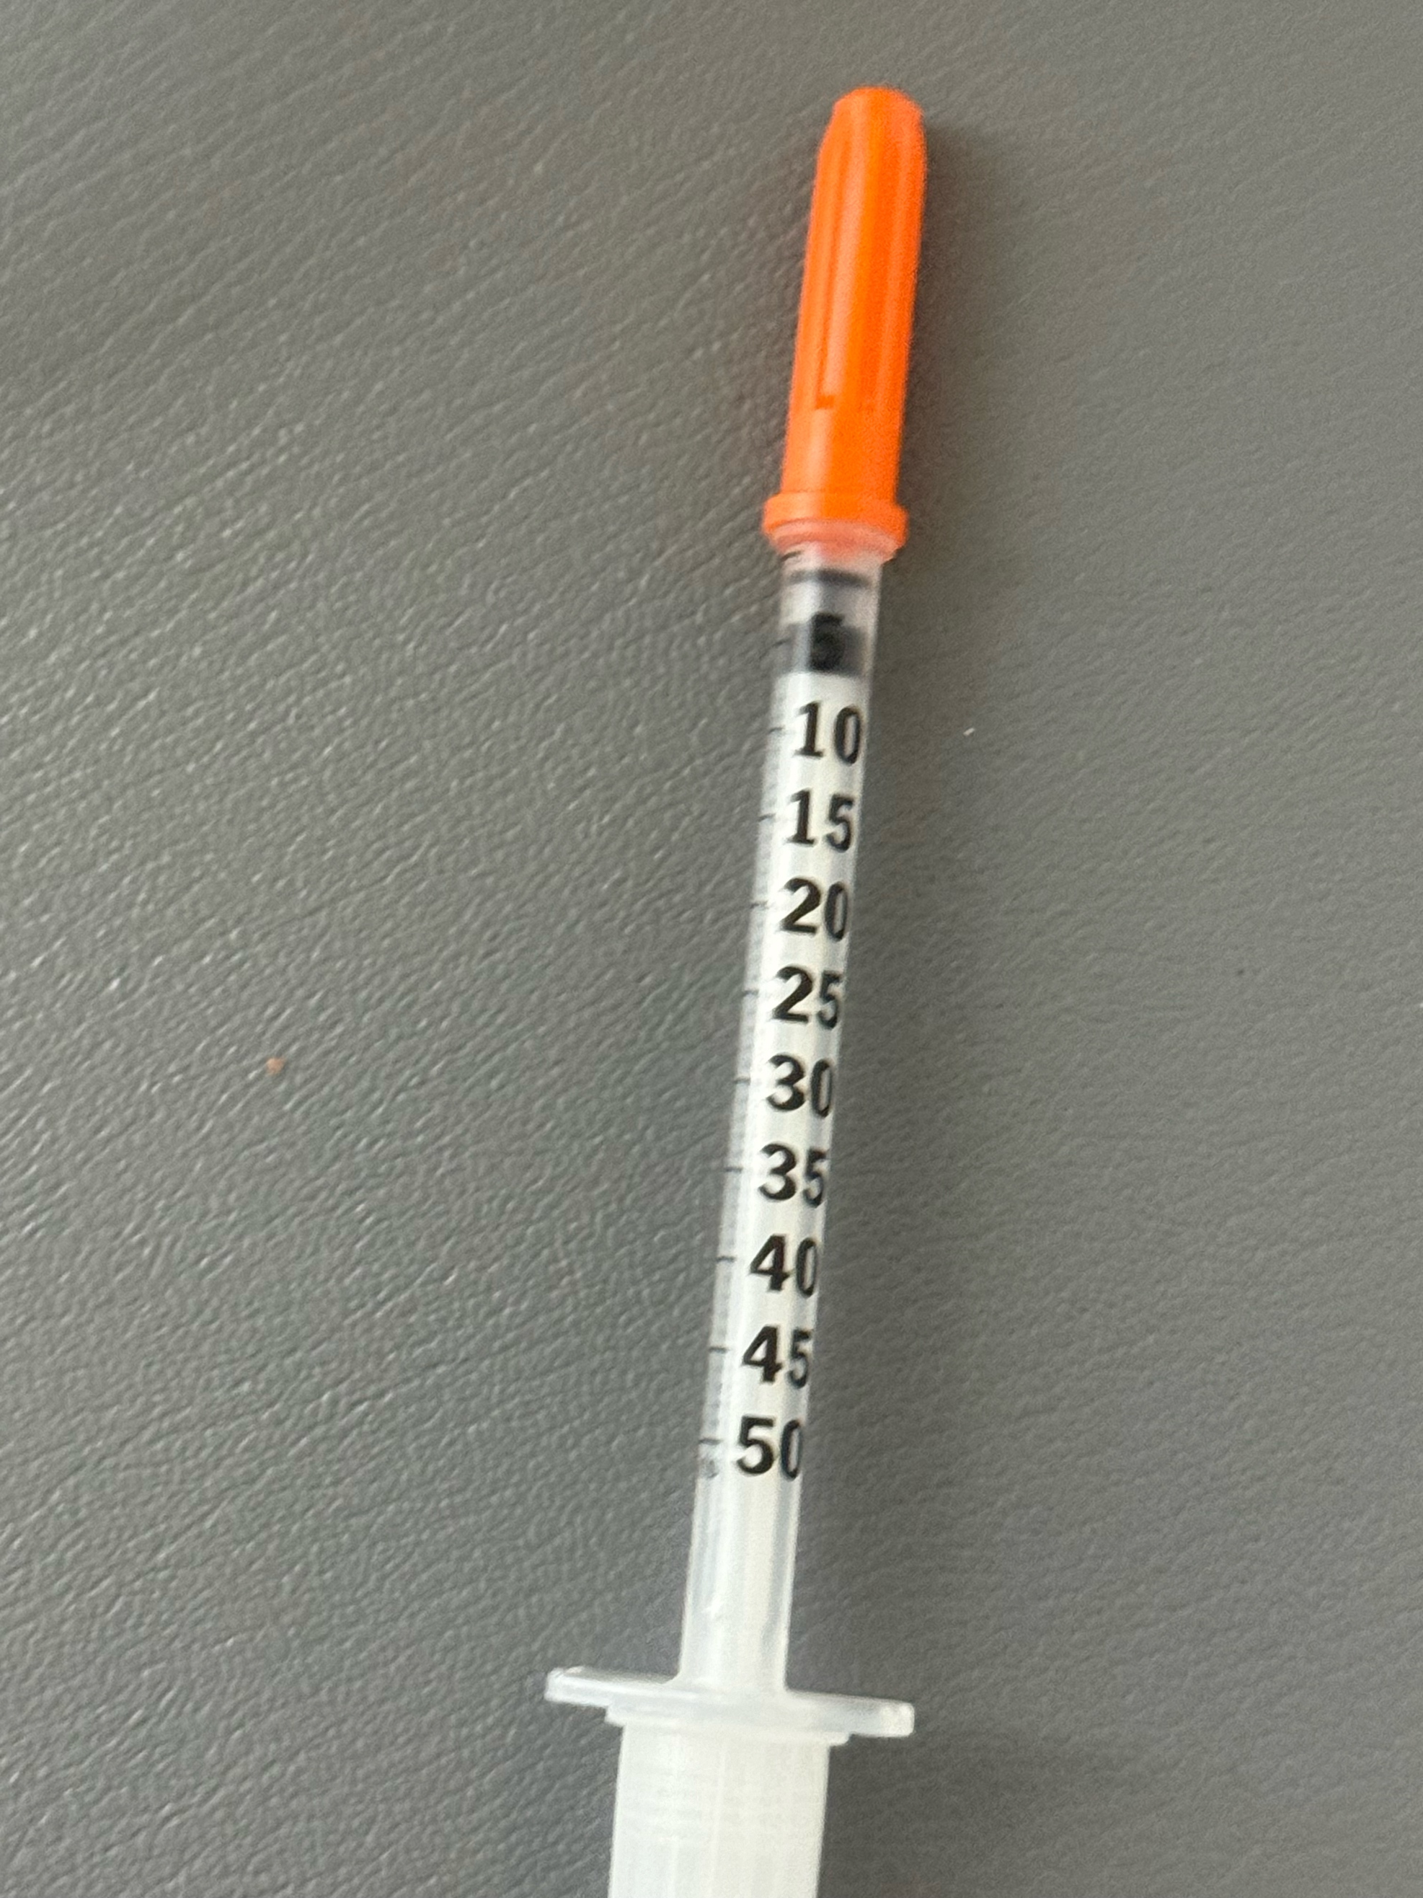
Individual Dosing
In contrast, compounding Semaglutide and Tirzepatide can be given in whatever dose the patient and doctor decide on.
Patients can start on a very low dose (micro-dosing) and work their way up, so side effects are minimized.
Patients have the leeway to adjust their own dose depending on appetite suppression and side effects, as well as costs.
This is a major advantage of the compounded drugs.

Slide 24
Are Compounding Pharmacies safe?
First it depends on the compounding pharmacy.
Dr. Friedman has researched compounding pharmacies across the country and has found a few that he trusts to make a safe product.
He does not recommend random compounding pharmacies on the internet or using companies that have virtual doctors prescribing these medicines to patients at a profit without having a doctor-patient relationship.
Dr. Friedman only recommends compounding pharmacies that are Accredited by the Pharmacy Compounding Accreditation Board (PCAB).
At the compounding pharmacies below, each batch is tested for sterility and potency by a 3rd party independent laboratory and provides a Certificate of Analysis.

Slide 25
Are Compounding Pharmacies safe?
Second, these medicines, even brand name versions, have side effects.
While nausea, decreased appetite, and constipation are common for both brand name and compounded pharmacies, more serious side effects including pancreatitis and bowel obstruction can also occur with both sources.
As these drugs are widely prescribed, the number of these anecdotal side effects may seem large, but as a percentage they are low.
Dr. Friedman has not seen data that the side effects are more common among compounded pharmacies than brand-name pharmacies.
In fact, side effects are likely less with compounded versions due to the ability to give individualized dosing.

Slide 26
Are Compounding Pharmacies safe?
Both compounding pharmacies and pharmaceutics batch process their drugs using sterile conditions.
While Novo Nordisk and Lilly have spent millions on their production plants and certainly make sure their products are of high quality,
Dr. Friedman is not convinced that compounded products are inferior.

Slide 27
503A vs 503B compounding pharmacies
The FDA has designated 503A compounding pharmacies as those that compound according to prescriptions specific to particular patients and are required by state boards of pharmacy to comply with USP and other guidelines.
The FDA has designated 503B compounding pharmacies as those with outsourcing facilities that may manufacture large batches with or without prescriptions to be sold to healthcare facilities for office use only.
Unlike a 503A facility, 503B compounding pharmacies must validate every process according to CGMP.

Slide 28
Which Compounding pharmacies does Dr. Friedman use for GLP-1RAs?
Because of their excellent service and reliability and ability to ship both semaglutide and tirzepatide to 45 states, Dr. Friedman’s go to compounding pharmacy is University Compounding Pharmacy (UCP) which is a 503A pharmacy.
Dr. Friedman has used this pharmacy based in San Diego for decades for compounded testosterone. Their price is reasonable, and they can ship multiple vials with each order. They ship to all states except Alabama, Arkansas, Iowa, Mississippi, North Carolina, and Washington DC.
Prescribing is easy and after Dr. Friedman prescribes your medicine, they contact you for shipping and billing information (patients pay them directly).
The vials plus free syringes and alcohol pads arrive refrigerated in 2-3 days.
The price for Tirzepatide Injectable 20 mg/mL (1 mL vial) is $200 plus shipping (usually $25 per shipment) for 1 vial, $325 for 2 vials, $450 for 3 vials.
Depending on the dose, each vial typically last 2 months.

Slide 29
UCP
UCP also has Semaglutide (TWO) with Cyanocobalamin (B12) 2 mg-0.4 mg/mL #1 mL (2 mg of Semaglutide /vial) - Price $199 and
Semaglutide (FIVE) / Cyanocobalamin (B12) 5 mg-0.4 mg/mL #2 mL (10 mg of Semaglutide /vial) - Price $299

Slide 30
UCP
UCP | How to order | Mg per vial | Typical Dosing Regimen recommend by Dr. Friedman | Theoretical doses per vial* | Cost per vial* | State
Tirzepatide | 20 mg/mL | 20 mg | 2 mg (0.1mL) weekly for 4 weeks, then 4 mg weekly until your next appointment | 7 | $200 | 45 states including CA
Semaglutide/ B12 TWO | 2 mg-0.4 mg/mL #1 mL | 2 mg | 0.25 mg weekly for 4 weeks, then 0.5 mg weekly for 2 weeks, then go to 5 mg vial | 6 | $199 | 45 states including CA
Semaglutide/ B12 FIVE | 5 mg-0.4 mg/mL #2 mL | 5 mg | 0.25 mg weekly for 4 weeks, then 0.5 mg weekly for 4 weeks, then 1 mg weekly for 2weeks | 10 | $299 | 45 states including CA
*Based on typical dosing; shipping charges are extra (usually $25 per shipment).

Slide 31
Strive Pharmacy
Strive Pharmacy, which compounds Semaglutide (brand name Ozempic, Wegovy), and Tirzepatide (brand name Mounjaro, Zepbound) is a 503B compounding pharmacy that offers GLP-1RAs to patients at a low price in 31 states including California.
For Strive pharmacy, patients pay Dr. Friedman directly.
Dr. Friedman will ask the patient for a PayPal payment of $299 with instructions to submit the PayPal receipt, state of residence, preferred drug and number of vials.
There are 3 options available at Strive Pharmacy, as seen in this table:
Strive | How to order | Mg per vial | Use for which dose | Theoretical doses per vial* | Cost per vial* | State
Semaglutide# | 2.5 mg/ml - 2 ml vial | 5 mg | 0.25 mg weekly for 4 weeks, then .5 mg weekly for 4 weeks, then 1 mg weekly for 2 weeks | 10 | $299 | CA
Semaglutide/Glycine/B12 | 5mg/5mg/1mg/mL 2 ml vial | 10 mg | 0.25 mg weekly for 4 weeks, then 0.5 mg weekly for 4 weeks, then 1 mg weekly for 7 weeks | 15 | $299 | Out of CA
Tirzepatide/Glycine/B12 | 10mg/5mg/500mcg/mL 2 ml vial | 20 mg | 2.5 mg weekly for 4 weeks, then 5 mg weekly for 2 weeks | 6 | $299 | Out of CA

Slide 32
Empower compounding pharmacy
For patients in Alabama, Arkansas and North Carolina that are not supplied by UCP or Strive, Dr. Friedman uses Empower compounding pharmacy. For patients on Semaglutide, this is a low cost option regardless of state. Patients pay Empower directly.
Empower* product | How to order | Mg per vial | Use for which dose | Theoretical doses per vial | Cost per vial**
Semaglutide / Cyanocobalamin | 1/0.5 mg/mL 1 mL Vial | 1 mg | 0.25 mg weekly | 4 | 86.63
Semaglutide / Cyanocobalamin | 1/0.5 mg/mL 2.5 mL Vial | 2.5 mg | 0.5 mg weekly | 5 | 114.48
Semaglutide / Cyanocobalamin | 5/0.5 mg/mL 1 mL Vial | 5 mg | 1 mg weekly | 5 | 150.06
Semaglutide / Cyanocobalamin | 5/0.5 mg/mL 2.5 mL Vial | 12.5 mg | 2mg weekly 2.4 mg weekly | 6 5 | 230.50
Tirzepatide / Niacinamide | 8/2 mg/mL 2.5 mL Vial | 20 mg | 2.5 mg weekly 5 mg weekly | 8 4 | 242
Tirzepatide / Niacinamide | 17/2 mg/mL 2 mL Vial | 34 mg | 7.5 mg 10 mg | 4 3 | 476
Tirzepatide / Niacinamide | 17/2 mg/mL 4 mL Vial | 68 mg | 10 mg 12.5 mg 15 mg | 6 5 4 | 698
** Plus overnight shipping charges of $41

Slide 33
How long are the compounded vials good for?
Officially, the CDC recommends most multidose vial be discarded 28 days from first puncture.
However, UCP has performed potency, stability, and sterility testing which allows them to guarantee the medication unopened for 50 days and is doing testing that confirms that.
Dr. Friedman recommends that refrigerated unopened vials can be used for a year and refrigerated open vials can be kept for 90 days.
We usually start with one vial to make sure you don’t have side effects and can refill it for one to three vials.

Slide 34
What dose does Dr. Friedman recommend?
How much is a unit?
For weight loss, Dr. Friedman recommends the lowest dose that gives appetite suppression and does not give side effects.
To avoid side effects, Dr. Friedman recommends a slow increase in the dose.
For Tirzepatide from UCP, Dr. Friedman recommends starting at 2 mg (0.1 mL=10 units) weekly for a month, then 4 mg (0.2 mL=20 units) weekly for a month, then 6 mg (0.3 mL=30 units) for the next month.
Patients with a history of side effects to GLP-1RA or concern about dosing can start at 1 mg (0.05 mL= 5 units) and those who have been on GLP-1RA before can start at a higher dose such as 5 mg (0.25 mL=25 units).

Slide 35
What dose does Dr. Friedman recommend?
How much is a unit?
If patients have been off GLP-1RA for more than a month, Dr. Friedman recommends starting back at a lower dose.
If off for less than a month, the same dose can be restarted.
The maximum dose of Tirzepatide is 15 mg a week, however the cost is greater at that dose.
Some patients continue to lose weight on a low dose, while others need to keep increasing the dose.
If you are at your target weight, you can go on a low dose maintenance dose (2 mg)
A unit is the markings on the syringe. 10 units equal 0.1 mLs.

Slide 36
What dose does Dr. Friedman recommend?
Semaglutide
For Semaglutide, Dr. Friedman also recommends the lowest dose possible with a gradual increase in dosing.
The maximum dose is 2.4 mg/week, but the cost goes up with higher doses.
A typical dosing regimen is 0.25 mg weekly for 4 weeks, then 0.5 mg weekly for 4 weeks, then 1 mg weekly for 4 weeks and then increase to 2 mg weekly depending on budget.

Slide 37
Tirzepatide vs Semaglutide
Dr. Friedman recommends Tirzepatide over Semaglutide for most patients
Patients on Semaglutide can switch to Tirzepatide if they get side effect or stop losing weights.
Occasionally, some patients do better on Semaglutide than Tirzepatide.
If you are taking GLP-1RAs for diabetes, please discuss dosing at your appointment.

Slide 38
Is B12 helpful?
B12 and glycine are added by compounding pharmacies to reduce the reduce nausea and to be able to distinguish themselves from conventional pharmacies.
Studies in mice presented at the 2024 ADA meeting attended by Dr. Friedman suggest that it decreases the weight loss effects.
Some patients have allergies or otherwise don’t want B12.
Tirzepatide from UCP does not contain B12.

Slide 39
Side effects of Tirzepatide and Semaglutide
The most common side effects for both drugs include nausea and constipation.
Patients also report acid reflux, fatigue, stomach pain, vomiting, burping and diarrhea.
Depression and anxiety often improve, but can worsen.
Muscle loss can occur, and Dr. Friedman recommends increasing protein intake (plant-based protein, if possible).
The side effect of nausea is less common with Tirzepatide and can be minimized with both drugs by eating small meals and drinking a lot of fluid.
Dr. Friedman can prescribe Zofran for nausea if needed.
Both drugs should not be used if the patient or any family members have been diagnosed with Multiple Endocrine Neoplasia Syndrome Type 2 or Medullary thyroid cancer (rare).
Other types of thyroid cancer are okay.

Slide 40
What do you do when Tirzepatide or Semaglutide stops working?
Push the diet and exercise
Take a break for a month and restart
Try/add phentermine

Slide 41
  Phentermine
Also called Adipex-P, Suprenza
Was part of Fen-phen, fenfluramine was removed from the market due to heart and lung problems, phentermine has been used for 50 years and is safe
15 mg, 30 mg, or 37.5 mg tablets or capsules
$40/month (37.5 mg)
Approved for short-term use (2-4 months)
Decreasing appetite and may have some effects on increased metabolism
In the family of amphetamine-like drugs.
Common side effects
  hyper or jittery
  rapid heart beat,
  increased blood pressure
  trouble sleeping
  urinary retention
Works well at low cost
I usually give a half pill before lunch and dinner, if insomnia move to earlier in the day
Long -term use not established
I usually gives this for a period of 2 to 6 months.

Slide 42
Phendimetrazine
Also called (Bontril)
Immediate release 35 mg. SR 105 mg
32.14 per 90 tablets (35 mg) $33.64 (30 tablets105 mSR)
Decreasing appetite and may have some effects on increased metabolism
In the family of amphetamine-like drugs.
Common side effects
  dizziness
  dry mouth
  difficulty sleeping (insomnia
  irritability
  nausea
  vomiting
  upset stomach
  Diarrhea
The standard immediate-release form is labeled as PDM, a reference to the active ingredient phendimetrazine.
It is a 35 mg tablet most often prescribed for use two to three times per day, to be taken orally 30-60 minutes before each meal.
The sustained-release formula is taken as a single dose of one 105 mg tablet taken 30-60 minutes before the morning meal each day
May work in people who failed phentermine
Sometimes hard to find

Slide 43
How do weight loss medications work with diet and exercise?
Weight loss medications curb appetite, so you put less toxic foods in your body
Food is expensive and time consuming
Allows for a jumpstart
Decreases cravings
Decreases insulin resistance
People feel better with less weight
Improves inflammation
Easier to exercise
Better gut health (microbiome)

Slide 44
GLP-1RA diet
Tirzepatide and Semaglutide can result in loss of muscle mass, so consume a fair amount of protein (plant-based if possible).
Ride the decrease in food cravings and eat a low carb diet
Eat clean

Slide 45
How do I get Tirzepatide and Semaglutide ?
Must be an active, current patient and will discuss risks and benefits at your appointment.
I usually don’t give on the first appointment while I am sorting out your endocrine problem
We usually start with one vial and give a refill if needed until your next appointment
Appointments every 3 months are needed.

Slide 46
How long do you take weight loss medications?
Until you get side effects
Until you are at your ideal weight (and then go on a maintenance dose)
Phentermine usually stops working in 3-6 months, take a holiday and restart
Most weight loss medications have some rebound weight gain when they are stopped

Slide 47
Questions and comments
Patients to share their experience on Facebook

Slide 48
For more information/to schedule an appointment
Talk will be posted at www.goodhormonehealth.com in a few days
Please email us at mail@goodhormonehealth.com

