Slide 1
AEROBIC VS. ANAEROBIC
Mishael Umejesi
Tiye Masnegete

Slide 2

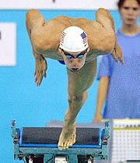
Aerobic vs. Anaerobic

Slide 3
What Is Aerobic Exercise?
-Aerobic means "with oxygen"
-Also known as cardio
-Aerobic exercise contains any of the following effects:
-Breaking a sweat
-Heart pumping and blood is flowing
-Able to sustain the exercise for 30 minutes or more

Slide 4

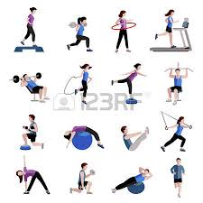


Examples include:
-Walking one mile can burn up to 100 calories.
-Swimming/ water aerobics can burn up to 240 calories per hour.
-An hour of yoga can burn up to 189 calories.
-At home exercises and stretching can burn up to 135-200 calories per half hour.

Slide 5

What is Anaerobic Exercise?
Anaerobic means "without oxygen."
Anaerobic exercise is the type where you get out of breath in just a few moments.
Examples include sprinting, climbing a long flight of stairs, and lifting weights
This type of energy generally last between 30 seconds and 3 minutes, depending on the intensity of the activities. You can only sustain very intense activities for a short period of time.

Slide 6
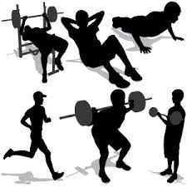

Examples Include:
- Half an hour of weightlifting can burn up to 112 calories
-Half an hour of push-ups can burn up to 298 calories.
- Going up and down stairs for about 11 minutes can burn up 102 calories.

Slide 7
CONCLUSION
1. Aerobic exercise will burn more fat and calories-you can do this for longer periods of time since no lactic acid accumulates.
2. If you suddenly shift into anaerobic mode you will get lactic acid, thus quicker fatigue and small caloric expenditure.
Lactic acid is nasty stuff. Your muscles produce it during intense exercise. It's a metabolic byproduct that makes no contribution to exercise performance. It causes muscle fatigue and post-exercise muscle soreness.

