Slide 1


The Spectrum of Adrenal Dysfunction from Addison’s to Cushing’s Disease
Part 2 Cushing’s Disease
Theodore C. Friedman, M.D., Ph.D.
Professor of Medicine-UCLA
Chairman, Department of Internal Medicine
Charles R. Drew University
Dr. Friedman’s Endocrinology Clinic
A4M/Metabolic Medical Institute (MMI)
August 15, 2021

Slide 2


Slide 3

States of Glucocorticoid Excess
ACTH-dependent States
a. Pituitary Adenoma (Cushing’s Disease) 90-95%
b. Ectopic ACTH Syndrome
ACTH-independent States
a. Adrenal adenoma
b. Adrenal carcinoma
Exogenous Sources
Glucocorticoid intake
Psychiatric Conditions (Pseudo-Cushing Disorders)
a. Depression
b. Alcoholism
Pregnancy

Slide 4

Pseudo-Cushing States
High Cortisol Secretion Rate without Convincing Clinical Features of Cushing Syndrome

Slide 5
Eucortisolemic Cushing’s Syndrome
Clinical Manifestations of Cushing’s Syndrome without evidence of increased cortisol levels
Exogenous glucocorticoid administration
Episodic (periodic) Cushing’s syndrome-common
Recently cured Cushing’s syndrome

Slide 6
Need to Distinguish Early or Mild Cushing’s from Other Diseases
Cushing’s is considered rare, but may not be that rare.
It is probably under diagnosed.
Other diseases that have some symptoms/signs in common with Cushing’s (PCOS or Metabolic Syndrome) are more common, but present differently from Cushing’s. The treatment is different for these other diseases
Thus, a strategy needs to be developed to diagnose Cushing’s syndrome.

Slide 7
Symptoms and Signs in Cushing’s, PCOS and Growth hormone deficiency
Symptoms/signs | Cushing’s | GH deficiency | PCOS
Weight gain | +++ | ++ | +
Irregular periods | ++ | + | +++
Daytime fatigue | +++ | +++ | +
Acne, facial hair | ++ | + | +++
Hairloss | ++ | ++ | ++
Poor sleep | +++ | ++ | ++
Joint pain | ++ | +++ | +
Depression/mood changes | +++ | ++ | ++
Infertility | ++ | + | +++

Slide 8
Is Cushing’s Syndrome Rare?
Probably not
Catargi et al. JCEM 2003, 88:5808-200 consecutive overweight patients with type 2 diabetes, but no other stigmata of hypercortisolism. 4 (2%) patients were found to have Cushing’s syndrome and another 7 are being evaluated.
Reimondo et al. Clin. Endo 2007,67:225-229 found that 5% of patients with diabetes failed to suppress to dexamethasone.
Kadioglu et al. Endo Society 2004 86: P2-455- 100 consecutive obese patients. Cushing’s syndrome was diagnosed in 11%.
Nishikawa et al. Endo Society 2004 86: P3-437- 1020 patients with hypertension. 11 had Cushing’s syndrome and 10 had subclinical Cushing’s syndrome (2%).
These studies may have missed mild Cushing’s syndrome and may actually be low.
Maybe Cushing’s syndrome is not so rare

Slide 9
Do all diseases progress from mild to severe?
Rapid onset
Linear
Delayed onset

Slide 10

Should Cushing’s be Diagnosed Early?
Cushing’s patients are miserable.
Effective treatment (surgery and medicines) exists
Most doctors are not familiar with Cushing’s syndrome and may only be familiar with severe cases.

Slide 11

How to Diagnose Cushing’s Syndrome
Careful history and physical
Change in weight and body habitus
Look at old pictures
Not all patients have all signs and symptoms, especially “early” and “episodic” patients.
Most published data compared severe Cushing’s with normals.
Important to diagnose early before devastating sequelae develop.
Initial diagnosis most difficult aspect of Cushing’s syndrome.
“Gestalt” with as much information as possible
Episodic Cushing’s common, so one positive test may be worth more than 10 negative tests

Slide 12
Common symptoms I see
Wired at night
Trouble sleeping-trouble falling asleep or frequent awakenings
Severe fatigue-new onset
Abrupt weight gain-without other cause such as decreased activity or depression
Decreased ability to exercise
Menstrual abnormalities
Cognitive changes- “brain fog”
Decreased libido
Symptoms of adrenal insufficiency-joint pains, can’t get out of bed, nausea and vomiting
Depression, anxiety, mood-swings

Slide 13
Common Signs I see
Central obesity
Muscle atrophy
Thin skin on top of hand (Liddle’s sign)
Buffalo hump
Round, red face
Bruising
Extra hair growth
Acne
Loss of hair on head
Stretch marks

Slide 14
The Diagnosis of Cushing’s Syndrome: An Endocrine
Society Clinical Practice Guideline
J Clin Endocrinol Metab. May 2008, 93(5):1526–1540
1st line recommended tests
  UFC
  Low dose or overnight dexamethasone test
  Night-time salivary cortisols
Testing for Cushing’s syndrome in patients with multiple and progressive features compatible with the syndrome
Patients with an abnormal result see an endocrinologist and undergo a second test, either one of the above or, in some cases, a serum midnight cortisol or dexamethasone-CRH test.

Slide 15
The Diagnosis of Cushing’s Syndrome: An Endocrine
Society Clinical Practice Guideline
J Clin Endocrinol Metab. May 2008, 93(5):1526–1540
Patients with 2 or more normal results should not undergo further evaluation.
Recommend additional testing in patients with discordant results, normal responses suspected of cyclic hypercortisolism, or initially normal responses who accumulate additional features over time.

Slide 16
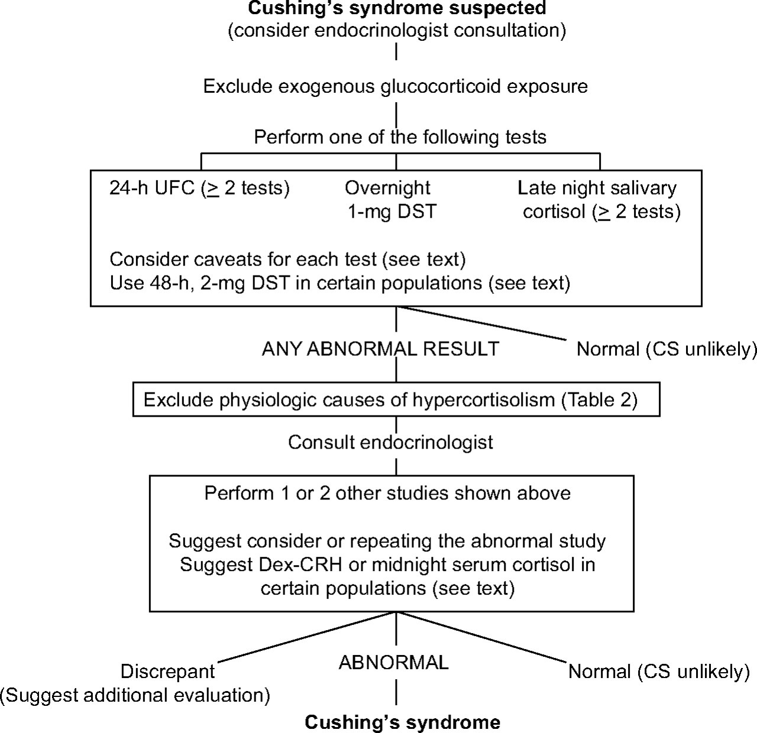
FIG. 1. Algorithm for testing patients suspected of having Cushing's syndrome (CS)

Slide 17
Episodic, Cyclical, Periodic
Periodic and cyclical refer to changes in cortisol levels that occur on a regular predictable basis.
Episodic refers to high cortisol levels that are random.
Most of my patients are episodic.

Slide 18
Episodic Cushing’s is common
Friedman, T.C., Ghods, D.E., Zachery, L., Shayesteh, N., Seasholtz, S., Zuckerbraun, E., Shahinian, H.K., Lee, M.L., McCutcheon, I.E. (2010) High Prevalence of Normal Tests Assessing Hypercortisolism in Subjects with Mild and Episodic Cushing’s Syndrome Suggests that the Paradigm for Diagnosis and Exclusion of Cushing’s Syndrome Requires Multiple Testing. Hormone and Metabolic Research. 42: 874-881.
We found that 65 of the 66 patients with Cushing’s syndrome had at least one normal test of cortisol status and most patients had several normal tests.
The probability of having Cushing’s syndrome when one test was negative was 92% for 2300 h salivary cortisol, 88% for 24-h UFC, 86% for 24-h 17OHS and 54% for night-time plasma cortisol.

Slide 19
Episodic Cushing’s is common
These results demonstrated that episodic hypercortisolism is highly prevalent in subjects with mild Cushing’s syndrome and no single test was effective in conclusively diagnosing or excluding the condition.
Rather, the paradigm for the diagnosis should be a careful history and physical examination and in those patients in whom mild Cushing’s syndrome/disease is strongly suspected, multiple tests assessing hypercortisolism should be performed on subsequent occasions, especially when the patient is experiencing signs and symptoms of short-term hypercortisolism.

Slide 20
Episodic Cushing’s is common
Our paper on episodic Cushing’s syndrome showed that most patients with confirmed Cushing’s syndrome are episodic with one or more normal values among high values.
Thus one normal value does not exclude Cushing’s.
A series of normal values does make Cushing’s unlikely at the current time

Slide 21
Episodic Cushing's: Conclusion
Data shows that all patients are episodic to some degree
May account for many patients incorrectly diagnosed as normal.
Marked by mostly normal (or low) cortisol levels with some high values accounting for the signs and symptoms of Cushing's syndrome
But lows interspersed with highs may make symptoms worse.
Can be all types of Cushing's syndrome, but in my hands, its pituitary.
Very difficult to diagnose and exclude

Slide 22
Episodic Cushing's Conclusions
I agree with the Endocrine Society recommendations and like to see 2 different tests high.
The higher the test, the more likely Cushing's is
May limit the severity of the signs of hypercortisolism. (less weight gain)
Patients with mild/episodic Cushing's seem to have as many symptoms and as poor a quality of life as full-blown-may be due to daytime lows.

Slide 23
Episodic Cushing's Testing
Need to test in a high
Multiple 24 hr UFC (and 17 OHS)
Multiple 11 PM salivary cortisols-when symptoms of high cortisol.
Midnight serum cortisol (> 7.5 ug/dL)
Overnight or low dose Dex tests (not helpful in episodic Cushing’s syndrome)
Very low dose Dex test
Pituitary MRI
Dex-CRH-not recommended in episodic
Ketoconazole trial

Slide 24
AM I HIGH?
Wired at night
Weight gain
Acne
Anxiety increase/mood swings/irritability
Euphoria/more energy than usual
Very few aches and pains
Tasks seem easier
Insomnia/inability to stay or fall asleep.
Energy levels that “perk up” after sunset.
“Speed talking” – mind is going faster than your brain can process the thoughts to speak them.
Water weight gain – edema
High blood pressure
High blood sugar if patient has diabetes

Slide 25
AM I HIGH?
.
A “high” period has some telltale signs for most patients
However, in some cases, what patients have labeled as their “high” could be their “low” phase.
  Nausea
  Weight loss
  Depression
  Lethargy
  Extreme fatigue
  Muscle/joint pain

Slide 26
Late Night Salivary Cortisol Test
    Salivary cortisol levels reflect plasma cortisol levels.
    Midnight plasma cortisol measurement requires blood-drawing and may be difficult to obtain in an outpatient setting.
    Can be done on multiple settings
    Quest, Labcorp, Esoterix, ACL
    Uses a "Salivette" in which the patient chews on a cotton tube for 2-3 minutes.
    The samples are stable for a week at room temperature or can be frozen and salivary cortisol is independent of the rate of saliva production.

Slide 27
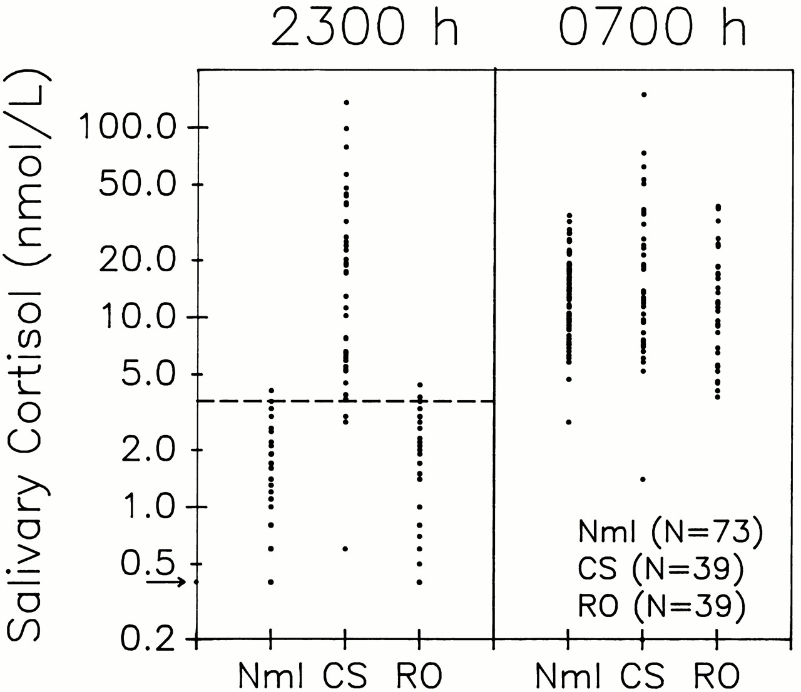
Late Night Salivary Cortisol Test
    36/39 patients with Cushing syndrome had a salivary cortisol > 3.6 nmol/L (0.13 μg/dl).
    38/39 normal volunteers had a value ≤ 3.6 nmol/l (mean 1.2 nmol/L) and 37/39 patients with rule/out Cushing syndrome had a value ≤ 3.6 nmol/l (mean 1.6 nmol/L).

Slide 28
Salivary cortisols in episodic Cushing’s
Convenient for periodic patients as the patient can collect many samples easily
Try to have the patient collect when high symptoms
I start with 4 at 11 PM
Patients can tests between 11 PM and 1 AM when symptoms of highs
Other times not helpful, cortisol starts rising at 2 AM.
Don’t use salivary kits geared for patients, ZRT, Genova, etc
Can complement UFC for picking up mild cases.

Slide 29
24-Hour Urinary Free Cortisol (UFC)
    Integration of plasma cortisol throughout the day
    “Good” assays (using HPLC or mass spectroscopy) have a normal range of 10-34 μg, with higher levels for men.
    Cushing’s patients may have low cortisol during the day and high at night, cancelling out the high, yielding normal results.
    PseudoCushings patients may have normal values in newer assays, but elevated levels in older assays.
    Many Cushing’s patients have normal values in the new assay

Slide 30
Urinary 17-OH Corticosteroids (17-OHS)
One of the earliest tests
Went out of favor in the 90s and has been (incorrectly) replaced by UFC.
UFC is probably better for full-blown Cushing’s compared to obese and normal subjects.
17-OHS may be better for picking up mild cases.
Can use the same collection for both, so its worthwhile to measure 17-OHS in addition to UFC.
Can also express results per gram of creatinine to correct for obesity
I don’t use the 17OHS/Cr to diagnose Cushing’s only to confirm
Available from ARUP.

Slide 31
17-hydroxysteroids (2)
At lower cortisol production rates, the 17OHS assay may be able to detect mild hypercortisolism in some patients with normal 24-h UFC levels.
UFC measurements will increase only mildly until a point of saturation of cortisol binding to CBG is exceeded
17OHS measurements which are not dependent on cortisol exceeding the threshold of binding to CBG are more likely to be linear with cortisol production.

Slide 32
Night Time Plasma Cortisol Test
    Normal individuals and patients with pseudo-Cushing states have a pronounced diurnal rhythm of cortisol with the highest values in the morning and lower values at night.
    Patients with Cushing syndrome lack their diurnal variation of cortisol.
    Papanicolaou et al. (JCEM, 1998, 83:1163-1167) compared morning and nighttime plasma cortisol in 97 patients with proven Cushing syndrome and 31 patients with pseudo-Cushing states.
    A midnight plasma cortisol greater than 7.5 μg/dL makes Cushing’s syndrome likely.
    Patients taking oral estrogens (or birth control pills) will have an increase in their CBG and a falsely high serum cortisol level.
    Can be done as an outpatient (Scand J Clin Lab Invest. 2002;62(5):357-60)
    Pretty good test, but hard to arrange (except in my Tuesday night clinic)

Slide 33
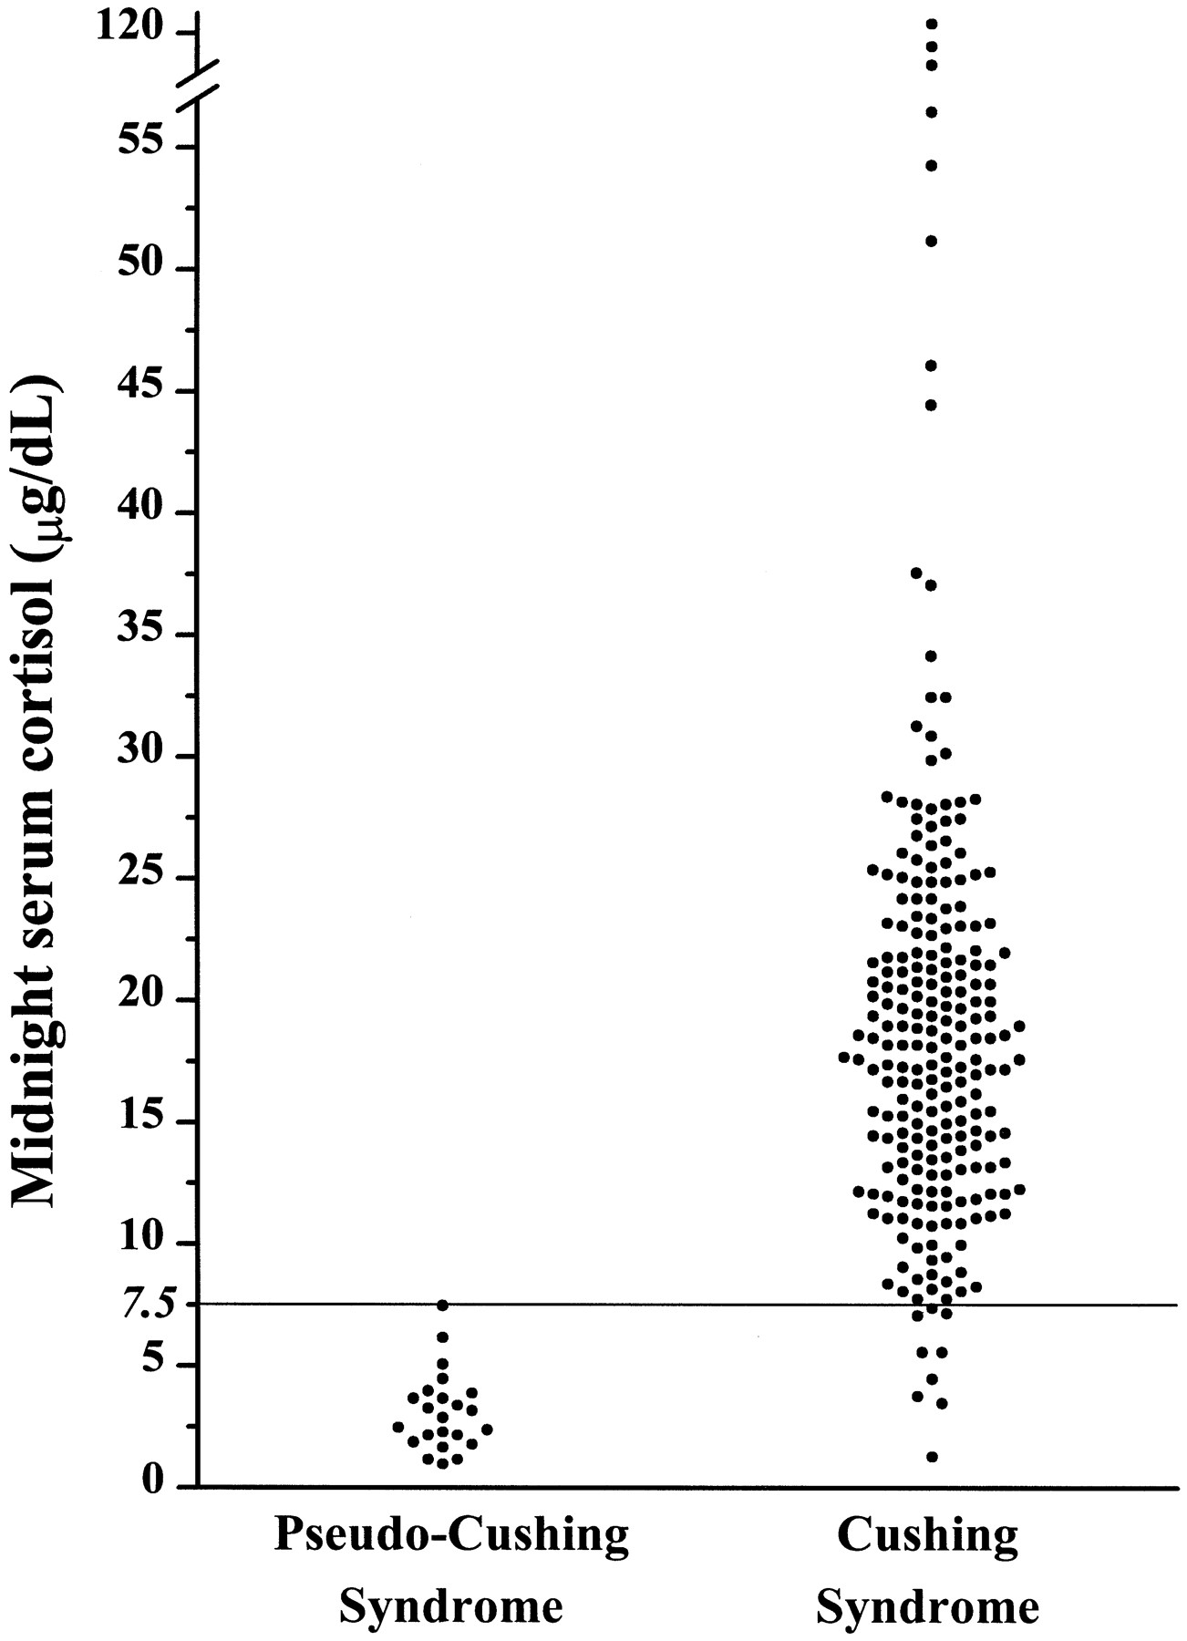
Midnight plasma cortisol
Papanicolaou et al. (JCEM, 1998, 83:1163-1167)

Slide 34
Both UFC and Salivary Cortisol are unlikely to pick-up mild Cushing’s
Serum cortisol less than 20 μg/dL (lower in evening when CBG is lower) is mainly (but not exclusively) bound to CBG and therefore little free cortisol is present in the blood.
This results in little increase in salivary cortisol or UFC.
At serum cortisol concentrations exceeding this cut-off, then salivary cortisol and UFC will rise dramatically.
Still these are the best tests we have.

Slide 35
Another problem why its hard to diagnose Cushing’s: Cortisol-Lowering Medications
Many sleep aids (most Cushing’s patients have trouble sleeping!) lower cortisol.
Unclear how long a patient needs to stop the medicine before testing.

Slide 36
MEDICATIONS AND SUPPLEMENTS AFFECTING CORTISOL LEVELS

Slide 37
Overnight dexamethasone test
Give 1 mg of dexamethasone at 11 PM or midnight- collect 8 am plasma cortisol
Cushing’s patients resistant to glucocorticoid feedback.
Old cut-off 5 mg/dL, new cut-off 1.8, mg/dL. Value greater than that consistent with Cushing’s syndrome.
Cortisol assay isn’t that good at low values
May get falsely high values if on oral estrogens.
Only half of classic Cushing’s patients have the genetic defects leading to resistance to dexamethasone-probably lower in mild/episodic patients (Bilodeau et al. 2006 20: 2871-2886 Genes & Dev.)
Friedman, T.C. (2006) An Update on the Overnight Dexamethasone Suppression Test for the Diagnosis of Cushing’s Syndrome: Limitations in Patients with Mild and/or Episodic Hypercortisolism. Experimental and Clinical Endocrinology and Diabetes 216: 356-360.

Slide 38
Overnight dexamethasone test
0800 h cortisol (μg/dL)
Patient #

Slide 39
Overnight dexamethasone test
Conclusion: test unhelpful for excluding Cushing’s syndrome.
If someone has a high value after dexamethasone, may help with the diagnosis of Cushing’s syndrome, but those patients usually are severe and can be diagnosed anyway
If patient suppresses to overnight dexamethasone, adrenal adenoma or ectopic is unlikely.

Slide 40
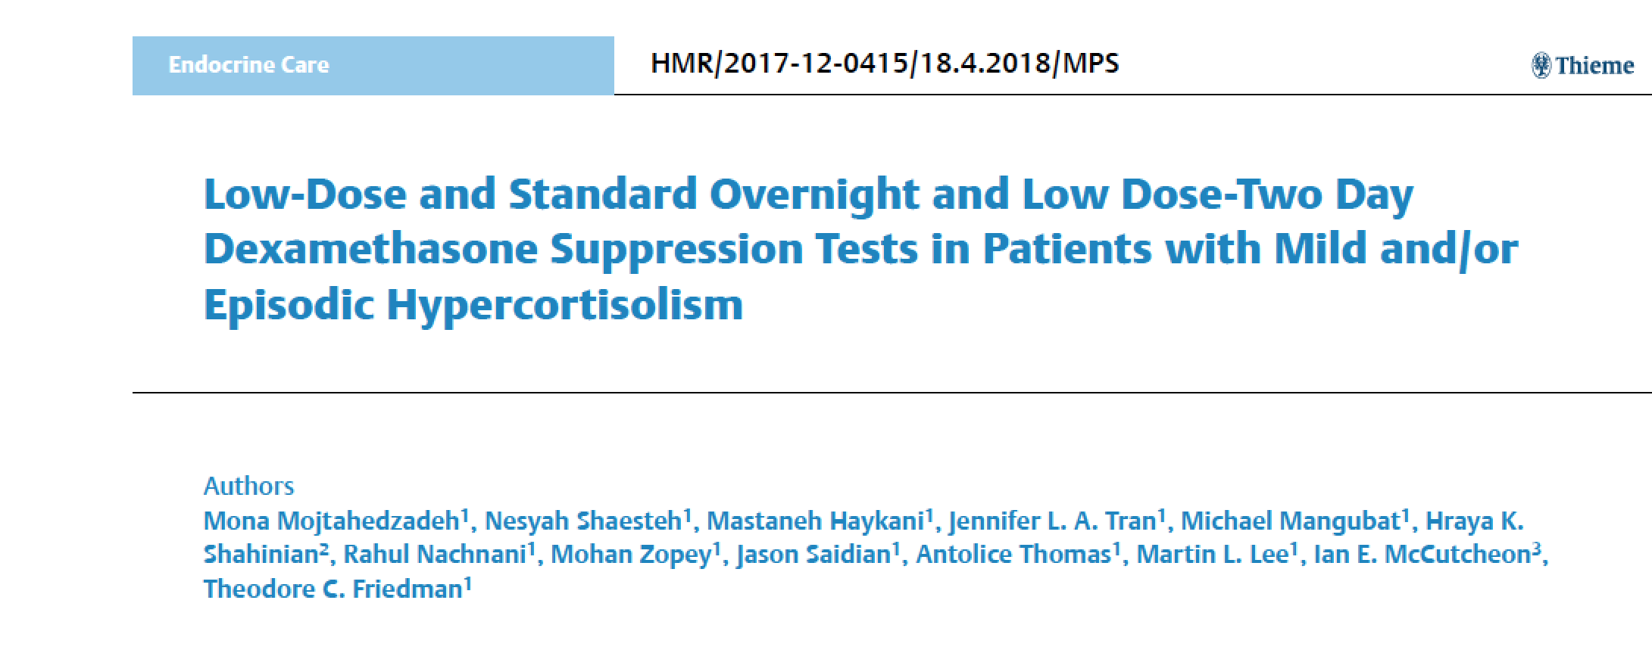
Very Low Overnight dexamethasone test

Slide 41
Very Low Overnight dexamethasone test
The objective of the current study was to determine the sensitivity and specificity of a 0.25 mg overnight DEX suppression test, the standard 1 mg overnight DEX suppression test and the two-day low-dose (Liddle test) DEX suppression test with and without correction for DEX levels in patients evaluated for mild and/or periodic Cushing’s syndrome.
Thirty patients determined to have Cushing’s syndrome by biochemical testing and 14 patients determined not to have the condition had the 0.25 mg and standard 1 mg overnight DEX suppression test and the two-day low-dose DEX suppression tests.

Slide 42
Very Low Overnight dexamethasone test
Our results show that morning serum cortisol and cortisol/DEX ratios following a 1 mg overnight dexamethasone suppression test were similar in patients with Cushing’s syndrome and those not having Cushing’s syndrome.
However, a morning cortisol value above 7.6 μg/dL following a dose of DEX of 0.25 mg was found in 12 patients with Cushing’s syndrome and none in those not having Cushing’s syndrome, suggesting that a high cortisol value after this low dose of dexamethasone can indicate that further testing for Cushing’s syndrome is warranted.
Our data suggests that the traditional 1 mg overnight or the 2 mg-2 day DEX suppression testing should no longer be used as a screening test in patients who could have mild and/or periodic Cushing’s syndrome, while the 0.25 mg dose of DEX may pick up some patients with mild Cushing’s syndrome.

Slide 43
Very Low Overnight dexamethasone test

Slide 44
Very Low Overnight dexamethasone test

Slide 45
Very Low Overnight dexamethasone test

Slide 46
Very Low Overnight dexamethasone test: Conclusions
In conclusion, our paper provides evidence that suppressibility to the 1 mg overnight or 2 mg-two day DEX test should not be used to exclude patients suspected of having mild or episodic Cushing’s syndrome.
A high cortisol value following the 0.25 mg DEX test suggest that the patient may have Cushing’s syndrome and should be evaluated further.
Patients suspected of Cushing’s syndrome should be screened with other tests such as nighttime serum or salivary cortisol measurements or UFC.
Evaluation of the 0.25 mg overnight DEX test in a larger number of patients with mild Cushing’s syndrome as well as those in whom Cushing’s syndrome was excluded may yield discrimination between the two conditions.

Slide 47
Dexamethasone-CRH test
    Patients with pseudo-Cushing’s states show a diminished response to exogenous CRH and a greater inhibition of cortisol production by glucocorticoids than patients with Cushing’s syndrome.
    Yanovski et al. (JAMA 1993, 269:2232-2238) studied 39 patients with surgery confirmed Cushing’s syndrome and 19 patients with pseudo-Cushing states. Both groups of patients had UFC between 90-360 ug/day (nl 20-100 ug/day).
    Dexamethasone (0.5 mg) is given every 6 hours for 8 doses, starting at noon. The last dose is given at 6 A.M, 2 hours before the CRH test. Ovine CRH (1 mg/kg) is then given at 8 A.M. Plasma samples were analyzed for cortisol and ACTH at 4 basal time points (-15, -10, -5 and 0) and at 5, 15, 30, 45 and 60 minutes after oCRH.

Slide 48
Dexamethasone-CRH test
    Using a cutoff of 1.4 mg/dL, a plasma cortisol drawn 15 minutes after oCRH administration (following dexamethasone suppression) was able to completely separate patients with pseudo-Cushing states from those with Cushing syndrome. This was much better than just performing a oCRH test or dexamethasone test alone.
    Subsequently, many articles have shown the test is not full-proof
    Timing is crucial.
    Has not been tested in mild or periodic patients.
    The dex-CRH test is expensive and time consuming. I found that most of my patients with mild Cushing’s syndrome had low cortisol values following the test.
    Cannot tell if a patients is in a high, so hard to plan when to perform test in those with episodic Cushing’s

Slide 49
Role of Imaging for the diagnosis of Cushing’s
Most of the patients I see have pituitary Cushing’s disease.
3T MRIs are high quality; most pituitary tumors are seen on MRI, especially on dynamic sequences.
I haven’t seen better results with 7T MRI
Patients can have incidentalomas, so having a tumor doesn’t make the diagnosis of Cushing’s, but does give an important piece of information.
A negative MRI in a patient that has a normal or mildly elevated ACTH pretty much excludes Cushing’s (low ACTH=adrenal Cushing’s, high ACTH=ectopic)

Slide 50
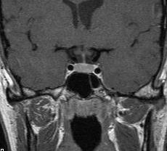
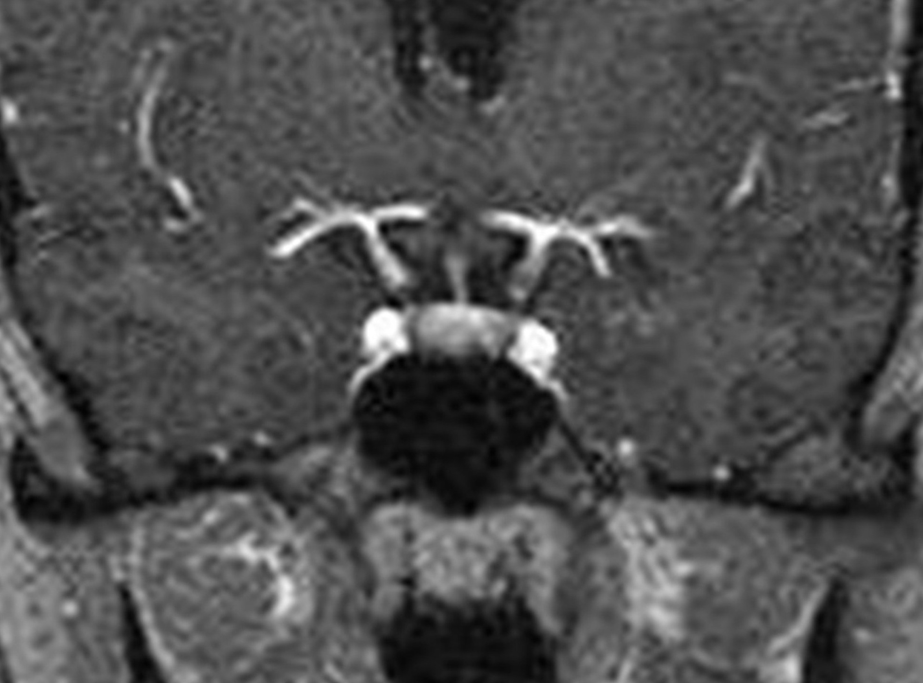
Dynamic Pituitary MRI
Coronal T1-weighted
Static MRI (Contrasted)
Coronal T1-weighted
Dynamic MRI (Contrasted)

Slide 51
Pituitary MRI
In literature approximately 50% of patients with Cushing disease have a visible tumor on MRI (older, non-dynamic, lower power MRIs).
10% of normal volunteers have MRIs consistent with a pituitary adenoma (Hall et al. Ann. Intern. Med., 1994, 120:817-820).
Now 3 Tesla dynamic MRIs can pick up small tumors are done.
Patients without Cushing’s syndrome or with adrenal/ectopic Cushing’s can have a pituitary incidentaloma.
Friedman, T.C., Zuckerbraun, E., Lee, M.L., Kabil, M.S., Shahinian, H.K. (2007) Dynamic Pituitary MRI Has High Sensitivity and Specificity for the Diagnosis of Mild Cushing’s Syndrome and Should be Part of the Initial Workup. Hormone and Metabolic Research 39:451-456.

Slide 52
Pituitary MRI
23 of 24 patients had had a MRI consistent with a pituitary lesion
12
10
8
Tumor size (mm)
6
4
2
0
Pt #

Slide 53
Pituitary MRI
    23 of 24 patients had had a MRI consistent with a pituitary lesion (21 with a microadenoma, two with pituitary asymmetry).
    Only 3 of 20 patients (2 patient did not have MRIs) in the Cushing’s excluded group had a pituitary lesion on dynamic MRI.
    Dynamic pituitary MRI had the highest sensitivity and negative predictive value of any testing modalities and its specificity and positive predictive value were similar to that of other tests.
    A negative MRI goes a long way in excluding Cushing’s syndrome, except in the patient with adrenal or ectopic Cushing’s syndrome, who usually has more severe hypercortisolism and is usually easy to diagnose.
    Positive MRI is helpful, but still needs biochemical evidence for hypercortisolism.

Slide 54
Unhelpful tests
Morning cortisol (Friedman, T.C. and Yanovski, J.A. (1995) Morning Plasma Free Cortisol: Inability to Distinguish Patients with Mild Cushing Syndrome from Patients with Pseudo-Cushing States. J. Endocrinol. Invest. 18:696-701)
Morning ACTH (except to determine type of Cushing’s)
Late afternoon cortisol
Insulin tolerance test
CRH test

Slide 55
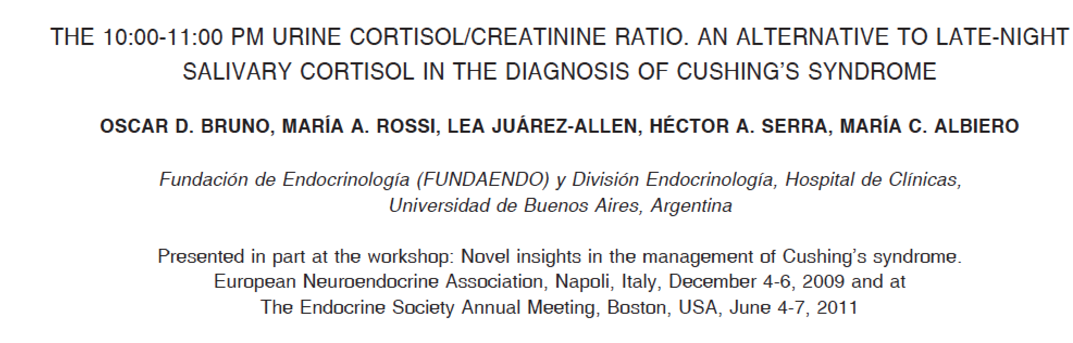
10 PM to 11 PM urine Cortisol/Cr

Slide 56
10 PM to 11 PM urine Cortisol/Cr
Cutoff 31.6 ug/g

Slide 57
Ketoconazole Trial for Cushing’s
Ketoconazole is safe, with the main side effect being increased liver tests, which usually occur at doses > 1000 mg/day and are reversible.
It does interact with a lot of drugs, but these interactions can usually be dealt with by changing the other drug or watching for side effects
It has a short-half life so it should be given at night, when cortisol is inappropriate high in Cushing’s patients.
I usually give 200 mg at 8 and 10 PM and have patients take 2.5-5 mg of Cortef in the AM, if needed.

Slide 58
Ketoconazole Trial for Cushing’s
Ketoconazole can be used diagnostically to determine which symptoms a patient has are due to high cortisol.
I use it in patients who I am pretty sure, but not completely sure has Cushing's and I want them to get symptomatic relief.
I’m concerned if someone doesn’t get better on ketoconazole, they really don’t have Cushing's.
I have kept patients on ketoconazole for up to 3 years without problems.
I often stop it for a round of testing, or if a patient develops a tumor on MRI.
Rise in ACTH following ketoconazole might be a sign of pituitary Cushing’s disease

Slide 59
RECOMMENDATIONS
Careful history and physical
At least 4 UFC and 17-OHS
At least 4 11 pm salivary cortisols
Night time serum cortisol
MRI
Ketoconazole trial
Make diagnosis if two distinct values are high
Have patient keep a diary and try to collect when “high”

Slide 60
Medical treatment for Cushing’s syndrome
*Ketoconazole-In my opinion, the best: inexpensive, no pre-auth
*Isturisa (osilodrostat) needs pre-auth
Korlym (RU486)-can get adrenal insufficiency and hard to monitor or correct adrenal insufficiency
Metyrapone- available on a compassion use basis from company
Aminoglutethimide- not sure if available
Mitotane-permanent adrenal insufficiency, hard to swallow
Trilostane- can be given IV
*Cabergoline-sporadic
*Paseriotide-somatostatin analog

Slide 61
Transphenoidal surgery remains the best option for Cushing’s Disease
Needs to be done with an experienced surgeon
If fails or surgery is not an option:
  Medical treatment
  Bilateral Adrenalectomy
  Radiation Therapy

Slide 62
Ketoconazole
Off-label use, not FDA approved for Cushing’s syndrome.
Works by blocking several steps in cortisol biosynthesis.
May also inhibit pituitary cell growth
Has a pretty short half-life-6-8 hrs-I often give it at night as Cushing’s disease is marked by high cortisol at night.
Side effect-elevation of liver tests, which is reversible on stopping drug.
Liver test abnormalities are more pronounced at higher doses-> 1200 mg.
Check liver tests at baseline and every 2-3 months

Slide 63
Ketoconazole
Cushing’s syndrome is a disease of high night time cortisol, some patients have low daytime cortisol.
  I start by giving 200 mg 1 hr and 3 hr before bedtime to decrease night time cortisol
  Can go up on the dose for continued hypercortisolism
  I usually give patients some 5 mg pills of hydrocortisone to be taken in the AM, if symptoms of adrenal insufficiency (nausea, vomiting, diarrhea, abdominal pain, achy).

Slide 64
Ketoconazole
Works in almost all patients
Educate patients about adrenal insufficiency
Interacts with drugs, especially statins.
Rarely, long QT interval on EKG
Can be used to determine how much of patients symptoms are due to high cortisol.
Can be used to get patients healthier prior to surgery.
May decrease the drop from high cortisol to normal cortisol post-op
I use it often before adrenalectomy (may decrease hyperplasia seen on pathology)
Monitor symptoms, UFC (not 17OHS) and serum cortisol
Can be used for years with monitoring of liver tests (LFTs) and pituitary tumor
Should be gold-standard to compare new drugs

Slide 65
Isturisa (osilodrostat)
  Potent oral inhibitor of cytochrome P450 11β hydroxylase (same as metyrapone)
  87% of patients had normalization of their mean UFC.
  The most common adverse events observed during the overall study with osilodrostat were arthralgia (45%), decreased appetite (45%), fatigue (38%), and nausea (37%).
  I give at 2-4 mg at bedtime
  My second choice

Slide 66
Cabergoline
The D2-receptor agonist, cabergoline, at doses of 2.5 -5 mg/week, leads to long-term biochemical remission in about 30% of patients.
Side effects include nausea, headache, and dizziness; cardiac valve fibrosis seen was not noted in doses given to patients with Cushing’s disease.
This treatment represents an off –label use of the drug.

Slide 67
Korlym (Mifepristone)
Mifepristone is a glucocorticoid and progesterone receptor antagonist that can ameliorate the signs and symptoms of Cushing’s syndrome.
Because it increases ACTH and cortisol concentrations in patients with Cushing’s disease, clinical cortisol-dependent variables (hyperglycemia and hypertension) need to be used to adjust the dose.
The absence of a measurable marker makes it hard to monitor.
Adverse events include symptoms of cortisol insufficiency (fatigue, nausea, vomiting, arthralgias, and headache), increased mineralocorticoid effects (hypertension, hypokalaemia, and oedema), and antiprogesterone effects (endometrial thickening)
Mifepristone is approved in the USA for the treatment of hyperglycemia related to Cushing’s syndrome in non-surgical candidates.
My third choice

Slide 68
Pasireotide
Pasireotide is a somatostatin receptor ligand.
FDA-approved
A trial of 162 patients showed that subcutaneous pasireotide at a dose of 600 μg or 900 μg twice a day normalized UFC production in 15% of patients receiving the 600 μg dose and 26% of patients receiving the 900 μg dose.
Hyperglycemia occurred in 73% of patients.
Does not seem as good as ketoconazole to me

Slide 69
Bilateral Adrenalectomy
Cures Cushing’s 95% of the time
Can be done laparoscopically-even through belly button-no scar!
One surgeon can perform a unilateral adrenalectomy in 30 min!
Much less mortality than before
Need lifelong hydrocortisone, fludrocortisone and probably DHEA
Higher risk of adrenal insufficiency than if hypopituitarism
Bracelet and solucortef, emergency letter, phone app, nausea meds.
Most of my patients have done well with adrenalectomy
Still I recommend pituitary surgery over adrenalectomy as most pituitary patients are off most medicines in one year.

Slide 70
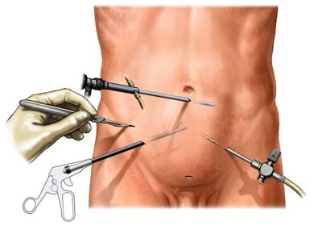
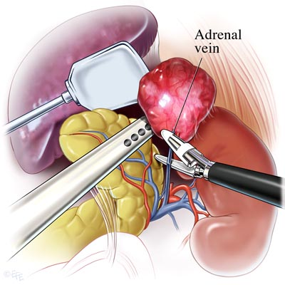
Adrenalectomy
Rate of remission: 90-100%
Done laparoscopically
Must remove both adrenals completely
Risk of subsequent adrenal crisis:
  < 1 yr after surgery: 36%
  > 1 yr after surgery: 44%
Thus, vigilance is required

Slide 71
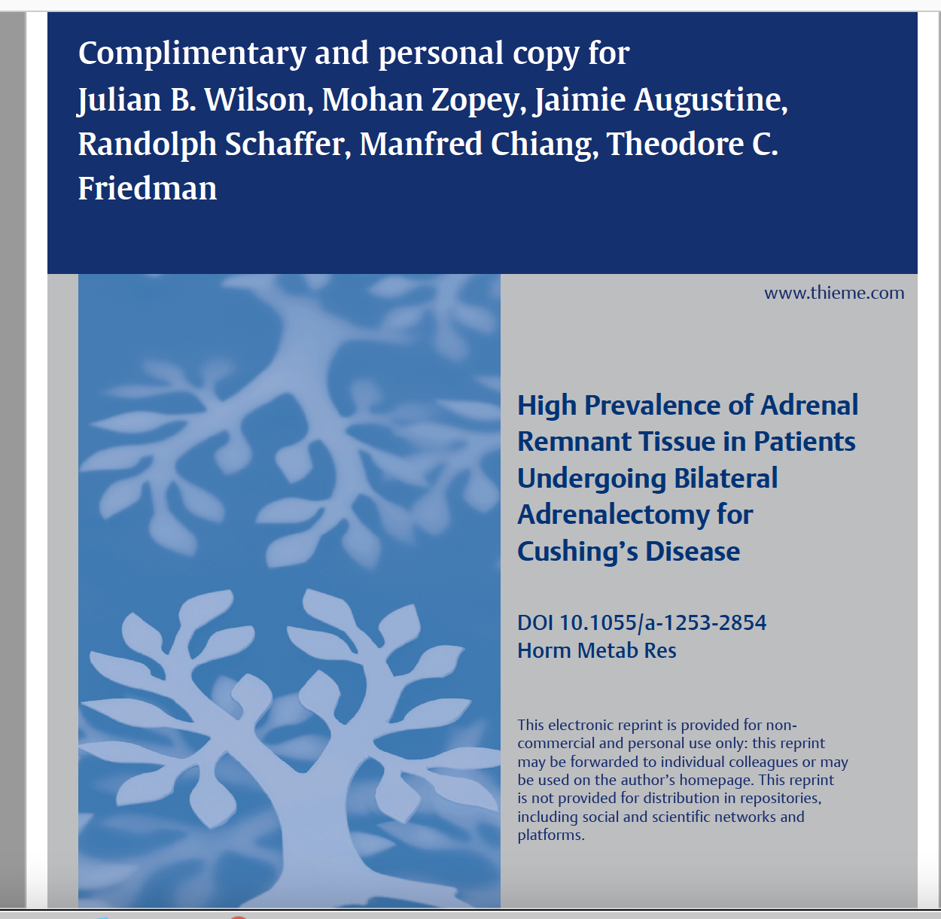
Problem: adrenal remnant

Slide 72
Problem: Adrenal Remnant Tissue following BLA
Ten of 51 patients who underwent BLA during this time period had adrenal remnant/rest tissue marked by detectable endogenous glucocorticoid production.
9 of the 10 patients had signs and symptoms of hypercortisolism.
Most had detectable cortisol values at night.
Localization and treatment proved difficult.
We conclude that the incidence of adrenal remnant/rest tissue in those undergoing BLA following unsuccessful pituitary surgery was 12% although there may have been a selection bias affecting this prevalence.

Slide 73
Problem: Adrenal Remnant Tissue following BLA
The first indication of remnant tissue occurrence is a reduction in glucocorticoid replacement with symptoms of hypercortisolism.
If this occurs, endogenous cortisol production should be tested for by cortisol measurements using a highly specific cortisol assay while the patient is taking dexamethasone or no glucocorticoid replacement.
Endocrinologists need to monitor the development of both adrenal remnant tissue and Nelson’s syndrome following BLA

Slide 74
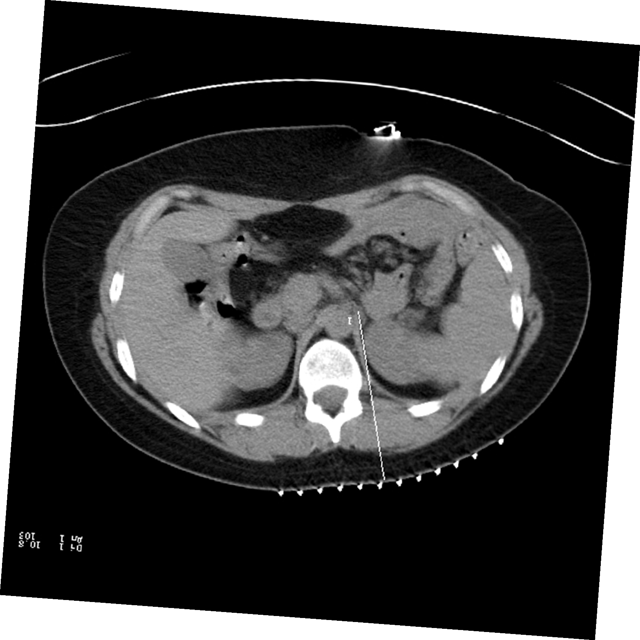
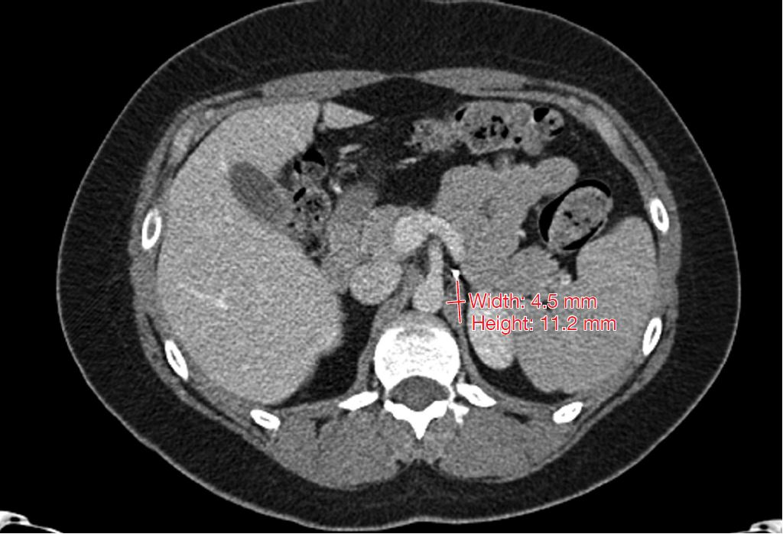
Problem: adrenal remnant
CT with contrast of adrenal remnant tissue measuring 11.2 mm by 4.5 mm.
CT posterior approach ethanol ablation of residual adrenal tissue.

Slide 75
Adrenalectomy-Nelson’s syndrome
Absence of glucocorticoid feedback can in theory cause pituitary tumors to grow unchecked
Leads to pituitary tumor growth, high ACTH levels (< 1500 pg/mL is probably normal) and hyperpigmentation.
Happens more frequently in aggressive, rapidly growing tumors, most of my patients have slow growing tumors
Need to monitor pituitary tumor by MRI yearly-if tumor grows, need surgery
Pituitary radiation probably decreases likelihood of Nelson’s syndrome

Slide 76
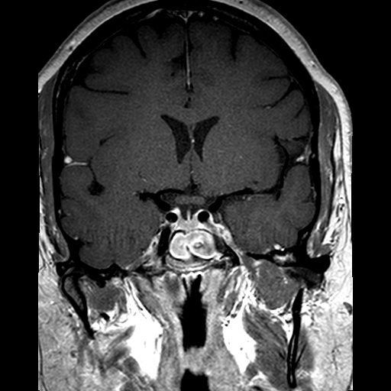
Who might get adrenalectomy?
39 yr old woman with Cushing’s x 1 yr
TSS removed corticotroph hyperplasia
High cortisol persisted, but MRI was normal
Chose BLA as relief more immediate

Slide 77
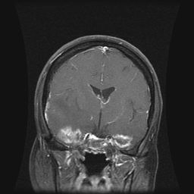
Risks of RT
Tumor effects
  edema
  Hemorrhage
Injury to nearby structures
  optic nerves or chiasm
  temporal lobe(s) of brain
Injury to distant structures
  scalp hair loss

Slide 78
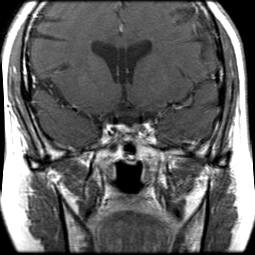
Who might get radiosurgery
33 yo woman
Cushing’s x 13 yr
TSS in 2004 and again in 2007
Cortisol never normalized
Scarring will make removal difficult

Slide 79
Adrenalectomy vs RT
I usually recommend adrenalectomy as most of my patients want an immediate cure and can’t wait the time for RT to kick in
Exception, someone well controlled on ketoconazole
Aggressively growing pituitary tumors may also lead me to RT
How much hypopituitarism they have affects the decision, if already has hypopituitarism, I’m less worried about RT.
Some patients get both RT and adrenalectomy

Slide 80
How to decide?
Radiosurgery
Takes a year to work
Dependent on highly technical factors for efficacy
Works best with defined target
Chance of losing hormone function depends on target size / dose
Adrenalectomy
Effect on tumor more immediate
Effect on cortisol more immediate, hence risk of Addisonian crisis and need for immediate cortisol replacement
Risk of Nelson’s
Either method can fail!

Slide 81
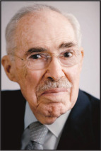
Cushing’s as a Continuum
Gabrilove JL (1916-2014)
The continuum of adrenocortical disease: a thesis and its lesson to medicine. J Mt Sinai Hosp N Y 32:634-6) (1916-2014) postulated that adrenocortical hyperfunction is a continuum from normality to the florid clinical state and its manifestation will vary widely between individuals.
Furthermore, Gabrilove also proposed, without experimental data, that many tests to diagnosis adrenocortical hyperfunction will fail in the mild patient, a postulate proven by the data here.

Slide 82

Camille at her wedding

Slide 83
For more information or to refer patients
Goodhormonehealth.com

Slide 84
Thanks
Sahar Swidan, Pharm.D., BCPS, ABAAHP, FAARFM, FACA and the A4M/Metabolic Medical Institute (MMI) for organizing the event and inviting me.
Tiffany Duke and Lindsay Genereaux for organizing the CME

