Slide 1
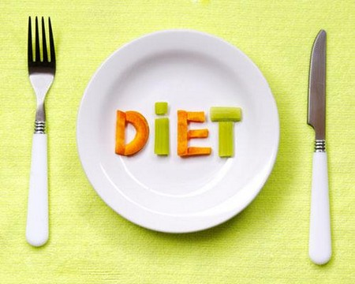
10 DIET TRAPS and how to avoid them
Jasmine Eugenio, MD

Slide 2
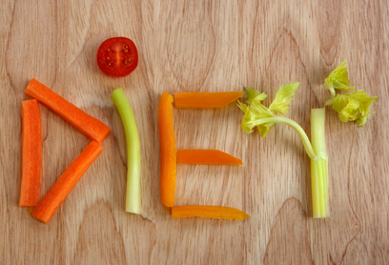
ON a Diet????
You’ve done everything!!!
Nothings happening
Diet errors are sabotaging your weight loss efforts

Slide 3
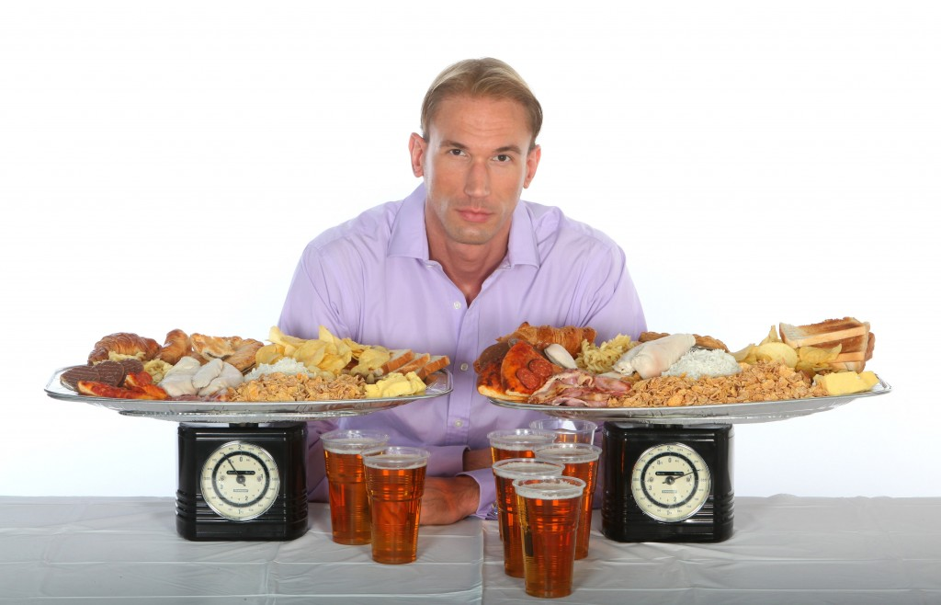
1. Your portions are too big
Don’t let your hungry eyes dictate your portions
Even if you are eating healthily you’ll struggle to shed pounds if you are having large portions

Slide 4
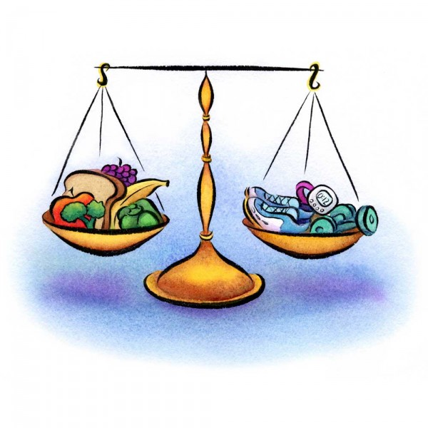
1. Your portions are too big
DO: WEIGH,
MEASURE
out your portions

Slide 5
2. You’re not paying attention to the foods you are eating
Know your guidelines for daily amounts for calories, fat, saturated fats, sugar and salt for average adults
Low fat doesn’t always mean low calories
Some low fat foods contain extra sugars to improve their state

Slide 6
2. You’re not paying attention to the foods you are eating
Each Day | Calories | Fat | Saturates | Salt | Sugars
Women | 2000 | 70 g | 20 g | 6g | 90 g
Men | 2500 | 95 g | 30 g | 6 g | 120 g
DO: Always check calories content and guideline daily amounts before you buy

Slide 7
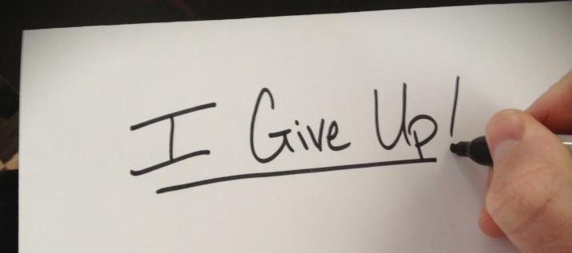
3. You feel like giving up
Overeating or indulging in naughty treats can guilt trip dieters into giving up
Join groups, get back up
Come to POWER visit
DO: Get back on track and don’t lose hope

Slide 8
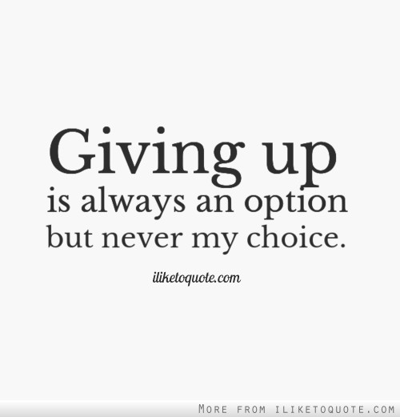
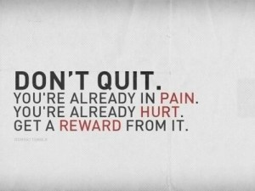

Slide 9
4. You’re doing less exercise
People tend to move less when they start dieting
Research show that people activity levels tend to drop 40% when they try to los e weight

Slide 10
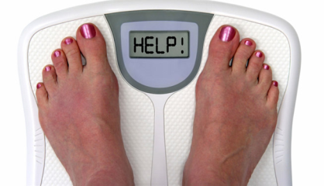
4. You’re doing less exercise
ADULT should do a minimum of
Weight loss
30 MINUTES
___________
day
5
days/
week
=
X
DO: Exercising helps KEEP YOUR WEIGHT LOSS ON Track!!!

Slide 11
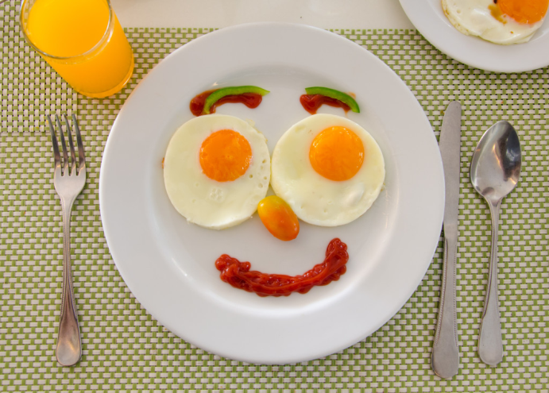
5. You SKIP breakfast
Studies show that people who skip breakfast eat more high calorie foods later in the day
You are 43% less likely to become obese
if you eat breakfast

Slide 12
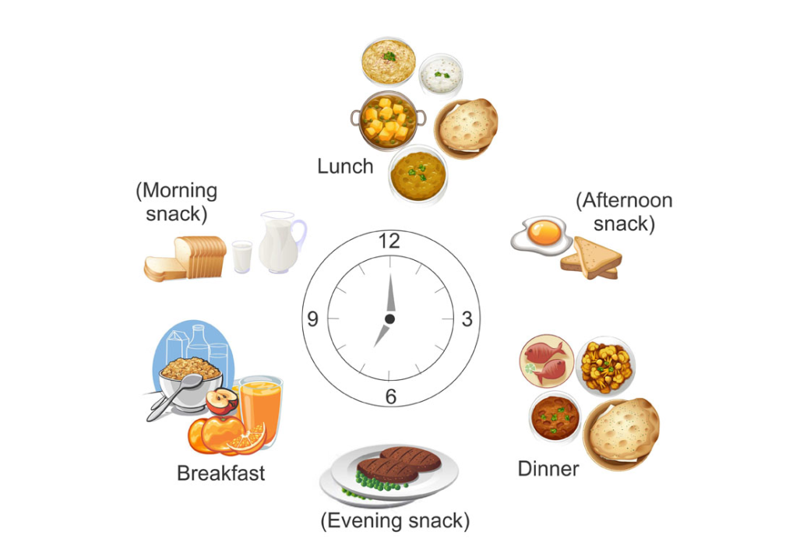
5. You SKIP breakfast
DO: Eat three regular meals a day and stabilize your overall calorie intake

Slide 13
6. You’ve stopped snacking
Its okay to snack
The ideal snacks are high in protein and fiber
Choose small handful of nuts, dried fruit (apricots) or some hummus and carrot sticks
Regular, healthy snacking can help to maintain your energy and blood sugar levels

Slide 14
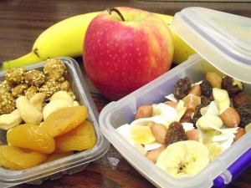
6. You’ve stopped snacking
DO: Listen to our body and keep hunger pangs at bay

Slide 15
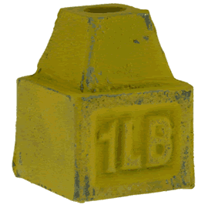
7. You’re not eating enough
Don’t deprive yourself of meals or cut back on calories too much. This can slow your metabolism and even end up burning your muscles for energy
DO: AIM to LOSE NO MORE than 1 kg/week (2 lbs)
=
+
ONE week
1 lb
1 lb

Slide 16
8. You’re not getting enough vitamins
No food provides all the nutrients that we need so its important to eat w wide variety of different types of food, especially if you are on a diet
DO: VITAMINS and MINERALS are important for keeping your energy level up

Slide 17
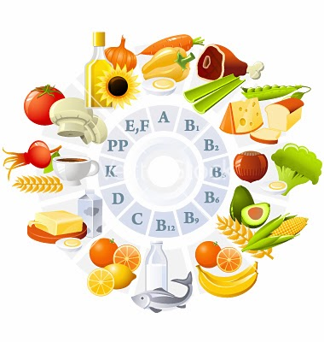
8. You’re not getting enough vitamins

Slide 18
9. You use FOOD as a reward
86 % eat comfort foods when happy
74% EAT to reward themselves
Take a step back and consider rewarding yourself in other ways such as a long bath or spa treatment
ARE you attached to CALORIE RICH FOODS?

Slide 19
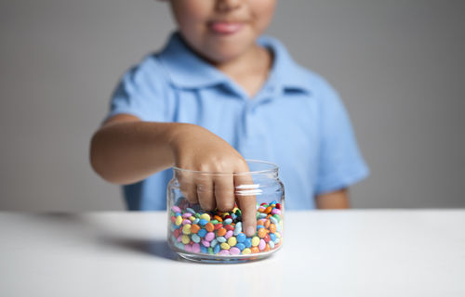
9. You use FOOD as a reward
DO: Think about how you view your food

Slide 20
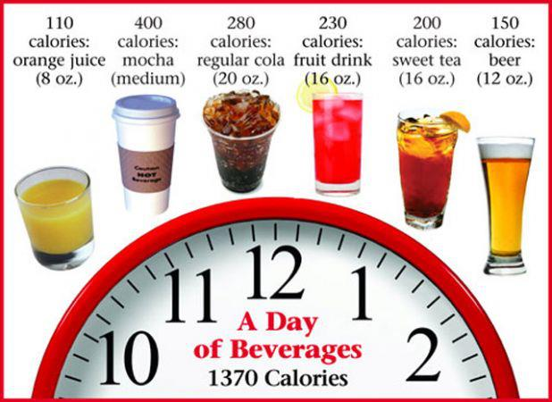
10. You’re drinking too much
Many people forget how many calories in their drinks, even a glass of healthy orange juice contains around 100 calories
Large latte 260 calories
Glass of red wine 90 cal
Smoothie 500 cal
Pint of beer 170 cal
Water 0 cal
DO: Count the Calories in your drinks too

