Slide 1





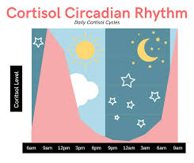
Theodore C. Friedman, M.D., Ph.D.
(the Wiz)
Professor of Medicine-UCLA
Chairman, Department of Internal Medicine
Charles R. Drew University
Cortisol Circadian Rhythm:
Under-appreciated patterns that are the guide to Cushing’s disease and wellness
GoodHormoneHealth Webinar
Joined by Zoya Brar
COO Eli Health
August 17, 2025

Slide 2




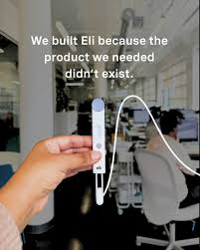
Cortisol Hormometer
is not intended to diagnose, cure, or manage any disease or condition, including Cushing’s. Its role is solely as a wellness tool to support lifestyle management.
© Eli Health, 2025

Slide 3



Eli Health
Medical Director
Marina Rivas CEO

Slide 4
Outline
Topics to be discussed include:
What is the normal Cortisol Circadian Rhythm and What Happens in Cushing’s?
What happens if your Cortisol Circadian Rhythm is off?
How does Eli Health Salivary Cortisol work and how it can be used in conjunction with commercial laboratory salivary measurements?
Why is Dr. Friedman recommending salivary day curves to diagnose and monitor treatment for Cushings?
How does the Cortisol Circadian Rhythm affect treatment for Cushings?

Slide 5
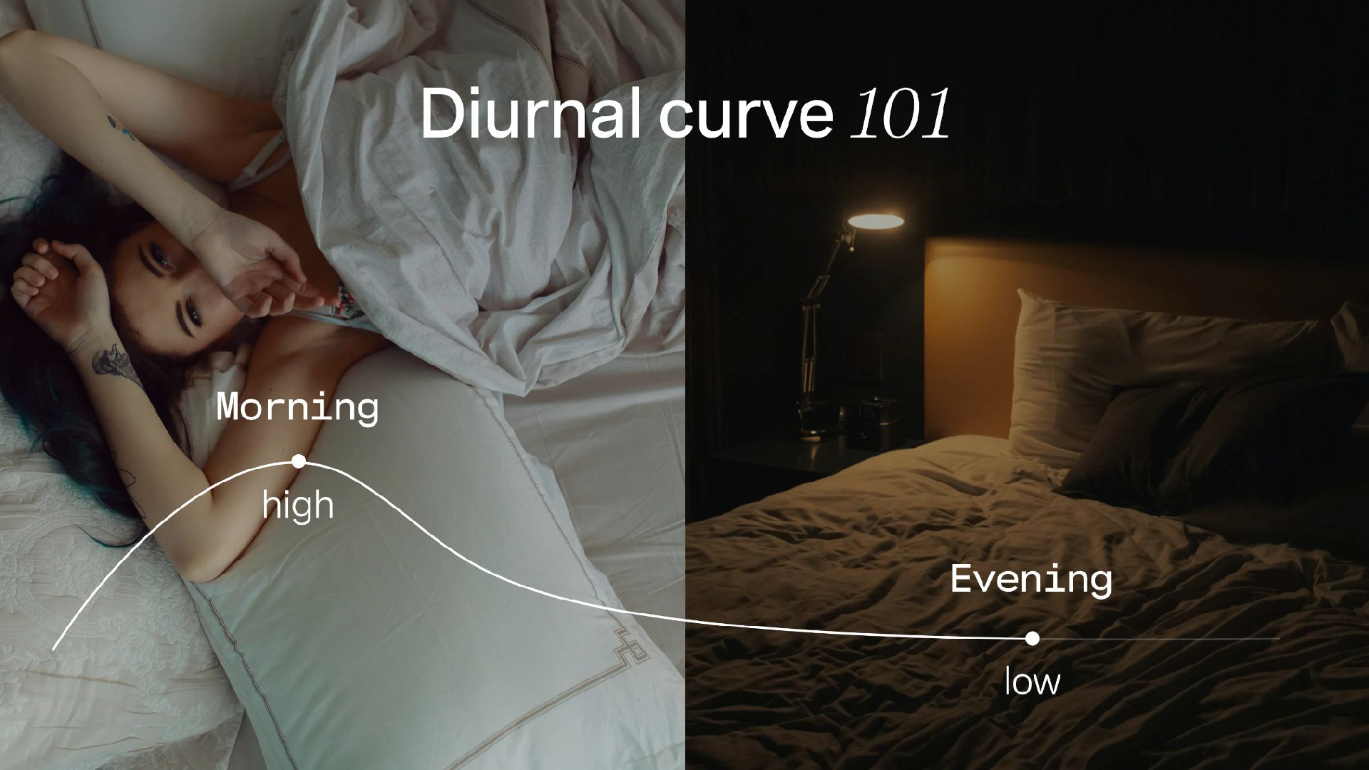

Slide 6
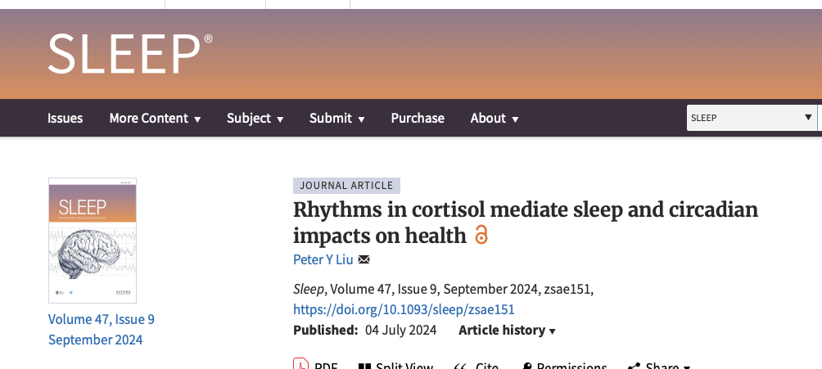
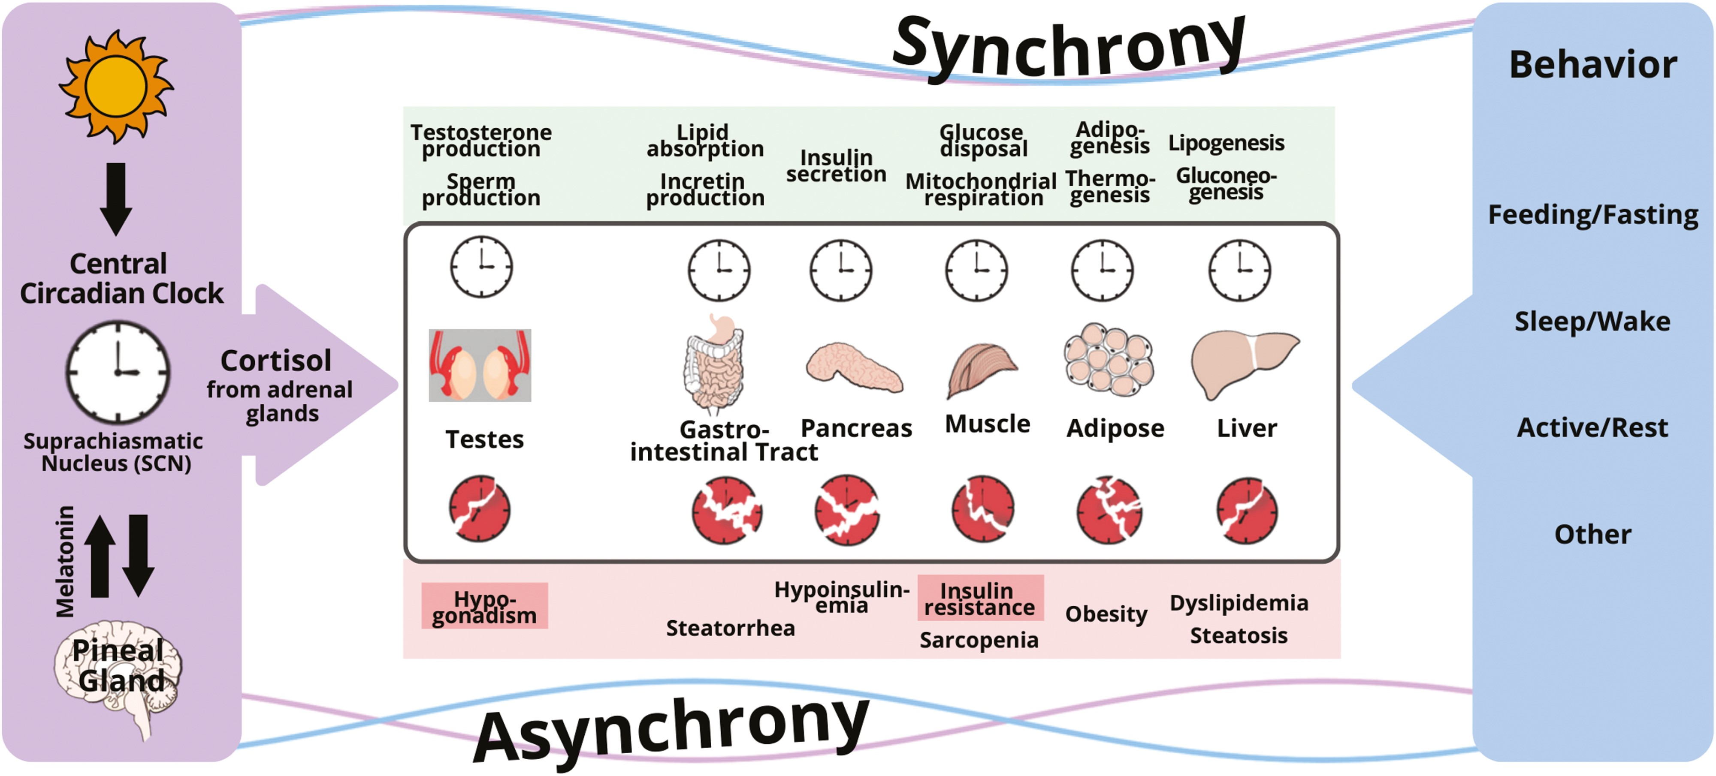

Notes:
Figure 1. Conceptual framework for the disruption of the circadian regulation of clocks in peripheral organs by conflicting signaling from the central circadian clock and behavioral cycles (feeding–fasting, sleep–wake, and activity–rest). The central timing signal is cortisol for Leydig cells in the testes, and peripheral organs responsible for whole-body metabolism (gut, pancreas, muscle, fat, and liver), whereas peripheral signals governed by behavior include glucagon, insulin, other hormones, metabolites, and others. When peripheral clocks receive conflicting signals, clocks are disrupted and desynchrony occurs, which leads to insulin resistance and other pathologies.
Unless provided in the caption above, the following copyright applies to the content of this slide: © The Author(s) 2024. Published by Oxford University Press on behalf of Sleep Research Society.This is an Open Access article distributed under the terms of the Creative Commons Attribution License (https://creativecommons.org/licenses/by/4.0/), which permits unrestricted reuse, distribution, and reproduction in any medium, provided the original work is properly cited.

Slide 7

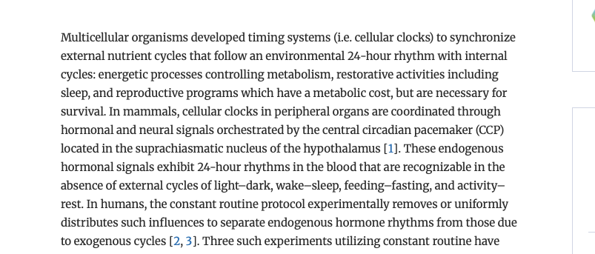
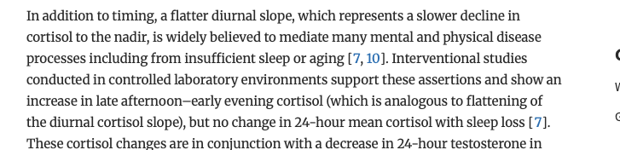
Notes:
Figure 1. Conceptual framework for the disruption of the circadian regulation of clocks in peripheral organs by conflicting signaling from the central circadian clock and behavioral cycles (feeding–fasting, sleep–wake, and activity–rest). The central timing signal is cortisol for Leydig cells in the testes, and peripheral organs responsible for whole-body metabolism (gut, pancreas, muscle, fat, and liver), whereas peripheral signals governed by behavior include glucagon, insulin, other hormones, metabolites, and others. When peripheral clocks receive conflicting signals, clocks are disrupted and desynchrony occurs, which leads to insulin resistance and other pathologies.
Unless provided in the caption above, the following copyright applies to the content of this slide: © The Author(s) 2024. Published by Oxford University Press on behalf of Sleep Research Society.This is an Open Access article distributed under the terms of the Creative Commons Attribution License (https://creativecommons.org/licenses/by/4.0/), which permits unrestricted reuse, distribution, and reproduction in any medium, provided the original work is properly cited.

Slide 8
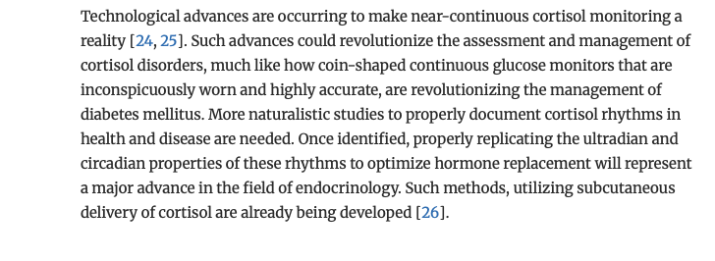
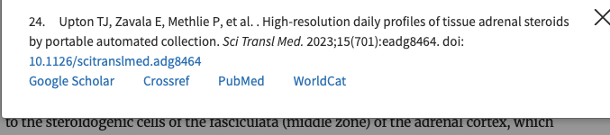

Notes:
Figure 1. Conceptual framework for the disruption of the circadian regulation of clocks in peripheral organs by conflicting signaling from the central circadian clock and behavioral cycles (feeding–fasting, sleep–wake, and activity–rest). The central timing signal is cortisol for Leydig cells in the testes, and peripheral organs responsible for whole-body metabolism (gut, pancreas, muscle, fat, and liver), whereas peripheral signals governed by behavior include glucagon, insulin, other hormones, metabolites, and others. When peripheral clocks receive conflicting signals, clocks are disrupted and desynchrony occurs, which leads to insulin resistance and other pathologies.
Unless provided in the caption above, the following copyright applies to the content of this slide: © The Author(s) 2024. Published by Oxford University Press on behalf of Sleep Research Society.This is an Open Access article distributed under the terms of the Creative Commons Attribution License (https://creativecommons.org/licenses/by/4.0/), which permits unrestricted reuse, distribution, and reproduction in any medium, provided the original work is properly cited.

Slide 9

1 in 3 adults have cortisol dysregulation
WHY TRACK CORTISOL?
Master controller hormone—touches nearly every system in the body
Sets your morning “wake-up” signal and keeps energy steady through the day
Modulates stress response so you can stay calm and focused under pressure
Natural anti-inflammatory that supports immunity and healing
Key to workout recovery—guides muscle repair and adaptation
Influences how we age, from skin quality to metabolic health
Concern is a blunted circadian rhythm with lower peak values and higher nighttime values

Slide 10
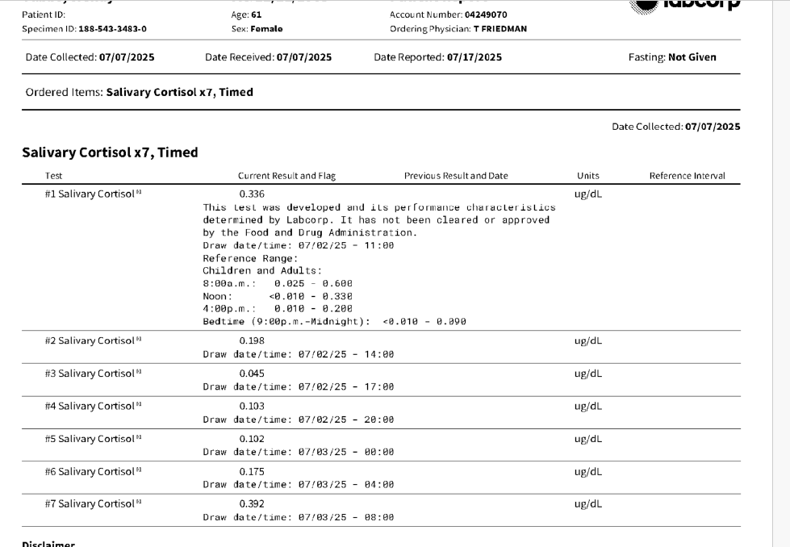
Sample salivary day curve at Labcorp

Slide 11
What happens if your Cortisol Circadian Rhythm is off?
1. Sleep Disruptions:
Insomnia and Nighttime Awakenings:
Cortisol normally rises in the early morning to prepare you for wakefulness. If it's elevated at night due to a disrupted rhythm, it can interfere with sleep onset and cause you to wake up during the night.
Daytime Sleepiness:
Conversely, if cortisol levels are not high enough in the morning, you may experience excessive daytime sleepiness and fatigue.
2. Mood and Cognitive Issues:
Mood Swings:
Fluctuations in cortisol can lead to anxiety, depression, and irritability.
Cognitive Problems:
Cortisol affects brain function, including memory and focus. Imbalances can lead to difficulties with concentration and decision-making.
3. Metabolic and Weight Issues:
Weight Gain:
Cortisol affects metabolism and appetite. A disrupted rhythm can lead to increased appetite, fat storage, and weight gain, particularly around the abdomen.
Metabolic Problems:
Long-term disruptions can contribute to metabolic disorders like insulin resistance and increased risk of type 2 diabetes.

Slide 12
What happens if your Cortisol Circadian Rhythm is off?
4. Immune System and Other Health Problems:
Compromised Immune Function:
Cortisol plays a role in regulating the immune response. Imbalances can weaken the immune system, making you more susceptible to infections and illnesses.
Other Health Risks:
Disrupted cortisol rhythms have also been linked to cardiovascular problems, inflammation, and other health issues.

Slide 13
What happens if your Cortisol Circadian Rhythm is off and your nighttime cortisols are high?
Make sure you don’t have Cushing’s
Check for menopause
Don’t eat with 3 hrs of bedtime.
Morning sunlight, avoid evening sunlight
Morning exercise.
Avoid night time electronics

Slide 14
Alternative Options
Supplements
  GABA with L-Theanine
  Melatonin
  Valerian
  5-HTP
  CBD oil
  Lavender and Chamomile
Light Control
  Avoid cell phones, tablets and TV's
  Blue-light blocking glasses

Slide 15
Hormone Treatments
Estrogen/Progesterone for menopause
Vitamin E 400 iU a day helps with hot flashes
Phosphotidyl Serine (Seriphos) 300 mg an hour before bedtime lowers night time cortisol
DHEA-25 mg a day in women and 50 mg a day in men at night, counteracts cortisol
Gingko bilabo 120 mg twice a day lowers cortisol
Ashwaganda may be helpful
Serovital raises growth hormone

Slide 16
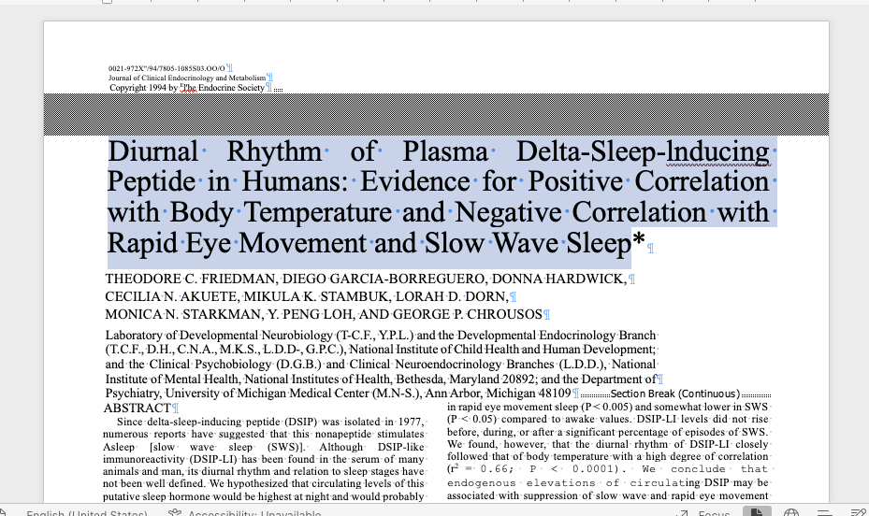
Dr.Friedman’s publication in 1994

Slide 17
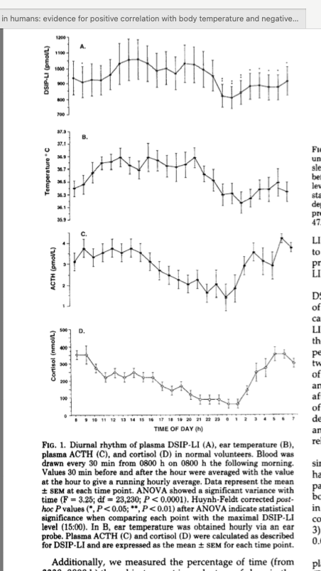
Dr. Friedman’s publication in 1994

Slide 18
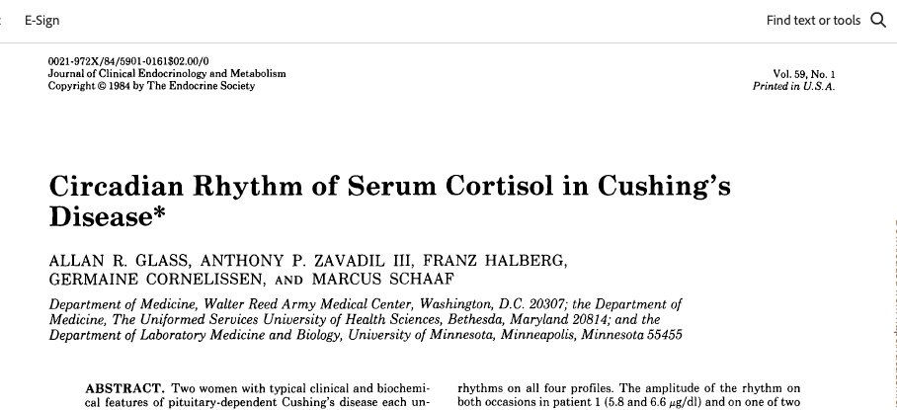
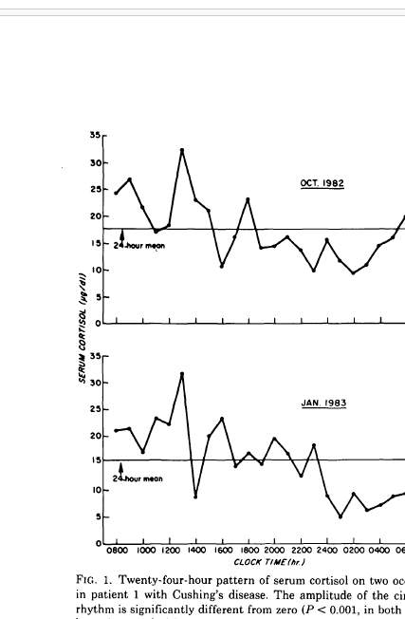
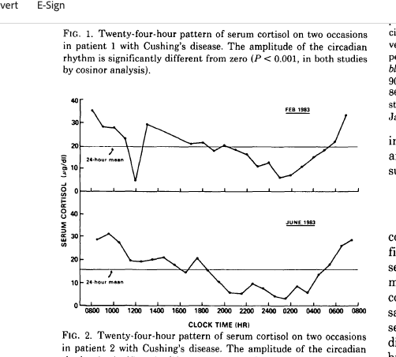
Serum Cortisol in Cushing’s

Slide 19
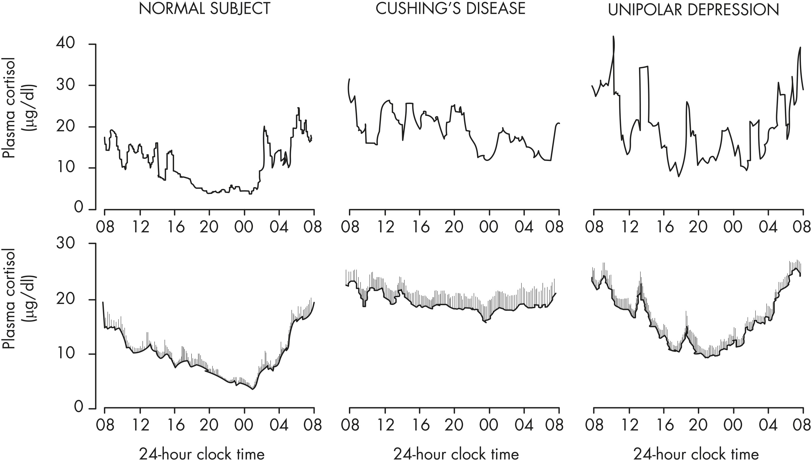

Figure 13. Comparison of the 24-hour profile of plasma cortisol in normal nonobese adults (left), patients with ...
Notes:
Figure 13. Comparison of the 24-hour profile of plasma cortisol in normal nonobese adults (left), patients with pituitary-dependent Cushing’s disease (center), and patients with untreated major depression of the unipolar subtype (right). For each condition, a representative example is shown in the top panel and mean (+ SEM) profiles from eight to 10 subjects are shown in the bottom panel. [Redrawn from E. Van Cauter: Physiology and pathology of circadian rhythms. In: Edwards CW, Lincoln DW, eds. Recent Advances in Endocrinology and Metabolism. Vol. 3. Churchill Livingstone, Edinburgh, UK, 1989:109–134 (435), with permission.]
Unless provided in the caption above, the following copyright applies to the content of this slide: Copyright © 2017 Endocrine SocietyThis article has been published under the terms of the Creative Commons Attribution License (CC BY; https://creativecommons.org/licenses/by/4.0/).

Slide 20
How to Diagnose Cushing's Syndrome?
Careful history and physical
Change in weight and body habitus
Look at old pictures
Not all patients have all signs and symptoms, especially “early” and “periodic” patients.
Most published data compared severe Cushing's with normals.
Important to diagnose early before devastating sequelae develop.
Initial diagnosis most difficult aspect of Cushing's syndrome.
“Gestalt” with as much information as possible
Episodic Cushing's common, so one positive test may be worth more than 10 negative tests

Slide 21
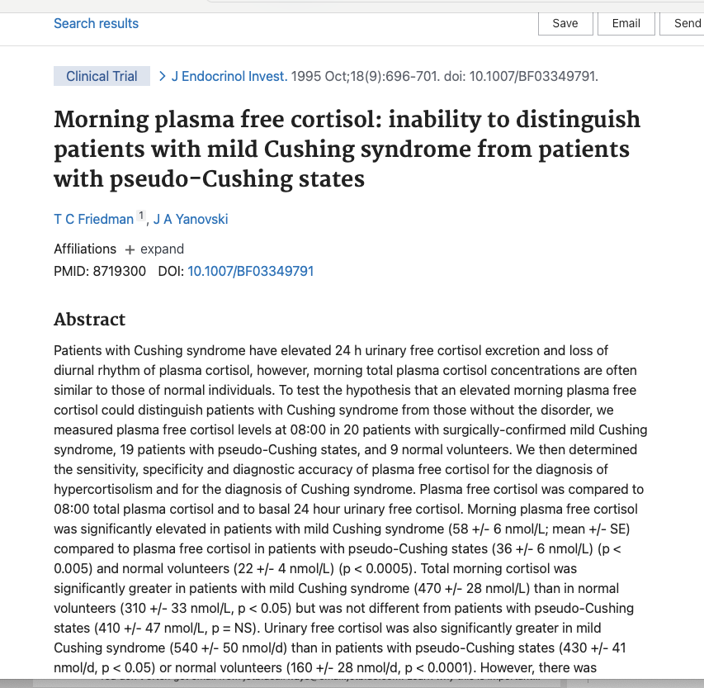
The problems with all types of Endogenous Cushing's Syndrome is abnormal circadian rhythm
Cushing’s syndrome is due to inappropriately high cortisol at night
Morning free and total cortisol are similar between those with Cushing’s syndrome, pseudo-Cushings and normal.
Cushing’s syndrome is due to inappropriately high cortisol at night

Slide 22
Episodic, Cyclical, Periodic
Periodic and cyclical refer to changes in cortisol levels that occur on a regular predictable basis.
Episodic refers to high cortisol levels that are random.
Most of my patients are episodic.

Slide 23
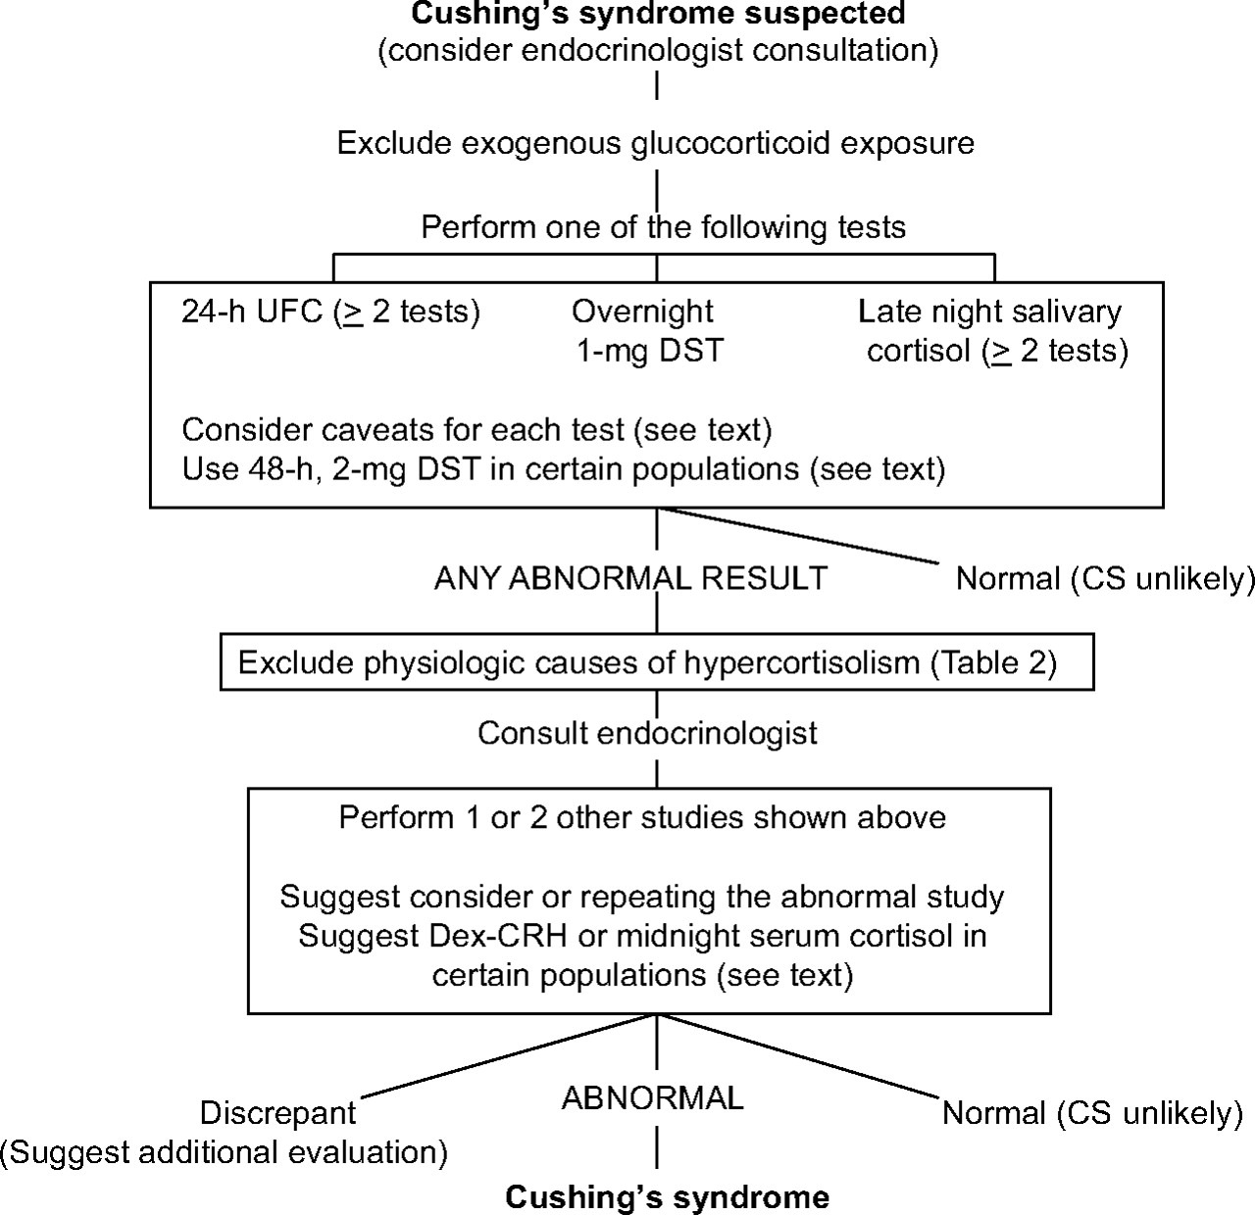
FIG. 1. Algorithm for testing patients suspected of having Cushing's syndrome (CS)
J Clin Endocrinol Metab. May 2008, 93(5):1526–1540

Slide 24
AM I HIGH?
Every patient is unique in how their bodies respond to fluctuations in cortisol.
A “high” period has some telltale signs for most sufferers.
However, in some cases, what patients have labeled as their “high” could be their “low” phase.
  Nausea
  Weight loss
  Depression
  Lethargy
  Extreme fatigue
  Muscle/joint pain

Slide 25
AM I HIGH?
Wired at night
Weight gain
Acne
Anxiety increase/mood swings/irritability
Euphoria/more energy than usual
Very few aches and pains
Tasks seem easier
Insomnia/inability to stay or fall asleep.
Energy levels that “perk up” after sunset.
“Speed talking” – mind is going faster than your brain can process the thoughts to speak them.
Water weight gain – edema
High blood pressure
High blood sugar if patient has diabetes

Slide 26
Episodic Cushing’s is common
Friedman, T.C., Ghods, D.E., Zachery, L., Shayesteh, N., Seasholtz, S., Zuckerbraun, E., Shahinian, H.K., Lee, M.L., McCutcheon, I.E. (2010) High Prevalence of Normal Tests Assessing Hypercortisolism in Subjects with Mild and Episodic Cushing’s Syndrome Suggests that the Paradigm for Diagnosis and Exclusion of Cushing’s Syndrome Requires Multiple Testing. Hormone and Metabolic Research. 42: 874-881.
We found that 65 of the 66 patients with Cushing’s syndrome had at least one normal test of cortisol status and most patients had several normal tests.
The probability of having Cushing’s syndrome when one test was negative was 92% for 2300 h salivary cortisol, 88% for 24-h UFC, 86% for 24-h 17OHS and 54% for night-time plasma cortisol.

Slide 27
Salivary cortisols in episodic Cushing’s
Convenient for periodic patients as the patient can collect many samples easily
Try to have the patient collect when high symptoms
I start with 4 at 11 PM
Patients can tests between 11 PM and 12:30 AM when symptoms of highs
Can complement UFC for picking up mild cases.
Can do salivary day curve

Slide 28
Beachboys: Wouldn’t it be nice:
To be able test your cortisol to see if you are in a high and get your results back right away?
Point of care testing: blood glucose monitoring, home pregnancy testing
What if you had the diagnostic resources of a clinical laboratory and the expertise of a medical specialist right on your smartphone?
In 2017 I talked about a company that proposed that
http://i-calq.com/ that has come up with a a salivary cortisol kit for your smartphone.
Website is still there, but I don’t think they are in business
I think Eli Health is the real deal

Slide 29


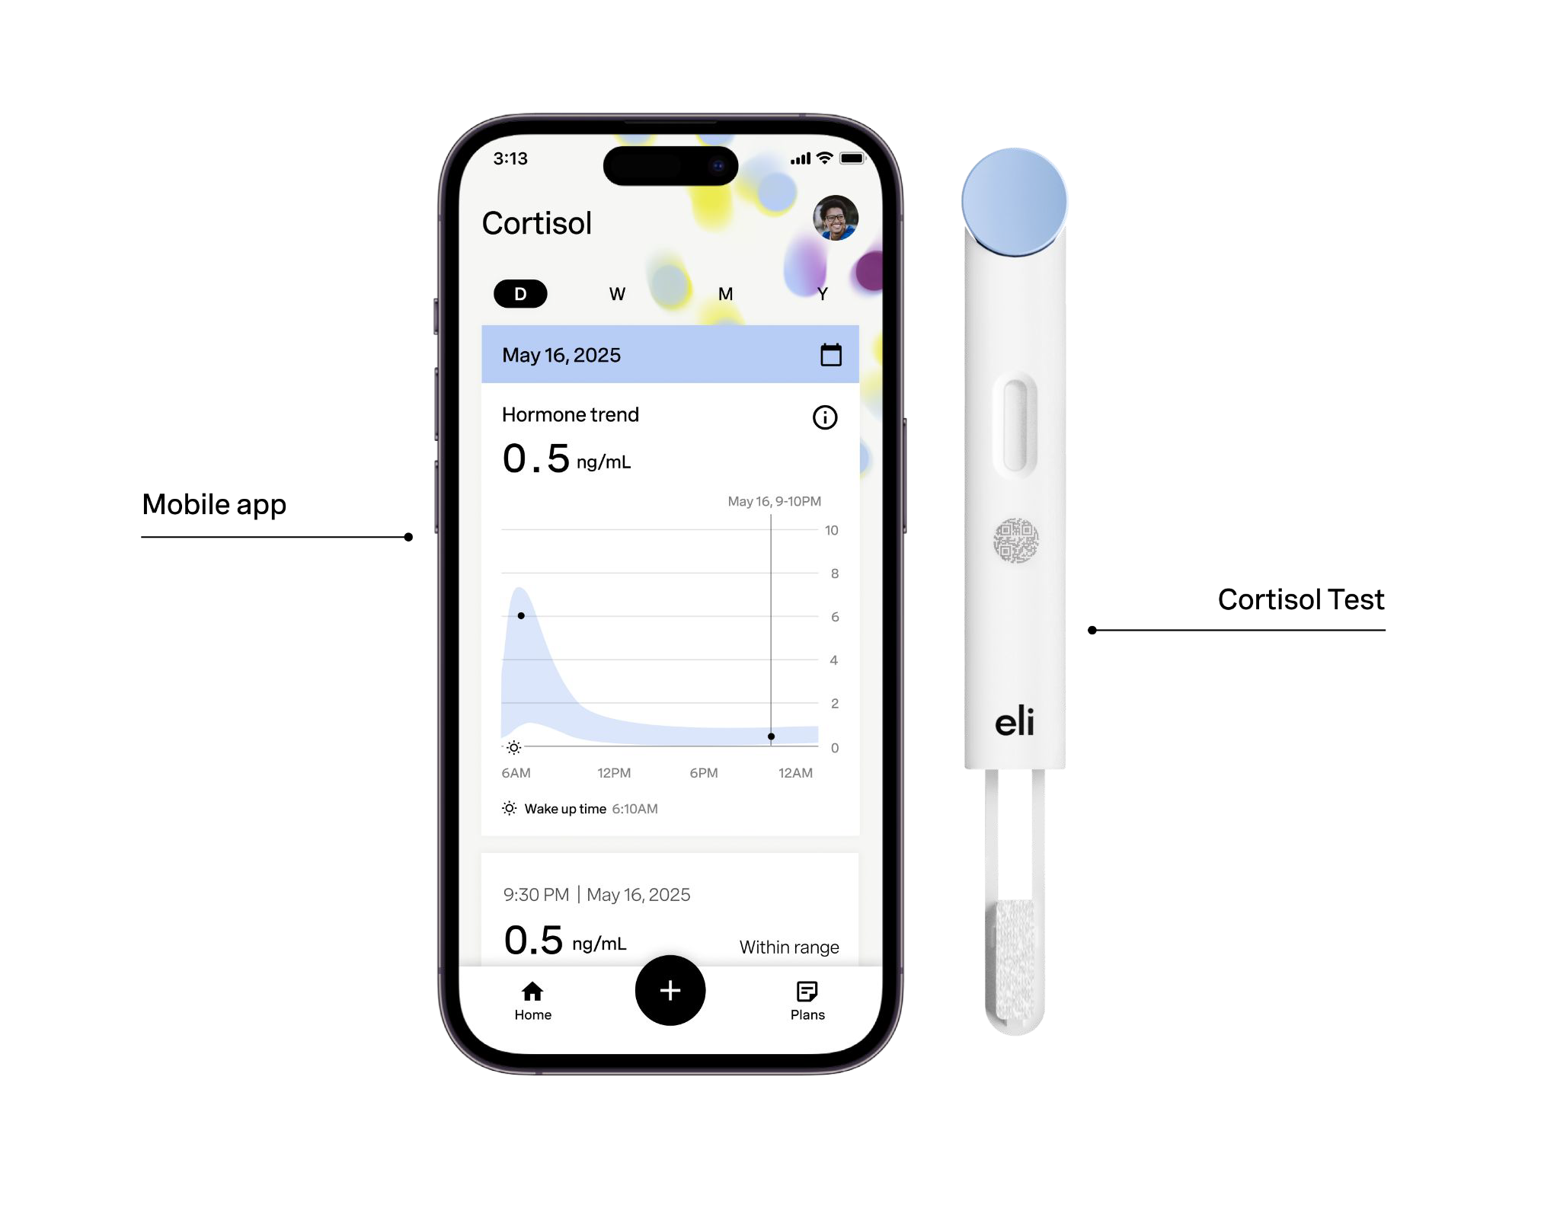
Eli Cortisol Hormometer TM
ELI CORTISOL HORMOMETERTM

Slide 30
How to use
HormometerTM

Slide 31

HOW TO USE HORMOMETERTM
Step 1: Download the Eli App.
Scan me!

Slide 32
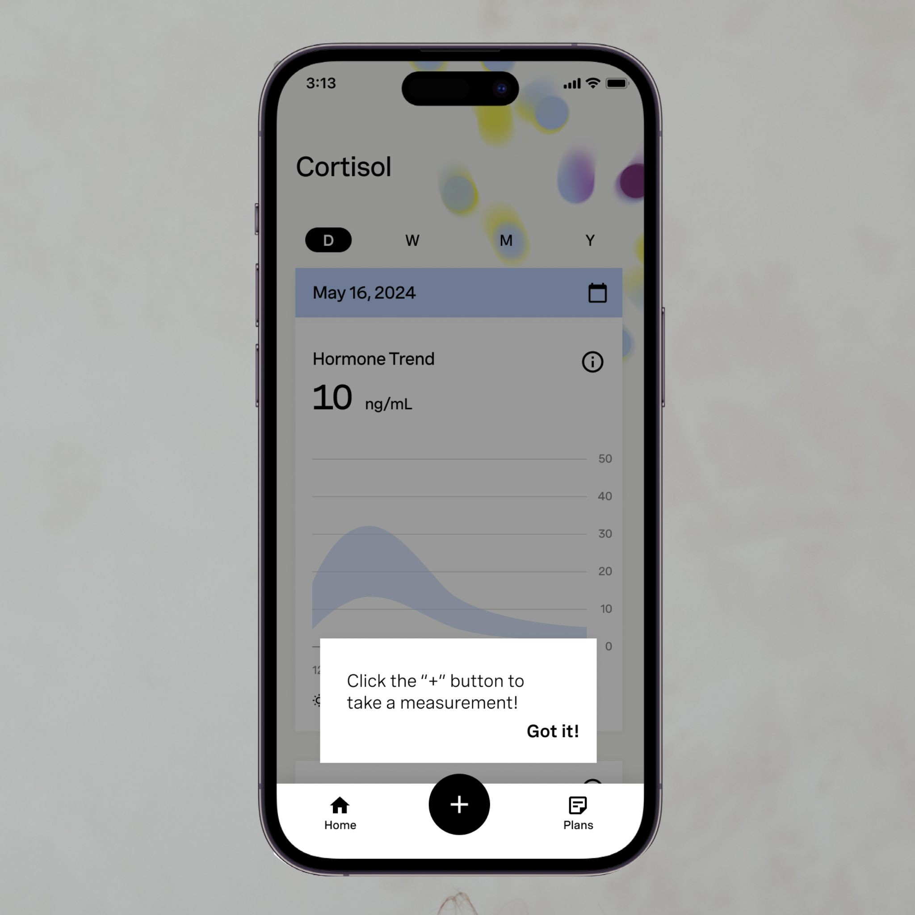
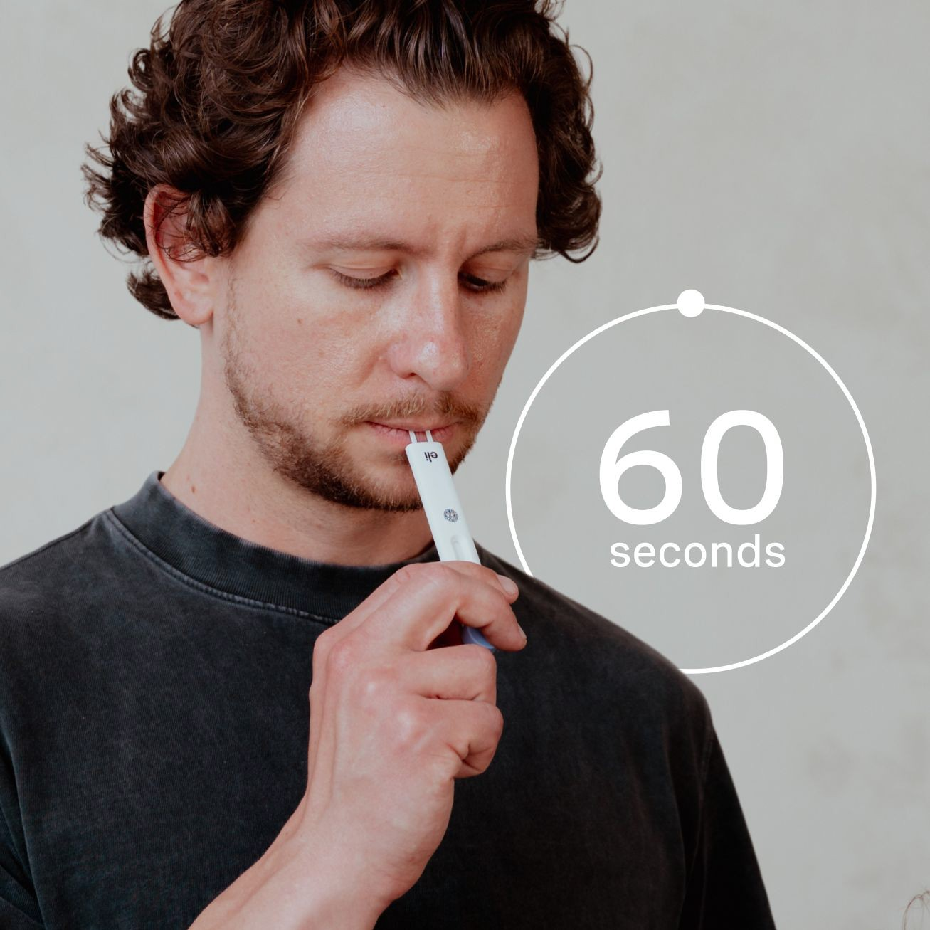
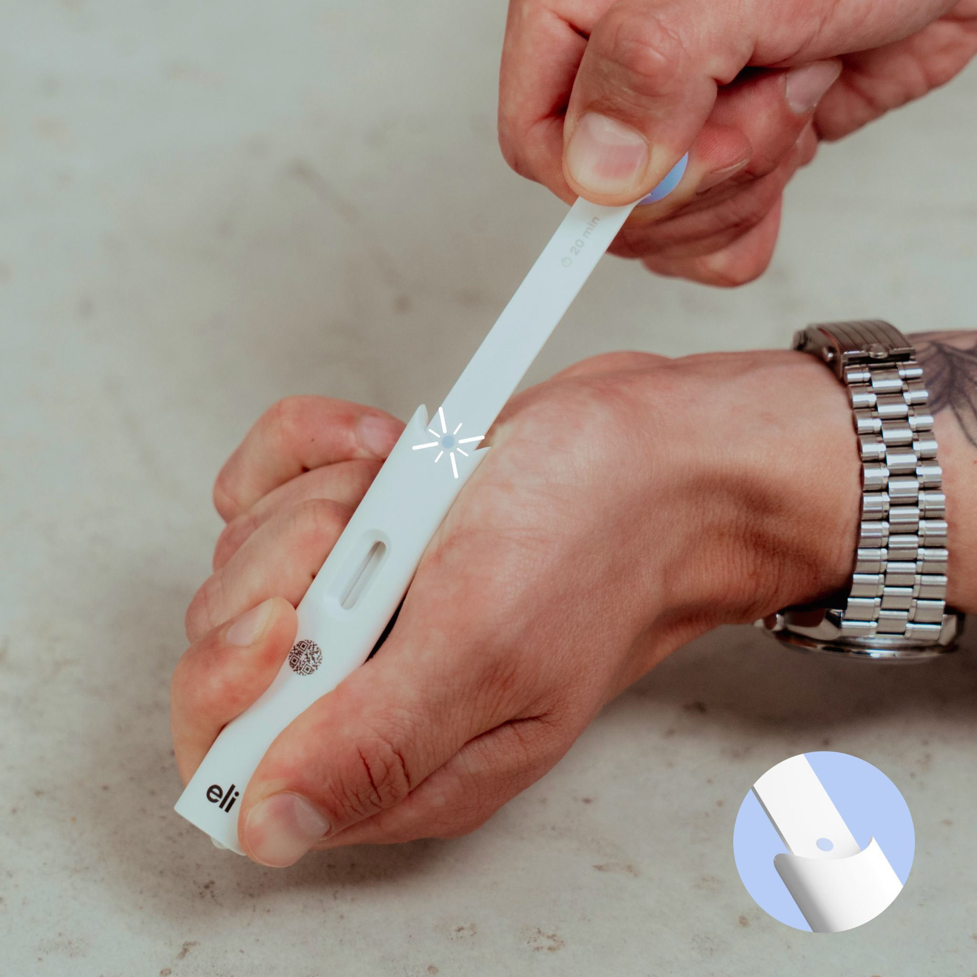
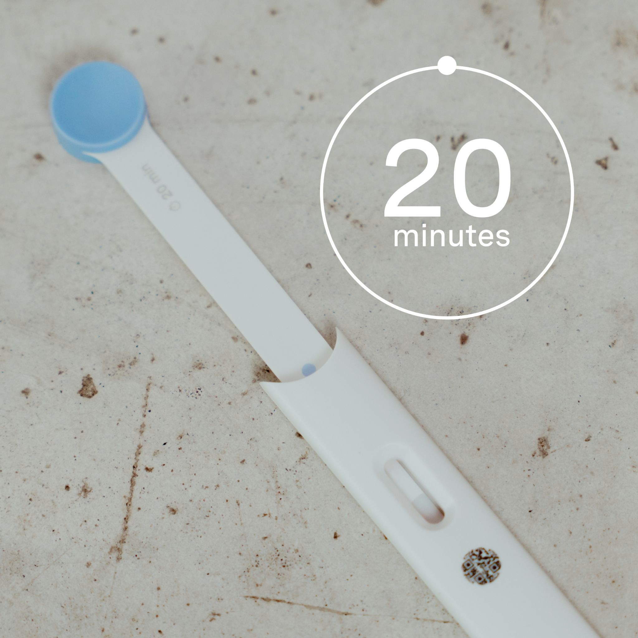
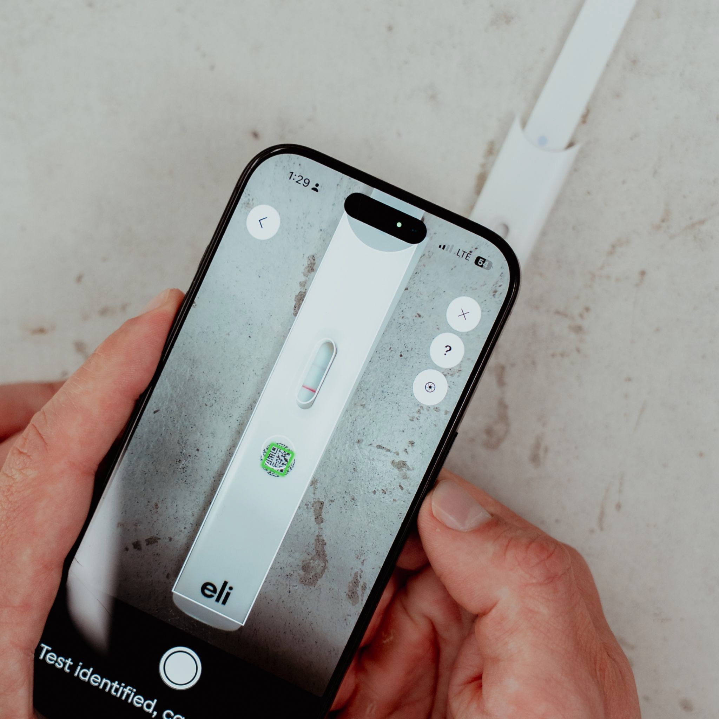
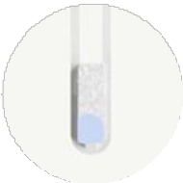

How to test
HOW TO USE HORMOMETERTM
It all starts with a “+”
Collect saliva
Activate the test
Wait 20 minutes
Capture your results
Drool & pull
The winning combo
The more saliva the better. The pad should be fully soaked to ensure it is flowing through the assay.
Once pulled, you should see fully a blue dot. Don't stop at the first sign of resistance.

Slide 33
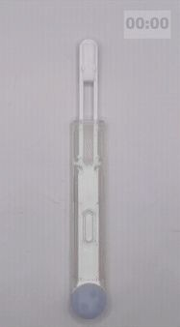
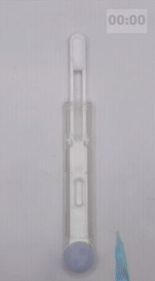
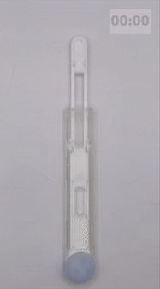
Behind the Scenes
HOW TO USE HORMOMETERTM
Example with enough saliva and pull
No lines, cause #1: insufficient saliva
No lines, cause #2: insufficient pulling
There is enough saliva, and the pad is fully pulled. The saliva flow and lines develop.
There is saliva, but not enough to be released despite a full pull. As a result, no flow.
There is enough saliva. The pad is not fully pulled, preventing fluid release. As a result, no flow.

Slide 34
Why track
Cortisol?

Slide 35
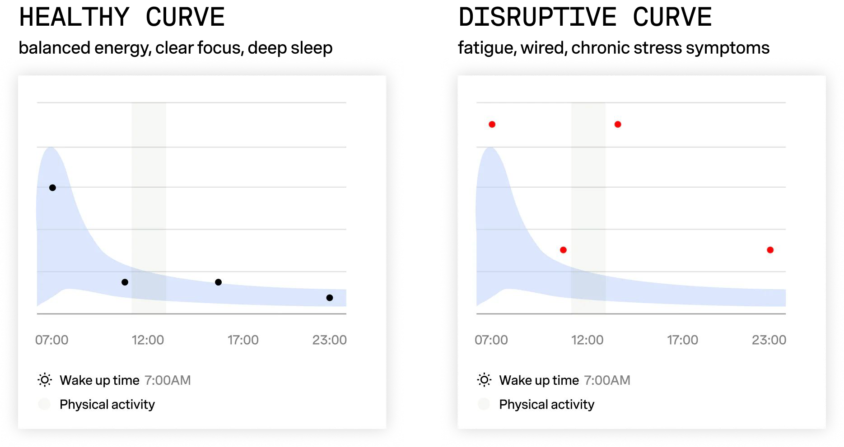
WHY TRACK CORTISOL?
When the rhythm breaks, you can rebuild it

Slide 36
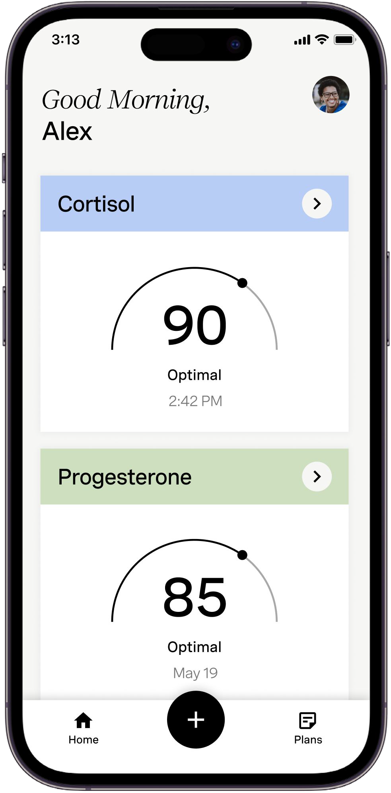
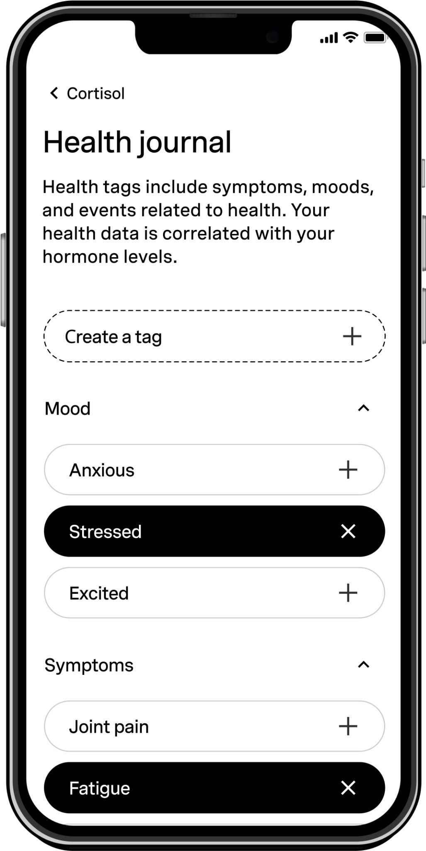
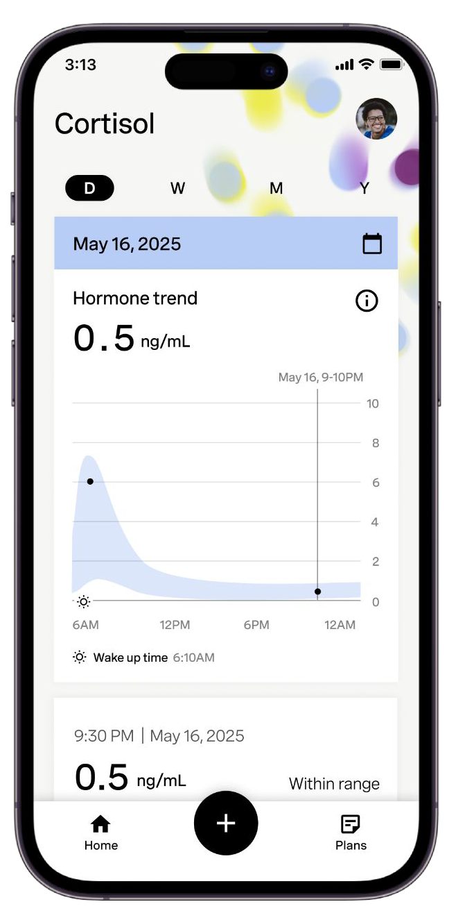
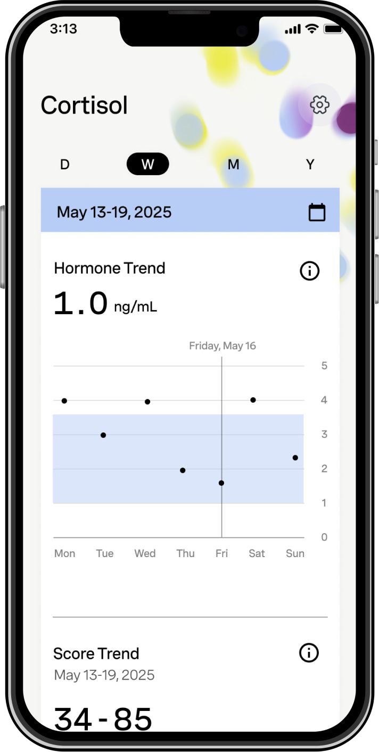
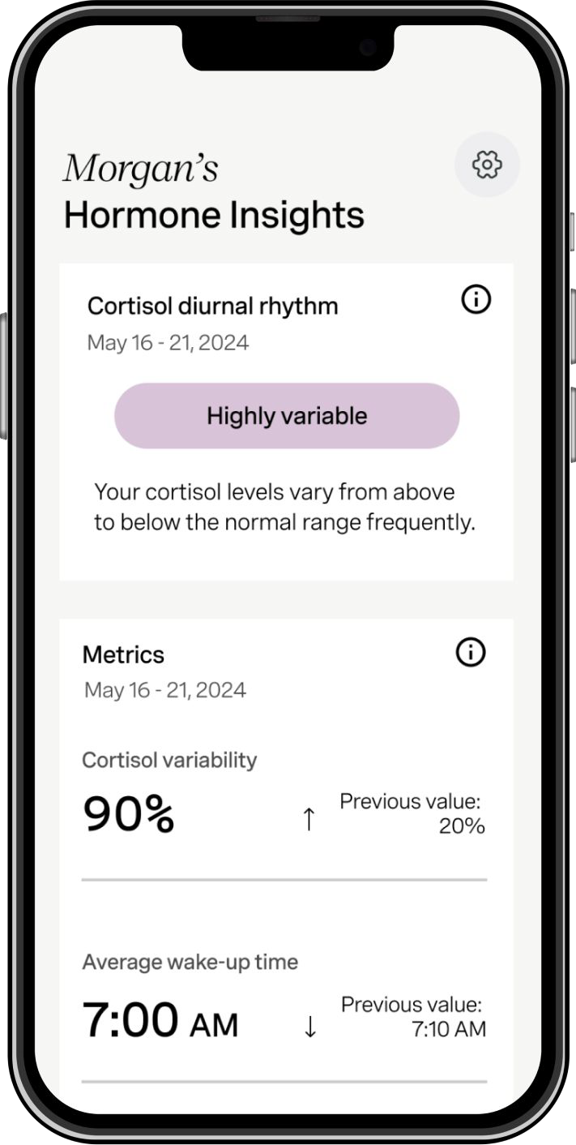
After your ﬁrst test
RESULTS INTERPRETATIONS
After several tests
Cortisol Score
Lifestyle Log Prompt
Diurnal Rhythm
Trend Graphs
Personalized Insights

Slide 37
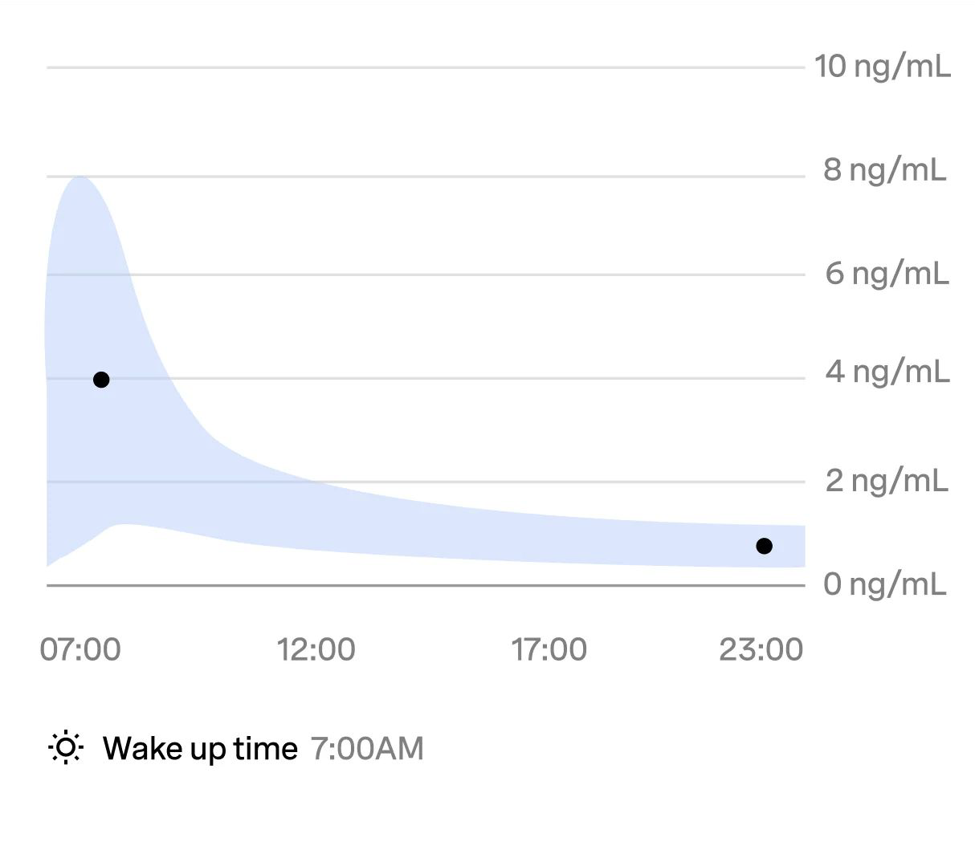
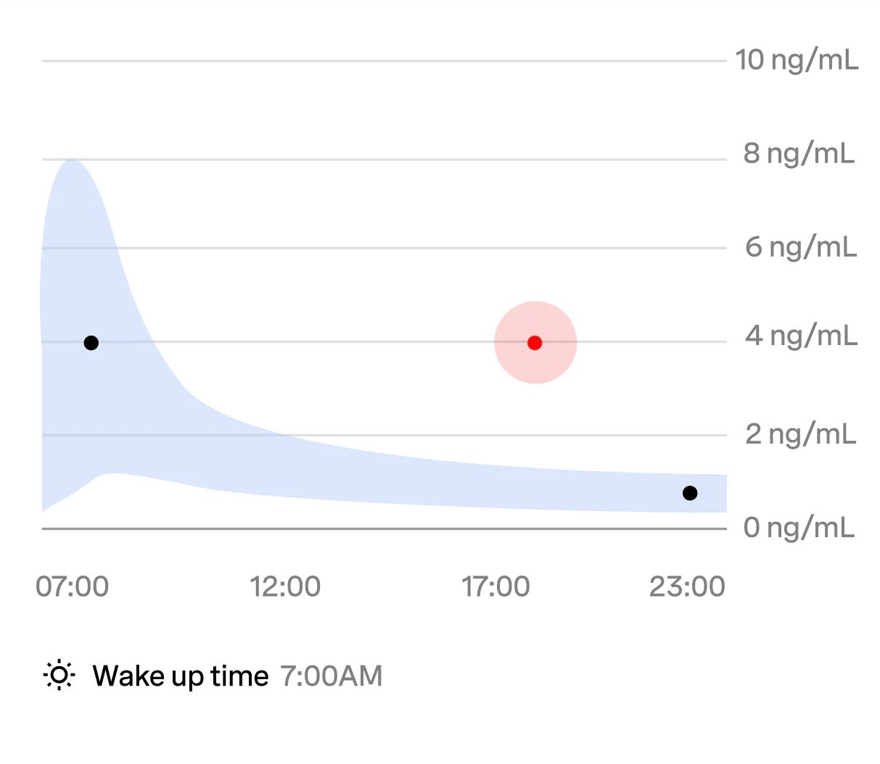
WHEN TO TEST
1 Daily baseline = Diurnal Rhythm
Morning measurement:
the peak of your day
30 minutes after waking
Evening measurement:
low levels to wind down
1–2 hours before bedtime
2 Spot testing
After workouts
Following stressful events
During relaxation
When sleep is disrupted
3
Deep dive
Test multiple times in one day to map your full diurnal rhythm.
Compare weekdays vs. weekends to highlight how routine impacts recovery.
Experiment with actions to explore how it affects your response.

Slide 38


Join us
in shaping the future of anytime, anywhere testing
https://eli.health

Slide 39
How can Eli Health Salivary Cortisol be used in conjunction with commercial laboratory salivary measurements?
Eli Health Products are not intended to diagnose, cure, or manage any disease or condition, including Cushing’s. Its role is solely as a wellness tool to support lifestyle management.
Purchase Eli Health salivary cortisol kits and use when you think you are in a high between 11 PM and 12:30 AM
Determine what symptoms correspond to highs in you as a wellness tool.
If you get a high on the Eli Health, then use Labcorp or Quest salivary cortisols
A high on Eli Health by itself doesn’t count and can’t be used to diagnose Cushings’s disease.
We hope that Dr. Friedman’s patients will get a discount with Eli Health and that we will start a study to correlate Eli Health salivary cortisols with commercial salivary cortisols

Slide 40
Why is Dr. Friedman recommending salivary day curves to diagnose and monitor treatment for Cushings?
8 point salivary cortisol at Labcorp or Quest
8 AM, 11 AM, 2 PM, 5 PM, 8 PM, midnight, 2 AM and 4 AM
Can show a pattern of cortisol Circadian rhythm
Can guide treatment-when to give cortisol lowering agents
I would still require high salivaries between 11 PM and 12:30 AM, but may use this in the future

Slide 41
How does the Cortisol Circadian Rhythm affect treatment for Cushing’s?
Cushing’s syndrome is due to inappropriately high cortisol at night
Morning cortisols are normal (occasionally low) in Cushings
Treatments should address high nighttime cortisol by giving short-acting treatments at night
Ketoconazole 200 mg at 8 and 10 PM
Or Isturisa 1-2 mg 1 hr before bedtime
Or both
Avoid morning dosing
Long half-life treatments like Korlym or Pasireotide are unlikely to work except in more severe Cushings

Slide 42
How does the Cortisol Circadian Rhythm affect treatment for Cushing’s?
Can monitor with salivary day curve at commercial labs
And compare to pretreatment salivary day curve
Some people may have an afternoon rise in cortisol and may need medical treatment earlier in the afternoon (2 PM)
Pituitary surgery should correct abnormal circadian rhythm
For cortisol replacement, most hydrocortisone should be given in the morning, but some throughout the day including at bedtime

Slide 43
Visit goodhormonehealth.com
For more information or to schedule an appointment.
Talk will posted in a few days on my Website and YouTube
https://www.facebook.com/goodhormonehealth
It will also be on Dr. Friedman’s podcast channel- available on spotify, apple podcasts, iheartradio, podcastidex, and amazon music
mail@goodhormonehealth.com
Special thanks to Zoya Brar from Eli Health

