Slide 1
Webinar on the posterior pituitary hormones, AVP and oxytocin
GoodHormoneHealth Webinar
August 26, 2018
I will mute everyone’s phones, please use the chat button

Slide 2
Posterior pituitary

Slide 3
Posterior pituitary
We routinely measure and replace most pituitary hormones
Exceptions
AVP
Oxytocin
Β-endorphin
Prolactin
MSH

Slide 4
Posterior pituitary

Slide 5
Actions of Vasopressin

Slide 6
Actions of Vasopressin

Slide 7
Brain-Hypothalamic-
Pituitary-Adrenal-AXIS
Site
Catecholamines,
Brain
Cytokines, Growth
-
factors
CRH
-
-
Hypothalamus
AVP
Pituitary
-
ACTH
Adrenal
Cortisol

Slide 8
Vasopressin Receptors

Slide 9
Vasopressin and Osmolality

Slide 10
Actions of Vasopressin

Slide 11
Diabetes Insipidus (AVP deficiency)
Excessive urination and thirst
Mild cases are probably common and worthy of treatment
Chronic polyuria may lead to bladder/kidney problems
How many times are you waking up at night?

Slide 12
Diabetes Insipidus (2)
I screen by having the patient collect urine for 24 hours and measure the volume.
Greater than 3 L indicates diabetes insipidus is possible
I confirm with a 12 hour fast (no water!) and collect an 8 AM serum and urine osmolality.
DI-High serum osmolality (>300 mOsm/kg), low urine osmolality (<500 mOsm/kg) and low AVP < 1 pg/mL).
Formal water deprivation test not needed.
It is possible patients can have vasopressin deficiency manifesting as other symptoms besides diabetes insipidus

Slide 13
Diabetes Insipidus (3)
DDAVP pills are probably the best; most Endocrinologists still recommend nasal puffs.
Take most of the dose at night to prevent waking up at night.
Can take a second dose in the AM
Should have a period of “break-through” urination next day.
Treatment is pretty benign.

Slide 14
Oxytocin

Slide 15
Oxytocin
“love hormone”
“social hormone”,
“cuddle hormone”,
“happy hormone”

Slide 16
Oxytocin
Oxytocin is made by the posterior pituitary like AVP.
Only prominent pituitary hormone not tested or replaced
Patients with more complete hypopituitarism are thought to be more likely to have oxytocin deficiency.
2015 Endocrine Society abstract showed oxytocin gave weight loss in men

Slide 17
The symptoms and diseases related to oxytocin deficiency
Menopause & Surgical Menopause
Prolonged Stressful Situations
Hypothyroidism
Depression
AIDS
CMV infection
Multiple Sclerosis
Fibromyalgia
Chronic Opioid Use
Parkinson’s Disease
Prader Willi Syndrome
Feelings of Loneliness
Anxiety Disorders
Schizophrenia
Autism

Slide 18
Potential benefits of oxytocin
Labor and delivery.
Milk production
Bonding, especially in females but possibly also in males.
Help control pain,
Help with intimacy (more open to intimacy)
Achieving orgasm
Issues of trust.
Energy and confidence
Abdominal pain and other symptoms of GI discomfort.
Preventing social withdrawal
Stimulates stem cells in bone marrow to create new bone

Slide 19
Breast implants and oxytocin
Breast implants are concerning because they damage the connection between the nipples and the brain and can lead to decreased oxytocin making abilities.

Slide 20
Oxytocin’s inhibitory effect on food intake is stronger in obese than normal-weight men Thienal et al. International Journal of Obesity 2016
Oxytocin (24 IU) via the intranasal route was given to 18 young obese men with the results in a group of 20 normal-weight men.
Oxytocin markedly reduced hunger-driven food intake in the fasted state in obese but not in normal-weight men
Oxytocin led to a reduction in snack consumption in both groups, while energy expenditure remained generally unaffected.
Hypothalamic-pituitary-adrenal axis secretion and the postprandial rise in plasma glucose were blunted by oxytocin in both groups.

Slide 21
Oxytocin reduces caloric intake in men Lawson et al. Obesity 2015
A randomized, placebo-controlled crossover study of single-dose intranasal oxytocin (24 IU) in 25 fasting healthy men was performed.
Oxytocin reduced caloric intake with a preferential effect on fat intake and increased levels of the anorexigenic hormone cholecystokinin without affecting appetite or other appetite-regulating hormones.
Oxytocin reduced caloric intake by 122 cal/meal, which if sustained, would lead to a 17 kg weight loss/year.

Slide 22
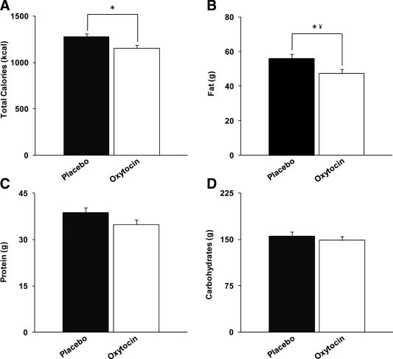
Oxytocin reduces caloric intake in men
Obesity Volume 23, Issue 5, pages 950-956, 10 APR 2015 DOI: 10.1002/oby.21069 http://onlinelibrary.wiley.com/doi/10.1002/oby.21069/full#oby21069-fig-0002
Notes:
Compared to placebo, oxytocin reduced (A) total caloric intake by 122 ± 51 kcal, (B) fat intake by 8.7 ± 3.8 g, (C) protein intake by 3.9 ± 2.2 g, and (D) carbohydrate content by 7.2 ± 9.4 g. *P = 0.03. ¥No longer significant after controlling for multiple comparisons.
IF THIS IMAGE HAS BEEN PROVIDED BY OR IS OWNED BY A THIRD PARTY, AS INDICATED IN THE CAPTION LINE, THEN FURTHER PERMISSION MAY BE NEEDED BEFORE ANY FURTHER USE. PLEASE CONTACT WILEY'S PERMISSIONS DEPARTMENT ON PERMISSIONS@WILEY.COM OR USE THE RIGHTSLINK SERVICE BY CLICKING ON THE 'REQUEST PERMISSIONS' LINK ACCOMPANYING THIS ARTICLE. WILEY OR AUTHOR OWNED IMAGES MAY BE USED FOR NON-COMMERCIAL PURPOSES, SUBJECT TO PROPER CITATION OF THE ARTICLE, AUTHOR, AND PUBLISHER.

Slide 23
Oxytocin is beneficial in young children with Prader-Willi syndrome
Prader–Willi syndrome (PWS) is known for hyperphagia with impaired satiety and a specific behavioural phenotype with stubbornness, temper tantrums, manipulative and controlling behaviour and obsessive–compulsive features.
PWS is associated with hypothalamic and oxytocinergic dysfunction.
Crossover intervention with twice daily intranasal oxytocin (dose range 24-48 IU/day) and placebo administration, both during 4 weeks, in 25 children with PWS (aged 6 to 14 years).
Kuppens RJ, et al. Clin Endocrinol. 2016;doi:10.1111/cen.13169.

Slide 24
Oxytocin is beneficial in young children with Prader-Willi syndrome (2)
In the total group, no significant effects of oxytocin on social behavior or hyperphagia were found.
In the 17 children younger than 11 years, parents reported significantly less anger, sadness, conflicts and food-related behavior, and improvement of social behavior during oxytocin treatment compared with placebo.
Conclusion was that intranasal oxytocin administration has beneficial effects on social behavior and food-related behavior in children with PWS younger than 11 years of age, but not in those older than 11 years of age.

Slide 25
Oxytocin Interactions with Hormones
Oxytocin therapy decreases serum cortisol levels (Coiro V. Oxytocin Reduces Exercise-Induced ACTH and Cortisol Rise in Man. Acta Endocrinoligial (Copenh) 1988;119:405-412)
Many of my patients find that their cortisol requirements go up when started on oxytocin.
Some of the weight loss effects may be from lower cortisol
Oxytocin has been shown to support thyroid function by improving the import of iodine into thyroid cells (doubt clinically important).
In 2011, researchers published a paper in Menopause that found topical oxytocin therapy could treat vaginal atrophy.

Slide 26
Oxytocin and Naltrexone Successfully Treat Hypothalamic Obesity in a Boy Post-Craniopharyngioma Resection
The Journal of Clinical Endocrinology & Metabolism, Volume 103, Issue 2, 1 February 2018, Pages 370–375, https://doi.org/10.1210/jc.2017-02080
Eugenia Hsu about her son

Slide 27
Oxytocin and Naltrexone Successfully Treat Hypothalamic Obesity in a Boy Post-Craniopharyngioma Resection
Oxytocin (OT), a hypothalamic neuropeptide, has been shown to play a role in the regulation of energy balance and to have anorexigenic effects in animal studies.
Naltrexone (NAL), an opiate antagonist, has been shown to deter hedonic eating and to potentiate OT’s effects.

Slide 28
Oxytocin and Naltrexone Successfully Treat Hypothalamic Obesity in a Boy Post-Craniopharyngioma Resection
Oxytocin (OT), a hypothalamic neuropeptide, has been shown to play a role in the regulation of energy balance and to have anorexigenic effects in animal studies.
Naltrexone (NAL), an opiate antagonist, has been shown to deter hedonic eating and to potentiate OT’s effects.

Slide 29
Oxytocin and Naltrexone Successfully Treat Hypothalamic Obesity in a Boy Post-Craniopharyngioma Resection
13-year-old male with confirmed hypothalamic obesity and hyperphagia post-CP resection
Administration of intranasal OT for 10 weeks (phase 1)
Followed by a combination of intranasal OT and NAL for 38 weeks (phase 2)
Treatment resulted in 1) reduction in body mass index (BMI) z score from 1.77 to 1.49 over 10 weeks during phase 1;
2) reduction in BMI z score from 1.49 to 0.82 over 38 weeks during phase 2;
3) reduced hyperphagia during phases 1 and 2;
4) continued hedonic high-carbohydrate food-seeking in the absence of hunger during phases 1 and 2;
5) sustained weight reduction during decreased parental monitoring and free access to unlocked food in the home during the last 10 weeks of phase 2.

Slide 30
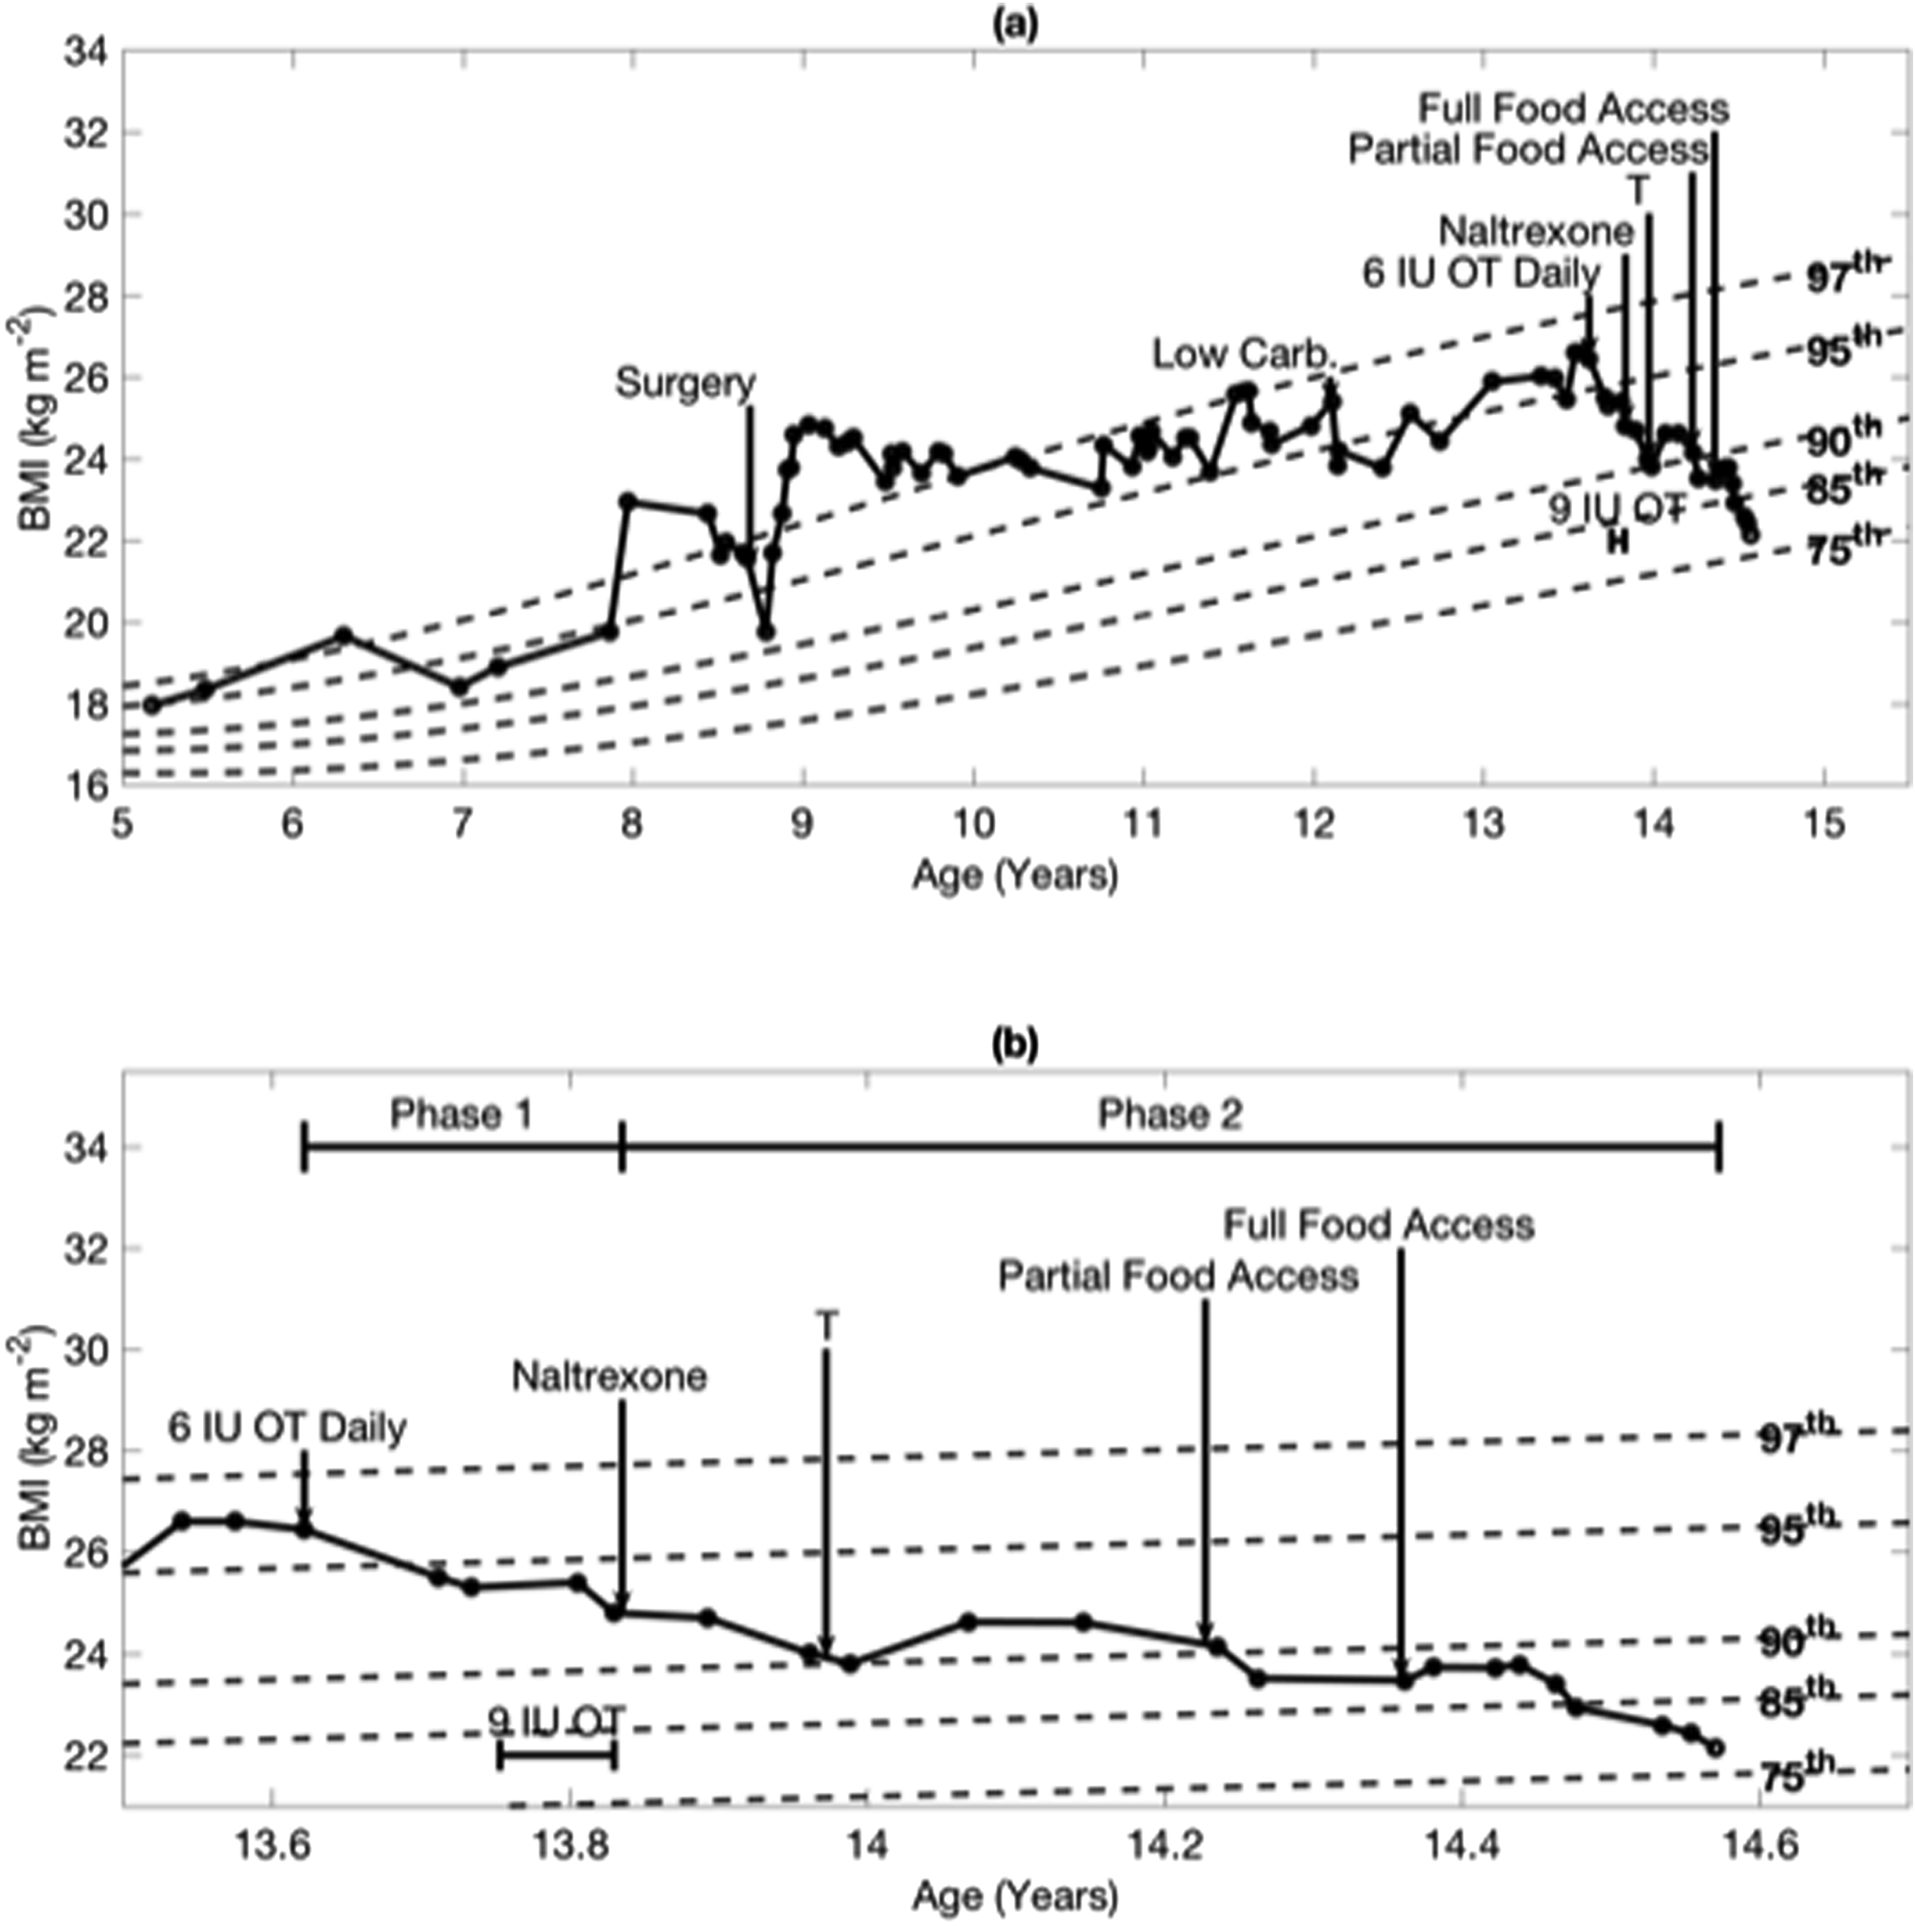
From: Oxytocin and Naltrexone Successfully Treat Hypothalamic Obesity in a Boy Post-Craniopharyngioma Resection
J Clin Endocrinol Metab. 2017;103(2):370-375. doi:10.1210/jc.2017-02080
J Clin Endocrinol Metab | Copyright © 2018 Endocrine Society
Notes:
Figure 2. (a) BMI timeline since before diagnosis with intervention starting points. (b) BMI timeline since age 13.5 years with intervention starting points including phases 1 and 2.
30

Slide 31
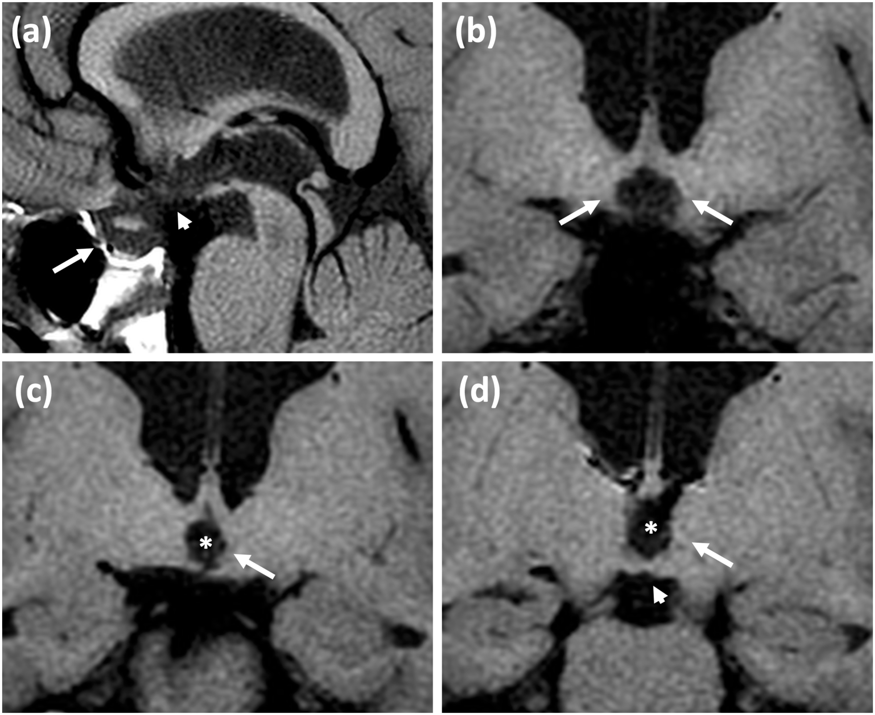
From: Oxytocin and Naltrexone Successfully Treat Hypothalamic Obesity in a Boy Post-Craniopharyngioma Resection
J Clin Endocrinol Metab. 2017;103(2):370-375. doi:10.1210/jc.2017-02080
J Clin Endocrinol Metab | Copyright © 2018 Endocrine Society
Showing injury to the floor of the third ventricle and bilateral anterior hypothalamus, including the region of the paraventricular nuclei and supraoptic nuclei.
Notes:
Figure 1. Magnetic resonance imaging T1-weighted images 6 months following resection of CP demonstrating extent of hypothalamic damage. (a) Sagittal midline image demonstrates damage to the floor of the third ventricle (short arrow) as well as sellar contents (long arrow), including the pituitary and infundibulum. (b) Coronal image through the anterior hypothalamus demonstrates injury to the bilateral anterior hypothalamus (long arrows), including the regions of the paraventricular and supraoptic nuclei. Coronal images of the (c) mid and (d) posterior hypothalamus. In addition to third ventriculomegaly (*), there is irregularity and volume loss along the left lateral wall, indicating at least unilateral mid and posterior hypothalamic damage (long arrows). The mammillary bodies are intact (short arrow).
31

Slide 32
Oxytocin Supplementation
Oxytocin is available from several compounding pharmacy as sublingual tablets or nasal spray (during the chat session, I’d like to get patients opinions about nasal vs sublingual and where they get theirs from)
I give a questionnaire for hypopit patients to complete before and after oxytocin administration.
Assay for 24 hr urine oxytocin commercially available at Meridian Valley Labs before and after oxytocin administration.
No information of reliability of assay
Contact us (established patients only) if you want to to be prescribed oxytocin.

Slide 33
Questions?
What questions can we answer for you about vasopressin and oxytocin
Thank you for sharing your time tonight!
If you have any more questions after tonight just email: mail@goodhormonehealth.com
www.goodhormonehealth.com
Article “Oxytocin for patients with pituitary dysfunction?” available on www.goodhormonehealth.com
Webinar will posted in a few days

Slide 34
Questions using the chat button
Keep the questions related to the topic
Please share your experience
One per person until everyone asks one
Try to keep then general and not personal

