Slide 1
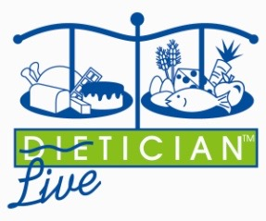
SUPERFOODS FOR LEANNESS & OPTIMAL HEALTH!
Hosted by Theodore Friedman, MD, PHD
With Deborah A. Klein, MS, RD

Slide 2
Die – tician ?
Liv – it – ician !

Slide 3
Nutrient Density =
Nutrients
__________
Bite

Slide 4
Balance =
Fuel (Carbs)
Sustain (Protein)
Satisfy (Fat)

Slide 5
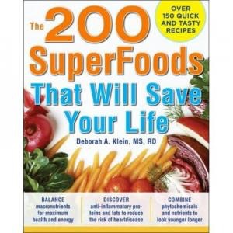

Slide 6
Carbs

Slide 7
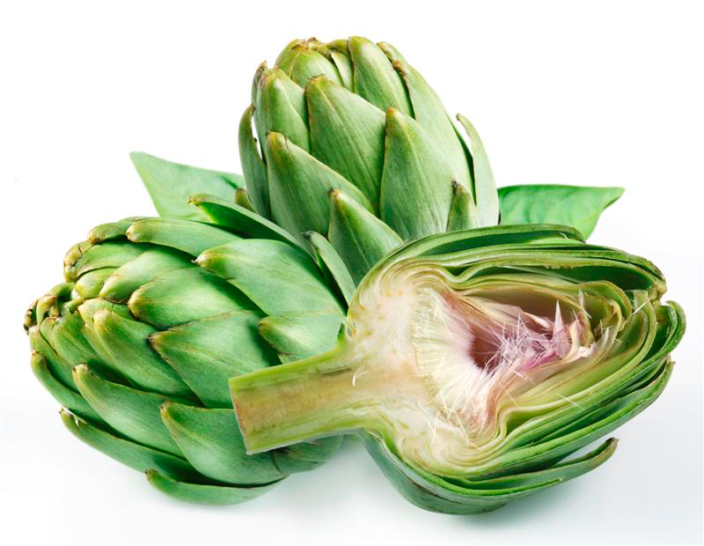

Slide 8
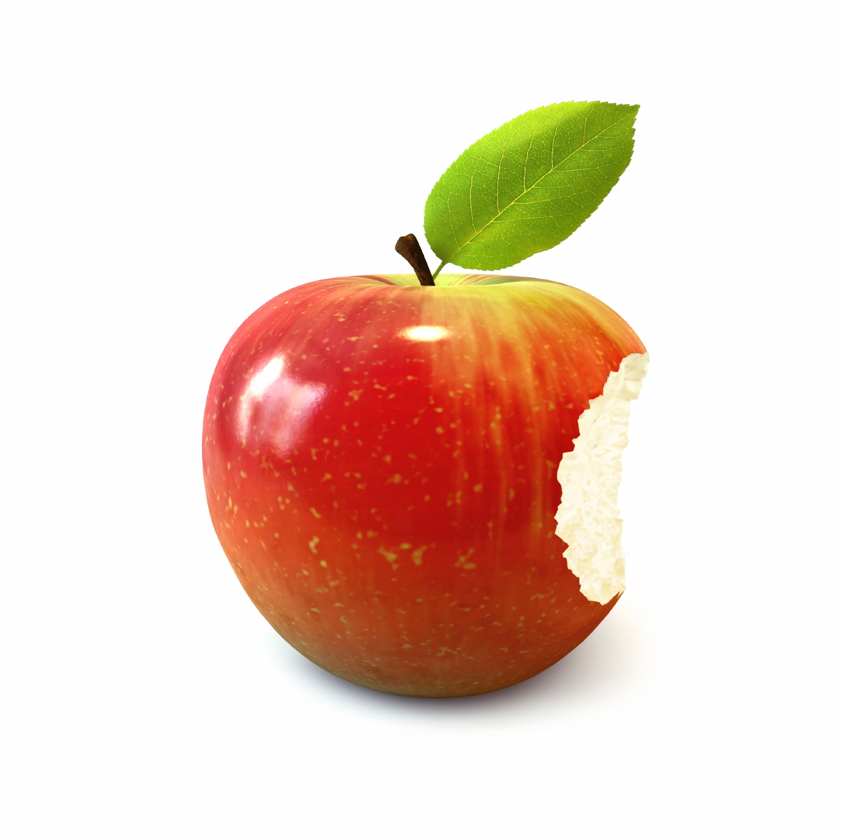

Slide 9
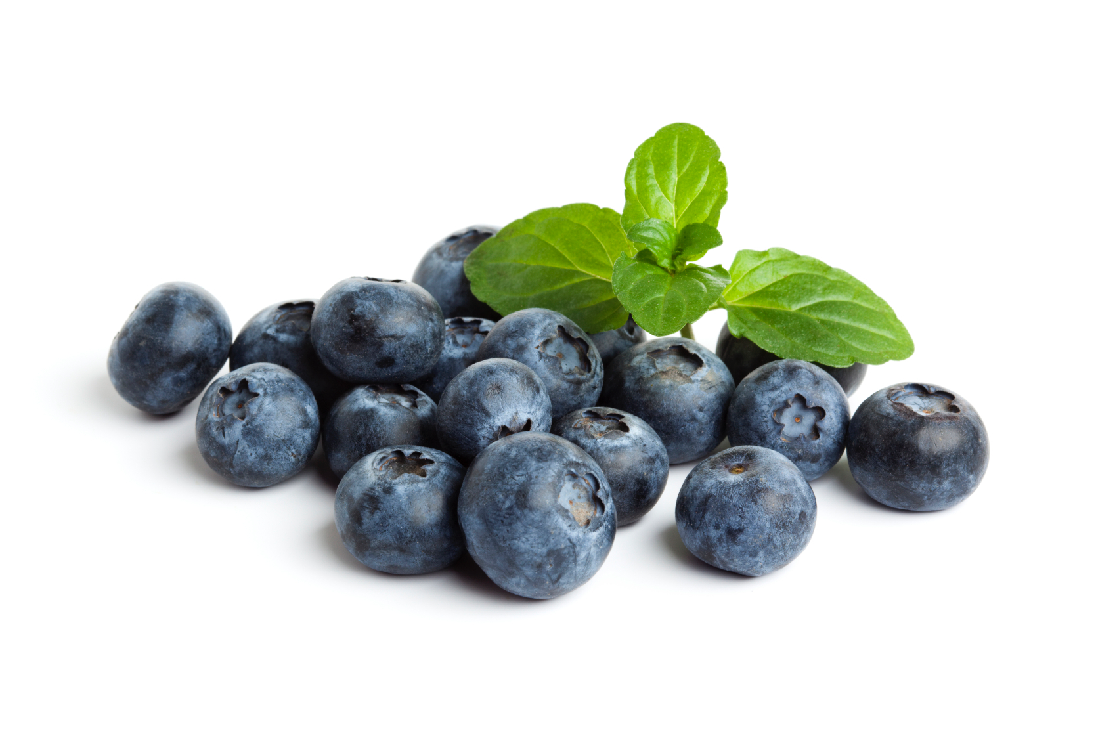

Slide 10
Proteins

Slide 11
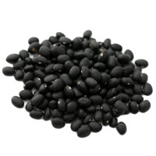

Slide 12
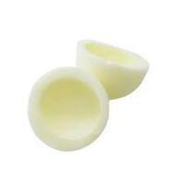

Slide 13
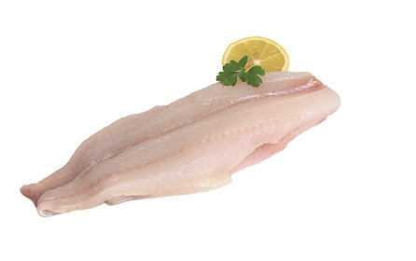

Slide 14
Fats

Slide 15
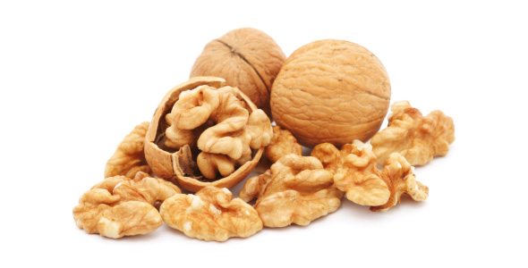

Slide 16
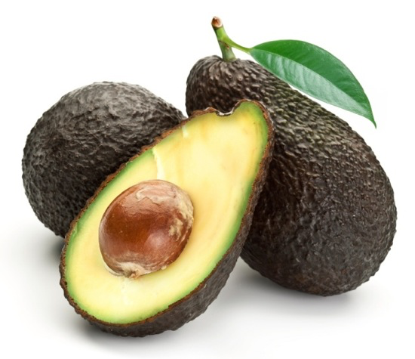

Slide 17
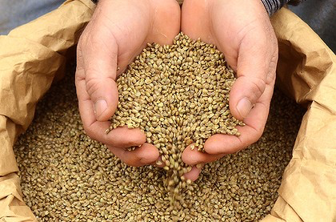

Slide 18
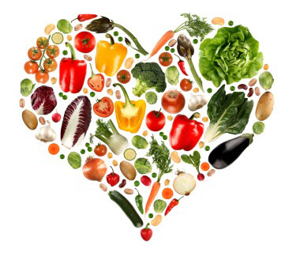
Unlimited Veggies

Slide 19
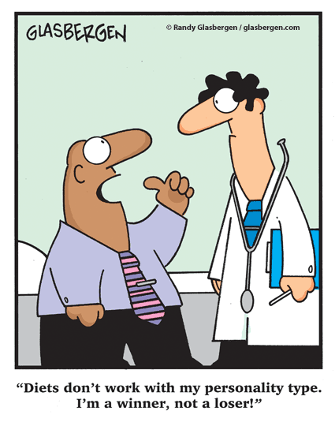
LIVIT Instead Of DIET!
To have weight loss
success, do it in
a way that you can
live with for life!

Slide 20
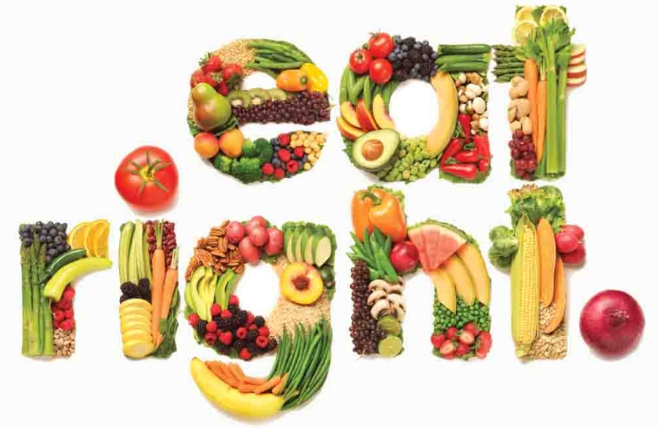
Beyond SuperFoods = SUPER BALANCE!

Slide 21
Super Balance =
Every meal and snack you eat, have a balance of macronutrients- protein, carbohydrate, & fat to provide sustainable energy.
Choose predominately organic, ~40-50% of calories from high fiber carbs (e.g., berries, small yam, butternut squash, sugar snap peas, an artichoke…), ~20% to 25% from protein (one non-meat protein source-legumes/fish meal/d); 20% to 30% from fat (<10% from saturated (animal) fat, mostly unsaturated and omega-3 fats (e.g., avocados, extra-virgin olive oil, chia seeds, ground flaxseed, walnuts, almonds, shelled hempseeds, pecans).

Slide 22
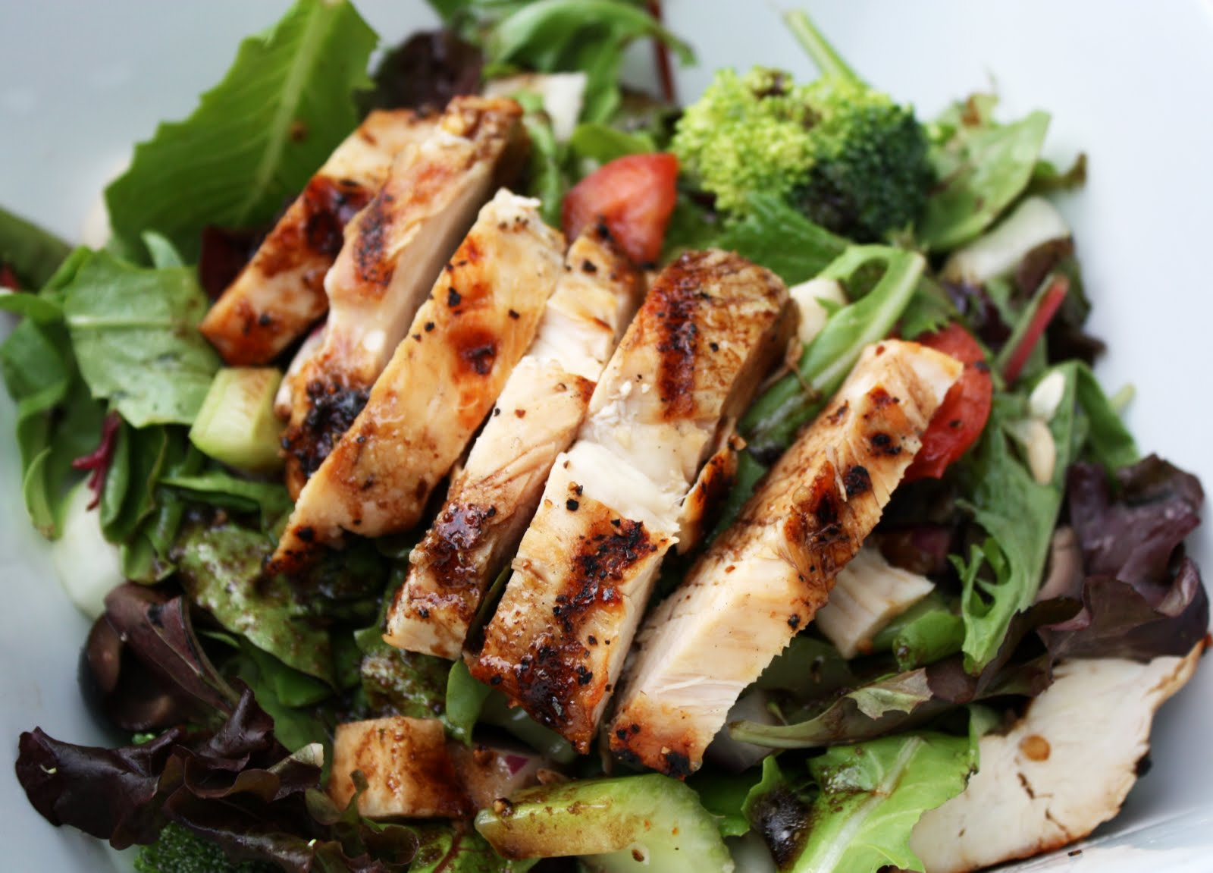
A balanced meal?

Slide 23
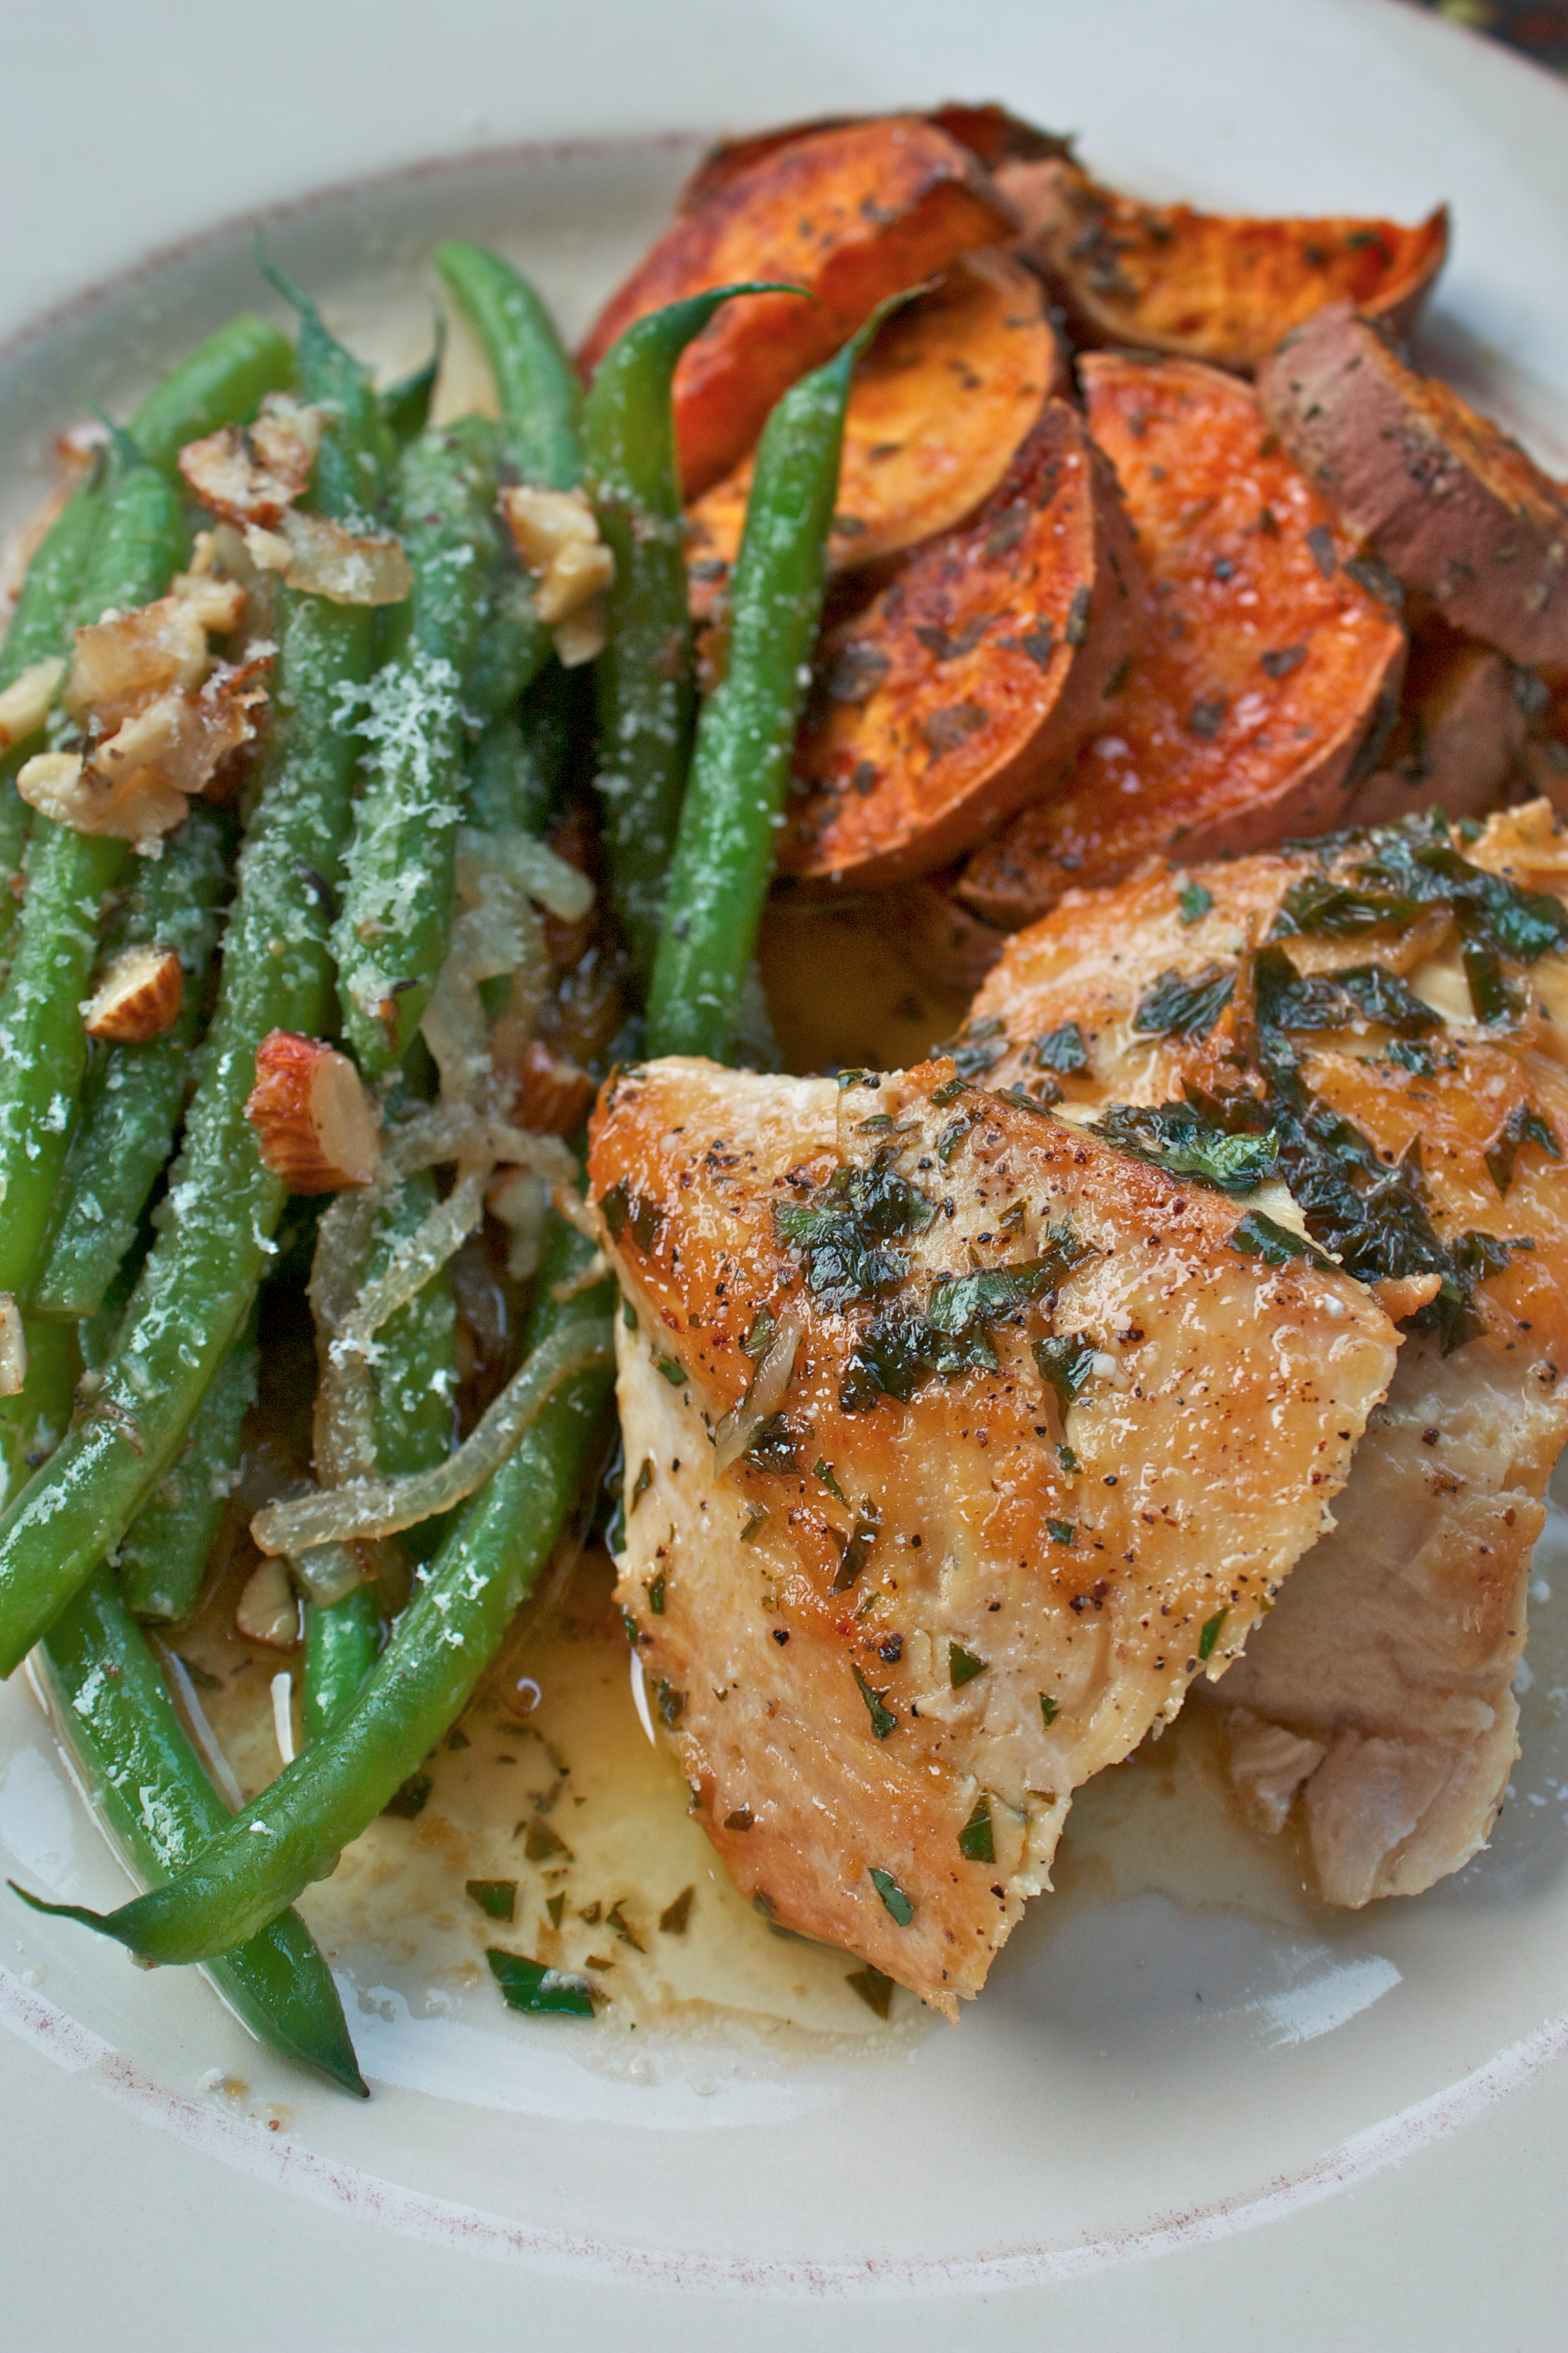
EAT CLEAN TO BE LEAN!
Yes, balanced
eating does
include
CARBS!!

Slide 24
Obesogens –
Chemicals that derail the body’s homeostatic weight control
mechanisms,
predisposing exposed individuals to weight gain despite normal diet and exercise.
Endocrine disruptors, obesogens: BPA, MSG, Atrazine, soy
phytoestrogen (genistein).
Reference: Thomas F. Whayne. (2015) Epigenetics in the development, modification, and prevention of cardiovascular disease.
Molecular Biology Reports 42, 765-776.

Slide 25
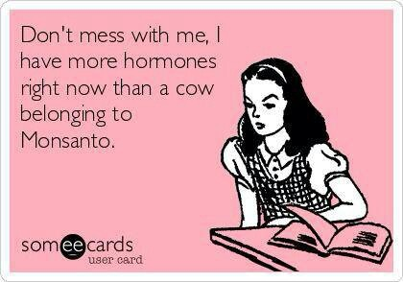
GO ORGANIC!
Pesticides, chemicals, added hormones act like xenoestrogens (obesogens), that stimulate fat storage.

Slide 26
Oxygenation
Diaphragmatic Breathing
aka
“soft belly breathing”
“If I could give only one tip for better health, it would be to breathe properly.” Dr. Andrew Weil

Slide 27
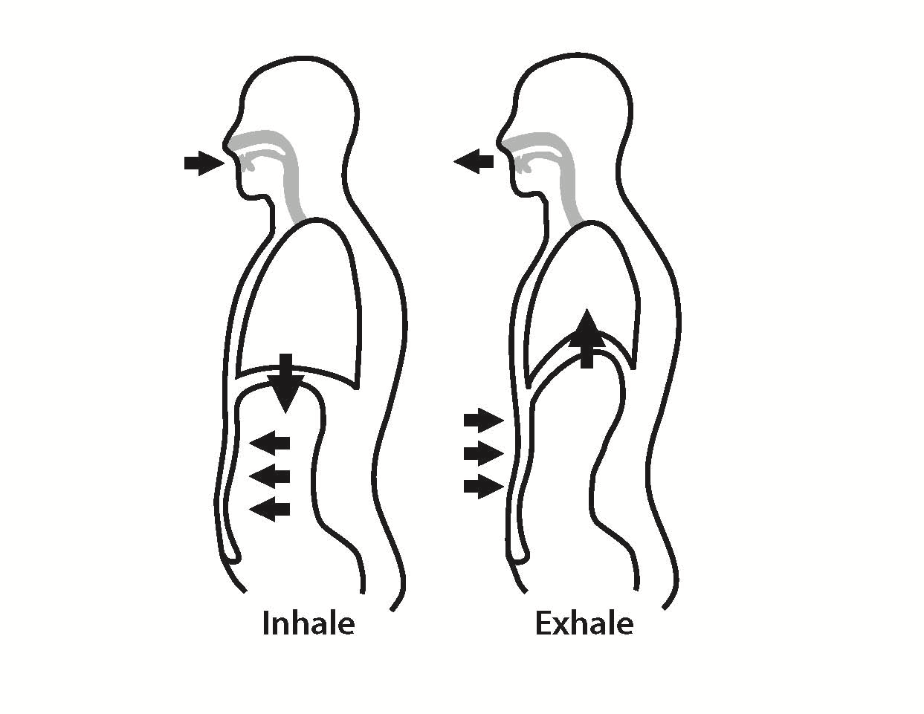

Slide 28
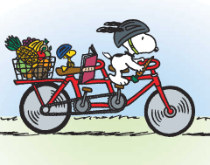
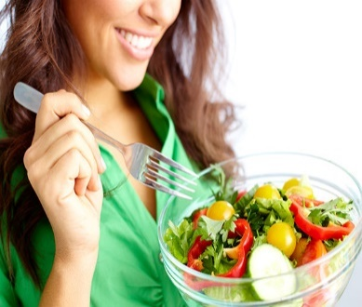
Life Style Changes
Eating better
More exercise
Optimize hormones

Slide 29
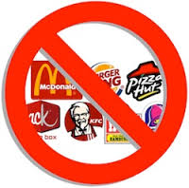
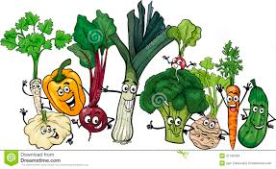
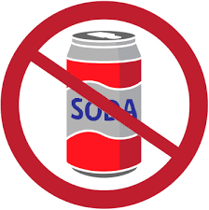
Change in What You Eat
Low fat
Low calorie
Low carbohydrates (< 40 g per day)
More vegetables
Less processed foods
Think of a diet you can follow in 10 years and stick to that diet

Slide 30
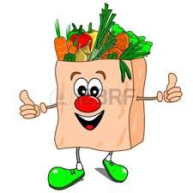
Vegetable Diet
Vegetables have lots of nutrition and little calories
Eat as much vegetables as you want (except corn and potatoes), but at least 2 servings per meal.
Focus on vegetables with a lot of fiber (asparagus, green beans, broccoli)
Vegetables can be fresh, canned, frozen or blended (keep the fiber) or in soups

Slide 31
Low Carb Diet
I emphasize on limiting carbohydrates
When you take in more than 40 g a meal of carbs, they go to fat.
Deborah will disagree with me, but no data that you need a certain amount of carbs for energy
Limit carbs to 40 g per day
Limit starches (potatoes, rice, bread, tortillas, cereal)
Limit starchy vegetables (corn, peas, beans)
1 cup oatmeal = 27 g of carbs

Slide 32
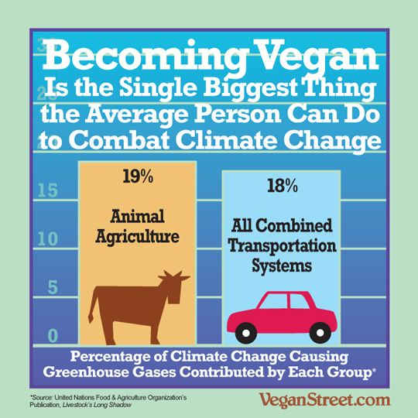
Vegetable Diets: Motivation
Improve Health
Prevent Animal Cruelty
Fight Global Warming

Slide 33
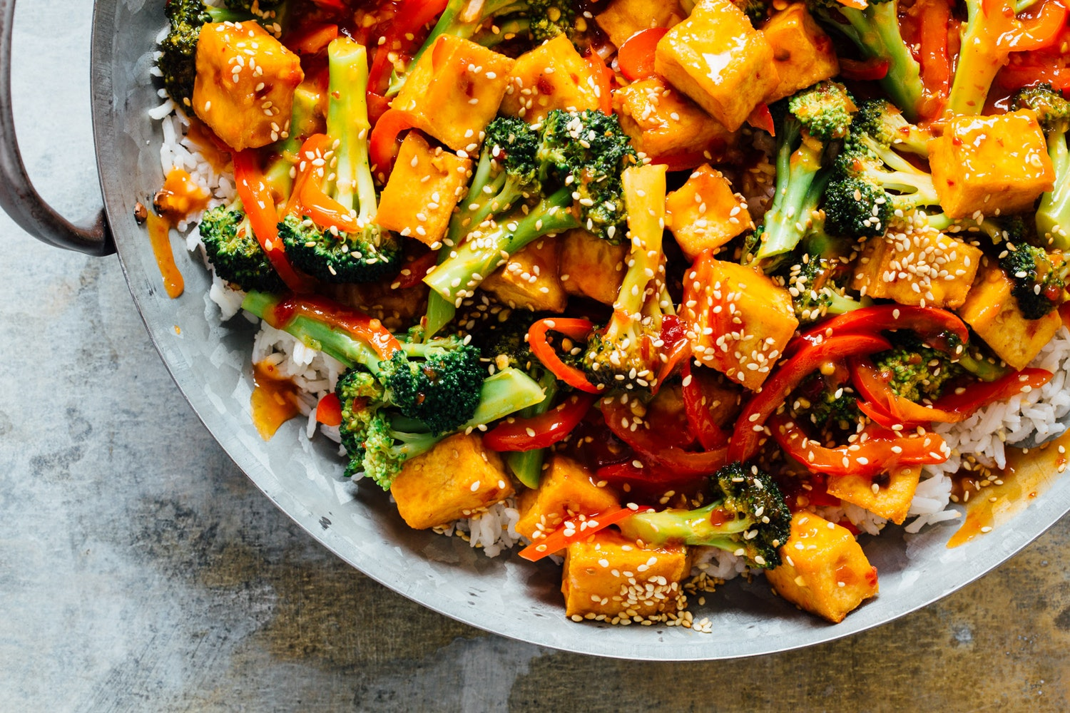
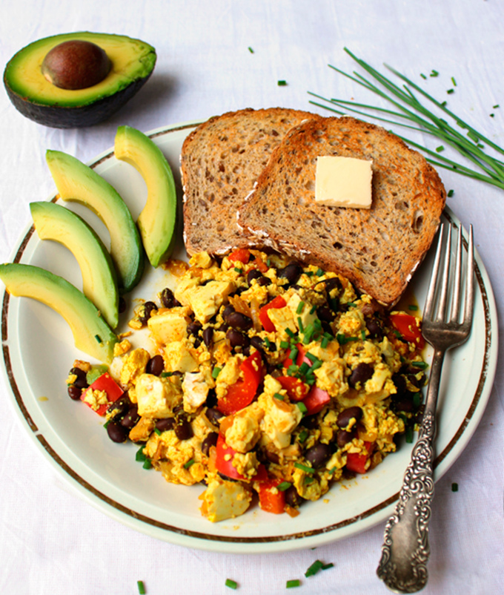
Vegan
Grains, seeds, nuts, legumes, soy, fruits, vegetables, and oils
No Animal Products
No dairy
No eggs

Slide 34
Vegan
Pros
Less Calories, Fat (generally)
More Fiber, Fullness
Cons
Could have lots of starches
Calories Fat (peanut butter)
Difficult to obtain Protein
Need “complimentary” Proteins (beans and rice)

Slide 35
Paleo Diet = Caveman Diet
Humans “born” began 500,000 years ago during last Ice Age
For 490,000 years no farms
No bread or processed foods
Meat, Vegetables, Nuts, Berries
Should we be eating bread?

Slide 36
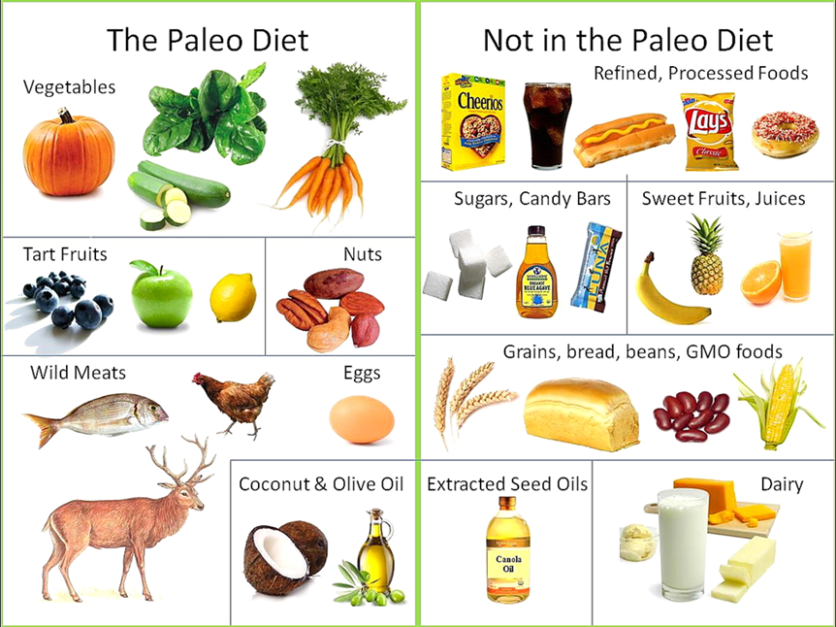
Paleo Diet = Caveman Diet

Slide 37
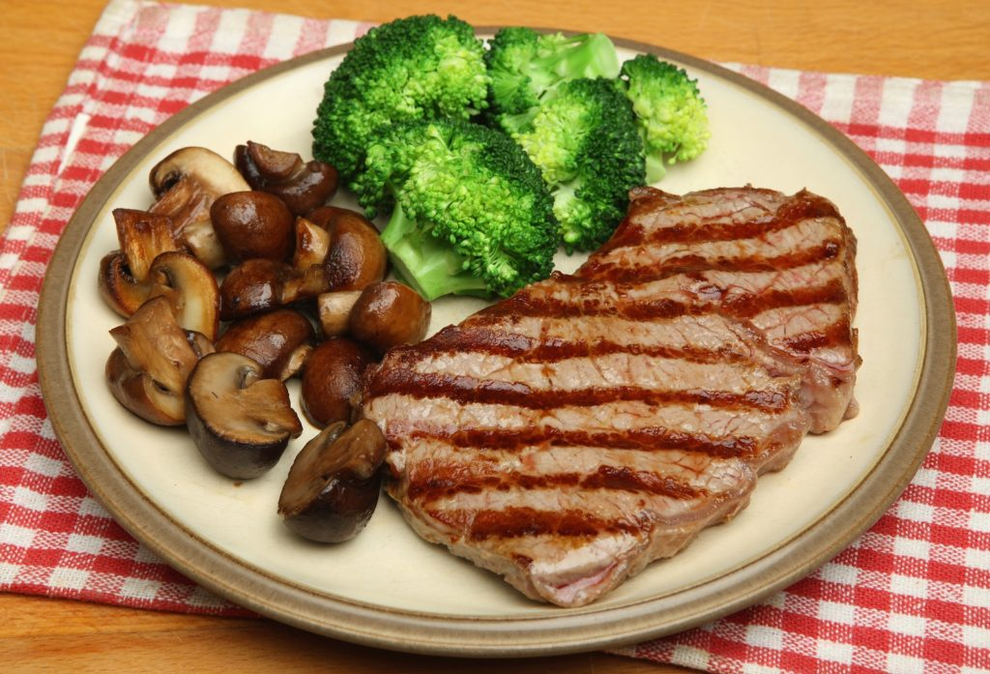
Paleo Diet = Caveman Diet
Pros
Less calories, fat (meat could have a lot of fat
More fiber, fullness
Can easily get Protein
Cons
Could have lots of calories and fat
Cooked meat and cancer

Slide 38
Keto Diet
The ketogenic diet is a very low-carb, high-fat diet that shares many similarities with the Atkins and low-carb diets.
It involves drastically reducing carbohydrate intake and replacing it with fat.
This reduction in carbs puts your body into a metabolic state called ketosis.

Slide 39
Keto Diet
A high fat, moderate protein, very low carbohydrate plan
The diet asks for cutting out major groups of foods, such as grains, legumes and dairy and sometimes cutting back on certain nutrient-rich vegetables.

Slide 40
Keto Diet
The idea is to get your body to switch from burning carbs to burning fat for fuel, in turn producing ketones, leading to ketosis.
Some evidence that it is helpful in epilepsy, since there’s research that shows it can help control seizures.

Slide 41
Keto Diet
Some people measure their ketones to make sure they are in ketosis.
Probably not the best for you to be in ketosis

Slide 42
Keto Diet-Dr. Friedman’s take
Too much fat (even “good” fat)
Not enough non-starchy vegetables
I had one patient on it whose cholesterol when from 150 to 400 on the keto diet

Slide 43
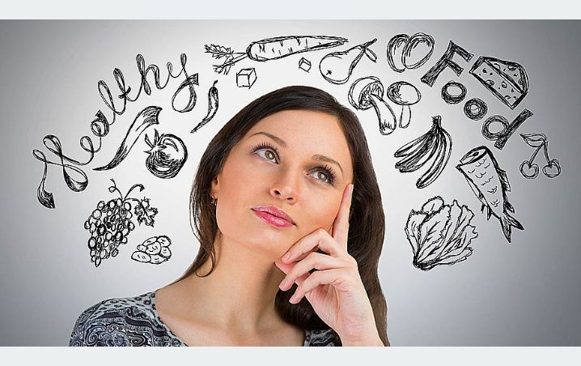
Vegan vs. Paleo Vs Keto
Can gain or lose weight with any diet
Depends on the portions and calories
Clean foods
Eat right amount and will lose weight
Depends on the food type
Eat right food and will lose weight
Pick a diet you will stick with

Slide 44
Dr. Friedman’s Recommended Diet
Lots of vegetables
Low fat
Moderate lean protein
Low starchy carbs

Slide 45
Food Time Restriction
Intermittent fasting

Slide 46
Clinical and Translational Report
A Smartphone App Reveals Erratic Diurnal Eating Patterns in Humans that Can Be Modulated for Health Benefits
Graphical Abstract
Highlights
d The daily eating pattern in healthy adults is highly variable from day to day
d More than half of the adults eat for 15 hr or longer every day
d Sleep duration parallels the fasting duration
d Reducing the daily eating duration can contribute to weight loss
Authors
Shubhroz Gill, Satchidananda Panda
Correspondence
satchin@salk.edu
In Brief
Gill et al. developed a smartphone app to monitor food intake in healthy adults, revealing frequent and erratic daily eating patterns rather than the self-reported three daily meals, leading to ‘‘metabolic jetlag.’’ In a pilot study, overweight individuals using the app to eat for only
10–11 hr/day experienced sustained weight loss.
Gill & Panda, 2015, Cell Metabolism 22, 789–798
November 3, 2015 ª2015 Elsevier Inc.
http://dx.doi.org/10.1016/j.cmet.2015.09.005

Slide 47
Food Time Restriction

Slide 48
Food Time Restriction

Slide 49
Food Time Restriction
Wilkinson and Manoogian et al. studied
the impact of time-restricted eating in
metabolic syndrome by reducing participant’s daily eating window from 14 h to a self-selected 10 h window for 12 weeks.
Time-restricted eating led to weight loss, healthier body composition, lower blood pressure, and decreased levels of cardiovascular disease-promoting
lipids.

Slide 50
Food Time Restriction
The daily eating pattern in healthy adults is highly variable from day to day
More than half of the adults eat for 15 hr or longer every day
Sleep duration parallels the fasting duration
Reducing the daily eating duration can contribute to weight loss
Don’t eat at night! (if you can)

Slide 51
Questions?
Please use the chat button
Thank you for sharing your time tonight!
If you have any more questions after tonight or want an appointment with Dr. Friedman, please email: mail@goodhormonehealth.com
www.goodhormonehealth.com
Deborah A. Klein, MS, RD The Livitician® Network
Email: Livitician@Gmail.com
https://www.livitician.com
Webinar will be posted in a few days

