Slide 1
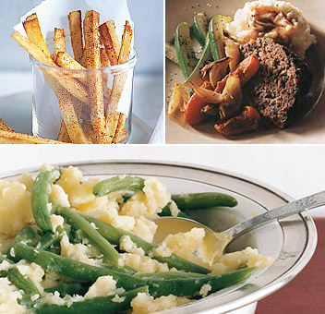
Comfort Foods
Jasmine Eugenio, MD

Slide 2
What are comfort foods?
They are foods that soothe the psyche by reminding us of comforting childhood memories.
For most of us, these foods are far from gourmet and generally epitomize home cooking.
They invoke feelings of nostalgia, safety, and security.

Slide 3
When do we eat…
Comfort food is traditionally eaten food to provides a nostalgic or sentimental feeling to the person eating it
The nostalgic element most comfort food has, may be specific to either the individual or a specific culture.
Many comfort foods are flavorful; some may also be easily prepared.

Slide 4
Why do we eat …
Comfort foods may be consumed to positively pique emotions, to relieve negative psychological effects or to increase positive feelings. The term was first used, according to Webster's Dictionary, in 1977.

Slide 5
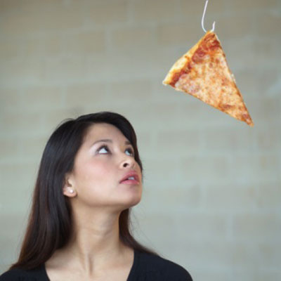
WHY?
We select particular foods to modify mood or effect
studies show that the medical-therapeutic use of particular foods may ultimately be a matter of mood-alteration

Slide 6
What do we like?
One study divided college-students' comfort-food identifications into four categories nostalgic foods indulgence foods convenience foods physical comfort foods
We like to eat a familiar meal: usually soft in consistency, and rich in calories or nutrients, or both.

Slide 7
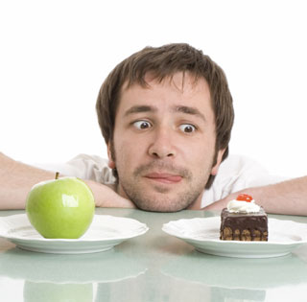
Preferences by sex, age ?
males preferred warm, hearty, meal-related comfort foods (such as steak, casseroles, and soup)
females preferred comfort foods that were more snack related (such as chocolate and ice cream)
younger people preferred more snack-related comfort foods compared to those over 55 years of age.

Slide 8
Psychology of comfort foods
Studies also revealed strong connections between consumption of comfort foods and feelings of guilt.
Comfort food consumption has been seen as a response to emotional stress
key contributor to the epidemic of obesity in the United States

Slide 9
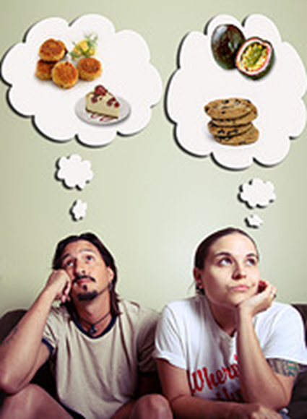
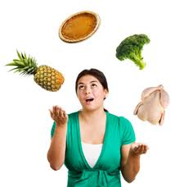
Psychology of comfort foods
The consumption of comfort food is triggered in men by positive emotions, and by negative ones in women.

Slide 10
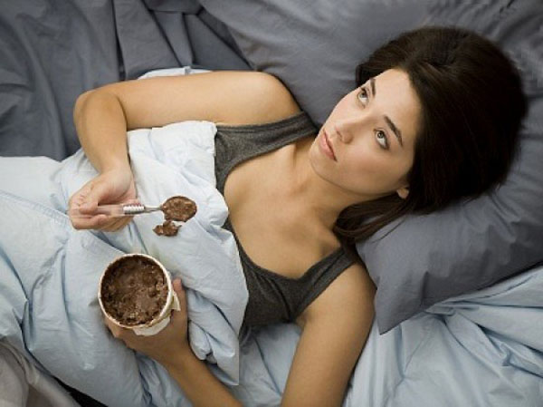
Psychology…
The stress effect is particularly pronounced among college-aged women, with only 33% reporting healthy eating choices during times of emotional stress.
For women specifically, these psychological patterns may be maladaptive.

Slide 11
Trends
One recent development, as chefs have explored the roots of American cuisine and tried to define it as a unique style, is the advent of fine dining comfort food restaurants that feature more careful cooking and presentation, higher quality, and fresh organic ingredients, along with consequently higher prices

Slide 12
Favorite comfort foods
In a recent reader's poll, studies showed the favorite American comfort foods distinctive trends relating to:
age
childhood regional location
ethnic upbringing.

Slide 13
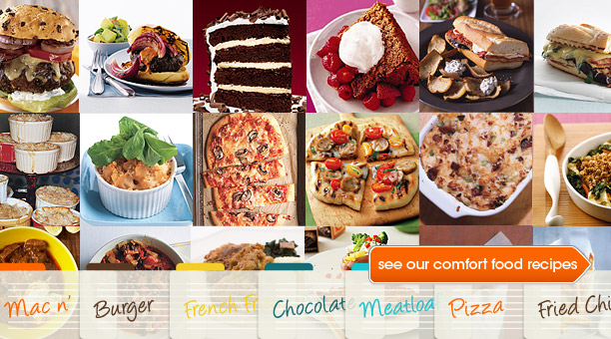
Most popular
Peanut butter and jelly sandwiches and grilled cheese ranked highest
The next highest on the list were meatloaf, mashed potatoes, brisket pot roast, fried chicken, macaroni and cheese, spaghetti, and good ol' tuna casserole.

Slide 14
the most common comfort foods in America
Apple pie
Baked beans
Banana pudding
Beef stew
Brisket pot roast
Chicken and dumplings
Chicken pot pie
Chicken soup
Chili con carne
Chocolate chip cookies
Pizza
French Fries
Crispito
Corn on the cob
Fried chicken
Gelatin dessert
Green bean casserole
Grilled cheese sandwich (runner-up)
Hamburgers (runner-up)
Hot dogs
Ice cream
Macaroni and cheese

Slide 15
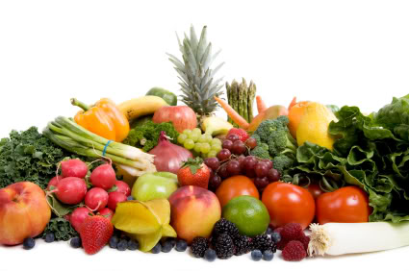
What to do?
Rethink your comfort foods
Understand why you need it
Try the healthier choices and stock up your pantry and refrigerator with it

Slide 16
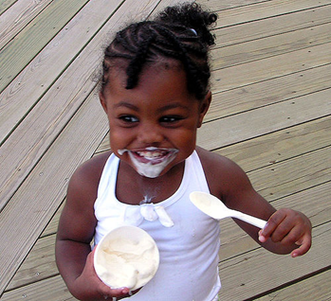
What to do?
Throw away left overs and don’t bring it to work!
Stop rewarding yourself and your children with food

Slide 17
What to do?
Bring healthy snacks to work
When you feel the urge to eat, exercise
When you are stressed, exercise!!!!
If all else fails make a healthy version of your comfort food

Slide 18
Suggestions for Healthy snacks
Fruits and Vegetables: strawberries, cantaloupe, carrots, celery, edamame
Nuts: Almonds, peanuts
Yogurt with the above
Oatmeal

Slide 19
Questions
What are your comfort foods?
How will you curve your comfort food cravings?

